Slide 1
Dynamics of Florida’s GDP and Unemployment Rate from 2019-2021
AI Boot Camp Project 1
Team Members: Angelica Padilla, Leigh Nash, Antoine Baize, Bharat Kumar, Enock Mudzamiri, and Oliver Tabibzadeh

Slide 2
Project Overview
Project Purpose / Description
The project analyzes the relationship between GDP and the unemployment rate at the county level in Florida from 2019 to 2021. Additionally, we viewed this data through the lens of global events during this period, particularly the COVID-19 pandemic, on the observed trends in our data.
This project represents a change in scope, which initially began as an exploration of the correlations between GDP and hurricanes affecting Florida over the same time span. Due to a lack of major hurricanes during this time period we pivoted from studying hurricane data to unemployment data.

Slide 3
Project Overview
Goals/Questions to be addressed
What is the relationship between Florida’s GDP per county and the unemployment rate between 2019 and 2021 and how does it aid in understanding economic growth/decline through unemployment rates across counties?
How does the relationship we observe in the data match our expectations?
Propose a hypothesis for the pattern that we see in our data. How does this analysis provide a more comprehensive picture of Florida’s economic landscape, the state’s potential vulnerabilities or strengths within specific counties?

Slide 4
Project Overview
Overview of data collection, cleanup and exploration process
To prepare the data for analysis, a comprehensive cleaning process was implemented in the activities outlined below
Exploration of data - Using Kaggle, BEA.gov, unitedstateszipcodes.org/, to obtain data sources and functions such as df.head(), df.tail() to obtain an overview of the DataFrames.
Importing data - using functions such as pd.read_csv ()for CSV files to load them into a Pandas DataFrame.
Data transformation - using df.concat(), df.rename(), to rename columns and create new column based on existing data. Filtered data for Florida specific data.
Data Imputation - Filled missing values using the mean technique
Data Visualization - created visualizations to explore relationships and patterns in the data.
NOTE: These steps were conducted in iterations and required back and forth to ensure the data was cleaned effectively. Each dataset had unique cleaning requirements and were adapted accordingly.

Slide 5
Project Overview
Approach taken to achieve goals
Team utilized an agile approach to the project.
Development team consisted of 6 self managing members
Team created a RACI chart to manage and distribute tasks among the development team
Each sprint/iteration was 3 hours utilizing the assigned time for the Bootcamp but also team members would work outside the bootcamp to make contributions on the project
Team members with expert coding knowledge were leads in applying the technical expertise
Initially team selected Hurricane data to establish correction with GDP in selected counties in Florida but were dropped based on lack of data for the selected years
Team settled for GDP and unemployment data

Slide 6
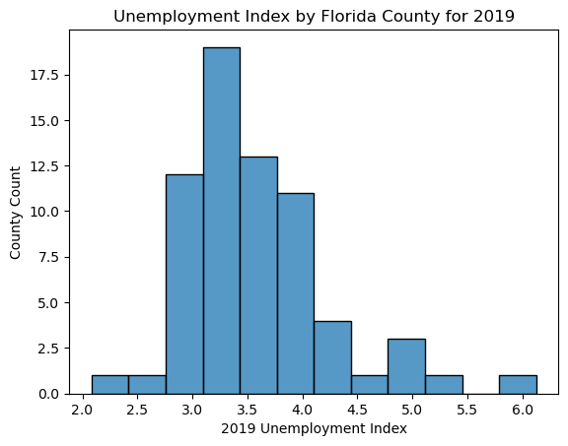
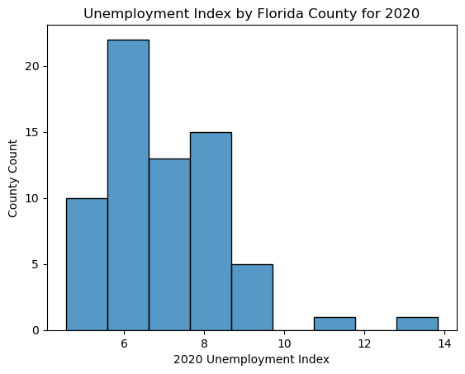
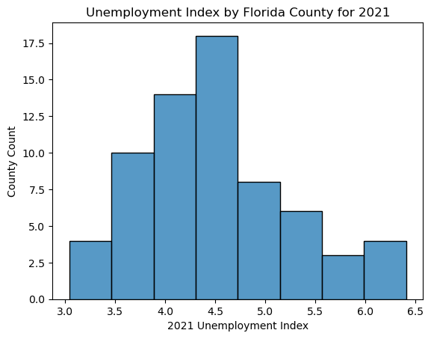
Result/Conclusion 1
The mean unemployment distribution shifted from 3.25% to 6% from 2019 to 2020
2020 data was unevenly distributed potentially to the disproportionate effect of Covid on Florida counties
The mean Florida unemployment index dropped in 2021 but not back to pre-2020 levels
Notes:
The values on the x-axis are the mean unemployment index at a yearly level

Slide 7
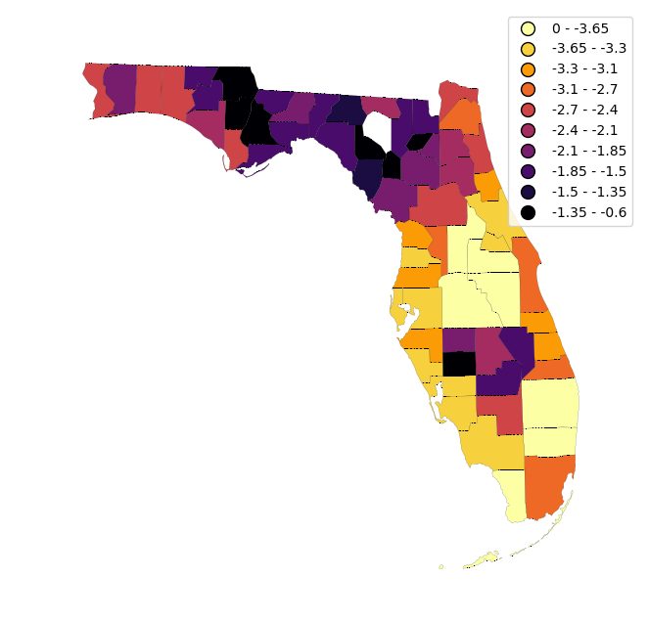
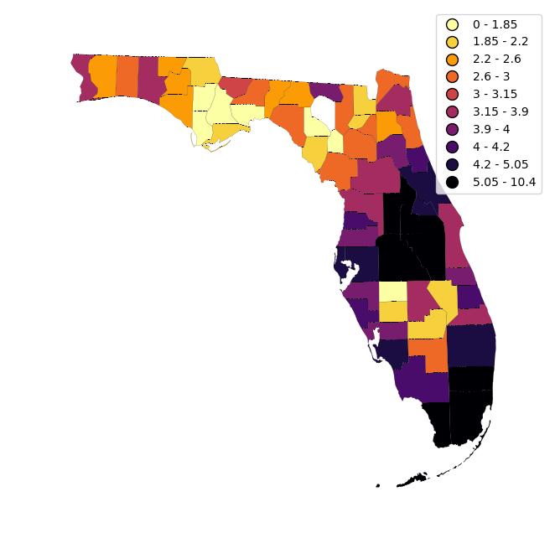
Result/Conclusion 1
Central and southern Florida counties had the biggest increase in unemployment index from 2019 to 2020
The counties affect the most by Covid had the least improvement in a year
Raw change in unemployment 2019-2020
Raw change in unemployment 2020-2021

Slide 8
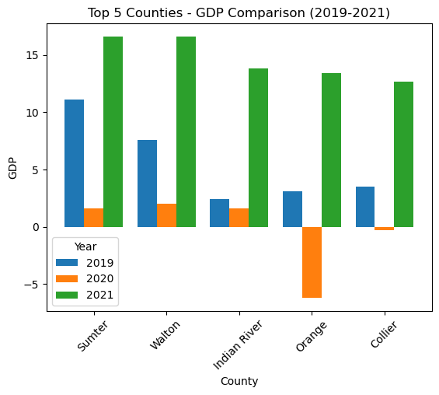
Result/Conclusion 2
Orange County was one of the counties with the biggest growth from 2019-2021 but was also one of the counties with the biggest loss in 2020
Noticeable decrease in GDP during 2020 for most counties

Slide 9
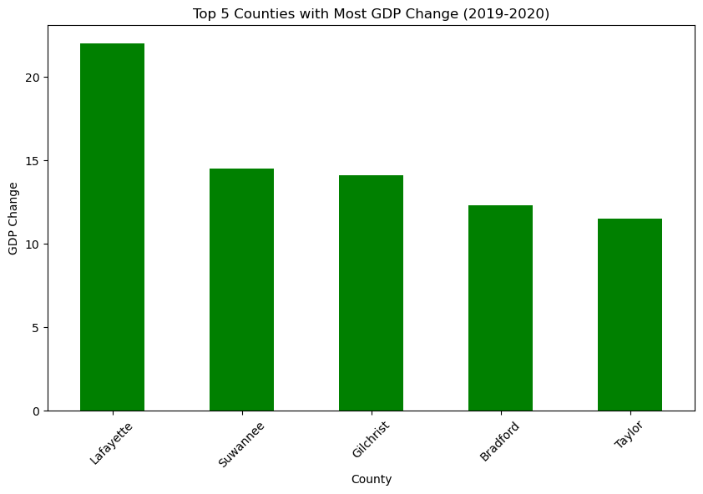
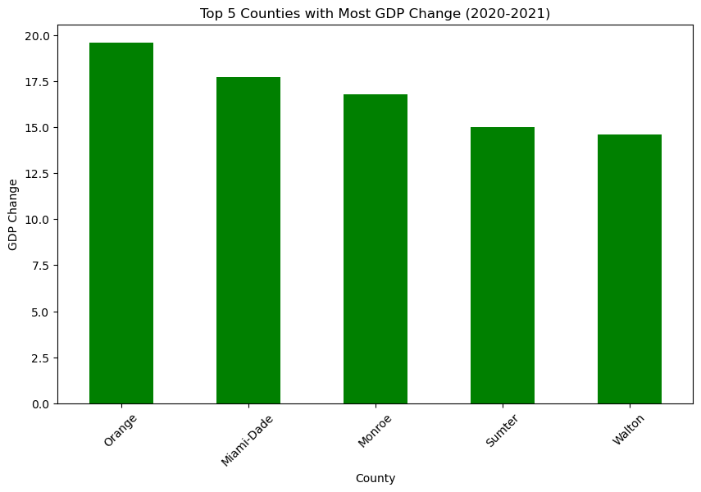
Result/Conclusion 3
No county has the biggest change in GDP in consecutive years

Slide 10
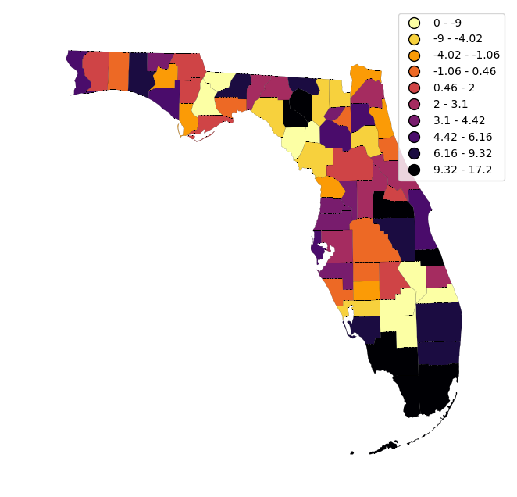
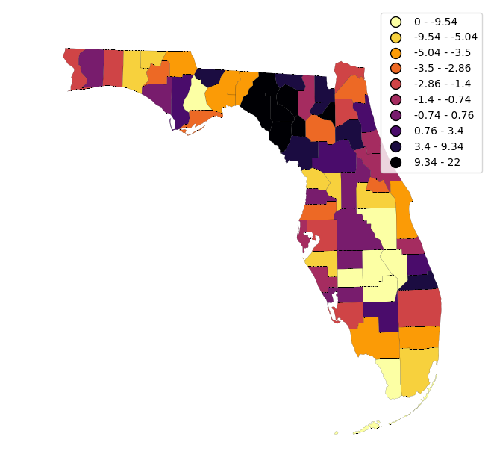
Result/Conclusion 3
The most impacted counties in 2020 are the tourism heavy areas (Orlando and Miami)
Change in GDP per county (2019-2020)
Change in GDP per county (2020-2021)

Slide 11
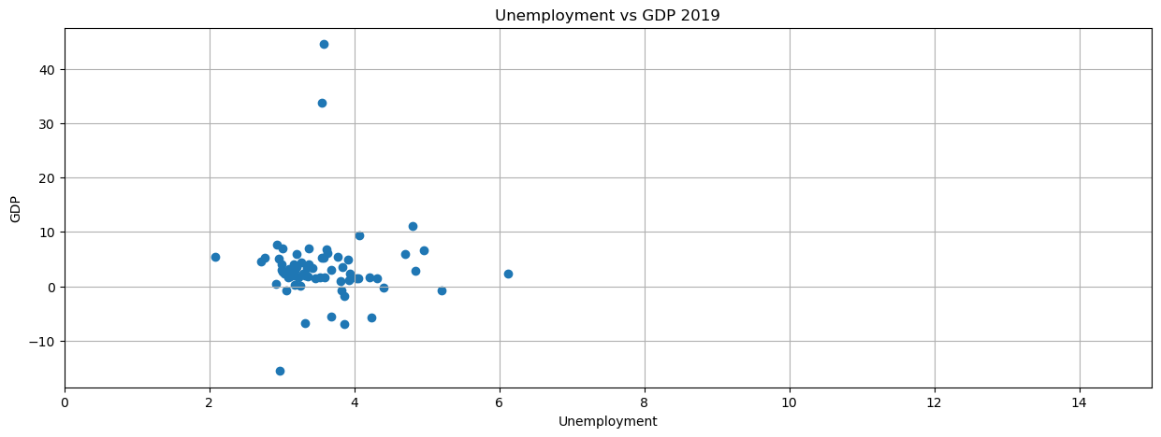
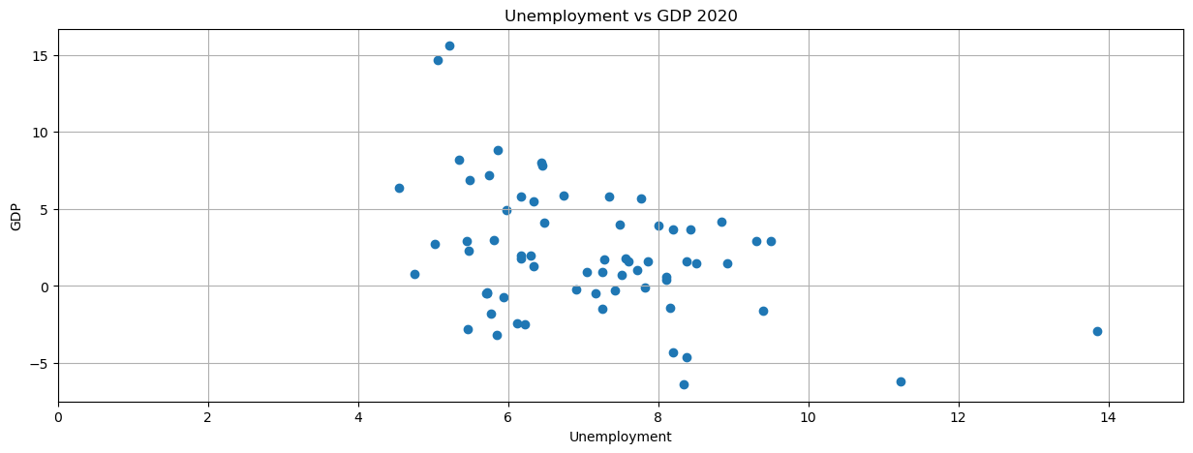
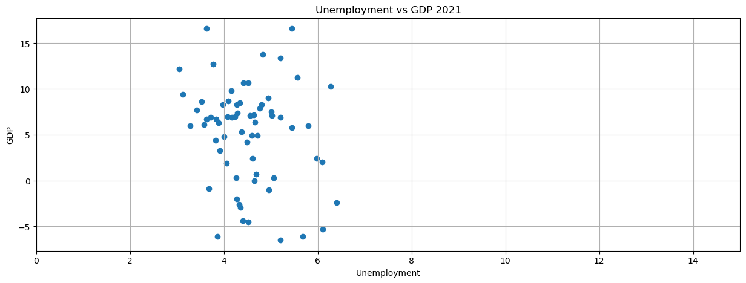
Result/Conclusion 4
The only clear trend is the dramatic increase in unemployment during 2020
There is weak/no correlation in between GDP and Unemployment
Text
Corr = 0.05
Corr = -0.17
Corr = 0.07

Slide 12
Storm data collection issues: Difficulty finding an appropriate dataset via Kaggle and BEA
Change in project scope due to limited hurricane data.
The first issue that we encountered was the coordinate data we had to track hurricanes was captured before the hurricane made landfall so there was no county location against which to track effect on GDP.
The second issue that we encountered was that only two hurricanes made landfall in Florida and were in the years 2017 and 2018 and the GDP data we were analyzing was between the years 2019 and 2021.
Problems Encountered
Notes:
Leigh:

Slide 13
As a group we had several divergent avenues of exploration from the findings of this project including:
Looking at the relationship between GDP and unemployment throughout major US and world events
Bring in tourism data to understand its correlation to current dataset, especially for middle and southern Florida where we saw the biggest Covid impact
Revisit the hurricane data and study the relationship between the effect of Hurricanes on GDP versus the effect of Covid-19
After analyzing the effect of different natural disasters, we could build a model to predict the effect of a new disaster on the GDP and unemployment rates
Future Considerations

