Slide 1
Introductions
Course outlines Philip Leftwich

Slide 2
class: title-slide, left, top

Slide 3
Introductions
Course outlines
Philip Leftwich
Slides released under CC-BY 2.0 ]

Slide 4
layout: true
Philip Leftwich - 5023Y

Slide 5
Introductions
.left-code[

Slide 6


Slide 7
Associate Professor
Genetics & Data Science
University of East Anglia
twitter: [@PhilipLeftwich](https://twitter.com/PhilipLeftwich)
]
.right-plot[
Go to Slido.com
Participant code #2920374
Ask questions and answer quizzes
]

Slide 8
class: center, inverse

Slide 9
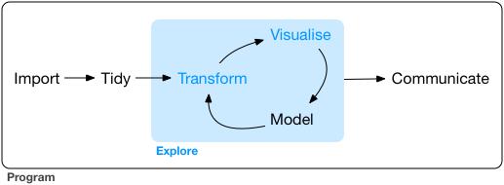
Introductions

Slide 10
Learning outcomes
Program in R
Data wrangling
Data visualisation
Data analysis
Reproducible Research

Slide 11
R is for Open Reproducible Research
.left-code[
Reproducible
Robust
Transparent
Reusable
Shareable research materials
]
.right-plot[

Slide 12
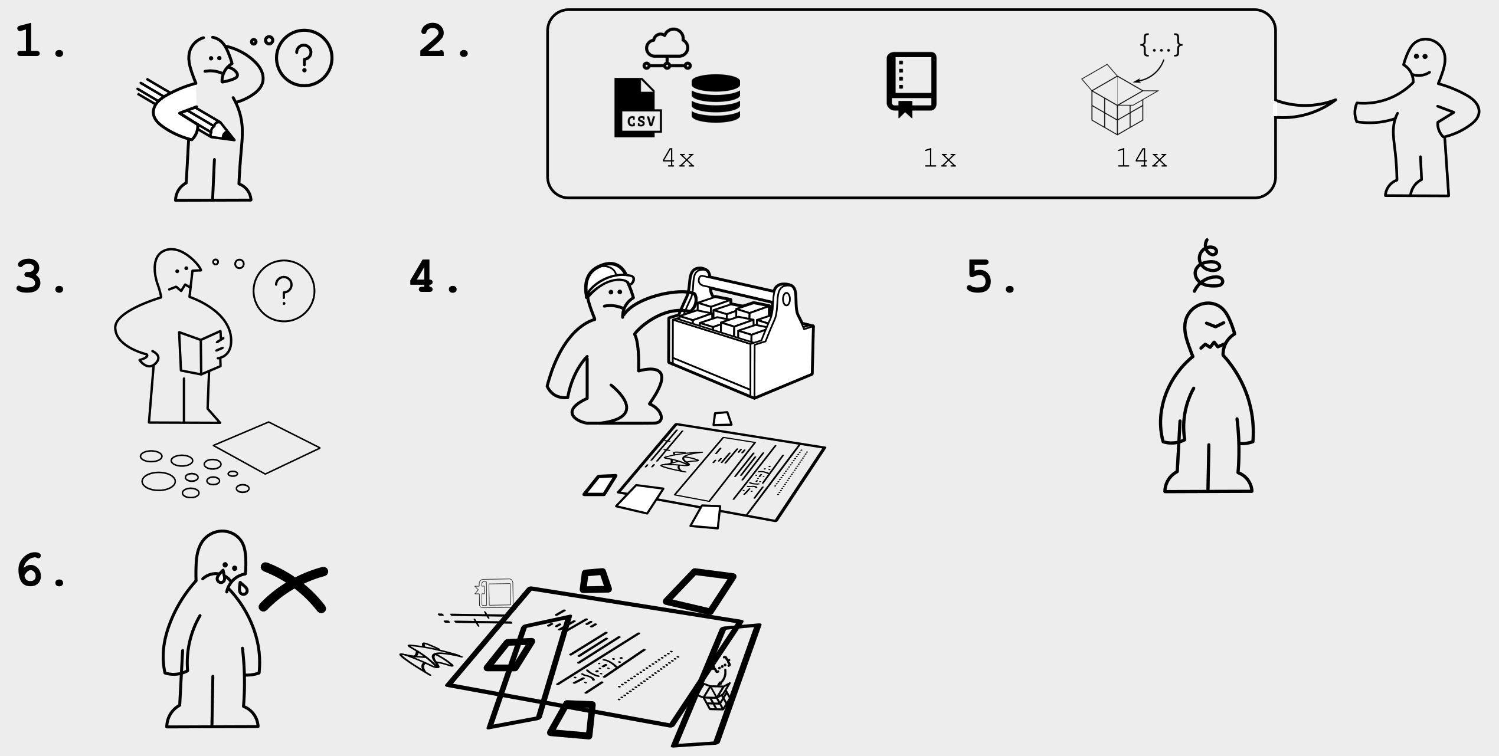

Slide 13
]

Slide 14
What is R?
R is a full programming language
R is a calculator
R simulates & generates data
R reads, processes and manipulates data
R analyses data
R makes plots, graphics, reports and presentations

Slide 15
class: center
## What is RStudio?

Slide 16
class: center
What is RStudio Cloud?

Slide 17
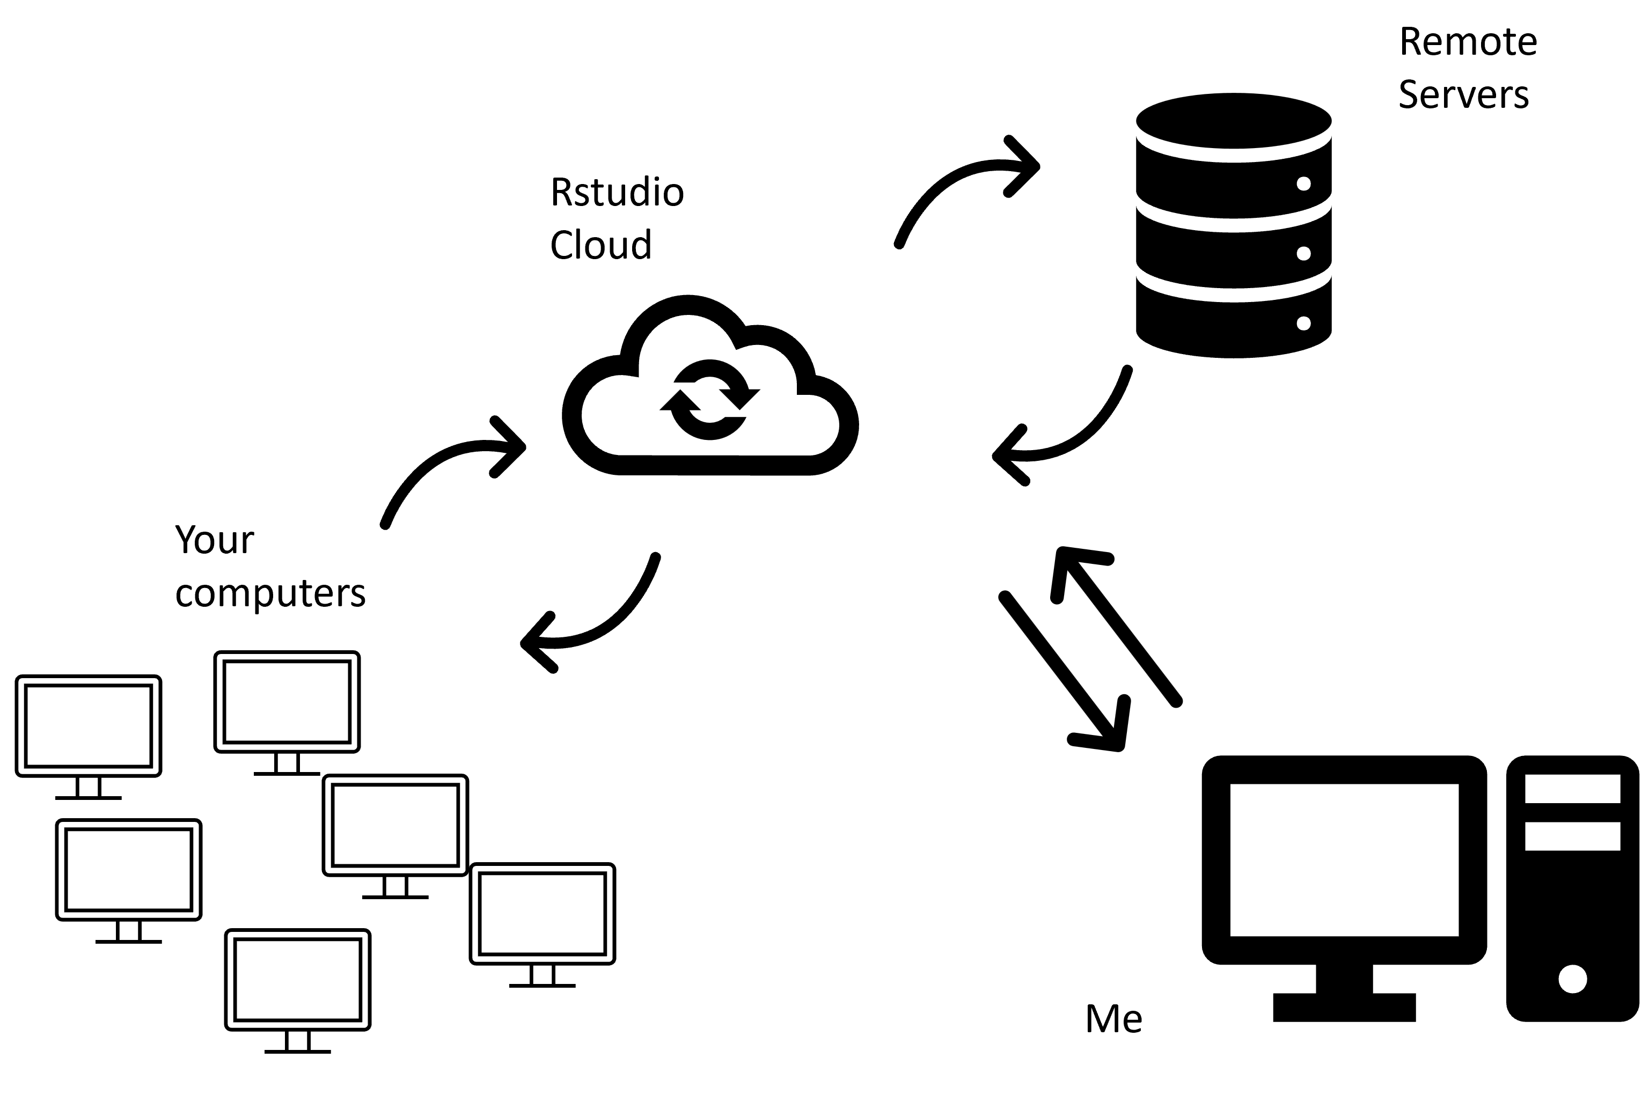

Slide 18
RStudio Cloud(https://rstudio.cloud/)

Slide 19
class: center, middle
## Workflow
We will do everything in well-annotated, organized scripts that contain streamlined and easy-to-follow records of our entire analyses from raw data through final reports, with unbreakable file paths and with a complete history of changes made.

Slide 20
class: center, middle
Workflow

Slide 21
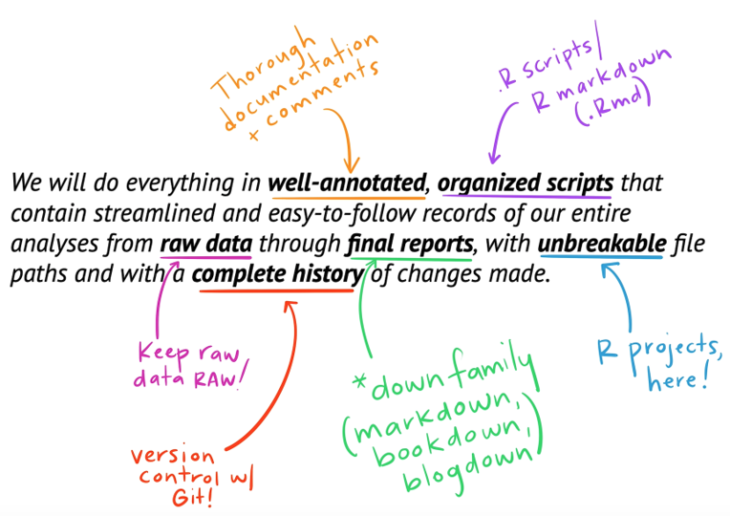

Slide 22
## Data wrangling
* Naming things
* Coding basics & tidyverse wrangling/viz
* Good coding habits
* Code annotation & organization
* Data visualization
* Troubleshooting
* Relative file paths
* Literate programming

Slide 23
class: center, middle, inverse
Once we get, wrangle, explore, and visualize data reproducibly, we star building stats skills…

Slide 24
Descriptive statistics
Central Tendency (mean, median, mode) mean(), median(), mode()
Data Spread (range, variance, standard deviation) range(), var(), sd()

Slide 25
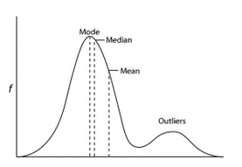

Slide 26
Probability distributions
Probability distributions come in many types
They underpin our ability to make inferences from our data
Deviations from expected distributions underping statistical significance

Slide 27
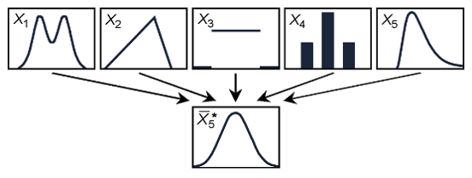

Slide 28
Hypothesis testing
Ask a question about some data or a claim. Collect sample(s).
Define the null and alternative hypotheses
Select your criteria (significance level)
Calculate the test statistic
Compare the test statistic to the critical statistic (or convert it to a p-value)
Make a decision to reject or retain the null
class: middle
Data analysis needs:
.pull-left[
Data tidying and cleaning
Data Exploration
Data visualization
Defining research questions
]
.pull-right[
Produce statistical models
Interpret outcomes
Express uncertainty
Communicate
]

Slide 29
The p-value is meaningful and can be useful in decision making, but it has dominated stats discussions for too long.
It’s rarely the most interesting/important part of the story
At high enough n, everything becomes significant – but does the difference actually matter?
There is nothing magical about 0.05
“Wanting” to find p < 0.05 leads to biased science (p-harking, publication bias etc.)

Slide 30
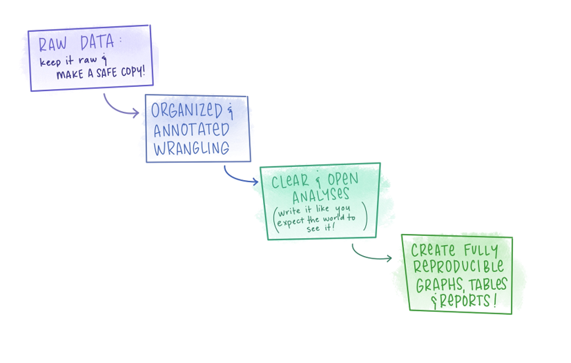
Make your analysis easy to understad, easy to follow, easy to reproduce!

Slide 31
We will start
Learning to work comfortably in R/RStudio projects
Understanding R and R programming
Data wrangling tools

Slide 32
Course Outline
1 x weekly lecture
1 x weekly computer lab
Weekly quizzes/small tasks
2 x coursework assignments
Ask lots of questions.

Slide 33
Get Help
.pull-left[

Slide 34
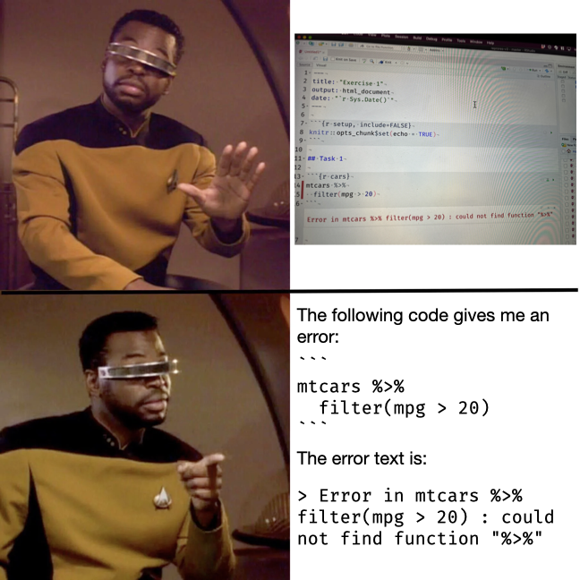

Slide 35
]
.pull-right[ There will be a discussion board on Blackboard to ask all of your coding questions.
Make your questions as clear as possible
What are you trying to do?
What is the exact error message or output
What code did you run to produce this
]

Slide 36
class: center, middle, inverse

Slide 37
Lets’ start!

