Slide 1
Deep Learning-based Facial Expression Recognition using the RAF-DB
Instructor: Mrs. Dong Lanfang Major: Computer Technology University: University of Science and Technology of China

Slide 2
Table of contents
01
Introduction
03
Experiments and Results
Introduce Convolutional Neural Network (CNN) and RAF-DB Dataset
Talk about the Experiments and the Results obtained
02
04
Method
Discussion, Conclusion, and Future work
Discuss the Method used
State a few future directions of the papers

Slide 3
Introduction
What is CNN?
CNN stands for Convolutional Neural Network.
Widely used in computer vision for tasks like face recognition and image classification.
Similar to a basic neural network but with learnable parameters such as weights and biases.
https://towardsdatascience.com/covolutional-neural-network-cb0883dd6529

Slide 4
Introduction
Why use CNN?
Addresses the computational inefficiency of large input sizes in traditional feedforward neural networks.
CNN extracts features from images and reduces dimensions without losing characteristics.
https://towardsdatascience.com/covolutional-neural-network-cb0883dd6529

Slide 5
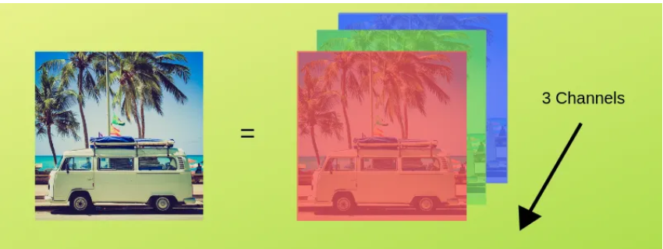
Introduction
Important Concepts
Image Representation: Images represented as tensors with height, width, and color channels (RGB).
https://towardsdatascience.com/covolutional-neural-network-cb0883dd6529

Slide 6
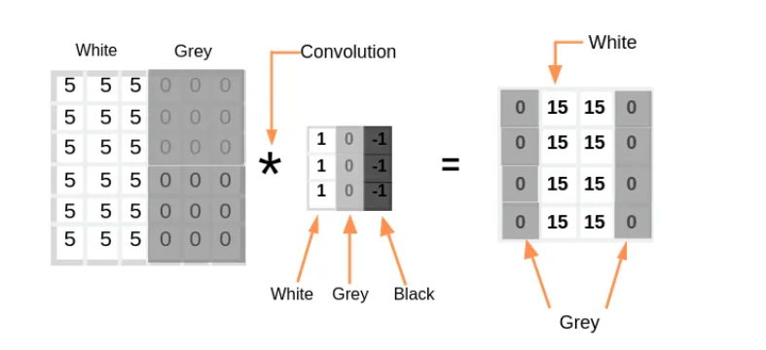
Introduction
Important Concepts
Image Representation: Images represented as tensors with height, width, and color channels (RGB).
Edge Detection: Convolution operation with filters for detecting edges in images.
https://towardsdatascience.com/covolutional-neural-network-cb0883dd6529

Slide 7
Introduction
Important Concepts
Image Representation: Images represented as tensors with height, width, and color channels (RGB).
Edge Detection: Convolution operation with filters for detecting edges in images.
Stride and Padding: Stride determines the step size in convolution, and padding is used to maintain output dimensions.
https://towardsdatascience.com/covolutional-neural-network-cb0883dd6529

Slide 8
Introduction
Layers in CNN
Input Layer: Reshape image data into a single column.
Convo Layer: Extracts features through convolution and applies ReLU activation.
Pooling Layer: Reduces spatial volume of input after convolution using max pooling.
Fully Connected Layer (FC): Connects neurons across layers for image classification.
Softmax/Logistic Layer: Used for multi-classification or binary classification.
Output Layer: Contains one-hot encoded labels.
https://towardsdatascience.com/covolutional-neural-network-cb0883dd6529

Slide 9
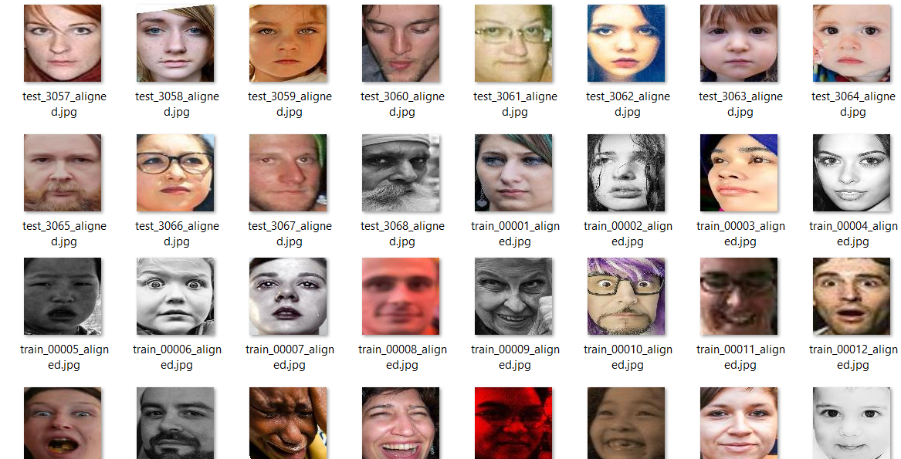
Introduction
RAF-DB (Real-world Affective Faces Database)
Collection of facial images for study
7 classes of facial expressions
Valuable testing ground for CNNs
30,000 facial images
source: https://rec.ustc.edu.cn/share/115e96b0-957b-11ee-bdf2-e14dad2cd3d8

Slide 10
Method
CNN Architecture
Model Overview
Utilized a four-layer Convolutional Neural Network (CNN)
Employed max-pooling for down-sampling and feature extraction
Implemented Adam optimizer for model optimization
Used categorical cross-entropy loss for effective training
Structured the CNN for sequential feature extraction and classification

Slide 11
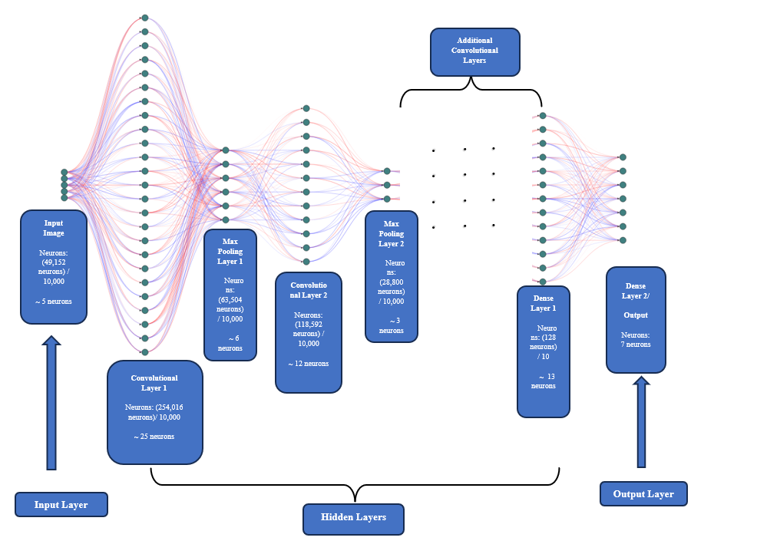
Method
CNN Architecture
Conceptual Overview of the Proposed Facial Expression Recognition Neural Network

Slide 12
Method
Hyperparameter Tuning
Learning Rate: Explored values: 0.01, 0.001, 0.0001
Epochs: Systematic variation to determine optimal training duration
Network Depth: Experimented with different depths to assess impact
Batch Size: Systematically explored various batch sizes for optimization

Slide 13
Experiments and Results
Hyperparameter Tuning
01
03
Learning Rate (LR)
Network Depth
02
04
Epochs
Batch Size

Slide 14
Experiments and Results
Learning Rate Experiment
Epochs: 50 (chosen at random but left constant for this experiment)
LR: 0.01, 0.001, 0.0001 (change learning rate till find optimal)
Optimal LR: 0.001 (see Table below)
Learning Rate | Loss | Accuracy | Val_loss | Val_accuracy | Discrepancy
0.01 | 1.6414 | 0.3889 | 1.6319 | 0.3862 | 0.0027
0.001 | 0.2538 | 0.9071 | 0.9752 | 0.7546 | 0.1525
0.0001 | 0.6241 | 0.7787 | 0.7161 | 0.7471 | 0.0316

Slide 15
Experiments and Results
Epochs Experiment
LR: 0.001 (optimal LR from last experiment left constant for this experiment)
Vary epochs: 100, 200, 500, 800, 1000 (change epoch till find optimal)
Optimal epochs: 100 (see Table below)
Epochs | Loss | Accuracy | Val_loss | Val_accuracy | Discrepancy
100 | 0.1257 | 0.9567 | 1.2703 | 0.7683 | 0.1884
200 | 0.0700 | 0.9763 | 1.7911 | 0.7598 | 0.2165
500 | 0.0536 | 0.9822 | 2.1033 | 0.7526 | 0.2296
800 | 0.0282 | 0.9910 | 2.8044 | 0.7562 | 0.2348
1000 | 0.0364 | 0.9887 | 2.9084 | 0.7239 | 0.2648

Slide 16
Experiments and Results
Network Depth Experiment
Optimal LR & epoch: 0.001 and 100 epochs respectively
Vary depth: 3, 4, 5, 6 (change network depth till find optimal)
Optimal depth: 4 (see Table below)
Network Depth | Loss | Accuracy | Val_loss | Val_accuracy | Discrepancy
3 | 0.0841 | 0.9703 | 1.3802 | 0.7803 | 0.1900
4 | 0.1015 | 0.9652 | 1.1369 | 0.7947 | 0.1705
5 | 0.1301 | 0.9514 | 1.0095 | 0.7956 | 0.1558
6 | 0.1220 | 0.9580 | 1.2100 | 0.7692 | 0.1888

Slide 17
Experiments and Results
Batch Size Experiment
Optimal LR, epochs & depth: 0.001, 100 epochs, and 4 respectively
Vary batch size: 128, 256, 512, 1024, 2048 (change batch size till find optimal)
Optimal size: 2048 (see Table below)
Batch Size | Loss | Accuracy | Val_loss | Val_accuracy | Discrepancy
128 | 0.1075 | 0.9619 | 1.0375 | 0.8035 | 0.1584
256 | 0.1153 | 0.9607 | 1.1335 | 0.7872 | 0.1735
512 | 0.1912 | 0.9311 | 0.7981 | 0.7924 | 0.1387
1024 | 0.2128 | 0.9223 | 0.8333 | 0.7774 | 0.1449
2048 | 0.4335 | 0.8467 | 0.6851 | 0.7774 | 0.0693

Slide 18
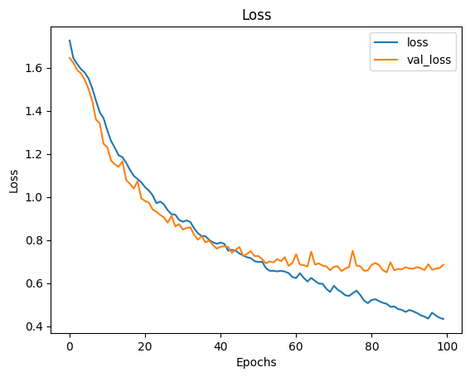
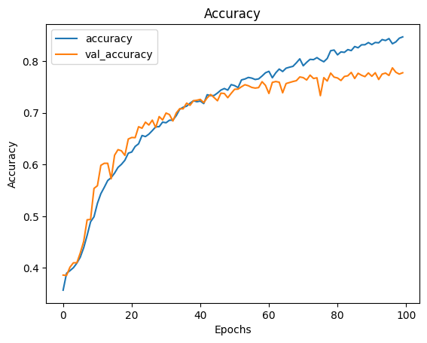
Experiments and Results
Batch Size Experiment
a₁
a₂
Training and Validation Loss Over Epochs (on the left) (a₁) and Training and Validation Accuracy Over Epochs (on the right) (a₂). for batch size 2048 (a₁ and a₂).

Slide 19
Experiments and Results
Testing on UTKFace Dataset
Additional evaluation on the optimized model
UTKFace: 23,707 unlabelled faces.
To determine model accuracy and challenges, I used the optimized/trained model to classify images in this dataset into appropriate facial expression class.
Although the model demonstrated high accuracy, it did not achieve 100% precision.

Slide 20
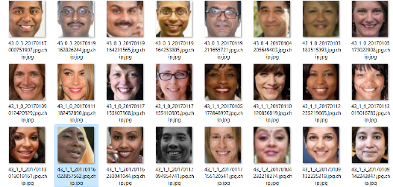
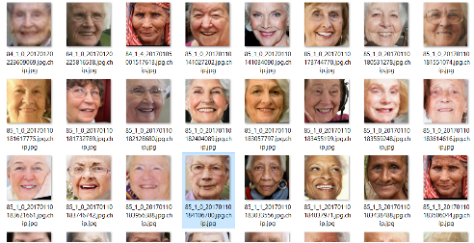
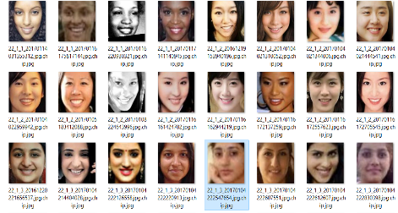
Experiments and Results
and neutral faces in that folder (Figure 14).
Challenges
a
b
c
Screenshots of some images in the 'happy faces' class show many happy faces, one sad face (a), and two neutral faces (b and c).
source: https://www.kaggle.com/datasets/moritzm00/utkface-cropped?resource=download

Slide 21
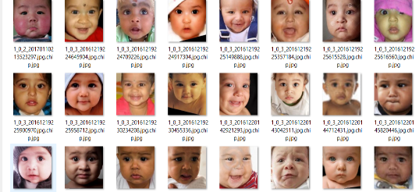
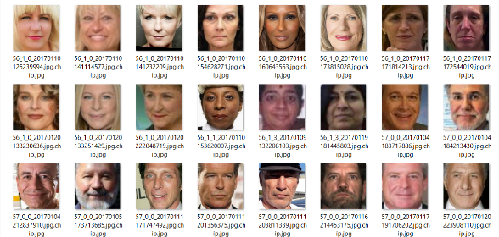
Experiments and Results
and neutral faces in that folder (Figure 14).
Challenges
a
b
Screenshot of some images in the class sad faces showing many sad and some happy baby (a) and adult (b) faces.
source: https://www.kaggle.com/datasets/moritzm00/utkface-cropped?resource=download

Slide 22
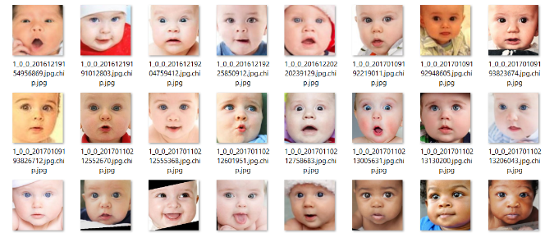
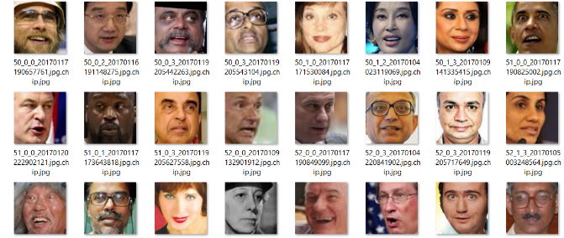
Experiments and Results
and neutral faces in that folder (Figure 14).
Challenges
a
b
Screenshot of some images in the class of surprised faces but the infants (a) have more surprised faces than the adults (b).
source: https://www.kaggle.com/datasets/moritzm00/utkface-cropped?resource=download

Slide 23
Discussion, Conclusion, and Future work
Discussion & Conclusion
A
Explored hyperparameters for facial expression recognition.
Optimal configurations: LR 0.001, 100 epochs, depth 4, batch size 2048.
Challenges observed in UTKFace dataset; misclassifications in mixed-emotion folders.
B
Future Work
Address challenges using advanced architectures.
Explore ensemble methods, transfer learning, or attention mechanisms.
Larger datasets for improved model training.
Continuous adaptation for enhanced real-world applicability.

Slide 24
References
[1] Yue, Z., et al. (2019). Facial expression recognition based on convolutional neural network.

