Slide 1
Who wants to talk about the network?
ResBaz
8th June, 2018,
Brett Rosolen

Slide 2
ANSWER…
No-one – it’s all about data and how to:
Move it
Store it
Manage it
Notes:
Whatever the case, expect more!!

Slide 3
ANSWER…
No-one – it’s all about data and how to:
Move it
Store it
Manage it
Notes:
Whatever the case, expect more!!

Slide 4
Misconception
The Internet is there to share ?
Well, yes and no…
Notes:
Whatever the case, expect more!!

Slide 5
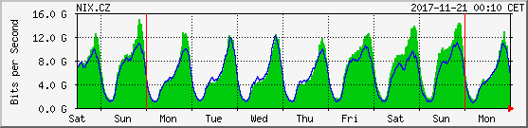
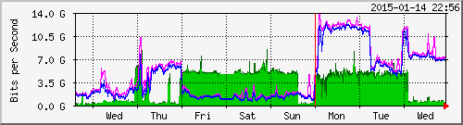
What does “R&E use” look like?
Commercial Networks
Research & Education Networks

Slide 6
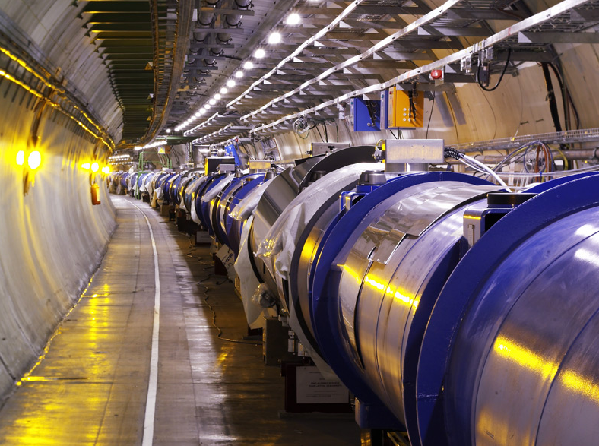
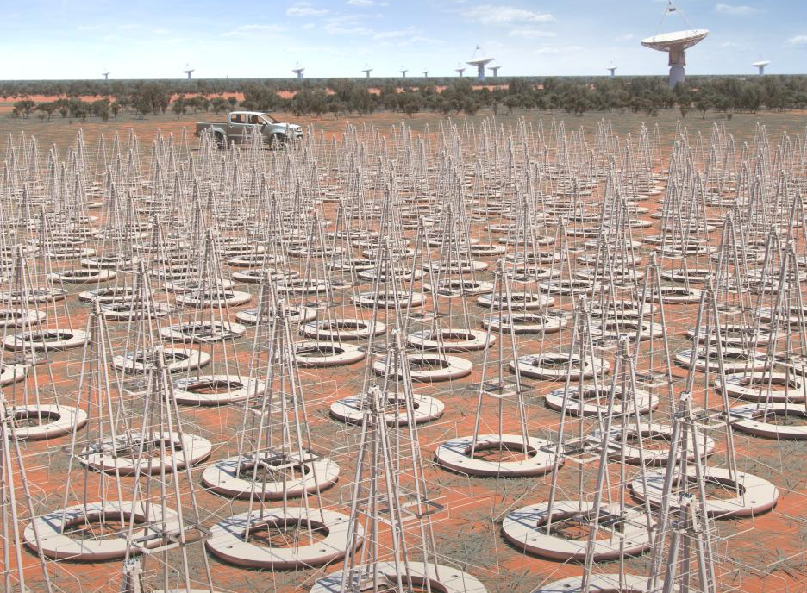
Science Drivers
Notes:
Exponential data generating capability – too much to keep!

Slide 7
Time TO MOVE DATA
 | 1 TB | 10TB | 100TB | 1PB
100 Mbps | 1 day | 10 days | 3 months | 3.4 years
1 Gbps | 2.5 hours | 1 day | 10 days | 3 months
10 Gbps | 13 min | 2.5 hours | 1 day | 10 days
100 Gbps | < 2 min | 13 min | 2.5 hours | 1 day
Notes:
Datasets get bigger, transfer times get longer. Utilising the available bandwidth is key.

Slide 8
Potential issues thwarting Elephant Flows
BLOCKER | REMEDY
Security models set for entire enterprise (i.e. many users) can cause significant bottlenecks for large flows | Use complementary and adjacent security processes only for the largest flows
Users do not know what to expect from the network | Set in place performance testing to demonstrate capability and show bottlenecks
Most typically used tools don’t perform well when latency increases (i.e. nationally and internationally) | Set in place systems designed for data transfer, with the right tools and tuning
Campus border could get saturated by large flows (business continuity risk!) | Architect borders differently to avoid congestion
Security
Monitoring
Data Transfer
Architecture

Slide 9
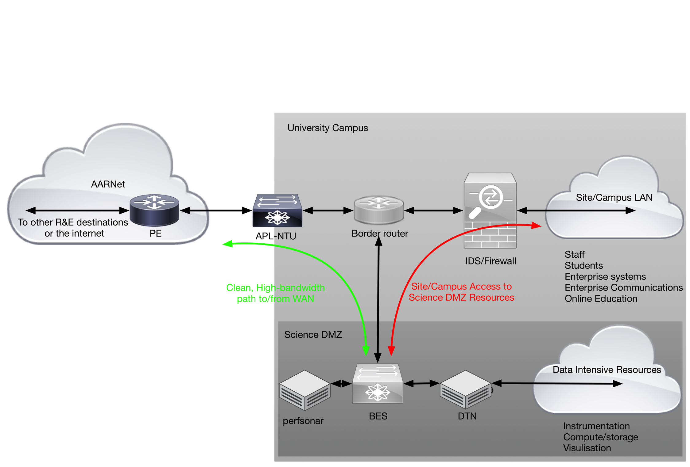
The alternative = Science DMZ
Architecture
Security
Monitoring
Data Transfer

Slide 10
ANSWER…
No-one – it’s all about data and how to:
Move it
Store it
Manage it
Notes:
Whatever the case, expect more!!

Slide 11
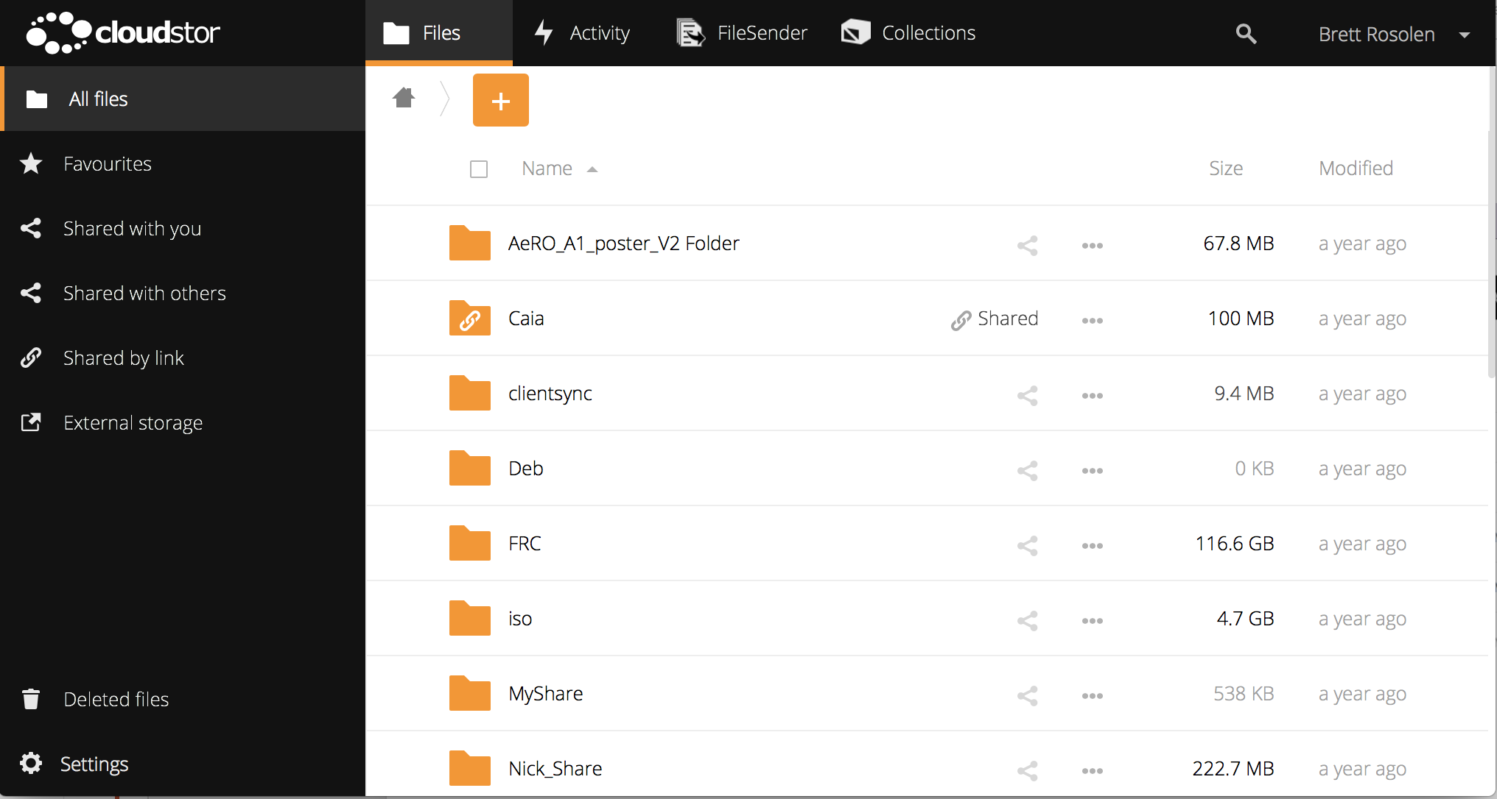
CLOUDSTOR
Notes:
Sync/share platform
Australian servers distributed nationally
Easy access through AAF

Slide 12
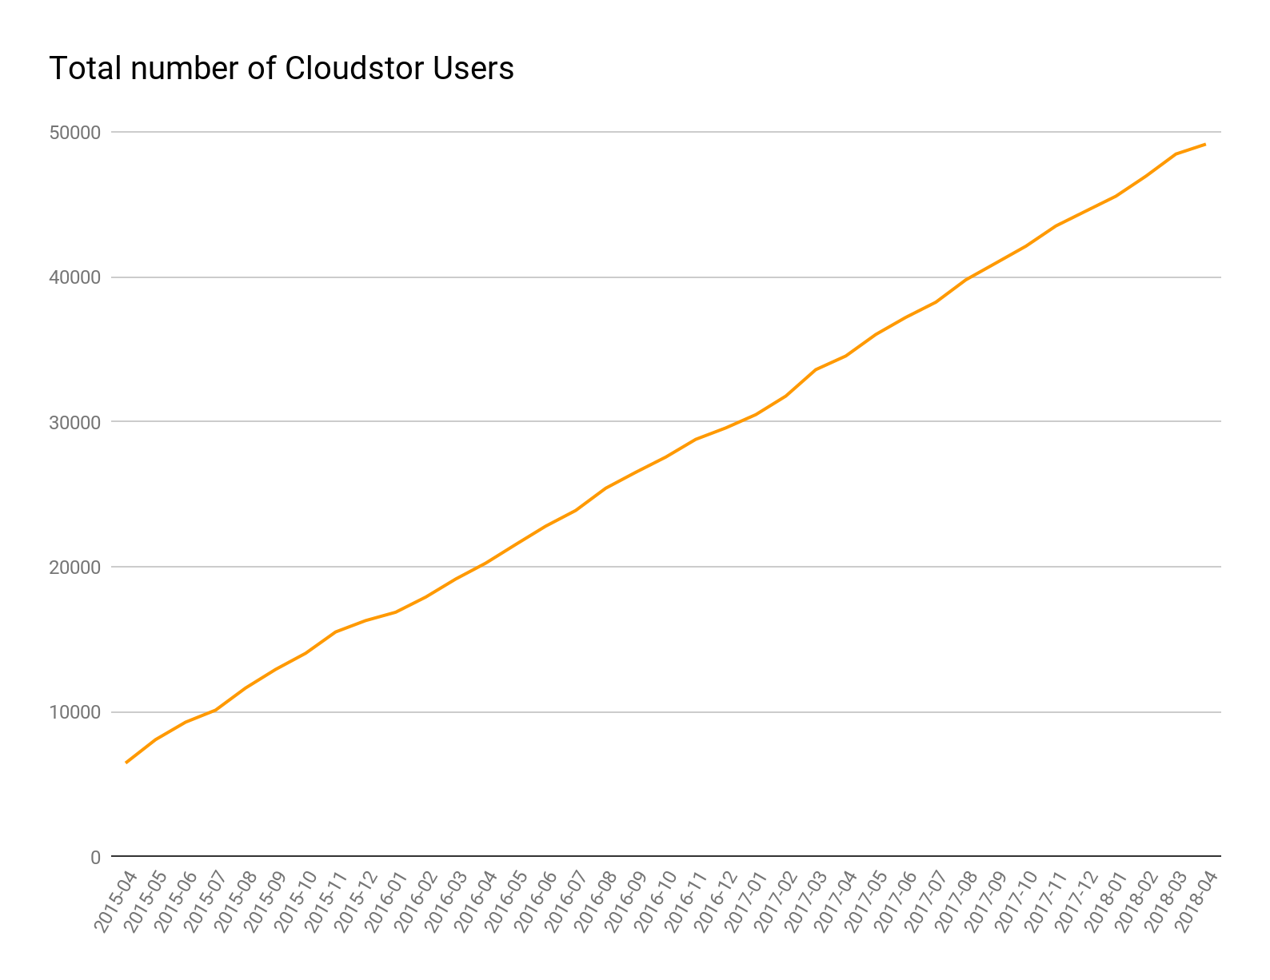
CLOUDSTOR
Users 49,000+
Domains 333
Storage Used 275+ TB
*Latest data as of 2018-04-17
Notes:
Growth across 3 years

Slide 13

SUSTAINABLE STORAGE
Included in AARNet subscription (no additional charge)
Institutional Charge
Based on storage used by institution
Available to all staff & students
Research & staff members
100GB per researcher
10TB per institution for groups
Unrestricted Storage
Notes:
Zero-barrier to entry - Entry level use of CS is included in the AARNet member subscription
free (and on-net)
Individual Researchers/Staff - AAF credentials - max allocation of 100GB per researcher
Australian sovereignty
easy cross-institution collaboration
And 10TB allocations can be made for research groups.
Institutional arrangement - both staff and students can access the service
University is free to manage individual and group allocations, and can access unrestricted storage allocations.
fee.

Slide 14
ANSWER…
No-one – it’s all about data and how to:
Move it
Store it
Manage it
Notes:
Whatever the case, expect more!!

Slide 15
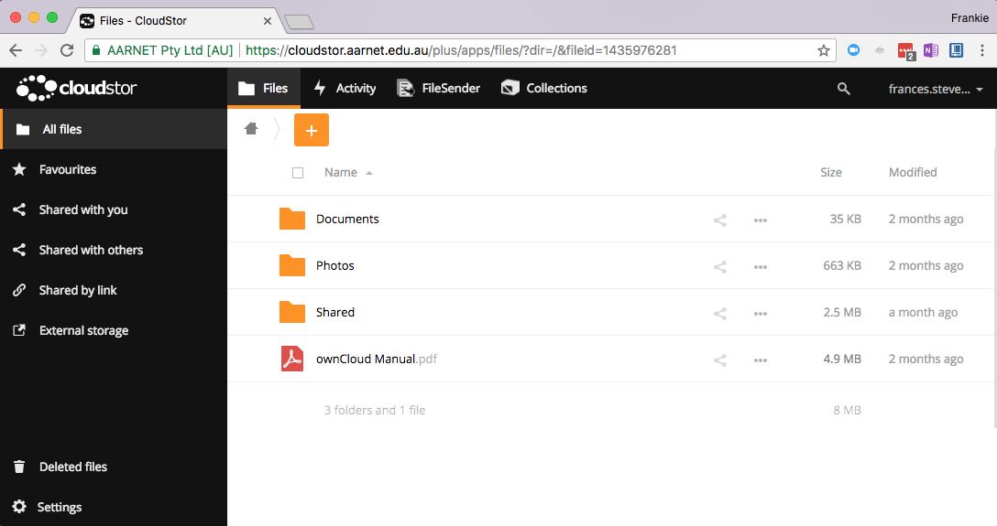
CLOUDSTOR
Notes:
further functionality to this platform.
"Filesender”
“Collections”

Slide 16
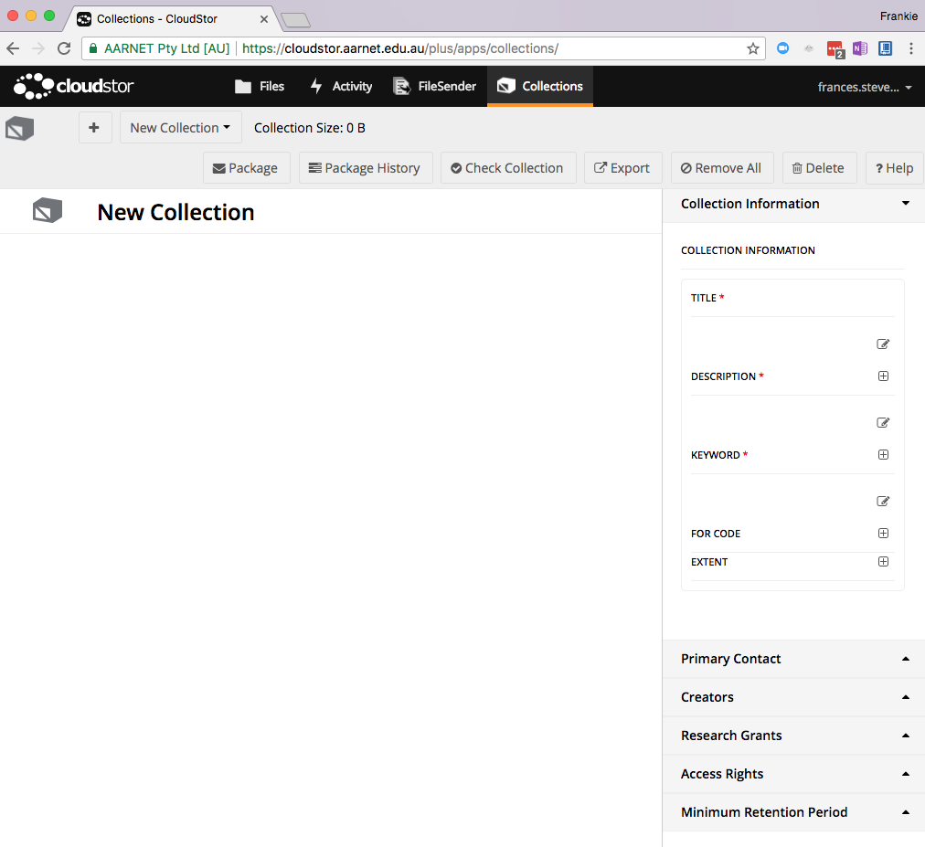
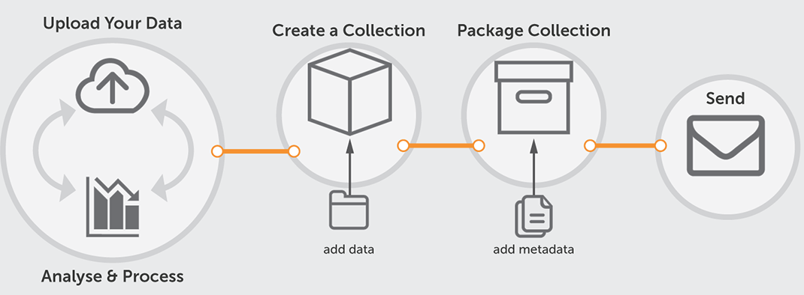
COLLECTIONS
Notes:
partnership between AARNet, Intersect and Western Sydney University.
easily collate, describe, package and share groups of files and associated metadata.
support data packaging through research and data curation lifecycles.
can create collections of CloudStor-based files.
collections described through mandatory and optional metadata elements.
Collections packaged into an archive, complete with copies of the files, manifest and metadata.
Packages created within the CloudStor filesystem - can be downloaded / shared
can export metadata human + machine readable formats.
Unstructured toward structured data

Slide 17
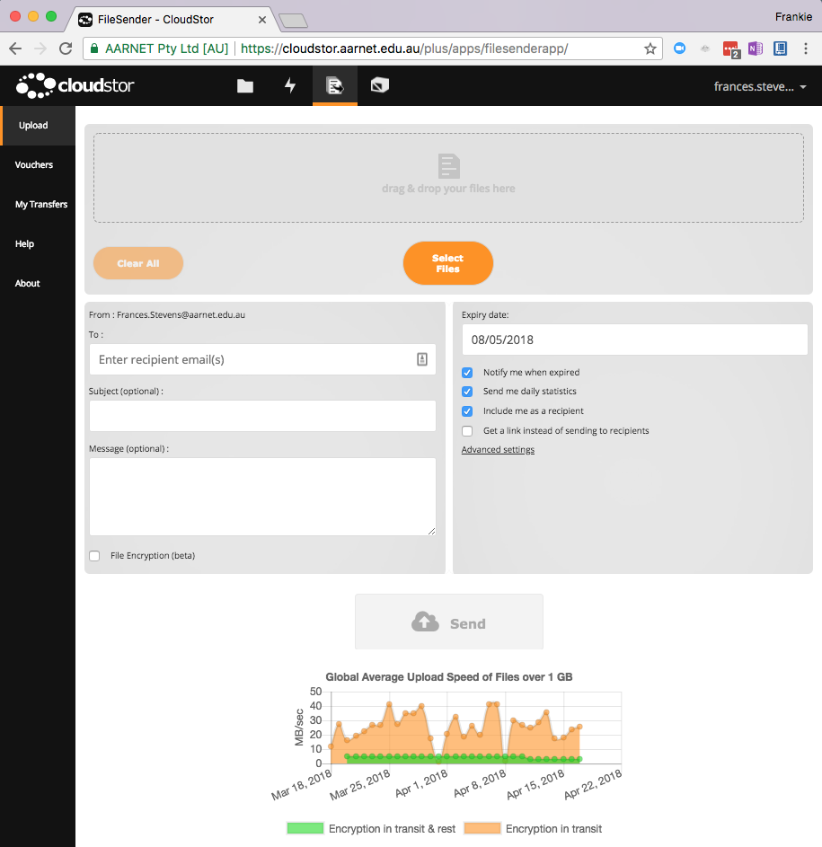
Filesender
Users 43,800+
Domains 226
Files sent 561,000+
Notes:
Email - send messages and small files.
Large files - email no good.
benefits:
URL to your files
guests “Vouchers”
expiry dates
end-to-end encryption of any data
no restriction on file type.
up to to 100 files max size of 2PB per upload.

Slide 18

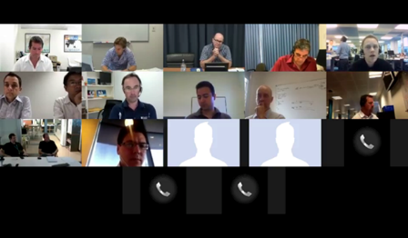
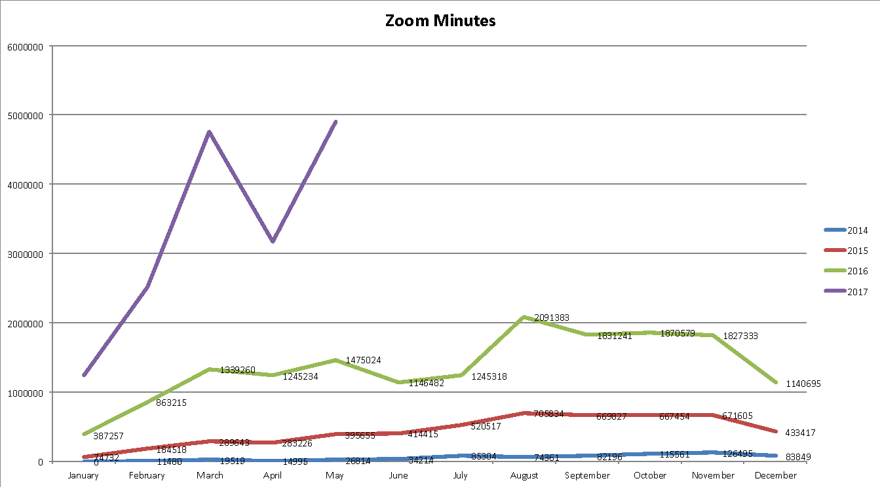
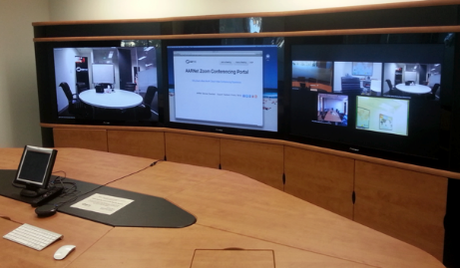
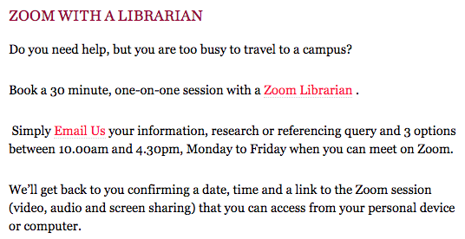

ZOOM CONFERENCING
Notes:
eResearch done right - such that no one even considers it so. The “e” has been lost from this research tool, which is what should happen with all eResearch services.
Intersect - webinar capabilities deliver training
UWS is using Zoom to support reference enquiries

Slide 19

Questions

Slide 20
Thank you

