Slide 1
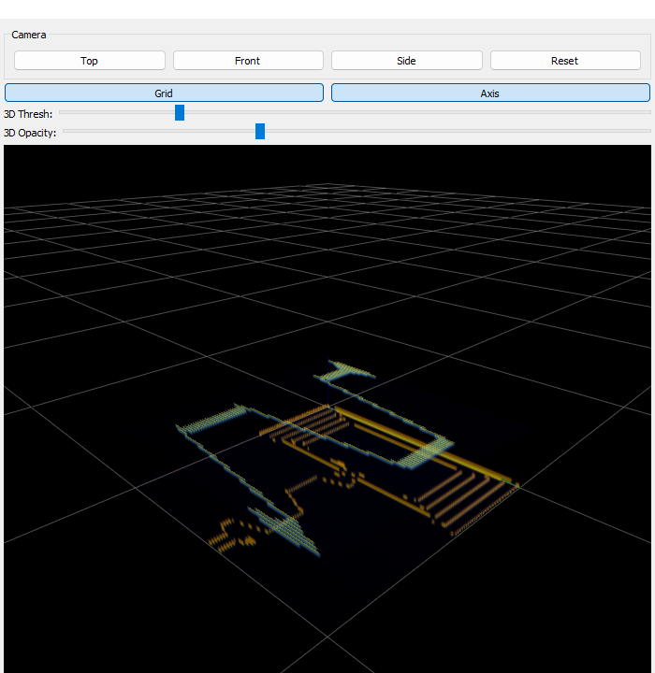
PROJECT UPDATE
Gerber vs. Real X-Ray CT
Registration & Multi-Material Comparison
July 2, 2026
real 3D render — RoyalBlue54L NFC antenna Gerber

Slide 2
MOTIVATION
Goal: Ground-Truth Materials on Real CT Data
2/10
1
2
3
4
Load Gerber
Dual-Pane View
Register Volumes
Transfer Labels
Real CT (left) + Gerber model (right) → registered → auto-labeled

Slide 3
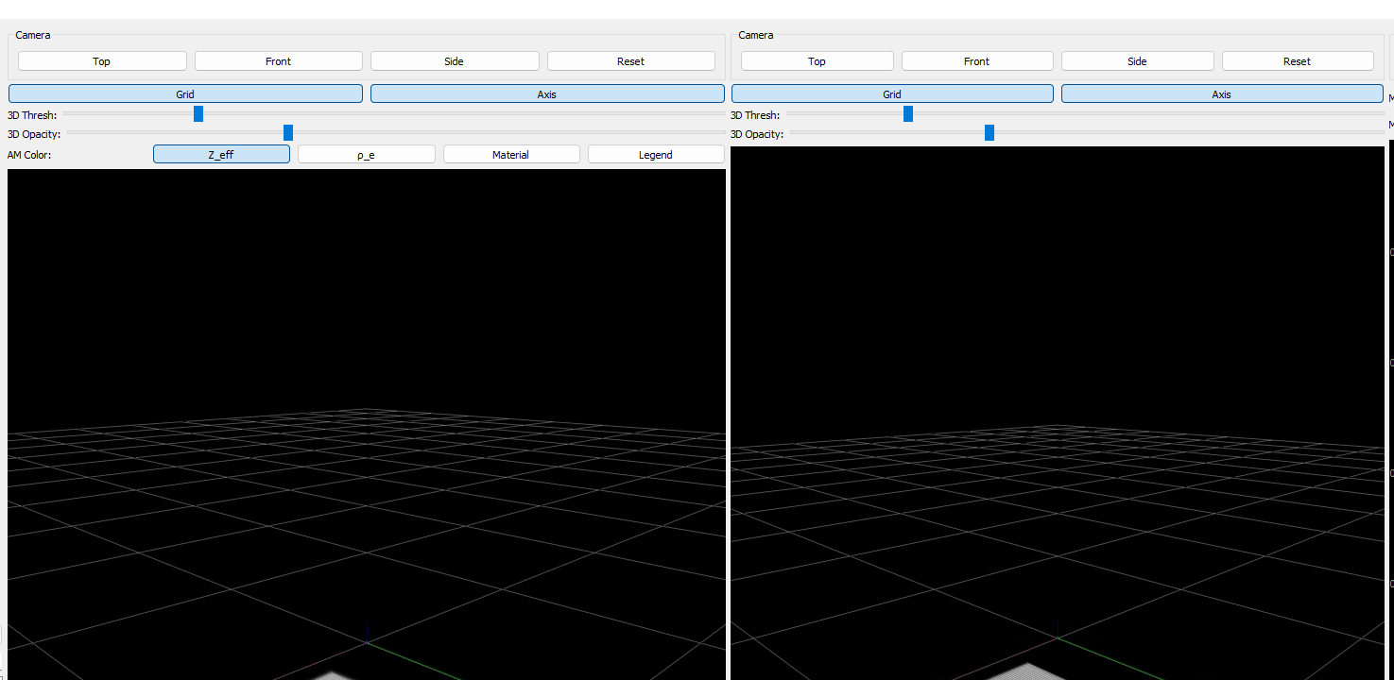
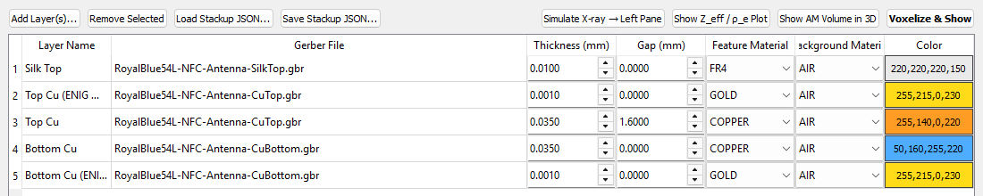
PHASE 1 — DONE
Dual-Pane 3D Viewer
3/10
REAL CT
GERBER MODEL
Stackup Editor (real)
31/31
live app screenshot — independent camera / threshold / opacity per pane
pytest checks passing

Slide 4
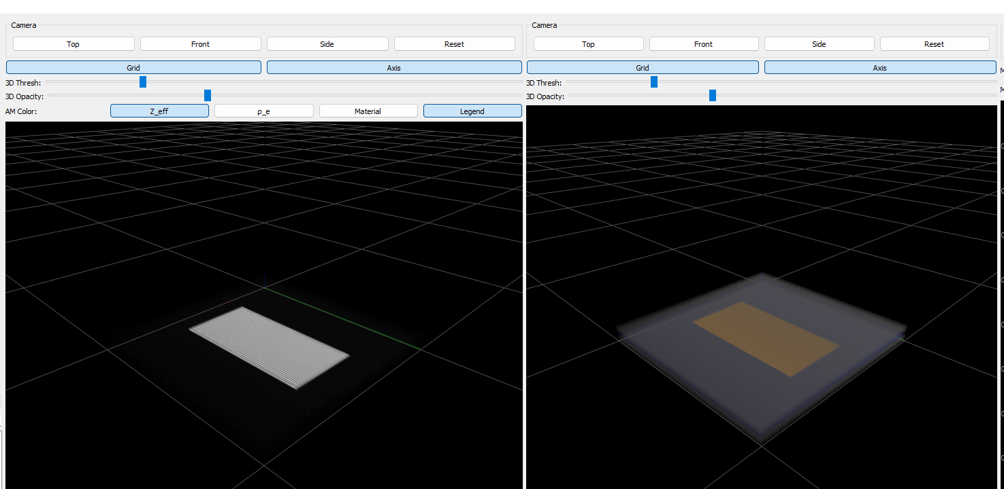
BRIDGE STEP — DONE
Simulated X-Ray Demo
4/10
SIMULATED CT (Radon + FBP)
GERBER GROUND TRUTH
✓ Perfectly Pre-Registered

Slide 5
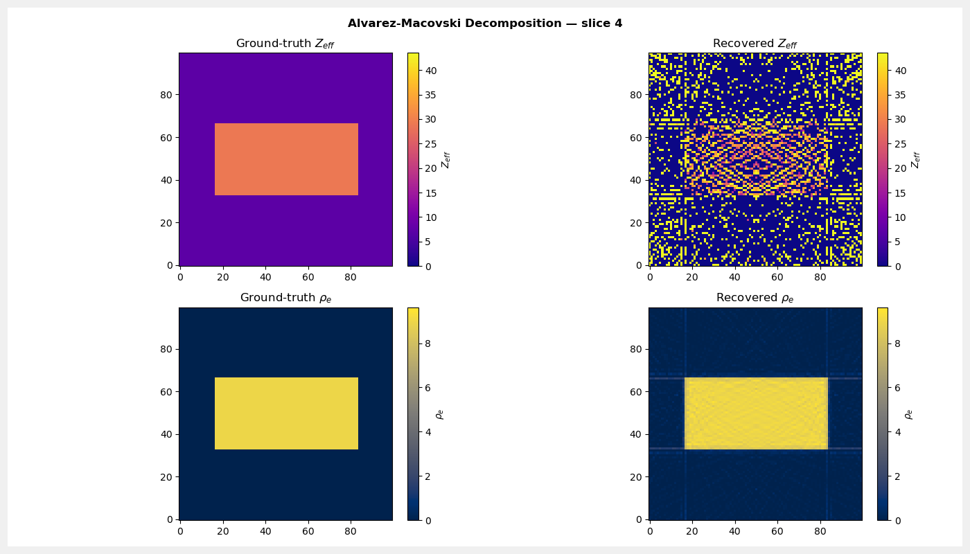
MATERIAL PHYSICS
Dual-Energy Decomposition
5/10
real decomposition output — ρ_e recovery is clean, Z_eff recovery is noisy (expected, ratio-based method)

Slide 6
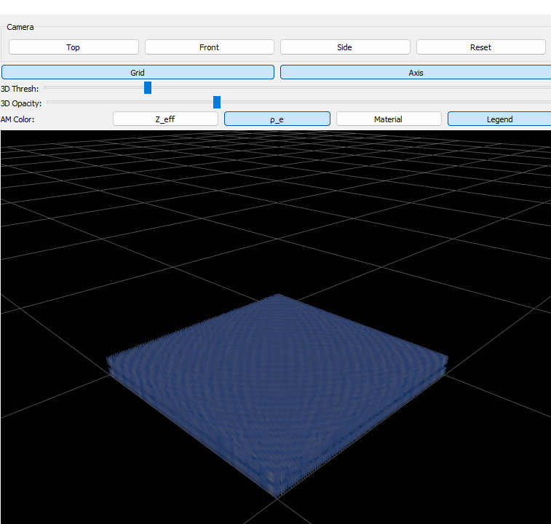
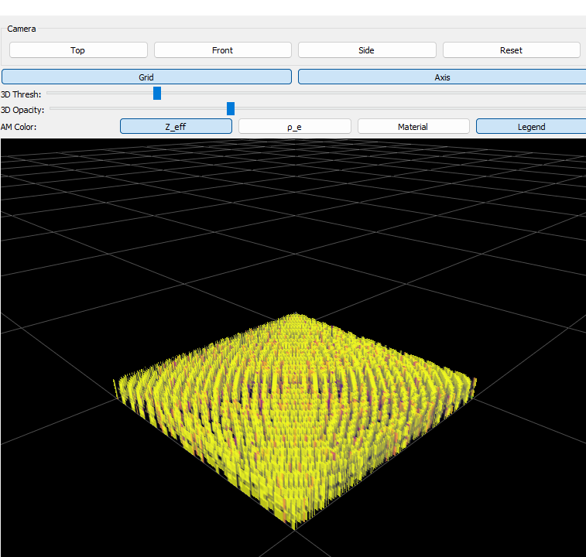
MATERIAL PHYSICS
Colorized Volumes + Legend
6/10
ρ_e clean
Z_eff noisy
AIR
COPPER
Z=7.2 ρ=0.00
Z=29.0 ρ=8.96
FR4
GOLD
Z=6.5 ρ=1.85
Z=79.0 ρ=19.30
SILVER
SOLDER
Z=47.0 ρ=10.49
Z=60.0 ρ=8.50
ρ_e (electron density)
Z_eff (real recovered volume)
real computed reference values (live app legend)
Classification accuracy (real run)
Noisy Z_eff recovery is the main driver of the
accuracy gap — an expected physics limitation,
not a bug.

Slide 7
PHASE 2 — DONE
Registration Foundations
7/10
GERBER (moving)
REAL CT (fixed)
✓ mm/voxel spacing
✓ mm/voxel spacing
5-DOF Rigid + Scale Transform
Tx
Ty
Tz
Rot Z
Scale
0.20 mm
-0.15 mm
0.02 mm
3.00°
1.02x
values shown: a real accepted transform from the synthetic-demo test fixture

Slide 8
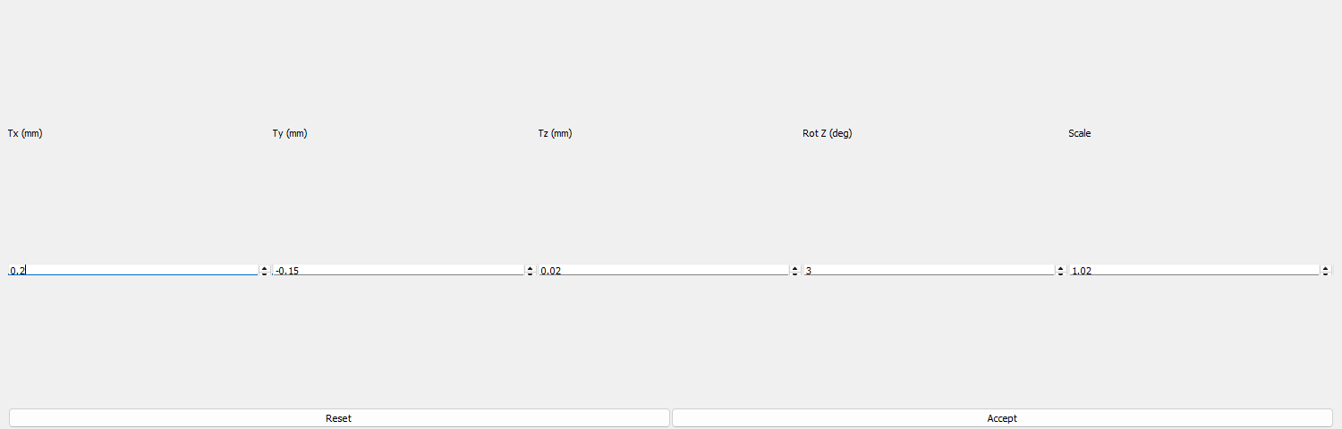
PHASE 2 — DONE
Manual Registration Tool
8/10
MOVING (Gerber, red)
LIVE OVERLAY PREVIEW
FIXED (Real CT, green)
real control panel — accepted transform matches the known-misalignment test fixture

Slide 9
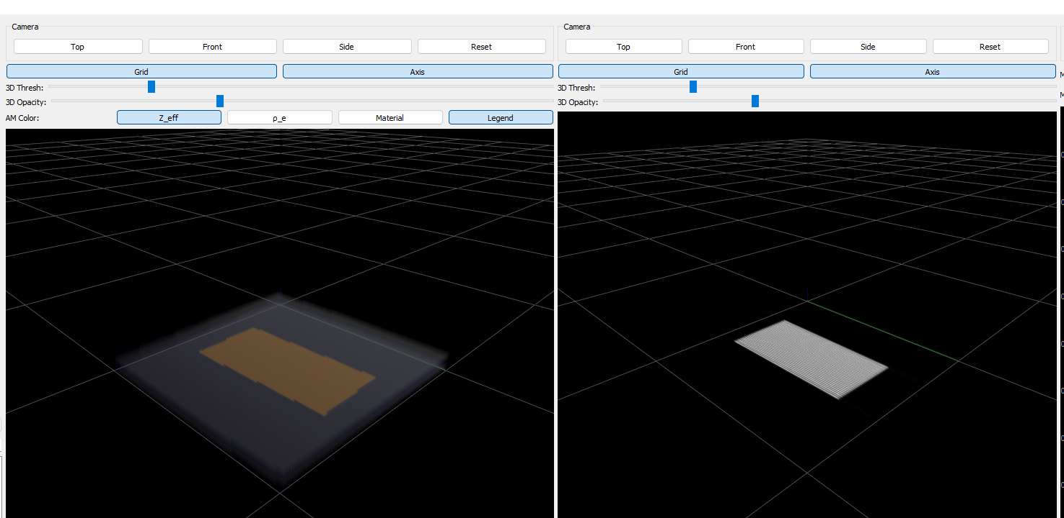
PHASE 2 — DONE
Label Transfer: Gerber → Real CT
9/10
nearest-neighbor resample — exact labels, no blending
LABELED REAL CT
REGISTERED GERBER
copper trace on translucent FR4 — verified

Slide 10
QUALITY & NEXT STEPS
Testing & What's Next
10/10
31/31 tests passing (pytest, just now)
Next steps
Real matched Gerber + CT dataset
Evaluate auto-registration
Improve Z_eff recovery accuracy

