Slide 1

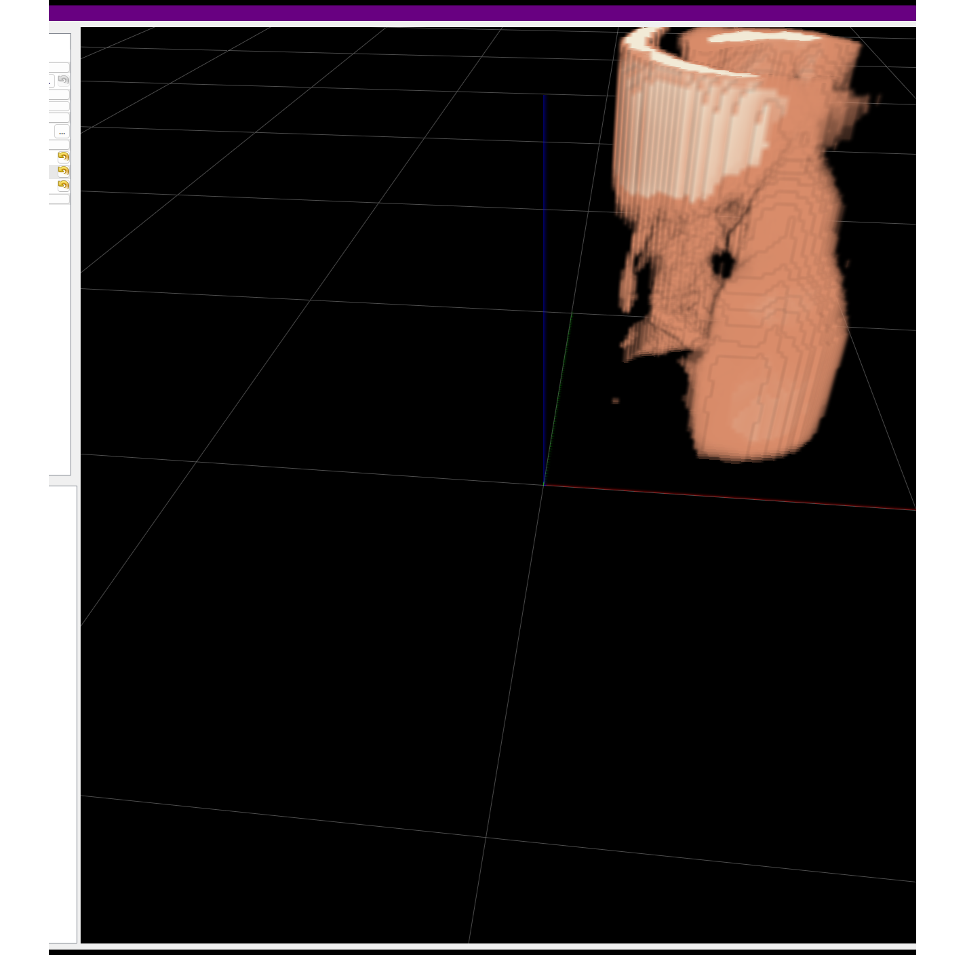
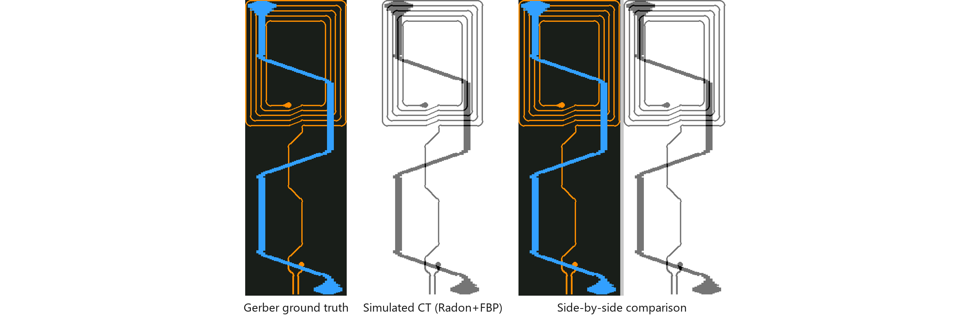
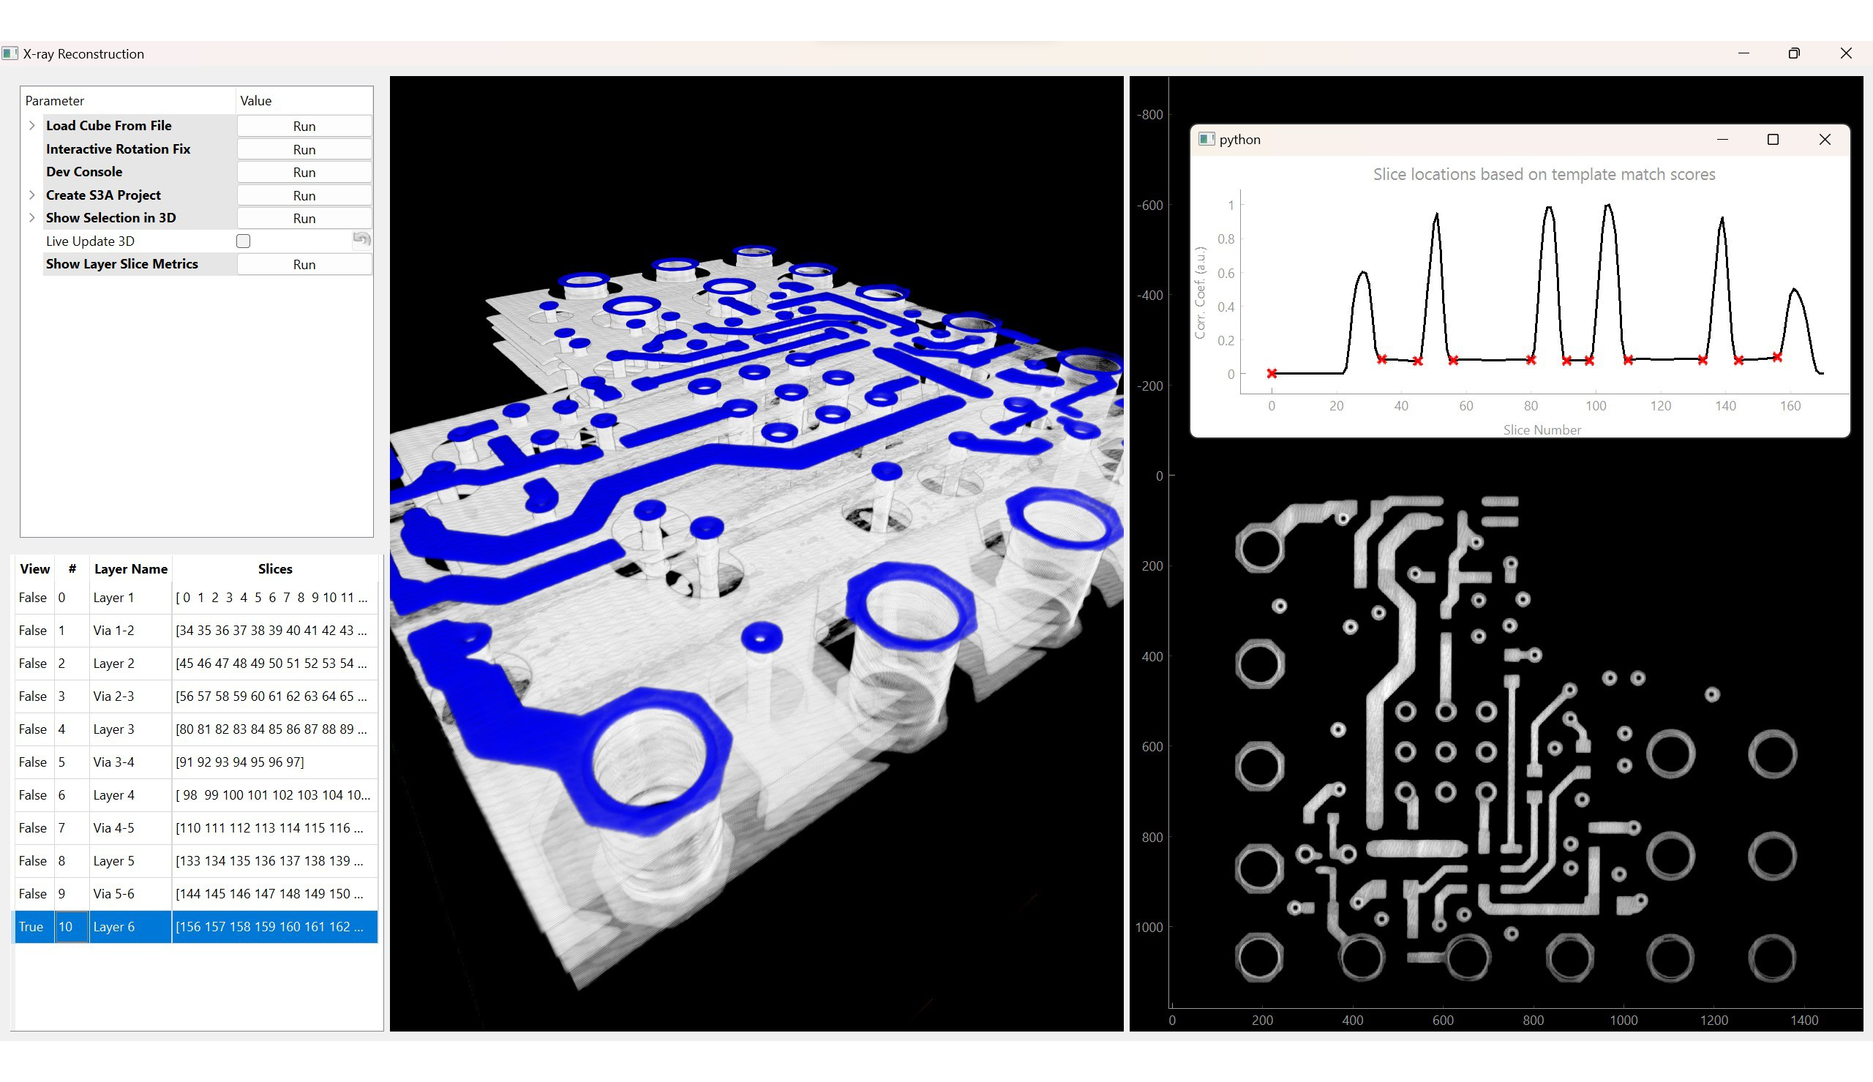
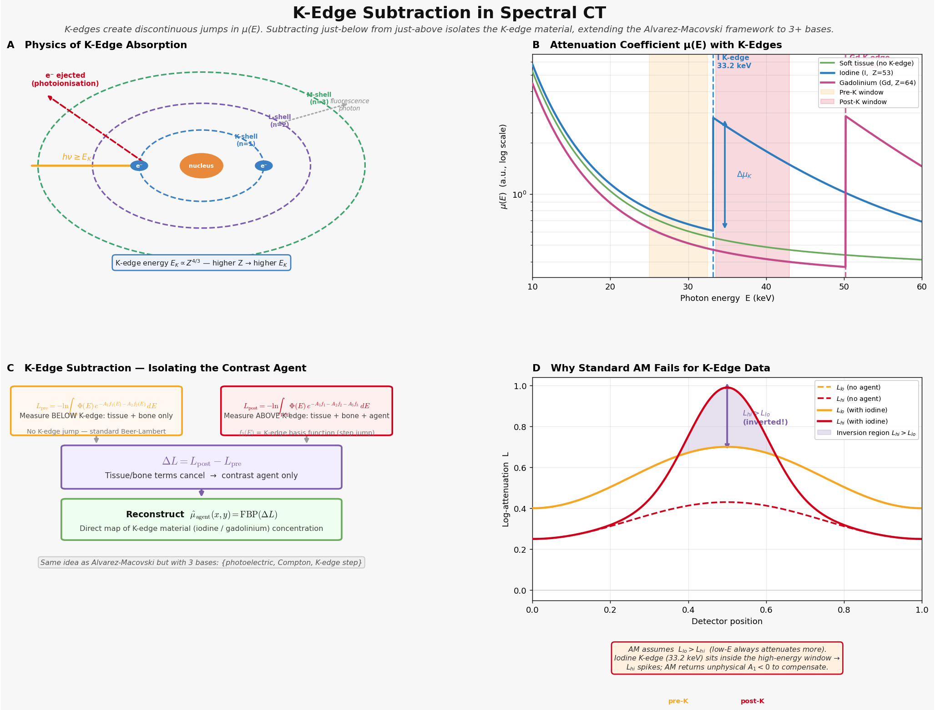
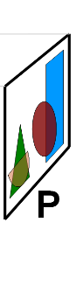
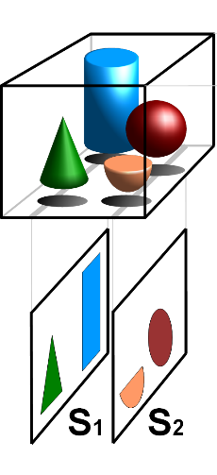
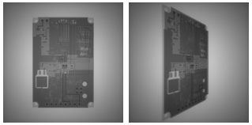
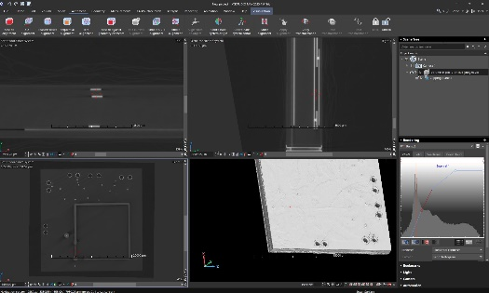
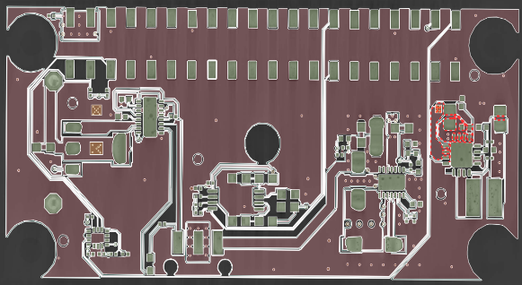
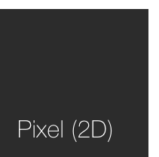
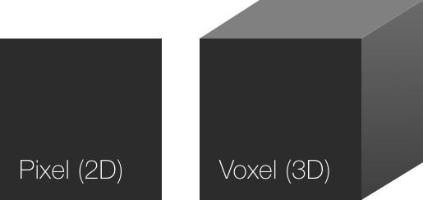
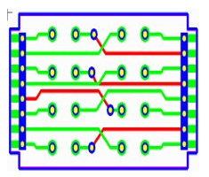
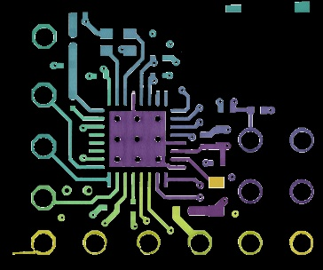
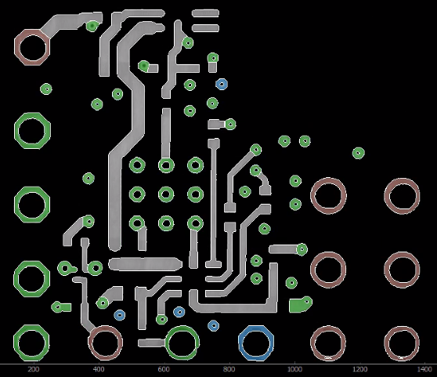
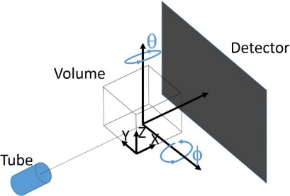
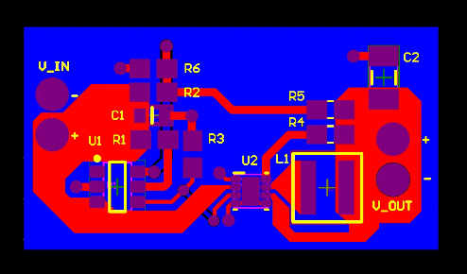
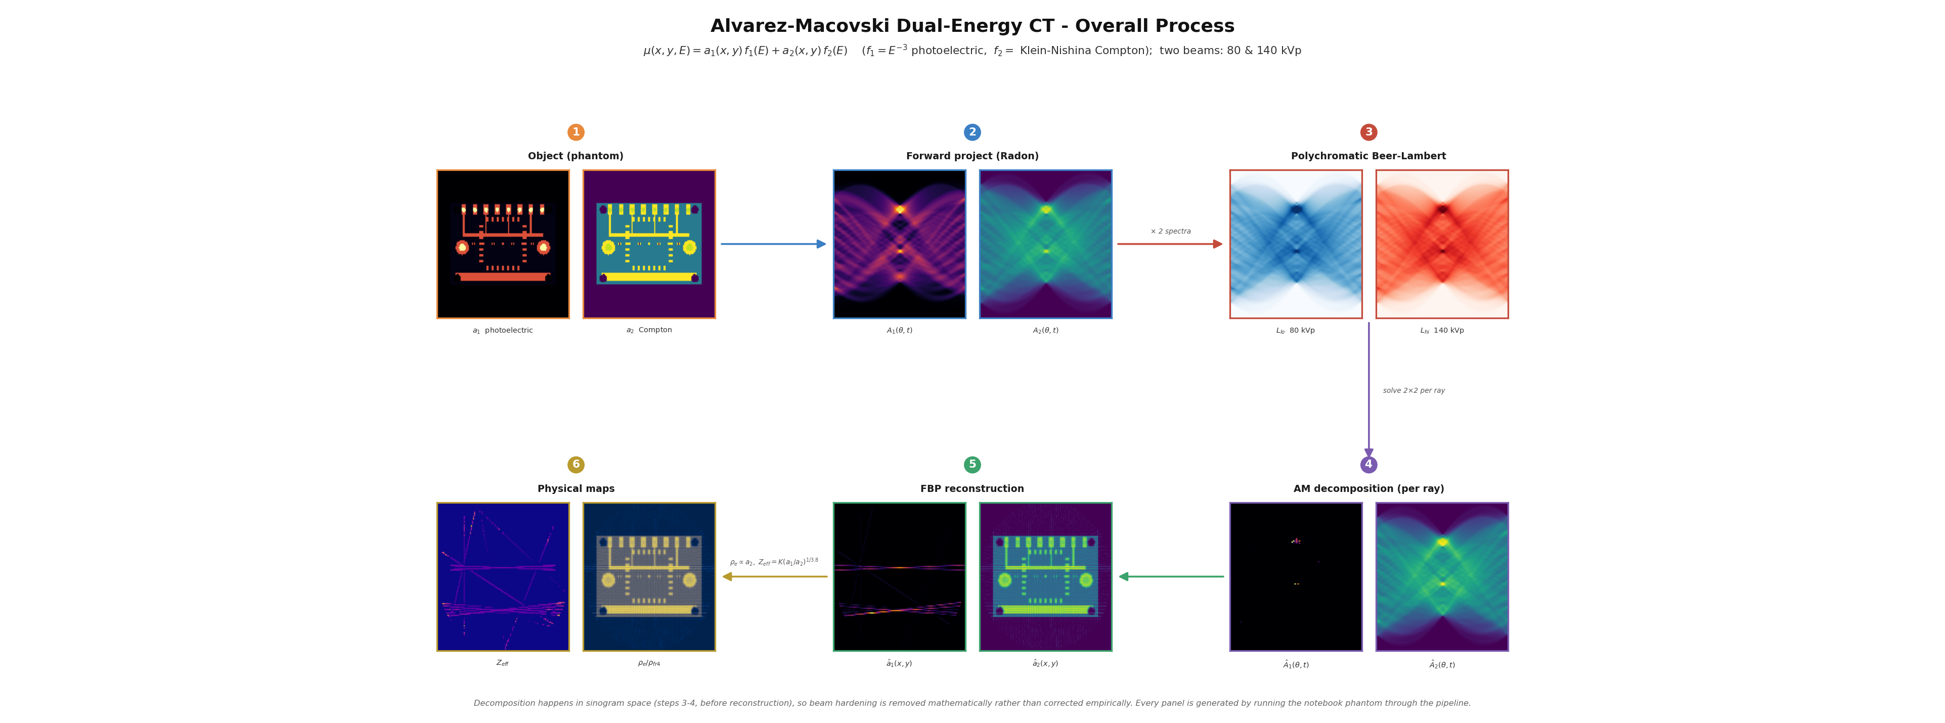
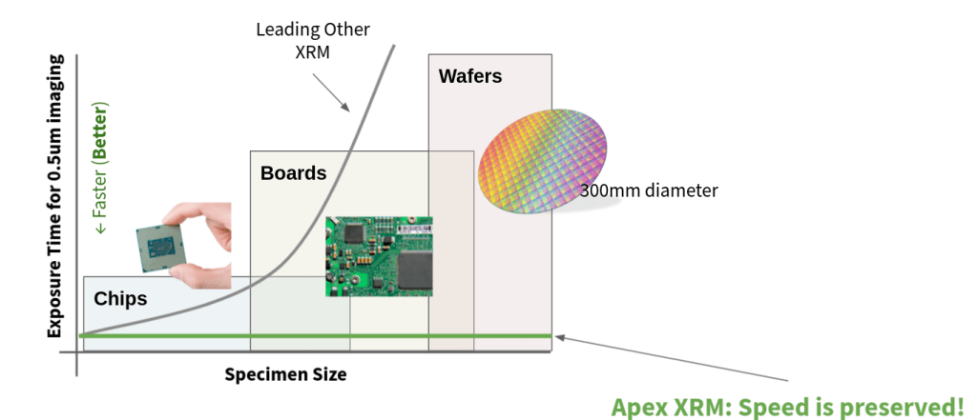
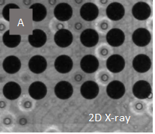
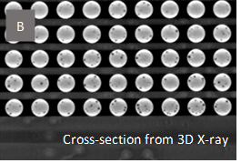
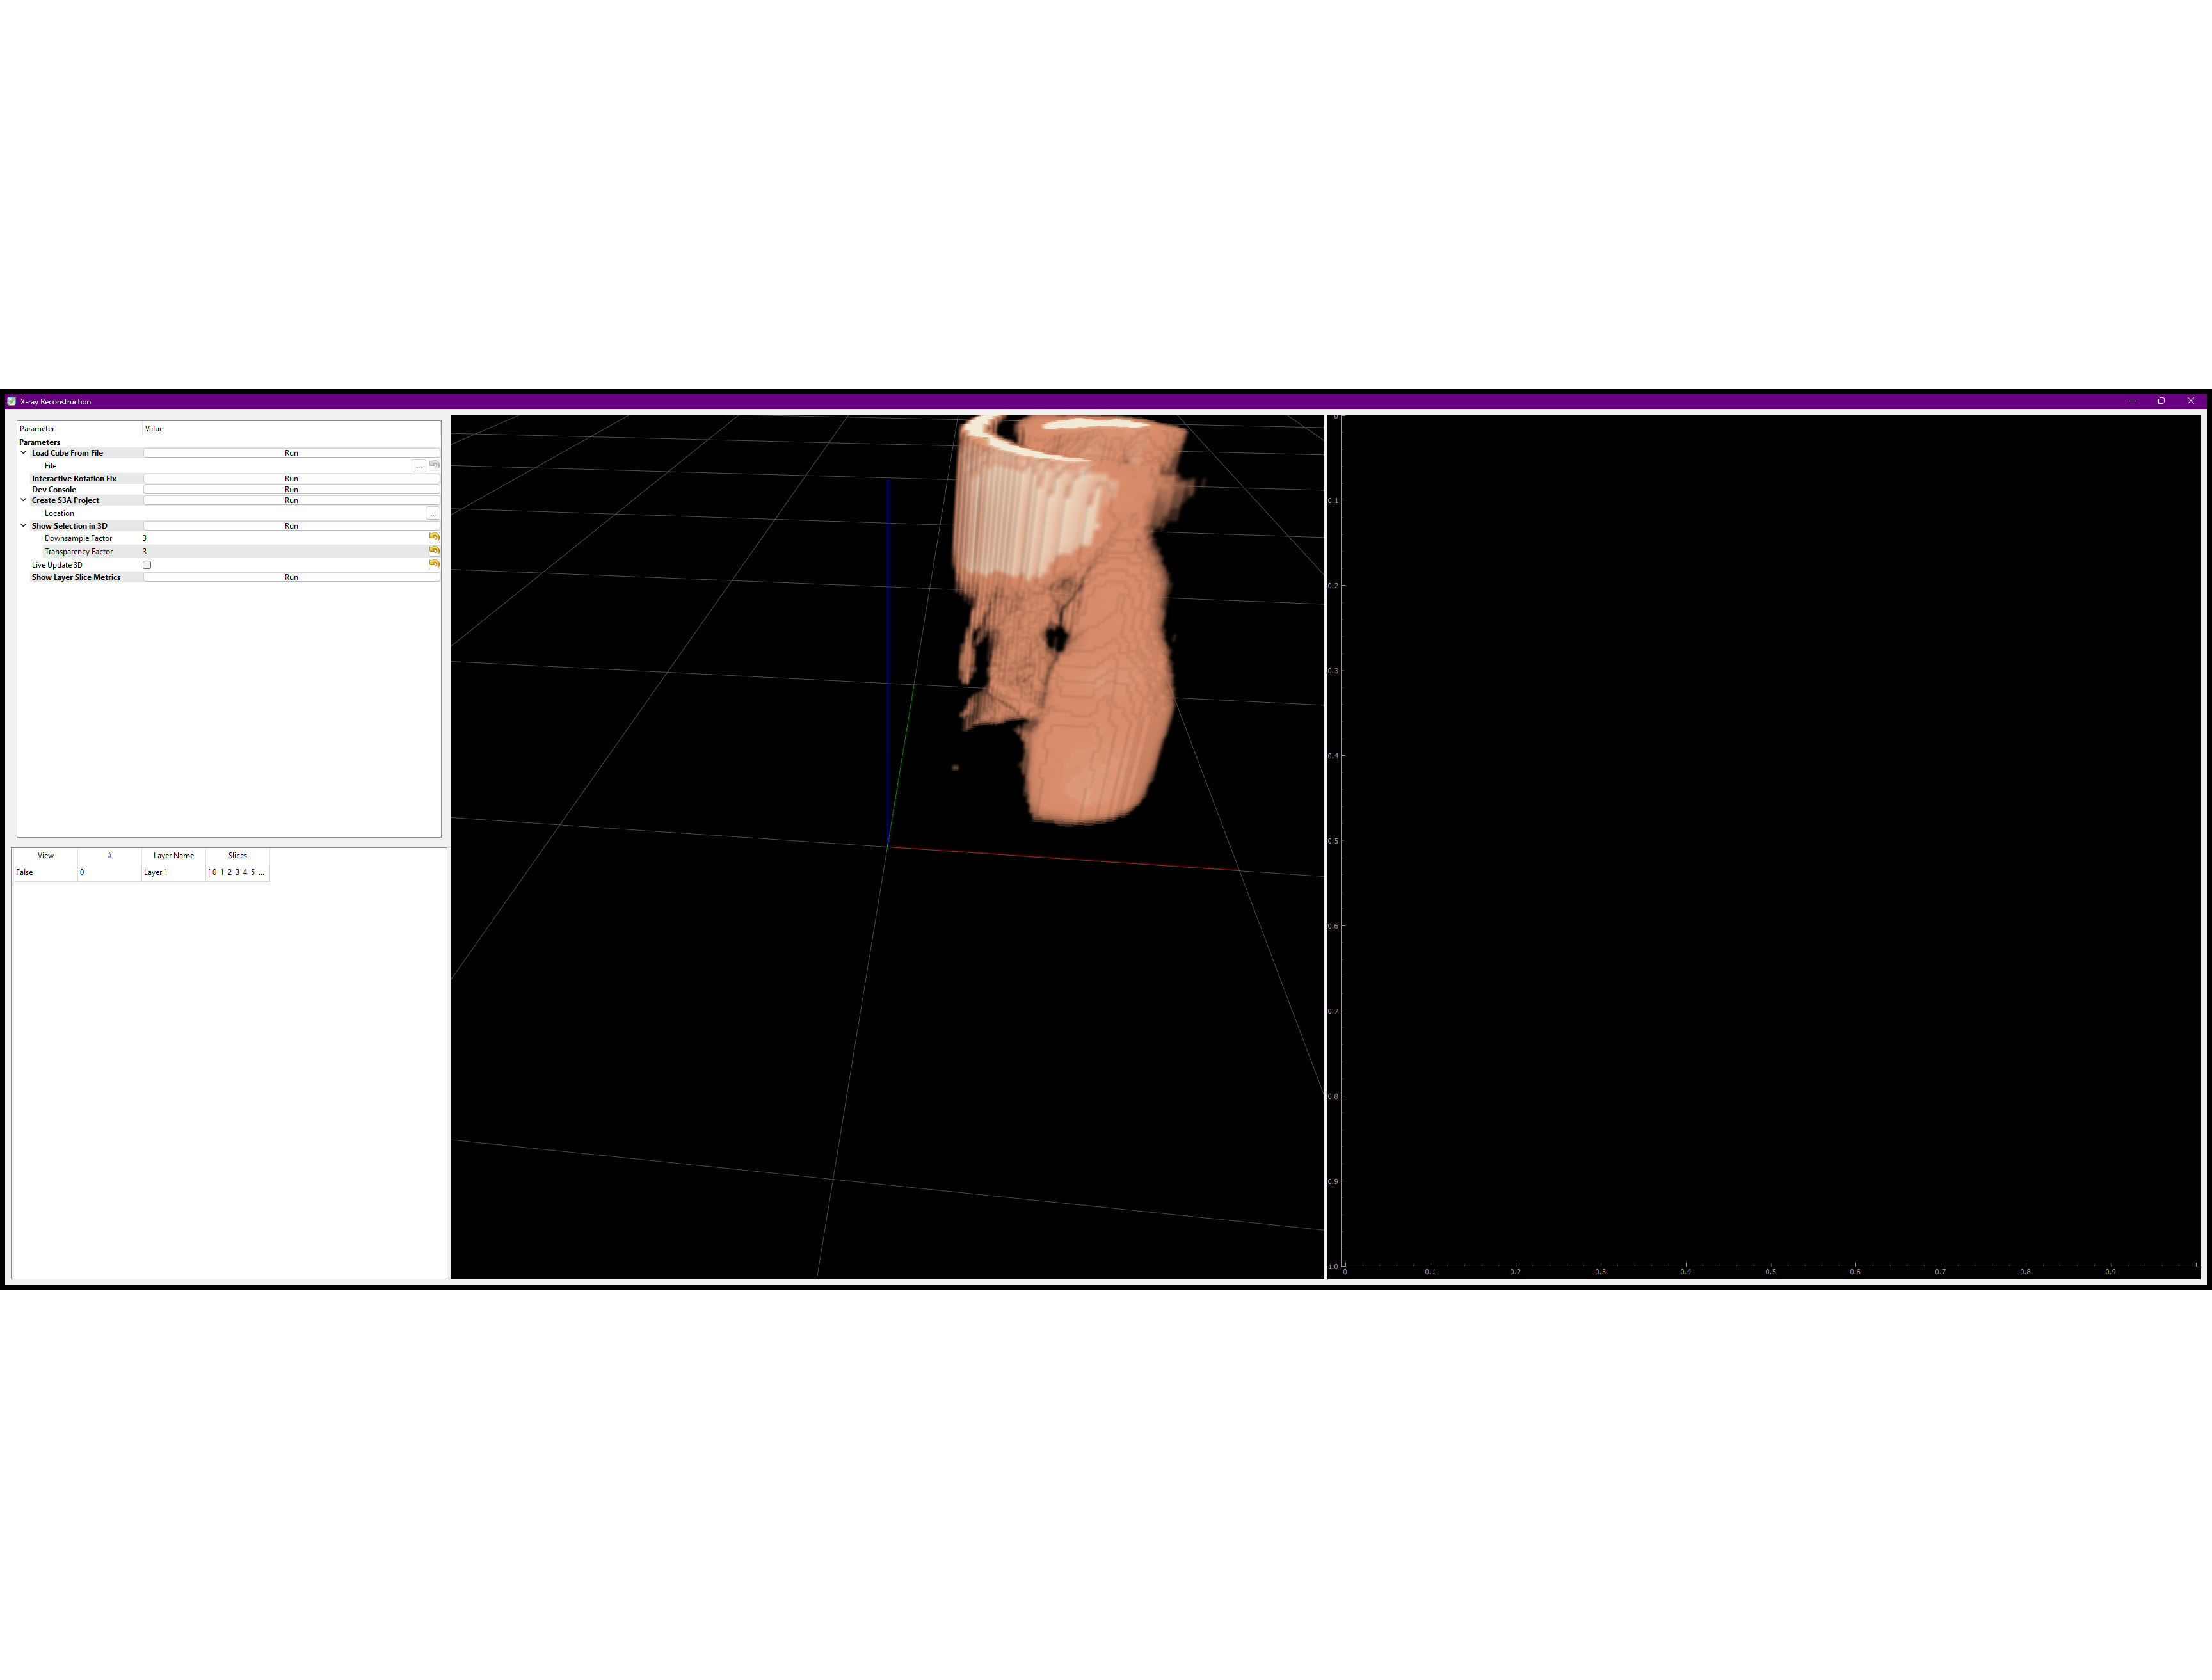
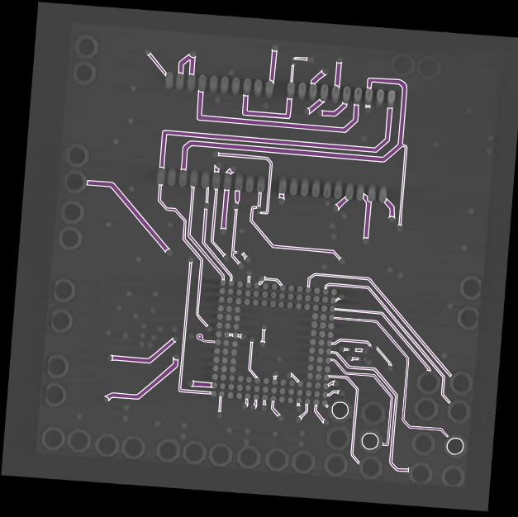
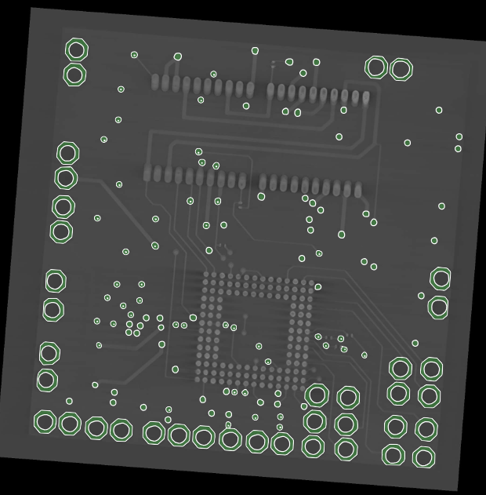
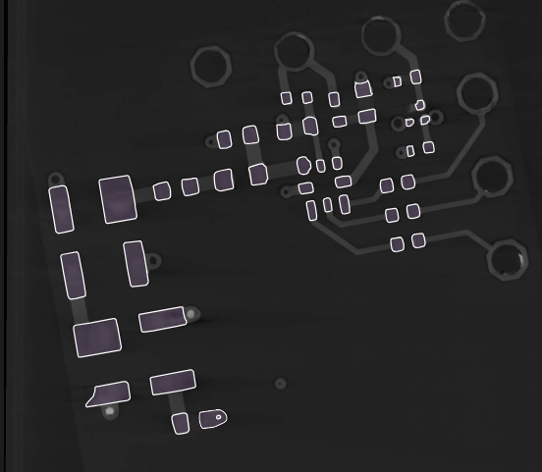

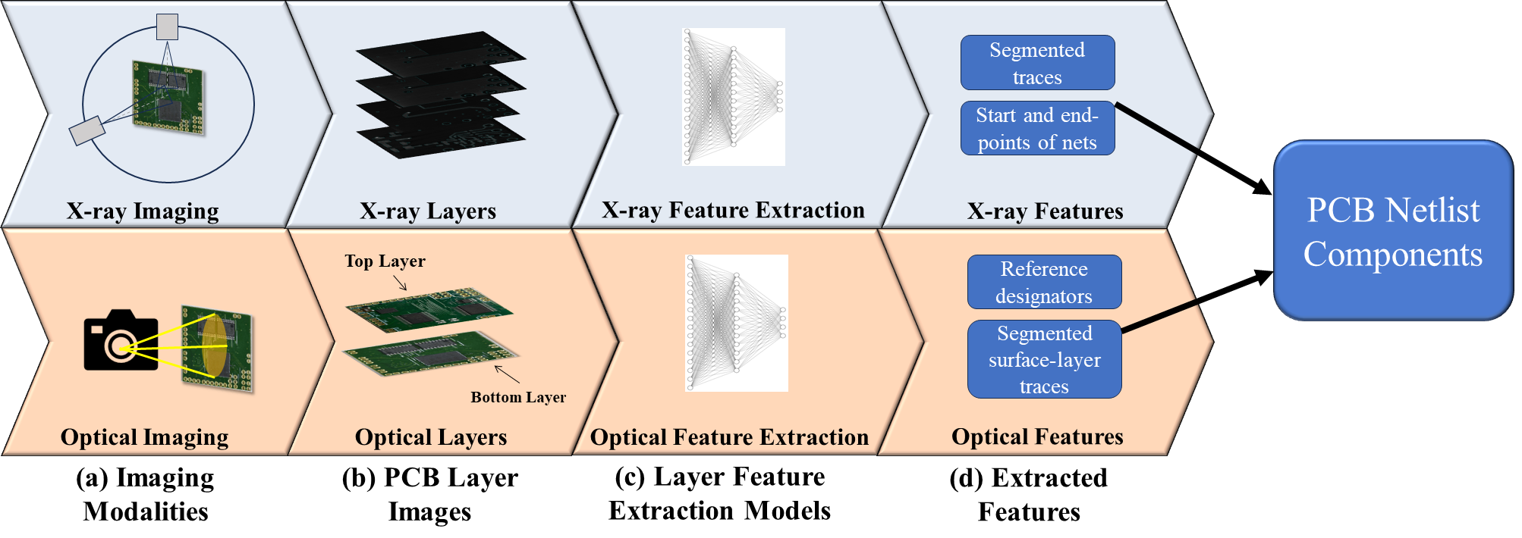
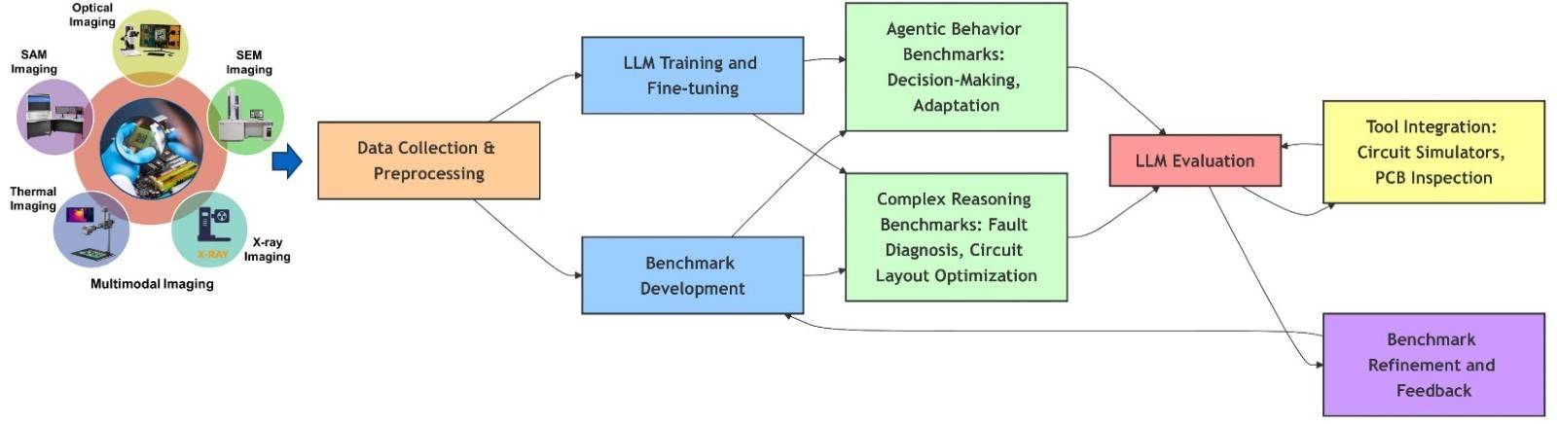
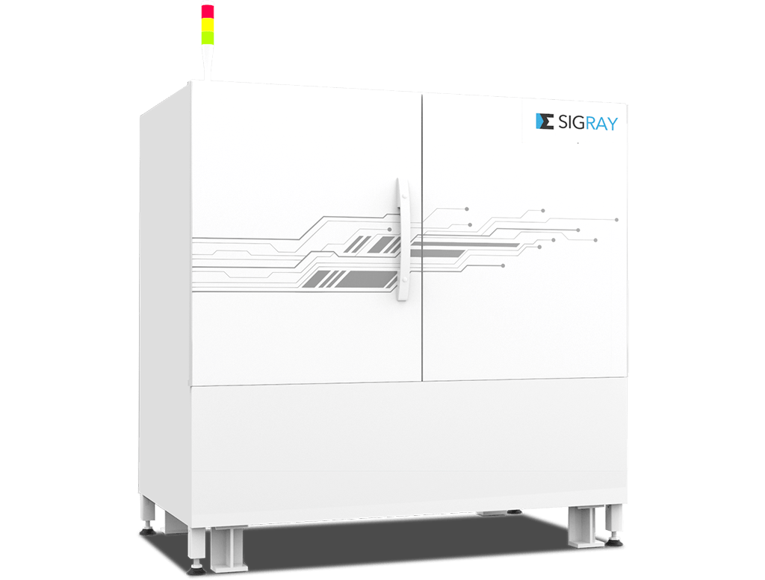
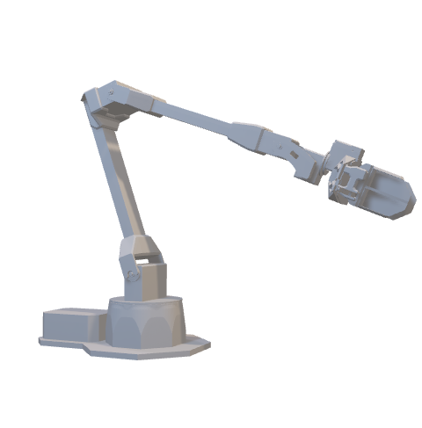

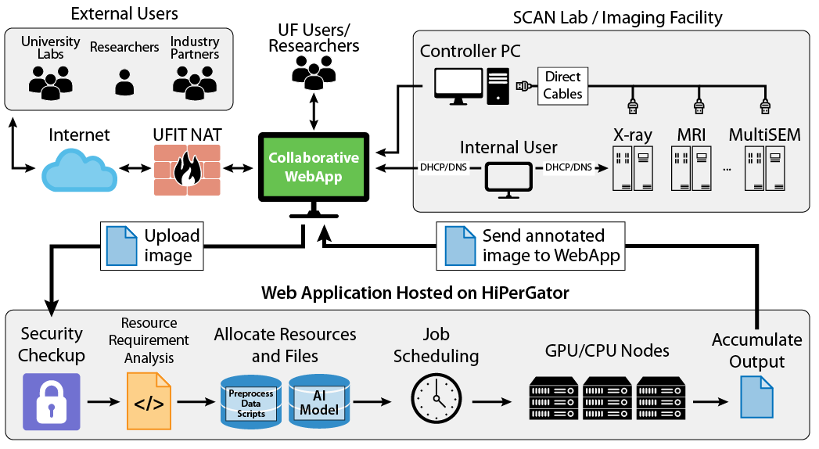
xrayrecon: Registering Gerber PCB Designs to Real X-ray CT Data
Patrick Craig
xrayrecon Project — Sandia PCB X-ray CT Analysis Initiative
Pillars of the xrayrecon Toolkit
Simulated X-ray/CT Validation Bridge
An Open, Scriptable Python Pipeline
+
Dual-Energy Physics: Beyond Two Materials
A true Radon-transform + filtered-back-projection simulation (scikit-image) of a Gerber stackup's voxelized (Z_eff, electron density) data produces a realistic CT volume with authentic FBP artifacts — no added noise.
Because the simulated CT and the Gerber ground truth derive from the same voxel grid, this pair is perfectly pre-registered — ideal for validating label-transfer logic before tackling real, misaligned CT data.
X-ray CT Volume (TIFF/.npy)
Registration (5-DOF)
S3A Annotation
Real CT Scan
X-Ray Parameters
X-ray Projections
FBP Reconstruction
Gerber Stackup
Label Transfer
Alvarez-Macovski Dual-Energy Material Classification
Registration, voxelization, and label transfer live in pure, no-Qt Python modules (registration.py, stackup_voxelize.py) that can be scripted outside the GUI.
The same pipeline that renders live in the dual-pane viewer can be driven headlessly for batch processing, regression testing, or integration with other tools.
Scan Geometry
Voxelization
Schematic Capture
Validating Before Tackling Real Data
The xrayrecon Pipeline: From Schematic to Registered, Labeled CT Volume
The dual-pane 3D viewer renders real X-ray CT data and a Gerber-derived model side by side, each with independent camera, threshold, and opacity controls.
A 5-DOF manual registration tool (XYZ translate, Z-rotation, uniform scale) aligns the Gerber model to real CT data with a live red/green overlay preview.
Once registered, the Gerber model's known per-voxel materials are resampled onto the real CT grid to auto-label it, verified against a known synthetic ground truth.
A dual-energy (80/140 kVp) simulated scan is decomposed per-ray into photoelectric and Compton basis functions, recovering Z_eff and electron density per voxel.
Recovered values are nearest-match classified against a materials database (copper, FR4, solder, gold, ...); electron density recovers geometry cleanly, while Z_eff recovery is noisier for low-Z materials — an honest, documented limitation.
Addressing Challenges in PCB Design Verification
Real PCB Dataset: Gerber Design + Matched X-ray CT
A synthetic misalignment with a known answer key exercises the full registration UI before any real, noisy CT scan is attempted.
21 automated pytest checks cover registration math, material-label transfer, spacing metadata, and GUI smoke tests — all passing.
This staged validation catches real bugs (a missing camera reset, stale layer ranges after a cube-depth change) long before they reach real data.
A
B
C
A
B
C
Conclusion and Future Work
Phase 1 (independent dual-pane viewing) and Phase 2 (5-DOF registration + label transfer) are complete and verified end-to-end on a synthetic pair with known ground truth.
Future work: calibrate real voxel spacing and register the newly acquired real PCB CT scan against its Gerber design, extend material-classification accuracy, and explore K-edge spectral subtraction for 3+ material bases.
Comparing a PCB's real X-ray CT scan to its as-designed Gerber files is normally manual and error-prone. (A) a 2D X-ray projection and (B) a reconstructed cross-section from real PCB CT data; (C) the same kind of data explored live in xrayrecon's dual-pane viewer.
First real X-ray CT scan of a physical PCB loaded alongside a real Gerber design, streamed from a ~22 GB TIFF stack at responsive resolution.
Not yet a confirmed registered pair — shown side by side as independent real data until voxel spacing is calibrated and registration is run.
A companion synthetic ENIG/HASL stackup (nickel, gold, tin, lead finishes) exercises the same material-labeling pipeline with fully known ground truth.

