Slide 1
A Gerber Model Registered to Real CT Data Can Auto-Label Its Own Materials
xrayrecon Project Update · Sandia Project · Internal Lab Meeting
Patrick Craig · xrayrecon
July 2, 2026

Slide 2
Comparing a PCB's known design to its real CT scan is currently manual and error-prone
• Situation: xrayrecon already loads real X-ray CT volumes and can voxelize a Gerber PCB design with per-layer materials assigned.
• Complication: the two were never viewable side by side, and there was no way to use the design's known geometry to identify materials in the noisy real scan.
• Gap: no existing tool in this codebase registered a CAD-derived model to real CT data or transferred ground-truth labels onto it.

Slide 3
This update asks: can a Gerber model's known materials be registered and transferred onto real CT data?
Can a Gerber model, once registered to a real CT scan, transfer its known materials onto that scan automatically—without a pre-registered real dataset to validate the pipeline first?
• Contribution: a dual-pane 3D viewer, a 5-DOF manual registration tool, and a nearest-neighbor label-transfer pipeline—validated end-to-end on a synthetic pair with a known ground-truth misalignment.

Slide 4
Phase 1 built independent dual-pane viewing; Phase 2 added registration and label transfer
Design
Validation
• Dual-pane viewer: real CT (left) and Gerber model (right), independent camera/threshold/opacity.
• Spacing metadata: mm/voxel captured for both volumes—neither carried it before.
• Registration: 5-DOF rigid + uniform scale transform (XYZ translate, Z-rotation, scale), scipy-only.
• Label transfer: nearest-neighbor resample of Gerber material IDs onto the real-CT grid.
• No real matched pair exists yet: the only real CT sample on hand is a battery scan, not a PCB.
• Synthetic ground truth: a known misalignment applied to an already-verified simulated-CT bridge.
• Simulated CT bridge: true Radon-transform + FBP reconstruction of the Gerber stackup—perfectly pre-registered by construction.

Slide 5
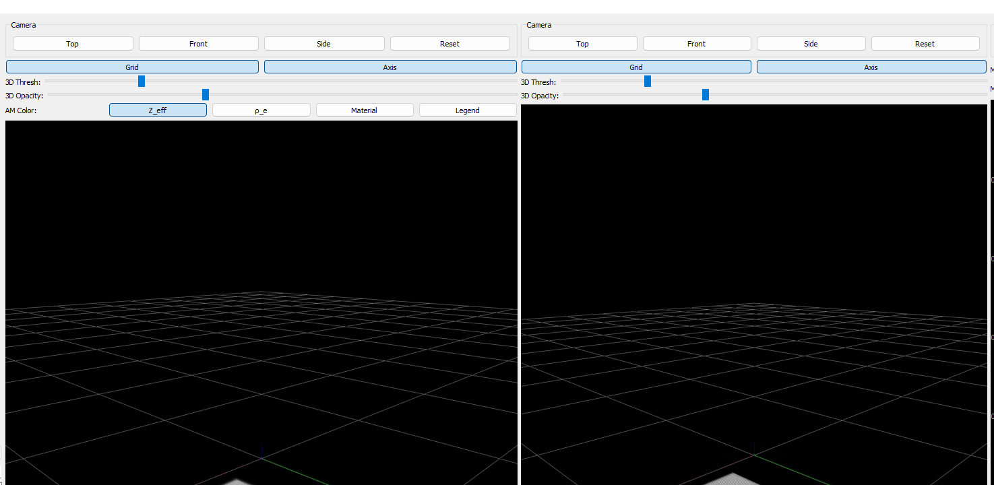
The dual-pane viewer renders real CT data and the Gerber model correctly and independently
What to take away
Both panes independent
• Live screenshot from the running app, not a mockup.
• Left pane: real CT volume (misaligned demo scan).
• Right pane: Gerber-derived model, same synthetic PCB.
• Each pane keeps its own camera, threshold, and opacity—verified independently controllable.

Slide 6
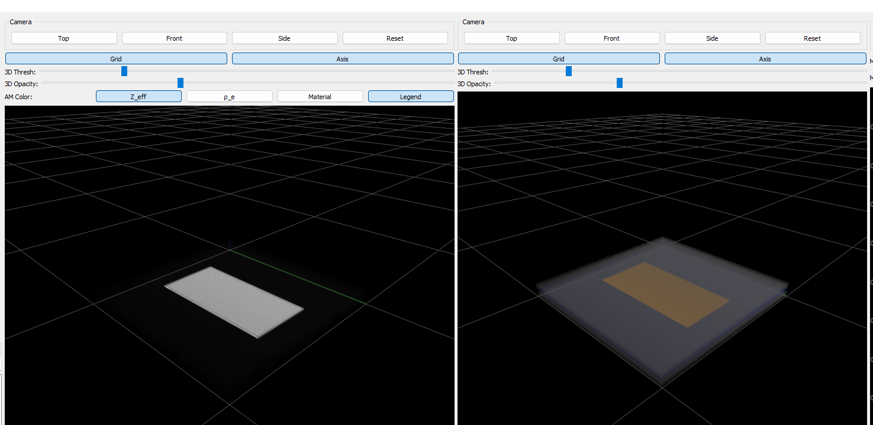
A simulated CT reconstruction validates the pipeline on a perfectly pre-registered pair first
What to take away
Pre-registered by construction
• Left: simulated CT (Radon transform + filtered back-projection).
• Right: Gerber ground truth, same voxel grid.
• Because both derive from one grid, this pair is pre-registered by construction—it isolates whether the material-transfer logic itself works before alignment error is introduced.

Slide 7
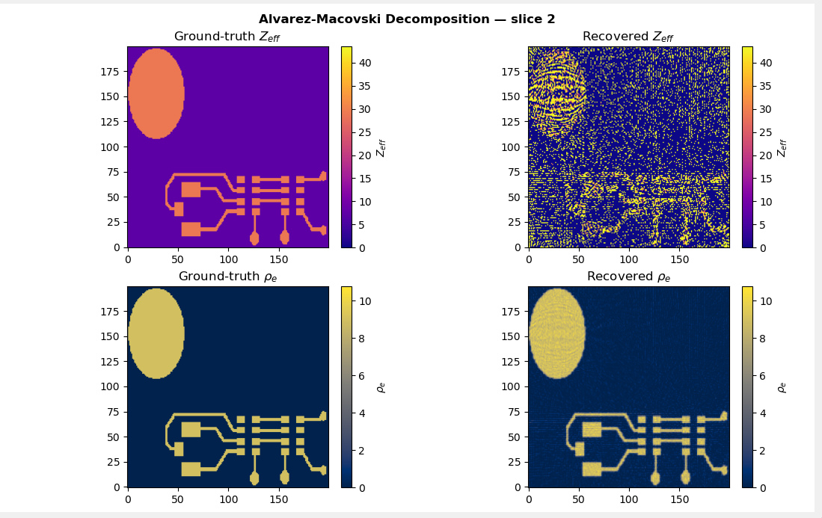
Dual-energy decomposition recovers electron density cleanly but atomic number noisily
What to take away
ρ_e clean / Z_eff noisy
• ρ_e (density): recovered volume matches ground truth almost exactly.
• Z_eff (atomic number): recovery is visibly noisy—an expected limitation of the ratio-based decomposition, not a bug.
• This noise is the main driver of material-classification error reported next.

Slide 8
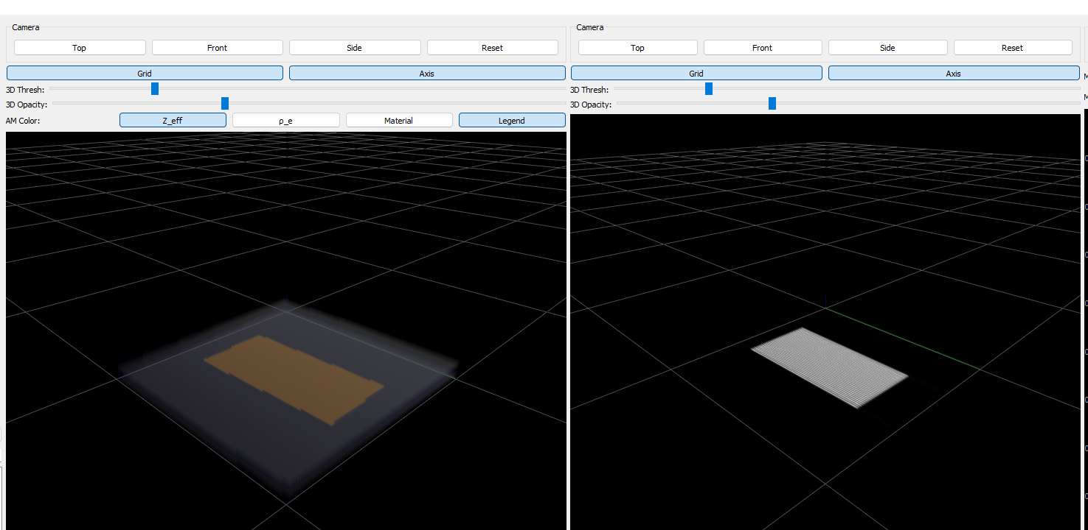
Nearest-neighbor resampling transfers Gerber ground-truth materials onto real CT without blending
What to take away
Labels transferred
• Left: real CT volume, now labeled—copper trace correctly located on translucent FR4.
• Right: registered Gerber volume it was derived from.
• Nearest-neighbor crosresampling guarantees only real material IDs appear in the output—no interpolated "in-between" materials.

Slide 9
Z_eff noise limits classification accuracy, and no real matched dataset exists yet to validate end-to-end
Interpretation
• Ground-truth classification: 100% correct (exact input, sanity check).
• Recovered/noisy classification: 56% voxel agreement against ground truth.
• Cause: Z_eff's ratio-based recovery is inherently noisier than ρ_e, especially for low-Z materials like FR4.
Main limitation
• External validity: the only real CT sample in the repo is a battery scan, not a PCB—end-to-end registration is validated only on synthetic data so far.
• Next validation step: acquire or locate a real CT scan with a matching known Gerber design.
Classification accuracy computed live from the AM decomposition run behind slide 7.

Slide 10
Conclusions
1. Dual-pane viewing and Gerber material assignment are done and verified: 31/31 automated tests pass across registration math, material labeling, spacing, and app smoke tests.
2. Registration and label transfer work end-to-end on synthetic ground truth: the tool recovers a known 5-DOF misalignment and correctly transfers materials onto the aligned volume.
3. ρ_e (density) recovery is reliable; Z_eff (atomic number) recovery is noisy: an expected, physics-driven limitation—not a defect in this pipeline.
4. The remaining gap is data, not method: no real matched Gerber + CT pair exists yet to validate the full pipeline outside simulation.

