Slide 1
Expected Utility

Slide 2
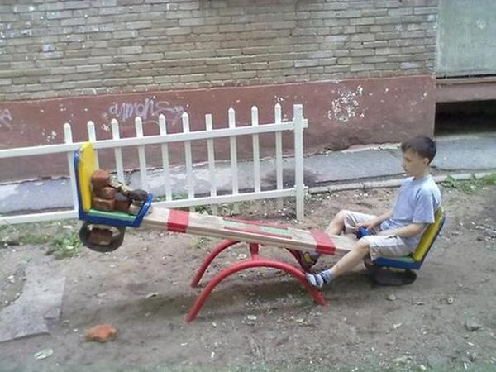

Finally, games...
One-person games :(

Slide 3

Lotteries
To every action there is a consequence...

Slide 4
Lotteries
So far, in our modeling situations each action deterministically leads to a particular consequence

Slide 5
Lotteries
From now on, the correspondence between actions and consequences is stochastic
The choice of an action is viewed as choosing a lottery where the prizes are the consequences

Slide 6
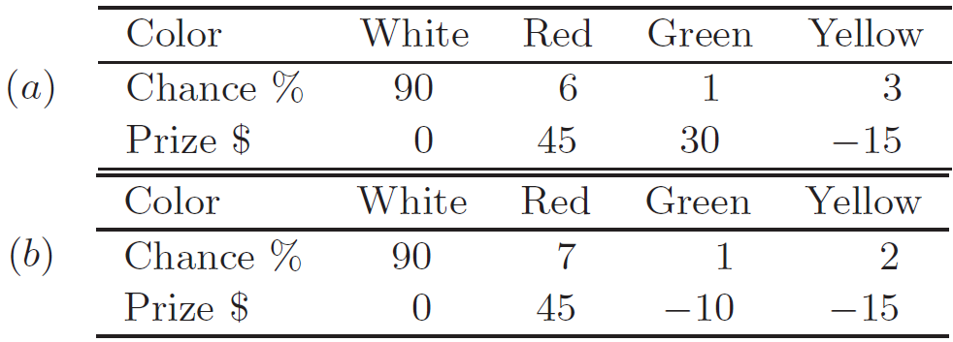
Lotteries
We will be interested in preferences and choices over the set of lotteries

Slide 7
Lotteries
Let Z be a set of consequences (prizes)
for now, Z is finite
A lottery is a probability measure on Z
a lottery p is a function that assigns a nonnegative number p(z) to each prize z, where Σ_{z∈Z}p(z) = 1
The number p(z) is taken to be the objective probability of obtaining the prize z given the lottery p

Slide 8
Lotteries
p_{a}(0) = 0.9
p_{a}
Z_{a}
p_{b}
Z_{b}

Slide 9
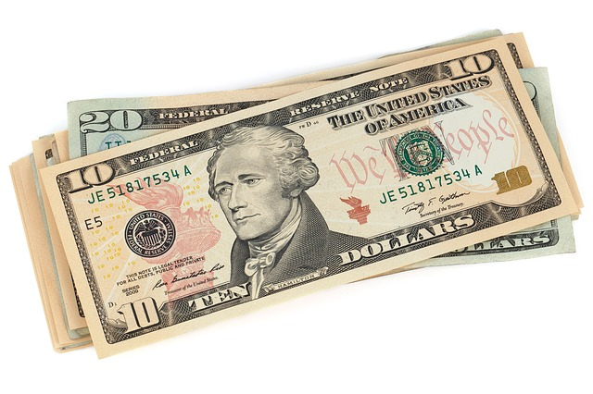
Lotteries
Which lottery do you prefer?
(a)
(b)
OR
Z_{a} = {$35}
p_{a}($35)=1
Z_{b} = {$20,$80}
p_{b}($20)=0.75
p_{b}($80)=0.25

Slide 10
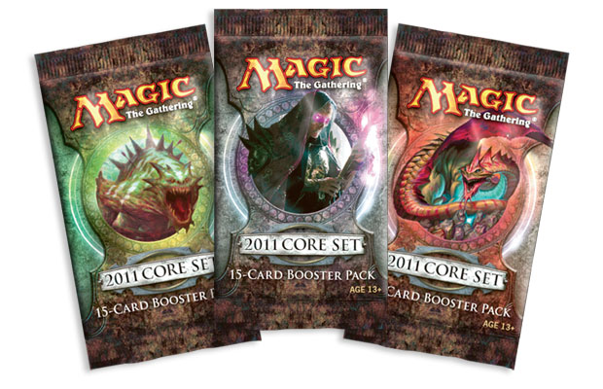


Lotteries
Which lottery do you prefer?
(a)
(b)
OR
Z_{a} = { }
p_{a}( )=1
Z_{b} = { , }
p_{b}( )=0.75
p_{b}( )=0.25

Slide 11
Lotteries
Denote by [z] the degenerate lottery for which p(z) = 1
We will use the notation
αx ⊕ (1 − α)y
to denote the lottery in which the prize x is realized with probability α and the prize y with probability 1 − α

Slide 12
Lotteries
Denote by L(Z) the (infinite) space containing all lotteries with prizes in Z
A simplex in Euclidean space:
L(Z) = {x ∈ ℝ₊^{Z} | Σx_{z} = 1}
where ℝ₊^{Z} is the set of functions from Z into ℝ₊

Slide 13
Preferences over Lotteries
Let us think about examples of “sound” preferences over a space L(Z)
What makes a lottery better than the other?

Slide 14
Preferences over Lotteries
Preference for uniformity
The decision maker prefers the lottery that is less disperse where dispersion is measured by
Σ_{z}(p(z) − 1/|Z|)²
Example:
a lottery over my music collection (all songs have the same chance of being played)

Slide 15



Preferences over Lotteries
Preference for most likelihood
The decision maker prefers p to q if max_{z}p(z) is greater than max_{z}q(z)
Example
Weather conditions before going out

Slide 16
Preferences over Lotteries
The size of the support
The decision maker evaluates each lottery by the number of prizes that can be realized with positive probability
supp(p) = {z|p(z) > 0}
He prefers a lottery p over a lottery q if
|supp(p)| ≤ |supp(q)|
Example
A multiple choice question in an exam

Slide 17
Preferences over Lotteries
These three examples are degenerate
Ignored the consequences and were dependent on the probability vectors alone

Slide 18
Preferences over Lotteries
Increasing the probability of a “good” outcome
The set Z is partitioned into two disjoint sets G and B (good and bad), and between two lotteries the decision maker prefers the lottery that yields “good” prizes with higher probability
Example
Choosing a route from city A to city B

Slide 19
Preferences over Lotteries
The worst case
The decision maker evaluates lotteries by the worst possible case
He attaches a number v(z) to each prize z and p ≿ q if min{v(z) | p(z) > 0} ≥ min{v(z) | q(z) > 0}
Example:
"This criterion is often used in computer science, where one algorithm is preferred to another if...
it functions better in the worst case independently of the likelihood of the worst case occurring"

Slide 20
Preferences over Lotteries
Comparing the most likely prize
The decision maker considers the prize in each lottery that is most likely (breaking ties in some arbitrary way) and compares two lotteries according to a basic preference relation over Z
Example
Selecting a career

Slide 21
Preferences over Lotteries
Lexicographic preferences:
The prizes are ordered z₁, . . . , z_{K}, and the lottery p is preferred to q if
(p(z₁), . . . , p(z_{K})) ≥_{L} (q(z₁), . . . , q(z_{K}))
Example
choosing a movie to watch
explosions ≻₁ funny ≻₂ romance ≻₃ etc

Slide 22
Preferences over Lotteries
Expected utility:
A number v(z) is attached to each prize, and a lottery p is evaluated according to its expected v, that is, according to Σ_{z}p(z)v(z)
Thus,
Example
Games in a casino

Slide 23
Preferences over Lotteries
Examples could be even richer...

Slide 24
Preferences over Lotteries
The richness of examples calls for the classification of preference relations over lotteries
Study of properties that these relations satisfy

Slide 25


Preferences over Lotteries
Formally state general principles (axioms) that may apply to preferences over the space of lotteries
Consistency requirement
Procedural aspect of decision making

Slide 26
Preferences over Lotteries
A set of axioms characterizing a family of preferences is a justification for focusing on that specific family

Slide 27

Preferences over Lotteries
What are the desired properties of choice procedures over lotteries?

Slide 28
von Neumann and Morgenstern Axiomatization
Six axioms are usually presented
ordering of alternatives
reduction of compound lotteries
continuity
substitutability
transitivity
monotonicity

Slide 29
An axiomatic treatment of utility
Assumption 1: ordering of alternatives
The preference relation ≿ between two prizes z_{i} and z_{j} is transitive
Either z_{i} ≿ z_{j} or z_{j} ≿ z_{i}
If z_{i} ≿ z_{j} and z_{j} ≿ z_{k}, then z_{i} ≿ z_{k}
Transitiveness is not always seen in data!
specially when people are presented with paired comparisons

Slide 30
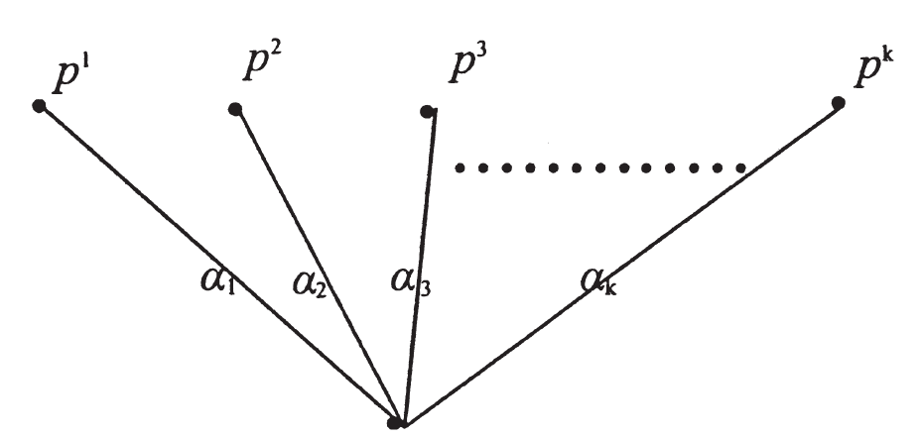
Compound Lotteries
⊕^{K}_{k=1}α_{k}p^{k}

Slide 31
An axiomatic treatment of utility
Assumption 2: reduction of compound lotteries
A compound lottery CL = ⊕^{K}_{k=1}α_{k}p^{k} = (α₁p¹, α₂p²,...,α_{K}p^{K})
Any compound lottery is indifferent to a simple lottery with the same prize list
(α₁p¹, α₂p²,...,α_{K}p^{K}) ~ (p₁(z₁), p₂(z₂), ..., p_{r}(z_{r}))
where
p_{i}(z_{i}) = α₁p¹(z_{i}) + α₂p²(z_{i}) + ... α_{K}p^{K}(z_{i})

Slide 32
An axiomatic treatment of utility
Assumption 3: continuity
Each prize z_{i} is indifferent to some lottery ticket involving just z₁ (the best prize) and z_{r} (the worst)
There exists a number p such that z_{i} is indifferent to [ pz₁, (1-p)z_{r} ]
And for Z = {$1, $0.01, death}?

Slide 33
An axiomatic treatment of utility
Assumption 4: substitutibility
If z_{i} ~ z_{j}, then one may substitute the other in a lottery

Slide 34
An axiomatic treatment of utility
Assumption 5: transitivity
Preference and indifference among lotteries (or lottery tickets) are transitive relations

Slide 35
An axiomatic treatment of utility
From these five assumptions
it is possible to find for any lottery ticket one to which it is indifferent and which only involves z₁ and z_{r}

Slide 36

An axiomatic treatment of utility
Assumption 6: monotonicity
A lottery [p(z₁), (1-p)z_{r} ] is preferred or indifferent to [p'(z₁), (1-p')z_{r} ] if and only if...
... p >= p’
Two lotteries involving only two prizes, I should prefer the one which renders the most preferred prize more probable
But is it always?

Slide 37
von Neumann and Morgenstern Axiomatization
Do these axioms make sense?
If we accept these six axioms, it turns out that we have no choice but to
accept the existence of single-dimensional utility functions
whose expected values agents want to maximize
If we do not want to reach this conclusion, we must therefore give up at least one of the axioms

Slide 38
von Neumann and Morgenstern Axiomatization
Theorem (von Neumann and Morgenstern, 1944)
If ≿ satisfies assumptions 1 through 6, there are numbers u_{i} associated with z_{i} such that, for two lotteries p and q,
p₁(z₁) u₁ + ... + p_{r}(z_{r}) u_{r} and q₁(z₁) u₁ + ... + q_{r}(z_{r}) u_{r}
reflect the preferences between the lotteries

Slide 39
von Neumann and Morgenstern Axiomatization
Two axioms may do the job
I: independence
C: continuity

Slide 40
Compound Lotteries
⊕^{K}_{k=1}α_{k}p^{k}

Slide 41
An axiomatic treatment of utility
I: independence
For any p, q, r ∈ L(Z)
and any α ∈ (0, 1),
p ≿ q iff
αp ⊕ (1 − α)r ≿ αq ⊕ (1 − α)r
No correlation between lotteries

Slide 42
An axiomatic treatment of utility
C: continuity
If p ≻ q, then there are neighborhoods B(p) of p and B(q) of q such that for all p′ ∈ B(p) and q′ ∈ B(q), p′ ≻ q′
Alternativelly, if p ≻ q ≻ r, then there exists α ∈ (0, 1) such that:
q ∼ [αp ⊕ (1 − α)r]
Reality may be different...
if r is a lottery involving an extremely bad prize such as ‘death’

Slide 43
Preferences over Lotteries
Preference for most likelihood
The decision maker prefers p to q if max_{z}p(z) is greater than max_{z}q(z)
Example
Choosing which clothes I should wear

Slide 44
An axiomatic treatment of utility
Preferences for most likelihood
Satisfies C since the function max{p₁, . . . , p_{K}} that represents it is continuous in probabilities
It does not satisfy I since, for example,
[z₁] ∼ [z₂],
[z₁] = 1/2[z₁] ⊕ 1/2[z₁] ≻ 1/2[z₂] ⊕ 1/2[z₁]

Slide 45
Preferences over Lotteries
The worst case
The decision maker evaluates lotteries by the worst possible case
He attaches a number v(z) to each prize z and p ≿ q if min{v(z) | p(z) > 0} ≥ min{v(z) | q(z) > 0}
Example:
"This criterion is often used in computer science, where one algorithm is preferred to another if it functions better in the worst case independently of the likelihood of the worst case occurring"

Slide 46
An axiomatic treatment of utility
The worst case:
Does not satisfy C
In the two-prize case
v(z₁) > v(z₂), [z₁] ≻ 1/2[z₁] ⊕ 1/2[z₂]
In R₊², we can rewrite this as
(1, 0) ≻ (1/2, 1/2)
Any neighborhood of (1, 0) contains lotteries that are not strictly preferred to (1/2, 1/2)
Does not satisfy I
[z₁] ≻ [z₂] but 1/2[z₁] ⊕ 1/2[z₂] ∼ 1/2[z₂] ⊕ 1/2[z₂]

Slide 47
Preferences over Lotteries
Expected utility:
A number v(z) is attached to each prize, and a lottery p is evaluated according to its expected v, that is, according to Σ_{z}p(z)v(z)
Thus,
Example
Games in a casino

Slide 48
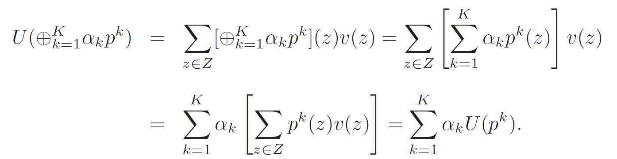
An axiomatic treatment of utility
Expected utility:
It is linear, so it satisfies I
It is continuous in the probability vector, so it satisfies C

Slide 49
Preferences over Lotteries
Increasing the probability of a “good” outcome
The set Z is partitioned into two disjoint sets G and B (good and bad), and between two lotteries the decision maker prefers the lottery that yields “good” prizes with higher probability
Example
Choosing a route from city A to city B

Slide 50
An axiomatic treatment of utility
Increasing the probability of a “good” consequence
Satisfies I and C, since it can be represented by the expectation of v where v(z) = 1 for z ∈ G and v(z) = 0 for z ∈ B

Slide 51
Utility Representation
Theorem (vNM):
Let ≿ be a preference relation over L(Z) satisfying I and C
There are numbers (v(z))_{z∈Z} such that
U(p) is the utility of lottery p
v(z) is the vNM utility, representing ≿ over Z

Slide 52
Utility Representation
Let ≿ be a preference relation over a set of lotteries
If to each lottery p there is assigned a number U(p) such that U(p) ≥ U(q) iff p ≿ q,
then there is a utility function U over L(Z)
When faced about uncertainty about which outcomes he will receive, the agent prefers outcomes that maximize U

Slide 53
Utility Representation
If I and C (or the six axioms presented previously) are met, then there is a linear vNM utility function v over the prizes
v(z₁) = 1,
v(z_{i}) = v_{i}, for 1 < i < r
v(z_{r}) = 0,
U(p(z₁), ..., p(z_{r})) = p(z₁)v(z₁) + ... + p(z_{r})v(z_{r})

Slide 54
Utility Representation
Let U(p) satisfy ≿ over L(Z) from a linear vNM utility function v(z)
For some α>0 and β, we can make
w(z) = αv(z) + β
W(p) = Σ_{z∈Z}p(z)w(z)
W(p) will also satisfy ≿ over L(Z)

Slide 55
Utility Representation
What does this mean?
The absolute magnitudes of the utility function evaluated at different outcomes are unimportant
Instead, every positive affine transformation of a utility function yields another utility function for the same agent
In other words, if u(o) is a utility function for a given agent then u'(o) = αu(o) + β is also a utility function for the same agent, as long as α and β are constants and α is positive

Slide 56
Utility Representation
Which lottery do you prefer?
L = (0.25z₁, 0.25z₂, 0.25z₃, 0.25z₄)
L' = (0.15z₁, 0.50z₂, 0.15z₃, 0.20z₄)
Suppose by continuity
z₂ ~ z₂' = (0.6z₁, 0.4z₄)
z₃ ~ z₃' = (0.2z₁, 0.8z₄)
L = (0.25z₁, 0.25(0.6z₁, 0.4z₄), 0.25(0.2z₁, 0.8z₄), 0.25z₄)
L = (0.45z₁, 0.55z₄), L' = (0.48z₁, 0.52z₄)
Thus, L' ≻ L

Slide 57
Utility Representation
Which lottery do you prefer?
L = (0.25z₁, 0.25z₂, 0.25z₃, 0.25z₄)
L' = (0.15z₁, 0.50z₂, 0.15z₃, 0.20z₄)
Suppose by continuity
z₂ ~ z₂' = (0.6z₁, 0.4z₄)
z₃ ~ z₃' = (0.2z₁, 0.8z₄)
u'(x) = 2u(x) – 0.4

Slide 58
V or F
A lottery p is preferred to q because the expected utility U(p) is greater than the expected utility U(q)
Fallacy!
The problem is the causal relationship, since the utility function is built upon the preferences and not the other way around

Slide 59
V or F
Suppose that A ≻ B ≻ C ≻ D and that the vNM utilities of these prizes satisfy v(A) + v(D) = v(B) + v(C), then (1/2B, 1/2C) should be preferred to (1/2A,1/2D) because, although they have the same expected utility, the former has the smaller utility variance
Fallacy!
Misinterpretation of utility: preferences precede the utility function

Slide 60
V or F
Suppose that A ≻ B ≻ C ≻ D and that the vNM utility function has the property that v(A)-v(B) > v(C)-v(D), then the change from B to A is more preferred than the change from D to C
Fallacy!
if D is “death”... :)

Slide 61
Interpersonal comparison of utility
Very hard to define a universal value of utility
It changes from person to person
a gamble of $1 between a rich and a poor person
possible way to deal with it: normalize the maximum value to 1 and the lowest to 0

