Slide 1
Class #7 – part 2
Introduction no Noncooperative Game Theory:
Other solution concepts

Slide 2
Other solution concepts
We reason about multiplayer games using solution concepts
interesting subsets of the outcomes of a game
While the most important solution concept is the Nash equilibrium, there are also a large number of others

Slide 3
Other solution concepts
Maxmin and minmax strategies
Minimax regret
Removal of dominated strategies
Correlated Equilibrium
Trembling-hand perfect equilibrium
ξ-Nash equilibrium

Slide 4
Maxmin and minmax strategies
Security level
The maxmin strategy of player i
in an n-player, general-sum game
is a strategy that maximizes i’s worst-case payoff,
in the situation where all the other players happen to play the strategies which cause the greatest harm to i
Minimum amount of payoff guaranteed by a maxmin strategy

Slide 5
Maxmin and minmax strategies
The maxmin strategy for player i is
and the maxmin value for player i is

Slide 6
Maxmin and minmax strategies
The maxmin strategy is i’s best choice when first i must commit to a strategy,
and then the remaining agents −i observe this strategy - but not i’s action choice -
and choose their own strategies to minimize i’s expected payoff

Slide 7
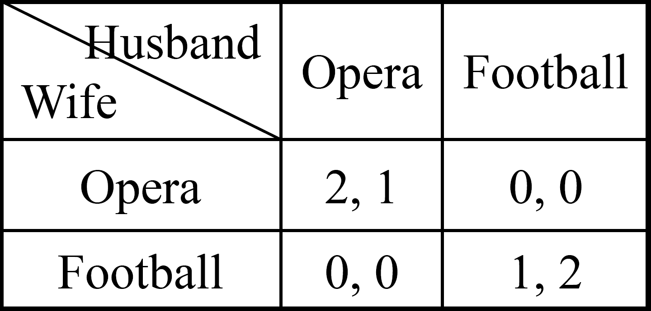
Maxmin and minmax strategies
What is the maxmin strategy?

Slide 8
Maxmin and minmax strategies
What is the maxmin strategy?
Wife’s strategy s_{w} = (p, 1 – p)
Husband’s strategy s_{h} = (q, 1 – q)
u_{w}(p,q) = 2pq + (1 – p)(1 – q) = 3pq – p – q + 1
For any fixed p, u_{w}(p,q) is linear in q
q
1-q
p
1-p

Slide 9
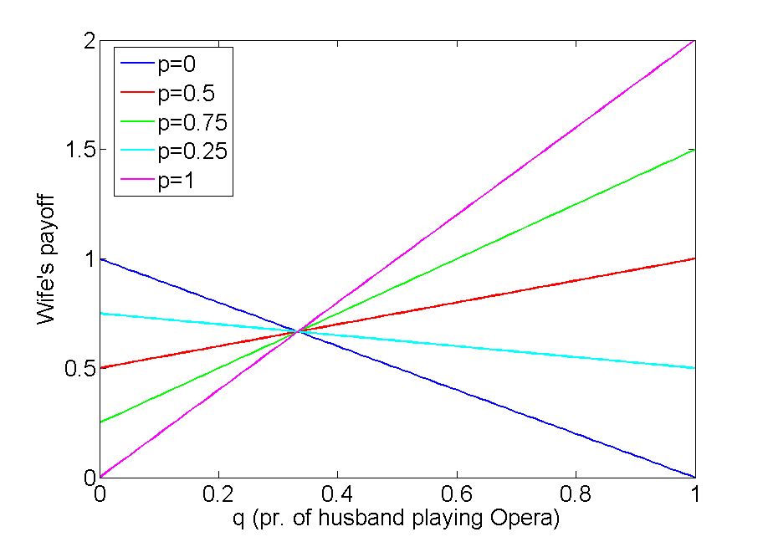
Maxmin and minmax strategies
What is the maxmin strategy?
u_{w}(p,q) = 3pq – p – q + 1
For any fixed p, u_{w}(p,q) is linear in q

Slide 10
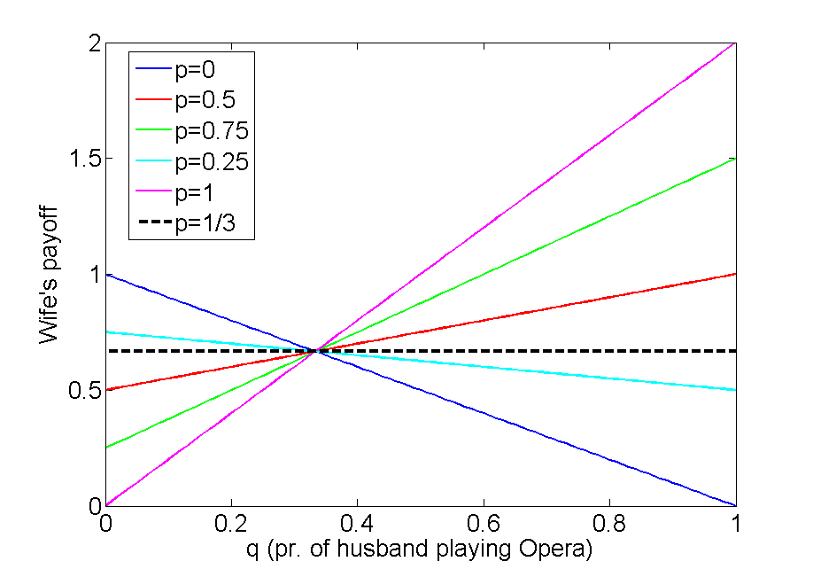
Maxmin and minmax strategies
What is the maxmin strategy?
u_{w}(p,q) = 3pq – p – q + 1
For any fixed p, u_{w}(p,q) is linear in q

Slide 11
Maxmin and minmax strategies
q
1-q
What is the maxmin strategy?
Wife’s strategy s_{w} = (p, 1 – p)
Husband’s strategy s_{h} = (q, 1 – q)
u_{w}(p,q) = 2pq + (1 – p)(1 – q) = 3pq – p – q + 1
For any fixed p, u_{w}(p,q) is linear in q and
since 0 ≤ q ≤ 1, the min must be at q = 0 or q = 1
min_{q}u_{w}(p,q) = min (u_{w}(p,0), u_{w}(p,1))
= min(1 – p, 2p)
p
1-p

Slide 12
Maxmin and minmax strategies
q
1-q
What is the maxmin strategy?
Since
min_{q}u_{w}(p,q) = min(1 – p, 2p)
Now we have to find
arg max_{p}(min(1 – p, 2p))
p
1-p

Slide 13
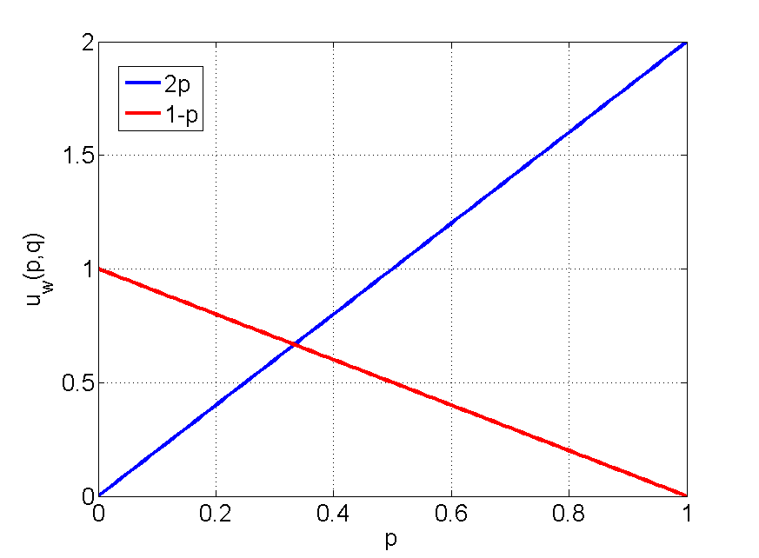
Maxmin and minmax strategies
q
1-q
What is the maxmin strategy?
arg max_{p}(min(1 – p, 2p))
p
1-p
q=1
q=0

Slide 14
Maxmin and minmax strategies
q
1-q
What is the maxmin strategy?
arg max_{p}(min(1 – p, 2p))
p
1-p
q=1
q=0
min(1-p, 2p)

Slide 15
Maxmin and minmax strategies
q
1-q
What is the maxmin strategy?
arg max_{p}(min(1 – p, 2p))
2p = 1-p
p = 1/3
p
1-p
q=1
q=0
min(1-p, 2p)

Slide 16
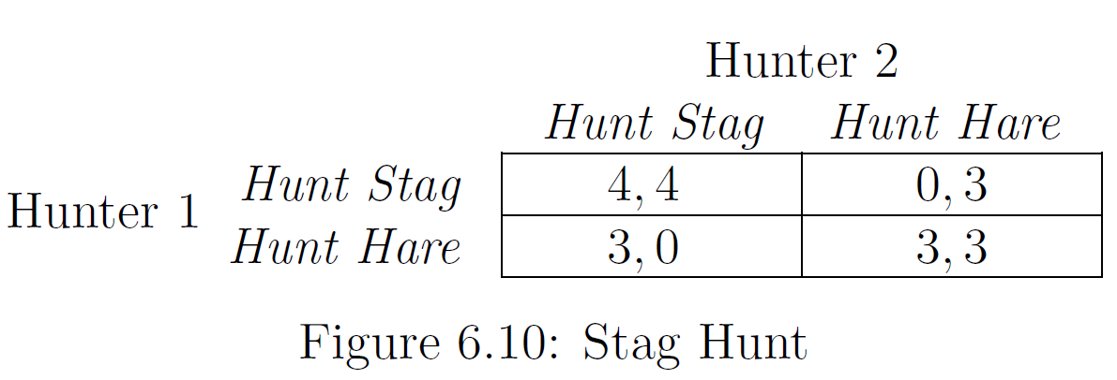
Maxmin and minmax strategies
Why might an agent i want to use a maxmin strategy?

Slide 17
Maxmin and minmax strategies
Why might an agent i want to use a maxmin strategy?
Useful if i is cautious (wants to maximize his/her worst-case utility) and doesn’t have any information about the other agents
whether they are rational
what their payoffs are
whether they draw their action choices from known distributions
Useful if i has reason to believe that the other agents’ objective is to minimize i’s expected utility

Slide 18
Maxmin and minmax strategies
The minmax strategy and minmax value play a dual role to their maxmin counterparts
In two-player games the minmax strategy for player i against player −i is a strategy that keeps the maximum payoff of −i at a minimum
The minmax value of player −i is that minimum
The amount that one player can punish another without regard for his own payoff

Slide 19
Maxmin and minmax strategies
In a two-player game, the minmax strategy for player i against player −i is
Player −i’s minmax value is

Slide 20
Maxmin and minmax strategies
In n-player games with n > 2, defining player i’s minmax strategy against player j is a bit more complicated
Why?
i will not usually be able to guarantee that j achieves minimal payoff by acting unilaterally
However, if we assume that all -i players choose to “gang up” on j, then we can define minmax strategies for the n-player case

Slide 21
Maxmin and minmax strategies
In an n-player game, the minmax strategy for player i against player j ≠ i is i’s component of the mixed-strategy profile s_{−j} in the expression
where −j denotes the set of players other than j
The minmax value for player j is

Slide 22
Maxmin and minmax strategies
Minmax Theorem (von Neumann, 1928)
Let G be any finite two-player zero-sum game
For each player i, i’s expected utility in any Nash equilibrium
= i’s maxmin value
= i’s minmax value

Slide 23
Maxmin and minmax strategies
In two players zero sum game
The maxmin value for player 1 is called the value of the game
For both players, the set of maxmin strategies coincides with the set of minmax strategies
Any maxmin strategy profile (or, equivalently, minmax strategy profile) is a Nash equilibrium

Slide 24
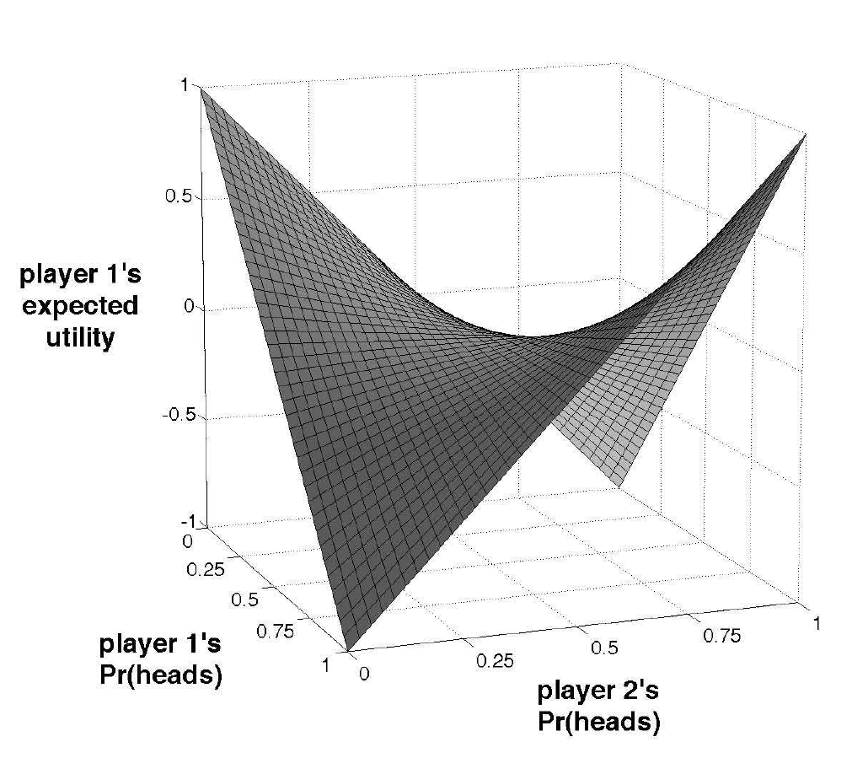
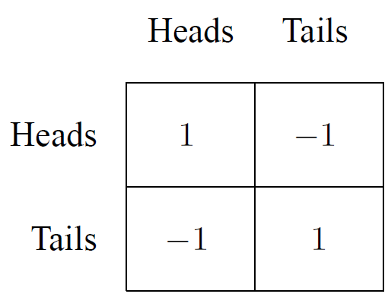
Maxmin and minmax strategies
Are there any other Nash Equilibria besides (1/2, 1/2)?

Slide 25
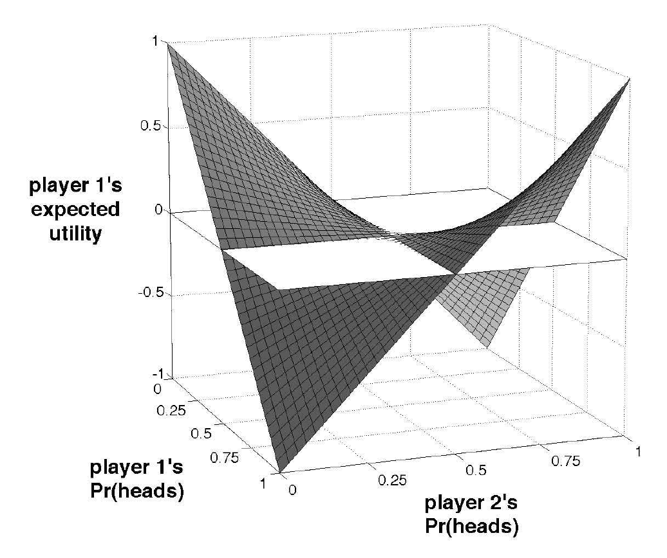
Maxmin and minmax strategies
Saddle point

Slide 26
Maxmin and minmax strategies
Theorem (Julia Robinson) [Robinson 1951]: In two players zero-sum repeated games in normal form
if in each round each player chooses the best response pure strategy against the observed mixed strategy of the total history of the other player
then the mixed strategies of the whole history converge to a pair of mixed strategies forming a Nash equilibrium

Slide 27
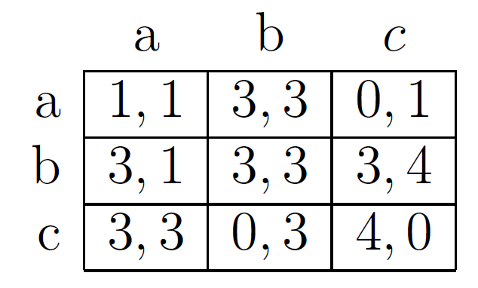
Maxmin and minmax strategies
How does it work in non-zero sum games?
Is it a Nash equilibrium?

Slide 28
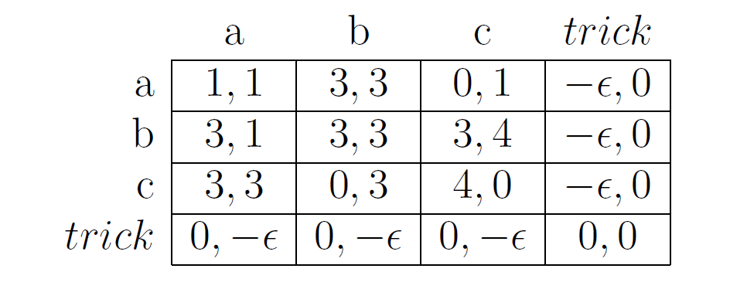
Maxmin and minmax strategies
How does it work in non-zero sum games?

Slide 29
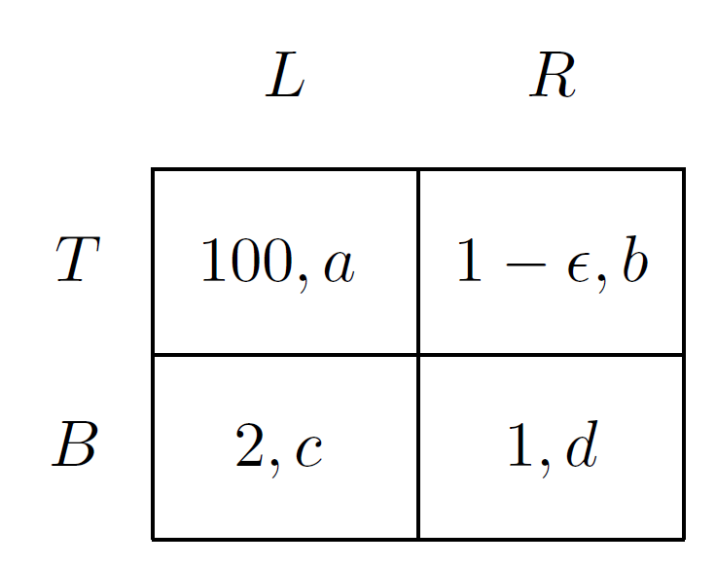
Maxmin and minmax strategies
Let's play another game...
100, 2 | 0.9, 5
2, 1 | 1, 0

Slide 30
Maxmin and minmax strategies
Let's play another game...
What are the maxmin and minmax strategies?
100, 2 | 0.9, 5
2, 1 | 1, 0

Slide 31
Maxmin and minmax strategies
Let's play another game...
What are the maxmin and minmax strategies?

Slide 32
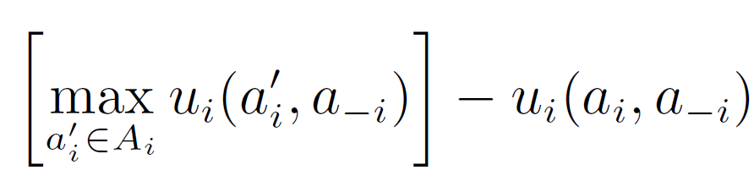
Regret
An agent i’s regret for playing an action a_{i} if the other agents adopt action profile a_{−i} is defined as
The amount that i loses by playing a_{i}, rather than playing his best response to a_{-i}
Considers those actions that would give him the highest regret for playing a_{i}

Slide 33
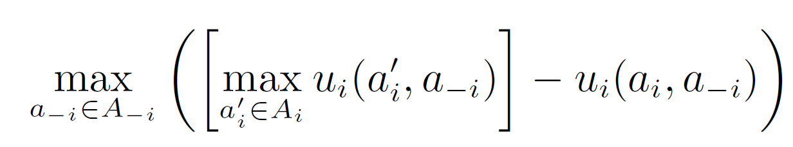
Max regret
An agent i’s maximum regret for playing an action a_{i} is defined as
This is the amount that i loses by playing a_{i} rather than playing his best response to a_{−i}, if the other agents chose the a_{−i} that makes this loss as large as possible

Slide 34
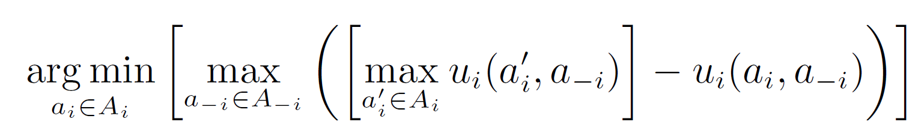
Minimax regret
Minimax regret actions for agent i are defined as
An action that yields the smallest maximum regret

Slide 35
Minimax regret
100, a | 0.5, b
2, c | 1, d

Slide 36
Minimax regret
0, a | 0.5, b
98, c | 0, d

Slide 37
Minimax regret
0, a | 0.5, b
98, c | 0, d

Slide 38
Minimax regret
0, a | 0.5, b
98, c | 0, d

Slide 39
Minimax regret
Minimax regret can be extended to a solution concept in the natural way
Identification of action profiles that consist of minimax regret actions for each player
Note that we can safely restrict ourselves to actions rather than mixed strategies because of the linearity of expectation

Slide 40

Minimax regret
Who in the world plays minimax regret?
I don't care about receiving my worst-case payoff, I care about not receiving my best-case payoff

Slide 41
Minimax regret
What is the strategical flaw in playing minimax regret?
Players don't care about other players' payoffs

Slide 42
Another game to be played
Two firms that are each planning to produce and market a new product
Two market segments
people who would only buy a low-priced version of the product
people who would only buy an upscale version
the profit any firm makes on a sale of either a low price or an upscale product is the same
Each firm wants to maximize its profit

Slide 43
Another game to be played
People who would prefer a low-priced version account for 60% of the population
People who would prefer an upscale version account for 40% of the population
Firm 1 is the much more popular brand
Firm 1 gets 80% of the sales and Firm 2 gets 20% of the sales of the same product
If a firm is the only one to produce a product for a given market segment, it gets all the sales

Slide 44
Another game to be played
If the two firms market to different market segments, they each get all the sales in that segment
So the one that targets the low-priced segment gets a payoff of .6 and the one that targets the upscale segment gets .4.
If both firms target both segments
For the low-priced segment, Firm 1 gets 80% of it, for a payoff of (.8)(.6)=.48, and Firm 2 gets 20% of it, for a payoff of .(.2)(.6)=.12
For the upscale segment, Firm 1 gets a payoff of (.8)(.4) = .32 and Firm 2 gets (.2)(.4) = .08

Slide 45
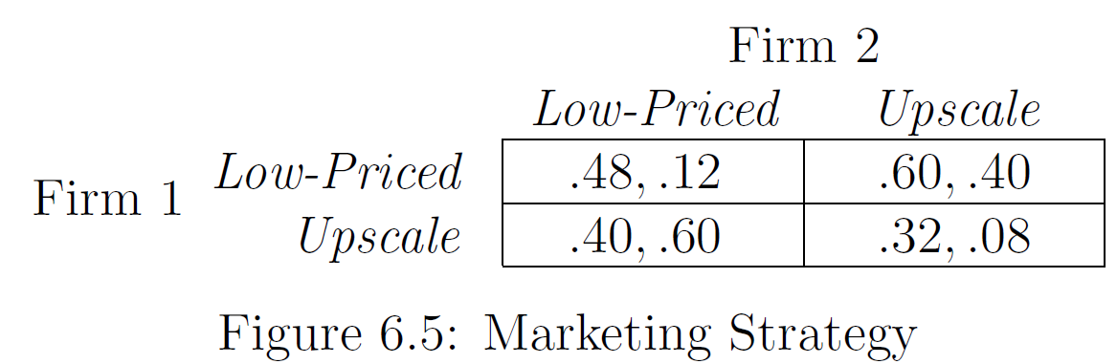
Another game to be played

Slide 46
A Game in Which Only One Player Has a Strictly Dominant Strategy
The players have common knowledge of the game
they know the structure of the game, they know that each of them know the structure of the game, they know that each of them know that each of them know, and so on

Slide 47
Removal of dominated strategies
Let s_{i} and s_{i}′ be two strategies of player i, and S_{−i} the set of all strategy profiles of the remaining players. Then
s_{i} strictly dominates s_{i}′ if for all s_{-i} ∈ S_{−i}, it is the case that u_{i}(s_{i}, s_{-i}) > u_{i}(s_{i}′, s_{-i})
s_{i} weakly dominates s_{i}′ if for all s_{-i} ∈ S_{−i}, it is the case that u_{i}(s_{i}, s_{-i}) ≥ u_{i}(s_{i}′, s_{-i}), and for at least one s_{-i} ∈ S_{−i}, it is the case that u_{i}(s_{i}, s_{-i}) > u_{i}(s_{i}′, s_{-i})

Slide 48
Removal of dominated strategies
A strategy is strictly (resp., weakly) dominant for an agent if it strictly (weakly) dominates any other strategy for that agent
Is a strategy profile (s₁, . . . , s_{n}) in which every s_{i} is dominant for player i (whether strictly, weakly, or very weakly) a Nash equilibrium?
equilibrium in (strictly, weakly) dominant strategies
Is an equilibrium in strictly dominant strategies necessarily the unique Nash equilibrium?
Is it Pareto optimal?

Slide 49
Removal of dominated strategies
Dominant strategies are rare, but dominated strategies are not
A strategy s_{i} is strictly (weakly) dominated for an agent i if some other strategy s_{i}′ strictly (weakly) dominates s_{i}

Slide 50
A Game in Which Only One Player Has a Strictly Dominant Strategy
Strict dominant strategy for Firm 1
(all first row payoffs are > second row payoffs)

Slide 51
A Game in Which Only One Player Has a Strictly Dominant Strategy
Firm 2 knows Firm 1 is going to pick Low-Priced. What should it do, then?

Slide 52
A Game in Which Only One Player Has a Strictly Dominant Strategy
Firm 2 knows Firm 1 is going to pick Low-Priced.
What should it do, then?
Upscale is its best response when Firm 1 plays Low Priced

Slide 53
A Game in Which Only One Player Has a Strictly Dominant Strategy
Both firms are developing their marketing strategies concurrently and in secret
The intuitive message of this prediction
Firm 1 is so strong that it can proceed without regard to Firm 2's decision
Firm 2's best strategy is to stay safely out of the way of Firm 1

Slide 54
Another solution concept
Let's play another game...
 | L | C | R
U | 3,1 | 0,3 | 0,0
M | 1,5 | 1,1 | 10,0
B | 0,½ | 4,2 | 5,0
Notes:
(Marcos, Larissa) = (1,5)

Slide 55
Another solution concept
Let's play a game...
 | L | C | R
U | 3,1 | 0,3 | 0,0
M | 1,5 | 1,1 | 10,0
B | 0,½ | 4,2 | 5,0

Slide 56
Another solution concept
Let's play a game...
 | L | C
U | 3,1 | 0,3
M | 1,5 | 1,1
B | 0,½ | 4,2

Slide 57
Another solution concept
Let's play a game...
 | L | C
U | 3,1 | 0,3
M | 1,5 | 1,1
B | 0,½ | 4,2
Why is the action dominated?

Slide 58
Another solution concept
Let's play a game...
 | L | C
U | 3,1 | 0,3
M | 1,5 | 1,1
B | 0,½ | 4,2
Why is the action dominated?
(p)
When P2 plays L:
3p+0(1-p) > 1, p>1/3
When P2 plays C:
0p+4(1-p) > 1, p<3/4
So, for all 1/3<p<3/4, M should never be played, regardless of what P2 does
(1-p)

Slide 59
Another solution concept
Let's play a game...
 | L | C
U | 3,1 | 0,3
B | 0,½ | 4,2

Slide 60
Another solution concept
Let's play a game...
 | L | C
U | 3,1 | 0,3
B | 0,½ | 4,2

Slide 61
Another solution concept
Let's play a game...
 | C
U | 0,3
B | 4,2

Slide 62
Another solution concept
Let's play a game...
 | C
U | 0,3
B | 4,2

Slide 63
Another solution concept
Let's play a game...
 | C
B | 4,2

Slide 64
Removal of dominated strategies
Games solvable by iterated elimination of dominated strategies
Might the order of elimination affect the final outcome?
for strictly dominated strategies, no!
Church–Rosser property
for weakly dominated strategies, yes

Slide 65
Removal of dominated strategies
Experiment by B.A. Baldwin and G.B. Meese (1979) “Social Behavior in Pigs Studied by Means of Operant Conditioning,” Animal Behavior, Vol 27, pp 947-957
Two pigs in a cage, one is larger: “dominant’’ (sorry for the terminology...)
need to press a lever to get food to arrive
food and lever are at opposite sides of cage
run to press and the other pig gets the food

Slide 66
Removal of dominated strategies
10 units of food - the typical split:
if large gets to food first then (1,9) split
1 for small, 9 for large
if small gets to food first then (4,6) split
if get to food at the same time then (3,7) split
Pressing the lever costs 2 units of food in energy

Slide 67
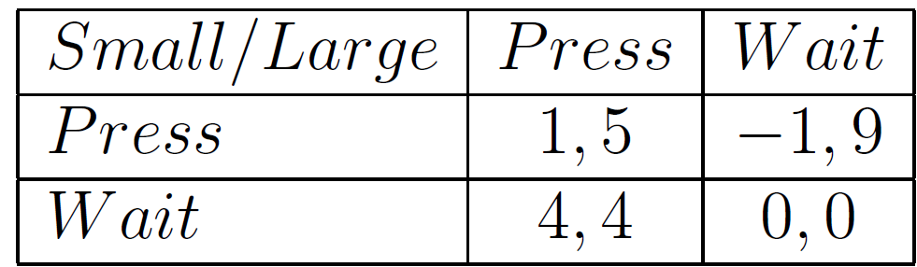
Removal of dominated strategies
Payoff matrix

Slide 68
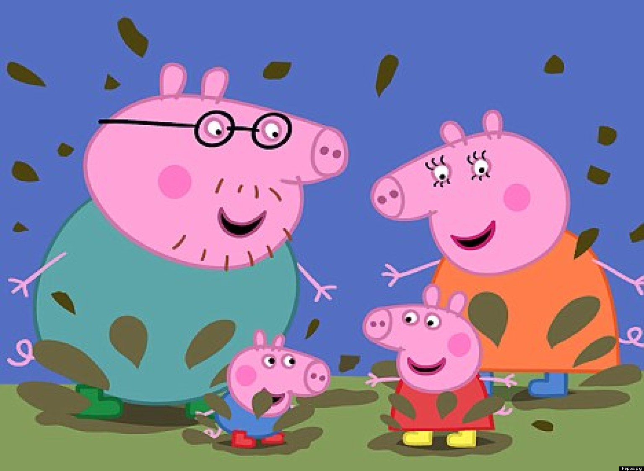
Removal of dominated strategies
Do pigs eliminate their dominated strategies?

Slide 69
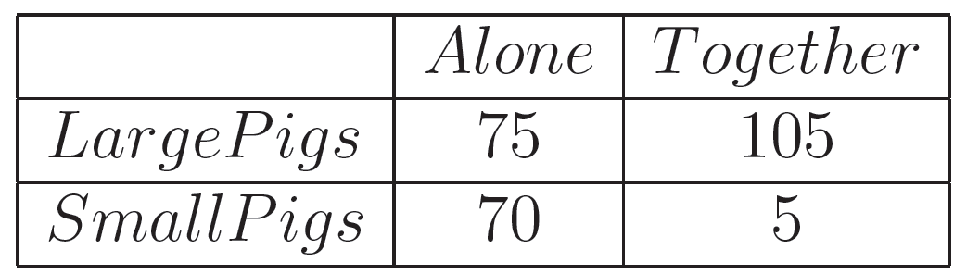
Removal of dominated strategies
Pigs Behavior: Frequency of pushing the lever per 15 minutes, after ten tests (learning...)

Slide 70
Battle of Sexes: replay
What is the Nash Equilibrium for this game?
s = (2/3, 1/3), u(s) = (2/3, 2/3)

Slide 71
Battle of Sexes: replay
Alternative setting
I will flip a coin and let you know the result
You can communicate before the coin toss

Slide 72
Correlated Equilibrium
If heads, then both play Opera
If tails, then both play Football
What is the expected payoff for each player?
(3/2, 3/2) > (2/3, 2/3)

Slide 73

Correlated Equilibrium
"If there is intelligent life on other planets, in a majority of them, they would have discovered correlated equilibrium before Nash equilibrium"
Roger Myerson (Nobel prize winner)

Slide 74
Correlated Equilibrium
Two animals are engaged in a contest to decide how a piece of food will be divided
Each animal can choose to behave aggressively (the Hawk strategy) or passively (the Dove strategy)
If the two animals both behave passively, they divide the food evenly
If one behaves aggressively while the other behaves passively, then the aggressor gets most of the food, while the passive one gets a little
If both animals behave aggressively, then they destroy the food (and possibly injure each other)

Slide 75
Correlated Equilibrium
How the payoff matrix would look like for this game?

Slide 76
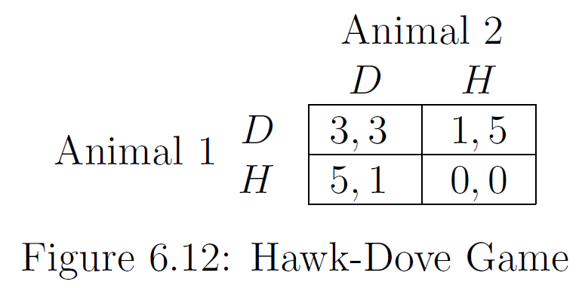
Correlated Equilibrium
How the payoff matrix would look like for this game?

Slide 77
Correlated Equilibrium
Let's play it!

Slide 78
Correlated Equilibrium
Is there any pure strategy Nash equilibria?
YES

Slide 79
Correlated Equilibrium
Is there any mixed strategy Nash equilibria?
Of course!
3q + 1 – q = 5q, q = 1/3
s = (1/3, 1/3), u(s) = (5/3, 5/3)

Slide 80
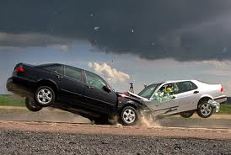
Correlated Equilibrium
Another example: the game of chicken

Slide 81
Correlated Equilibrium
Hawk or Dove (game of chicken)
Very hard to predict!
Ultimate example: countries at war
If a country is being aggressive, the best response of the other is to be passive
Where else?
Another name: Snowdrift Dilemma

Slide 82
Correlated Equilibrium
Let's play an alternative setting...
I have three cards, of which I will randomly pick one
Then, I will secretly tell you what you should do
d, d
h, d
d, h
 | D | H
D | 3,3 | 1,5
H | 5,1 | -2,-2

Slide 83
Correlated Equilibrium
Let's play an alternative setting...
I have three cards, of which I will randomly pick one
Then, I will secretly tell you what you should do
The expected payoff is:
u(s) = 1/3 * 3 + 1/3 * 5 + 1/3 * 1 = 3 > 5/3
d, d
h, d
d, h
 | D | H
D | 3,3 | 1,5
H | 5,1 | -2,-2

Slide 84
Correlated Equilibrium
What would have happened if I had a single card?
d, d
 | D | H
D | 3,3 | 1,5
H | 5,1 | -2,-2

Slide 85
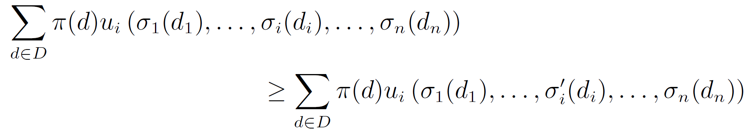
Correlated Equilibrium
Given an n-agent game G = (N,A,u), a correlated equilibrium is a tuple (v, π, σ),
where v is a tuple of random variables v = (v₁, . . . , v_{n}) with respective domains D = (D₁, . . . ,D_{n}),
π is a joint distribution over v, σ = (σ₁, . . . , σ_{n}) is a vector of mappings σ_{i} : D_{i} → A_{i},
and for each agent i and every mapping σ_{i}′ : D_{i} → A_{i} it is the case that

Slide 86
Correlated Equilibrium
d, d
h, d
d, h
D₁ = {d, h}, D₂ = {d, h}
v₁ = [⅔, ⅓], v₂ = [⅔, ⅓]
π =
σ₁ =
 | d | h
d | 1/3 | 1/3
h | 1/3 | 0
D₁ | A₁
d | D
h | H
 | D | H
D | 3,3 | 1,5
H | 5,1 | -2,-2

Slide 87
Correlated Equilibrium
d, d
h, d
d, h
D₁ = {d, h}, D₂ = {d, h}
v₁ = [⅔, ⅓], v₂ = [⅔, ⅓]
π =
σ₁ =
σ'₁ =
 | d | h
d | 1/3 | 1/3
h | 1/3 | 0
D₁ | A₁
d | D
h | H
D₁ | A₁
d | H
h | H
 | D | H
D | 3,3 | 1,5
H | 5,1 | -2,-2
u(σ₁) =1/3 * 3 + 1/3 * 1 + 1/3 * 5 = 3
u(σ’₁)=1/3 * 5 + 1/3 * -2 + 1/3 * 5 = 8/3
1 should not deviate to H!

Slide 88
Correlated Equilibrium
d, d
h, d
d, h
D₁ = {d, h}, D₂ = {d, h}
v₁ = [⅔, ⅓], v₂ = [⅔, ⅓]
π =
σ₁ =
 | d | h
d | 1/3 | 1/3
h | 1/3 | 0
D₁ | A₁
d | D
h | H
 | D | H
D | 3,3 | 1,5
H | 5,1 | -2,-2
u₁(D|d) = (3 + 1) / 2 = 2
u₁(H|d) = (5 - 2) / 2 = 1.5
1 should not deviate to H!

Slide 89
Correlated Equilibrium
d, d
h, d
d, h
D₁ = {d, h}, D₂ = {d, h}
v₁ = [⅔, ⅓], v₂ = [⅔, ⅓]
π =
σ₁ =
 | d | h
d | 1/3 | 1/3
h | 1/3 | 0
D₁ | A₁
d | D
h | H
?
 | D | H
D | 3,3 | 1,5
H | 5,1 | 0,0

Slide 90
Correlated Equilibrium
d, d
h, d
d, h
D₁ = {d, h}, D₂ = {d, h}
v₁ = [⅔, ⅓], v₂ = [⅔, ⅓]
π =
σ₁ =
 | d | h
d | 1/3 | 1/3
h | 1/3 | 0
D₁ | A₁
d | D
h | H
?
 | D | H
D | 3,3 | 1,5
H | 5,1 | 0,0
u₁(D|d) = (3 + 1) / 2 = 2
u₁(H|d) = (5 + 0) / 2 = 2.5
1 should deviate to H!

Slide 91
Correlated Equilibrium
d, d
h, d
d, h
D₁ = {d, h}, D₂ = {d, h}
v₁ = [?, ?], v₂ = [?, ?]
π =
σ₁ =
 | d | h
d | ? | ?
h | ? | ?
D₁ | A₁
d | D
h | H
 | D | H
D | 3,3 | 1,5
H | 5,1 | 0,0

Slide 92
Correlated Equilibrium
d, d
h, d
d, h
D₁ = {d, h}, D₂ = {d, h}
v₁ = v₂ = [4/7, 3/7]
π =
σ₁ =
 | d | h
d | 1/7 | 3/7
h | 3/7 | 0
D₁ | A₁
d | D
h | H
 | D | H
D | 3,3 | 1,5
H | 5,1 | 0,0
u₁(D|d) = (3 + 3*1) / 4 = 6/4
u₁(H|d) = (5 + 3*0) / 4 = 5/4
1 should not deviate to H!

Slide 93
Correlated Equilibrium
Standard games can be viewed as the degenerate case in which the signals of the different agents are probabilistically independent
Do we play games in which we achieve a Correlated Equilibrium?

Slide 94
Correlated Equilibrium
Theorem
For every Nash equilibrium s∗ there exists a corresponding correlated equilibrium σ
let D_{i} = A_{i}
let π(d) = ∏_{i∈N} s_{i}*(d_{i})
σ_{i} maps each d_{i} to the corresponding a_{i}
Thus, correlated equilibria always exist

Slide 95
Correlated Equilibrium
o, o
o, f
f, o
f, f
D₁ = D₂ = {o, f} (could be other signals)
v₁ = v₂ = [⅔, ⅓]
π =
σ₁ = σ₂ =
 | o | f
o | 2/9 | 4/9
f | 1/9 | 2/9
D₁ | A₁
o | O
f | F
 | O | F
O | 2,1 | 0,0
F | 0,0 | 1,2
u₁(O|o) = (1*2 + 2*0) / 3 = 2/3
u₁(F|o) = (1*0 + 2*1) / 3 = 2/3
1 does not gain by deviating to F!

Slide 96
Correlated Equilibrium
Not every correlated equilibrium is equivalent to a Nash equilibrium
thus, correlated equilibrium is a weaker notion than Nash

Slide 97
Correlated Equilibrium
Any convex combination of the payoffs achievable under correlated equilibria is itself realizable under a correlated equilibrium
start with the Nash equilibria (each of which is a CE)
introduce a second randomizing device that selects which CE the agents will play
regardless of the probabilities, no agent has incentive to deviate
the probabilities can be adjusted to achieve any convex combination of the equilibrium payoffs
the randomizing devices can be combined

Slide 98


Traveler's Dilemma

Slide 99
Traveler's Dilemma
Two travelers purchase identical African masks while on a tropical vacation. Their luggage is lost on the return trip, and the airline asks them to make independent claims for compensation. In anticipation of excessive claims, the airline representative announces: “We know that the bags have identical contents, and we will entertain any claim between $180 and $300, but you will each be reimbursed at an amount that equals the minimum of the two claims submitted. If the two claims differ, we will also pay a reward R>1 to the person making the smaller claim and we will deduct a penalty R>1 from the reimbursement to the person making the larger claim

Slide 100
Traveler's Dilemma
Action: choose an integer between 180 and 300
If both players pick the same number, they both get that amount as payoff
If players pick a different number:
the low player gets his number (L) plus some constant R
the high player gets L – R
R = 5
R = 180

Slide 101
Traveler's Dilemma
What is the equilibrium?
(180; 180) is the only equilibrium, for all R > 1
What happens?
with R = 5 most people choose 295-300
with R = 180 most people choose 180

Slide 102
ε-Nash Equilibrium
Fix ε > 0
A strategy profile s = (s₁, . . . , s_{n}) is an ε-Nash equilibrium if, for all agents i and for all strategies s_{i}′ ≠ s_{i},
u_{i}(s_{i}, s_{−i}) ≥ u_{i}(s_{i}′, s_{−i}) − ε

Slide 103
Traveler's Dilemma
What is the minimum value of ε that would give an ε-Nash equilibrium and would maximize their expected payoffs?
Maximum value both players can get
300
If one deviates, her utility can be
299 + R
Definition of ε-Nash
u_{i}(s_{i}, s_{−i}) ≥ u_{i}(s_{i}′, s_{−i}) − ε
Then…
300 ≥ 299 + R - ε
ε ≥ R-1 → ε = R-1

Slide 104
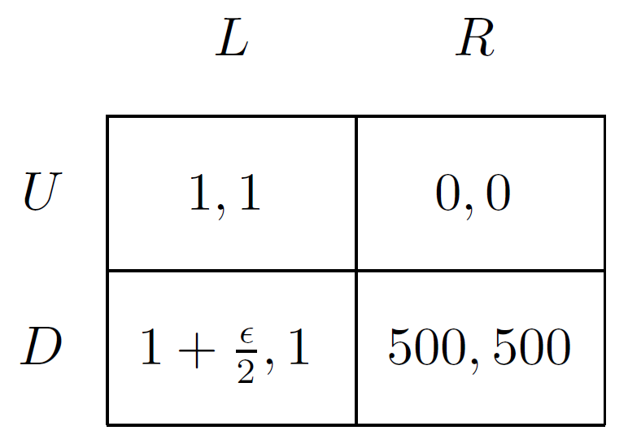
ε-Nash Equilibrium
What are the Nash equilibria?
What are the ε-Nash equilibria?

Slide 105
ε-Nash Equilibrium
Neither player’s payoff under the ε-Nash equilibrium is within ε of his payoff in a Nash equilibrium
In general both players’ payoffs under an ε-Nash equilibrium can be arbitrarily less than in any Nash equilibrium
The problem is that the requirement that player 1 cannot gain more than ε by deviating from the ε-Nash equilibrium strategy profile of (U,L) does not imply that player 2 would not be able to gain more than ε by best responding to player 1’s deviation

Slide 106
ε-Nash Equilibrium
Second, some ε-Nash equilibria might be very unlikely to arise in play
Although player 1 might not care about a gain of ε, he might reason that the fact that D dominates U would lead player 2 to expect him to play D, and that player 2 would thus play R in response

Slide 107
ε-Nash Equilibrium
Advantage
Some games may have only irrational, i.e. not exact, Nash equilibrium points [Nash, 1951]

