Slide 1
Computing Solution Concepts of
Normal-Form Games

Slide 2
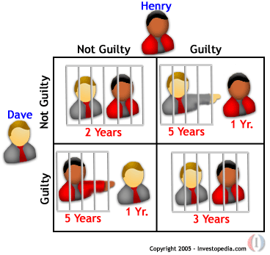
Computing Nash Equilibria
How hard is it to compute the Nash equilibria of a game?

Slide 3
History
1950 Nash: existence of Equilibrium in multiplayer, general-sum games
Intense effort on equilibrium algorithms:
Kuhn ’61, Mangasarian ’64, Lemke-Howson ’64, Rosenmüller ’71, Wilson ’71, Scarf ’67, Eaves ’72, Laan-Talman ’79, Porter et al. ‘04
All exponential in the worst case

Slide 4
NE in two-player, zero-sum games
The easiest class to solve
The NE problem for such games can be expressed as a linear program (LP)
equilibria can be computed in polynomial time

Slide 5
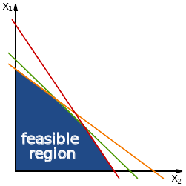
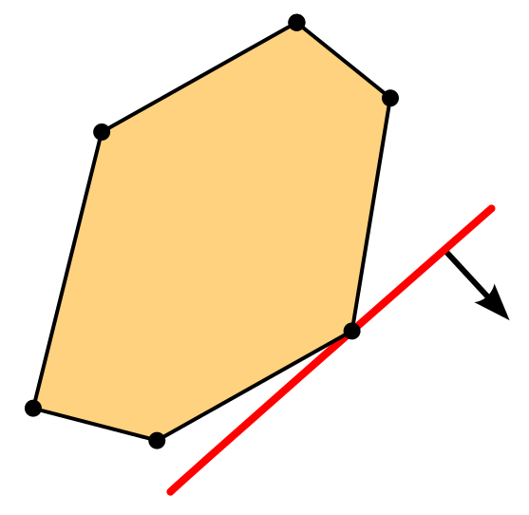
Linear Programming

Slide 6
NE in two-player, zero-sum games
Consider a two-player, zero-sum game G = ({1, 2}, A₁ × A₂, (u₁, u₂))
Let U_{i}∗ be the expected utility for player i in equilibrium
the value of the game: U₁∗ = -U₂∗

Slide 7
NE in two-player, zero-sum games
The minmax theorem tells us that
U₁∗ holds constant in all equilibria
It is the same as the value that player 1 achieves under a minmax strategy by player 2

Slide 8
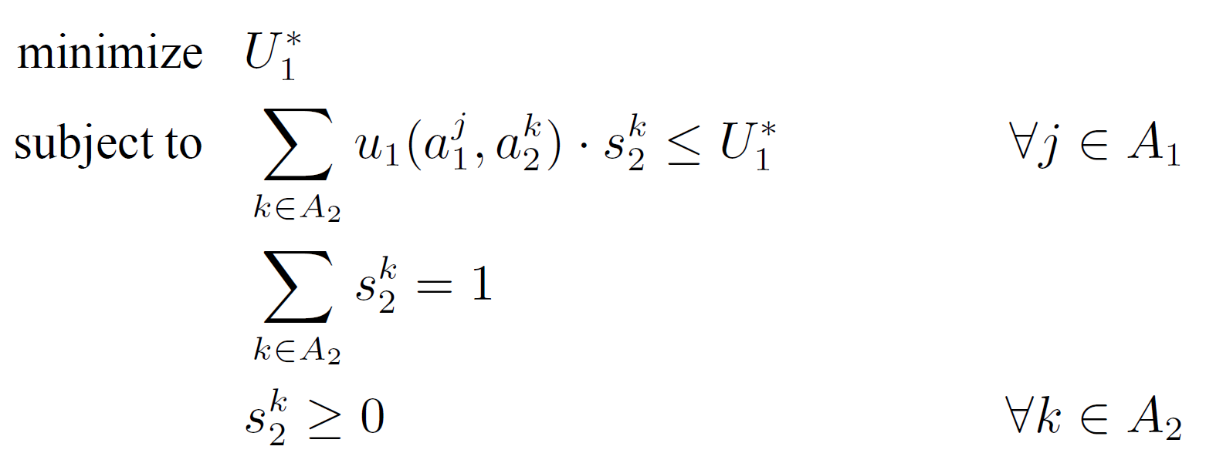
NE in two-player, zero-sum games
Using this result, we can construct the following linear program
Prob. of 2 playing action k

Slide 9
NE in two-player, zero-sum games
Using this result, we can construct the following linear program
constant
variables

Slide 10
NE in two-player, zero-sum games
For every pure strategy j of player 1, his expected utility for playing any action j ∈ A₁ given player 2’s mixed strategy s₂ is at most U₁∗

Slide 11
NE in two-player, zero-sum games
Those pure strategies for which the expected utility is exactly U₁∗ will be in player 1’s best response set

Slide 12
NE in two-player, zero-sum games
Player 2 plays the mixed strategy that minimizes the utility player 1 can gain by playing his best response

Slide 13
NE in two-player, zero-sum games
The values of the variables s₂^{k} must be interpreted as probabilities

Slide 14
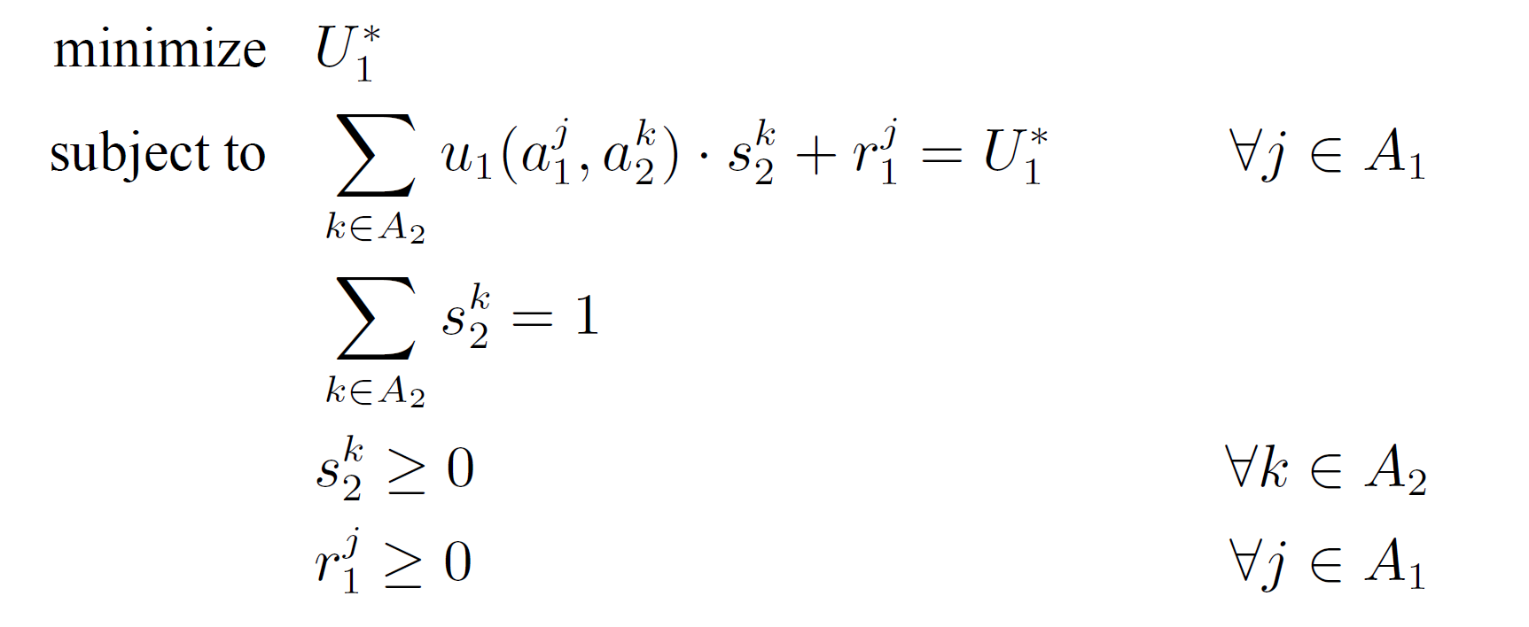
NE in two-player, zero-sum games
Similar formulation (useful later)
slack variables to allow equality

Slide 15
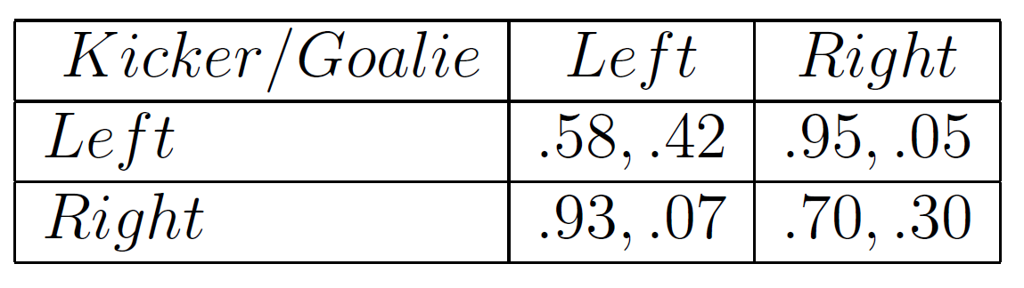
NE in two-player, zero-sum games
Example
zero sum
Kicker / Goalie | Left | Right
Left | 0.08 | 0.45
Right | 0.43 | 0.20

Slide 16
NE in two-player, zero-sum games
Kicker / Goalie | Left | Right
Left | 0.08 | 0.45
Right | 0.43 | 0.20
Example
minimize U₁*
s.t. 0.08 s₂¹ + 0.45 s₂² - U₁* ≤ 0
0.43 s₂¹ + 0.20 s₂² - U₁* ≤ 0
s₂¹ + s₂² = 1
s₂¹ ≥ 0
s₂² ≥ 0

Slide 17
NE in two-player, zero-sum games
Kicker / Goalie | Left | Right
Left | 0.08 | 0.45
Right | 0.43 | 0.20
Example
minimize x₃
s.t. 0.08 x₁ + 0.45 x₂ - x₃ ≤ 0
0.43 x₁ + 0.20 x₂ - x₃ ≤ 0
x₁ + x₂ = 1
x₁ ≥ 0
x₂ ≥ 0

Slide 18
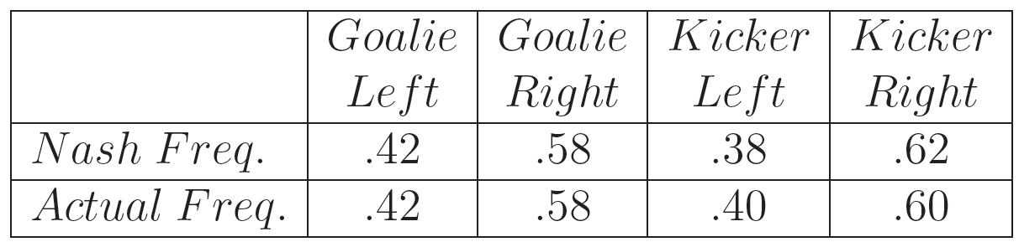
NE in two-player, zero-sum games
Kicker / Goalie | Left | Right
Left | 0.08 | 0.45
Right | 0.43 | 0.20
Example

Slide 19
NE in two-player, zero-sum games
Example in Matlab
% s₂¹*0.08 + s₂²*0.45 – U₁* ≤ 0
% s₂¹*0.43 + s₂²*0.20 – U₁* ≤ 0
A = [0.08 0.45 -1; 0.43 0.20 -1]
b = [0; 0]
% x1 and x2 must be probabilities, ie, x₁ + x₂ = 1, or A_{eq} * x = b_{eq}
Aeq = [1 1 0];
beq = 1;
% x₁ and x₂ must be probabilities, ie, x₁ ≥ 0 and x₂ ≥ 0
lb = [0 0 -inf];
% minimize(0*x₁ + 0*x₂ + x₃), where x₃ = U₁*
f = [0 0 1];
z = linprog(f,A,b,Aeq,beq,lb);
Kicker/Goalie | Left | Right
Left | 0.08 | 0.45
Right | 0.43 | 0.20

Slide 20
NE in two-player, zero-sum games
Example in Python
from scipy.optimize import linprog
f = [0, 0, 1]
A = [[0.08, 0.45, -1], [0.43, 0.20, -1]]
b = [0, 0]
Aeq = [[1, 1, 0]]
beq = [1]
x0_bounds = (0, None)
x1_bounds = (0, None)
x2_bounds = (None, None)
res = linprog(f, A_ub=A, b_ub=b, bounds=(x0_bounds, x1_bounds, x2_bounds), A_eq=Aeq, b_eq=beq)
Kicker/Goalie | Left | Right
Left | 0.08 | 0.45
Right | 0.43 | 0.20

Slide 21
NE in two-player, zero-sum games
Example in Python
>>> res
status: 0
slack: array([ 0., 0.])
success: True
fun: 0.29583333333333339
x: array([ 0.41666667, 0.58333333, 0.29583333])
message: 'Optimization terminated successfully.'
nit: 4
Kicker/Goalie | Left | Right
Left | 0.08 | 0.45
Right | 0.43 | 0.20

Slide 22
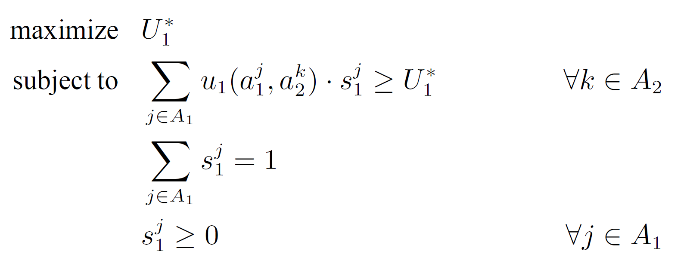
NE in two-player, zero-sum games
How to compute player 1's mixed strategies?

Slide 23
NE in two-player, zero-sum games
Example in Matlab
% min(-U₁*)
f = [0 0 -1];
A = [-0.08 -0.43 1; -0.45 -0.20 1];
z = linprog(f,A,b,Aeq,beq,lb);
Kicker/Goalie | Left | Right
Left | 0.08 | 0.45
Right | 0.43 | 0.20

Slide 24
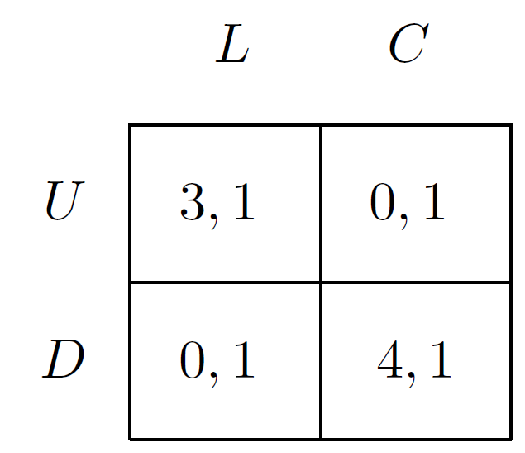
NE in two-player, general-sum games
Can we use linear programming for such games?

Slide 25
NE in two-player, general-sum games
Can we use linear programming for such games?
No... :(
The two players’ interests are no longer diametrically opposed
Problem cannot be stated as an optimization problem
One player is not trying to minimize the other’s utility

Slide 26
NE in two-player, general-sum games
What is the complexity of computing a sample Nash equilibrium?
No known reduction exists from our problem to a decision problem that is NP-complete, nor has our problem been shown to be easier
Why it cannot be NP-complete?
Every game has at least one Nash equilibrium, whereas known NP-complete problems are expressible in terms of decision problems that do not always have solutions

Slide 27
NE in two-player, general-sum games
Aspect | NP | PPAD
Problem Type | Decision problems (yes/no answers) | Search problems (find a solution guaranteed to exist)
Solution Verification | Can verify a solution in polynomial time | Verifying is easy, but finding one may not be
Existence of Solution | Not guaranteed — problem may have no solution | Solution is always guaranteed to exist by topology
Canonical Example | SAT (Satisfiability) | Nash Equilibrium (via Brouwer fixed point theorem)

Slide 28
NE in two-player, general-sum games
Theorem (Gilboa and Zemel, 1989) The following are NP-complete problems, even for symmetric games: Given a two-player game in strategic form, does it have
at least two NASH equilibria?
a NASH equilibrium in which player 1 has utility at least a given amount?
a NASH equilibrium in which the two players have total utility at least a given amount?
a NASH equilibrium with support of size greater than a given number?
a NASH equilibrium whose support contains strategy s?
a NASH equilibrium whose support does not contain strategy s?

Slide 29
PPAD
Stands for "Polynomial Parity Arguments on Directed graphs"

Slide 30
PPAD: End of the line problem
Let G be a graph with 2^{n} vertices
e.g. all the strings ∈ {0,1}^{n}
We have two functions
node id
P
node id
node id
C
node id
An edge exists between two nodes i and j if
P(i) = j and C(j) = i
i.e., i believes j is its parent and j believes i is its child
restriction: node {0}^{n} cannot be a child

Slide 31
PPAD: End of the line problem
How this graph will look like?

Slide 32
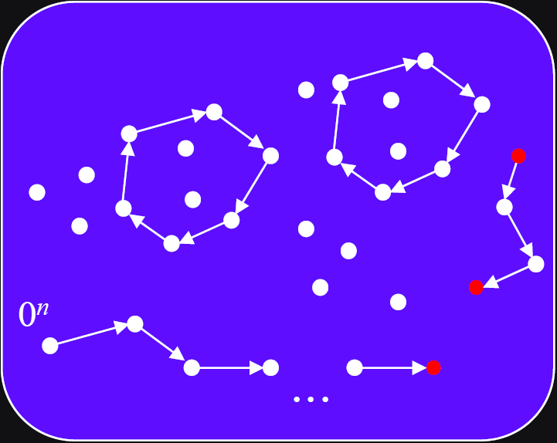
PPAD: End of the line problem

Slide 33
PPAD
The computational task of problems in the class PPAD is finding either a sink or a source other than {0}^{n} ∈ G
Such a solution always exists: because {0}^{n} is a source, there must be some sink which a descendent of {0}^{n}

Slide 34
PPAD
Simple algorithm: start from the standard source, and follow the path until you find a sink
Why this is not efficient?
Because the number of vertices in the graph is exponentially large and such paths are exponentially long (Savani and von Stengel, 2004)

Slide 35
PPAD
Theorem
The problem of finding a sample Nash equilibrium of a general-sum finite game with two or more players is PPAD-complete
Achieved by showing that the problem is in PPAD and that any other problem in PPAD can be reduced to it in polynomial time
Full result, obtained in 2005, is a culmination of a series of intermediate results obtained over more than a decade
The complexity of computing a Nash equilibrium. Daskalakis, 2005. 2008 ACM Doctoral Dissertation Award

Slide 36
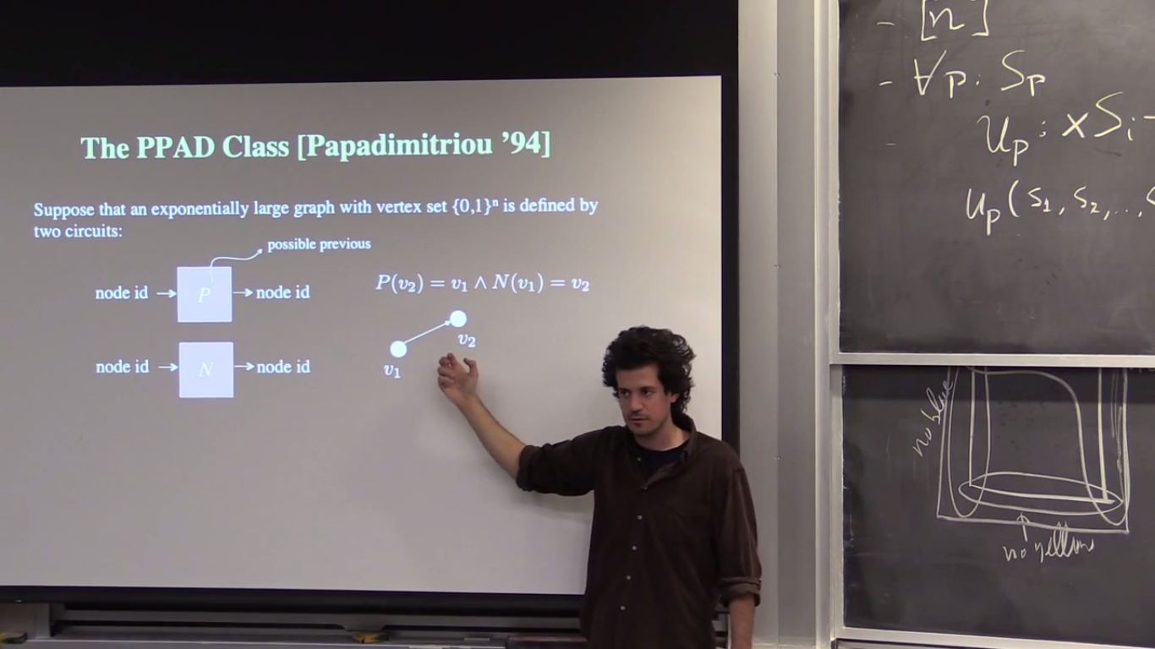
PPAD
Highly recommended video:
PPAD and Nash Equilibrium
Constantinos Daskalakis
https://www.youtube.com/watch?v=TUbfCY_8Dzs

Slide 37
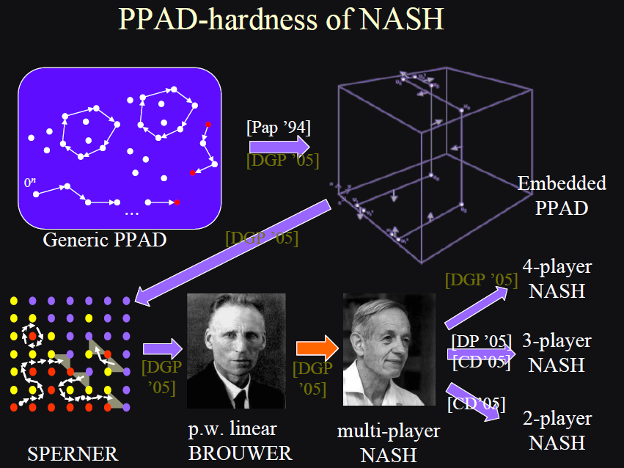

Slide 38
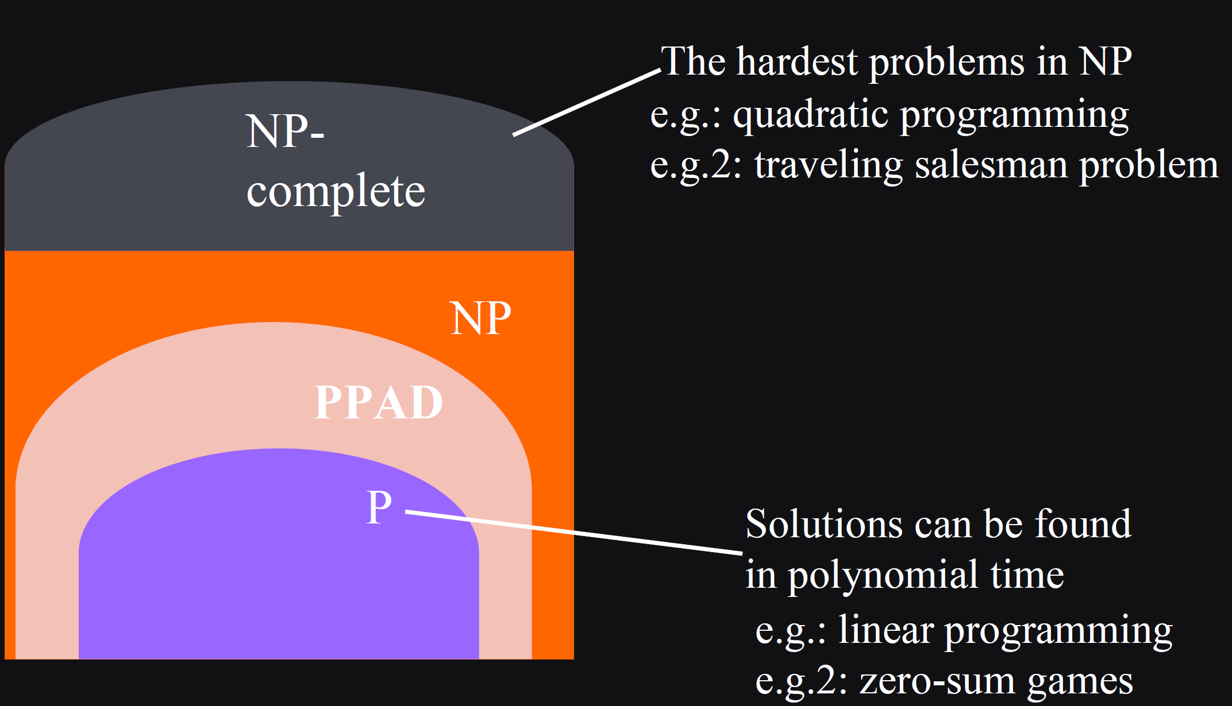
Where is PPAD?

Slide 39
Support of a mixed strategy
Let s_{i}(a_{i}) be the probability that an action a_{i} will be played under mixed strategy s_{i}
The subset of actions that are assigned positive probability by the mixed strategy s_{i} is called the support of s_{i}

Slide 40
Support of a mixed strategy
Definition (Support)
The support of a mixed strategy s_{i} for a player i is the set of pure strategies {a_{i} | s_{i}(a_{i} ) > 0}
A pure strategy is in the support of a mixed strategy if that pure strategy is played with positive probability according to the mixed strategy

Slide 41
Support of a mixed strategy
(Theorem) A mixed strategy is a best response if and only if all pure strategies in its support are best responses and yield an equal expected payoff
Thus players combine pure best response strategies
proof see Algorithmic Game Theory p. 25
Intuition: Otherwise, the player could profitably deviate to playing the specific strategy in the support that generated a higher payoff

Slide 42
Support of a mixed strategy
Thus finding the Nash equilibrium comes down to finding the right support
Once found the precise mixed strategy can be computed by solving a system of algebraic equations
see Algorithmic Game Theory book p. 31
Hence finding the Nash equilibrium is a combinatorial problem

Slide 43
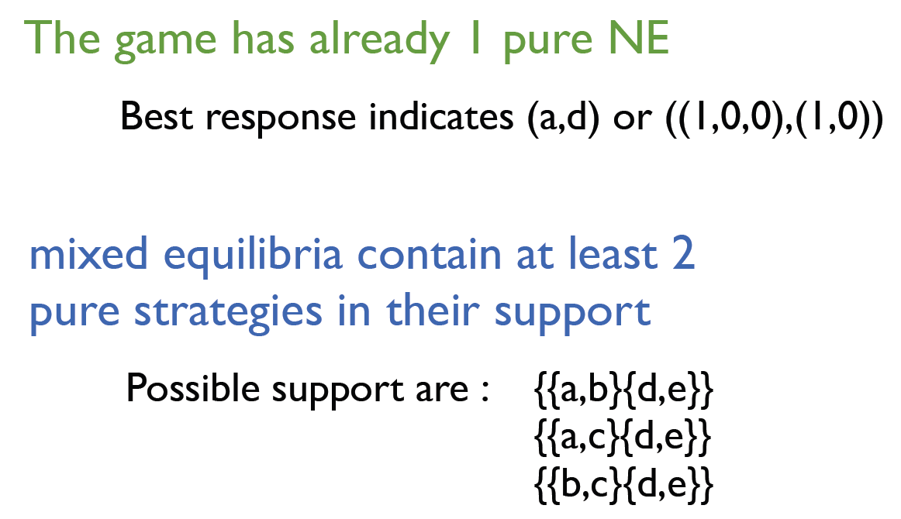
Finding Supports
y_{d}
y_{e}
 | d | e
a | (3,3) | (3,2)
b | (2,2) | (5,6)
c | (0,3) | (6,1)
x_{a}
x_{b}
x_{c}

Slide 44

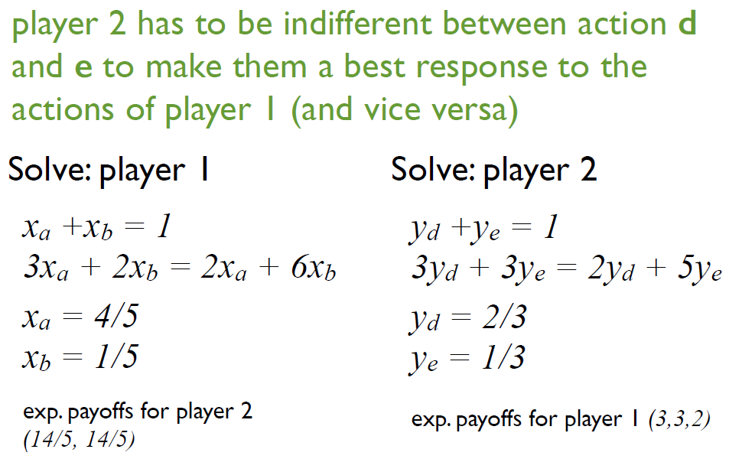
Finding Supports
y_{d}
y_{e}
 | d | e
a | (3,3) | (3,2)
b | (2,2) | (5,6)
c | (0,3) | (6,1)
x_{a}
x_{b}
x_{c}

Slide 45
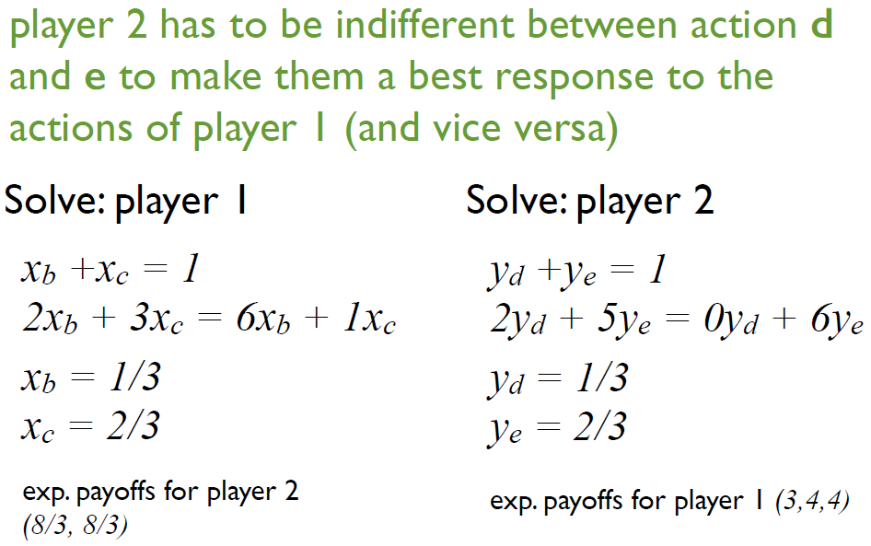
Finding Supports
y_{d}
y_{e}
 | d | e
a | (3,3) | (3,2)
b | (2,2) | (5,6)
c | (0,3) | (6,1)
x_{a}
x_{b}
x_{c}

Slide 46
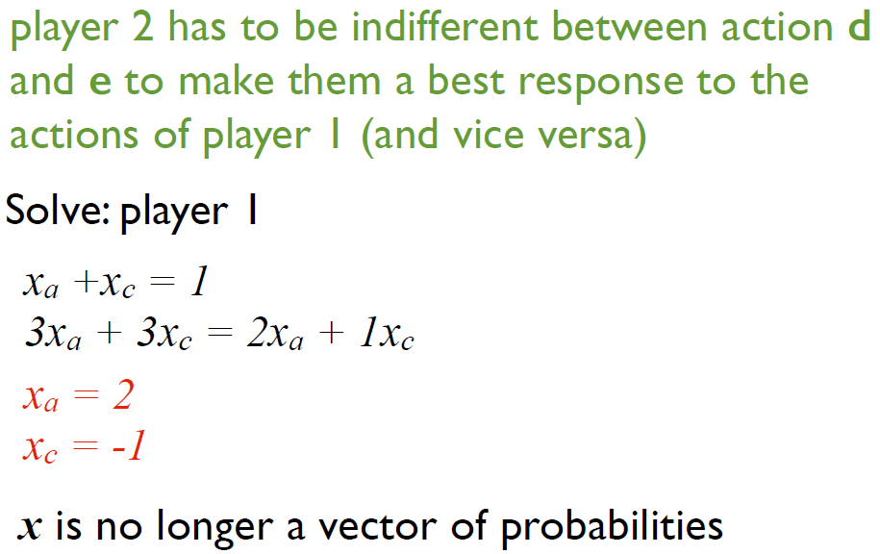
Finding Supports
y_{d}
y_{e}
 | d | e
a | (3,3) | (3,2)
b | (2,2) | (5,6)
c | (0,3) | (6,1)
x_{a}
x_{b}
x_{c}

Slide 47
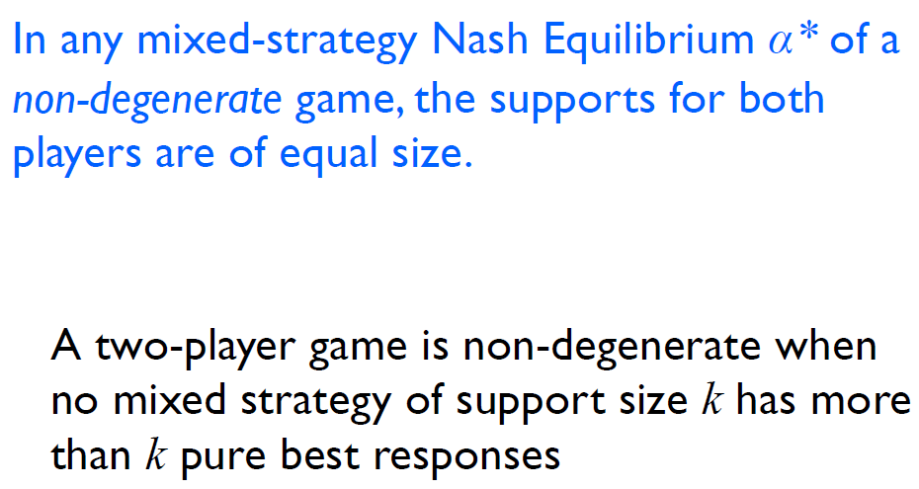
Finding Supports
y_{d}
y_{e}
 | d | e
a | (3,3) | (3,2)
b | (2,2) | (5,6)
c | (0,3) | (6,1)
x_{a}
x_{b}
x_{c}

Slide 48
Degenerate games
A two-player normal-form game is said to be degenerate if:
There exists a mixed strategy (used by one player) that gives more than the expected number of best responses to the other player.
More precisely:
In a non-degenerate game, when a player uses a mixed strategy that mixes over k pure strategies, the other player should have exactly k best responses (pure strategies that are best replies).
A game is degenerate if there are more than k best responses, creating ambiguity.

Slide 49
Degenerate games
The original definition of degenerate games was given in [Lemke, Howson 1964]
Further to this, [Stengel 1999] offers a nice overview of a variety of equivalent definitions
Sadly, all of these definitions require finding a particular mixed strategy profile (x,y) for which a particular condition holds
To be able to implement a test for degeneracy based on any of these definitions would require a continuous search over possible mixed strategy pairs
More about degenerate games: https://vknight.org/unpeudemath/code/2015/06/25/on_testing_degeneracy_of_games.html

Slide 50
The LCP Formulation
Two-player, general-sum game
The problem of finding a sample Nash equilibrium cannot be formulated as a linear program
Can be formulated as a linear complementarity problem (LCP)

Slide 51
The LCP Formulation
LCP has no objective function at all
A constraint satisfaction problem, or a feasibility program, rather than an optimization problem
We need to discuss both players explicitly

Slide 52
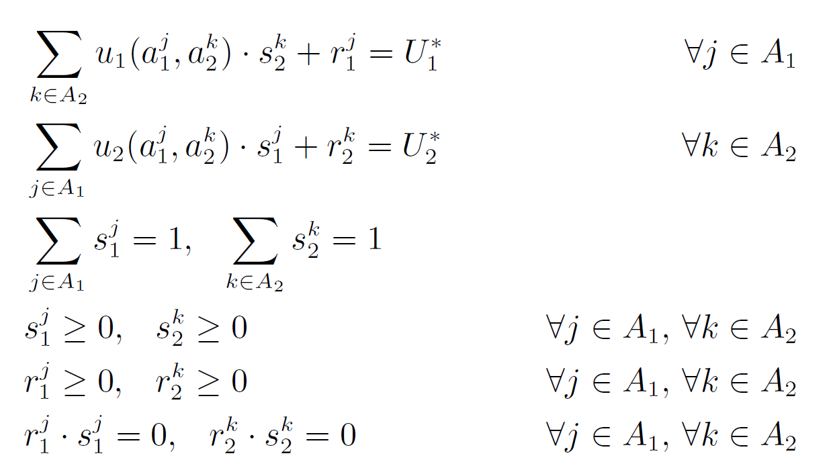
The LCP Formulation
two players

Slide 53
The LCP Formulation
slack variables
that is, ∀j ∈ A_{i}, u_{i}(a_{i}^{j},a_{-i}) + r_{i}^{j} = U_{i}*

Slide 54
The LCP Formulation
probabilities

Slide 55
The LCP Formulation
Why those nonlinear constraints?

Slide 56
The LCP Formulation
Why does the complementarity condition fix our problem formulation?
If s_{i}^{j} >0 (or p(a_{i}^{j})>0), then r_{i}^{j} =0
Each r_{i}^{j} can be viewed as the player’s incentive to deviate from a_{i}^{j}
In equilibrium, all s_{i}^{k} > 0 must yield the same expected payoff, while all strategies that lead to lower expected payoffs are not played
All constraints together: each player plays a best response to the other player’s mixed strategy

Slide 57
The Lemke-Howson algorithm
The best-known algorithm designed to solve this LCP formulation
Graphical exposition
Algorithm itself

Slide 58
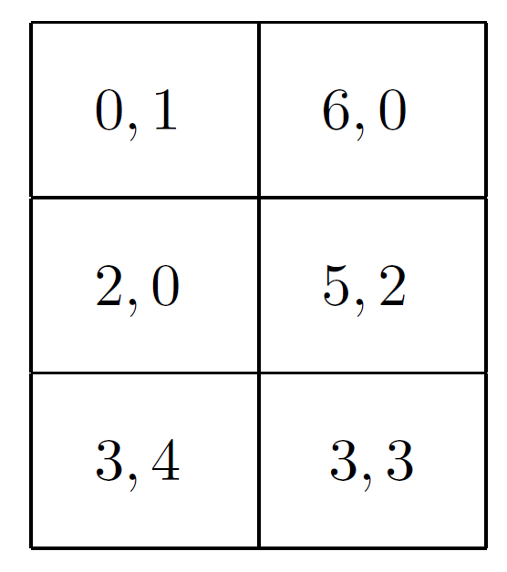
The Lemke-Howson algorithm
Consider the following game
a₂¹
a₂²
a₁¹
a₁²
a₁³

Slide 59
The Lemke-Howson algorithm
(0,0,1)
(1,0)
(0,1)
(1,0,0)
(0,1,0)

Slide 60
The Lemke-Howson algorithm
(0,0,1)
(0.25,0.25,0.5)
(1,0)
(0,1)
(1,0,0)
(0,1,0)

Slide 61
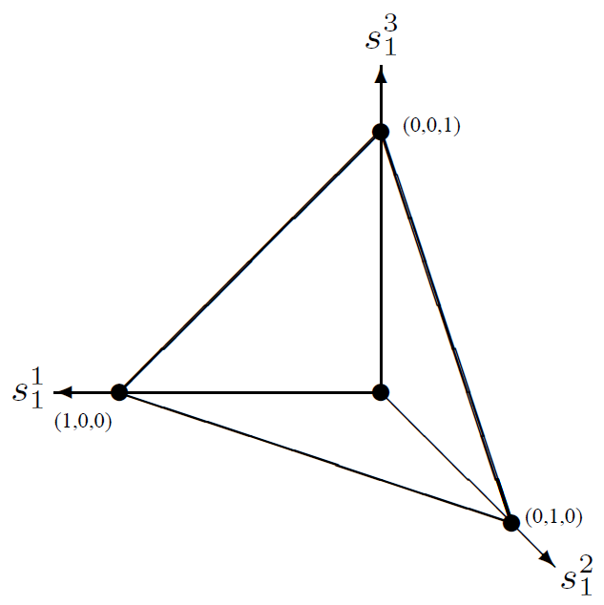
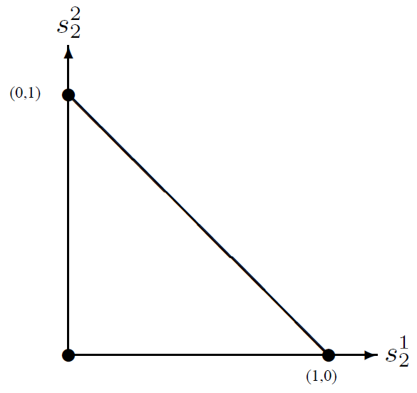
The Lemke-Howson algorithm
Replaces Σ_{j}s_{i}^{j} = 1 by Σ_{j}s_{i}^{j} ≤ 1
(0,0,0)
(0,0)

Slide 62
The Lemke-Howson algorithm
Next step: to define a labeling on the strategies
Every s_{i} is given a set of labels L(s_{i} ) ⊆ A₁ ∪ A₂
For player i and the other player as −i, mixed strategy s_{i} for player i is labeled as follows:
with each of player i’s actions a_{i}^{j} that is not in the support of s_{i}
with each of player −i’s actions a_{-i}^{j} that is a best response by player −i to s_{i}

Slide 63
Example
y_{d}
y_{e}
 | d | e
a | (3,3) | (3,2)
b | (2,2) | (5,6)
c | (0,3) | (6,1)
x_{a}
x_{b}
x_{c}
L1 = {a, d, e}
L2 = {b, c}

Slide 64
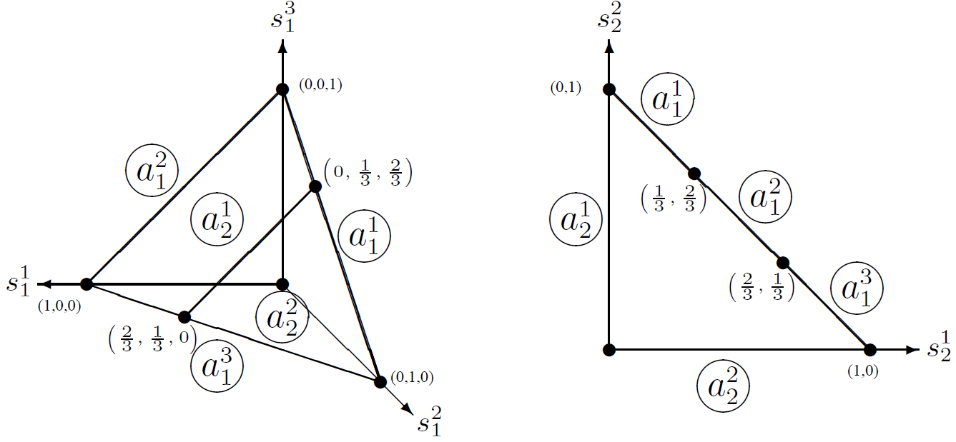
The Lemke-Howson algorithm
0 probability of playing a₂¹
player 1`s strategy space
player 2`s strategy space

Slide 65
The Lemke-Howson algorithm
0 probability of playing a₂²
player 1`s strategy space
player 2`s strategy space

Slide 66
The Lemke-Howson algorithm
a₁¹ is a best response of P1 when P2's strategy is between (0,1) and (1/3,2/3)
player 1`s strategy space
player 2`s strategy space

Slide 67
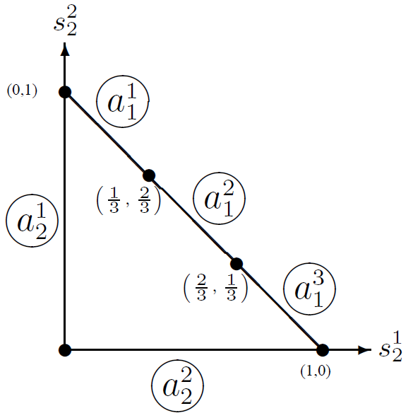
The Lemke-Howson algorithm
player 2`s strategy space
4
4
3
6
5
3
2
3
3
0
2
3
The algorithm has no use for interior points

Slide 68
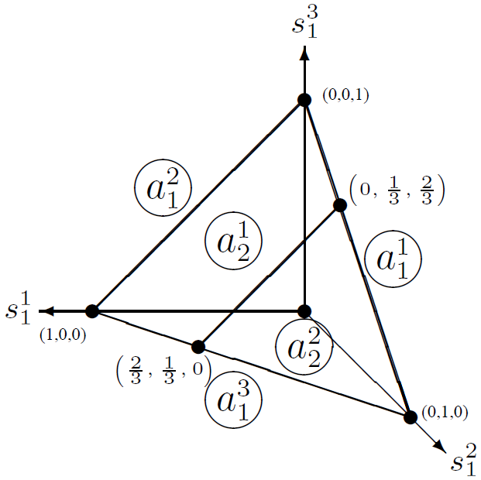
The Lemke-Howson algorithm
player 1`s strategy space
4 | 3
2.66 | 2.66
1 | 0
0 | 2
0.66 | 0.66

Slide 69
The Lemke-Howson algorithm
Next step: to define a labeling on the strategies
Why is this useful?
A pair of strategies (s₁, s₂) is a Nash equilibrium if and only if it is completely labeled
L(s₁) ∪ L(s₂) = A₁ ∪ A₂
For a pair to be completely labeled, each action a_{i}^{j} must either played by player i with zero probability, or be a best response by player i to the mixed strategy of player −i

Slide 70
The Lemke-Howson algorithm
Restatement of the complementarity condition given in the LCP formulation
The slack variable r_{i}^{j}=0 exactly when its corresponding action a_{i}^{j} is a best response to the mixed strategy s_{−i}

Slide 71
The Lemke-Howson algorithm
Define G₁ and G₂ to be graphs, for players 1 and 2 respectively
The nodes in the graph are fully labeled points in the labeled space
triply labeled points in G₁
doubly labeled points in G₂
An edge exists between pairs of points that differ in exactly one label

Slide 72
The Lemke-Howson algorithm
(a₂¹,a₁¹)
(a₁¹,a₁²)
(a₁²,a₁³)
(a₂²,a₁³)
(a₂¹,a₂²)

Slide 73
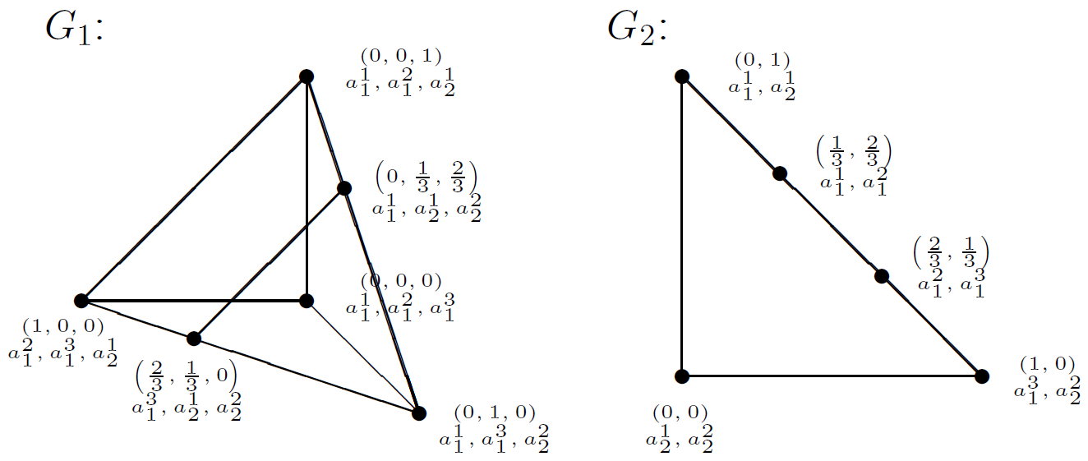
The Lemke-Howson algorithm
L(0,0,0) U L(0,0) = {a₁¹, a₁², a₁³ , a₂¹, a₂²}

Slide 74
The Lemke-Howson algorithm
L(0,1,0) U L(0,0) = {a₁¹, a₁³, a₂², a₂¹, a₂²}
?

Slide 75
The Lemke-Howson algorithm
L(0,1,0) U L(0,1) = {a₁¹, a₁³, a₂², a₁¹, a₂¹}
?

Slide 76
The Lemke-Howson algorithm
L(2/3,1/3,0) U L(0,1) = {a₁³, a₂¹, a₂², a₁¹, a₂¹}

Slide 77
The Lemke-Howson algorithm
L(2/3,1/3,0) U L(1/3,2/3) = {a₁³, a₂¹, a₂², a₁¹, a₁²}

Slide 78
The Lemke-Howson algorithm
How to compute the graph nodes from the game description?
We do not compute the nodes in advance at all
We compute them incrementally along the path being explored
At each step, we find the missing label to be added (called the entering variable) and add it
Then, we find out which label has been lost (it is called the leaving variable)
The process repeats until no variable is lost in which case a solution has been obtained
This procedure is called pivoting, and also underlies the simplex algorithm for solving linear programming problems

Slide 79
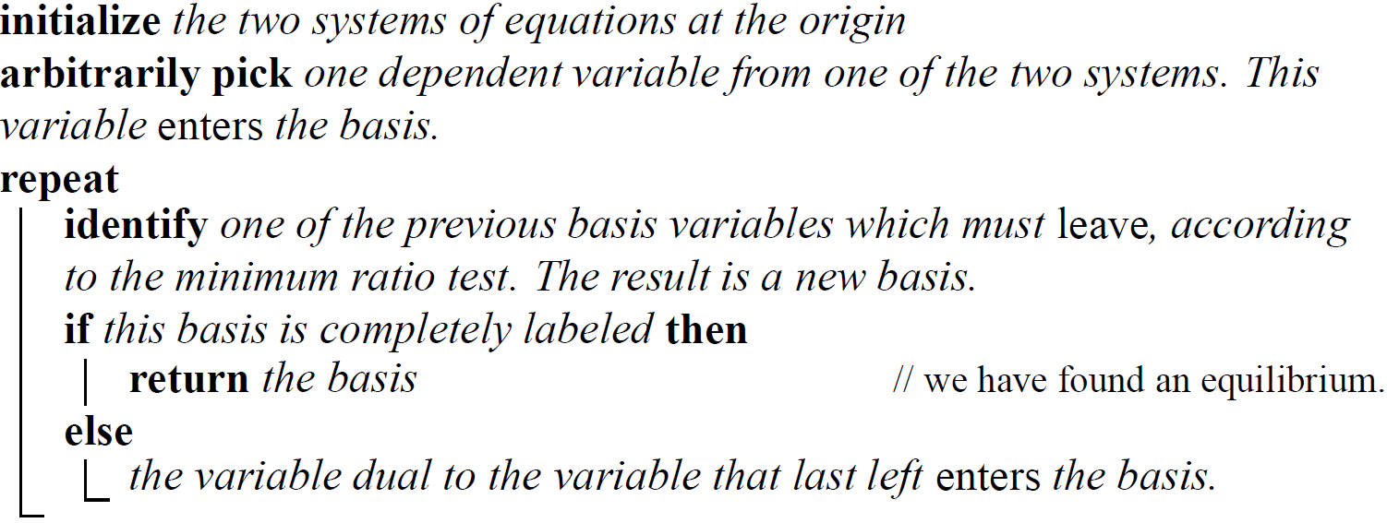
The Lemke-Howson algorithm

Slide 80
The Lemke-Howson algorithm

Slide 81
The Lemke-Howson algorithm

Slide 82
The Lemke-Howson algorithm

Slide 83
The Lemke-Howson algorithm

Slide 84
The Lemke-Howson algorithm

Slide 85
The Lemke-Howson algorithm

Slide 86
The LCP formulation

Slide 87
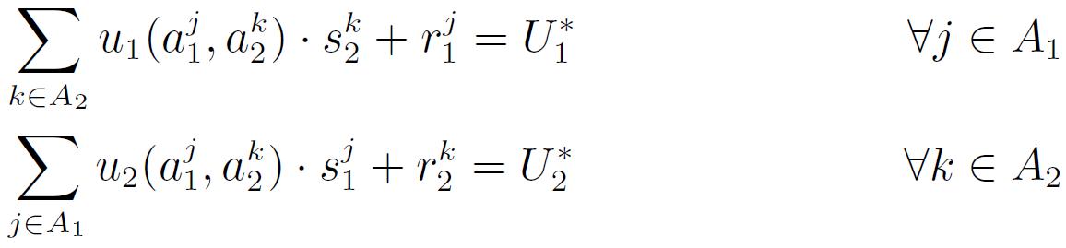
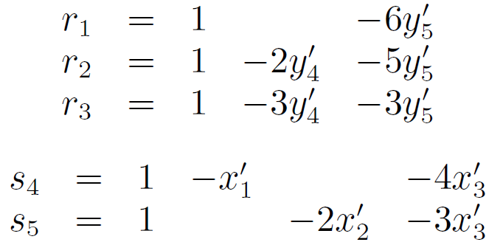
The Lemke-Howson algorithm
from the LCP formulation

Slide 88
The Lemke-Howson algorithm
0 to all variables (players' strategies) on the right-hand side
r₁, r₂, r₃, s₄, s₅ form the basis of our system of equations

Slide 89
The Lemke-Howson algorithm
Note that each basis variable has a dual dependent one
G₁
G₂
(a₁¹, a₁², a₁³)
(a₂¹, a₂²)

Slide 90
The Lemke-Howson algorithm
Which variable should enter the basis?
Initially the choice is arbitrary
Thereafter, it is the dual to the variable that previously left

Slide 91
The Lemke-Howson algorithm
y₄', s₄
y₅', s₅
x₂' is the first entering variable
x₁', r₁
s₅ should leave the basis, since it is the only clashing variable
x₂', r₂
x₃', r₃
G₁
G₂
(a₁¹, a₁², a₁³)
(a₂¹, a₂²)

Slide 92
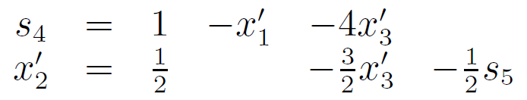
The Lemke-Howson algorithm
y₄', s₄
y₅', s₅
since x₂' is in the basis now, we should update the equations
x₁', r₁
x₂', r₂
x₃', r₃
G₁
G₂
(a₁¹, a₁², a₁³)
(a₂¹, a₂²)
(a₂¹, a₁²)

Slide 93
The Lemke-Howson algorithm
y₄', s₄
y₅', s₅
a₂² left the basis of 2, so it should appear in the basis of 1: a₂² is now a best response
x₁', r₁
x₂', r₂
x₃', r₃
G₁
G₂
(a₁¹, a₁², a₁³)
(a₂¹, a₂²)
(a₂¹, a₁²)

Slide 94
The Lemke-Howson algorithm
Which variable should leave the basis?
When a variable enters, the candidates to leave are all the “clashing variables"
these are all the current basis variables in whose equation the "entering variable" appears
If there is only one such equation, we are done
If not, perform the minimum ratio test to decide

Slide 95
The Lemke-Howson algorithm
Which variable should leave the basis?
The minimum ratio test
Each such equation has the form v = c+qu+T
v is the clashing variable
c is a constant (initially they are all 1)
u is the entering variable
q is a constant coefficient
T is a linear combination of variables other than v or u
The clashing variable to leave is the one in whose equation the q/c ratio is smallest

Slide 96
The Lemke-Howson algorithm
y₄', s₄
y₅', s₅
a₂² left the basis of 2, so it should appear in the basis of 1: a₂² is now a best response
x₁', r₁
x₂', r₂
x₃', r₃
G₁
G₂
(a₁¹, a₁², a₁³)
(a₂¹, a₂²)
(a₂¹, a₁²)

Slide 97
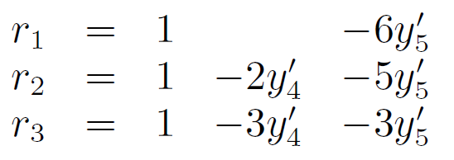
The Lemke-Howson algorithm
clashing variables
entering variable
MRT(r₁) = -6/1 = -6
MRT(r₂) = -5/1 = -5
MRT(r₃) = -3/1 = -3
r₁ has the smallest MRT, so it should leave the basis
Minimum ratio test (MRT)
Each such equation has the form v = c+qu+T
v is the clashing variable
c is a constant (initially they are all 1)
u is the entering variable
q is a constant coefficient
T is a linear combination of variables other than v or u
The clashing variable to leave is the one in whose equation the q/c ratio is smallest

Slide 98
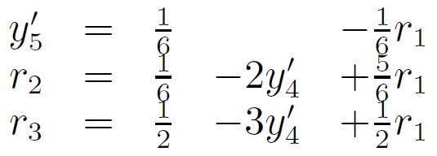
The Lemke-Howson algorithm
y₄', s₄
y₅', s₅
r₁ has the smallest MRT, so it should leave the basis
x₁', r₁
a₂² enters the basis
x₂', r₂
since r₁ has left, a₁¹ is being played by 1, so a₁¹ must enter the basis
x₃', r₃
G₁
G₂
(a₁¹, a₁², a₁³)
(a₂¹, a₂²)
(a₂², a₁², a₁³)
(a₂¹, a₁²)

Slide 99
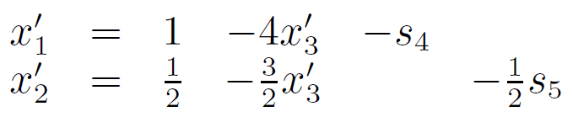
The Lemke-Howson algorithm
y₄', s₄
y₅', s₅
since r₁ has left, a₁¹ is being played by 1, so a₁¹ must enter the basis
x₁', r₁
x₂', r₂
a₁¹ appears in only one equation, so s₄ leaves the basis
x₃', r₃
G₁
G₂
(a₁¹, a₁², a₁³)
(a₂¹, a₂²)
(a₁¹, a₁²)
(a₂², a₁², a₁³)
(a₂¹, a₁²)

Slide 100
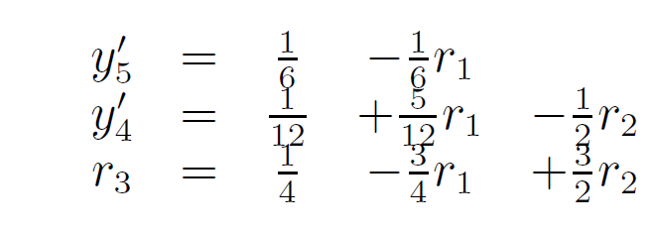
The Lemke-Howson algorithm
y₄', s₄
y₅', s₅
since s₄ has left, a₂¹ is being played by 2, so a₂¹ must enter the basis
x₁', r₁
x₂', r₂
MRT(r₂) = -12
MRT(r₃) = -6
x₃', r₃
G₁
G₂
(a₁¹, a₁², a₁³)
(a₂¹, a₂²)
(a₂¹, a₂², a₁³)
(a₁¹, a₁²)
(a₁¹, a₁²)
(a₂², a₁², a₁³)
(a₂¹, a₁²)

Slide 101
The Lemke-Howson algorithm
y₄', s₄
y₅', s₅
(a₂¹, a₂², a₁³) U (a₁¹, a₁²) contains all labels, so the algorithm stops!
x₁', r₁
x₂', r₂
But what is the solution?
x₃', r₃
G₁
G₂
(a₁¹, a₁², a₁³)
(a₂¹, a₂²)
(a₂¹, a₂², a₁³)
(a₁¹, a₁²)
(a₁¹, a₁²)
(a₂², a₁², a₁³)
(a₂¹, a₁²)

Slide 102
The Lemke-Howson algorithm
But what is the solution?
all variables on the right-hand are equal to 0
Thus, y₅' = 1/6 and y₄' = 1/12
Normalizing to probabilities,
y₅' = (1/6) / (3/12) = 2/3
y₄' = (1/12) / (3/12) = 1/3
x₁' = 1 and x₂' = 1/2
Normalizing to probabilities,
x₁' = (1) / (3/2) = 2/3
x₂' = (1/2) / (3/2) = 1/3
u₁(s) = s₁^{T} U₁ s₂^{T} = 4
u₂(s) = s₁^{T} U₂ s₂^{T} = 2/3
Thus, s = ( (2/3, 1/3, 0), (1/3, 2/3) )

Slide 103
The Lemke-Howson algorithm
To practice (good question for an exam):
Run the Lemke-Howson algorithm for the game bellow and start putting a₂¹ in the basis
 | a₂¹ | a₂²
a₁¹ | (2,1) | (4,4)
a₁² | (1,5) | (10,10)

Slide 104
Properties of the Lemke-Howson algorithm
It is guaranteed to find a sample Nash equilibrium
Its constructive nature constitutes an alternative proof of the existence of a Nash equilibrium
The path through almost completely labeled pairs to an equilibrium is unique
While the algorithm is nondeterministic, all the nondeterminism is concentrated in its first move
It can be used to find more than one Nash equilibrium
Once we have found another completely labeled pair, we can use it as the starting point, allowing us to reach additional equilibria

Slide 105
Properties of the Lemke-Howson algorithm
:( The search graph can be disconnected, and the algorithm is only able to find the equilibria in the connected component that contains the origin
:( There is not an efficient way to determine whether or not all equilibria have been found

Slide 106
Properties of the Lemke-Howson algorithm
:( The algorithm provides no guidance on how to make a good first choice
:( There are cases in which all paths are of exponential length
:( and thus the time complexity of the Lemke–Howson algorithm is provably exponential
:( The fact that the algorithm has no objective function means that it provides no obvious guideline to assess how close it is to a solution before actually finding one

