Slide 1
Computing Solution Concepts of
Normal-Form Games

Slide 2
NE in n-player, general-sum games
Can no longer be represented even as an LCP
Impractical to solve exactly
Unclear how to best formulate the problem as input to an algorithm

Slide 3
NE in n-player, general-sum games
There has been some success approximating the solution using a sequence of linear complementarity problems (SLCP)
Each LCP is an approximation of the problem, and its solution is used to create the next approximation in the sequence
Can be thought of as a generalization to Newton’s method of approximating the local maximum of a quadratic equation
Although not globally convergent, it is possible to try a number of different starting points because of its relative speed

Slide 4
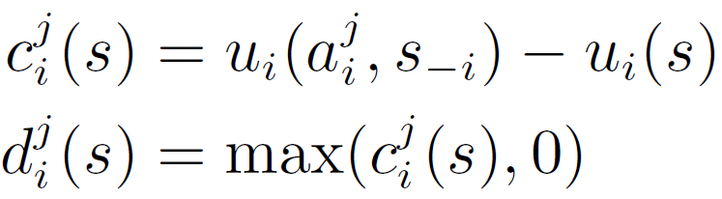
NE in n-player, general-sum games
Another approach is to formulate the problem as a minimum of a function
Starting from a strategy profile s, let c_{i}^{j}(s) be the change in utility to player i if he switches to playing action a_{i}^{j} as a pure strategy
Then, define d_{i}^{j}(s) as c_{i}^{j}(s) bounded from below by zero

Slide 5
NE in n-player, general-sum games
Note that d_{i}^{j}(s) is positive if and only if player i has an incentive to deviate to action a_{i}^{j}(s)
Thus, strategy profile s is a Nash equilibrium if and only if d_{i}^{j}(s) = 0 for all players i, and all actions j for each player

Slide 6
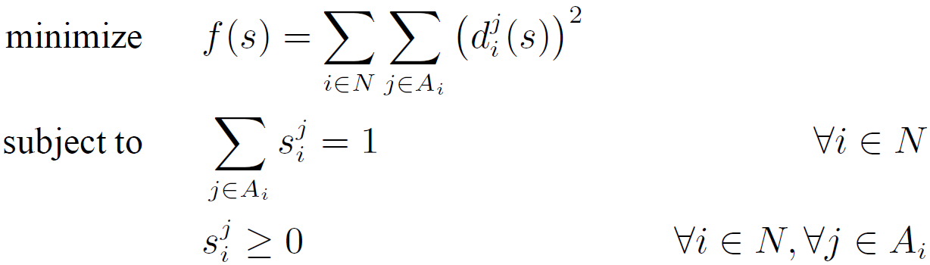
NE in n-player, general-sum games
This function has one or more global minima at 0, and the set of all s such that f(s) = 0 is exactly the set of Nash equilibria
We can now apply any method for constrained optimization
makes the function differentiable everywhere

Slide 7
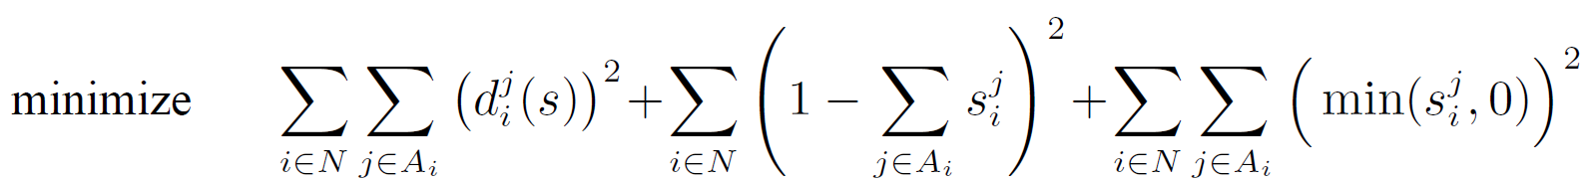
NE in n-player, general-sum games
For an unconstrained optimization method, we can roll the constraints into the objective function
We still have a differentiable function that is zero if and only if s is a Nash equilibrium

Slide 8
NE in n-player, general-sum games
:( Both optimization problems have local minima which do not correspond to Nash equilibria
Considering the commonly-used optimization methods
:( hill-climbing gets stuck in local minima
:( simulated annealing often converges globally only for parameter settings that yield an impractically long running time

Slide 9
NE in n-player, general-sum games
Alternative algorithms
Scarf's algorithm
Govindan and Wilson
SEM

Slide 10
Identifying dominated strategies
Computational uses for identifying dominated strategies
Computational complexity of this process

Slide 11
Identifying dominated strategies
Iterated removal of strictly dominated strategies
The same set of strategies will be identified regardless of the elimination order
All Nash equilibria of the original game will be contained in this set
Can be used to narrow down the set of strategies to consider before attempting to identify a sample Nash equilibrium
In the worst case this procedure will have no effect
In practice, it can make a big difference

Slide 12
Identifying dominated strategies
Iterated removal of weakly dominated strategies
The elimination order does make a difference
the set of strategies that survive iterated removal can differ depending on the order in which dominated strategies are removed
Removing weakly dominated strategies can eliminate some equilibria of the original game
No new equilibria are ever created by this elimination
Since every game has at least one equilibrium, at least one of the original equilibria always survives
Will often produce a smaller game

Slide 13
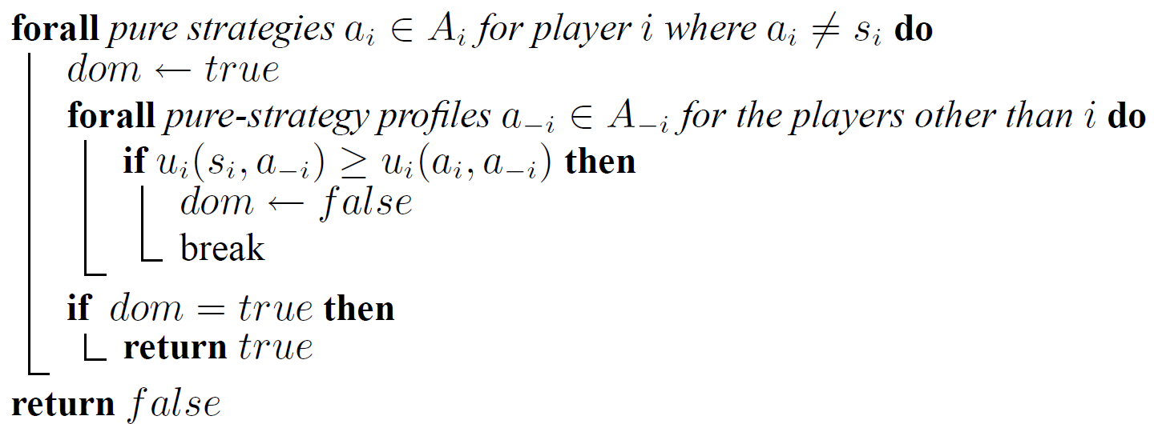
Identifying dominated strategies
Algorithm for determining whether s_{i} is strictly dominated by any pure strategy

Slide 14
Identifying dominated strategies
How to change this algorithm to determine whether s_{i} is weakly dominated by any pure strategy?
, flag = false
>
else if u_{i}(s_{i},a_{-i}) < u_{i}(a_{i},a_{-i}) then
flag ← true
and flag = true then

Slide 15
Identifying dominated strategies
For all of the definitions of domination, the complexity of the procedure is O(|A|), linear in the size of the normal-form game

Slide 16
Domination by a mixed strategy
We cannot use the previous simple algorithm to test whether a given strategy s_{i} is dominated by a mixed strategy because these strategies cannot be enumerated
However, it turns out that we can still answer the question in polynomial time by solving a linear program
Each flavor of domination requires a somewhat different linear program

Slide 17
Another solution concept
Reminder:
 | L | C
U | 3,1 | 0,3
M | 1,5 | 1,1
B | 0,½ | 4,2
Why is the action dominated?

Slide 18
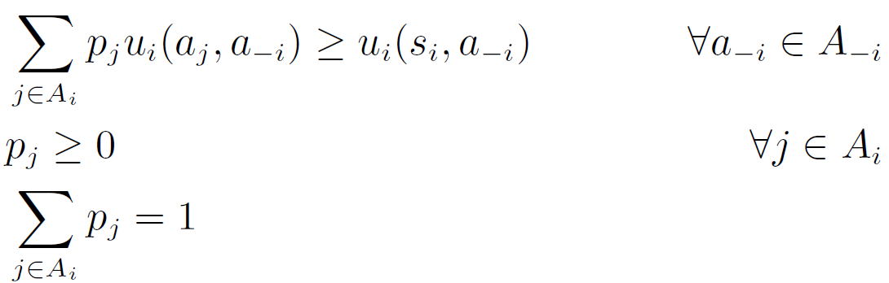
Domination by a mixed strategy
Q: What does this feasibility program give us for a given strategy s_{i}?
A: Very weakly dominance!

Slide 19
Domination by a mixed strategy
Matlab code:
A = [-3 0; 0 -4]
b = [-1 -1];
Aeq = [1 1];
beq = 1;
lb = [0 0];
f = [];
z = linprog(f,A,b,Aeq,beq,lb)
z = 0.3349
0.6651
 | L | C
U | 3,1 | 0,3
M | 1,5 | 1,1
B | 0,½ | 4,2

Slide 20
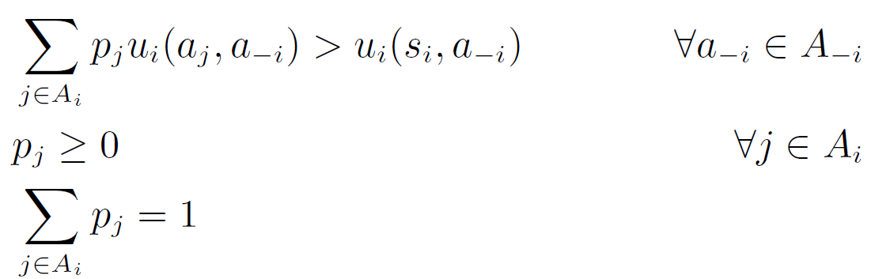
Domination by a mixed strategy
Then, let us consider strict domination by a mixed strategy
This would seem to have the following straightforward LP formulation (indeed, a mere feasibility program)

Slide 21
Domination by a mixed strategy
The problem is that the constraints in linear programs must be weak inequalities
cannot be written in LPs

Slide 22
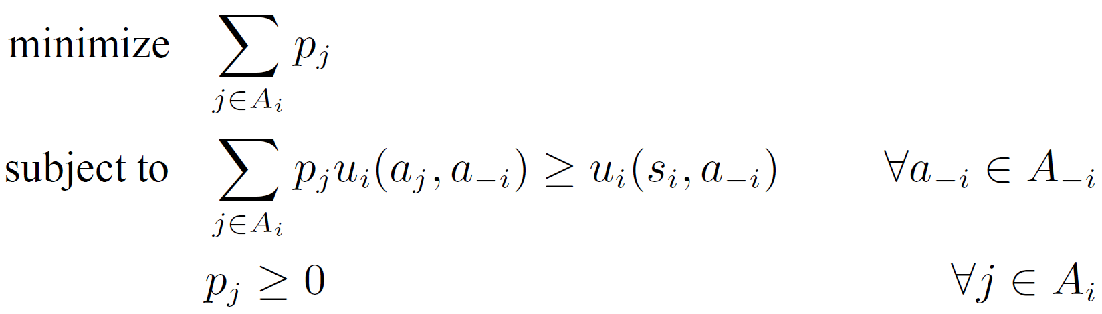
Domination by a mixed strategy
Instead, we must use the LP that follows

Slide 23
Domination by a mixed strategy
This LP simulates the strict inequality of constraint through the objective function
no constraints restrict the p_{j}’s from above: this LP will always be feasible
In the optimal solution, the p_{j}’s may be smaller or greater to 1

Slide 24
Domination by a mixed strategy
A strictly dominating mixed strategy therefore exists iff the optimal solution to the LP has objective function < 1
In this case, we can add a positive amount to each p_{j} in order to cause constraint to hold in its strict version everywhere while achieving the condition Σ_{j}p_{j} = 1

Slide 25
Domination by a mixed strategy
Matlab code:
A = [-3 0; 0 -4]
b = [-1 -1];
Aeq = [];
beq = [];
lb = [0 0];
f = [1 1];
z = linprog(f,A,b,Aeq,beq,lb)
z =
0.3333
0.2500
 | L | C
U | 3,1 | 0,3
M | 1,5 | 1,1
B | 0,½ | 4,2

Slide 26
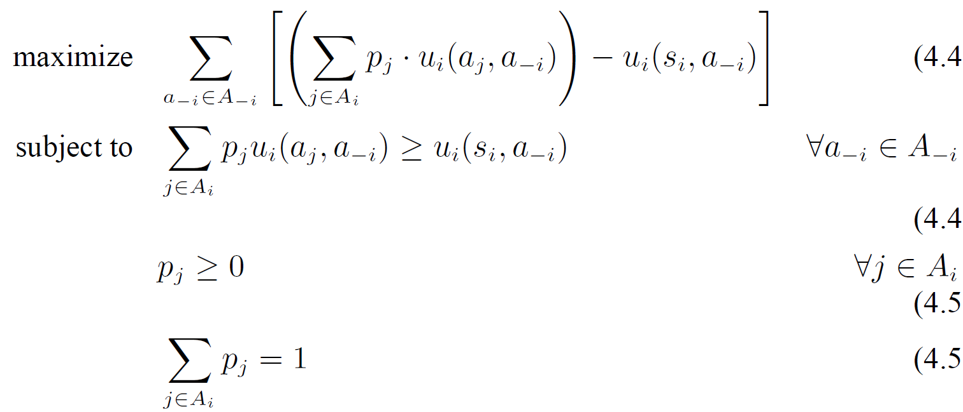
Domination by a mixed strategy
How to identify if strategy s_{i} is weakly dominated by a mixed strategy?
any feasible solution will have a non-negative objective value

Slide 27
Domination by a mixed strategy
If the optimal solution > 0 (not ≥), the mixed strategy given by the p_{j} ’s achieves strictly positive expected utility for at least one a_{−i} ∈ A_{−i}, meaning that s_{i} is weakly dominated by this mixed strategy

Slide 28
Iterated dominance
For all three flavors of domination, it requires only polynomial time to iteratively remove dominated strategies until the game has been maximally reduced
A single step of this process consists of checking whether every pure strategy of every player is dominated by any other mixed strategy, which requires us to solve at worst Σ_{i∈N}|A_{i}| linear programs
Each step removes one pure strategy for one player, so there can be at most Σ_{i∈N}(|A_{i}|-1) steps

Slide 29
Iterated dominance
Some forms of dominance can produce different reduced games
Some computational questions
(Strategy elimination) Does there exist some elimination path under which the strategy s_{i} is eliminated?
(Reduction identity) Given action subsets A_{i}′ ⊆ A_{i} for each player i, does there exist a maximally reduced game where each player i has the actions A_{i}′?
(Reduction size) Given constants k_{i} for each player i, does there exist a maximally reduced game where each player i has exactly k_{i} actions?

Slide 30
Iterated dominance
Theorem
(i) For iterated strict dominance, the strategy elimination, reduction identity, uniqueness and reduction size problems are in P. (ii) For iterated weak dominance, these problems are NP-complete
(i) it follows from the fact that iterated strict dominance always arrives at the same set of strategies regardless of elimination order
(ii) Gilboa et al. [1989] and Conitzer and Sandholm [2005]

Slide 31
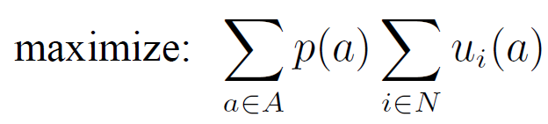
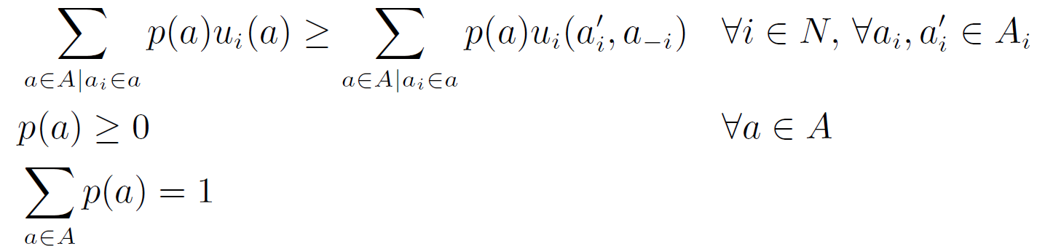
Computing Correlated Equilibria
probability of suggesting strategy profile a

Slide 32
Computing Correlated Equilibria

Slide 33
Computing Correlated Equilibria
max [6p(D,D) + 6p(D,H) + 6p(H,D) + 0p(H,H)]
s.t.
p(D,D)(3-5) + p(D,H)(1-0) ≥ 0
p(H,D)(5-3) + p(H,H)(0-1) ≥ 0
p(D,D)(3-5) + p(H,D)(1-0) ≥ 0
p(D,H)(5-3) + p(H,H)(0-1) ≥ 0
p(D,D) + p(D,H) + p(H,D) + p(H,H) = 1
p(D,D), p(D,H), p(H,D), p(H,H) ≥ 0
 | D | H
D | 3,3 | 1,5
H | 5,1 | 0,0

Slide 34
Computing Correlated Equilibria
max [6p(D,D) + 6p(D,H) + 6p(H,D)]
s.t.
-2 p(D,D) + p(D,H) ≥ 0
2 p(H,D) - p(H,H) ≥ 0
-2 p(D,D) + p(H,D) ≥ 0
2 p(D,H) - p(H,H) ≥ 0
p(D,D) + p(D,H) + p(H,D) + p(H,H) = 1
p(D,D), p(D,H), p(H,D), p(H,H) ≥ 0
 | D | H
D | 3,3 | 1,5
H | 5,1 | 0,0

Slide 35
Computing Correlated Equilibria
min -[6p(D,D) + 6p(D,H) + 6p(H,D)]
s.t.
2 p(D,D) - p(D,H) ≤ 0
-2 p(H,D) + p(H,H) ≤ 0
2 p(D,D) - p(H,D) ≤ 0
-2 p(D,H) + p(H,H) ≤ 0
p(D,D) + p(D,H) + p(H,D) + p(H,H) = 1
p(D,D), p(D,H), p(H,D), p(H,H) ≥ 0
 | D | H
D | 3,3 | 1,5
H | 5,1 | 0,0

Slide 36
Computing Correlated Equilibria
Matlab code:
f = [-6 -6 -6 0];
A = [ 2 -1 0 0 ;0 0 -2 1 ; 2 0 -1 0 ; 0 -2 0 1 ];
b = [0 0 0 0];
Aeq = [1 1 1 1];
beq = 1;
lb = [0 0 0 0];
z = linprog(f,A,b,Aeq,beq,lb)
z =
0.1220
0.4390
0.4390
0.0000
 | D | H
D | 3,3 | 1,5
H | 5,1 | 0,0
min -[6p(D,D) + 6p(D,H) + 6p(H,D)]
s.t.
2 p(D,D) - p(D,H) ≤ 0
-2 p(H,D) + p(H,H) ≤ 0
2 p(D,D) - p(H,D) ≤ 0
-2 p(D,H) + p(H,H) ≤ 0
p(D,D) + p(D,H) + p(H,D) + p(H,H) = 1
p(D,D), p(D,H), p(H,D), p(H,H) ≥ 0

Slide 37
Computing Correlated Equilibria
Theorem
The following problems are in the complexity class P when applied to correlated equilibria: uniqueness, Pareto optimal, guaranteed payoff, subset inclusion, and subset containment

Slide 38
Computing Correlated Equilibria
Problem:
Interpersonal comparison of utility
Depends upon the ability to aggregate, or sum up, individual preferences into a combined social welfare function
In the previous example, if you make cell (H,D) = (1000, 1), the correlated equilibrium will give probability 1 to this state

Slide 39
Computing Correlated Equilibria
Python code:
f = [-6, -7, -6, 0]
A = [[2, -1, 0, 0] , [0, 0, -2, 1], [3, 0, -1, 0 ], [0, -3, 0, 1 ]]
b = [0, 0, 0, 0]
Aeq = [[1, 1, 1, 1]]
beq = [1]
x0_bounds = (0, None)
x1_bounds = (0, None)
x2_bounds = (0, None)
x3_bounds = (0, None)
res = linprog(f, A_ub=A, b_ub=b, bounds=(x0_bounds, x1_bounds,
x2_bounds, x3_bounds), A_eq=Aeq, b_eq=beq)
x: array([0., 1., 0., 0.])
fun: -7.0
 | D | H
D | 3,3 | 1,6
H | 5,1 | 0,0
min -[6p(D,D) + 7p(D,H) + 6p(H,D)]
s.t.
2 p(D,D) - p(D,H) ≤ 0
-2 p(H,D) + p(H,H) ≤ 0
3 p(D,D) - p(H,D) ≤ 0
-3 p(D,H) + p(H,H) ≤ 0
p(D,D) + p(D,H) + p(H,D) + p(H,H) = 1
p(D,D), p(D,H), p(H,D), p(H,H) ≥ 0

Slide 40
Computing Correlated Equilibria
Python code:
f = [-6, -7, -6, 0]
A = [[2, -1, 0, 0] , [0, 0, -2, 1], [3, 0, -1, 0 ], [0, -3, 0, 1 ]]
b = [0, 0, 0, 0]
Aeq = [[1, 1, 1, 1],[0, 1, -1, 0]]
beq = [1, 0]
x0_bounds = (0, None)
x1_bounds = (0, None)
x2_bounds = (0, None)
x3_bounds = (0, None)
res = linprog(f, A_ub=A, b_ub=b, bounds=(x0_bounds, x1_bounds,
x2_bounds, x3_bounds), A_eq=Aeq, b_eq=beq)
x: array([0. , 0.5, 0.5, 0. ])
fun: -6.5
 | D | H
D | 3,3 | 1,6
H | 5,1 | 0,0
min -[6p(D,D) + 7p(D,H) + 6p(H,D)]
s.t.
2 p(D,D) - p(D,H) ≤ 0
-2 p(H,D) + p(H,H) ≤ 0
3 p(D,D) - p(H,D) ≤ 0
-3 p(D,H) + p(H,H) ≤ 0
p(D,D) + p(D,H) + p(H,D) + p(H,H) = 1
p(D,D), p(D,H), p(H,D), p(H,H) ≥ 0
p(D,H) - p(H,D) = 0

Slide 41
Computing Correlated Equilibria
Q: Why can we express the definition of a correlated equilibrium as a linear constraint, while we cannot do the same with the definition of a Nash equilibrium, even though both definitions are quite similar?
A: The difference is that a correlated equilibrium involves a single randomization over action profiles, while in a Nash equilibrium agents randomize separately

Slide 42
Software
GAMBIT [McKelvey et al., 2006] (http://www.gambit-project.org/) is a library of game-theoretic algorithms for finite normal-form and extensive-form games
GAMUT [Nudelman et al., 2004] (http://gamut.stanford.edu) is a suite of game generators designed for testing game-theoretic algorithms
NASHPY [Knight. 2017] (https://nashpy.readthedocs.io/en/stable/) is a Python library used for the computation of equilibria in 2 player strategic form games.

