Slide 1
Extensive form games

Slide 2
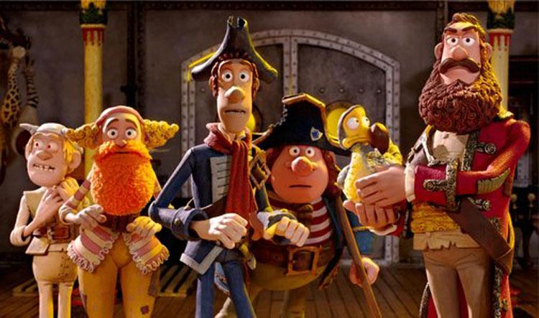
Five pirates' game

Slide 3
Five pirates' game
5 pirates found a chest containing 1000 gold coins
Instead of dividing it uniformly, they decided to play the following game
Each pirate (after a raffle) will propose a way to divide the coins
If the proposal is accepted by the majority, it will occur
If not, the pirate who made the proposal will be thrown at the sea
Each pirate wants to maximize the amount of coins he will receive
All pirates are blood thirsty, i.e., they prefer a dead pirate over an alive pirate

Slide 4
Extensive form games
The normal form game representation does not incorporate any notion of sequence, or time, of the actions of the players
The extensive form is an alternative representation that makes the temporal structure explicit
Two variants:
perfect information extensive-form games
imperfect-information extensive-form games

Slide 5
Perfect-information games in extesive form
A tree in the sense of graph theory
each node represents the choice of one of the players
each edge represents a possible action
the leaves represent final outcomes over which each player has a utility function
In certain circles (in particular, in artificial intelligence), these are known simply as game trees

Slide 6
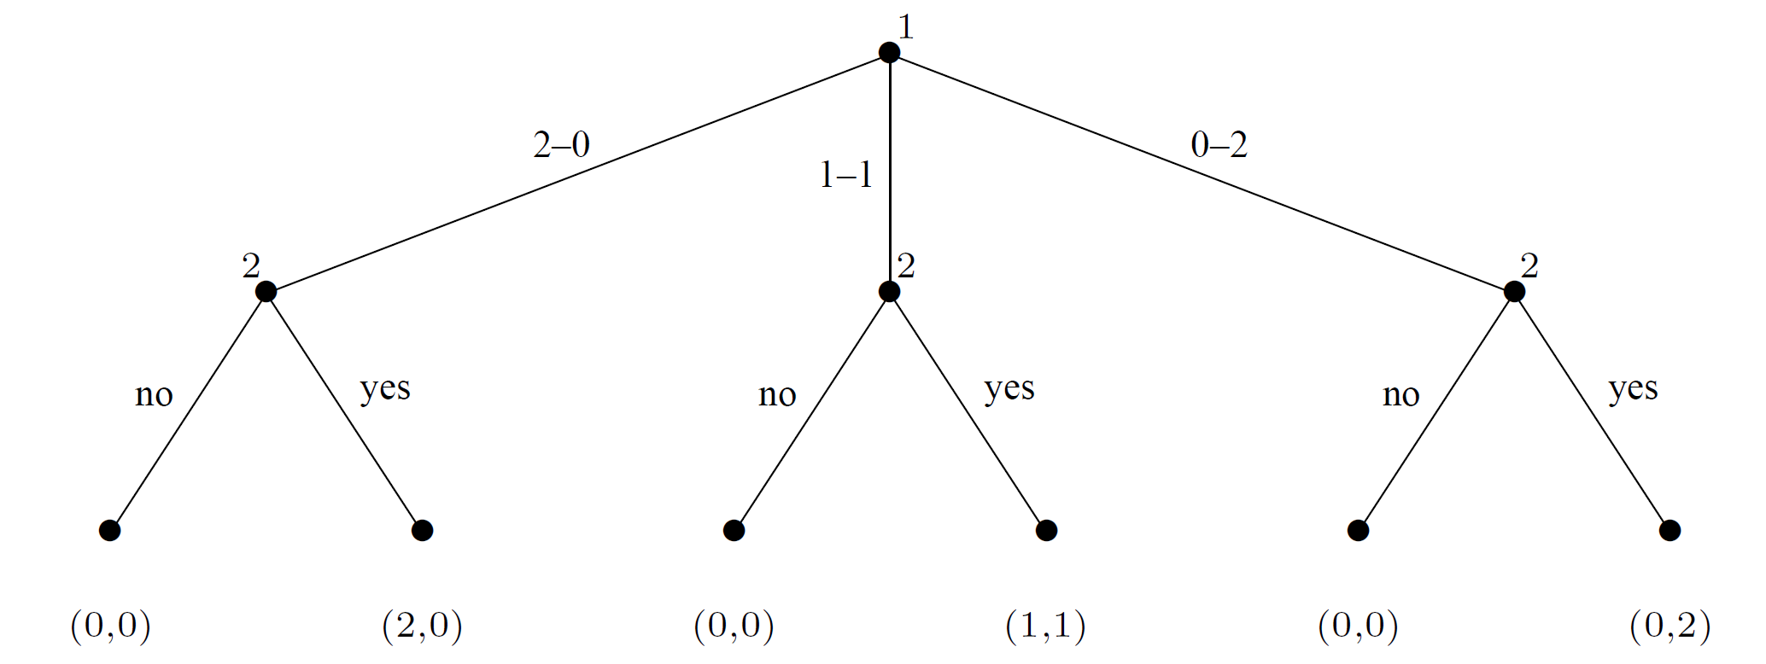
Perfect-information games in extesive form
The sharing game

Slide 7
Perfect-information games in extesive form
A (finite) perfect-information game (in extensive form) is a tuple G = (N,A,H,Z, χ, ρ, σ, u), where:
N is a set of n players
A is a (single) set of actions
H is a set of nonterminal choice nodes
Z is a set of terminal nodes, disjoint from H
χ : H → 2^{A} is the action function, which assigns to each choice node a set of possible actions

Slide 8
Perfect-information games in extesive form
A (finite) perfect-information game (in extensive form) is a tuple G = (N,A,H,Z, χ, ρ, σ, u), where:
N is a set of n players
A is a (single) set of actions
H is a set of nonterminal choice nodes
Z is a set of terminal nodes, disjoint from H
χ : H → 2^{A} is the action function
ρ : H → N is the player function, which assigns to each nonterminal node a player i ∈ N who chooses an action at that node

Slide 9
Perfect-information games in extesive form
A (finite) perfect-information game (in extensive form) is a tuple G = (N,A,H,Z, χ, ρ, σ, u), where:
N is a set of n players
A is a (single) set of actions
H is a set of nonterminal choice nodes
Z is a set of terminal nodes, disjoint from H
χ : H → 2^{A} is the action function
ρ : H → N is the player function
σ : H × A → H ∪ Z is the successor function, which maps a choice node and an action to a new choice node or terminal node such that for all h₁, h₂ ∈ H and a₁, a₂ ∈ A, if σ(h₁, a₁) = σ(h₂, a₂) then h₁ = h₂ and a₁ = a₂

Slide 10
Perfect-information games in extesive form
A (finite) perfect-information game (in extensive form) is a tuple G = (N,A,H,Z, χ, ρ, σ, u), where:
N is a set of n players
A is a (single) set of actions
H is a set of nonterminal choice nodes
Z is a set of terminal nodes, disjoint from H
χ : H → 2^{A} is the action function
ρ : H → N is the player function
σ : H × A → H ∪ Z is the successor function
u = (u₁, . . . , u_{n}), where u_{i} : Z → ℝ is a real-valued utility function for player i on the terminal nodes Z

Slide 11
Perfect-information games in extesive form
The sharing game
N = {1,2}, A₁ = {2-0, 1-1, 0-2}, A₂ = {no, yes}
σ(h₂,no) = z₁
σ(h₂,yes) = z₂
χ(h₂) = {no, yes}
H
ρ(h₂) = 2
h₂
z₁
z₂
Z
u₁(z₂) = 2 u₂(z₂) = 0

Slide 12
Perfect-information games in extesive form
Since the choice nodes form a tree, we can unambiguously identify a node with its history
We can also define the descendants of a node h, namely all the choice and terminal nodes in the subtree rooted at h

Slide 13
Perfect-information games in extesive form
What is the set of pure strategies?
A complete specification of which deterministic action to take at every node belonging to that player

Slide 14
Perfect-information games in extesive form
Pure strategies
Let G = (N,A,H,Z, χ, ρ, σ, u) be a perfect-information extensive-form game
Then the pure strategies of player i consist of the Cartesian product:
∏_{h∈ H, ρ(h)=i} χ(h)

Slide 15
Perfect-information games in extesive form
Notice that the definition contains a subtlety
An agent’s strategy requires a decision at each choice node, regardless of whether or not it is reacheable

Slide 16
Perfect-information games in extesive form
S₁ = {2–0, 1–1, 0–2}
S₂ = {(yes, yes, yes), (yes, yes, no), (yes, no, yes), (yes, no, no), (no, yes, yes), (no, yes, no), (no, no, yes), (no, no, no)}

Slide 17
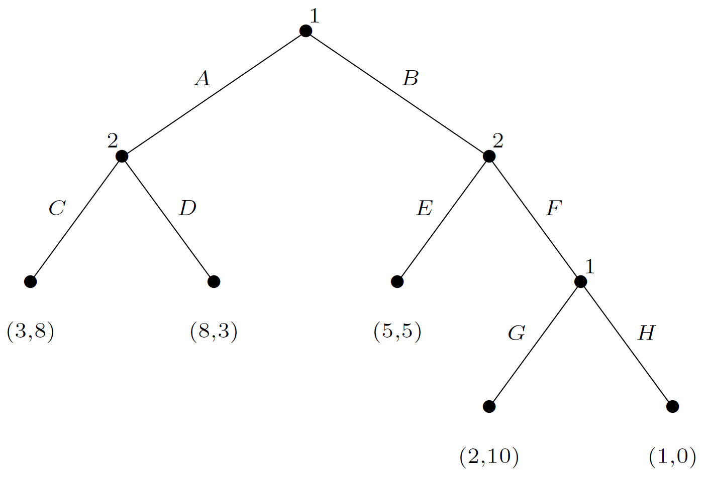
Perfect-information games in extesive form
In order to define a complete strategy for this game, each of the players must choose an action at each of his two choice nodes
S₁ = {(A,G), (A,H), (B,G), (B,H)}
S₂ = {(C,E), (C, F), (D,E), (D, F)}

Slide 18
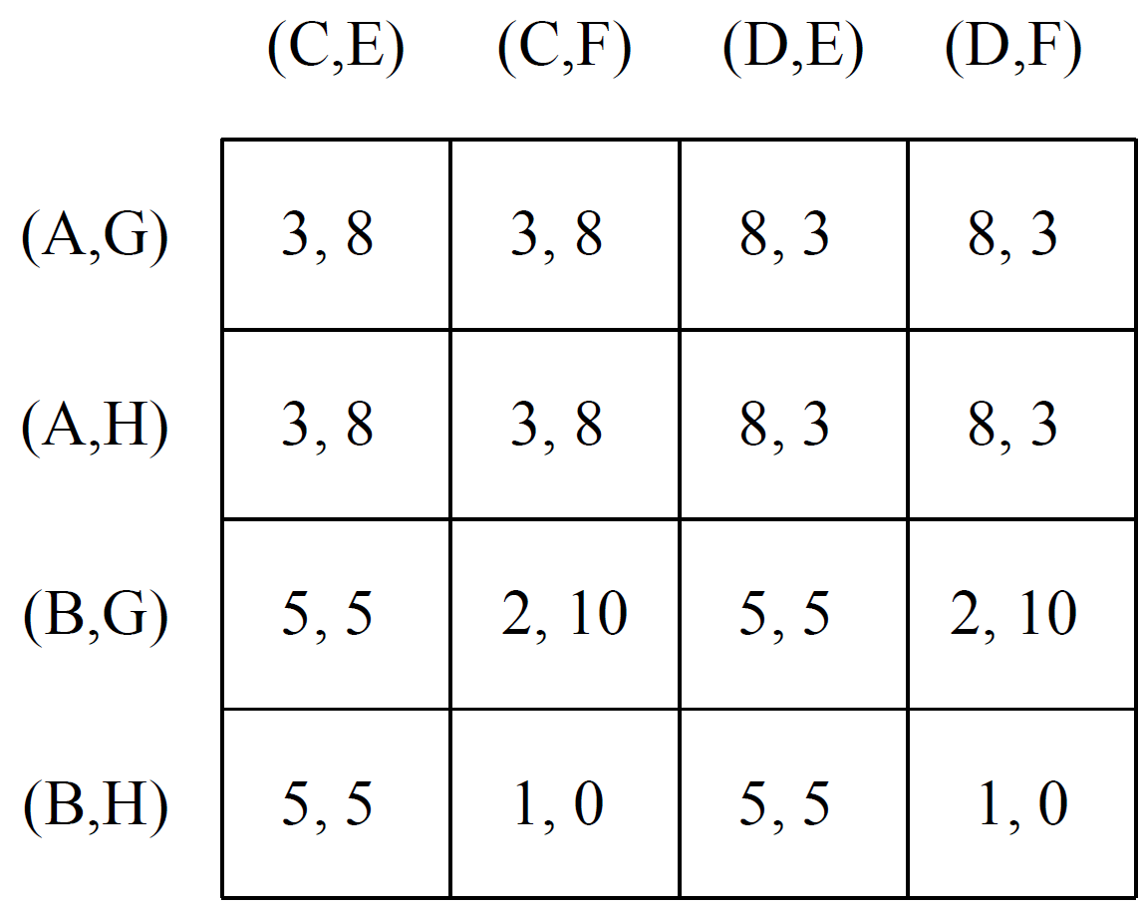
Perfect-information games in extesive form
For every perfect-information game there exists a corresponding normal-form game

Slide 19
Perfect-information games in extesive form
Given our new denition of pure strategy, we are able to reuse our old denitions of:
mixed strategies
best response
Nash equilibrium

Slide 20
Perfect-information games in extesive form
The temporal structure can result in a certain redundancy within the normal form
different # of outcomes: 5 vs. 16

Slide 21
Perfect-information games in extesive form
General lesson
While a transformation can always be performed, it can result in an exponential blowup of the game representation
This is an important lesson, since the didactic examples of normal-form games are very small, wrongly suggesting that this form is more compact

Slide 22
Perfect-information games in extesive form
Can we transform a normal form game into a extensive form game?
Not always
e.g.: Battle of the Sexes
Intuitively, the problem is that perfect-information extensive form games cannot model simultaneity
The general characterization of the class of normal-form games for which there exist corresponding perfect-information games in extensive form is somewhat complex

Slide 23
Perfect-information games in extesive form
Theorem
Every (finite) perfect-information game in extensive form has a pure-strategy Nash equilibrium

Slide 24
Perfect-information games in extesive form
This is perhaps the earliest result in game theory, due to Zermelo in 1913
Intuition: since players take turns, and history is available to everyone, it is never necessary to introduce randomness into action selection in order to find an equilibrium
Both this intuition and the theorem will cease to hold when we discuss more general classes of games such as imperfect-information games in extensive form

Slide 25
Sub-game perfect equilibrium
What are the NE of this game?

Slide 26
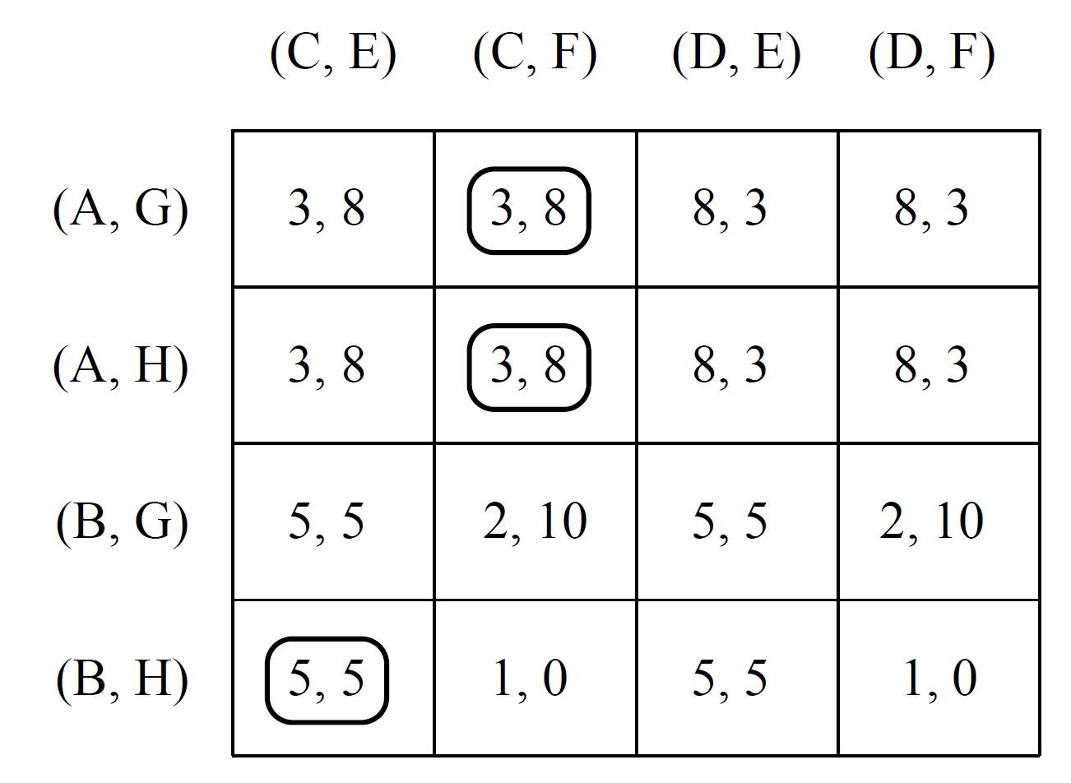
Sub-game perfect equilibrium
What are the NE of this game?

Slide 27
Sub-game perfect equilibrium
What are the NE of this game?

Slide 28
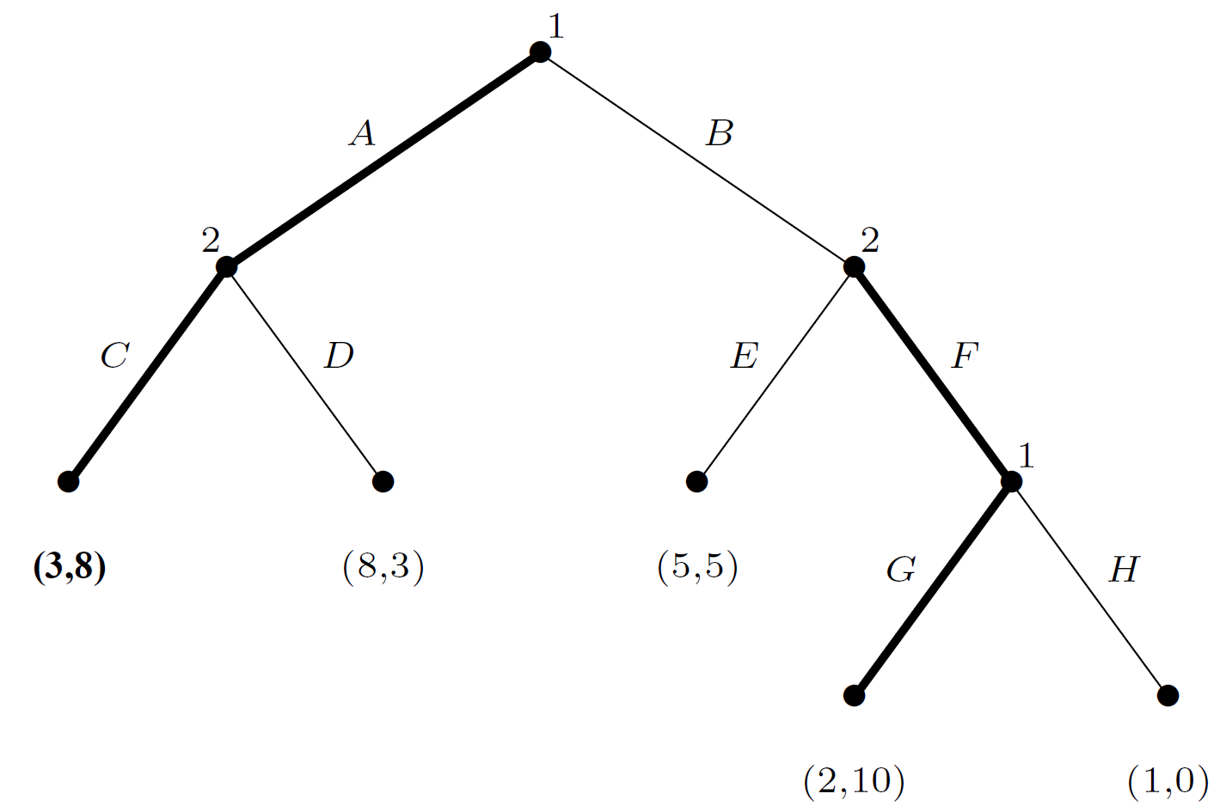
Sub-game perfect equilibrium
What are the NE of this game?
{(A,G), (C,F)}

Slide 29
Sub-game perfect equilibrium
What are the NE of this game?
{(A,G), (C,F)}
If player 2 played (C,E) rather than (C, F), then player 1 would prefer B
as it is, player 1 gets a payoff of 3 by playing A rather than a payoff of 2 by playing B

Slide 30
Sub-game perfect equilibrium
What are the NE of this game?

Slide 31
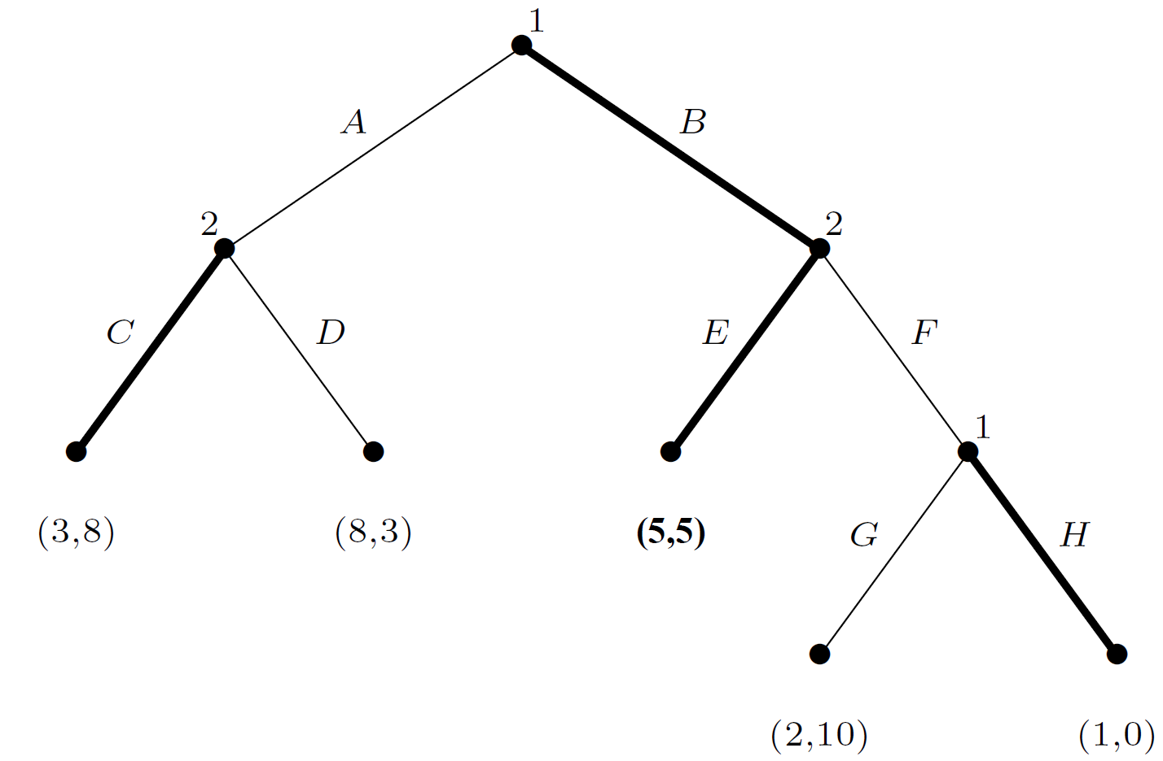
Sub-game perfect equilibrium
What are the NE of this game?
{(B,H), (C,E)}

Slide 32
Sub-game perfect equilibrium
What are the NE of this game?
{(B,H), (C,E)}
{(B,G), (C,E)} is not an equilibrium
the only reason that player 2 chooses to play the action E is that he knows that player 1 would play H at his second decision node (threat)

Slide 33
Sub-game perfect equilibrium
What are the NE of this game?
{(B,H), (C,E)}
If player 2 played F, would player 1 really follow through on his threat and play H, or would he relent and pick G instead?

Slide 34
Sub-game perfect equilibrium
To formally capture the reason why the {(B,H), (C,E)} equilibrium is unsatisfying, and
to define an equilibrium refinement concept that does not suffer from this problem:
Definition
Given a perfect-information extensive-form game G, the subgame of G rooted at node h is the restriction of G to the descendants of h
The set of subgames of G consists of all of subgames of G rooted at some node in G

Slide 35
Sub-game perfect equilibrium
Definition
The subgame-perfect equilibrium (SPE) of a game G are all strategy profiles s such that for any subgame G′ of G, the restriction of s to G′ is a Nash equilibrium of G′
Since G is its own subgame, every SPE is also a Nash equilibrium
SPE is a stronger concept than Nash equilibrium
every SPE is a NE, but not every NE is a SPE
Every perfect-information extensive-form game has at least one SPE
This definition rules out “noncredible threats”

Slide 36
Sub-game perfect equilibrium
What are the SPE?
It is not credible that player 1 will play H

Slide 37
Computing equilibria: backward induction
Inherent in the concept of SPE is the principle of backward induction
One identifies the equilibria in the “bottom-most” subgame trees, and assumes that those equilibria will be played as one backs up and considers increasingly larger trees
We can use this procedure to compute a sample Nash equilibrium
This is good news: not only are we guaranteed to find a SPE, but also this procedure is computationally simple

Slide 38
Computing equilibria: backward induction
It can be implemented as a single depth-first traversal of the game tree and thus requires time linear in the size of the game representation
Recall in contrast that the best known methods for finding Nash equilibria of general games require time exponential in the size of the normal form
The induced normal form of an extensive-form game is exponentially larger than the original representation

Slide 39
Computing equilibria: backward induction

Slide 40
Computing equilibria: backward induction
G: (2,10)

Slide 41
Computing equilibria: backward induction
C: (3,8)
G: (2,10)

Slide 42
Computing equilibria: backward induction
C: (3,8)
F,G: (2,10)

Slide 43
Computing equilibria: backward induction
A,C: (3,8)

Slide 44
Five pirates' game
0
0
0
0
0
1
2
3
4
5

Slide 45
Five pirates' game
0
0
0
0
0
1
2
3
4
5

Slide 46
Five pirates' game
0
0
0
0
?
0
1
2
3
4
5

Slide 47

Five pirates' game
0
0
0
-1
1001
1
2
3
4
5

Slide 48
Five pirates' game
0
0
0
-1
1001
1
2
3
4
5
?

Slide 49

Five pirates' game
0
0
1000
0
0
1
2
3
4
5

Slide 50
Five pirates' game
0
0
1000
0
0
1
2
3
4
5
?

Slide 51
Five pirates' game
0
998
0
1
1
1
2
3
4
5

Slide 52
Five pirates' game
0
998
0
1
1
1
2
3
4
5
?

Slide 53
Five pirates' game
997
0
1
2
0
1
2
3
4
5

Slide 54
Ultimatum game
Split $10 between you and your partner
If your partner accepts the split, done
If your partner rejects, both gets $0
Oosterbeek, H., Sloof, R., & Van De Kuilen, G. (2004). Cultural differences in ultimatum game experiments: Evidence from a meta-analysis. Experimental economics, 7(2), 171-188.

Slide 55
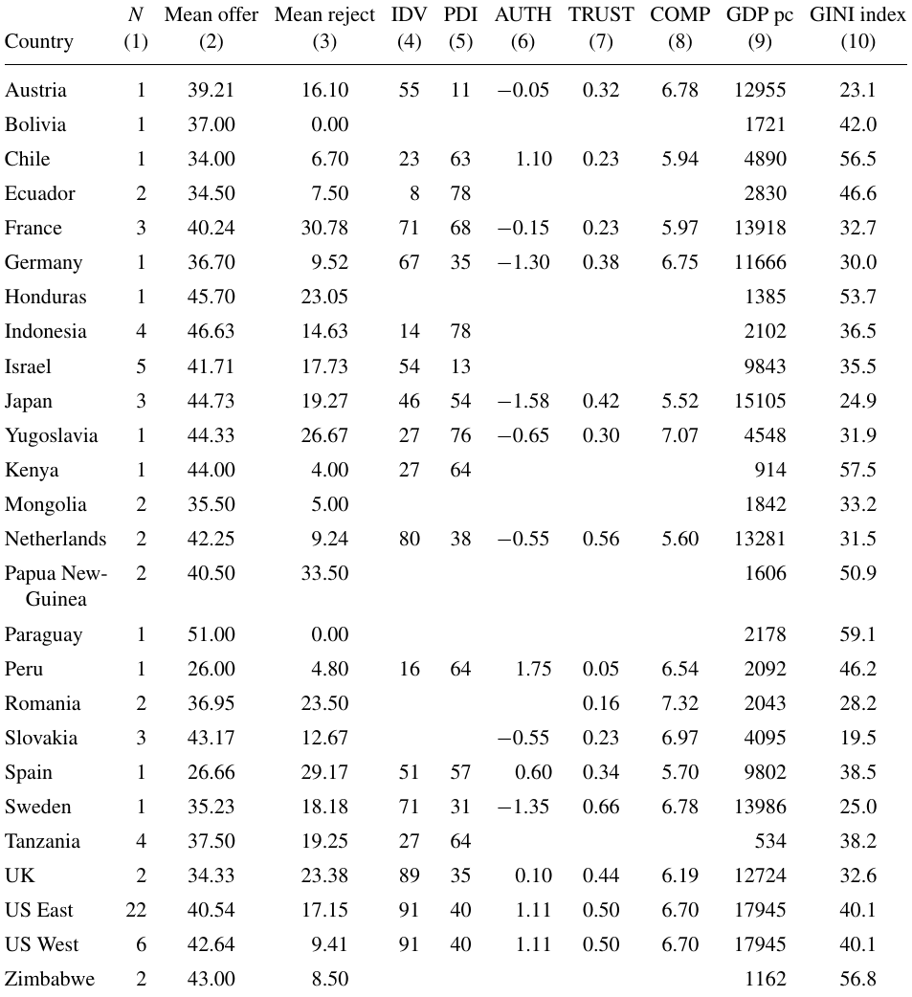

Slide 56
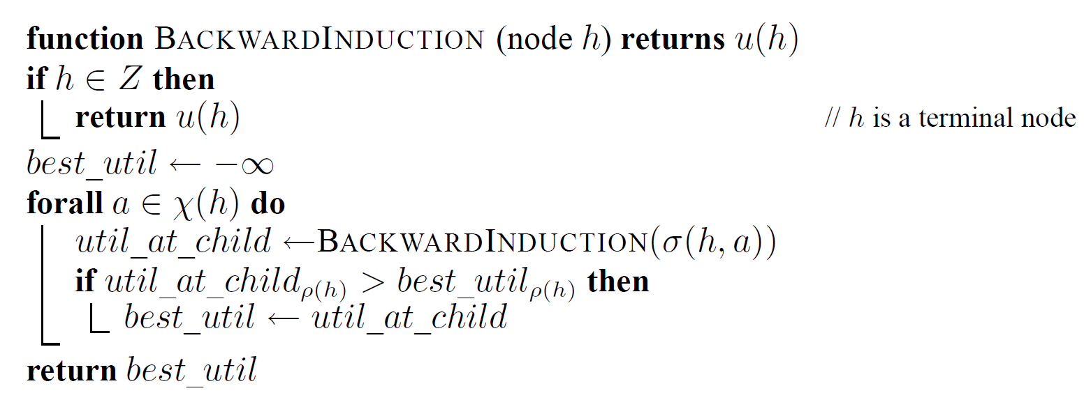
Computing equilibria: backward induction
for each available action a at non-terminal node h

Slide 57
Computing equilibria: backward induction
recursively fetch the utility for player ρ(h) at child node σ(h,a)

Slide 58
Computing equilibria: backward induction
returns the highest possible utility for player ρ(h) at node h

Slide 60
Computing equilibria: backward induction
Demonstrates that in principle a sample SPE is effectively computable
However, in practice many game trees are not enumerated in advance and are hence unavailable for backward induction
For example, the extensive-form representation of chess has around 10¹⁵⁰ nodes, which is vastly too large to represent explicitly

Slide 61
Computing equilibria: backward induction
For such games it is more common to discuss
the size of the game tree in terms of the average branching factor b (the average number of actions which are possible at each node)
a maximum depth m (the maximum number of sequential actions)
A procedure which requires time linear in the size of the representation thus expands O(b^{m}) nodes
Unfortunately, we can do no better than this on arbitrary perfect-information games

Slide 62
Two-player, zero-sum games: minimax and alpha-beta pruning
BACKWARDINDUCTION has another name in the two-player, zero-sum context: the minimax algorithm
In such games, only a single payoff number is required to characterize any outcome
Player 1 wants to maximize this number, while player 2 wants to minimize it
Propagates these single payoff numbers from the leaves up to the root

Slide 63
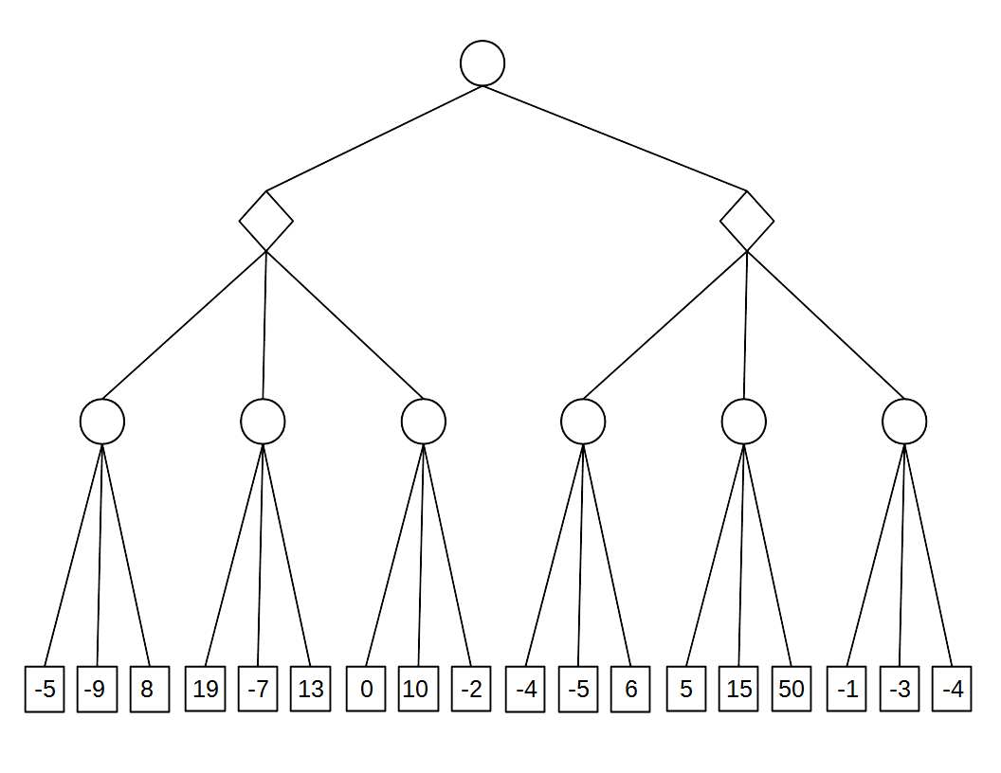

Slide 64
Two-player, zero-sum games: minimax and alpha-beta pruning
Each decision node for player 1 is labeled with the maximum of the labels of its child nodes
Each decision node for player 2 is labeled with the minimum of that node’s children’s labels
The label on the root node is the value of the game
player 1’s payoff in equilibrium

Slide 65
Two-player, zero-sum games: minimax and alpha-beta pruning
How can we improve on the minimax algorithm?
The fact that player 1 and player 2 always have strictly opposing interests means that we can prune away some parts of the game tree
We can recognize that certain subtrees will never be reached in equilibrium, even without examining the nodes in these subtrees
This leads us to a new algorithm called ALPHABETAPRUNING

Slide 66
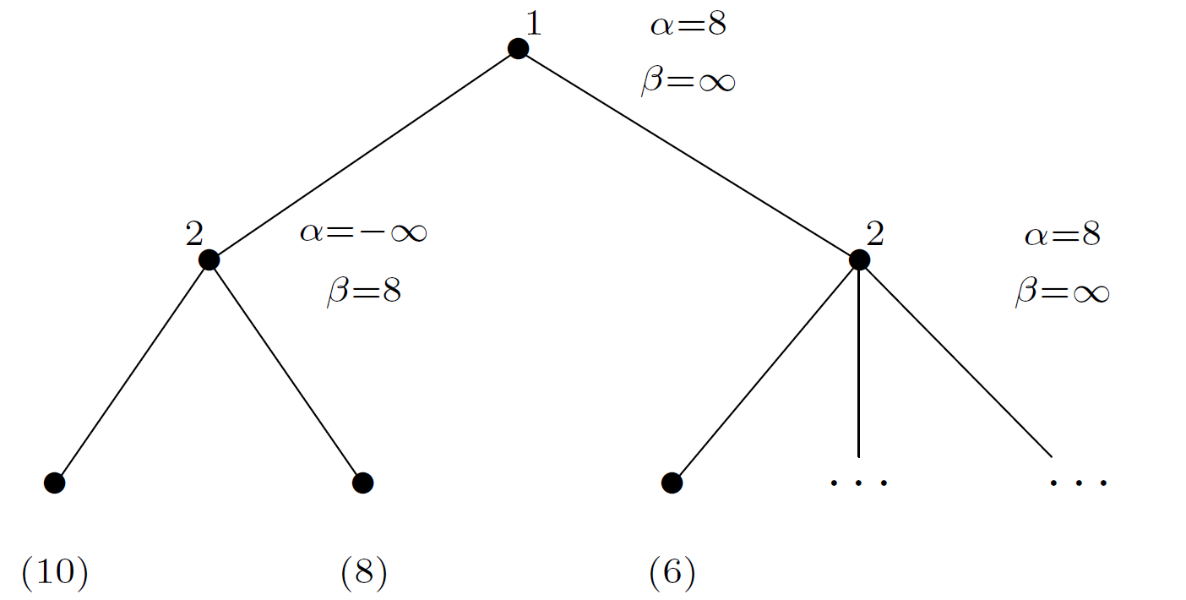
Two-player, zero-sum games: minimax and alpha-beta pruning
At each node h either α or β is updated with the value of the previously encountered node that their corresponding player (player 1 for α and player 2 for β) would most prefer to choose instead of h

Slide 67
Two-player, zero-sum games: minimax and alpha-beta pruning
At each node h either α or β is updated with the value of the previously encountered node that their corresponding player (player 1 for α and player 2 for β) would most prefer to choose instead of h

Slide 68
Two-player, zero-sum games: minimax and alpha-beta pruning
At each node h either α or β is updated with the value of the previously encountered node that their corresponding player (player 1 for α and player 2 for β) would most prefer to choose instead of h

Slide 69
Two-player, zero-sum games: minimax and alpha-beta pruning
At each node h either α or β is updated with the value of the previously encountered node that their corresponding player (player 1 for α and player 2 for β) would most prefer to choose instead of h

Slide 70
Two-player, zero-sum games: minimax and alpha-beta pruning
At each node h either α or β is updated with the value of the previously encountered node that their corresponding player (player 1 for α and player 2 for β) would most prefer to choose instead of h
best_util < α: player 1 will never go this way

Slide 71
Two-player, zero-sum games: minimax and alpha-beta pruning
At each node h either α or β is updated with the value of the previously encountered node that their corresponding player (player 1 for α and player 2 for β) would most prefer to choose instead of h
best_util < α: player 1 will never go this way

Slide 72
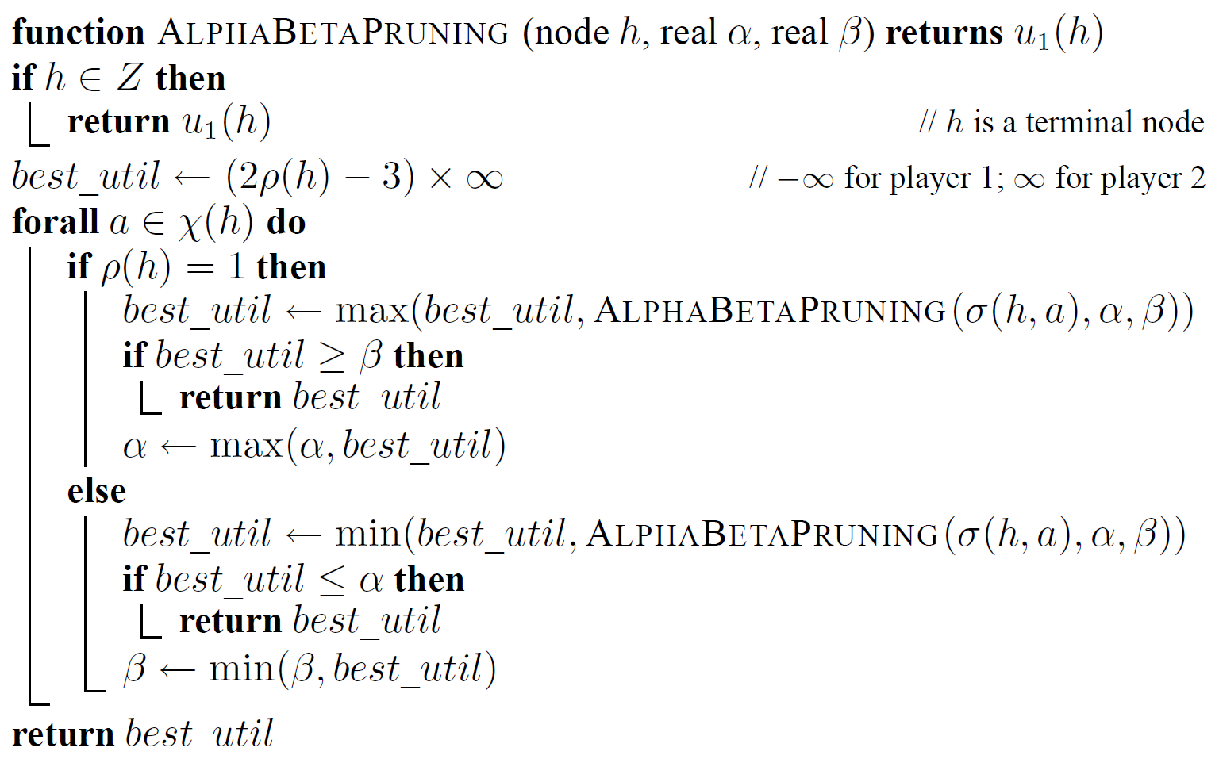
Two-player, zero-sum games: minimax and alpha-beta pruning

Slide 73
α = best already explored option along path to the root for maximizer
β = best already explored option along path to the root for minimizer

Slide 75
Two-player, zero-sum games: minimax and alpha-beta pruning
The effectiveness depends on the order in which nodes are considered
If player 1 (2) considers nodes in increasing (decreasing) order of their value, then no nodes will ever be pruned
In the best case (where nodes are ordered in decreasing (increasing) value for player 1 (2), it has complexity of O(b^{m/2})
If nodes are examined in random order, then the analysis becomes more complicated
when b is fairly small, the complexity of alpha-beta pruning is O(b^{3m/4}), which is still an exponential improvement

Slide 76
Two-player, zero-sum games: minimax and alpha-beta pruning
In practice, performance is between the best case and the random case
Offers substantial practical benefit in two-player, zero-sum games for which the game tree is represented implicitly

Slide 77
Two-player, zero-sum games: minimax and alpha-beta pruning
Commonly used to build strong computer players for two-player board games such as chess
The game tree in practical games can be so large that it is infeasible to search all the way down to leaf nodes
Instead, the search proceeds to some shallower depth
Where do we get the node values to propagate up using backward induction?

Slide 78
Two-player, zero-sum games: minimax and alpha-beta pruning
The trick is to use an evaluation function to estimate the value of the deepest evaluation node reached
taking into function account game-relevant features such as board position, number of pieces for each player, who gets to move next, etc., and either built by hand or learned)

Slide 79
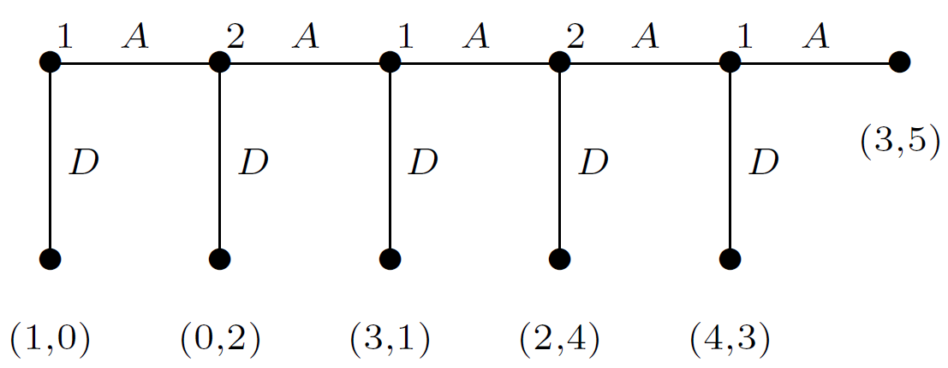
Centipede game

Slide 80
Centipede game
What backward induction says about this game?

Slide 81
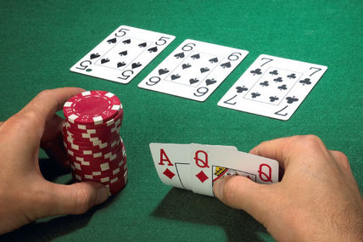
Imperfect Information Games
In many situations we may want to model agents
needing to act with partial or no knowledge of the actions taken by others
or even agents with limited memory of their own past actions

Slide 82
Imperfect Information Games
Each player’s choice nodes are partitioned into information sets I_{i} = {I_{i,1}, ... , I_{i,ki}}
Intuitively, if two choice nodes are in the same information set then the agent cannot distinguish between them
I have to decide
without knowing which
cards my
opponents have

Slide 83
Perfect-information games in extesive form
The sharing game
N = {1,2}, A₁ = {2-0, 1-1, 0-2}, A₁ = {no, yes}
σ(h₂,no) = z₁
σ(h₂,yes) = z₂
χ(h₂) = {no, yes}
H
ρ(h₂) = 2
h₂
z₁
z₂
Z
u₁(z₂) = 2 u₂(z₂) = 0

Slide 84
Imperfect Information Games
An imperfect-information game (in extensive form) is a tuple (N, A, H, Z, χ, ρ, σ, u, I), where:
(N, A, H, Z, χ, ρ, σ, u) is a perfect-information extensive-form game; and
I = (I₁, . . . , I_{n}),
where I_{i} = (I_{i,1}, . . . , I_{i,ki} ) is a set of equivalence classes on (i.e., a partition of) {h ∈ H : ρ(h) = i}
with the property that χ(h) = χ(h′) and ρ(h) = ρ(h′) whenever there exists a j for which h ∈ I_{i,j} and h′ ∈ I_{i,j}

Slide 85
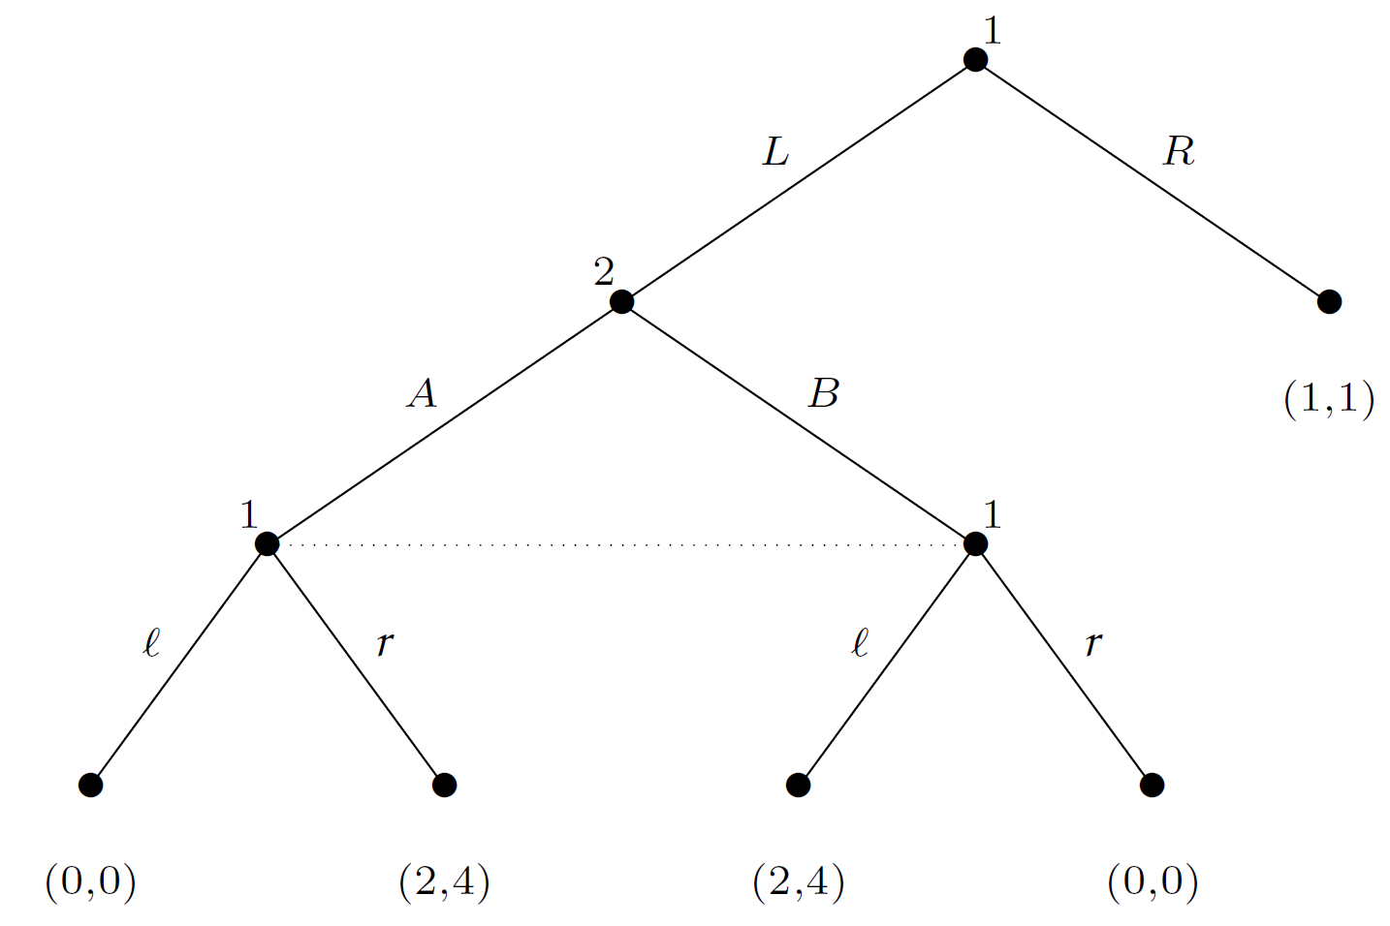
Imperfect Information Games
χ(h) = χ(h′) and ρ(h) = ρ(h′) whenever there exists a j for which h ∈ I_{i,j} and h′ ∈ I_{i,j}
h₁
I_{1,1} = {h₁}
χ(I_{1,2})= {l, r}
h₃
I_{1,2} = {h₃, h₄}
h₄

Slide 86
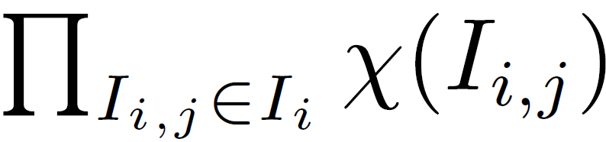
Strategies and Equilibria
Let G = (N, A, H, Z, χ, ρ, σ, u, I) be an imperfect-information extensive-form game
Then the pure strategies of player i consist of the Cartesian product
Perfect-information games is a imperfect-information game that every equivalence class of each partition is a singleton

Slide 87
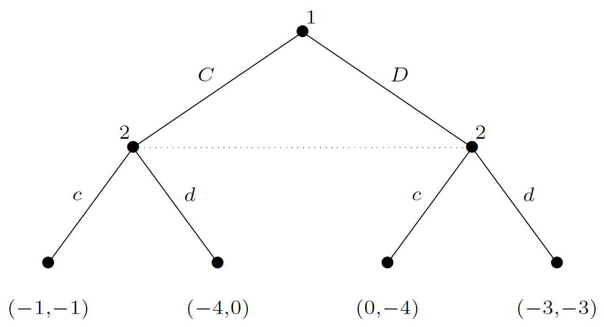
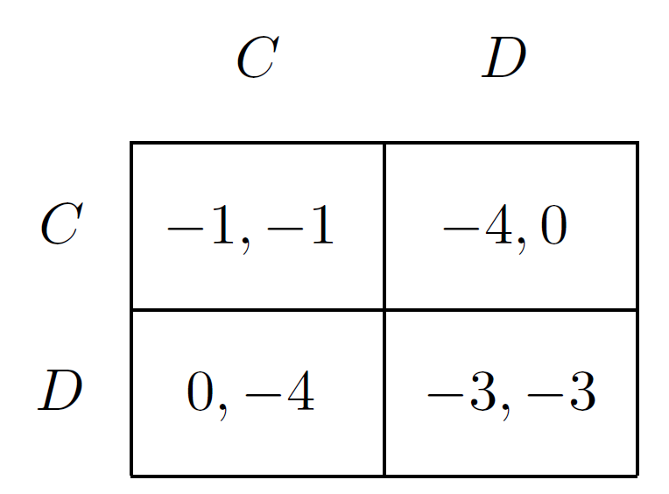
Strategies and Equilibria
Prisoner's Dilemma
Any normal-form game can be trivially transformed into an equivalent imperfect-information game

Slide 88
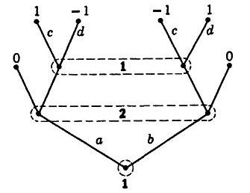
Strategies and Equilibria
Let's think about this game...
What player 2 knows about player 1 action at the root node?
?

Slide 89
Strategies and Equilibria
Let's think about this game...
What player 1 knows about player 2 action?
?

Slide 90
Strategies and Equilibria
Let's think about this game...
What player 1 knows about his previous action?
?

Slide 91
Behavioral Strategies
Independent coin toss every time an information set is encountered
A vector of probability distributions over the information sets
in some games there are outcomes that are achieved via mixed strategies but not by any behavioral strategies, and vice-versa

Slide 92
Behavioral Strategies
A behavioral strategy of player i ∈ N is a map b_{i} assigning to each information set I_{i,j} ∈ I_{i} a probability distribution over the set of actions χ(I_{i,j} )

Slide 93
Strategies and Equilibria
Which mixed strategy profile gives the best payoff for player 1 for a given s₂= “always continue”
s₁': ¼ (a,c), ¼ (a,d), ¼ (b,c), ¼ (b,d)
s₁'': ½ (a,c), 0 (a,d), 0 (b,c), ½ (b,d)

Slide 94
Strategies and Equilibria
What is the equivalent behavioral strategy for s₁' ?
s₁': ¼ (a,c), ¼ (a,d), ¼ (b,c), ¼ (b,d)
b_{1,2} = (½, ½)
b_{1,1} = (½, ½)

Slide 95
Strategies and Equilibria
What is the equivalent behavioral strategy for s₁'' ?
s₁'': ½ (a,c), 0 (a,d), 0 (b,c), ½ (b,d)
b_{1,2} = (½, ½)
b_{1,1} = (½, ½)

Slide 96
Strategies and Equilibria
What are the expected payoffs of these strategies?
s₁': ¼ (a,c), ¼ (a,d), ¼ (b,c), ¼ (b,d)
u₁(b) = (½ * ½ * 1) + (½ * ½ * -1) + (½ * ½ * -1) + (½ * ½ * 1) = 0
u₁(s₁', s₂) = (¼ * 1) + (¼ * -1) + (¼ * -1) + (¼ * 1) = 0
b_{1,2} = (½, ½)
b_{1,1} = (½, ½)

Slide 97
Strategies and Equilibria
What are the expected payoffs of these strategies?
s₁'': ½ (a,c), 0 (a,d), 0 (b,c), ½ (b,d)
u₁(b) = (½ * ½ * 1) + (½ * ½ * -1) + (½ * ½ * -1) + (½ * ½ * 1) = 0
u₁(s₁'', s₂) = (½ * 1) + (½ * 1) = 1
b_{1,2} = (½ , ½)
can't be correlated!
b_{1,1} = (½ , ½)

Slide 98
Perfect Recall
Games in which no player forgets any information they knew about moves made so far
in particular, they remember precisely all their own moves

Slide 99
Perfect Recall #1
Player i has perfect recall in an imperfect-information game G if for any two nodes h, h′ that are in the same information set for player i,
for any path h₀, a₀, h₁, a₁, . . . , h_{m}, a_{m}, h from the root of the game to h and for any path h₀', a₀', h₁', a₁', . . . , h_{m'}', a_{m'}', h' from the root to h′ it must be the case that:
m = m′
for all 0 ≤ j ≤ m, if ρ(h_{j}) = i, then h_{j} and h_{j}′ are in the same equivalence class for i
for all 0 ≤ j ≤ m, if ρ(h_{j}) = i, then a_{j} = a_{j}′
G is a game of perfect recall if every player has perfect recall in it

Slide 100
Perfect Recall #2
An information set I_{i,j} with a given branch (action) r is a signaling information set if there is a later information set I_{i,k} such that:
There is at least one node of I_{i,k} that can be reached by a path starting with r
There is at least one node of I_{i,k} that cannot be reached by any path starting with r
A game is said to have perfect recall if there are no signaling information sets

Slide 101
Strategies and Equilibria
Does not have perfect recall
1 cannot remember from where he came from
?

Slide 102
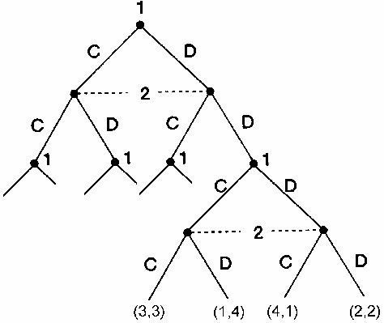
Strategies and Equilibria
Does have perfect recall

Slide 103
Perfect Recall
Theorem 5.2.4 (Kuhn, 1953)
In a game of perfect recall, any mixed strategy of a given agent can be replaced by an equivalent behavioral strategy, and vice-versa
These two strategies yield the same probabilities on the set of outcomes

Slide 104
Perfect Recall
Theorem 5.2.4 (Kuhn, 1953)
Q: What does it mean?
A: This result means that for such games it does not matter to the players whether they take the global view of mixed strategies or the more restricted (and plausible) view of behavioral strategies

Slide 105
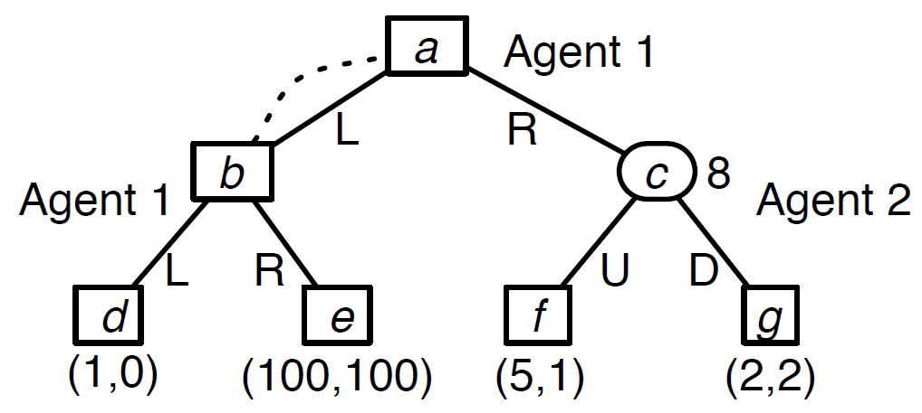
Strategies and Equilibria
Q: What is the equilibrium using mixed strategies?
D is a strictly best response for 2
R is a strictly best response for 1
A: (R,D)
1 arrives here, but does not know that!

Slide 106
Behavioral Strategies
What is an equilibrium in behavioral strategies?
Again, D strongly dominant for 2
If 1 uses the behavioural strategy (p; 1 - p), his expected utility is
1 * p² + 100 * p(1 - p) + 2 * (1 - p)
It simplifies to -99p² + 98p + 2
Its maximum is at p = 98/198
Thus equilibrium is (98/198; 100/198); (0, 1)

Slide 107
Computing equilibria: the sequence form
An obvious way to find an equilibrium of an extensive-form game is to first convert it into a normal-form game, and then find the equilibria using, for example, the Lemke–Howson algorithm
This method is inefficient, since the number of actions in the normal-form game is exponential in the size of the extensive-form game
The normal-form game is created by considering all combinations of information set actions

Slide 108
Computing equilibria: the sequence form
One way to avoid this problem is to operate directly on the extensive-form representation by employing behavioral strategies to express a game
using a description called the sequence form

Slide 109
Computing equilibria: the sequence form
Let G be an imperfect-information game of perfect recall
The sequence-form representation of G is a tuple (N, Σ, g, C), where
N is a set of agents
Σ = (Σ₁, Σ₂, . . . , Σ_{n}), where Σ_{i} is the set of sequences available to agent i
g = (g₁, . . . , g_{n}), where g_{i} : Σ → ℝ is the payoff function for agent i
C = (C₁, . . . ,C_{n}), where C_{i} is a set of linear constraints on the realization probabilities of agent i

Slide 110
Computing equilibria: the sequence form
What is a sequence σ ∈ Σ_{i}?
Insight: while there are exponentially many pure strategies in an extensive-form game, there are only a small number of nodes in the game tree
Does not build a player’s strategy around the idea of pure strategies
The sequence form builds it around paths in the tree from the root to each node

Slide 111
Computing equilibria: the sequence form
A sequence of actions of player i ∈ N, defined by a node h ∈ H ∪ Z of the game tree, is the ordered set of player i’s actions that lie on the path from the root to h
Let ∅ denote the sequence corresponding to the root node
The set of sequences of player i is denoted Σ_{i}
Σ₁ × · · · × Σ_{n} is the set of all sequences

Slide 112
Computing equilibria: the sequence form
A sequence can thus be thought of as a string listing the action choices that player i would have to take in order to get from the root to a given node h
h may or may not be a leaf node
The other players’ actions that form part of this path are not part of the sequence

Slide 113
Computing equilibria: the sequence form
Definition
The payoff function g_{i} : Σ → ℝ for agent i is given by
g_{i}(σ) = u_{i}(z) if a leaf node z ∈ Z would be reached when each player played his sequence σ_{i} ∈ σ
g_{i}(σ) = 0 otherwise

Slide 114
Computing equilibria: the sequence form
Given the set of sequences Σ and the payoff function g, we can think of the sequence form as defining a tabular representation of an imperfect-information extensive-form game, much as the induced normal form does.

Slide 115
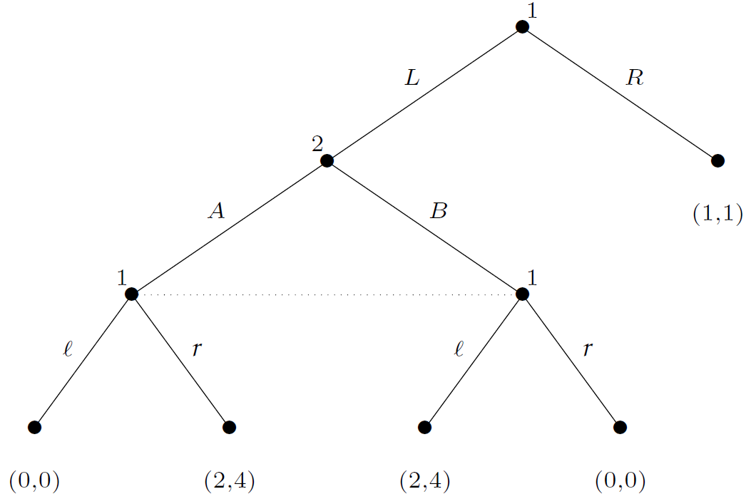
Computing equilibria: the sequence form
The sets of sequences for the two players are
Σ₁ = {∅,L,R,Lℓ,Lr}
Σ₂ = {∅,A,B}

Slide 116
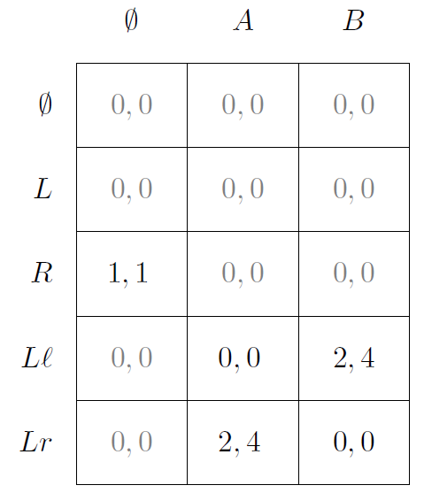
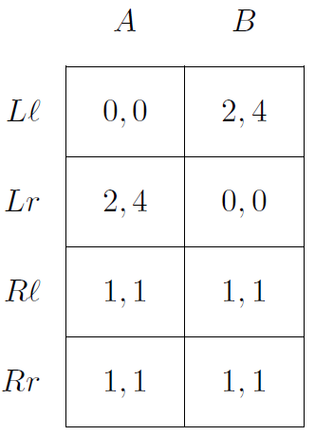
Computing equilibria: the sequence form
Why the sequence form can be better?

Slide 117
Computing equilibria: the sequence form
Each payoff that is defined at a leaf in the game tree occurs exactly once in the sequence-form table
If g was represented using a sparse encoding, only five values would have to be stored
In induced normal form, all of the eight entries correspond to leaf nodes from the game tree

Slide 118
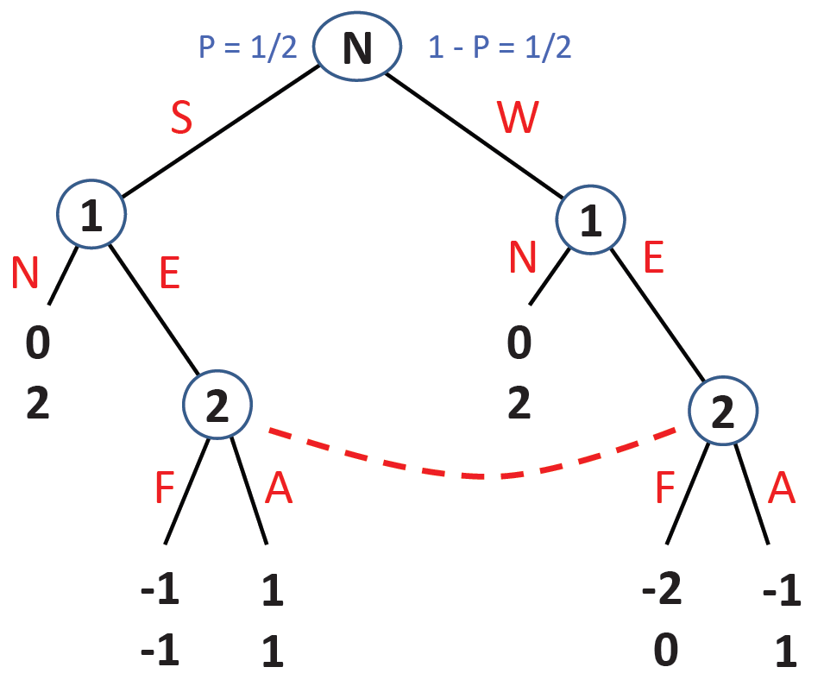
Sequential Equilibrium
Should firm 1 enter the market?

Slide 119
Sequential Equilibrium
What are the subgames of this game?

Slide 120
Sequential Equilibrium
What are the NE of this game?
1) if 1==S or 1==W
(N,F)
2) if 1 == S
(E,A)
if 1 == W
(N,A)
Notes:
SPE does not work.

Slide 121
Sequential Equilibrium
Similar idea with SPE
Equilibrium concept that explicitly model players’ beliefs about
where they are in the tree for every information set (what the other players have done)
Features:
Beliefs are not contradicted by the actual play of the game (on the equilibrium path)
Players best respond to their beliefs

Slide 122
Sequential Equilibrium
What are the NE of this game?
1) if 1==S or 1==W
(N,F)
2) if 1 == S
(E,A)
if 1 == W
(N,A)
what is the
probability that
I am here?
what is the
probability that
I am here?

Slide 123
Sequential Equilibrium
What should P2 do if I enter?
What should P2 do if I enter?
What are the NE of this game?
1) if 1==S or 1==W
(N,F)
2) if 1 == S
(E,A)
if 1 == W
(N,A)

Slide 124
Sequential Equilibrium
What are the NE of this game?
1) if 1==S or 1==W
(N,F)
2) if 1 == S
(E,A)
if 1 == W
(N,A)

Slide 125
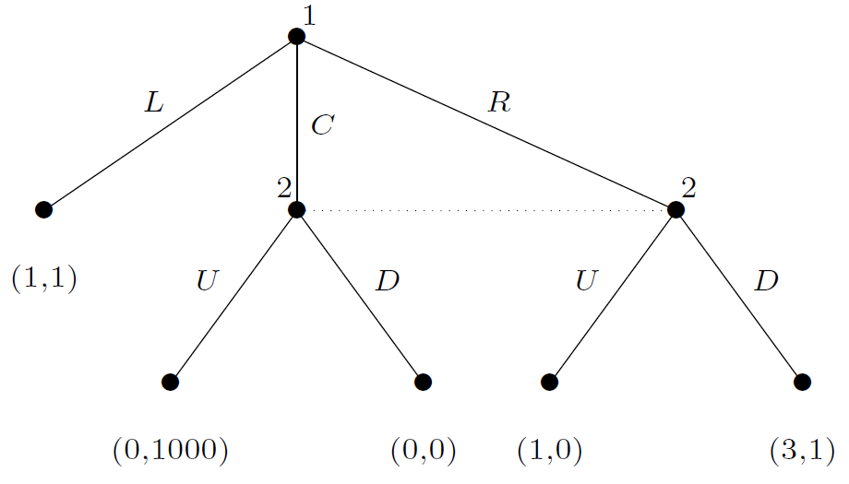
Sequential Equilibrium
Does player 2 know where he is?

Slide 126

Sequential Equilibrium
The best AI programs are starting to approach the level of human experts
Construct a statistical model of the opponent
What kinds of bets the opponent is likely to make under what kinds of circumstances
Combine with game-theoretic reasoning techniques, e.g.,

Slide 127
Sequential Equilibrium
Rather, at each info set, a “subforest” or a collection of subgames
The best-known way for dealing with this is sequential equilibrium (SE)
More info in the text book
Theorem: every finite game of perfect recall has a sequential equilibrium
Theorem: in extensive-form games of perfect information, the sets of SPE and SE are always equivalent

Slide 128
Sequential Equilibrium
Works for games with perfect recall
for general-sum games, can compute equilibrium in time exponential in the size of the extensive form game
exponentially faster than converting to normal form
for zero-sum games, computing equilibrium is polynomial in the size of the extensive form game
exponentially faster than the LP formulation we saw before
Solutions via linear programs

