Slide 1
Richer Representations:
Beyond the Normal and Extensive Forms

Slide 2
Richer Representations
Infinite games cannot be represented in normal or extensive form
e.g. what happens when a simple normal-form game such as the Prisoner’s Dilemma is repeated infinitely?
Games played by an uncountably infinite set of agents
An interval of the real numbers as each player’s action space

Slide 3
Richer Representations
Assumption that agents have perfect knowledge of everyone’s payoffs
Agents might have private information that affects their own payoffs
Agents might have only probabilistic information about each others’ private information
Big impact: agent’s actions can depend on what he knows about another agent’s payoffs

Slide 4
Richer Representations
As the number of players and actions grow, games can be too large to reason about
Settings that are most interesting in practice tend to involve highly structured payoffs
a large game actually corresponds to finitely repeated play of a small game
the number of agents who are able to directly affect any given agent’s payoff is small

Slide 5
Repeated Games
What happens when a simple normal-form game such as the Prisoner’s Dilemma is repeated infinitely?

Slide 6
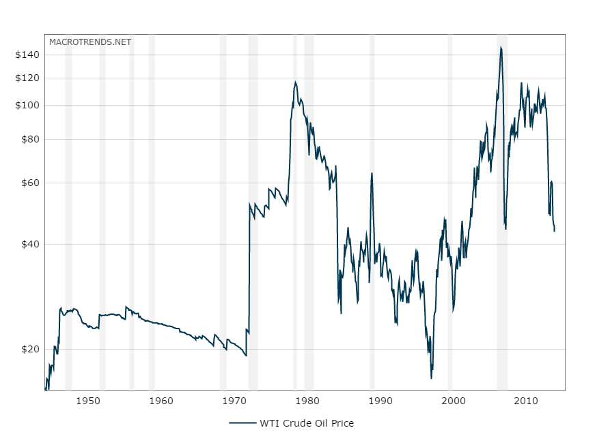
Repeated games
Investments on oil alternatives
USA, China, etc started to import less oil
S.A. imposes minimum production
Oil embargo
OPEC was created
Sept. 11
Gulf war
OPEC regroup

Slide 7
Repeated games
Many (most?) interactions occur more than once:
Firms in a marketplace
Political alliances
Friends (favor exchange...)
Workers (team production...)
Many are like a repeated Prisoner’s Dilemma
Need to easily observe each other’s plays and react (quickly) to punish undesired behavior

Slide 8
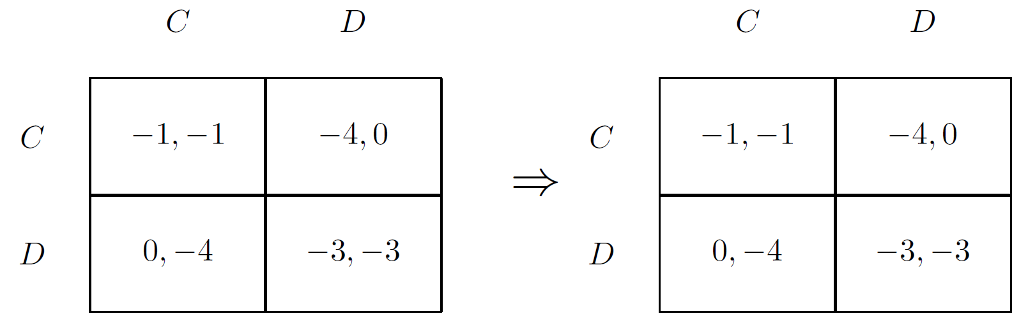
Repeated games
Consider the following representation of a two-stage prisoner`s dilemma game

Slide 9
Repeated games
Do agents see what the other agents played earlier?
Do they remember what they knew?
What is the utility of the entire repeated game?

Slide 10
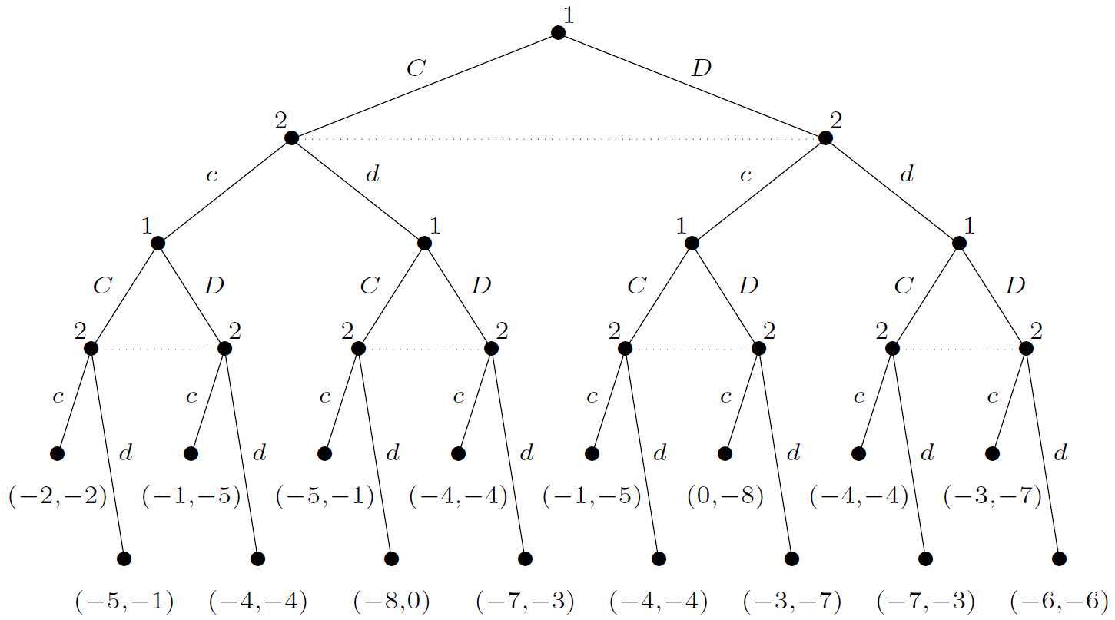
Finitely repeated games
Imperfect-information game in extensive form to completely disambiguate the semantics of a finitely repeated game

Slide 11
Finitely repeated games
At each iteration the players do not know what the other player is playing but afterward they do
The payoff function of each agent is additive

Slide 12
Finitely repeated games
What is the equilibrium of this game?

Slide 13
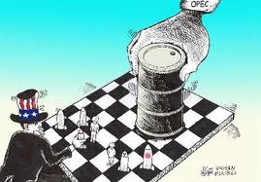
Infinitely repeated games
Does it mean that the game will go on forever?
No, it means that the players do not know when it will end

Slide 14
Infinitely repeated games
When the infinitely repeated game is transformed into extensive form, the result is an infinite tree
Payoffs cannot be attached to any terminal nodes
Payoffs cannot be defined as the sum of the payoffs in the stage games
Q: why not?
A: in general, they will be infinite
There are two common ways of defining a player’s payoff to get around this problem

Slide 15
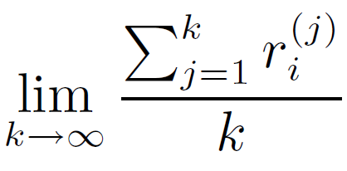
Infinitely repeated games
Given an infinite sequence of payoffs r_{i}⁽¹⁾, r_{i}⁽²⁾, . . . for player i, the average reward of i is

Slide 16
Infinitely repeated games
Two friends are in a running competition
Every saturday they check who have run the most
Both of them prefer not running to running
They have to plan how much they should run each week
Is the average reward model appropriate?

Slide 17
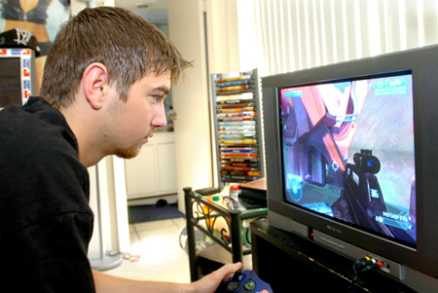


Infinitely repeated games
Sometimes, the agent may care much more about the present than the future

Slide 18
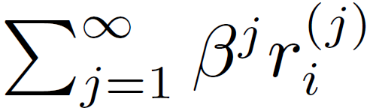
Infinitely repeated games
Given an infinite sequence of payoffs r_{i}⁽¹⁾, r_{i}⁽²⁾, . . . for player i, and a discount factor β with 0 ≤ β ≤ 1, the future discounted reward of i is
e.g.: U_{i} = 0.8¹ r_{i}⁽¹⁾ + 0.8² r_{i}⁽²⁾ + 0.8³ r_{i}⁽³⁾ + ...

Slide 19
Infinitely repeated games
The discount factor β can be interpreted as
The agent cares more about his well-being in the near term than in the long term
The agent cares about the future just as much as he cares about the present, but with some probability 1 − β the game will be stopped any given round
The analysis of the game is not affected by which perspective is adopted

Slide 20
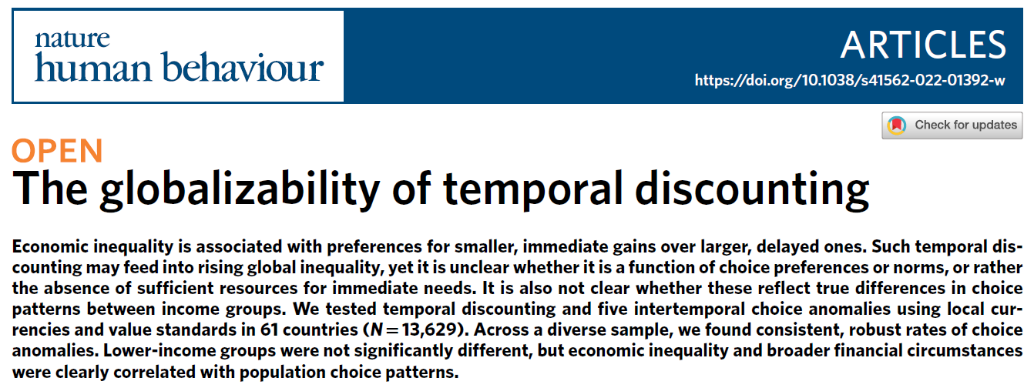
Infinitely repeated games
Notes:
The globalizability of temporal discounting | Nature Human Behaviour

Slide 21
Infinitely repeated games
What is a pure strategy in an infinitely-repeated game?
a choice of action at every decision point
an action at every stage game, which is an infinite number of actions!
Can be thought of an 'instruction' to a third person who will play the game for you

Slide 22
Infinitely repeated games
What is a pure strategy in an infinitely-repeated game?
Some famous strategies (repeated PD):
Tit-for-tat: Start out cooperating. If the opponent defected, defect in the next round. Then go back to cooperation (atualizar)
Grim trigger: Start out cooperating. If the opponent ever defects, defect forever

Slide 23
Infinitely repeated games
What can we say about Nash equilibria?
Unable to construct an induced normal form :(
Nash’s theorem only applies to finite games
With an infinite number of strategies, there could be an infinite number of pure-strategy equilibria!
However, we can characterize a set of payoffs that are achievable under equilibrium
without having to enumerate the equilibria

Slide 24
Reminder: maxmin e minmax
What are the maxmin value v'₁ and the minmax value v₁?
 | L | R
T | 0,a | 3,b
M | 2,c | 1,d
B | 4,e | 0,f

Slide 25
Reminder: maxmin e minmax
The maxmin value v'_{i} for a player is at most its minmax value v_{i}
i.e., v'_{i} ≤ v_{i}
 | L | R
T | 0,a | 3,b
M | 2,c | 1,d
B | 4,e | 0,f
3 is the minmax value for player 1
1 is the maxmin value for player 1

Slide 26
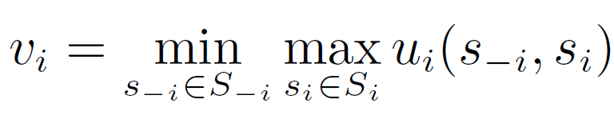
Infinitely repeated games
Consider any n-player game G = (N, A, u) and any payoff profile r = (r₁, r₂, . . . , r_{n})
Let
v_{i} is player i’s minmax value
his utility when the other players play minmax strategies against him, and he plays his best response

Slide 27
Infinitely repeated games
Definitions
A payoff profile r = (r₁, r₂, . . . , r_{n}) is enforceable if ∀i ∈ N, r_{i} ≥ v_{i}
A payoff profile r = (r₁, r₂, . . . , r_{n}) is feasible if there exist rational, nonnegative values α_{a} such that for all i, we can express r_{i} as Σ_{a∈A} α_{a}u_{i}(a), with Σ_{a∈A}α_{a}=1

Slide 28
Infinitely repeated games
Classify the following payoff profiles
(-1,1)
not enforceable, not feasible
(10,10)
enforceable, not feasible
(0,0)
feasible, not enforceable
(1,1)
feasible, enforceable
(2,2)
feasible, enforceable
 | L | R
U | 4,0 | 1,1
D | 0,0 | 0,4

Slide 29
Infinitely repeated games
Theorem (Folk Theorem)
Consider any n-player game G and any payoff vector r = (r₁, r₂, . . . , r_{n})
1. If r is the payoff in any Nash equilibrium of the infinitely repeated G with average rewards, then for each player i, r_{i} is enforceable
not feasible because sometimes it may yield irrational α's
2. If r is both feasible and enforceable, then r is the payoff in some Nash equilibrium of the infinitely repeated G with average rewards

Slide 30
Folk Theorem (Part 1)
Payoff in Nash ⇒ enforceable
Suppose r is not enforceable, i.e. r_{i} < v_{i} for some i
Then consider a deviation of player i to b_{i}(s_{−i}(h)) for any history h of the repeated game
b_{i} is any best-response action in the stage game
s_{−i}(h) is the strategy of other players given h
By definition of a minmax strategy, player i will receive a payoff of at least v_{i} in every stage game if he adopts this strategy, and so i’s average reward is also at least v_{i}
Thus i cannot receive the payoff r_{i} < v_{i} in any Nash equilibrium

Slide 31
Folk Theorem (Part 2)
Feasible and enforceable ⇒ Nash
Since r is a feasible enforceable payoff profile, we can write it as r_{i} = Σ_{a∈A} (β_{a} / γ) u_{i}(a), where β_{a} and γ are nonnegative integers
Recall that α_{a} were required to be rational, so γ can be their common denominator
Since the combination was convex, we have γ = Σ_{a∈A} β_{a}
 | L | R
U | 3/7 | 1/7
D | 0/7 | 3/7
β = (3, 1, 0, 3)
γ = 7

Slide 32
Folk Theorem (Part 2)
Feasible and enforceable ⇒ Nash
We are going to construct a strategy profile that will cycle through all outcomes a ∈ A of G with cycles of length γ, each cycle repeating action a exactly β_{a} times
Let (a^{t}) be such a sequence of outcomes
Let us define a strategy s_{i} of player i to be a trigger version of playing (a^{t})
if nobody deviates, then s_{i} plays a_{i}^{t} in period t
However, if there was a period t′ in which some player j ≠ i deviated, then s_{i} will play (p_{−j})_{i}, where (p_{−j}) is a solution to the minimization problem in the definition of v_{j}

Slide 33
Folk Theorem (Part 2)
Feasible and enforceable ⇒ Nash
If everybody plays according to s_{i}, then, by construction, player i receives average payoff of r_{i}
look at averages over periods of length γ
This strategy profile is a Nash equilibrium
Suppose everybody plays according to s_{i}, and player j deviates at some point
Then, forever after, player j will receive his minmax payoff v_{j} ≤ r_{j} , rendering the deviation unprofitable

Slide 34
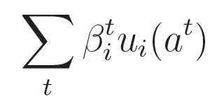
Discounted Repeated Games
Stage game: (N, A, u)
Discount factors: β₁, . . . , β_{n}, β_{i} ∈ [0, 1]
Assume a common discount factor for now
β_{i} = β for all i
Payoff from a play of actions a₁, . . . , a_{t}, . . .

Slide 35
Discounted Repeated Games
Histories of length t: H^{t} = {h^{t} : h^{t} = (a₁, ..., a_{t}) ∈ A^{t}}
All finite histories: H = U_{t}H^{t}
A strategy: s_{i} : H → Δ(A_{i})
a map from every possible history into a possibly mixed strategy over what I can do in a given period given a history

Slide 36
Discounted Repeated Games
Prisoners Dilemma
A_{i} = (C, D)
A history for 3 periods: h³ = ((C,C), (C,D), (D,D))
A strategy for period 4 would specify what a player would do after seeing h³

Slide 37
Discounted Repeated Games
Subgame perfection
Profile of strategies that are Nash in every subgame
So, a Nash equilibrium following every possible history
Repeatedly playing a Nash equilibrium of the stage game is always a subgame perfect equilibrium of the repeated game

Slide 38
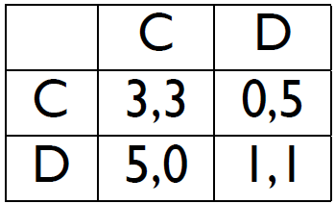
Discounted Repeated Games
Repeated Prisoner’s Dilemma
What happens if all players play the Grim Trigger strategy?
Cooperate as long as everyone has in the past
Both players defect forever after if anyone ever deviates

Slide 39
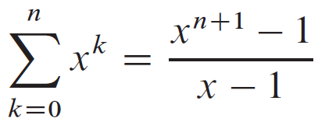
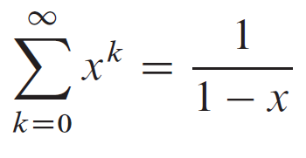
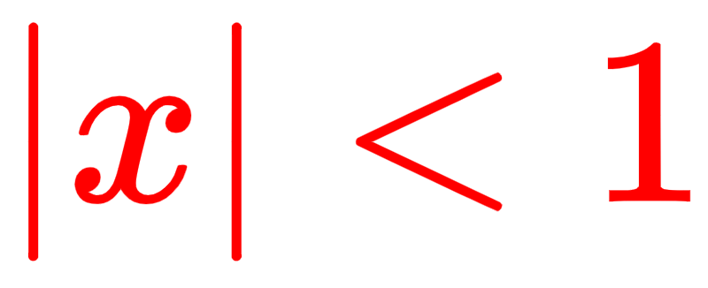
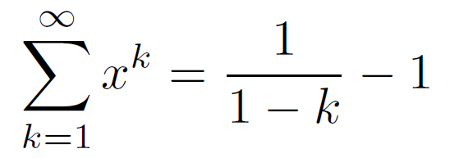
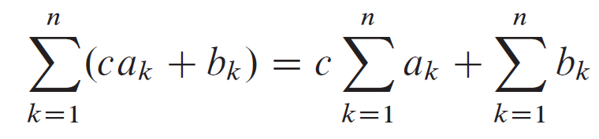
Reminder

Slide 40
Discounted Repeated Games
Let's check the payoff for deviating:
Cooperate:
Defect:

Slide 41
Discounted Repeated Games
Let's check the payoff for deviating:
Cooperate:
Defect:
Difference:
Difference is nonnegative if:
or
or

Slide 42
Discounted Repeated Games
Need to care about tomorrow at least half as much as today!

Slide 43
Discounted Repeated Games
Basic logic:
Play something with relatively high payoffs, and if anyone deviates
Punish by resorting to something that
has lower payoffs (at least for that player)
and is credible: it is an equilibrium in the subgame

Slide 44
Folk Theorem
Consider a finite normal form game G = (N, A, u)
Let a = (a₁, ..., a_{n}) be a Nash equilibrium of the stage game G
If a' = (a₁', ..., a_{n}') is such that u_{i}(a') > u_{i}(a) for all i,
then there exists a discount factor β < 1, such that
if β_{i} > β for all i, then there exists a subgame perfect equilibrium of the infinite repetition of G that has a′ played in every period on the equilibrium path

Slide 45
Folk Theorem
Outline of the Proof:
Play a′ as long as everyone has in the past
If any player ever deviates, then play a forever after (Grim Trigger)
Check that this is a subgame perfect equilibrium for high enough discount factors

Slide 46
Folk Theorem
Check that this is a subgame perfect equilibrium for high enough discount factors:
Playing a forever if anyone has deviated is a Nash equilibrium in any such subgame
Will someone gain by deviating from a′ if nobody has in the past?
Maximum gain from deviating is
Minimum per-period loss from future punishment is
If deviate, the maximum possible net gain is
Dev. not beneficial if:

Slide 47
Folk Theorem
Maximum gain from deviating is
Minimum per-period loss from future punishment is
If deviate, the maximum possible net gain is
Dev. not beneficial if:
M = 5 – 3 = 2
m = 3 – 1 = 2
or 2 – 2(β_{i} / (1- β_{i}))
β_{i} ≥ 2 / 4 ≥ ½

Slide 48
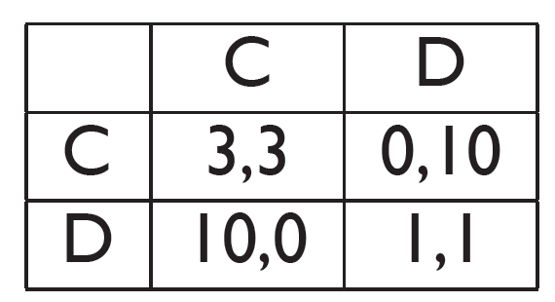
Folk Theorem
More complicated play:

Slide 49
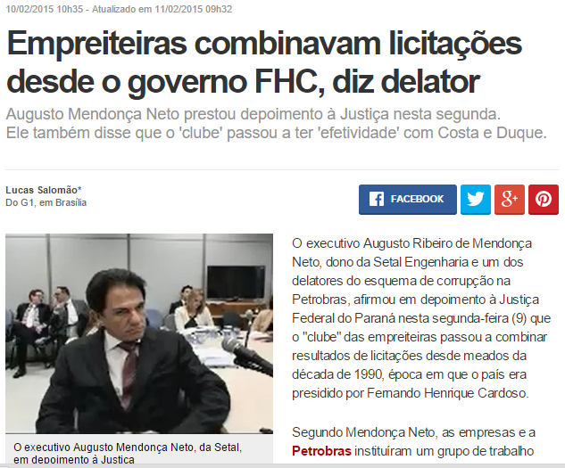
Folk Theorem
More complicated play:

Slide 50
Repeated Games
Players can condition future play on past actions
Brings in many(!) equilibria: Folk Theorems
Need key ingredients
Some (fast enough) observation about how others behave
Sufficient value to the future (limit of the means - extreme value) or high enough discount factor

Slide 51
Stochastic games
Intuitively speaking, a stochastic game is a collection of normal-form games
the agents repeatedly play games from this collection
the particular game played at any given iteration depends probabilistically on the previous game played and on the actions taken by all agents in that game

Slide 52
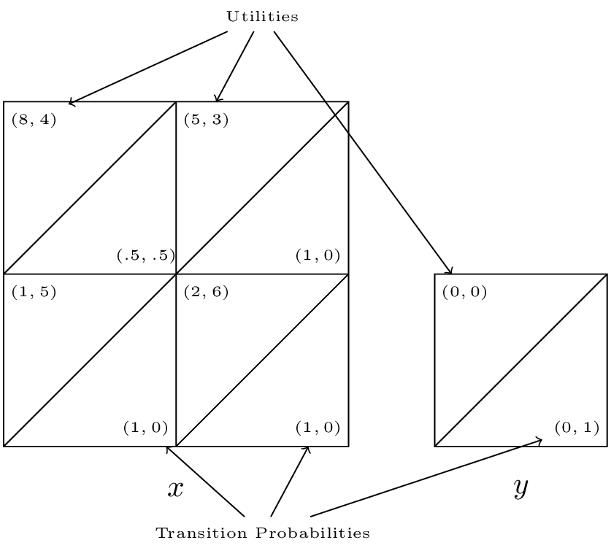
Stochastic games
Notes:
Chapter 14 - Stochastic games (vknight.org)

Slide 53

Bounded rationality

Slide 54
Bounded rationality
The idea that in decision-making, rationality of individuals is limited by:
the information they have
the cognitive limitations of their minds
the finite amount of time they have to make a decision

Slide 55
Bounded rationality
Until now, we have assumed that players are homogeneous and fully rational
What happens when agents are not perfectly rational expected-utility maximizers?
What happens when we impose specific computational limitations on them
How can we represent such limitations?

Slide 56
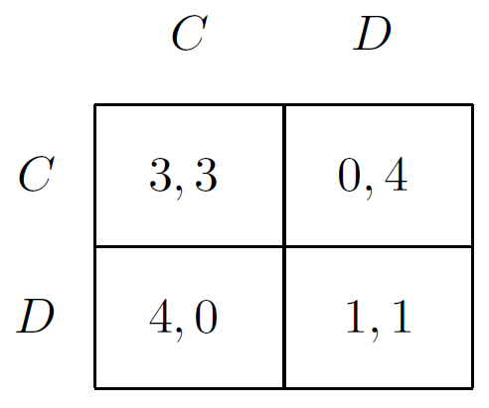
Bounded rationality
What happened in the games we played so far?
E.g. Prisoner's dilemma or Five Pirates' game

Slide 57
Bounded rationality
One approach: ε-equilibrium
Agents’ rationality may be bounded when they are willing to settle for ε-lower payoffs
In the finitely repeated Prisoner’s Dilemma game, the sets of cooperating ε-equilibria increases with size

Slide 58
Bounded rationality
Finitely repeated games (or imperfect-information extensive-form games)
A strategy for player i is a specification of an action for every information set belonging to i
A strategy for k repetitions of an m-action game is thus a specification of (m^{k−1}) / (m−1) different actions
One action for every possible history
How to demand less rationality?

Slide 59
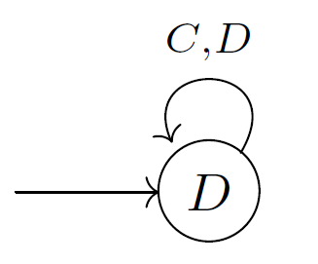
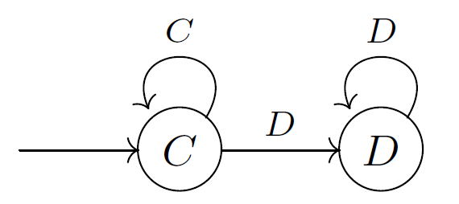
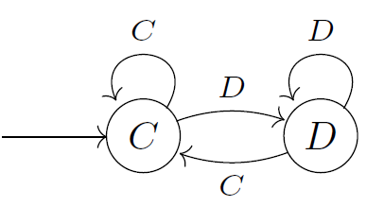
Bounded rationality
How to demand less rationality?

Slide 60
Finite-state automata
A two-player machine game G^{M} = ({1, 2}, M, G) of the k-period repeated game G is defined by:
a pair of players {1, 2}
M = (M₁, M₂), where M_{i} = {m₁, m₂, ... } is a set of available automata for player i
a normal-form game G = ({1, 2}, A, u)
A pair m₁ ∈ M₁ and m₂ ∈ M₂ deterministically yield an outcome o^{t}(m₁,m₂) at each iteration t
Thus, G^{M} induces a normal-form game ({1, 2}, M, U), in which each player i chooses an automaton m_{i} ∈ M_{i}, and obtains utility U_{i}(m₁,m₂) = Σ^{k}_{t=1}u_{i}(o^{t}(m₁,m₂))

Slide 61
Finite-state automata
A two-player machine game G^{M} = ({1, 2}, M, G) of the k-period repeated game G is defined by:
a pair of players {1, 2}
M = (M₁, M₂), where M_{i} = {m₁, m₂, ... } is a set of available automata for player i
a normal-form game G = ({1, 2}, A, u)
A pair m₁ ∈ M₁ and m₂ ∈ M₂ deterministically yield an outcome o^{t}(m₁,m₂) at each iteration t
Thus, G^{M} induces a normal-form game ({1, 2}, M, U), in which each player i chooses an automaton m_{i} ∈ M_{i}, and obtains utility U_{i}(m₁,m₂) = Σ^{k}_{t=1}u_{i}(o^{t}(m₁,m₂))
Can be easily replaced by the discounted utility

Slide 62
Automata of bounded size
Intuitively, automata with fewer states represent simpler strategies
Thus, one way to bound the rationality of the player is by limiting the number of states in the automaton

Slide 63
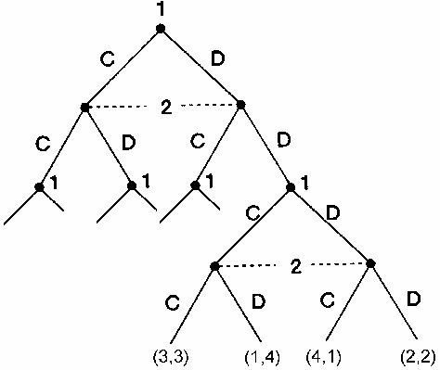
Automata of bounded size
How to find the "always defect" equilibrium in the finite RPD via automatas?

Slide 64
Automata of bounded size
Placing severe restrictions on the number of states not only induces an equilibrium in which cooperation always occurs, but also causes the always-defect equilibrium to disappear

Slide 65
Automata of bounded size
How to find the "always defect" equilibrium in the finite RPD via automatas?
Each player has to use backward induction to find his dominant strategy
In order to perform backward induction in a k-period repeated game, each player needs to keep track of at least k distinct states
one state to represent the choice of strategy in each repetition of the game

Slide 66
Automata of bounded size
In what follows,
the function s : M → Z represents the number of states of an automaton M
the function S(M_{i}) = max _{M∈Mi} s(M) represents the size of the largest automaton among a set of automata M_{i}

Slide 67
Automata of bounded size
In the Prisoner’s Dilemma, it turns out that if
2 < max(S(M₁ ), S(M₂ )) < k ,
then the constant-defect strategy does not yield a symmetric equilibrium, while the Tit-for-Tat automaton does

Slide 68
Automata of bounded size
Theorem
For any integer x, there exists an integer k₀ such that
for all k > k₀, any machine game G^{M} = ({1, 2}, M, G) of the k-period repeated PD game G,
in which k^{1/x} ≤ min{S(M₁), S(M₂)} ≤ max{S(M₁), S(M₂)} ≤ k^{x}
holds has a Nash equilibrium in which the average payoffs to each player are at least 3 − 1/x

Slide 69
Computing best-response automata
Theorem
Given a machine game G^{M} = (N, M, G) of a limit average infinitely repeated game G = (N, A, u)
with unknown N,
and a choice of automata m₁, . . . ,m_{n} for all players,
there does not exist a polynomial time algorithm for verifying whether m_{i} is a best-response automaton for player i
:) If we hold N fixed, than the problem belongs to P

Slide 70
Computing best-response automata
Theorem
Given a two-player machine game G^{M} = ({1, 2}, M, G) of a limit average infinitely repeated two-player game G = (N, A, u)
and a mixed strategy for player 2 in which the set of automata that are played with positive probability is finite,
the problem of verifying that an automaton m₁ is a best-response automaton for player 1 is NP-complete

Slide 71
Computing best-response automata
Theorem
Given a two-player machine game G^{M} = ({1, 2}, M, G) of a limit average infinitely repeated Prisoner’s Dilemma game G
an automaton m₂, and an integer k,
the problem of computing a best-response automaton m₁ for player 1,
such that size(m₁) ≤ k,
is NP-complete
:(

Slide 72
From finite automata to Turing machines
Turing machines are more powerful than finite-state automata due to their infinite memories
Q: Would game-theoretic results be preserved under this richer model?
A: No
For example, there is strong evidence that a PD game of two Turing machines can have equilibria that are arbitrarily close to the repeated C payoff

Slide 73
Machine Games
For more information, please read Chapters 8 and 9 of "A Course in Game Theory", by Ariel Rubinstein

