Slide 1
Congestion Games

Slide 2



Congestion games

Slide 3
Congestion games
Restricted class of games that are useful for modeling some important real-world settings
Have attractive theoretical properties
Simplify the representation of a game by imposing constraints on the effects that a single agent’s action can have on other agents’ utilities

Slide 4
Congestion games
In a congestion game each player chooses some subset from a set of resources
The cost of each resource depends on the number of other agents who select it

Slide 5
Congestion games
A congestion game is a tuple (N, R, A, c), where
N is a set of n agents
R is a set of r resources
A = A₁ × · · · × A_{n}, where A_{i} ⊆ 2^{R} \ {∅} is the set of actions for agent i
c = (c₁, . . . , c_{r} ), where c_{k} : ℕ → ℝ is a cost function for resource k ∈ R

Slide 6
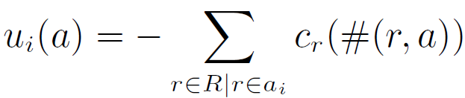
Congestion games
# : R × A → ℕ
a function for the number of players who took any action that involves resource r under action profile a
c_{k} : ℕ → ℝ
a cost function for each resource k
Given a pure-strategy profile a = (a_{i}, a_{−i})

Slide 7
Congestion games
Agents can have different actions available to them
But, they all have the same utility function
Congestion games have the anonymity property
players care about how many others use a given resource but they do not care about which others do so

Slide 8
Congestion games
Example:
r1
s
t
r2
R = {(s,r1), (s, r2), (r1, t), (r2, t), (r1, r2)}
A_{i} = {[(s,r1), (r1, t)], [(s,r1), (r1,r2), (r2,t)], [(s,r2), (r2,t)]}
c(i,j) = latency( #(r,a) )

Slide 9
Congestion games
Features functions c_{k}(·) that are increasing in the number of people who choose that resource
But can just as easily handle positive externalities
or even cost functions that oscillate

Slide 10
Congestion games
Santa Fe Bar problem
each of a set of people independently selects whether or not to go to the bar
the utility of attending increases with the number of other people who select the same night, up to the capacity of the bar
Beyond this point, utility decreases because the bar gets too crowded
Deciding not to attend yields a baseline utility that does not depend on the actions of the participants
minority games: agents get the highest payoff for choosing a minority action

Slide 11
Computing equilibria
Theorem 6.4.2
Every congestion game has a pure-strategy Nash equilibrium

Slide 12
Computing equilibria
Mixed-strategy equilibria are open to criticisms that they are less likely than pure-strategy equilibria to arise in practice
This theorem tells us that if we want to compute a sample Nash equilibrium of a congestion game, we can look for a pure-strategy equilibrium

Slide 13
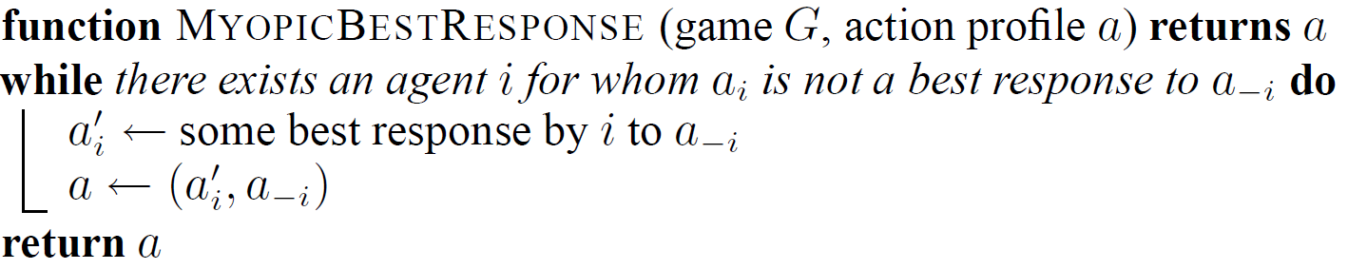
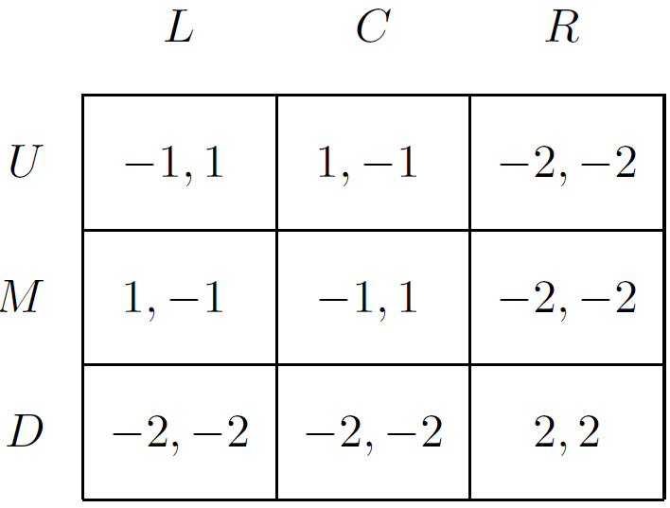
Computing equilibria

Slide 14
Computing equilibria
MYOPICBESTRESPONSE may be too simplistic to be useful in practice
Interestingly, it is useful for congestion games
Theorem 6.4.3
The MYOPICBESTRESPONSE procedure is guaranteed to find a pure-strategy Nash equilibrium of a congestion game

Slide 15
Computing equilibria
To prove the two previous theorems from the previous section, it is useful to introduce the concept of potential games

Slide 16
Potential games
Definition
A game G = (N, A, u) is a potential game if there exists a function P : A → ℝ such that, for all i ∈ N, all a_{−i} ∈ A_{−i} and a_{i}, a_{i}′ ∈ A_{i}
u_{i}(a_{i}, a_{−i}) − u_{i}(a_{i}′, a_{−i}) = P(a_{i}, a_{−i}) − P(a_{i}′ , a_{−i})
!the incentive of all players to change their strategy can be expressed using a single global function called the potential function!

Slide 17
Potential games
Theorem 6.4.5
Every (finite) potential game has a pure-strategy Nash equilibrium
Proof
Let a∗ = argmax_{a∈A} P(a)
Clearly for any other action profile a′, P(a∗) ≥ P(a′)
Thus by the definition of a potential function, for any agent i who can change the action profile from a∗ to a′ by changing his own action,
u_{i}(a∗) ≥ u_{i}(a′)

Slide 18
Potential games
Theorem 6.4.6
Every congestion game is a potential game
Proof
if
then

Slide 19
Potential games
A
c(s,A) = 1
c(A,t) = #(A,t)²
s
t
c(s,B) = 2
B
c(A,t) = #(B,t)²
u(a) | A | B
A | (-5,-5) | (-2,-3)
B | (-3,-2) | (-6,-6)
P(a) | A | B
A | 7 | 5
B | 5 | 9

Slide 20
Potential games
Theorem 6.4.6
Every congestion game is a potential game
Proof
if
then

Slide 21
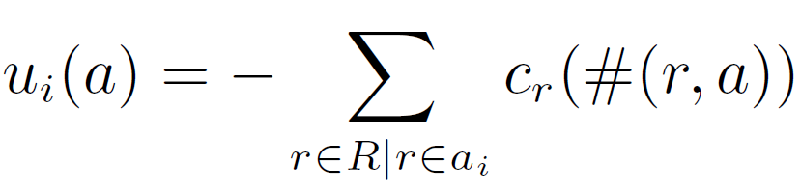
Potential games
A
c(s,A) = 1
c(A,t) = #(A,t)²
s
t
c(s,B) = 2
B
c(A,t) = #(B,t)²
u(a) | A | B
A | (-5,-5) | (-2,-3)
B | (-3,-2) | (-6,-6)
P(a) | A | B
A | -7 | -5
B | -5 | -9

Slide 22
Error in the MAS book
Thus, for the rest of the slides, consider that:

Slide 23
Potential games
Theorem 6.4.3
The MYOPICBESTRESPONSE procedure is guaranteed to find a pure-strategy Nash equilibrium of a congestion game
Proof
With every step of the while loop, P(a) strictly increases, because u_{i}(a_{i}′, a_{−i}) > u_{i}(a_{i}, a_{−i}) by construction
By the definition of a potential function P(a_{i}′, a_{−i}) > P(a_{i}, a_{−i})
Since there are only a finite number of action profiles, the algorithm must terminate

Slide 24
Potential games
Given a congestion game, MYOPICBESTRESPONSE will converge regardless of
the cost functions (e.g., they do not need to be monotonic)
the action profile with which the algorithm is initialized
which agent we choose as agent i in the while loop
when there is more than one agent who is not playing a best response)
Furthermore, it is not even necessary that agents best respond at every step

Slide 25
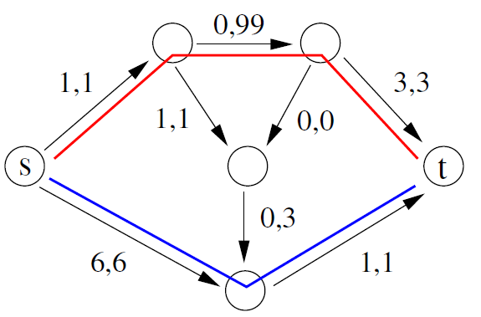
Example

Slide 26
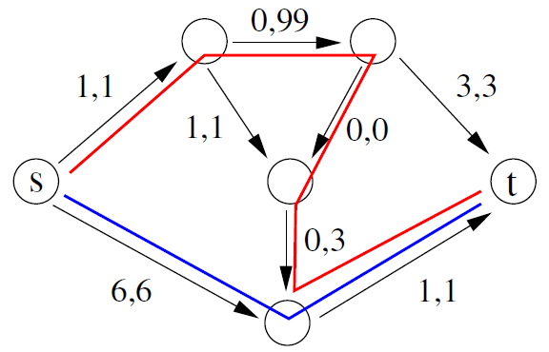
Example

Slide 27
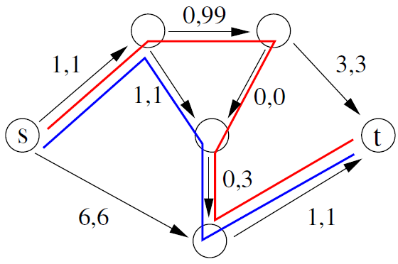
Example

Slide 28
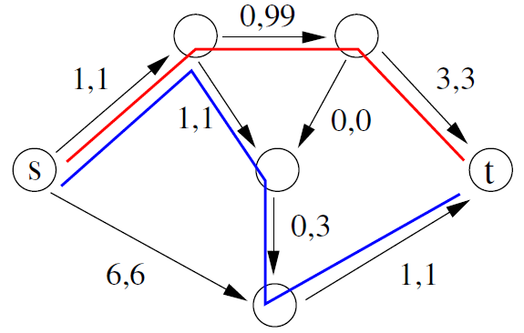
Example

Slide 29
Potential games
Recently, it was shown that the problem of finding a pure NE in a congestion game is PLS-complete
as hard to find as any other object whose existence is guaranteed by a potential function argument
Intuitively, this means that our problem is as hard as finding a local minimum in a traveling salesman problem using local search

Slide 30
Nonatomic congestion games
A nonatomic congestion game is a congestion game that is played by an uncountably infinite number of players
These games are used to model congestion scenarios in which
the number of agents is very large
each agent’s effect on the level of congestion is very small
For example, consider modeling traffic congestion in a freeway system

Slide 31
Nonatomic congestion games
A nonatomic congestion game is a tuple (N, μ, R, A, ρ, c), where:
N = {1, . . . , n} is a set of types of players
μ = (μ₁, . . . , μ_{n}); for each i ∈ N there is a continuum of players represented by the interval [0, μ_{i}]
R is a set of k resources
A = A₁ × · · · × A_{n}, where A_{i} ⊆ 2^{R} \ {∅} is the set of actions for agents of type i
ρ = (ρ₁, . . . , ρ_{n}), where for each i ∈ N, ρ_{i} : A_{i} × R → ℝ₊ denotes the amount of congestion contributed to a given resource r ∈ R by players of type i selecting a given action a_{i} ∈ A_{i}
c = (c₁, . . . , c_{k}), where c_{r} : ℝ₊ → ℝ is a cost function for resource r ∈ R, and c_{r} is nonnegative, continuous and nondecreasing

Slide 32
Nonatomic congestion games
To simplify notation, denote as the union of A₁, . . . ,A_{n}
Let
An action distribution s ∈ S indicates how many players choose each action
s(a_{i}), denote the element of s that corresponds to the measure of the set of players of type i who select action a_{i} ∈ A_{i}
An action distribution s must have the properties that all entries are nonnegative real numbers and that
Note that ρ_{i}(a_{i}, r) = 0 when r ∉ a_{i}

Slide 33
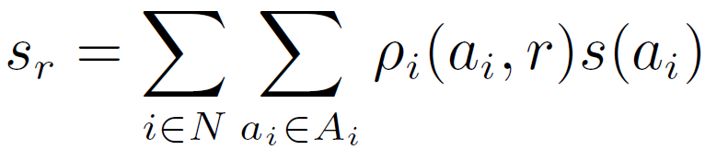
Nonatomic congestion games
Overloading notation, we write as s_{r} the amount of congestion induced on resource r ∈ R by action distribution s:

Slide 34
Nonatomic congestion games
We can now express the utility function
As in (atomic) congestion games, all agents have the same utility function
depends only on how many agents choose each action rather than on these agents’ identities

Slide 35
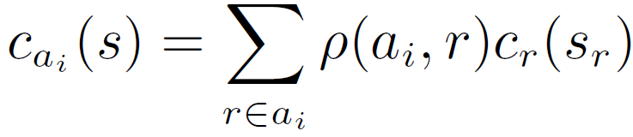
Nonatomic congestion games
The cost under an action distribution s to agents of type i who choose action a_{i} is given by
and so we have
i

Slide 36
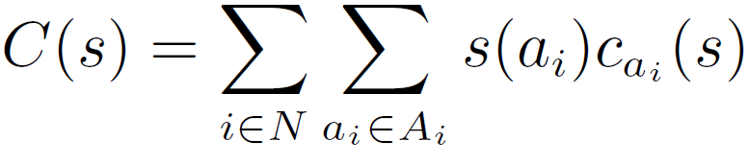
Nonatomic congestion games
Finally, we can define the social cost of an action profile as the total cost born by all the agents

Slide 37
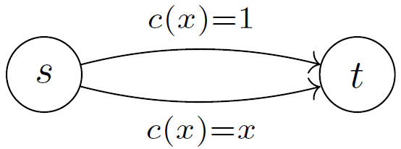
Nonatomic congestion games
input for cost functions
i
N = {1}
μ = {μ₁} and μ₁ = 1
Interval: [0 1]
R = {e_{top}, e_{bottom}}
A₁ = {a₁, a₂}
a₁={e_{top}}, a₂={e_{bottom}}
ρ₁(a, r)=1∀ a∈A₁, r∈ R ∩ a
ρ₁(a, r)=0 otherwise
for s(a₁) = 0, s(a₂) = 1:
s_{top} = ρ₁(a₁,e_{top})*0 + ρ₁(a₂,e_{top})*1
= 1*0 + 0*1 = 0
s_{bottom} = ρ₁(a₁,e_{bottom})*0 + ρ₁(a₂,e_{bottom})*1
= 0*0 + 1*1 = 1
c_{a1}(s) = ρ₁(a₁,e_{top})*c_{top}(0) = 1*1 = 1
c_{a2}(s) = ρ₁(a₂,e_{bottom})*c_{bottom}(1) = 1*1 = 1
C(s) = 0*1 + 1*1 = 1

Slide 38
Nonatomic congestion games
Even with an uncountably infinite number of agents, we can still define a Nash equilibrium in the usual way

Slide 39
Nonatomic congestion games
Definition
An action distribution s arises in a pure-strategy equilibrium of a nonatomic congestion game if for each player type i ∈ N and each pair of actions a₁, a₂ ∈ A_{i} with s(a₁) > 0, u_{i}(a₁, s) ≥ u_{i}(a₂, s) (and hence c_{a1}(s) ≤ c_{a2}(s)).

Slide 40
Nonatomic congestion games
Here we will only be concerned with pure-strategy equilibria
Not restrictive, since any mixed-strategy equilibrium corresponds to an “equivalent” pure-strategy equilibrium where the number of agents playing a given action is the expected number under the original equilibrium
We say only that an action distribution arises in an equilibrium because an action distribution does not identify the action taken by every individual agent, and hence cannot constitute an equilibrium

Slide 41
Nonatomic congestion games
Theorem 6.4.9
Every nonatomic congestion game has a pure-strategy Nash equilibrium.
Theorem 6.4.10
All equilibria of a nonatomic congestion game have equal social cost

Slide 42
Selfish Routing
Selfish routing is a model of how self-interested agents would route traffic through a congested network
This model was studied as early as 1920—long before game theory developed as a field
Today, we can understand these problems as nonatomic congestion games

Slide 43
Selfish Routing
Let G = (V,E) be a directed graph having n source–sink pairs (s₁, t₁), . . . , (s_{n}, t_{n})
Some volume of traffic must be routed from each source to each sink
For a given source–sink pair (s_{i}, t_{i}) let P_{i} denote the set of simple paths from s_{i} to t_{i}
We assume that P ≠ ∅ for all i
It is permitted for there to be multiple “parallel” edges between the same pair of nodes in V
Also permitted for paths from P_{i} and P_{j} (j ≠ i) to share edges

Slide 44
Selfish Routing
Let μ ∈ ℝ₊^{n} denote a vector of traffic rates
μ_{i} denotes the amount of traffic that must be routed from s_{i} to t_{i}
Every edge e ∈ E is associated with a cost function c_{e} : ℝ₊ → ℝ that can depend on the amount of traffic carried by the edge
e.g. amount of delay

Slide 45
Selfish Routing
Problem:
Determine how the given traffic rates will lead traffic to flow along each edge, assuming that agents are selfish and will direct their traffic to minimize the sum of their own costs

Slide 46
Selfish Routing
Selfish routing problems can be encoded as nonatomic congestion games as follows:
N is the set of source–sink pairs
μ is the set of traffic rates
R is the set of edges E
A_{i} is the set of paths P_{i} from s_{i} to t_{i}
ρ_{i} is always 1
c_{r} is the edge cost function c_{e}

Slide 47
The price of anarchy
From the reduction to nonatomic congestion games and from Theorems 6.4.9 and 6.4.10
every selfish routing problem has at least one pure strategy Nash equilibrium (or Wardrop equilibrium)
all of a selfish routing problem’s equilibria have equal social cost. These properties allow us to ask an interesting question:

Slide 48
The price of anarchy
Question: how similar is the optimal social cost to the social cost under an equilibrium action distribution?

Slide 49
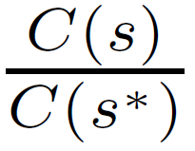
The price of anarchy
Definition
The price of anarchy of a nonatomic congestion game (N, μ, R, A, ρ, c) having equilibrium s and social cost minimizing action distribution s∗ is defined as
unless C(s∗) = 0, in which case the price of anarchy is defined to be 1

Slide 50
The price of anarchy
Intuition: the proportion of additional social cost that is incurred because of agents’ selfishness
When this ratio is close to 1, agents are routing traffic about as well as possible
When this ratio is large, agents’ selfish behavior is causing significantly suboptimal network performance
is it possible to change either the network or the agents’ behavior in order to reduce the social cost?

Slide 51
Nonatomic congestion games
input for cost functions
i
solution in equilibrium:
N = {1}
μ = {μ₁} and μ₁ = 1
Interval: [0 1]
R = {e_{top}, e_{bottom}}
A₁ = {a₁, a₂}
a₁={e_{top}}, a₂={e_{bottom}}
ρ₁(a, r)=1∀ a∈A₁, r∈ R ∩ a
ρ₁(a, r)=0 otherwise
s(a₁) = 0, s(a₂) = 1:
s_{top} = ρ₁(a₁,e_{top})*0 + ρ₁(a₂,e_{top})*1
= 1*0 + 1*1 = 1
s_{bottom} = ρ₁(a₁,e_{bottom})*0 + ρ₁(a₂,e_{bottom})*1
= 1*0 + 1*1 = 1
c_{a1}(s) = ρ₁(a₁,e_{top})*c_{top}(1) = 1*1 = 1
c_{a2}(s) = ρ₁(a₁,e_{bottom})*c_{bottom}(1) = 1*1 = 1
C(s) = 0*1 + 1*1 = 1

Slide 52
The price of anarchy
input for cost functions
N = {1}
μ = {μ₁} and μ₁ = 1
Interval: [0 1]
R = {e_{top}, e_{bottom}}
A₁ = {a₁, a₂}
a₁={e_{top}}, a₂={e_{bottom}}
ρ₁(a, r)=1∀ a∈A₁, r∈ R ∩ a
ρ₁(a, r)=0 otherwise
optimal solution
s(a₁) = ½, s(a₂) = ½:
s_{top} = ρ₁(a₁,e_{top})*½ + ρ₁(a₂,e_{top})*½
= 1*½ + 0*½ = ½
s_{bottom} = ρ₁(a₁,e_{bottom})*½ + ρ₁(a₂,e_{bottom})*½
= 0*½ + 1*½ = ½
c_{a1}(s) = ρ₁(a₁,e_{top})*c_{top}(½) = 1*1 = 1
c_{a2}(s) = ρ₁(a₁,e_{bottom})*c_{bottom}(½) = 1*½ = ½
C(s) = ½*1 + ½*½ = ¾

Slide 53
The price of anarchy
optimal solution
price of anarchy =
= 4/3
C(s*) = 0.75
solution in equilibrium
C(s) = 1

Slide 54
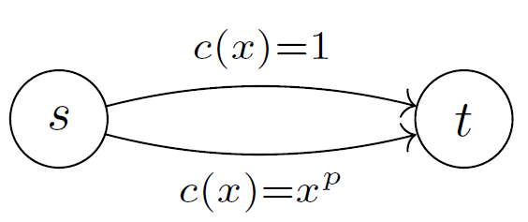
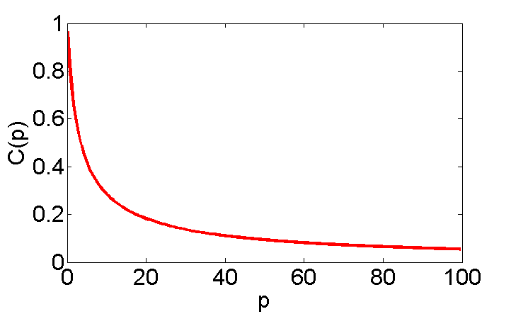
The price of anarchy
price of anarchy =
→ ∞
N = {1}
μ = {μ₁} and μ₁ = 1
solution in equilibrium
C(s) = 0*1 + 1*1 = 1
optimal solution
C(x) = (1-x) + x.x^{p}
argmin_{x}(C(x)) = (p+1)^{-1/p}
C(s*) = 1-p.(p+1)^{-(p+1)/p}
C(s*) → 0 as p → ∞

Slide 55
The price of anarchy
This example illustrates that the price of anarchy is unbounded for unrestricted cost functions
On the other hand, it turns out to be possible to offer bounds in the case where cost functions are restricted to a particular set

Slide 56
The price of anarchy
Question: how inefficient are Nash flows in more realistic networks?
Recommended reading: Selfish Routing and the Price of Anarchy, Tim Roughgarden, 2006

Slide 57
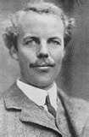
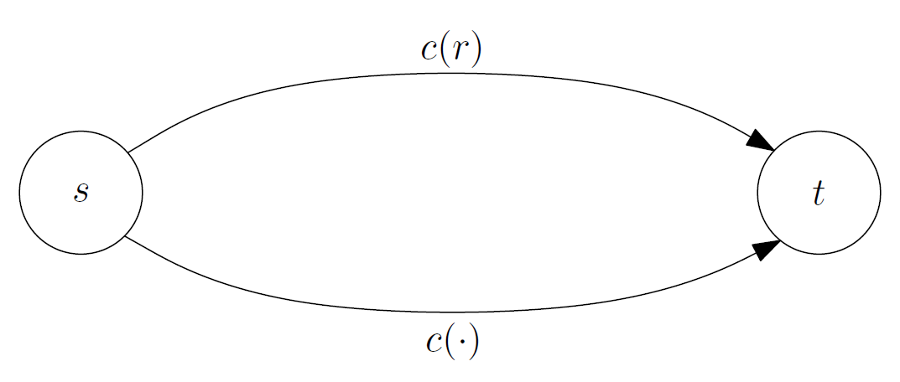
The price of anarchy
Pigou network
The economics of Welfare, 1920
Arthur C. Pigou
constant cost = c(all traffic) = c(μ)

Slide 58
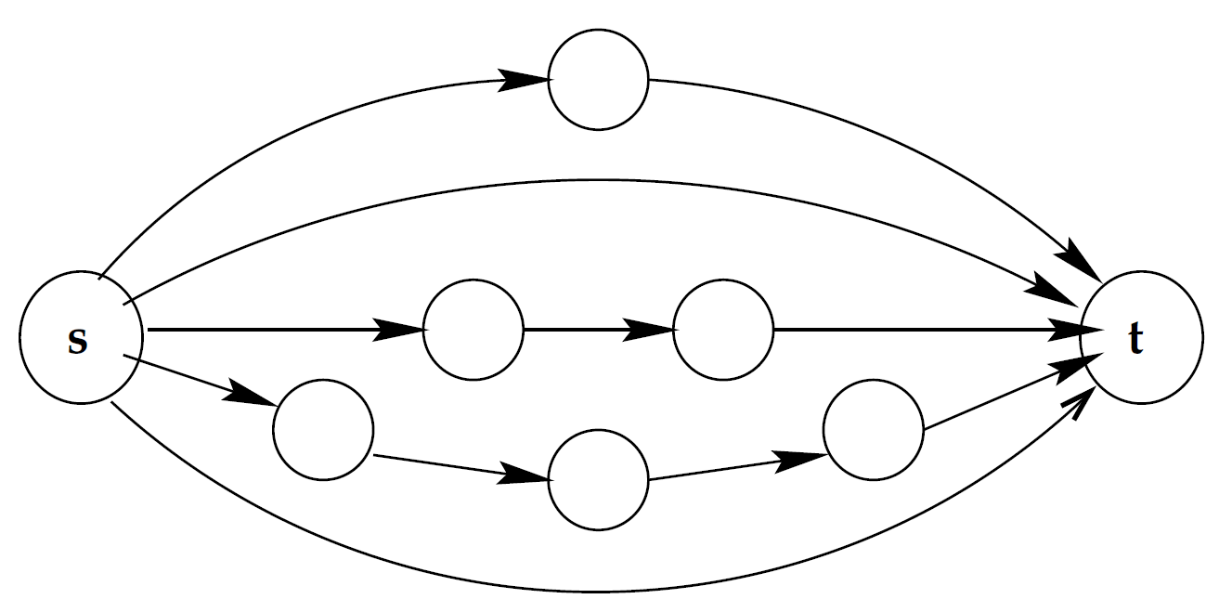
The price of anarchy
Theorem [Roughgarden 02]:
Fix any class of latency functions, and the worst price of anarchy occurs in a Pigou network
<

Slide 59
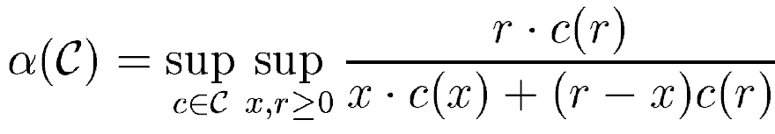
The price of anarchy
Theorem 6.4.12
The price of anarchy of a selfish routing problem whose cost functions are taken from the set C is never more than α(C), where

Slide 60
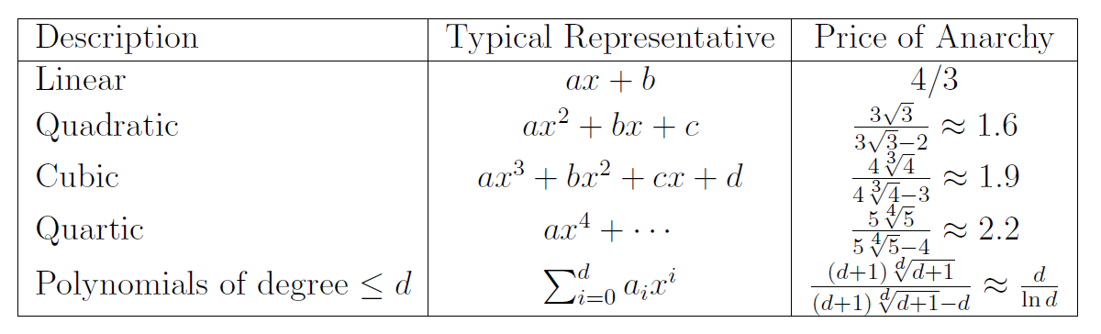
The price of anarchy
Theorem 6.4.12
The price of anarchy of a selfish routing problem whose cost functions are taken from the set C is never more than α(C)

Slide 61
Reducing the Social Cost
When the equilibrium social cost is undesirably high, a network operator might want to intervene in some way in order to reduce it

Slide 62
a
c(x)= x
c(x)=1
s
t
c(x)=1
b
c(x)= x
N = {1}
μ = {μ₁} and μ₁ = 1
R = {(s,a), (a,t), (s,b), (b,t)}
A₁ = {a₁, a₂}
a₁={(s,a), (a,t)}, a₂={(s,b), (b,t)}
ρ₁ = 1 (by definition)

Slide 63
Braess's Paradox
a
c(x)= x
c(x)=1
1/2
s
t
1/2
c(x)=1
b
c(x)= x
average latency = 1+0.5 =1.5
N = {1}
μ = {μ₁} and μ₁ = 1
R = {(s,a), (a,t), (s,b), (b,t)}
A₁ = {a₁, a₂}
a₁={(s,a), (a,t)}, a₂={(s,b), (b,t)}
ρ₁ = 1 (by definition)

Slide 64
Braess's Paradox
a
c(x)= x
c(x)=1
s
c(x)=0
t
c(x)=1
b
c(x)= x
N = {1}
μ = {μ₁} and μ₁ = 1
R = {(s,a), (a,t), (s,b), (b,t), (a,b)}
A₁ = {a₁, a₂, a₃}
a₁={(s,a), (a,t)}, a₂={(s,b), (b,t)}, a₃={(s,a), (a,b), (b,t)}
ρ₁ = 1 (by definition)

Slide 65
Braess's Paradox
a
c(x)= x
c(x)=1
1/2
s
c(x)=0
t
1/2
c(x)=1
b
c(x)= x
N = {1}
μ = {μ₁} and μ₁ = 1
R = {(s,a), (a,t), (s,b), (b,t), (a,b)}
A₁ = {a₁, a₂, a₃}
a₁={(s,a), (a,t)}, a₂={(s,b), (b,t)}, a₃={(s,a), (a,b), (b,t)}
ρ₁ = 1 (by definition)

Slide 66
Braess's Paradox
a
c(x)= x
c(x)=1
1/2
s
c(x)=0
t
1/2
c(x)=1
b
c(x)= x
N = {1}
μ = {μ₁} and μ₁ = 1
R = {(s,a), (a,t), (s,b), (b,t), (a,b)}
A₁ = {a₁, a₂, a₃}
a₁={(s,a), (a,t)}, a₂={(s,b), (b,t)}, a₃={(s,a), (a,b), (b,t)}
ρ₁ = 1 (by definition)

Slide 67
Braess's Paradox
a
c(x)= x
c(x)=1
1
s
c(x)=0
t
c(x)=1
b
c(x)= x
Average latency = 1+1 =2
N = {1}
μ = {μ₁} and μ₁ = 1
R = {(s,a), (a,t), (s,b), (b,t), (a,b)}
A₁ = {a₁, a₂, a₃}
a₁={(s,a), (a,t)}, a₂={(s,b), (b,t)}, a₃={(s,a), (a,b), (b,t)}
ρ₁ = 1 (by definition)

Slide 68
Braess's Paradox
a
c(x)= x
c(x)=1
1
s
c(x)=0
t
c(x)=1
b
c(x)= x
Average latency = 1+1 =2
PoA = 2/1.5 = 4/3
a
c(x)= x
c(x)=1
1/2
s
t
1/2
c(x)=1
b
c(x)= x
Average latency = 1+0.5 =1.5
PoA = 1.5/1.5 = 1

Slide 69
Reducing the Social Cost
Given a selfish routing problem, is it possible to find edges to remove to reduce the price of anarchy?
a
c(x)= x
c(x)=1
1
s
c(x)=0
t
c(x)=1
b
c(x)= x

Slide 70
Reducing the Social Cost
Theorem 6.4.13
It is NP-complete to determine whether there exists any set of edges whose removal from a selfish routing problem would reduce the social cost in equilibrium
This result implies that identifying the optimal set of edges to remove from a selfish routing problem in order to minimize the social cost in equilibrium is also NP-complete

Slide 71
Real world examples
In Seoul, South Korea, a speeding-up in traffic around the city was seen when a motorway was removed as part of the Cheonggyecheon restoration project
In Stuttgart, Germany after investments into the road network in 1969, the traffic situation did not improve until a section of newly built road was closed for traffic again
In 1990 the closing of 42nd street in New York City reduced the amount of congestion in the area
In 2012, scientists at the Max Planck Institute for Dynamics and Self-Organization demonstrated through computational modeling the potential for this phenomenon to occur in power transmission networks where power generation is decentralized
In 2012, a team of researchers published in Physical Review Letters a paper showing that Braess paradox may occur in mesoscopic electron systems. They showed that adding a path for electrons in a nanoscopic network paradoxically reduced its conductance

Slide 72
Reducing the Social Cost
When it is relatively inexpensive to speed up a network, doing so can have more significant benefits than getting agents to change their behavior

Slide 73
Reducing the Social Cost
Stackelberg routing
a small fraction of agents are routed centrally, and the remaining population of agents is free to choose their own actions
e.g. Pigou network
Raising edge costs
Taxes can be imposed on certain edges in the graph in order to encourage agents to adopt more socially beneficial behavior
“marginal cost pricing”: each agent pays the amount his presence cost other agents who are using the same edge

