Slide 1
Bayesian Games

Slide 2
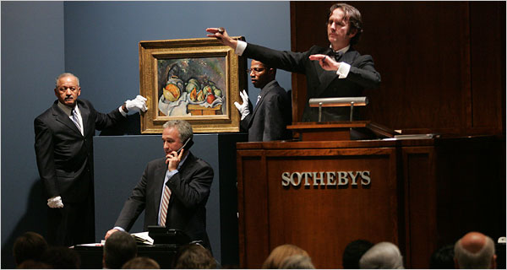
Auctions

Slide 3
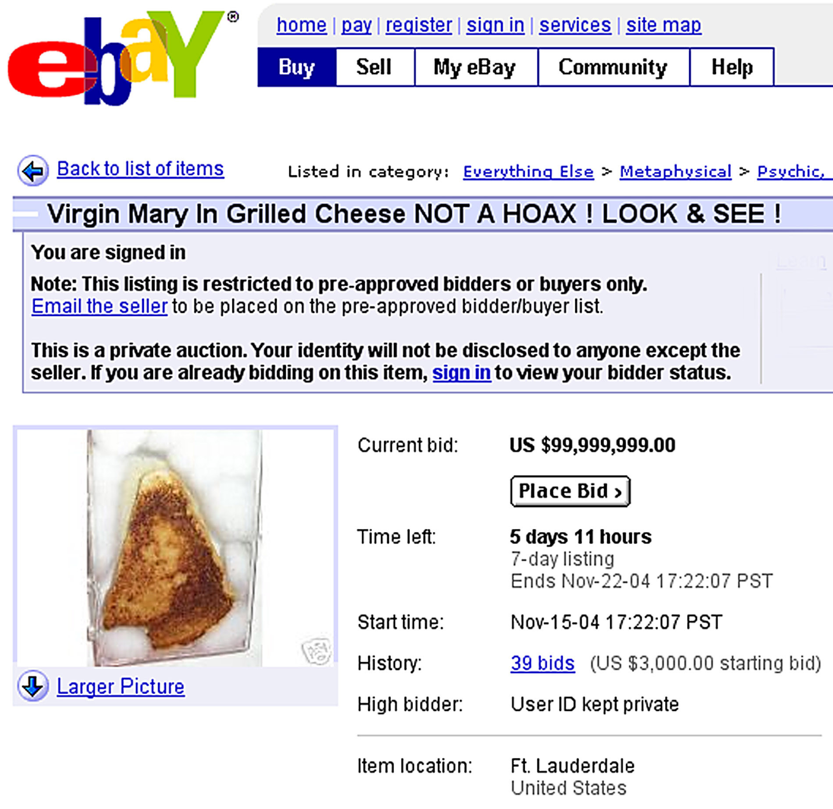
Auctions

Slide 4

Other examples

Slide 5
Very simple example
2 players
Each draw a card from a deck
The one who has the highest card wins everything
Two actions available: to bet or to check
If both bet, the game is worth $2
If both check, the game is worth $1
If one checks and the other bets, the one who bets wins

Slide 6
Bayesian Games
So far, all players know what game is being played
the number of players
the actions available for every player
the payoffs associated with each action vector
Even in imperfect information games?

Slide 7
Bayesian Games
Bayesian games allow us to represent players’ uncertainties about the very game being played
How?
This uncertainty is represented as a probability distribution over a set of possible games
Same players and actions
Different utility functions

Slide 8
Bayesian Games
We make two assumptions
1. All possible games have the same number of agents and the same strategy space for each agent; they differ only in their payoffs
2. The beliefs of the different agents are posteriors, obtained by conditioning a common prior on individual private signals

Slide 9
Bayesian Games
1. All possible games have the same number of agents and the same strategy space for each agent; they differ only in their payoffs
One can imagine many other potential types of uncertainty that players might have about the game
how many players are involved, what actions are available to each player, etc
These other types of uncertainty can be reduced to uncertainty only about payoffs via problem reformulation

Slide 10
Bayesian Games
Example: one player is uncertain about the number of actions available to the other players
We can reduce this uncertainty to uncertainty about payoffs by padding the game with irrelevant actions
E.g. a player does not know whether his opponent has only the two strategies L and R or also the third one C

Slide 11
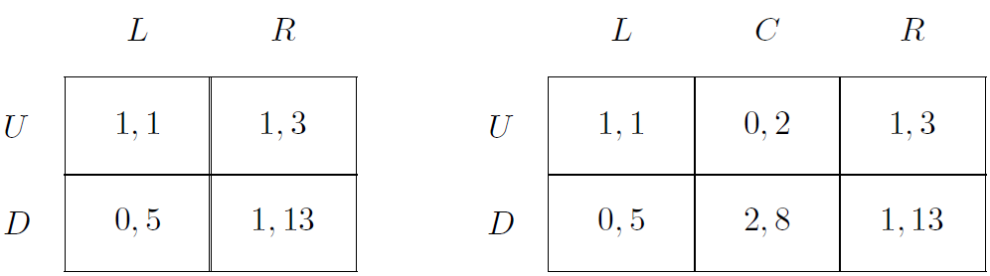
Bayesian Games
Let's change the game on the left

Slide 12
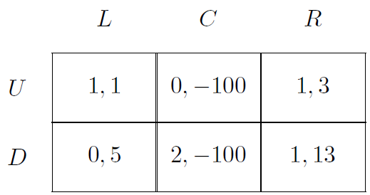
Bayesian Games
Newly added column is dominated
The uncertainty about the strategy space can be reduced to uncertainty about payoffs

Slide 13
Bayesian Games
It is possible to reduce uncertainty about other aspects of the game to uncertainty about payoffs only
reductions have been shown for all the common forms of uncertainty

Slide 14
Bayesian Games
2. The beliefs of the different agents are posteriors, obtained by conditioning a common prior on individual private signals
common prior: everybody starts with the same beliefs of what is possible in the world
individual private signals: agents might get private information about what game is being played
From the signals, they update the priors to reach a posterior

Slide 15
Bayesian Games
Still concerning Assumption #2
A bayesian game defines not only the uncertainties of agents about the game being played
but their beliefs about the beliefs of other agents about the game being played
and indeed an entire infinite hierarchy of nested beliefs (the so-called epistemic type space)

Slide 16
Definition
There are several ways of presenting Bayesian games
We will offer three different definitions
All three are equivalent, modulo some subtleties
Each formulation is useful in different settings and offers different intuition about the underlying structure of this family of games

Slide 17
Definition: Information Sets
Under this definition, a Bayesian game consists of a set of games that differ only in:
their payoffs
a common prior defined over them
a partition structure over the games for each agent

Slide 18
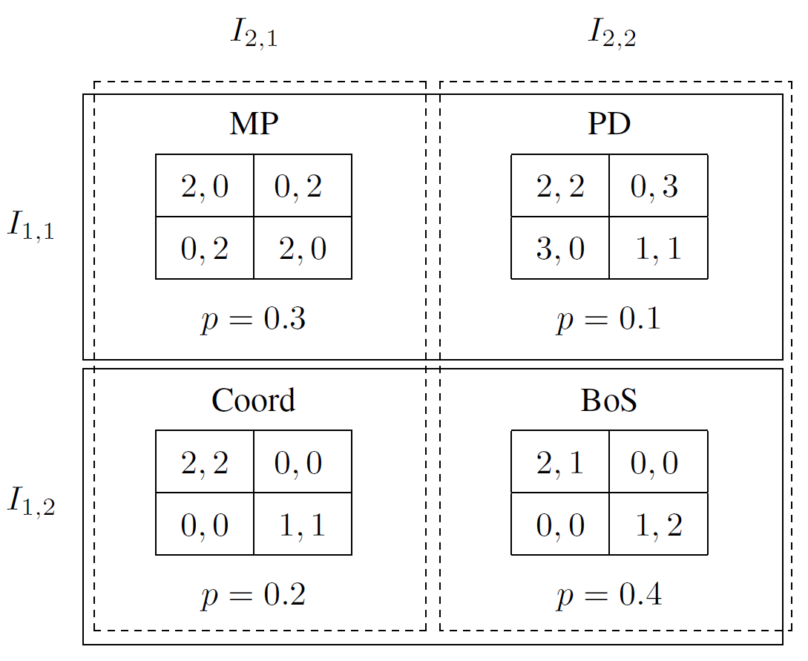
Definition: Information Sets

Slide 19
Definition: Information Sets
A Bayesian game is a tuple (N,G, P, I) where:
N is a set of agents
G is a set of games with N agents each such that if g, g′ ∈ G then for each agent i ∈ N the strategy space in g is identical to the strategy space in g′
P ∈ Π(G) is a common prior over games, where Π(G) is the set of all probability distributions over G
I = (I₁, ..., I_{N}) is a tuple of partitions of G, one for each agent

Slide 20
Definition: Extensive form with chance moves
A special agent called Nature who makes probabilistic choices
Nature makes all its choices at the beginning
Nature does not have a utility function (or a constant one payoff), and has the unique strategy of randomizing in a commonly known way
The agents receive individual signals about Nature’s choice, and these are captured by their information sets in a standard way

Slide 21
Definition: Extensive form with chance moves
The agents have no additional information
The information sets capture the fact that agents make their choices without knowing the choices of others
These chance moves of Nature require minor adjustments of existing definitions
replace payoffs by their expectations given Nature’s moves

Slide 22
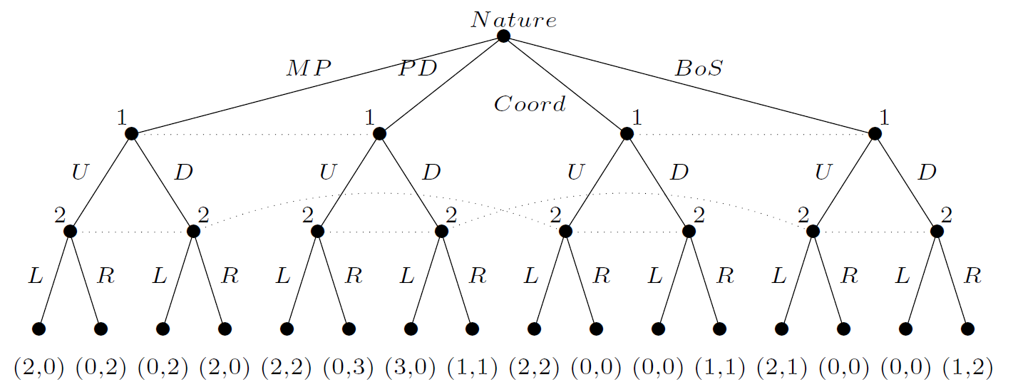
Definition: Extensive form with chance moves

Slide 23
Definition: Extensive form with chance moves
Can be initially more intuitive, but more cumbersome to work with
Use an extensive-form representation in a setting where players are unable to observe each others’ moves
For this reason, we will not make further use of this definition
One advantage: it extends very naturally to Bayesian games in which players move sequentially and do (at least sometimes) learn about previous players’ moves

Slide 24
Definition: epistemic types
Recall that a game may be defined by a set of players, actions, and utility functions
In the first definition, agents are really only uncertain about the game’s utility function
Here we use the notion of an epistemic type, or simply a type, as a way of defining uncertainty directly over a game’s utility function

Slide 25
Definition: epistemic types
Definition
Bayesian game is a tuple (N,A, Θ, p, u) where:
N is a set of agents
A = A₁ × · · · × A_{n}, where A_{i} is the set of actions available to player i
Θ = Θ₁ × . . . × Θ_{n}, where Θ_{i} is the type space of player i
p : Θ → [0, 1] is a common prior over types
u = (u₁, . . . , u_{n}), where u_{i} : A × Θ → ℝ is the utility function for player i

Slide 26
Definition: epistemic types
Definition
Bayesian game is a tuple (N,A, Θ, p, u) where:
N is a set of agents
A = A₁ × · · · × A_{n}, where A_{i} is the set of actions available to player i
Θ = Θ₁ × . . . × Θ_{n}, where Θ_{i} is the type space of player i
p : Θ → [0, 1] is a common prior over types
u = (u₁, . . . , u_{n}), where u_{i} : A × Θ → ℝ is the utility function for player i
Assumption: all of the above is common knowledge among the players

Slide 27
Definition: epistemic types
What is a type?
The type of agent encapsulates all the information possessed by the agent that is not common knowledge
This is often quite simple...
e.g. the agent’s knowledge of his private payoff function
... but can also include his beliefs about other agents’ payoffs, about their beliefs about his own payoff, and any other higher-order beliefs

Slide 28
Definition: epistemic types
For each of the agents we have two types, corresponding to his two information sets

Slide 29
Definition: epistemic types
A₁ = {U, D}
A₂ = {L, R}
Θ₁ = {θ_{1,1}, θ_{1,2}}
Θ₂ = {θ_{2,1}, θ_{2,2}}
joint distribution of these types:
p(θ_{1,1}, θ_{2,1}) = 0.3
p(θ_{1,1}, θ_{2,2}) = 0.1
p(θ_{1,2}, θ_{2,1}) = 0.2
p(θ_{1,2}, θ_{2,2}) = 0.4
the conditional probabilities for player 1:
p(θ_{2,1} | θ_{1,1}) = 3/4
p(θ_{2,2} | θ_{1,1}) = 1/4
p(θ_{2,1} | θ_{1,2}) = 1/3
p(θ_{2,2} | θ_{1,2}) = 2/3

Slide 30
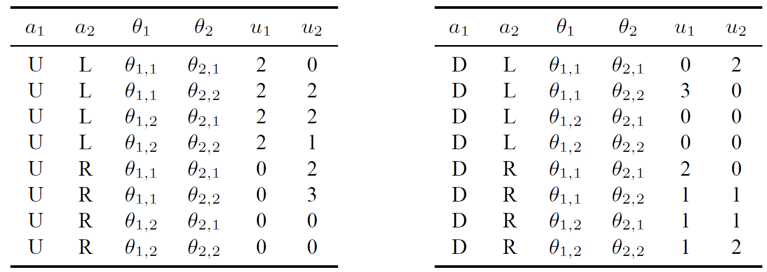
Definition: epistemic types
utility function for both players:

Slide 31
Strategies and Equilibria
How to reason about Bayesian games?
We will use the epistemic type definition
All of the concepts can also be expressed in terms of the other definitions

Slide 32
Strategies and Equilibria
What is the agent’s strategy space in a Bayesian game?
In imperfect-information extensive-form games:
a pure strategy is a mapping from information sets to actions
The definition is similar in Bayesian games:
a pure strategy α_{i} : Θ_{i} → A_{i} is a mapping from every type agent i could have to the action he would play if he had that type

Slide 33
Strategies and Equilibria
What is the agent’s strategy space in a Bayesian game?
Mixed strategies defined as probability distributions over pure strategies
A mixed strategy for i is defined as s_{i} ∈ S_{i}, where S_{i} is the set of all i’s mixed strategies
s_{j}(a_{j} | θ_{j}) to denote the probability under mixed strategy s_{j} that agent j plays action a_{j}, given that j’s type is θ_{j}

Slide 34
Other examples

Slide 35
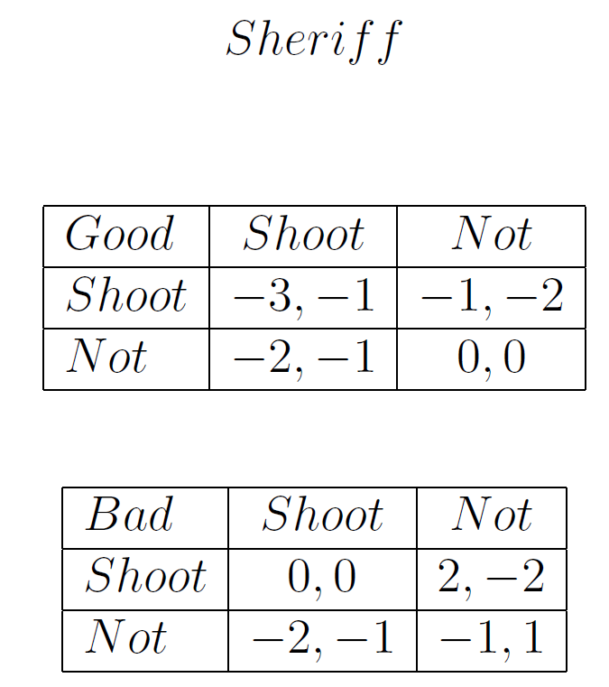
Example
Notes:
(17) GTO-6-05: Bayesian Games: Another Example - YouTube

Slide 36
Strategies and Equilibria
An environment with multiple sources of uncertainty
What is the expected utility of an agent?
Three meaningful notions of expected utility
ex post
computed based on all agents’ actual types
ex interim
agent knows his own type but not the types of the other agents
ex ante
agent does not know anybody’s type

Slide 37
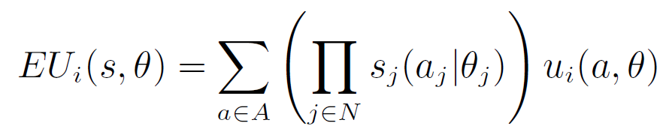
Ex post expected utility
Agent i’s ex post expected utility in a Bayesian game (N, A, Θ, p, u), where the agents’ strategies are given by s and the agent’ types are given by θ, is defined as
In this case, the only uncertainty concerns the other agents’ mixed strategies

Slide 38
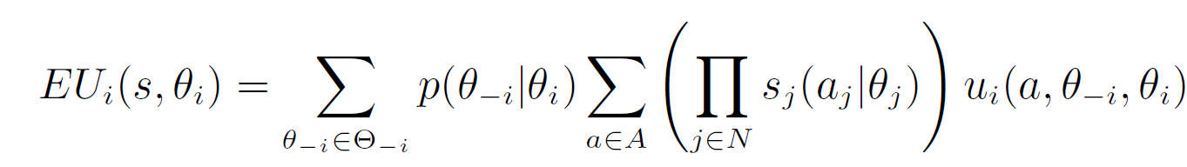
Ex interim expected utility
Agent i’s ex interim expected utility in a Bayesian game (N, A, Θ, p, u), where i’s type is θ_{i} and where the agents’ strategies are given by the mixed-strategy profile s, is defined as
i must consider every assignment of types to the other agents θ_{−i} and every pure action profile a in order to evaluate his utility function u_{i}(a, θ_{i}, θ_{−i})

Slide 39
Ex interim expected utility
Agent i’s ex interim expected utility in a Bayesian game (N, A, Θ, p, u), where i’s type is θ_{i} and where the agents’ strategies are given by the mixed-strategy profile s, is defined as
Utility of i is weighted by
(1) the probability that the other players’ types would be θ_{−i} given that his own type is θ_{i}
(2) the probability that the pure action profile a would be realized given all players’ mixed strategies and types

Slide 40
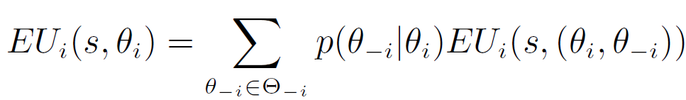
Ex interim expected utility
Agent i’s ex interim expected utility in a Bayesian game (N, A, Θ, p, u), where i’s type is θ_{i} and where the agents’ strategies are given by the mixed-strategy profile s, is defined as
Uncertainty over mixed strategies was already handled in the ex post case
Thus, we can also write ex interim expected utility as a weighted sum of EU_{i}(s, θ) terms

Slide 41
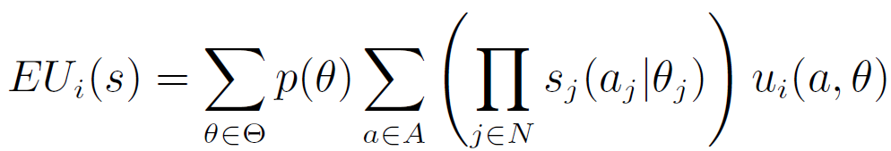
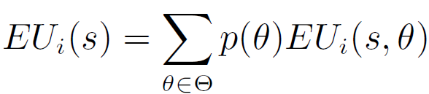
Ex ante expected utility
Agent i’s ex ante expected utility in a Bayesian game (N, A, Θ, p, u), where the agents’ strategies are given by the mixed-strategy profile s, is defined as
or
ex post
or
ex interim

Slide 42
Best response
The set of agent i’s best response to mixed-strategy profile s_{−i} are given by
what EU is this?
BR_{i} is a set because there may be many strategies for i that yield the same expected utility

Slide 43
Best response
It may seem odd that BR is calculated based on i’s ex ante EU
However, write EU_{i}(s) as
Observe that EU_{i}(s_{i}′, s_{−i}, θ_{i}) does not depend on strategies that i would play if his type were not θ_{i}
We are in fact performing independent maximization of i’s ex interim expected utilities conditioned on each type that he could have

Slide 44
Best response
Intuitively speaking, if a certain action is best after the signal is received, it is also the best conditional plan devised ahead of time for what to do should that signal be received

Slide 45
Bayes–Nash equilibrium
A Bayes–Nash equilibrium is a mixed strategy profile s that satisfies ∀i s_{i} ∈ BR_{i}(s_{−i})
This is exactly the definition we gave for the Nash equilibrium
each agent plays a best response to the strategies of the other players
Difference: built on top of the Bayesian game definitions of best response and expected utility

Slide 46
Bayes–Nash equilibrium
Observe that we would not be able to define equilibrium in this way if an agent’s strategies were not defined for every possible type
In order for a given agent i to play a best response to the other agents −i, i must know what strategy each agent would play for each of his possible types
Without this information, it would be impossible to evaluate the term EU_{i}(s_{i}′, s_{−i}) in previous equations

Slide 47
Bayes–Nash equilibrium
A BNE is a set of strategies, one for each type of player, such that no type has incentive to change his or her strategy given the beliefs about the types and what the other types are doing

Slide 48
Computing Equilibria
Despite its similarity to the Nash equilibrium, the Bayes–Nash equilibrium may seem conceptually more complicated
However, as we did with extensive-form games, we can construct a normal-form representation that corresponds to a given Bayesian game

Slide 49
Computing Equilibria
The induced normal form for Bayesian games has an action for every pure strategy
The actions for an agent i are the distinct mappings from Θ_{i} to A_{i}
Each agent i’s payoff given a pure-strategy profile s is his ex ante expected utility under s

Slide 50
Computing Equilibria
Then, the Bayes–Nash equilibria are precisely the Nash equilibria of its induced normal form
Nash’s theorem applies directly to Bayesian games, i.e.,Bayes–Nash equilibria always exist

Slide 51
Example

Slide 52
Example

Slide 53
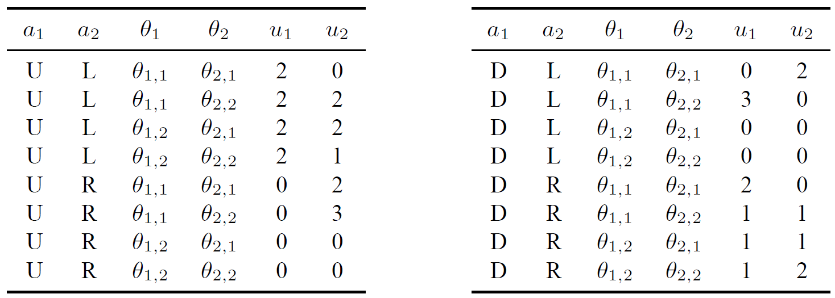
Computing Equilibria

Slide 54
Computing Equilibria
Each agent has four possible pure strategies
two types and two actions
Player 1’s four strategies in the Bayesian game can be labeled UU, UD, DU, and DD
UU means that 1 chooses U regardless of his type
UD that he chooses U when he has type θ_{1,1} and D when he has type θ_{1,2}, and so forth
Similarly, we can denote the strategies of player 2 in the Bayesian game by RR, RL, LR, and LL

Slide 55
Computing Equilibria
What if each agent has 2 actions and 3 types?
UUU, UUD, UDU, UDD, DUU, DUD, DDU, DDD
or 2³ (|A_{i}|^|Θ_{i}|) pure strategies in the induced normal form game

Slide 56
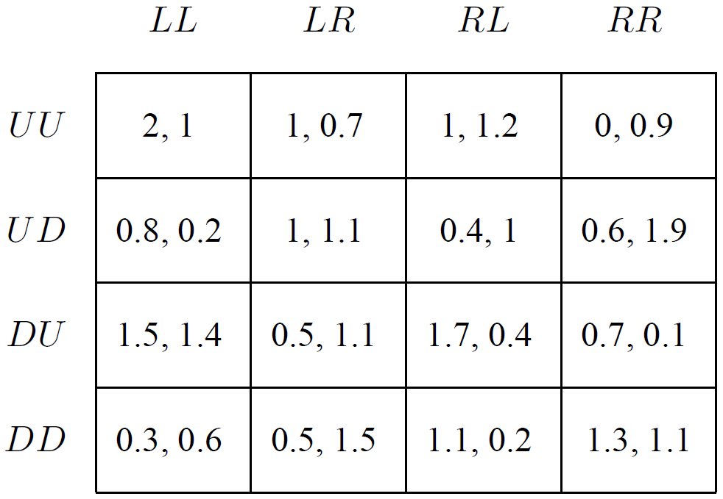
Computing Equilibria
4 × 4 normal-form game
these are the four strategies of the two agents
the payoffs are the expected payoffs in the individual games given the agents’ common prior beliefs

Slide 57
Reminder: ex ante expected utility
Agent i’s ex ante expected utility in a Bayesian game (N, A, Θ, p, u), where the agents’ strategies are given by the mixed-strategy profile s, is defined as
or
ex post
or
ex interim

Slide 58
Computing Equilibria
For example, player 2’s ex ante expected utility under the strategy profile (UU,LL) is calculated as:

Slide 59
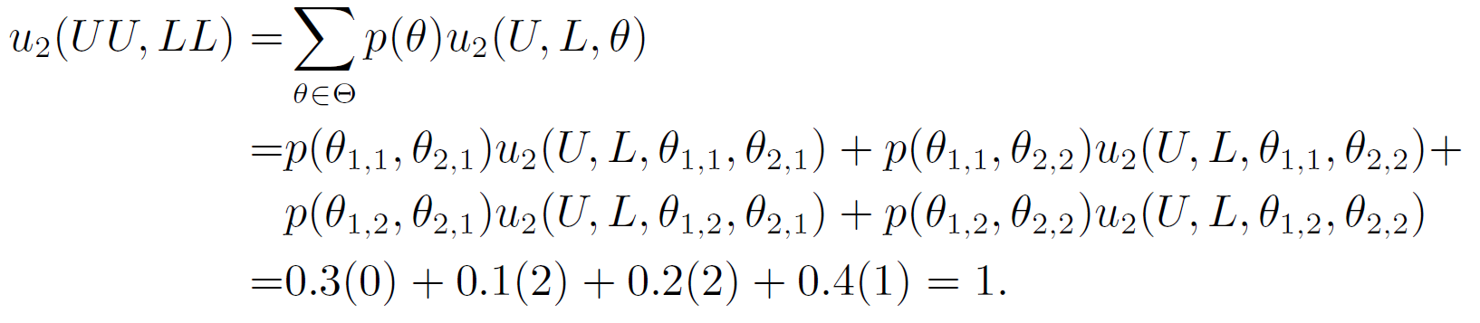
Computing Equilibria

Slide 60
Computing Equilibria

Slide 61
Computing Equilibria
Now the game may be analyzed straightforwardly
e.g.: player 1’s best response to RL is DU

Slide 62
Computing Equilibria
Given a particular signal, the agent can compute the posterior probabilities and recompute the expected utility of any given strategy vector
Thus in the previous example once the row agent gets the signal θ_{1,1} he can update the expected payoffs and compute the new game

Slide 63
Computing Equilibria

Slide 64
Computing Equilibria
p=0.75
p=0.25
p=0
p=0

Slide 65
p=0.75
p=0.25
p=0
p=0

Slide 66
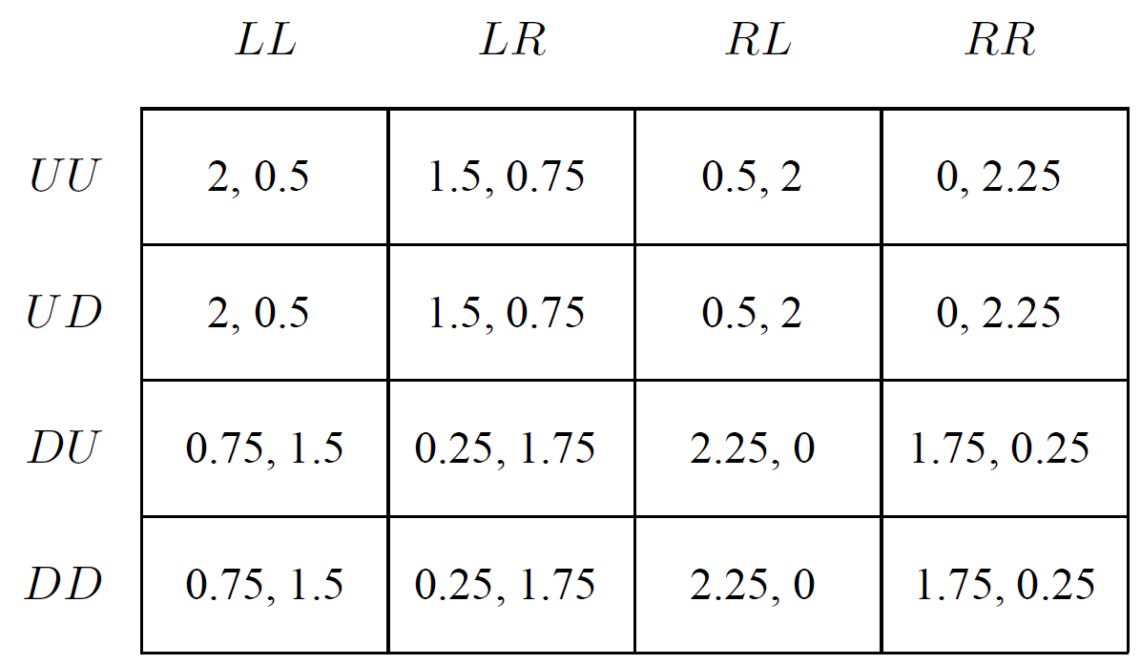
p=0.75
p=0.25
p=0
p=0

Slide 67
Computing Equilibria

Slide 68
Computing Equilibria
DU is still a best response to RL
But it won't always be the case
The row player’s payoffs are now independent of his choice of which action to take upon observing type θ_{1,2}
conditional on observing type θ_{1,1} the player needs only to select a single action U or D
this ex interim induced normal form could be written with four columns but only two rows

Slide 69
Computing Equilibria
Although we can use this matrix to find best responses for player 1, it turns out to be meaningless to analyze the Nash equilibria
Why? :(

Slide 70
Computing Equilibria
Although we can use this matrix to find best responses for player 1, it turns out to be meaningless to analyze the Nash equilibria
these expected payoffs are not common knowledge
if the column player were to condition on his signal, he would arrive at a different set of numbers
It is only in the induced normal form in which the payoffs do not correspond to any ex interim assessment of any agent, that the Nash equilibria are meaningful

Slide 71
Computing Equilibria
Expectmax algorithm
efficient for Bayesian games written using the “extensive form with chance moves” formulation
more details in the book

Slide 72
Dominance in Bayesian Games
Ex ante dominated strategy: a strategy for a player such that an alternative strategy for that player provides a greater payoff for that player regardless of all other players' strategies
Interim dominated strategy: a strategy for a type such that an alternative strategy for that type provides a greater payoff for that type regardless of all other players' strategies

Slide 73
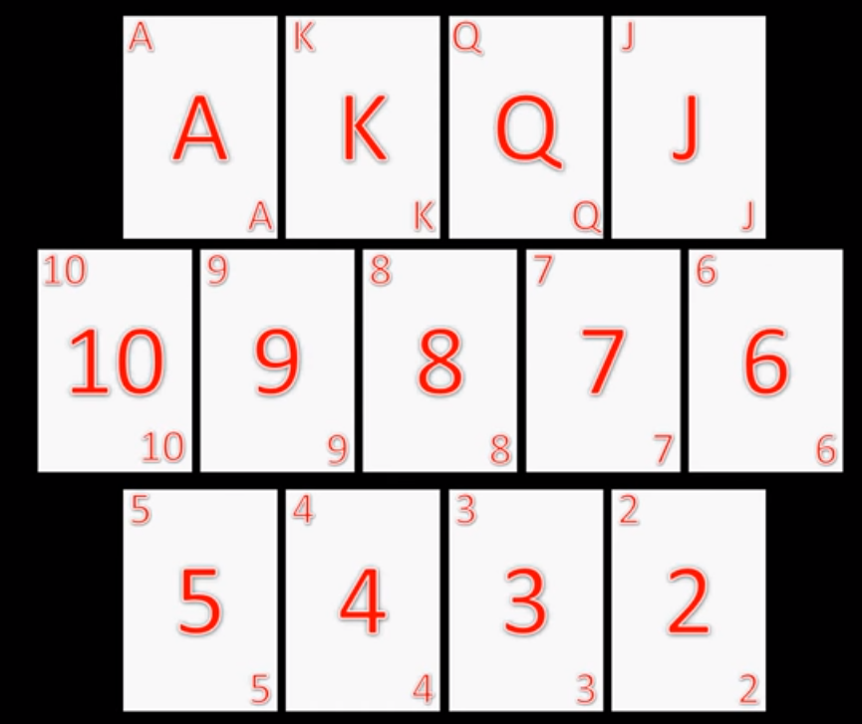
Dominance in Bayesian Games
ex ante dominance

Slide 74
Dominance in Bayesian Games
interim dominance

Slide 75
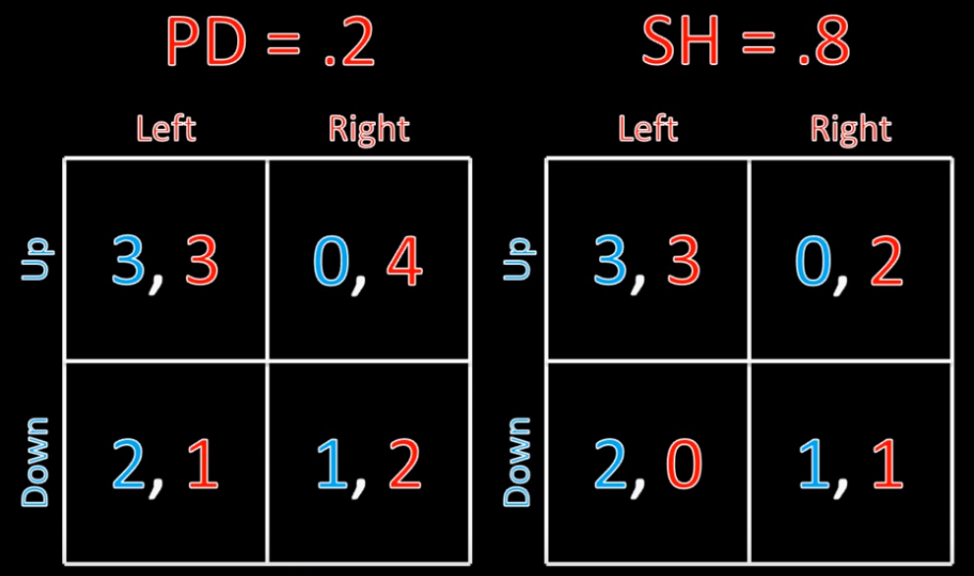
Dominance in Bayesian Games

Slide 76
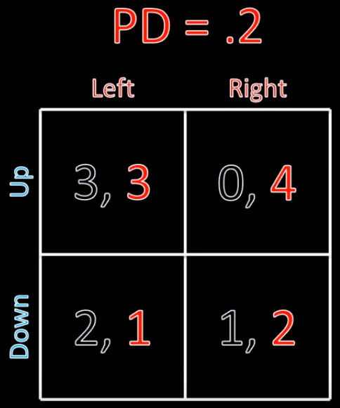
Dominance in Bayesian Games
interim dominance

Slide 77
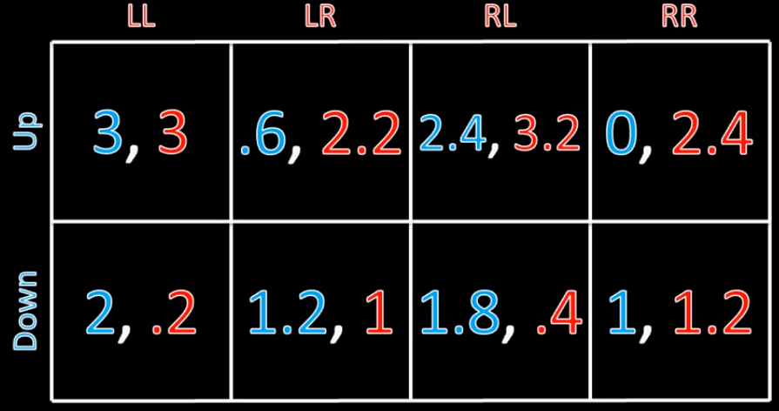
Dominance in Bayesian Games
ex ante dominance

Slide 78
Dominance in Bayesian Games
If a strategy is interim dominated, then it is ex ante dominated
The converse is not true: if a strategy is ex ante dominated, there may or may not be any corresponding interim dominance

Slide 79
An example
Player 1 has one type. What Player 2 should do?
Is there any dominated strategy?
A = 0.5
B = 0.5
 | Left | Right
Up | 0, 2 | 2, 5
Down | 2, 2 | 0, 1
 | Left | Right
Up | 0, 4 | 2, 5
Down | 2, 4 | 0, 1
Claim: RL ex ante strictly dominates LR

Slide 80
Another example
Player 2 know his type. What is the solution of this game?
Are there any dominant strategies?
PD = 0.9
SH = 0.1
 | Left | Right
Up | 3, 3 | 0, 4
Down | 2, 1 | 1, 2
 | Left | Right
Up | 3, 3 | 0, 2
Down | 2, 0 | 1, 1
Claim: Player 1 should play ‘Down’

Slide 81
Why Are There Antes in Poker?
Two players, each will draw a card at random

Slide 82
Why Are There Antes in Poker?
Two players, each will draw a card at random
Θ_{i} = {2, 3, ..., J, Q, K, A)
They will privately check the card and choose between two actions
bet 1$
fold
If at least one player folds, each gets $0
If both bet, the one with the highest card gets $1, the other loses $1

Slide 83
Why Are There Antes in Poker?
What would you play?
Naive strategy:
if I have a card higher than 8, I bet, else, I fold
Why is this strategy naive?
because it is not the rational solution

Slide 84
Why Are There Antes in Poker?
First observation:
impracticable to construct the matrix form of this game
Each player has 13 types
Each player has 2^13 pure strategies
Game matrix: 8192 x 8192

Slide 85
Why Are There Antes in Poker?
What would you do if you have an Ace?
bet weakly dominates fold

Slide 86
Why Are There Antes in Poker?
What would you do if you have a 2?
fold
What would you do if you have a 3?
fold, because if the other player has a 2, she will fold
What would you do if you have a 4?
...

Slide 87
Why Are There Antes in Poker?
If there were not antes in poker, only the unbeatable type has incentive to bet

Slide 88
Ex post equilibrium
Working with ex post utilities allows us to define an equilibrium concept that is stronger than the Bayes–Nash equilibrium
Definition
An ex post equilibrium is a mixed-strategy profile s that satisfies

Slide 89
Ex post equilibrium
This definition does not presume that each agent actually does know the others’ types
It says that no agent would ever want to deviate from his mixed strategy even if he knew the complete type vector θ
This form of equilibrium is appealing because it is unaffected by perturbations in the type distribution p(θ)

Slide 90
Ex post equilibrium
An ex post equilibrium does not ever require any agent to believe that the others have accurate beliefs about his own type distribution
a standard Bayes–Nash equilibrium can imply this requirement
The ex post equilibrium is similar to equilibria in dominant strategies, which do not require any belief that other agents act rationally
Since many dominant strategy equilibria are also ex post equilibria, it is easy to believe that this relationship always holds

Slide 91
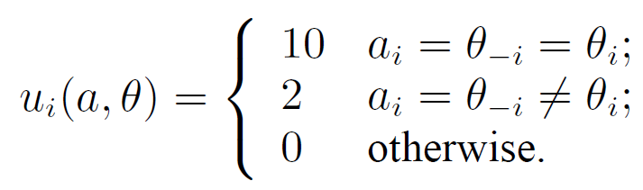
Ex post equilibrium
Consider a two-player Bayesian game
each agent has two actions and two corresponding types: ∀_{i∈N}, A_{i} = Θ_{i} = {H,L}
distributed uniformly: ∀_{i∈N}, P(θ_{i} = H) = 0.5
the same utility function for each agent i:

Slide 92
Ex post equilibrium

Slide 93
Ex post equilibrium
What is the ex interim dominant strategy?
play θ_{i}
What is the ex post best strategy?
play θ_{-i}
An equilibrium in these dominant strategies is not ex post

Slide 94
Ex post equilibrium
Unfortunately, similar to equilibria in dominant strategies is that neither kind of equilibrium is guaranteed to exist :(

Slide 95
Recommended Lectures
Game Theory 101 Course from William Spaniel
From (#64) to (#68)
starts at: https://www.youtube.com/watch?v=AzN-eV_Na10

