Slide 1
Introduction to Python
Principles and Practice

Slide 2
Agenda
Learning Strategies
Architecture
Resources

Slide 3
Learning Strategies
Space out your practice sessions
Don’t cut-and-paste code – type it out
Errors and warnings are learning opportunities
Get something working and build from there
Stuck? Ask for help!

Slide 4
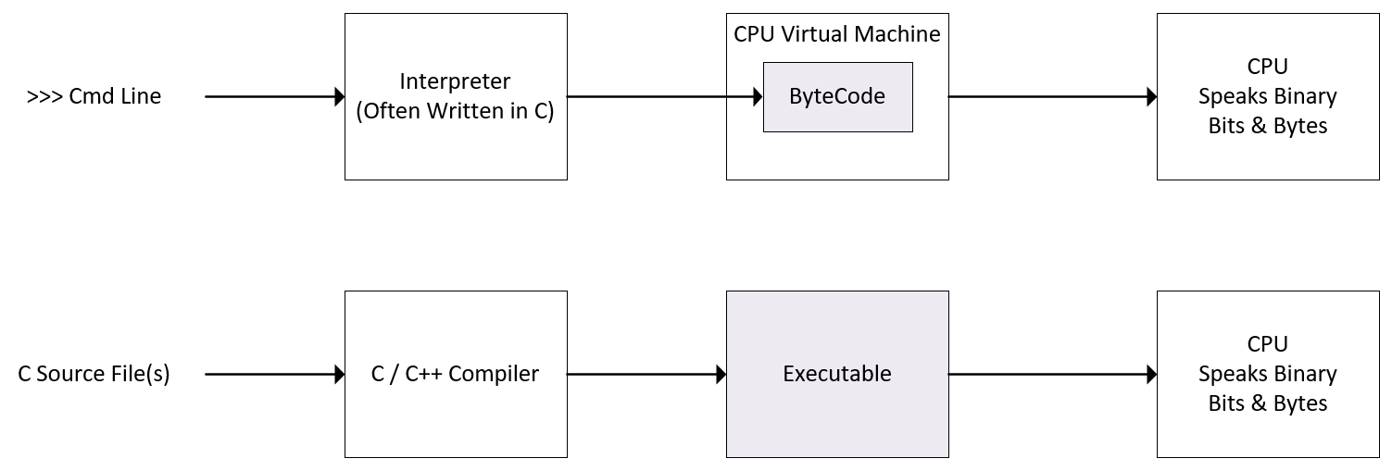
Architecture (Interpreted Languages)
Notes:
Interpreted languages are much slower than compiled languages. When performance matters, an interpreted language may not be the best solution. If that’s the case with you, Nvidia provides the Cuda development environment which supports the C and C++ languages. These are compiled languages as opposed to interpreted.

Slide 5
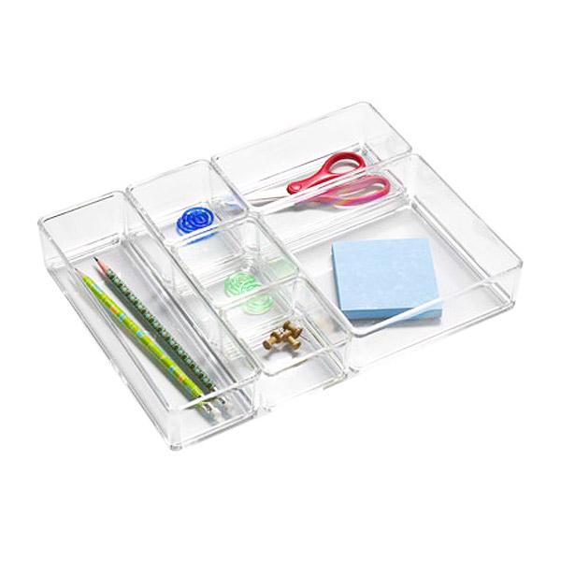
Architecture (Variables)
Notes:
In computer science, a variable is a named location in memory. Consider this clear plastic container with a variety of objects in it. Each object is a specific size and takes up a certain amount of space. Now think of this container as your computer’s memory. Each time you create and assign a specific value to a variable, the software allocates space in memory large enough to contain whatever you assign to it. Or using a container analogy, it creates a box to hold its value. The variable’s datatype determines the amount of memory required to hold it, just as we see in this picture. Behind the name you use for a variable, there’s a hidden address or pointer to its location or compartment in memory.

Slide 6

Retrieval Practice
Notes:
Okay – let’s wrap everything up with a short quiz. Retrieval practice is important when you’re learning a new topic. So think of this as a trip to the A.I. gym! Take 10 minutes to answer the questions at the link provided in Chat. Afterwards, we’ll reconvene and discuss your responses.

Slide 7
Resources
Text, text, text

