Slide 1

“COD Version 2 API” documentation Review

Slide 2



Beta Team Webinar
9 April 2021

Slide 3
Overview
Navigating the Documentation:
Metadata endpoints:
Those that will show more detail about individual datasets or components, such as contributor and dates.
Services endpoints:
Those that offer capabilities for viewing or querying data, such as vector tiles and lookups.
Download endpoints:
Those that will yield a dataset including geometry (usually), or supporting documents
https://beta.itos.uga.edu/CODV2API/Help

Slide 4

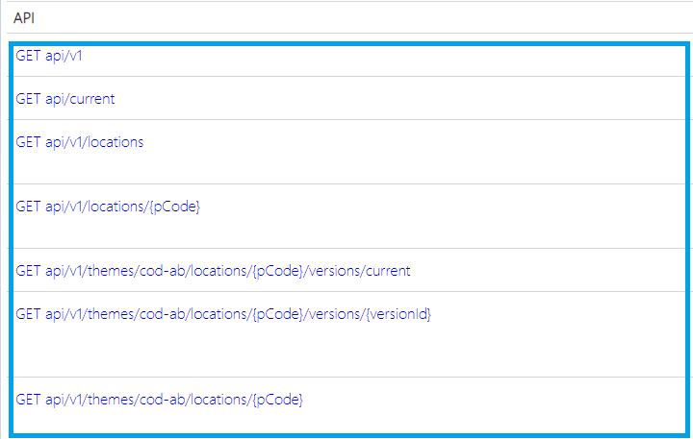
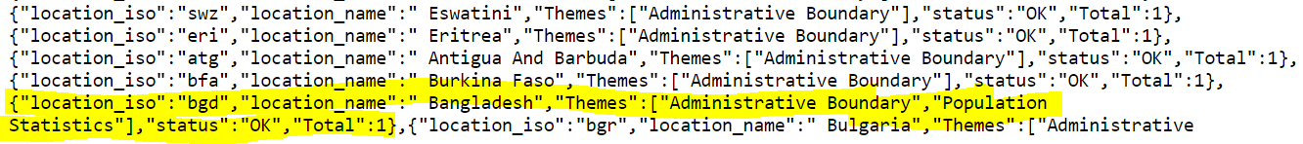

Slide 5


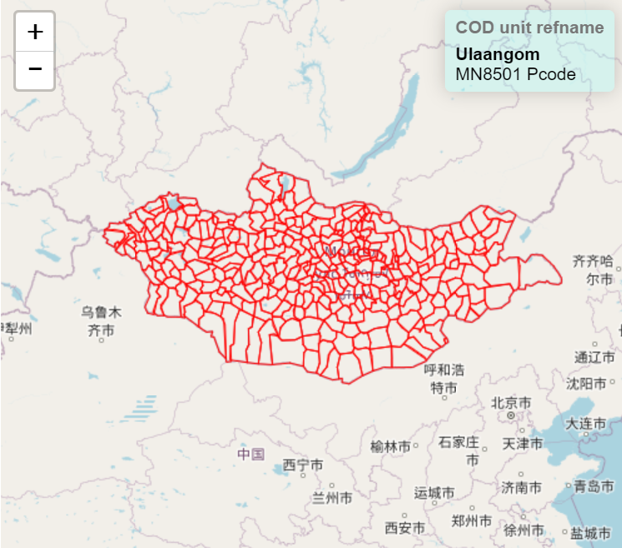
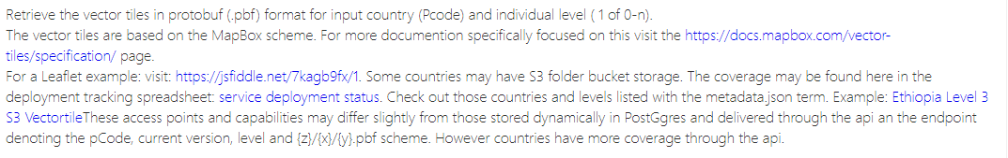

Slide 6

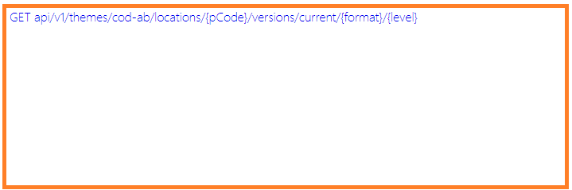
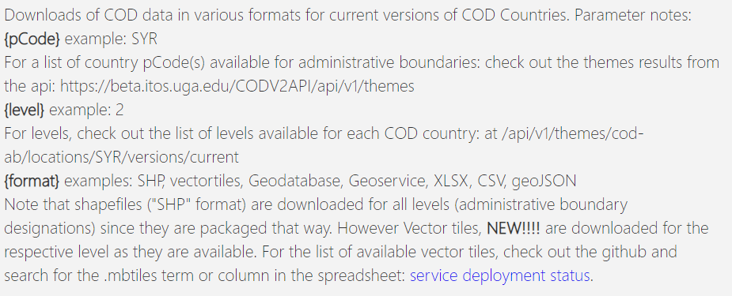

Slide 7
Using the help through a use case
I need to get the current vector tile dataset at a location
1. Check the documentation Https://beta.itos.uga.edu/CODV2API/Help
2. Ok. I see there are protobuf (.pbf)/folder support, I actually want to use this in QGIS.
Wait! I see there are .mbtiles file services. I see the parameters. What is my country ISO code? Is the country available?
I see the document that indicates available coverage has a link directly
to the download. I’ll enter that in the browser address.
3. https://beta.itos.uga.edu/CODV2API/api/v1/themes/cod-ab/locations/SOM/versions/current/vectortiles/2

Slide 8
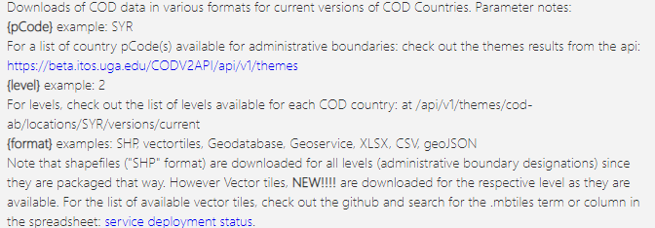
Using the help through a use case
I need to get the current vector tile dataset at a location

Slide 9
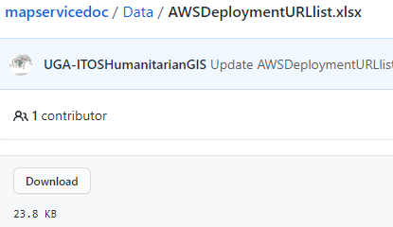
Using the help through a use case
I need to get the current vector tile dataset at a location

Slide 10



Using the help through a use case
I need to get the current vector tile dataset at a location

Slide 11

Using the help through a use case
I need to get the current vector tile dataset at a location
Use the API to verify the location country ISO code and profile of administrative levels

Slide 12
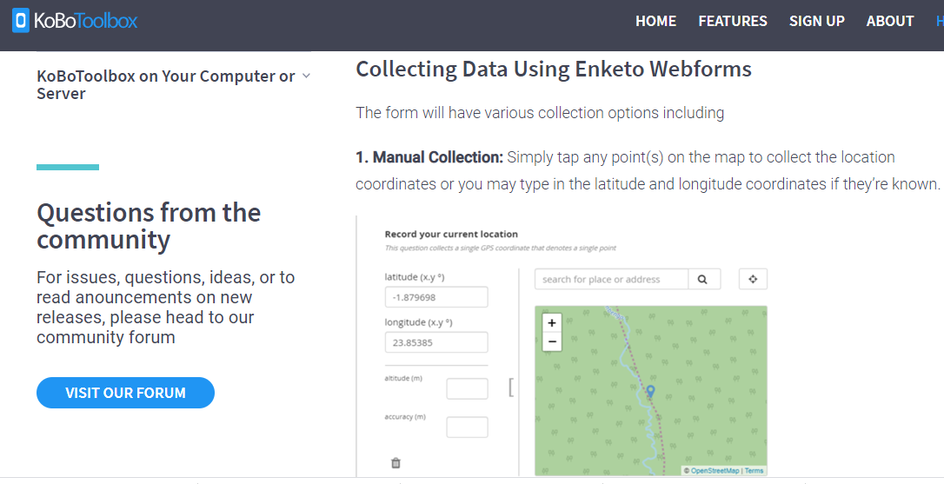
Using the help through a use case
I need to get the current vector tile dataset at a location
Use the API to verify the location country ISO code and profile of administrative levels….
using a lookup with latitude and longitude
Latitude and longitude
-as obtained through Kobo tools>>>
Or ArcGIS Online

Slide 13
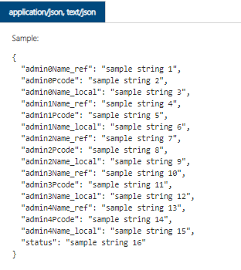
Using the help through a use case
I need to get the current vector tile dataset at a location
Use the API to verify the location country ISO code and profile of administrative levels….
using a lookup with latitude and longitude

Slide 14
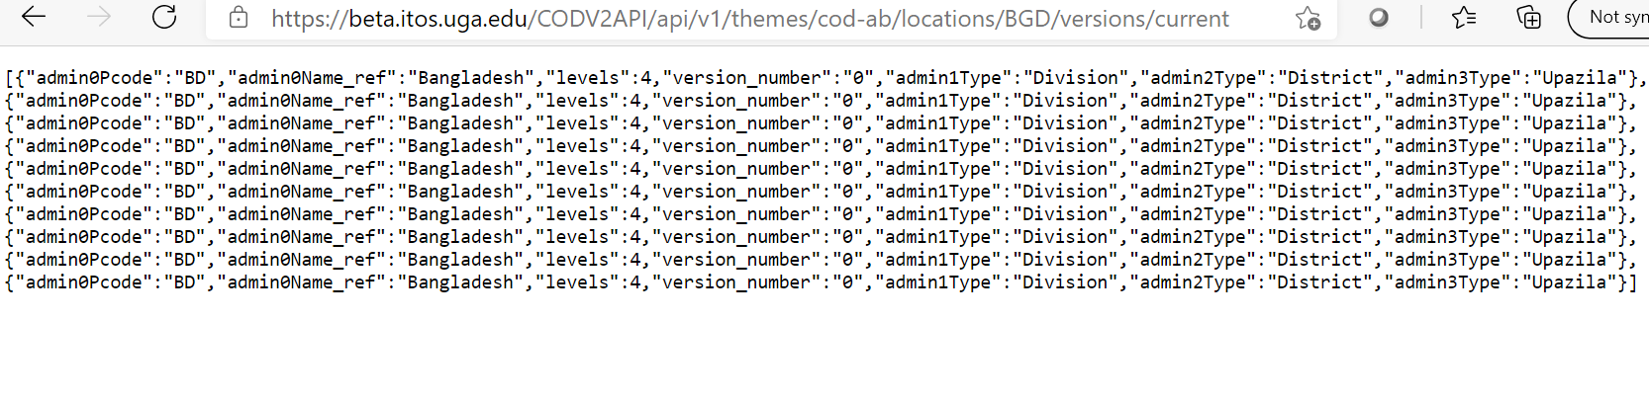
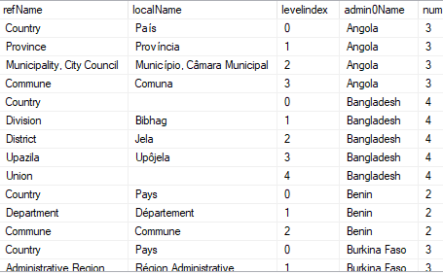
ApI datastore & API Endpoint Result
Reference names are output by country dataset in
Results:
Datastore stores local names for administrative levels of each country

Slide 15
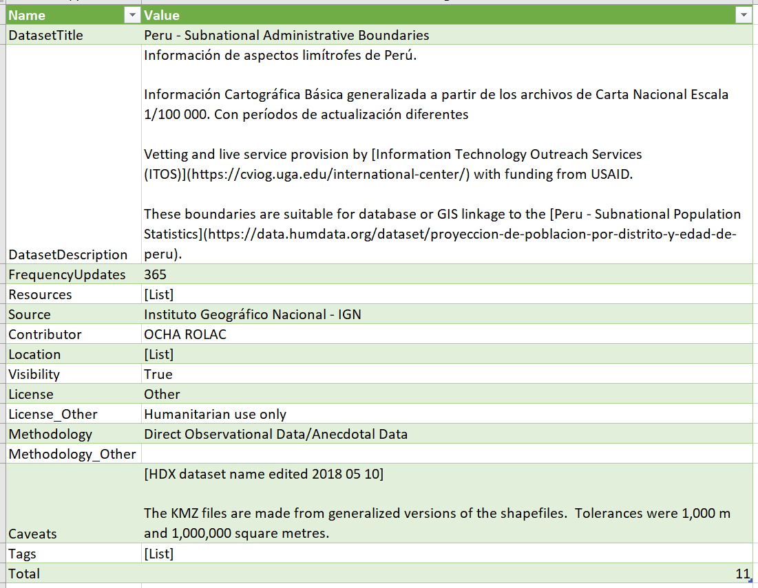
Interoperability COD Services ApI live in Excel

Slide 16
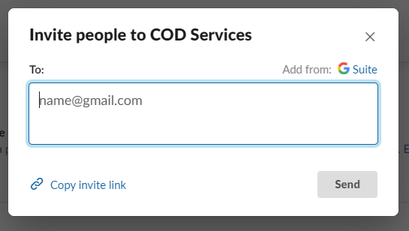
Support and Feedback
Options:
Slack:
Helpdesk
https://join.slack.com/t/cod-services/shared_invite/zt-oni7fxee-QHzb0q6EdoJZpFYQ8Sf4QQ
(cod-services.slack.com)

Slide 17
Beta Team Webinar
Thank you!

