Slide 1

Edited for GitHub

Slide 2
GPA1-B Instructions
Zachary Grantham
1/12/25

Slide 3
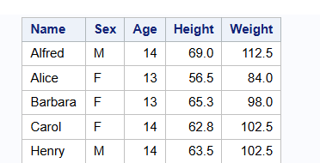

Slide 4
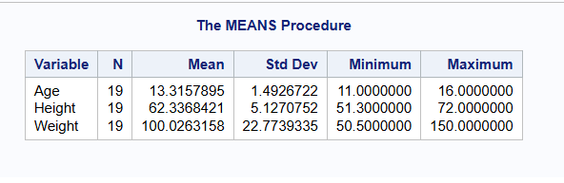

Slide 5
