Slide 1
GPA1-B Instructions
Zachary Grantham
1/12/25

Slide 2
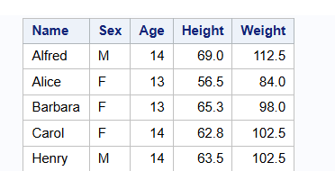

Slide 3
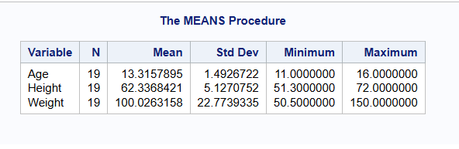

Slide 4
