Slide 1
6LoWPAN: an IoT ready protocol
Davide Gallitelli
Giulia Angarano

Slide 2
6LoWPAN: why so acronymous?
Definition
Overview
Great idea! But… possible?
OSI Model
Addressing: 802.15.4 Standard for WSN
Physical and Data link layers
Adaptation Layer:
Mesh Routing
Routing protocols
Fragmentation
Header Compression
Network, Transport and Application Layers
Embedded
Applications
Summary

Slide 3
6LoWPAN: why so acronymous?
6LoWPAN
or
6LowPAN
IPv6
Low Power
Personal Area Network
IPv6
Wireless
Personal Area Network

Slide 4

Definition
“IPv6 over Low power Wireless Personal Area Network”
- IETF
It is the working group name in the IETF (Internet Engineering Task Force).
The IETF 6LoWPAN working group was formed in 2004 to address the challenge of enabling wireless IPv6 communication over the newly standardized IEEE 802.15.4 low-power radio for devices with limited space, power and memory, such as sensor nodes.

Slide 5
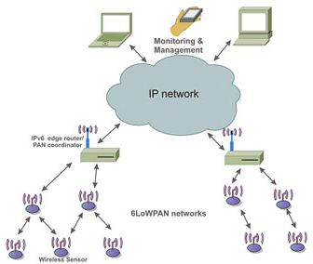
Overview
Born to give IP communication capabilities to a WSN
The Internet Protocol could and should be applied even to the smallest devices, and low-power devices with limited processing capabilities should be able to participate in the Internet of Things.

Slide 6

Great idea! But… possible?
PROBLEMS:
Addressing the large amount of devices in a PAN
Devices have short range for communicating
IPv6 addresses differ A LOT from PAN addresses
PANs have low memory: not all of them are made to go online
Redirecting packets in and from/to the network

Slide 7
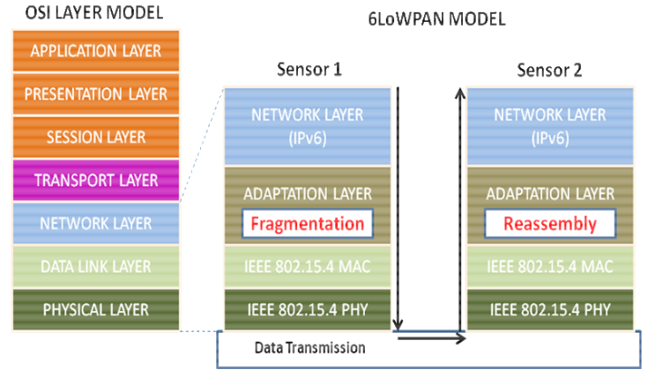
OSI Model

Slide 8
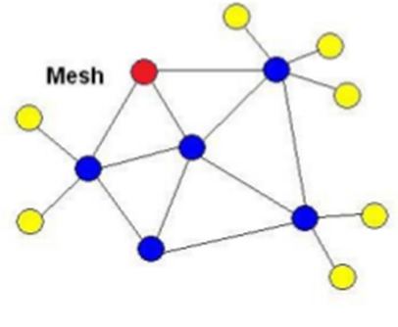
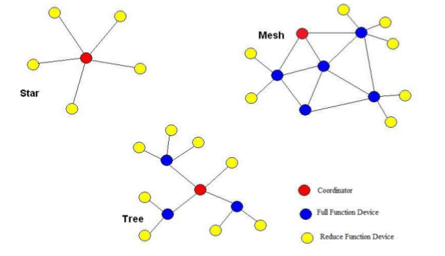
Addressing: 802.15.4 Standard for WSN
Devices:
RFD (Reduced Function Device)
FFD (Full Function Device)
Coordinator manages multihop
network
Topologies:
Star
Tree
Mesh

Slide 9
Addressing: 802.15.4 Standard for WSN
Devices can communicate between PANs (inter-PAN) or within their own PAN (intra-PAN)
Each PAN has a PAN-ID made by a 16-bit number
This PAN-ID is assigned as a short address to a device as soon as it joins the network by the PAN Coordinator; it is used for intra-PAN communication.
Apart from that, every device has a 64-bit extended address which is globally unique; this is used for inter-PAN communication.

Slide 10
Physical and Data link layers
The PHY layer provides the basic communication capabilities of the physical radio.
It is based on IEEE 802.15.4 with a data rate of 250 Kbps and operating frequency of 2.4 GHz; the Physical layer PDU (Protocol Data Unit) is IEEE 802.15.4 compliant with a maximum payload of 127 bytes.
The Data Link layer provides services to enable reliable, single-hop communication links between devices.
The MAC PDU is IEEE 802.15.4 compliant.
It’s the layer responsible for managing the routing of the packets.

Slide 11
OSI Model

Slide 12
Adaptation Layer: Mesh Routing
In order to save energy, the 802.15.4 standard enables communication at the 2.4 GHz frequency. However, that means that devices can comunicate at high frequency, but with short range.
This can be solved via the mesh routing, or multi-hops, and mesh addressing, by the adaptation layer.
It’s the ability to route messages through multiple hops on the network between source and destination;
The transfer of data goes from node to node until it reaches the destination or a gateway for IP communication;
The mesh addressing is made underneath the IPv6 layer and it is composed by the originator address, the final destination address and the hops left. The hops left are decremented by each forwarding node before sending this packet towards its next hop.
The mesh routing is designed into 802.15.4, but left to the adaptation layer or network layer.

Slide 13
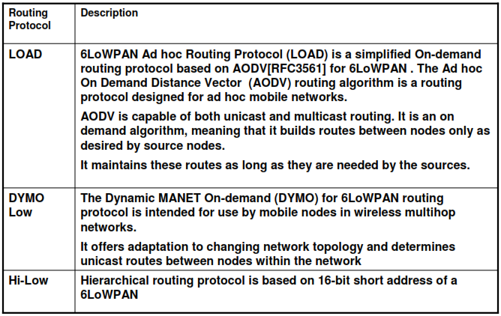
Adaptation Layer: Routing protocols
Routing is just not limited to intra-PAN and inter-PAN, packets need to be routed to/from the IPv6 domain from/to the PAN domain
Routing protocols should have low routing overhead (low chattiness), balanced with supporting topology changes and power conservation. The computation and memory requirements in the routing protocol should be minimal to satisfy the low cost and low power objectives.
For this specifical reason, routing protocols are being currently developed such as in the table:
DSR | The DSR is designed specifically for use in multi-hop wireless ad hoc networks of mobile nodes. DSR allows the network to be completely self-organizing and self-configuring, without the need for any existing network infrastructure or administration.

Slide 14
Adaptation Layer: Fragmentation
IPv6 has an MTU requirement of 1280 bytes.
IEEE 802.15.4 has a maximum frame size of 128 bytes.
Thus, it would require more packets to be sent, dividing the frame in more than 16 fragments.
The adaptation layer has to face and solve this problem, attaching to all of the fragments of an IP packet:
a “tag”, assigned at the source of the fragmentation;
a size field, encoding the entire size of the IP packet before link-layer fragmentation;
a byte for the offset field, to distinguish subsequent packets.

Slide 15
Adaptation Layer: Header Compression
TCP/IP headers are too large for IEEE 802.15.4 frames
Of 127 bytes available in a 802.15.4 frame:
25 bytes for 802.15.4 frame header
21 bytes for link-layer security
leaving 81 bytes
40 bytes for IPv6 header
20 bytes for TCP
8 bytes for UDP and ICMP
leaving only 13 bytes for the payload!
Thus, compression is necessary to transmit any information.

Slide 16
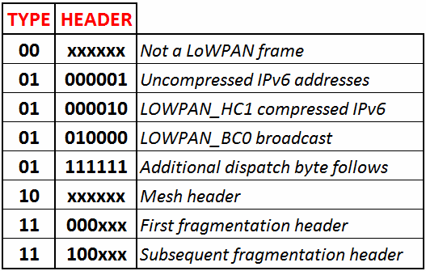
Adaptation Layer: Header Compression
A 6LoWPAN header includes, in order, of Mesh Addressing Header, Broadcast Header, Fragmentation Header, IPv6 Header, and UDP Header.
To distinguish between the different possible headers, the first byte is a special one, called Dispatch, assuming values shown in the table.
From this byte, it can be understood which headers are present and which are compressed.
The 40 bytes can be represented even with only 2 bytes, one of which is the LOWPAN_HC1 compressed IPv6 header, which specifies if the following fields are compressed or not by eliminating those who can be retrieved somehow or that are fixed. Every bit of this HC1_header represents if a certain field is uncompressed or deleted.

Slide 17
OSI Model

Slide 18
Network, Transport and Application Layers
Network Layer
Transport Layer
Application Layer
It's the one giving the capability to "go online" to sensor nodes
The network management is handled with SNMP (Simple Network Management Protocol)
Responsible for delivering data to the appropriate process on the host computers
Usually via TCP or UDP
6LoWPAN specific application using socket interface
Many brands have come out with their own applications based on the 6LoWPAN standard

Slide 19
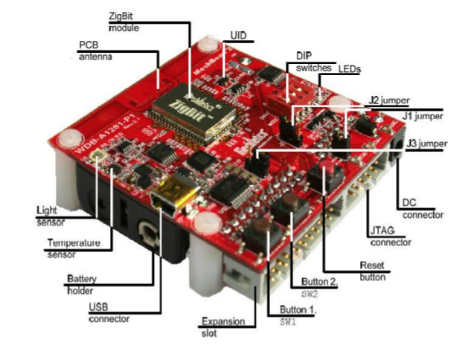
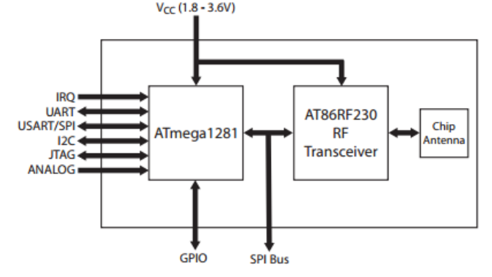
Embedded: MeshBean2
Parameter | Value
Compliance | 2.4 GHz IEEE 802.15.4
Operating Band | 2400-2483 MHz
TX Output Power | [-17 dBm to +3 dBm]
RF Transceiver | AT86RF230-ZU
Antenna | 2,4 GHz
Microcontroller | ATMega1281V
Ram/Flash Memory/EEPROM | 8 kBytes/128 kBytes/4 kBytes
Power Supply | Duall AA, auto switch to USB
Operating Voltage Range | 1.8-3.6 V

Slide 20
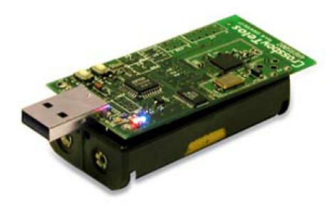

Embedded: Crossbow TelosB Mote
802.15.4 compliant
Integrated Onboard antenna
8 MHz TI MSP430 microcontroller
10 kBytes RAM
1 MB external flash for data logging
Programmable via USB
Runs TinyOS or Contiki
More info, follow the QR:

Slide 21


IoT Enabled OS
Contiki OS
«I run on Atari 8-bit and Commodore!»
TinyOS
«Keep tasks small»

Slide 22
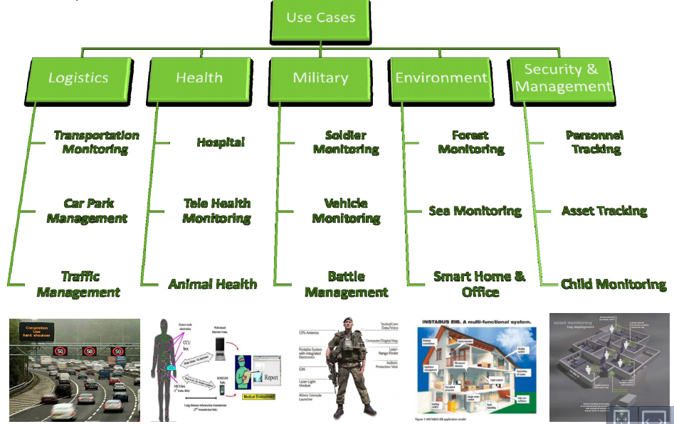

Applications
Others include:
Equipment Health Monitoring
Environment Monitoring
Security
Home and Industrial Automation
Energy Efficiency (Smart Grid)
Flexible RFID infrastructures and uses

Slide 23
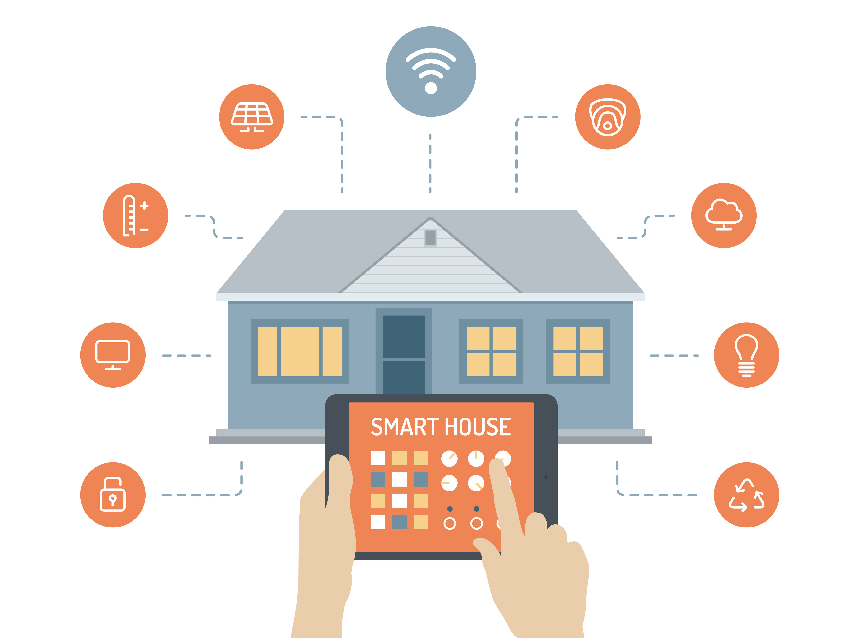
Smart House
6LoWPAN can offer local or remote access from the Internet to monitor the home via sensor but also to control it via actuators
With a more sophisticated system, it can also be possible to monitor energy consumption and optimize it
Smart Grid interaction.
Home to Grid: report of Kwatts
Grid to Home: receive load informations
The perfect topology would be the tree, with a coordinator in each room to work on his set number of sensors.

Slide 24

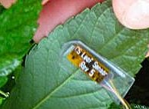
Automated Vineyard
Medium to large vineyard
~100 FFD manually deployed to provide full signal coverage over the study area
A leaf node per vine can join the network, communicating datas from these sensors with a FFD in a local wireless star topology. Actuators for sprinklers and hail-proof covers are also in the network.
The bigger the field, the more FFD working as aggregator for the leaf nodes.
All battery powered, or even solar powered!

Slide 25
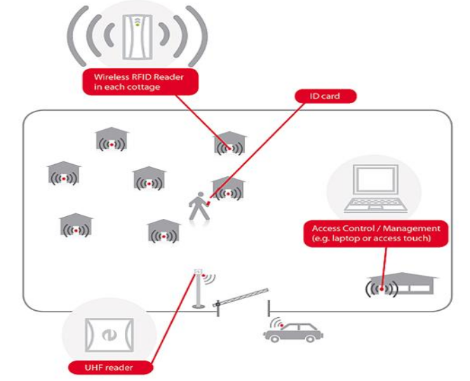
RFID + 6LoWPAN: a camping village
Access restricted with ID card from Reception
Cabling all the RFID readers would be expensive and time consuming
All the RFID readers are instead wirelessly connected to a network, managed from Reception

Slide 26

Q & A Time!

Slide 27

Thank you!
Davide Gallitelli
Giulia Angarano
https://goo.gl/Y833D2

