Slide 1

The Server-side JavaScript
Vikash Singh

Slide 2
What to expect ahead….
Introduction
Some (Confusing) Theory
5 Examples
A couple of weird diagrams
2 Pics showing unbelievable benchmarks
Some stuff from Internet
And Homer Simpson

Slide 3
Background
V8 is an open source JavaScript engine developed by Google. Its written in C++ and is used in Google Chrome Browser.
Node.js runs on V8.
It was created by Ryan Dahl in 2009.
Is still in Beta phase. Latest version is 0.6.11
Is Open Source. It runs well on Linux systems, can also run on Windows systems.
If you have worked on EventMachine (Ruby) or Python’s Twisted or Perl’s AnyEvent framework then following presentation is going to be very easy.

Slide 4
Introduction: Basic
In simple words Node.js is ‘server-side JavaScript’.
In not-so-simple words Node.js is a high-performance network applications framework, well optimized for high concurrent environments.
It’s a command line tool.
In ‘Node.js’ , ‘.js’ doesn’t mean that its solely written JavaScript. It is 40% JS and 60% C++.
From the official site:
‘Node's goal is to provide an easy way to build scalable network programs’ - (from nodejs.org!)

Slide 5
Introduction: Advanced (& Confusing)
Node.js uses an event-driven, non-blocking I/O model, which makes it lightweight. (from nodejs.org!)
It makes use of event-loops via JavaScript’s callback functionality to implement the non-blocking I/O.
Programs for Node.js are written in JavaScript but not in the same JavaScript we are use to. There is no DOM implementation provided by Node.js, i.e. you can not do this:
var element = document.getElementById(“elementId”);
Everything inside Node.js runs in a single-thread.

Slide 6
Example-1: Getting Started & Hello World
Install/build Node.js.
(Yes! Windows installer is available!)
Open your favorite editor and start typing JavaScript.
When you are done, open cmd/terminal and type this:
‘node YOUR_FILE.js’
Here is a simple example, which prints ‘hello world’
var sys = require(“sys”);
setTimeout(function(){
sys.puts(“world”);},3000);
sys.puts(“hello”);
//it prints ‘hello’ first and waits for 3 seconds and then prints ‘world’

Slide 7
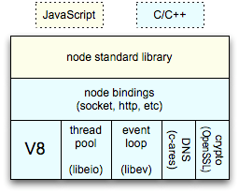
Some Theory: Event-loops
Event-loops are the core of event-driven programming, almost all the UI programs use event-loops to track the user event, for example: Clicks, Ajax Requests etc.
Client
Clients send HTTP requests
to Node.js server
Event loop returns
result to client
Event loop
(main thread)
An Event-loop is woken up by OS,
passes request and response objects
to the thread-pool
Long-running jobs run
on worker threads
Response is sent
back to main thread
via callback
C++ Threadpool
(worker threads)

Slide 8
Some Theory: Non-Blocking I/O
Traditional I/O
var result = db.query(“select x from table_Y”);
doSomethingWith(result); //wait for result!
doSomethingWithOutResult(); //execution is blocked!
Non-traditional, Non-blocking I/O
db.query(“select x from table_Y”,function (result){
doSomethingWith(result); //wait for result!
});
doSomethingWithOutResult(); //executes without any delay!

Slide 9
What can you do with Node.js ?
You can create an HTTP server and print ‘hello world’ on the browser in just 4 lines of JavaScript. (Example included)
You can create a TCP server similar to HTTP server, in just 4 lines of JavaScript. (Example included)
You can create a DNS server.
You can create a Static File Server.
You can create a Web Chat Application like GTalk in the browser.
Node.js can also be used for creating online games, collaboration tools or anything which sends updates to the user in real-time.

Slide 10
Example -2 &3 (HTTP Server & TCP Server)
Following code creates an HTTP Server and prints ‘Hello World’ on the browser:
var http = require('http');
http.createServer(function (req, res) {
res.writeHead(200, {'Content-Type': 'text/plain'});
res.end('Hello World\n'); }).listen(5000, "127.0.0.1");
Here is an example of a simple TCP server which listens on port 6000 and echoes whatever you send it:
var net = require('net');
net.createServer(function (socket) {
socket.write("Echo server\r\n");
socket.pipe(socket); }).listen(6000, "127.0.0.1");

Slide 11
Node.js Ecosystem
Node.js heavily relies on modules, in previous examples require keyword loaded the http & net modules.
Creating a module is easy, just put your JavaScript code in a separate js file and include it in your code by using keyword require, like:
var modulex = require(‘./modulex’);
Libraries in Node.js are called packages and they can be installed by typing
npm install “package_name”; //package should be available in npm registry @ nmpjs.org
NPM (Node Package Manager) comes bundled with Node.js installation.

Slide 12
Example-4: Lets connect to a DB (MongoDB)
Install mongojs using npm, a mongoDB driver for Node.js
npm install mongojs
Code to retrieve all the documents from a collection:
var db = require("mongojs")
.connect("localhost:27017/test", ['test']);
db.test.find({}, function(err, posts) {
if( err || !posts) console.log("No posts found");
else posts.forEach( function(post) {
console.log(post);
});
});

Slide 13
When to use Node.js?
Node.js is good for creating streaming based real-time services, web chat applications, static file servers etc.
If you need high level concurrency and not worried about CPU-cycles.
If you are great at writing JavaScript code because then you can use the same language at both the places: server-side and client-side.
More can be found at: http://stackoverflow.com/questions/5062614/how-to-decide-when-to-use-nodejs

Slide 14
Example-5: Twitter Streaming
Install nTwitter module using npm:
Npm install ntwitter
Code:
var twitter = require('ntwitter');
var twit = new twitter({
consumer_key: ‘c_key’,
consumer_secret: ‘c_secret’,
access_token_key: ‘token_key’,
access_token_secret: ‘token_secret’});
twit.stream('statuses/sample', function(stream) {
stream.on('data', function (data) {
console.log(data); });
});

Slide 15


Slide 16
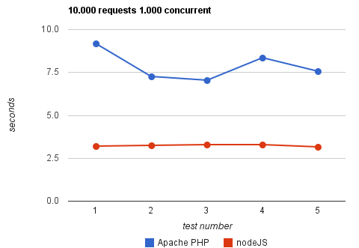
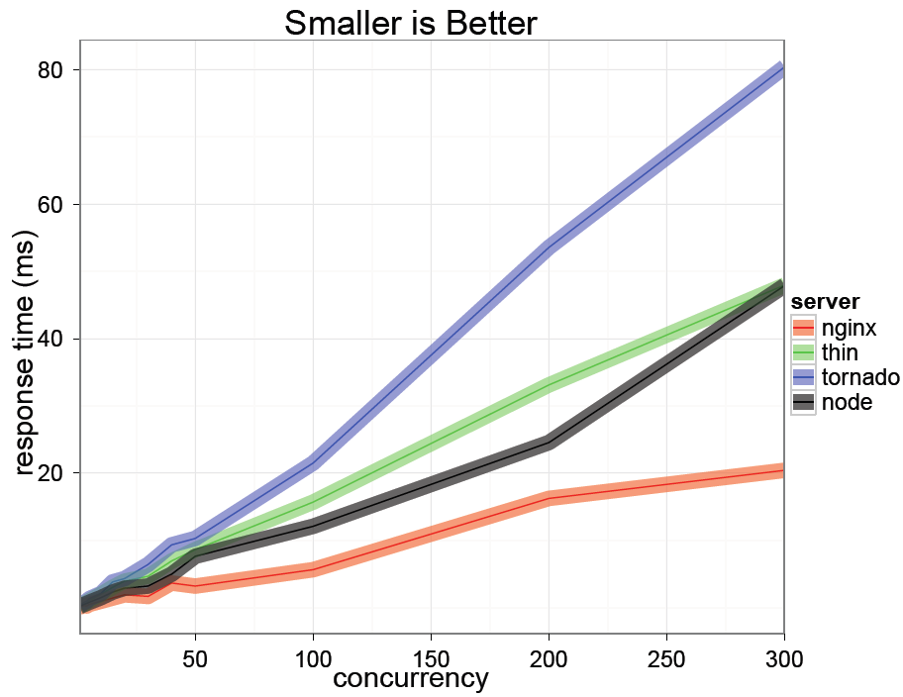
Some Node.js benchmarks
Taken from: http://code.google.com/p/node-js-vs-apache-php-benchmark/wiki/Tests
A benchmark between Apache+PHP and node.js, shows the response time for 1000 concurrent connections making 10,000 requests each, for 5 tests.
Taken from: http://nodejs.org/jsconf2010.pdf
The benchmark shows the response time in milli-secs for 4 evented servers.

Slide 17
When to not use Node.js
When you are doing heavy and CPU intensive calculations on server side, because event-loops are CPU hungry.
Node.js API is still in beta, it keeps on changing a lot from one revision to another and there is a very little backward compatibility. Most of the packages are also unstable. Therefore is not yet production ready.
Node.js is a no match for enterprise level application frameworks like Spring(java), Django(python), Symfony(php) etc. Applications written on such platforms are meant to be highly user interactive and involve complex business logic.
Read further on disadvantages of Node.js on Quora: http://www.quora.com/What-are-the-disadvantages-of-using-Node-js

Slide 18
Appendix-1: Who is using Node.js in production?
Yahoo! : iPad App Livestand uses Yahoo! Manhattan framework which is based on Node.js.
LinkedIn : LinkedIn uses a combination of Node.js and MongoDB for its mobile platform. iOS and Android apps are based on it.
eBay : Uses Node.js along with ql.io to help application developers in improving eBay’s end user experience.
Dow Jones : The WSJ Social front-end is written completely in Node.js, using Express.js, and many other modules.
Complete list can be found at: https://github.com/joyent/node/wiki/Projects,-Applications,-and-Companies-Using-Node

Slide 19
Appendix-2: Resource to get started
Watch this video at Youtube: http://www.youtube.com/watch?v=jo_B4LTHi3I
Read the free O’reilly Book ‘Up and Running with Node.js’ @ http://ofps.oreilly.com/titles/9781449398583/
Visit www.nodejs.org for Info/News about Node.js
Watch Node.js tutorials @ http://nodetuts.com/
For Info on MongoDB: http://www.mongodb.org/display/DOCS/Home
For anything else Google!

Slide 20
Appendix-3: Some Good Modules
Express – to make things simpler e.g. syntax, DB connections.
Jade – HTML template system
Socket.IO – to create real-time apps
Nodemon – to monitor Node.js and push change automatically
CoffeeScript – for easier JavaScript development
Find out more about some widely used Node.js modules at: http://blog.nodejitsu.com/top-node-module-creators

Slide 21


