Slide 1
GLOBALIZATION AND INEQUALITY
“ No society can surely be flourishing and happy of which by far the greater part of the numbers are poor and miserable” (Adam Smith, 1976)
Dr. Ratan Kumar Ghosal
Reader in Economics
University of Calcutta
Kolkata,
West Bengal, India.

Slide 2
OBJECTIVE OF STUDY:
To examine the nature of inequalities in the distribution of income, poverty and well being of people at the intra- country and cross-country level during the period of globalization.
To see whether the conventional Kuznetsian perception of inequality (i.e. inverted “U” hypothesis) holds or not by fitting cross country kuznets curve.
To account for the cross country differentials in the well being of people , in terms of cross country regression analysis.
To see whether there is a tendency of global convergence of PCI by making a Cross country regression analysis.

Slide 3
THE SETTING/ MOTIVATION
It is well known that we are living in the era of globalisation :there has been a rapid transformation of the economies in the world from the regime of bureaucratic control over trade, investment and finance to the market.
=> Switch over from conventional perception of comparative advantage and specialization to market fundamentalism.
=>Widespread deregulation of trade, investment and finance so as to integrate the countries of the world together in view of achieving competitive efficiency in respect of allocation of resources and productivity.
=>Alongside, there has also been an institutional transformation from legal agreement GATT to WTO in 1995 with the aim :
to (a) create fair and equitable multilateral trade system so as to ensure even distribution of gains from trade across the countries;
(b) to settle the multilateral trade disputes; (c) to deal with TRIPs, and finally to deal with trade in agricultural goods and trade in services.

Slide 4
Presently globalization is going on at a robust speed.
Conspicuous features of ongoing process of globalization:
The protagonists of this process are not the nation states of the respective countries in the world, but the multinational corporations, Banks and Financial institutions.
2. It is taking place at marker determined flexible exchange rate.
3. The international movement of capital is not accompanied by movement of labour and there is outsourcing.

Slide 5
Surprisingly the ongoing process of globalization is mainly manifested in the explosive growth of international finance in the form of private trading of foreign exchanges, which was of the order of 80 billion $ per day in 1980 and increased to 880 billion $ in 1992 and again to 1260 billion $ in 1995 per day and further to about 3000 billion $ dollars in 2004 .(Bhaduri,2000).
Astonishingly, less than 2% of this has been related to trade of goods and a very negligible proportion is used asFDI.
So most of this is being used for short-term speculative gain through investment in stocks and shares.
Further whatever trade is taking place about 40% of trade of goods are taking place between the multinationals and their foreign affiliates such that the basic nature of this trade is the trade of intermediate goods.

Slide 6
It is difficult for poor developing countries of the world to get the access to this nexus of multilateral trade system unless they can woo sufficientFDI.
It is reasonable to expect that most of the countries in the world are likely to be able to reap the benefits of globalization through their access to the liberalized multilateral trade system and to the modern technology .
Domestic PPF shifts outward => in Produvtivity => real PCI across countries => Cross country inequality in the levels of living will fall => Incidence of poverty will fall.
Surprisingly it is found that the actual number of people living in poverty has been increased by 100 million in the 90’s nevertheless the world GDP grew at an average rate of 2.5% (Stiglitz,2002).

Slide 7
Further the conventional theoretical wisdom suggests that with the expansion of multilateral trade system .
Change in output mix in the countries
Reallocation of resources in trading countries
Change in income distribution in favour of abundant factor.
Benefits to factor specific to export sector and cost to the same specific to import competing sector due to immobility.
Since there is domination of unskilled immobile labour force in poor developing countries the benefit of globalization is likely to be less in these countries as compared with opulent countries.
Global Inequality
Stiglitz (2002) and Krugman et al have also found this.

Slide 8
Further in the era of globalisation the countries in the world is experiencing a stiff competition of technology .
Use of labour saving devices
Income distribution be biased to owner of capital and technology.
Intra-country and cross-country inequality in distribution of income.
Cross country differentials in well being as an outcome of globalisation unless the nation states of the economies adopt adequate direct public action programmes to provide safety net to the worse affected people of their countries.
What do the data tell us?

Slide 9
Motivation of study
Basic questions:
Has the process of globalisation helped reducing the economic inequalities both across and within the countries in the world?
b) Does the Kuznetsian perception of inequality or Kuznet’s inverted ‘U’ hypothesis hold with the rapid progress of globalisation?
c) Is there any tendency towards the global convergence of the Real per-capita income?

Slide 10
DATA & METHODOLOGY
Sources of Data : Various issues of World Development Reports, World Development Indicators of World Bank, Human Development Reports of UNDP.
Since there is no time series data on the estimates of poverty and income distribution across the countries in the world and further, since the data on estimates of poverty and income distribution of the countries do not corresponds to uniform year, while analyzing the nature and dimension of poverty and inequality, we have used a range of years (e.g. 1969-77; 1990-95 and 1997-2002) and considered those countries for which such data are available.

Slide 11

Three measures of inequality are used :
Relative shares of top and bottom 20% of populations in NI.
The ratio of relative share of top 20% to bottom 20% of population of the respective countries in their national income.
Gini ratio (GR) and Lorenz curve.
Use of well being (W) function by using life expectancy at birth as surrogate of W :
W= W(Y, G, P)….(1)
(+) (-) (-)
Where, Y= PCI , G = GR , P = Income poverty.
Cross Country Regression model:
11

Slide 12

We have fitted cross country Kuznets curve
Cross country nonlinear regression model

Slide 13
FINDINGS on inequality:
Quintile distribution of income of the countries during 70’s and 90’s
Low income economies | Year | Lowest 20% | 2nd quintile | 3rd quintile | 4th quintile | Highest quintile | Highest 10% | Ratio of Highest 20% to lowest 20%
Bangladesh | 70’s 90’s | 6.9 8.7 | 11.3 12.0 | 16.1 15.7 | 23.5 20.8 | 42.2 42.8 | 27.4 28.6 | 6.12 4.92
Nepal | 70’s 90’s | 4.6 7.6 | 8.0 11.5 | 11.7 15.1 | 16.5 21.0 | 59.2 44.8 | 46.5 29.8 | 13.02 5.89
India | 70’s 90’s | 7.0 8.0 | 9.2 11.6 | 13.9 15.1 | 20.5 19.3 | 49.4 46.1 | 33.6 33.5 | 7.06 5.76
Tanzania | 70’s 90’s | 5.8 6.8 | 10.2 11.0 | 13.9 15.1 | 19.7 21.6 | 50.4 45.5 | 35.6 30.1 | 8.69 6.69
Kenya | 70’s 90’s | 2.6 5.0 | 6.3 9.7 | 11.5 14.2 | 19.2 29.9 | 60.4 50.2 | 45.8 34.9 | 23.23 10.04
C.V | 70’s 90’s |  |  |  |  | 14.4 5.92
MIDDLE INCOME ECONOMIES
Indonesia | 70’s 90’s | 6.6 8.0 | 7.8 11.3 | 12.6 15.1 | 23.6 20.8 | 49.4 44.9 | 34.0 30.3 | 7.49 5.61
Thailand | 70’s 90’s | 5.6 6.4 | 9.6 9.8 | 13.9 14.2 | 21.1 21.2 | 49.8 48.4 | 34.1 32.4 | 8.89 7.56
Philippines | 70’s 90’s | 5.2 5.4 | 9.0 8.8 | 12.8 13.2 | 19 20.3 | 54 50.3 | 38.5 36.6 | 10.35 9.31
UPPER INCOME ECONOMIES
Brazil | 70’s 90’s | 2.0 2.5 | 5.0 5.5 | 9.4 10.0 | 17 18.3 | 66.6 63.8 | 50.6 47.6 | 33.3 25.5
Mexico | 70’s 90’s | 2.9 3.6 | 7.0 7.2 | 12 11.8 | 20.4 19.2 | 57.7 58.2 | 40.6 42.8 | 19.83 16.25
Argentina | 70’s 90’s | 7.4 - | 9.7 - | 14.1 - | 21.5 - | 50.3 - | 35.2 | - -
Venezuela | 70’s 90’s | 3.0 3.7 | 7.3 8.4 | 12.9 13.6 | 22.8 21.2 | 54 53.1 | 35.7 37.0 | 18.0 12.43
C.V | 70’s 90’s |  |  |  |  | 11.07 12.98
13

Slide 14
INDUSTRIAL MARKET ECONOMIES
Spain | 70’s 90’s | 6.0 7.5 | 11.8 12.6 | 16.9 17.0 | 23.1 22.6 | 42.2 40.3 | 26.7 25.2 | 7.03 5.37
Italy | 70’s 90’s | 6.2 8.7 | 11.3 14.0 | 15.9 18.1 | 22.0 22.9 | 43.9 36.3 | 28.1 21.8 | 7.08 4.17
United Kingdom | 70’s 90’s | 7.0 5.2 | 11.5 10.5 | 17.0 15.6 | 24.8 22.4 | 39.7 46.4 | 23.4 30.5 | 5.67 8.44
Japan | 70’s 90’s | 8.7 10.6 | 13.2 14.2 | 17.5 17.6 | 23.1 22.0 | 36.8 35.7 | 21.2 27.7 | 4.23 3.37
Australia | 70’s 90’s | 5.4 5.9 | 10.0 12.0 | 15.0 17.2 | 22.5 23.6 | 47.1 41.3 | 30.5 25.4 | 8.72 7.00
France | 70’s 90’s | 5.3 7.2 | 11.1 12.6 | 16.0 17.2 | 21.8 22.8 | 45.8 35.8 | 30.5 21.6 | 8.64 4.97
Germany Fed. | 70’s 90’s | 7.9 8.2 | 12.5 13.2 | 17.0 17.5 | 23.1 22.7 | 39.5 38.5 | 24.0 23.7 | 5.07 3.59
Denmark | 70’s 90’s | 7.4 9.6 | 12.6 14.9 | 18.3 18.3 | 24.2 22.7 | 37.5 34.5 | 22.4 20.5 | 5.07 3.59
United States | 70’s 90’s | 4.6 5.2 | 8.9 10.5 | 14.1 15.6 | 22.1 22.4 | 50.3 46.4 | 33.4 30.5 | 10.93 8.92
C.V | 70’s 90’s |  |  |  |  | 10.82 11.45
Overall C.V | 70’s 90’s |  |  |  |  | 16.27 16.89

Slide 15
The degree of inequality in the distribution of income in the middle-income countries is higher than that in the low income and high income countries in the 70’s and 90’s.
While the richest 20% of population shares about 50-66% of country's NI , the poorest 20 % of people receives only 5-6.5% of country's NI in 70`s . Although the share of richest 20 % of people in NI has fallen in the range of 45-64 % in 90`s and the poorest 20% have experienced a marginal increase in their shares , the shares of the richest is still very high in the 90`s.Further the richest 40% of people in these countries still retains about 70-81% share in the NI of respective countries in the 90`s.
=> It seems that the globalization has failed bring about the transfer of income from the richest to poorest people of these countries

Slide 16
For low income countries (as the table reveals) although the shares of richest 20% of people in NI have declined in 90`s as compared with 70`s, the same for richest 40% have increased to 63 – 83 % in 90`s from 65-75% in 70`s.However the poorest 20 % of people have experienced an increase , though not remarkable , in their shares in NI in varying degrees in the 90`s .
Redistributive impact of globalization in such countries seems to be poor rather the expansion of informal service sector have been helpful in providing increased support to the poorer groups of people.

Slide 17
However the high income countries reveal a somewhat different scenario such that there has been a remarkable fall in the relative share of the richest 40% of the people in the national income of their country’s from the range of 61 to 72% in the 70’s to the range of 58% to 68% in the 90’s. This is accompanied by a rise in the relative shares of the poorest 20% of the people in their national income in the 90’s excepting for UK. This seems to be due to the improved human capital and infrastructure.
Although the poorest 20 % of the people across the countries have experienced increase in their shares in NI , the shares of the richest 20% of people have not declined substantially in the 90`s excepting for high income countries.
The ratios of the shares of richest 20% to the poorest 20 % of people in NI are found to be very high in high middle income countries followed by lower middle income countries and low income countries. But it is very low in the opulent countries.

Slide 18
Higher inequalities in Middle and Low income countries.
However, we find a declining trend of the same in the 90’s as compared with the figures of the 80’s in almost all the countries excepting UK .
C.V of relative shares of richest 20 % of people in NI => cross country differentials in inequality :
The value of CV for middle income, high income countries and overall countries have increased by 17.26, 5.82 and 3.81 percentage points, the same for the low income countries has declined by 58.92 percentage points.
The comparison of the CV of cross-country Gini-Coefficients for 1980-92 and 1997 to 2002 also reveals that the degree of inequality in the distribution of income across the countries in the world is of a higher order and it reveals an increase by a magnitude of 2.44 percentage point .

Slide 19
Appendix Table-2: Index and poverty for the countries
During the period 1980-95 and 1997-2000
Appendix Table-2: Index and poverty for the countries
During the period 1980-95 and 1997-2000
Appendix Table-2: G.Index and poverty for the countries
During the period 1980-95 and 1997-2000
Country | Gini index |  | Poverty (% of people living below 1$ per day)
 | 1980-95 | 1997-2002 | 1980-95 | 1997-2002
Algeria | 38.7 |  | <2 | <2
Burkina Faso |  | 48.2 |  | 61.2
Burundi |  | 33.3 |  | 58.4
Bangladesh | 28.3 | 31.8 |  | 36.0
Bolivia | 42.0 | 44.7 |  | 14.4
Brazil | 63.4 | 60.7 | 23.6 | -
Bulgaria | 30.8 | 31.9 | 2.6 | -
Costa Rica | 46.1 | 45.9 | 18.9 | 6.9
Chile |  | 57.5 | 15.0 | <2
China | 37.6 | 40.3 | 22.2 | 16.1
Dominica Rep. | 50.5 | 47.4 | 19.9 | <2
Ethiopia |  | 57.2 | 46.0 | 81.9
19

Slide 20
El Salvador |  | 50.8 |  | 21.4
Egypt | 32.0 | 34.4 | 7.6 | 3.1
Gambia |  | 47.8 |  | 59.3
Ghana | 33.9 | 39.6 |  | 44.8
Guatemala | 59.6 | 55.8 | 53.3 | 16.0
Honduras | 52.7 | 59.0 | 46.9 | 23.8
India | 33.8 | 37.8 | 47.0 | 34.7
Indonesia |  | 30.3 | 7.7 | 7.2
Iran |  | 43.0 |  | <2
Jordan | 43.4 | 36.4 | 2.5 | <2
Jamaica | 41.1 | 37.9 | 4.3 | <2
Kenya |  | 44.5 | 50.2 | 23.0
Mexico | 50.3 | 51.9 | 14.9 | 8.0
Malaysia | 48.4 | 49.2 | 4.3 | <2
Madagascar |  | 46.0 | 72.3 | 49.1
Morocco | 39.2 | 39.5 | <2 | <2
Mongolia |  | 44.0 |  | 13.9
Nepal | 30.1 |  | 50.3
Nicaragua |  | 60.3 | 43.8 | 82.3
Paraguay |  | 57.7 |  | 19.5
Philippines | 40.7 | 46.1 | 26.9 | 14.6
20

Slide 21
Pakistan |  | 33.0 | 11.6 | 13.4
Panama | 56.6 |  | 25.6
Russian Fed |  | 45.6 | <2
Rwanda | 28.9 |  | 45.7
Romania | 25.5 |  | 17.7
Senegal | 54.1 |  | 54.0
Turkey |  | 40.0 |  | <2
Tunisia | 40.2 |  | 3.9
Thailand | 46.2 | 43.2 | <2 | <2
Uruguay |  | 44.8 |  | <2
Uganda | 40.8 |  | 69.3
Ukraine | 25.7 | 29.0 | <2
Venezuela | 53.8 | 49.5 | 11.8 | 15.0
Viet Nam |  | 36.1 |  | 17.7
Zambia |  | 52.6 | 84.6 | 63.7
Zimbabwe | 56.8 |  | 41.0
Note: Poverty for 1980-95 is measured at 1985 prices adjusted with PPP and that For 1997-2000 is measured at 1995 prices adjusted with PPP.

Slide 22
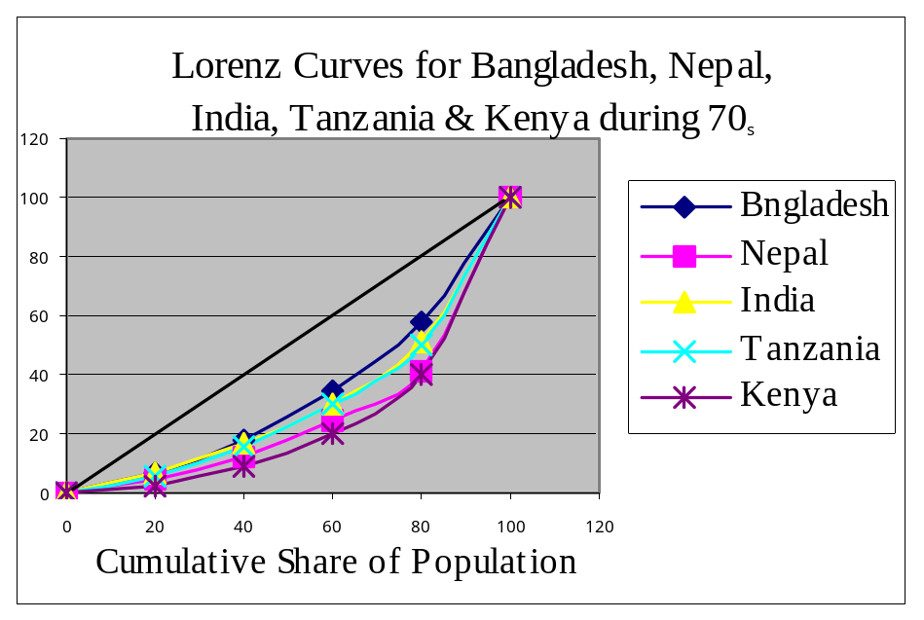
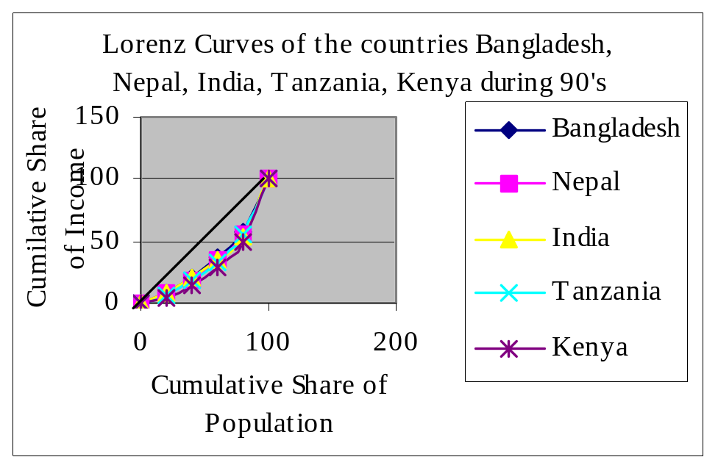
The Lorenz curves of the low income, , middle income and opulent countries for the period 1970’s and 1990’s also reveal a declining tendency of inequality in the overall distribution of income at the intra-country level and an increasing tendency of the same at the cross-country level

Slide 23
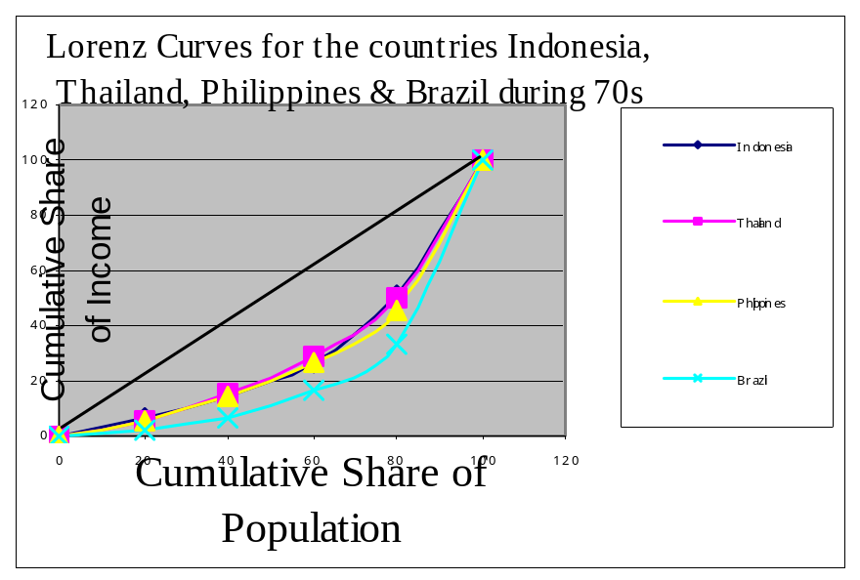
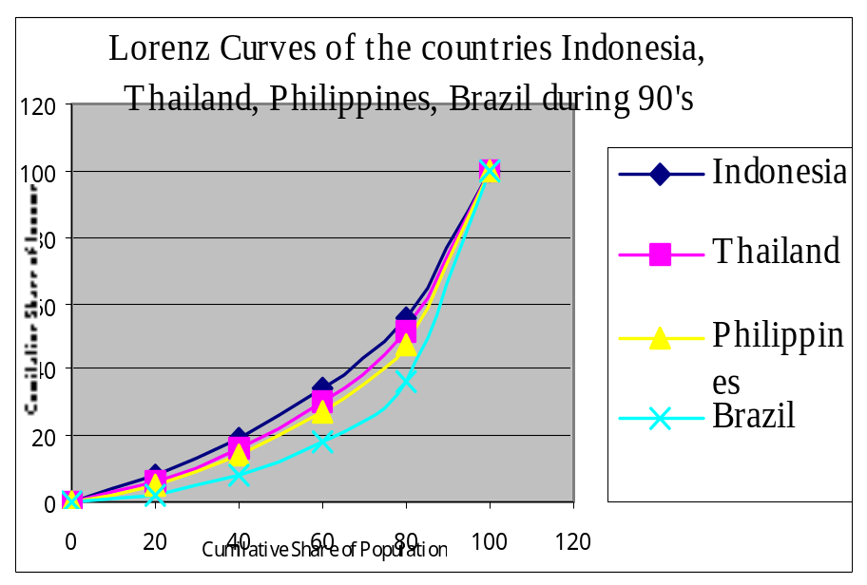
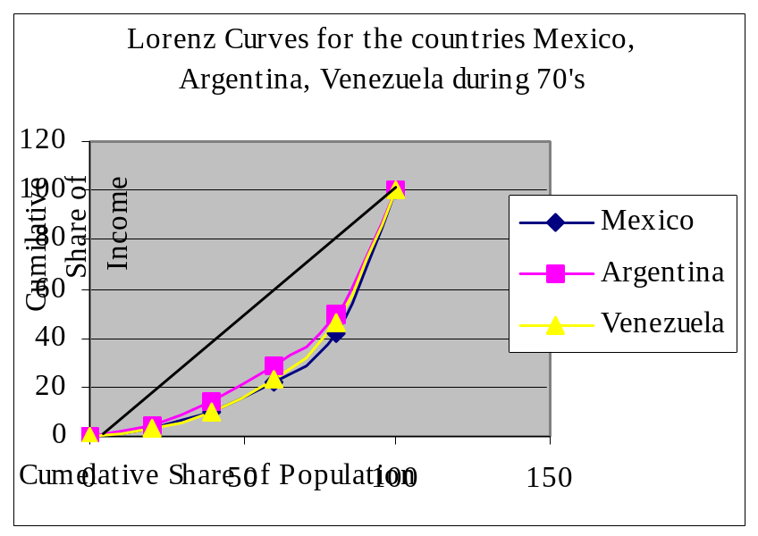
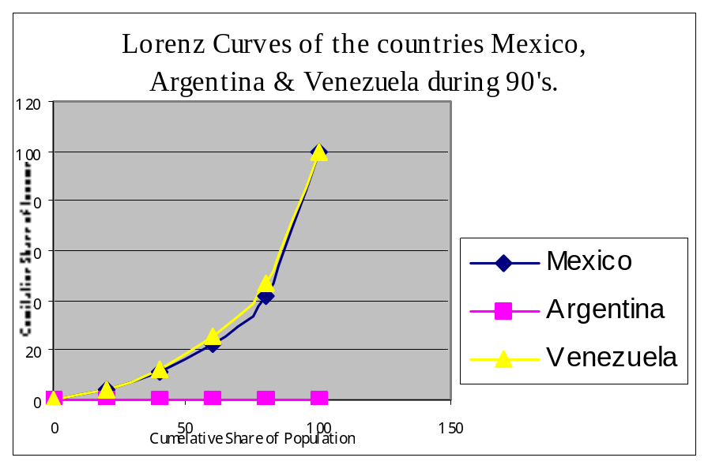

Slide 24
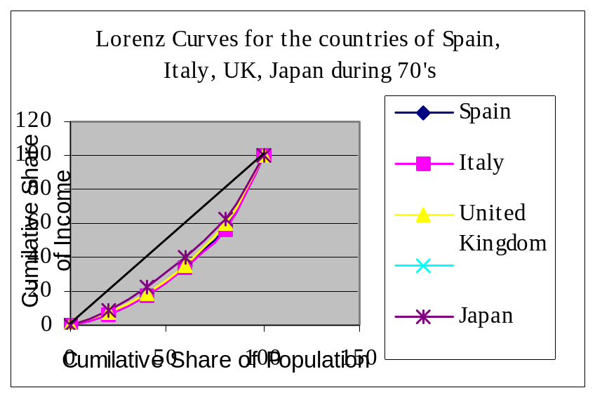
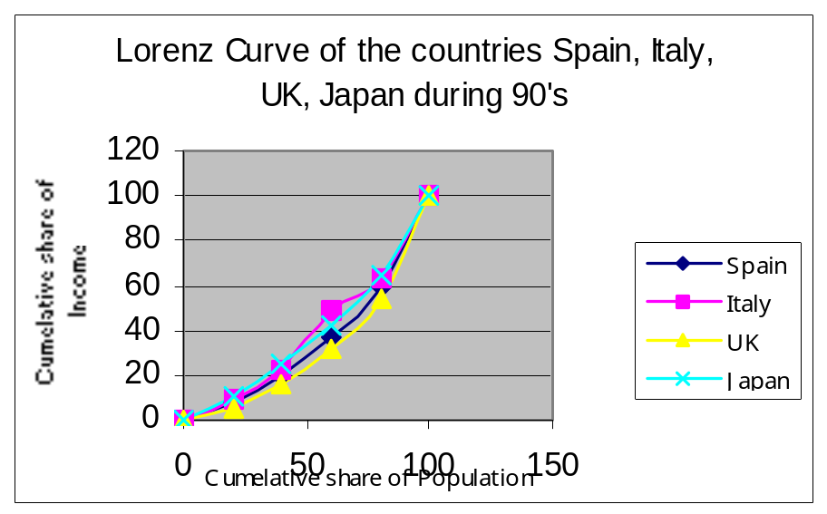
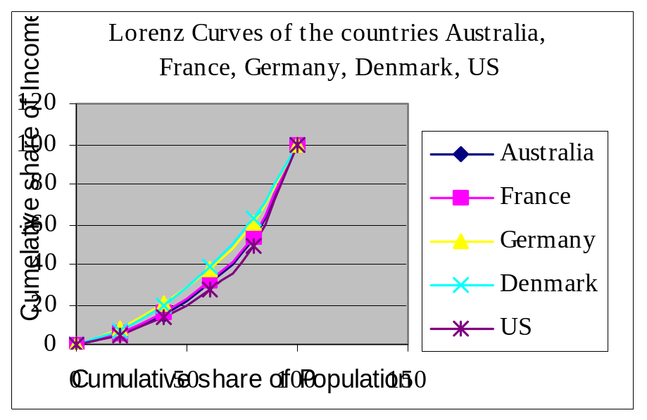
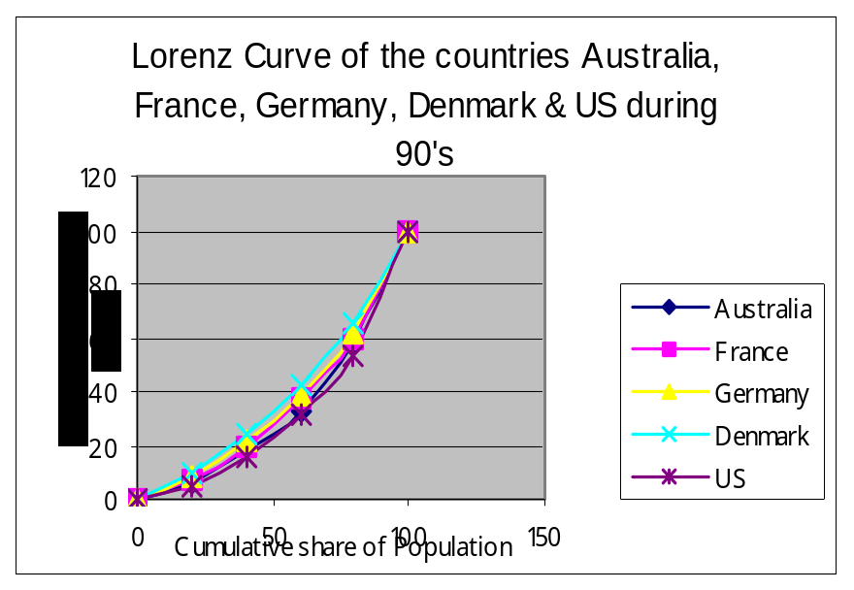

Slide 25
On the whole, we can say that the cross-country differentials in the degree of inequality in the distribution of income are increasing and it is increasing at a higher rate across the high and middle-income countries, albeit the same across the low-income countries reveals a declining tendency.
The distribution of 74 sample countries according to the value of Gini index reveals that about 45% of the sample countries experience high degree of inequality in the distribution of income such that value of Gini-coefficient ranges from .40 to .65.

Slide 26
Table-1: Distribution of countries according to Gini Index during 1997-2002
Value of Gini index | No. of countries | Percentage of countries
20.0-25.0 | 2 | 2.70
25.1-30.0 | 5 | 6.76
30.1-35.0 | 15 | 20.27
35.1-40.0 | 19 | 25.68
40.1-45.0 | 12 | 16.22
45.1-50.0 | 10 | 13.51
50.1-55.0 | 4 | 5.41
55.1-60.0 | 5 | 6.76
60.1-65.0 | 2 | 2.71
Total | 74 | 100

Slide 27
ON POVERTY
Since the data on the incidence of income poverty across the countries in the world do not correspond to uniform year and the estimation of poverty on the basis of international poverty line (i.e. 1 US$ per day) is not made on the basis of unique base price adjusted with purchasing power parity (PPP) it is difficult to compare the magnitude of poverty both inter-temporally and across the countries in the world.
The data on poverty (Table 2) gives some insight about the incidence of poverty.

Slide 28
Table-2:Distribution of countries according to income poverty
(proportion of people living below 1 US$ per day)
during 1988-93 and 1997-2002.
% of people below poverty | No. of countries |  | % of countries
 | 1988-93 | 1997-2002 | 1988-93 | 1997-2002
<2 | 11 | 15 | 18.33 | 21.74
2.0-22.0 | 24 | 24 | 40 | 34.78
22.1-42.0 | 11 | 15 | 18.33 | 21.75
42.1-62.0 | 11 | 10 | 18.33 | 14.49
62.1-82.0 | 2 | 3 | 3.33 | 4.34
82.1 & above | 1 | 2 | 1.66 | 2.90
Total | 60 | 69 | 100 | 100
Note: Poverty for 1988-93 is measured at 1985 prices adjusted
with PPP and that for 1997-2002 is measured
at 1995 prices adjusted with PPP.

Slide 29
Surprisingly, even after the globalization the noble aim of which is to create a world without poverty, about 43% of the sample countries reveal very high rate of poverty amongst their people such that the proportion of people living below the international poverty line in these countries are still greater than 22%. So one can safely conclude that globalization has failed to provide cushion against cross country poverty and inequality in the distribution of income.
Region wise distribution of people living below poverty line (1 US$ per day)
Region | Distribution of people living below poverty line (1 US$ per day)
 | 1987 | 1998
South Asia | 40.1 | 43.5
Sub-Saharan Africa | 18.4 | 24.3
East Asia & Pacific | 35.3 | 23.2
Europe & Central Asia | 0.1 | 2.0
Latin America & Caribbean | 5.4 | 6.5
Middle East & North Africa | 0.8 | 0.5

Slide 30
While the people in the South Asian and sub-Saharan African, European and Central Asian countries have experienced an increase in the incidence of poverty, the people of East Asian and Pacific and middle East and North African countries have experienced a fall in the extent of poverty.
In fact, the increase in the magnitude of poverty over the period between 1987 and 1998 is found to be highest in sub-Saharan Africa (i.e by 32.07 percentage point) which is followed by Latin America and Caribbean Countries (20.37 Percentage Point), and South Asian countries (8.48 percentage point). Astonishingly, the extent of poverty in Europe and Central Asia has increased substantially from .1 % in 1987 to 2 % in 1998.

Slide 31
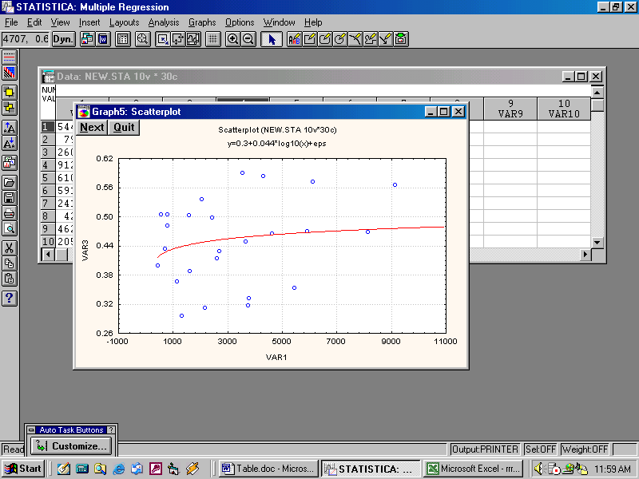
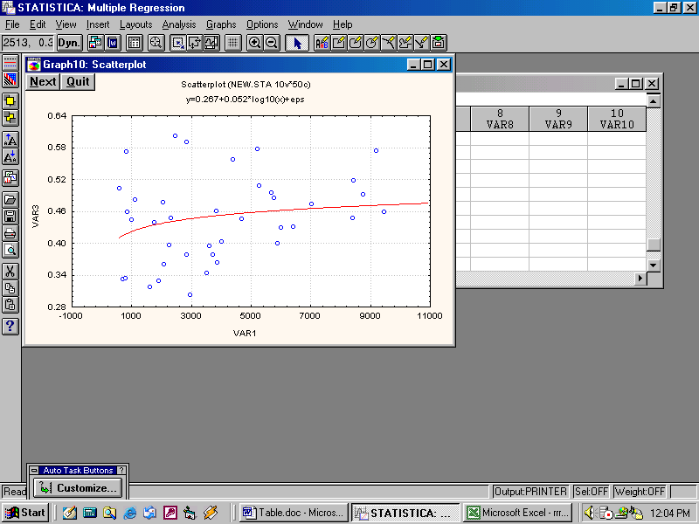
Kuznets Inverted ‘U’ Hypothesis
There is controversy about the validity of Kuznets ‘U’ hypothesis.
GR
PCI
PCI
Scatter Plot 1& 2 => Cross Country Kuznets curve for 25 sample countries for 93-96 and 35 countries for 97-2001.

Slide 32
There is no tendency of inequality to rise initially and then fall with the rise in per capita GNP. So we also do not find that the Kuznetsian perception of inequality holds for the countries.
So we run a non-linear cross country regression model and find the following results.
Results of Cross country Regression Analysis
Dependent variable | No. of obs. | Constant | Log(PCI) | [log(PCI)]2 | Adj. R²
Log (Gini-Coef.) (1993-96) | 25 | 3.38 (1.41) | -1.10 (0.86) | .173 (.130) | .016 (.087)
Log (Gini-Coef.) (1997-2001) | 35 | 1.46 (1.20) | -1.14 (.71) | .04 (.026) | .077 (.076)
Note: Figures in parentheses are the standard errors

Slide 33
We find a very poor or negligible relation between Gini-coefficients and per capita GNP of the countries. So we say that per capita income produces an almost negligible influence on the inequality in the distribution on income across the countries considered in our study.
However, cross country variations in the degree of inequality in the distribution of income, the magnitude of poverty and also the per capita income may be expected to have significant impact on the cross country differentials in the level of well-being of the people.
Results of Cross country Regression Analysis
Dependent variable | No. of Obs. | Constant | Gini Ratio | Income poverty | Per capita income | Adj. R²
Life exp. At birth (1993-96) | 25 | 55.49 (6.29) | 0.054 (0.149) | -0.098 (0.085) | 0.0030 (0.0008)* | 0.61
Life exp. At birth (1997-2001) | 35 | 55.55 (5.96) | 0.058 (0.162) | -0.141 (0.070) | 0.002 (.0006)* | 0.63
Note: Figures in parentheses are the standard errors.
* implies significant at 5% level of significance.

Slide 34
About 61% and 63% of the cross-country variations in the level of well-being are explained by the three variables together for the two periods respectively and PCI is the significant explanatory factors for the cross-country differentials in the level of well-being.
ON CONVERGENCE HYPOTHESIS
There is no unique or unequivocal conclusion on the global convergence of per capita income. However, in our study we find conditional convergence of real per capita income across the 53 sample countries during period 1980-98.
We have regressed Log difference of per capita income between 1998 and 1980 on the real per capita income of 1980 and real investment income ratio (I/Y) 1980 and the effective rate of depreciation (n+g+d) for 53 sample developed and developing countries. By conditioning that the effective rate of depreciation of physical capital and the technological progress (g+d) remain constant across the countries we have the conditional convergence (Ghosal, 2002).

Slide 35
Results of Cross-country Regression
Dep. Var. | No. of Obs. | Constant | I_{n}PCI1980 (Real) | I_{n} (I/Y) | In (n+g+δ) | Adj. R²
[LogPCI98]-[LogPCI80] | 53 | -.056 (0.19) | -0.032 (0.042) | 0.204 (0.113) | 0.561 (.107) | 0.22 (.13)
[LogPCI98]-[LogPCI80] | 53 | -0.152 (0.109) | .067 (.035) | - - | - - | 0.04 (0.114)
Note: Figures in parenthesis are standard errors. g+δ=.05 (Mankiw et. al, 1992)
(I/Y) = Investment Income Ratio. n=Rate of growth of population.
We find conditional convergence and unconditional divergence.

Slide 36
CONCLUDING OBSERVATIONS
It is found that the inequality in the distribution of income across the low and middle income sample countries is higher than that in the high income industrialized countries, albeit the poorest 20% of the people across the sample countries have experienced an increase in their relative shares in national income in varying degrees.
The richest 40% of the people in the middle-income countries have been able to retain their shares in income at the range (70 to 81 %) over the period.
The richest 40% of the people in the low income sample countries have experienced an increase in their relative share in income in the 90’s .
We do not find any remarkable change in the inequality in the distribution of income across the countries.
The Kuznetsian perception of inequality is not found to hold.

Slide 37
There is a wide cross-country differentials in the level of well being of the people across the countries and the differential in the per capita income is inter-alia the most significant explanatory factor for such differentials.
We find a tendency of conditional convergence of per capita income across the sample countries.

