Slide 1
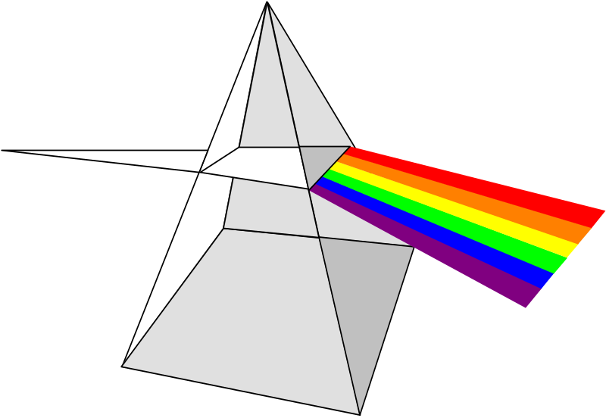
Economic Freedom of the World: 2005 Annual Report
Fraser Institute
Policy Briefing
Sultan Qaboos
University
October 2, 2005

Slide 2
THANK YOU FOR COMING!
The key to changing policy in the world is changing the climate of opinion about what works and what does not work in encouraging world development
The key to changing the climate of opinion is providing the widest possible audience with good information about the causes of development and under-development

Slide 3
Economic Freedom of the World Project
Objective: find a way to measure economic freedom and explore the connection between it and other variables
20 year project
Led by Professor Milton Friedman, Rose Friedman and Michael Walker
Involved 100 of the world’s top scholars

Slide 4
What is The Economic Freedom of the World Index?
An annual compilation of data representing factors which make a country economically free
Authors: James Gwartney and Robert Lawson
A compendium of 38 government policies affecting economic freedom based on objective data or independent surveys
A ranking of 127 countries representing 93% of the world’s population according to the extent to which they permit their citizens to be economically free
Now a collaboration of Institutes in 68 different countries

Slide 5
What is Economic Freedom
Individuals have economic freedom when property they acquire without the use of force, fraud, or theft is protected from physical invasions by others and they are free to use, exchange, or give their property as long as their actions do not violate the identical rights of others. An index of economic freedom should measure the extent to which rightly acquired property is protected and individuals are engaged in voluntary transactions.
James Gwartney et al. 1996

Slide 6
Components of The Economic Freedom of the World Index
Size of government and taxation
Private property and the rule of law
Soundness of Money
Trade regulation and tariffs
Regulation of business, labour and capital markets
Based entirely on objective or third party data for 127 countries

Slide 7
Talk about making a difference …

Slide 8
Member Institutes of Economic Freedom of the World Network
African Research Centre for Public Policy Research and Analysis, Kenya
Albanian Center for Economic Research (ACER), Albania
Alternate Solutions Institute, Pakistan
Association for Liberal Thinking, Turkey
Association pour la Liberté Economique et le Progrès Social (ALEPS), France
Bureau d'Analyse d'Ingenierie et de Logiciels (BAILO), Ivory Coast
CATO Institute, USA
Causa Liberal, Portugal
Center for Economic and Political Research, Azerbaijan
The Center for Entrepreneurship and Economic Development, Montenegro
Center for Free Enterprise, Korea
Center for Politiske Studier, Denmark
The Center for Research and Communication, Philippines
Centre for Civil Society, India
The Centre for the Dissemination of Economic Knowledge (CEDICE), Venezuela
Centre for the New Europe, Belgium
The Centre for Research on the National Economy, Guatemala
Centro de Investigación para el Desarrollo A.C., Mexico
Centro de Investigación y Estudios Legales (CITEL), Peru
Centro Einaudi, Italy
Centrum im. Adama Smitha, Poland
D'Letzeburger Land, Luxembourg
Economic Policy Institute-Bishkek Consensus, Kyrgyz Republic
The Estonian Institute for Open Society Research, Estonia
The F.A. Hayek Foundation, Slovak Republic
Free Market Center (FMC), Yugoslavia
The Free Market Foundation of Southern Africa, South Africa
Fundación Economía y Desarrollo Inc., Dominican Republic
Fundación Libertad, Argentina
Fundación Libertad, Panama
Fundación Libertad, Democracia y Desarrollo, Bolivia
Hong Kong Centre for Economic Research, Hong Kong
ILP - Instituto Libertad y Progreso, Colombia
Institut de Recherche pour la Liberte Economique et la Prosperite (IRLEP), Haiti
Institute for Advanced Strategic and Political Studies, Israel
The Institute for Development of Economics and Finance, Indonesia
Institute for Market Economics, Bulgaria
Institute of Business, Trinidad and Tobago
The Institute of Economic Affairs, Ghana
The Institute of Economic Affairs, United Kingdom
Institute of Economic Analysis, Russia
Institute of Economic Studies, Iceland
The Institute of Economics, Croatia
Institute of Public Affairs, Australia
Institute of Public Policy Analysis, Nigeria
Instituto Ecuatoriano de Economía Política, Ecuador
Instituto Liberal do Rio de Janeiro, Brazil
Instituto Libertad y Desarrollo, Chile
Instituto para la Libertad y el Análisis de Políticas, Costa Rica
Liberales Institut, Germany
Liberales Institut, Switzerland
Liberální Institut, Czech Republic
Lithuanian Free Market Institute, Lithuania
Making Our Economy Right (MOER), Bangladesh
The Nassau Institute, Bahamas
The New Zealand Business Roundtable, New Zealand
Open Republic Institute, Ireland
Open Society Forum, Mongolia
Pathfinder Foundation, Sri Lanka
Research Center for Entrepreneurship and Development Policies, Vietnam
Romania Think Tank,Romania
Scientific Research Mises Center, Belarus
Society for Disseminating Economic Knowledge:“New Economic School – Georgia”, Georgia
Szazadveg Policy Research Institute, Hungary
TIGRA®, Austria
Timbro, Sweden
The Ukrainian Center for Independent Political Research, Ukraine
Zambia Institute for Public Policy Analysis (ZIPPA), Zambia

Slide 9
Sample of Press Coverage for
Fraser Institute’ Economic Freedom of the World 2004
Agence France Press
Al-Ahram Weekly, Jordan
All Africa Global Media
Arvamus, Estonia
Asia Pulse, Hong Kong
Asian Wall Street
Bahamas Financial Services Board
BBC
Berlingske, Denmark
Business and Finance, Ireland
Business Daily, Hong Kong
Business Day, South Africa
Business Standard, India
Canale Italia, Italy
Chosun Ilbo, Korea
Critica, Panama
Cronache, Italy
CTK Daily News, Czechoslovakia
Dan, Montenegro
Dominion Post, New Zealand
Dong-a Ilbo, Korea
Dow Jones, Germany
Dow Jones International
Economist
El Comercio, Spain
El Diario, Chile
El Economista, Spain
El Nuevo Dia, Spain
Examiner, Canada
Financial Express, India
Forbes
Frankfurter Allgemeine Zeitung
Herald Sun, Australia
Hong Kong Economic Journal
Hospodarske, Czech Republic
In Copertina, Italy
Independent Business Weekly, New Zealand
Indian Business Insight
Inter Press, Hong Kong
International Herald Tribune
Investor's Business Daily, US
Irish Independent
Izvestia, Russia
Jakarta Post
Jerusalem Post
JoongAng Daily, Korea
Korea Economic Daily
Korea Times
La Estrella de Panama
La Nacion, Costa Rica
La Prensa, Panama
L'Adige, Italy
Latin America News Digest
Latvian News Agency
Lianhe Zaobao, Singapore
NavHind Times
New Zealand Herald
News Aktuell
Pobjeda, Montenegro
Primera, Mexico
Publika, Montenegro
Segye Times, Korea
Seoul Daily, Korea
Sing Tao Daily News, Hong Kong
South China Morning Post
Spanish News Digest
Spanish Worldstream
Standard, Hong Kong
Telegraph, India
Times of Oman
Washington Times
Xinhua News Agency, China

Slide 10
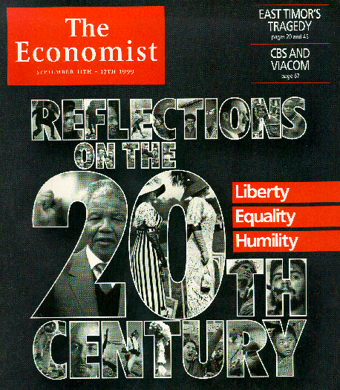

Slide 11

Introducing the 2005 Economic Freedom of the World Index Results

Slide 12
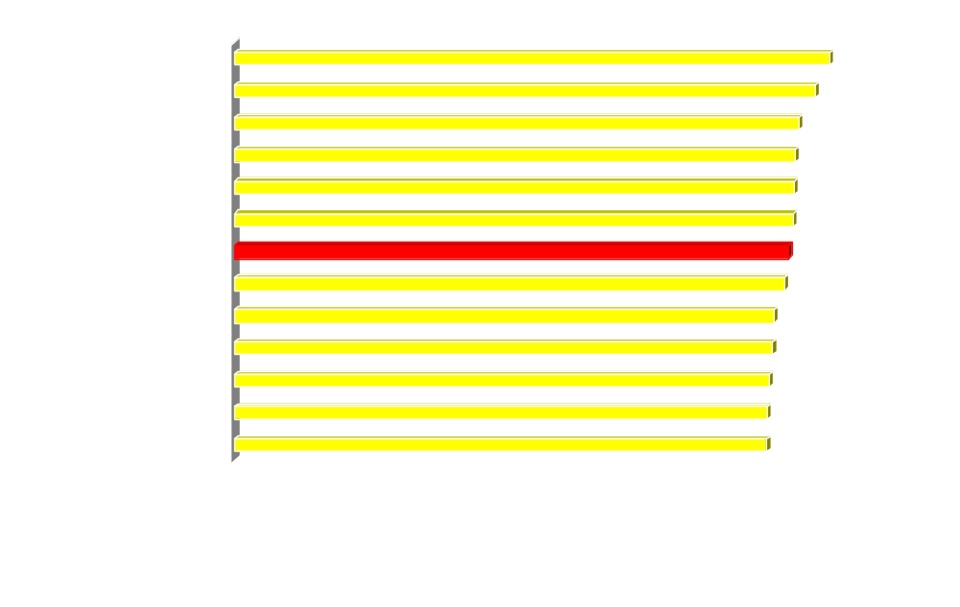
Overall Economic Freedom Index and the Top 12
Source: The Fraser Institute.

Slide 13
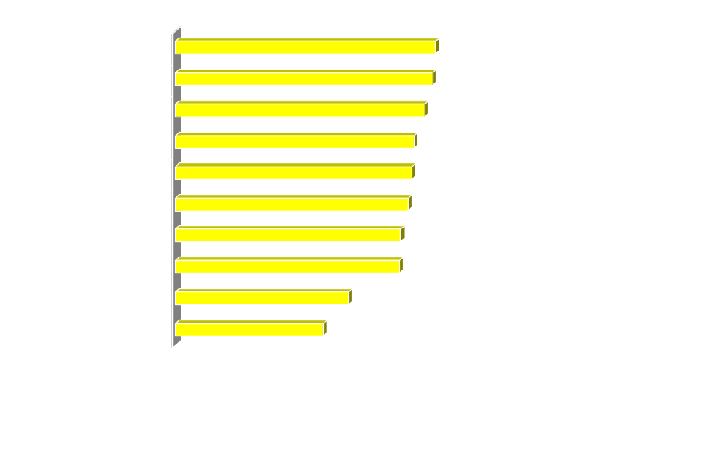
Overall Economic Freedom Index and the Bottom Ten
Source: The Fraser Institute.

Slide 14
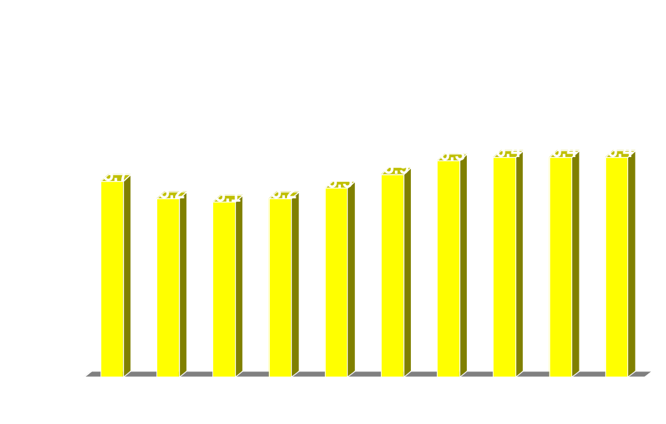
Economic Freedom Over Time
Source: The Fraser Institute.

Slide 15
Why is Economic Freedom Important?
Economic rights are fundamental rights in the sense that without them there can be no political freedom or civil freedoms
They are a prerequisite for growth and development
They are a prerequisite for broader human development

Slide 16
The impact on economic growth and development

Slide 17
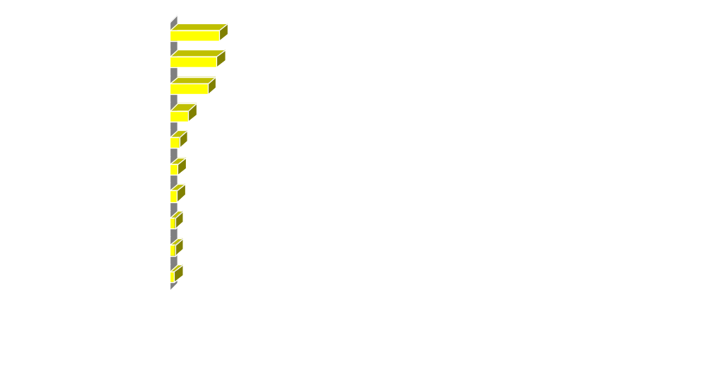
Income (per person) of the Bottom Ten
Sources: The Fraser Institute; The World Bank, World Development Indicators CD-ROM, 2005.

Slide 18
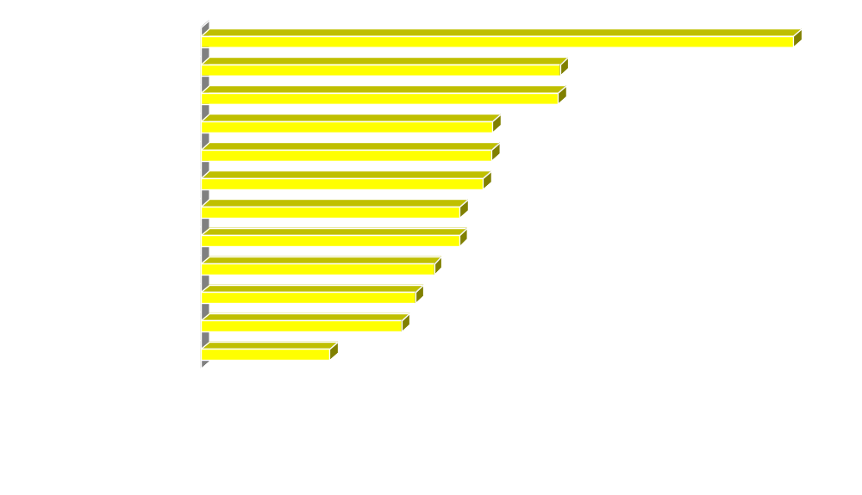
Income (per person) of the Top 12
Sources: The Fraser Institute; The World Bank, World Development Indicators CD-ROM, 2005.
Notes:
Note that Luxembourg was not one of the top ten last year.

Slide 19
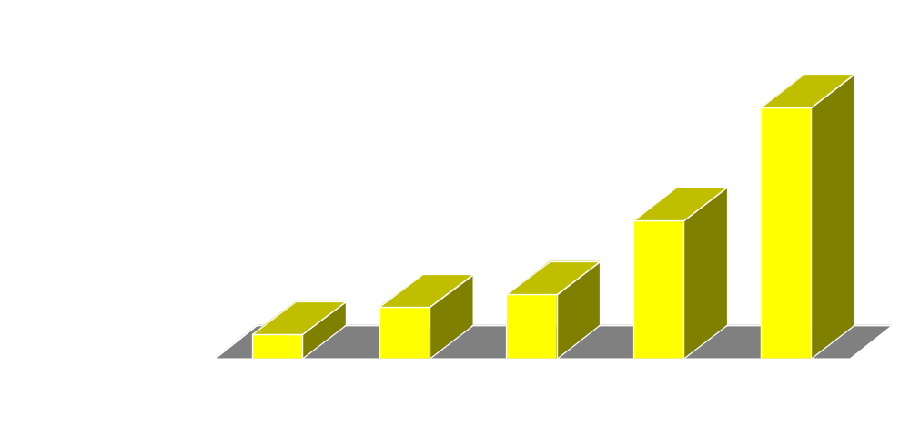
Per Capita Income and Economic Freedom Quintile
Least Free …………… Most Free
Sources: The Fraser Institute; The World Bank, World Development Indicators CD-ROM, 2005.

Slide 20
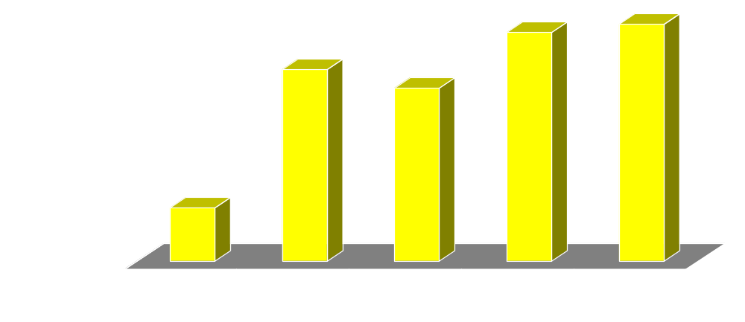
Growth in Real GDP Per Capita and Economic Freedom Quintile
Least Free ……………..….. Most Free
Sources: The Fraser Institute; The World Bank, World Development Indicators CD-ROM, 2005.

Slide 21
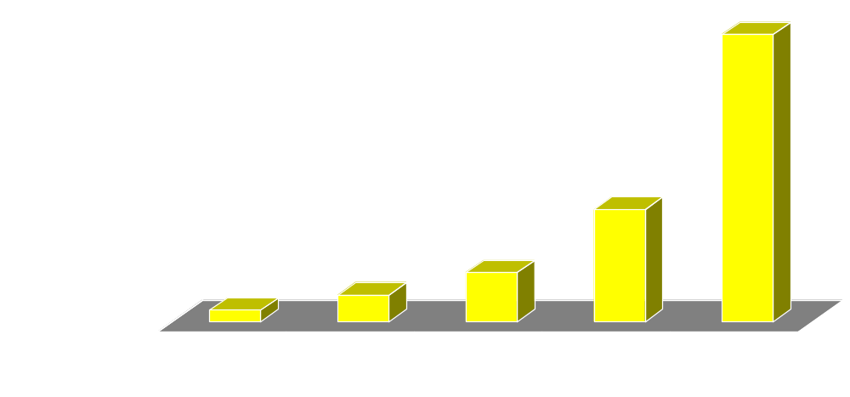
Economic Freedom and Investment
Least Free ……………..….. Most Free
Sources: The Fraser Institute; The World Bank, World Development Indicators CD-ROM, 2005.

Slide 22
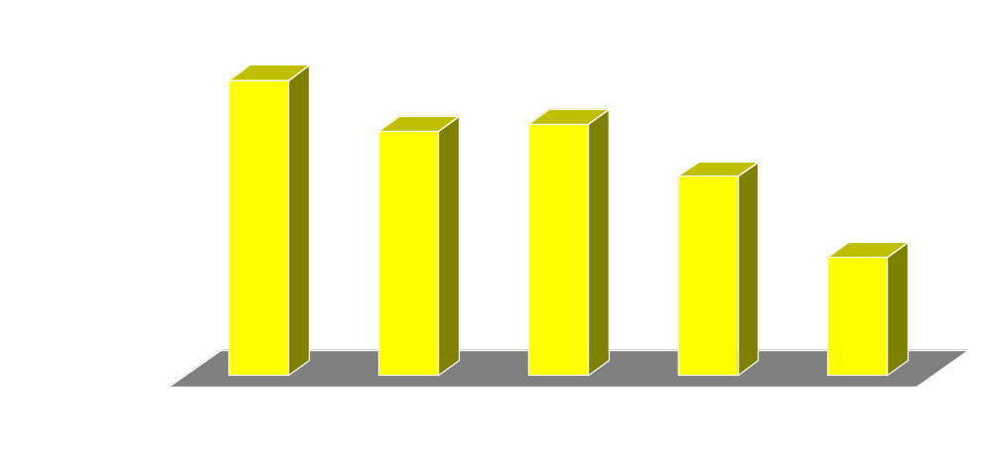
Economic Freedom and Unemployment
Least Free ……………..….. Most Free
Sources: The Fraser Institute; The World Bank, World Development Indicators CD-ROM, 2005.

Slide 23
New research:
Economic Freedom and Peace

Slide 24
Economic Freedom and Peace:
1) the “democratic peace”
Does the concept of a “democratic peace” hold up to scrutiny?
Democracies tend not to go to war with each other but go to war about as often in general as non-democracies.
Developing democracies are as prone as non-democracies to violent conflict.
Thus, “democratic peace” fails close study.

Slide 25
Economic Freedom and Peace:
2) the “capitalist peace”
Stable democracies typically have high levels of economic freedom – which promotes peace.
When both are included in a statistical test, economic freedom is 50 times more potent in reducing conflict than democracy.
Nations which score below 2 in the EF index are 14 times more prone to conflict than top scoring nations.
Economically free nations fight each other less and go to war against other nations less as well.

Slide 26
Causes of the Capitalist Peace
Wealth and power are created by markets and the efficient production that arises from them, not by conquest of land or raw materials.
Wealth created by market economies through efficient production, unlike wealth derived from land or resources, is difficult for nations to “steal” by violent action.
Efficient production requires property rights and free decisions by market participants that cannot be effectively coordinated to the victor’s advantage.
Markets provide new methods for signaling among nations and create areas in which states can compete without having to go to war.

Slide 27
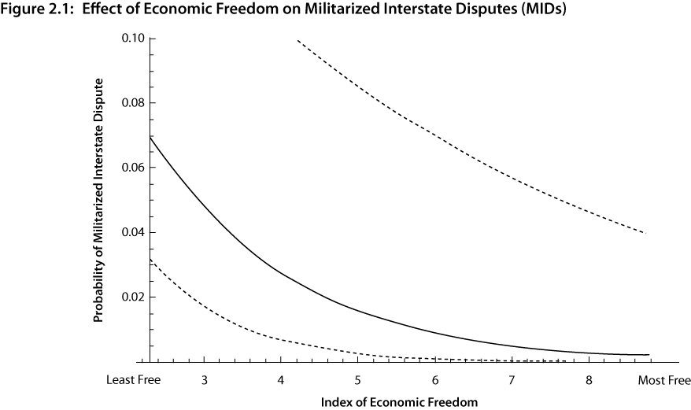
Source: The Fraser Institute.

Slide 28
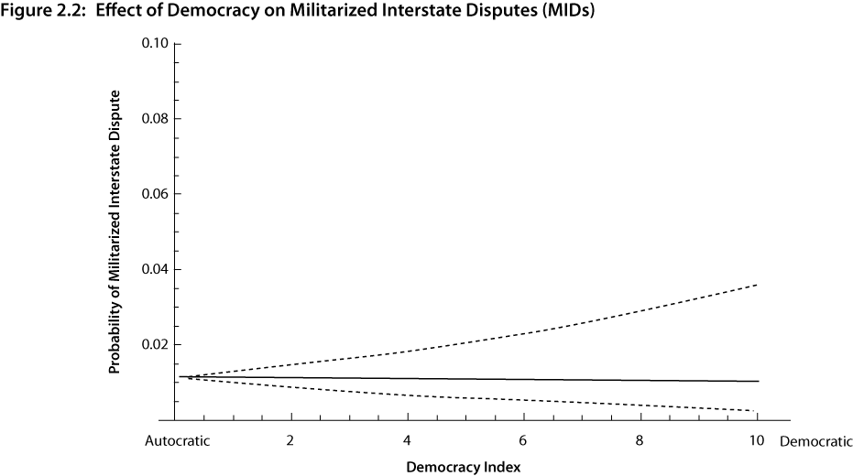
Source: The Fraser Institute.

Slide 29
Policy Implications:
Efforts to promote democracy may not produce the peace dividend
Policy should be to promote economic freedom
Economic freedom has been shown to promote democracy over the long term (and many other good outcomes)
Therefore, promoting economic freedom will both lead to less conflict and, in the long run, to democracy.

Slide 30
Economic Freedom,the Poor, and
Inequality

Slide 31
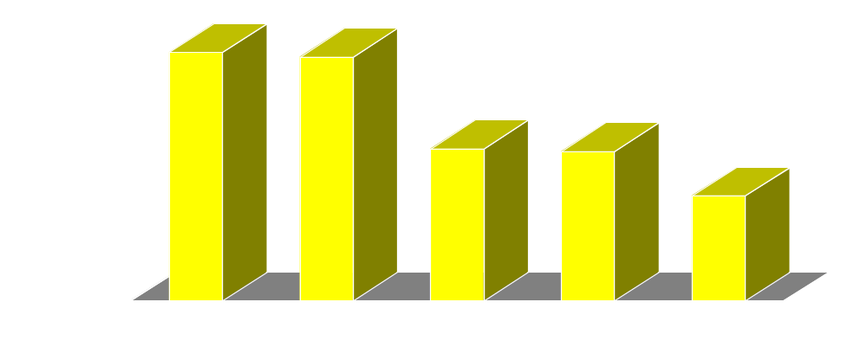
Human Poverty Index, 2002, and Economic Freedom Quintile
Least Free …………..…. Most Free
Sources: The Fraser Institute; United Nations Development Programmme, Human Development Indicators 2004, available at http://hdr.undp.org/statistics/data/index_indicators.cfm (accessed on July 5, 2005).

Slide 32
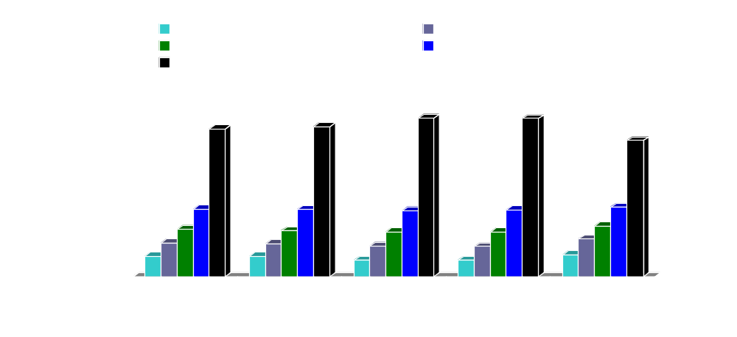
Income Inequality, 1998-2002
Percent of income accruing to the
Least Free …….. Most Free
Sources: The Fraser Institute; The World Bank, World Development Indicators CD- ROM, 2005.

Slide 33
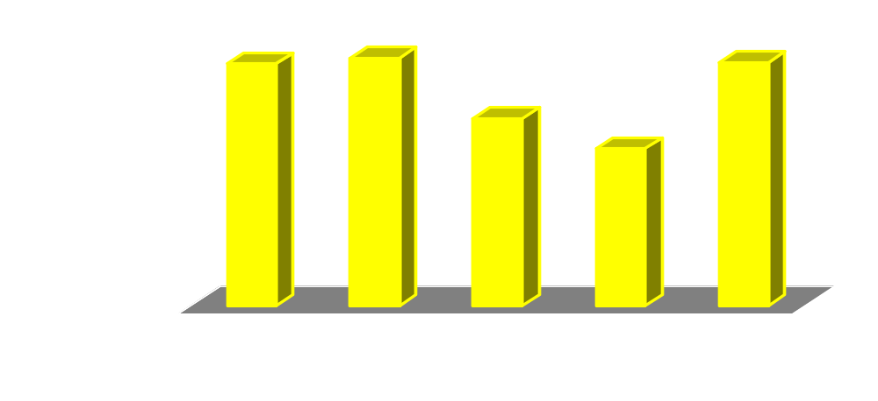
Income Share of the Poorest 10% and Economic Freedom
Least Free …….. Most Free
Sources: The Fraser Institute; The World Bank, World Development Indicators CD- ROM, 2005.

Slide 34
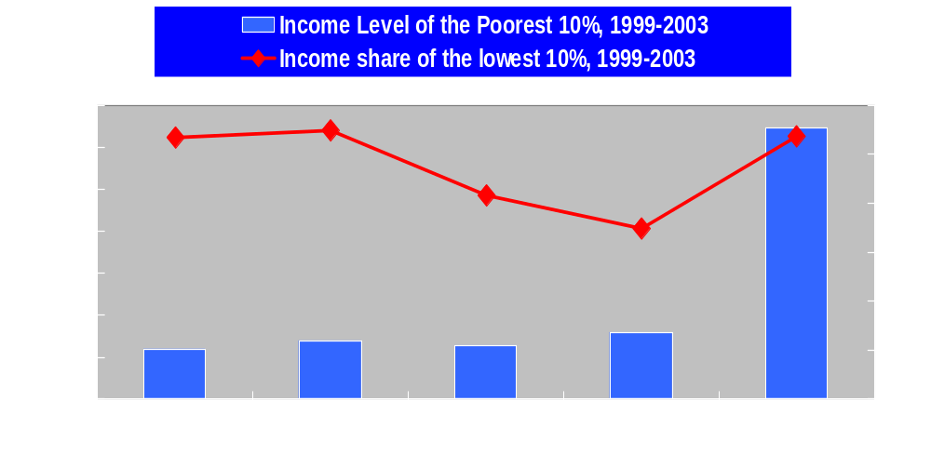
Per Capita Income of Poorest 10% and Economic Freedom
Least Free …….. Most Free
Sources: The Fraser Institute; The World Bank, World Development Indicators CD-ROM, 2005.

Slide 35
Economic Freedom, Other Freedoms and Democracy

Slide 36
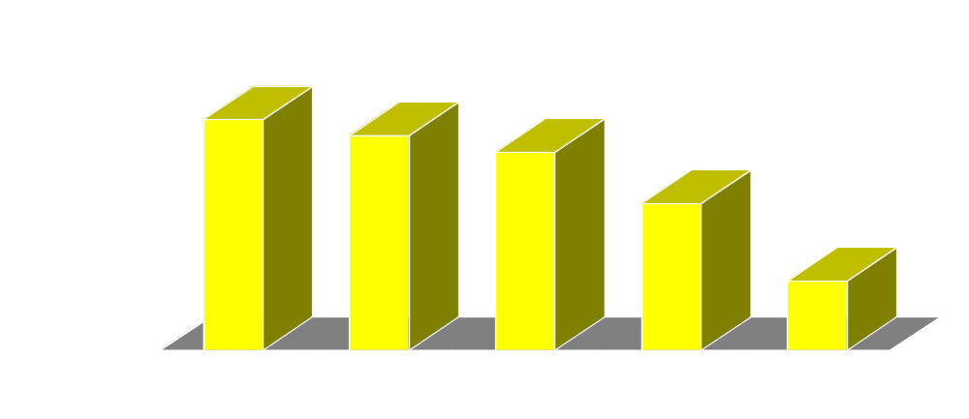
Economic Freedom Versus Corruption
10 =highly corrupt and 0 =highly clean
Least Free ………….. Most Free
Sources: The Fraser Institute; Transparency International, Corruption Perceptions Index 2004, available at http://www.transparency.org/cpi/2004/cpi2004.en.html#cpi2004 (accessed on July 5, 2005).

Slide 37
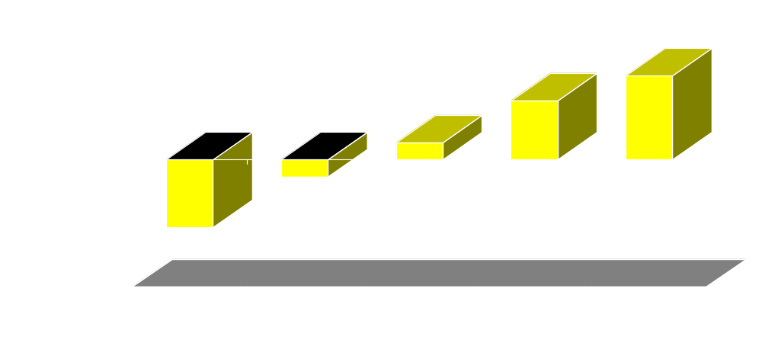
Economic Freedom and Voice and Accountability
-2.5 =low voice and accountability and 2.5 =high voice and accountability
Least Free ………….. Most Free
Sources: The Fraser Institute; The World Bank Group, Governance & Anti-Corruption, available at http://info.worldbank.org/governance/kkz2004/tables.asp (accessed on July 5, 2005).

Slide 38
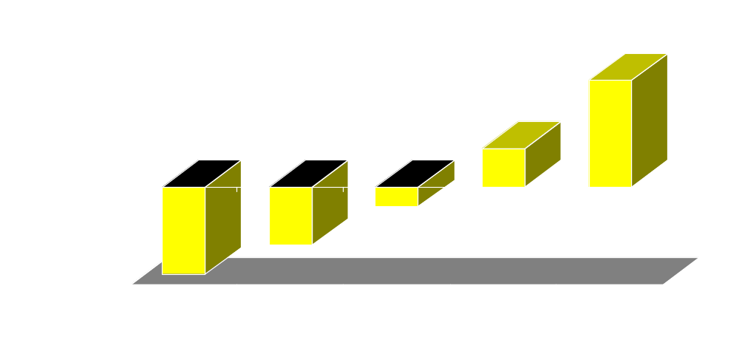
Political Stability and Economic Freedom -2.5 =low political stability and 2.5 =high political stability
Least Free ………..… Most Free
Sources: The Fraser Institute; The World Bank Group, Governance & Anti-Corruption, available at http://info.worldbank.org/governance/kkz2004/tables.asp
(accessed on July 5, 2005).

Slide 39
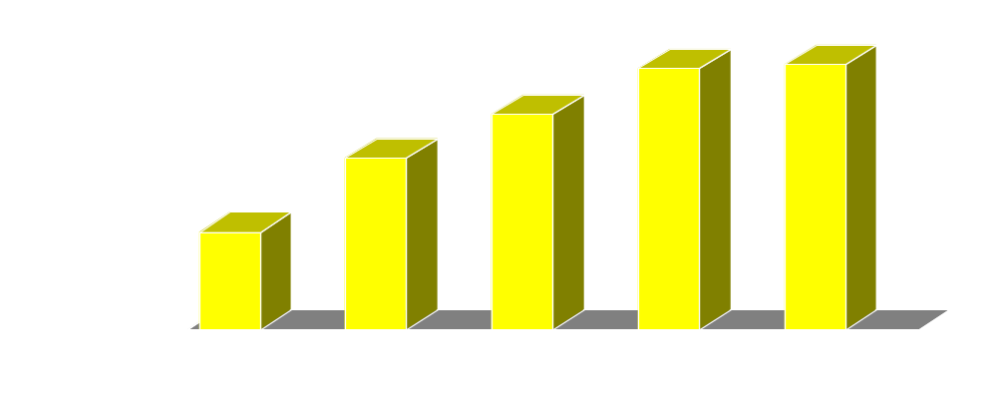
Economic Freedom and Political Rights ten representing the highest degree of political rights and zero the lowest
Least Free ……………. Most Free
Sources: The Fraser Institute; Freedom House, Freedom in the World Country Ratings, 1972 through 2003, available at http://www.freedomhouse.org/ratings/index.htm (accessed on July 5, 2005).

Slide 40
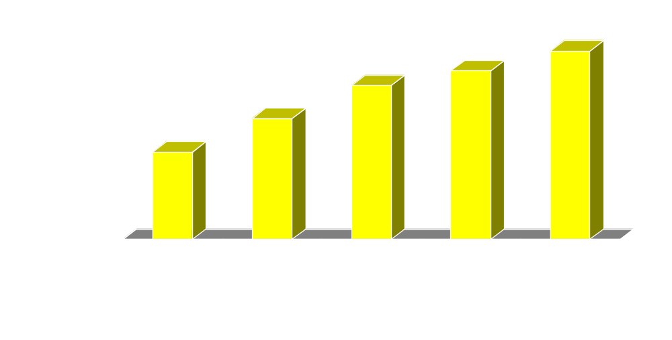
Economic Freedom and Civil Liberties ten representing the highest degree of civil liberties and zero the lowest
Least Free …….. Most Free
Sources: The Fraser Institute; Freedom House, Freedom in the World Country Ratings, 1972 through 2003, available at http://www.freedomhouse.org/ratings/index.htm (accessed on July 5, 2005).

Slide 41
The impact of Economic Freedom on the UN’s Human Development Index and other indicators of well-being

Slide 42
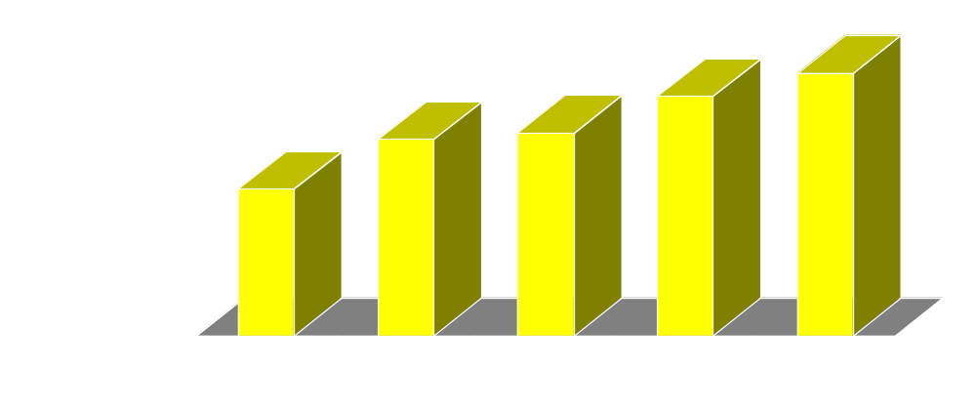
Human Development Index, 2002, and Economic Freedom Quintiles
Least Free ……………. Most Free
Sources: The Fraser Institute; United Nations Development Programmme, Human Development Indicators 2004, available at http://hdr.undp.org/statistics/data/index_indicators.cfm (accessed on July 5, 2005).

Slide 43
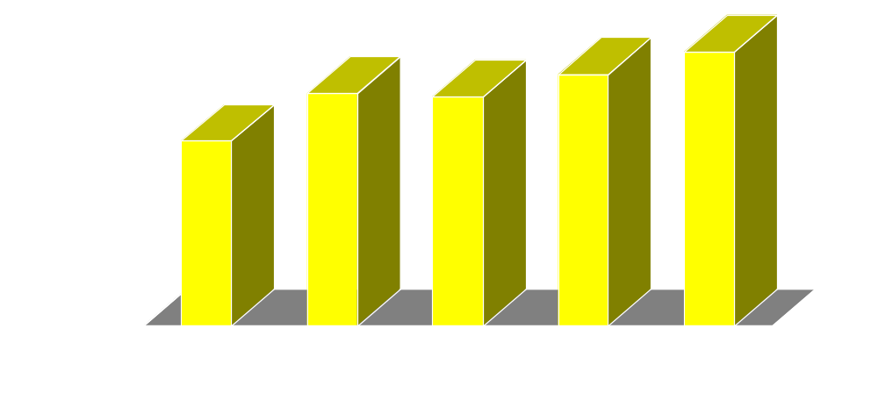
Life Expectancy at Birth and Economic Freedom Quintiles
Least Free ……………. Most Free
Sources: The Fraser Institute; The World Bank, World Development Indicators CD- ROM, 2005.

Slide 44
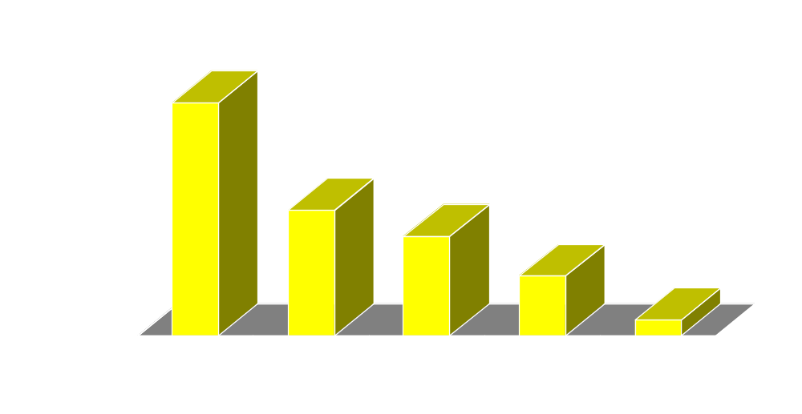
Infant Mortality and Economic Freedom Quintile
Least Free ………..…. Most Free
Sources: The Fraser Institute; The World Bank, World Development Indicators CD-ROM, 2005.

Slide 45
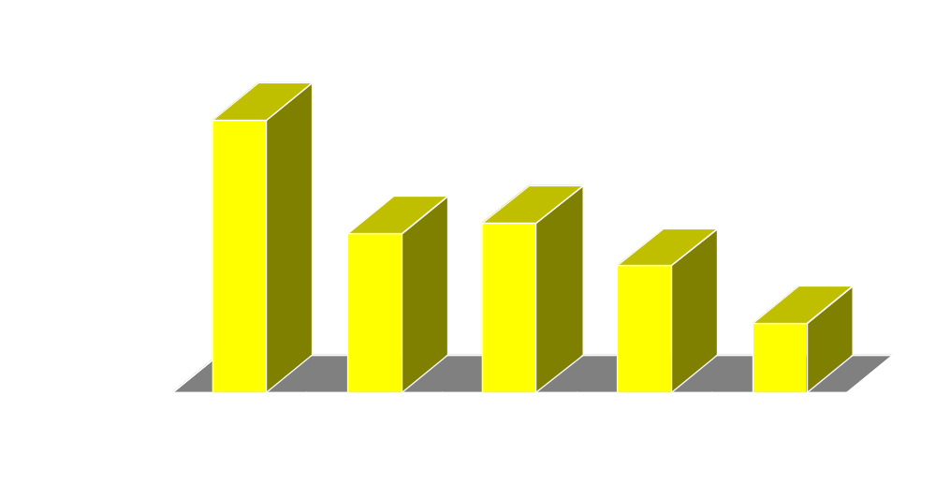
Adult Mortality (2000) and Economic Freedom Quintile
Least Free ………..…. Most Free
Sources: The Fraser Institute; The World Bank, World Development Indicators CD-ROM, 2005.

Slide 46
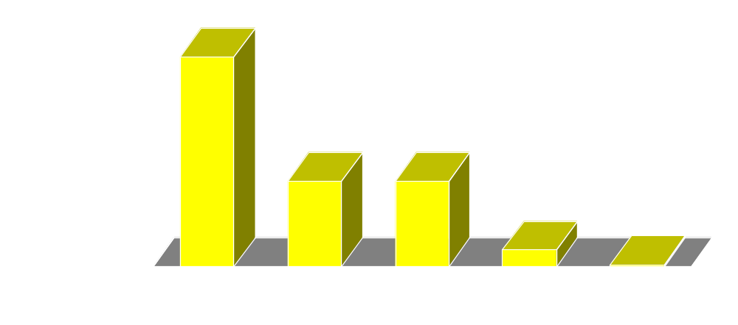
Economic Freedom and Labor force, children 10-14 (% of age group)
Least Free ……………. Most Free
Sources: The Fraser Institute; The World Bank, World Development Indicators CD-ROM, 2005.

Slide 47
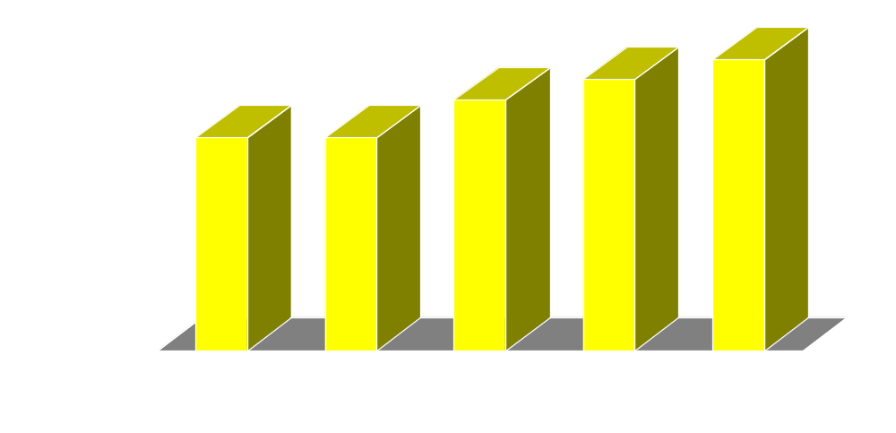
% of Population Using Improved Water Sources, 2002
Least Free …………….. Most Free
Sources: The Fraser Institute; The World Bank, World Development Indicators CD-ROM, 2005.

Slide 48
The Arab
World

Slide 49
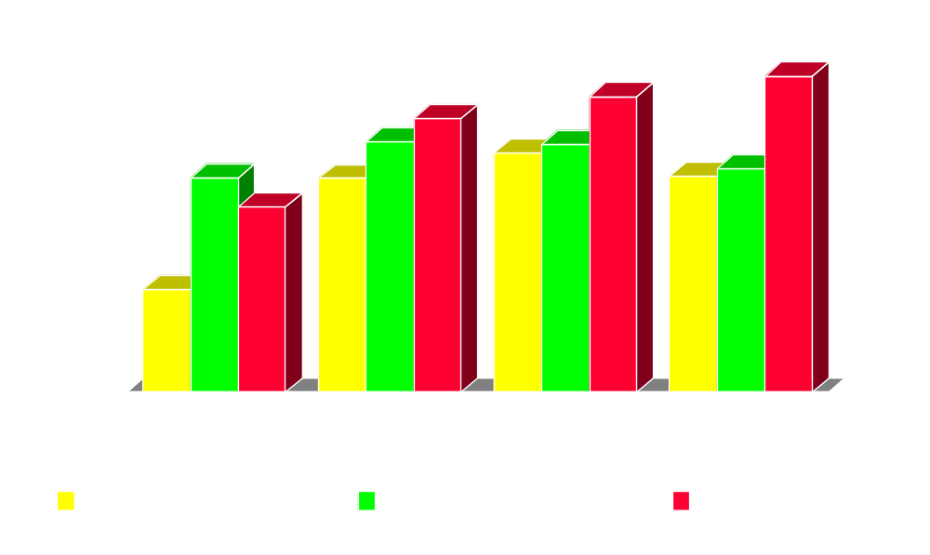
Area 1: Size of Government

Slide 50
Area 2: Rule of Law

Slide 51
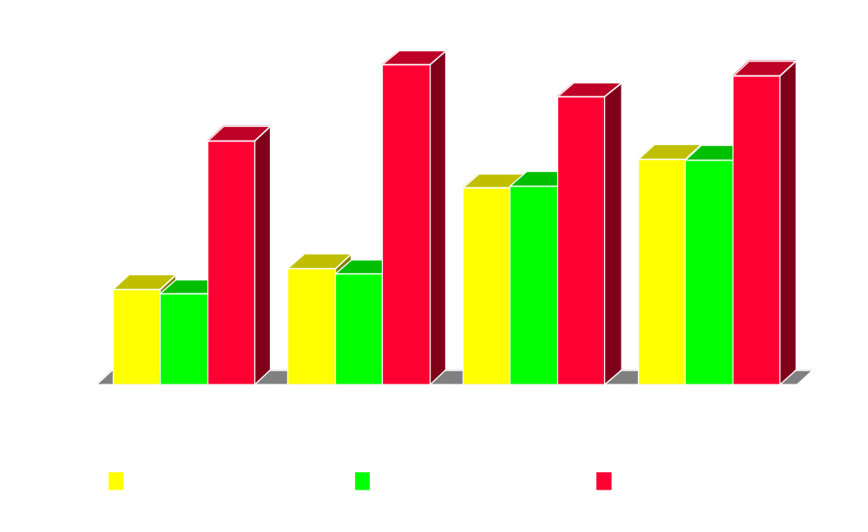
Area 3: Sound Money

Slide 52
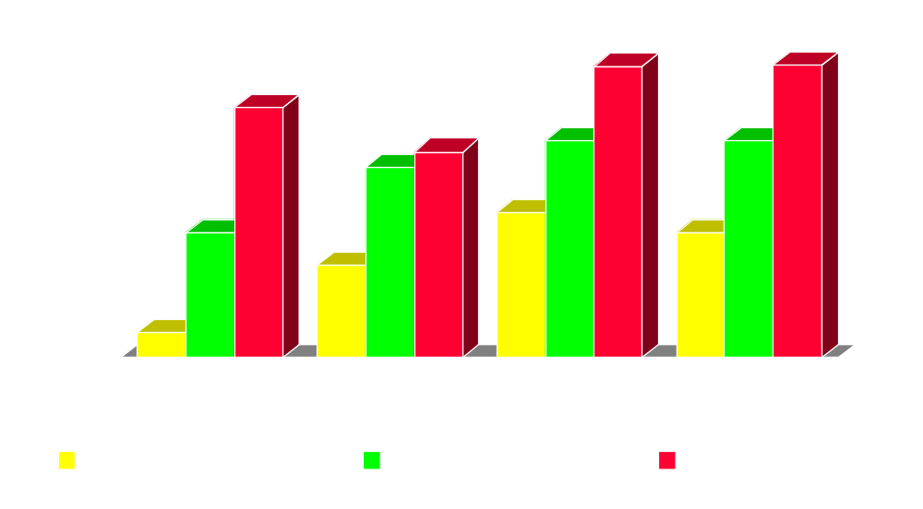
Area 4: Freedom to Trade

Slide 53
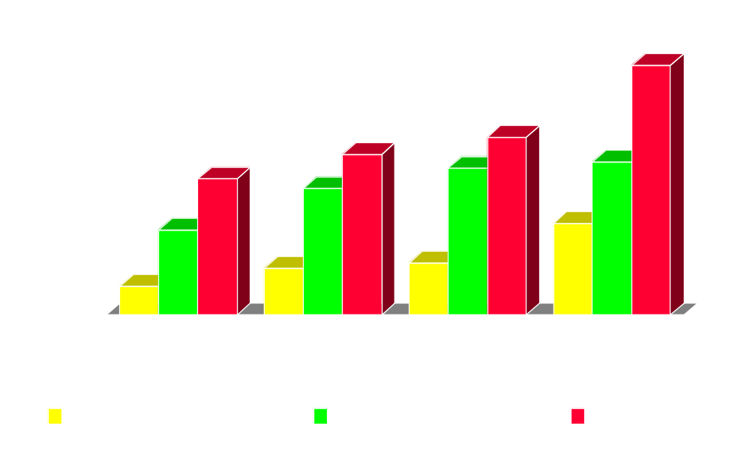
Area 5: Regulations

Slide 54
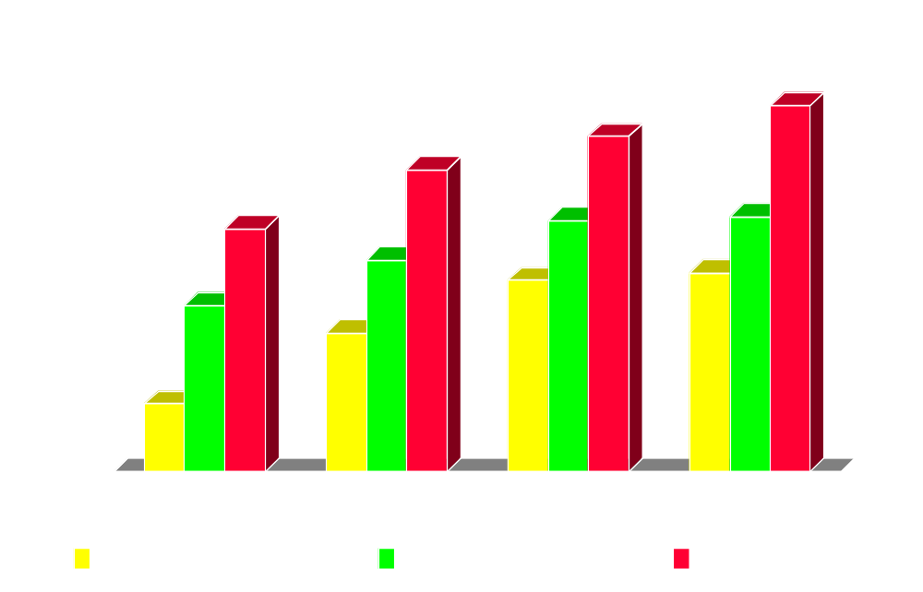
Overall Score

Slide 55
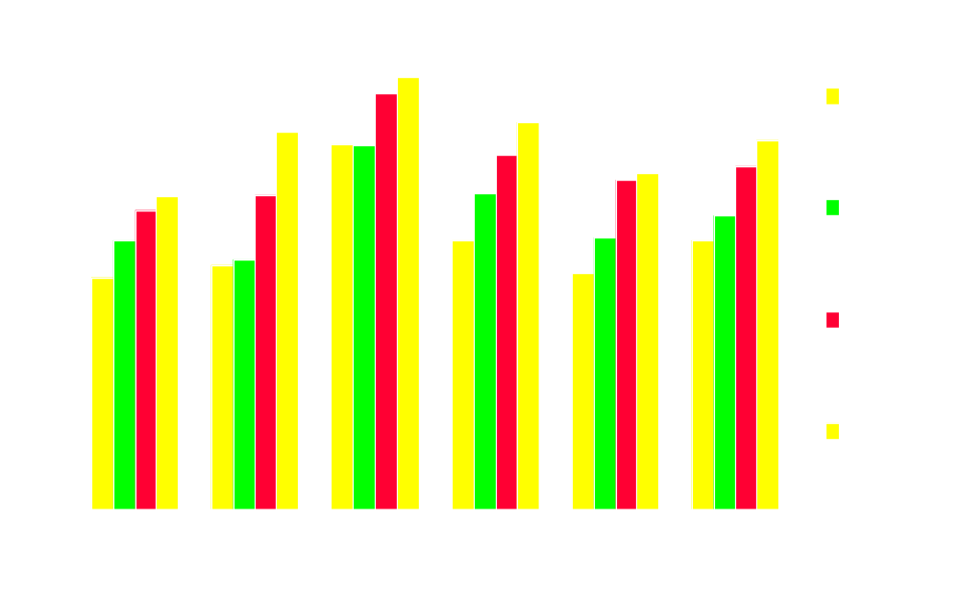
Compared to top 12

Slide 56
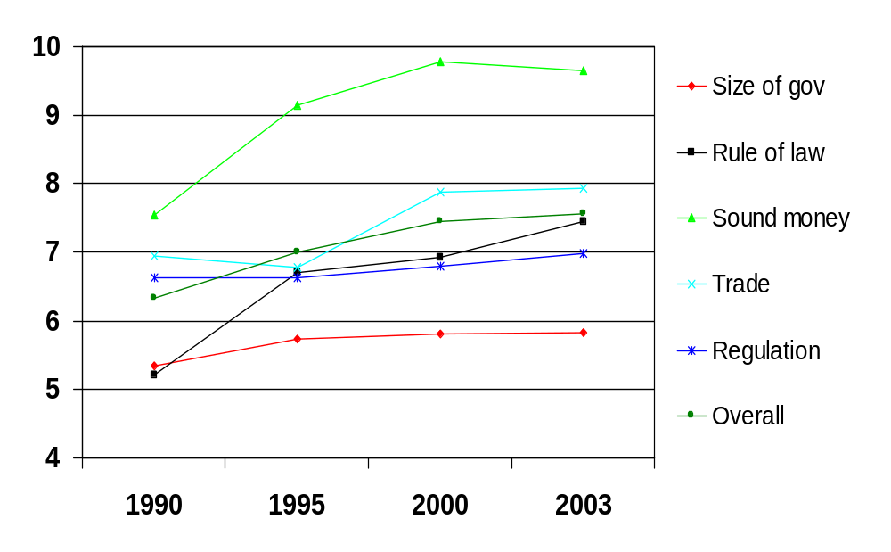
Oman’s Profile

Slide 57
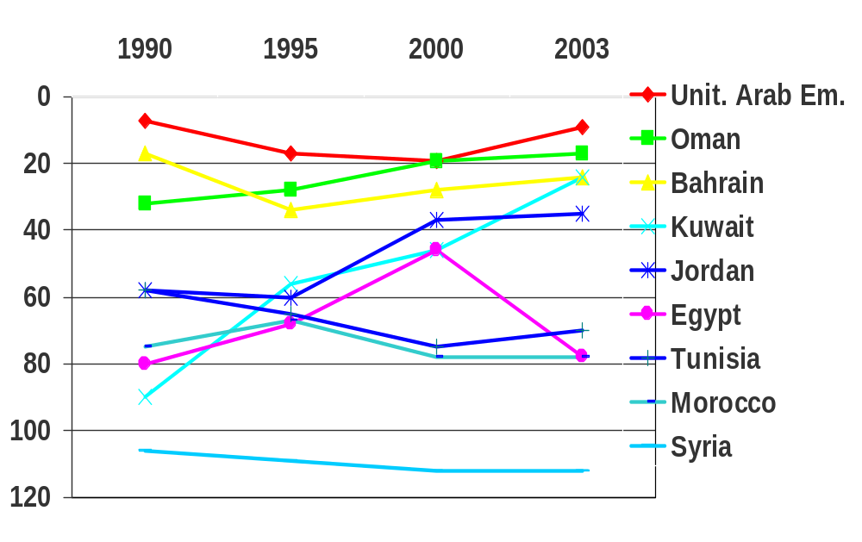
Arab Overview

Slide 58
Arab World Conclusions
Arab nations have closed the gap with world average or moved ahead
But this reflects two trends
  Gulf states typically high and gaining in economic freedom
  Other Arab states backsliding or stagnant, except for gains by Jordan
Gulf states typically in or close to the top 12
Rest of Arab world must continue progress to reach top 12

Slide 59
Conclusions
Economic Freedom spurs
Increased prosperity for all
Poverty reduction
Other freedoms
Reduces Probability of War
Quality of life improvements
All this can be seen in today’s data and lessons from history

Slide 60
www.freetheworld.com www.fraserinstitute.ca fredm@fraserinstitute.ca

