Slide 1

G2M Case Study
Data Science Virtual Internship
10-Oct-2021

Slide 2
Background – G2M(Cab Industry) Case Study
XYZ is a private equity firm in US. Due to remarkable growth in the Cab Industry in last few years and multiple key players in the market, it is planning for an investment in Cab industry.
Objective : Provide actionable insights to help XYZ firm in identifying the right company for making investment.
The analysis has been divided into four parts:
Data Understanding
Forecasting profit and number of rides for each cab type
Finding the most profitable Cab company
Recommendations for investment

Slide 3
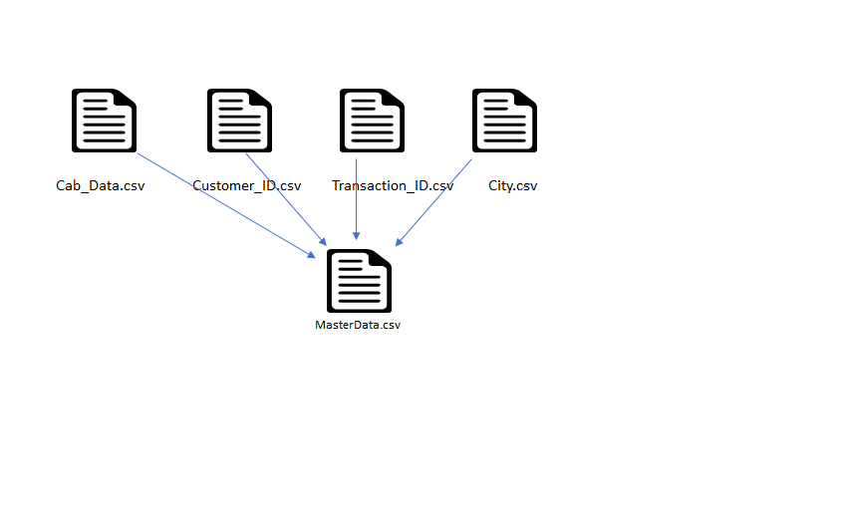
Data Exploration
20 Features( including 6 derived features)
Timeframe of the data: 2016-01-31 to 2018-12-31
Total data points :359,392
Assumptions:
Outliers are present in Price_Charged feature but due to
unavailability of trip duration details ,we are not treating this as outlier.
Profit of rides are calculated keeping other factors constant and only
Price_Charged and Cost_of_Trip features used to calculate profit.
Users feature of city dataset is treated as number of cab users in the city.
we have assumed that this can be other cab users as well(including Yellow and
Pink cab)

Slide 4
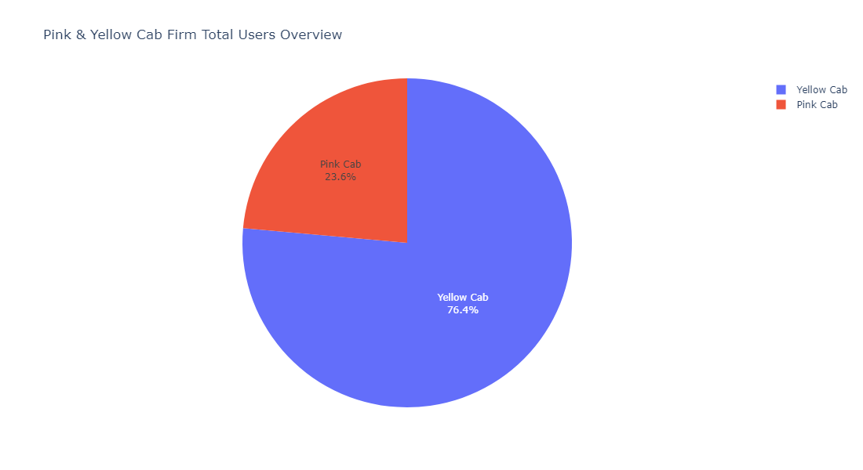
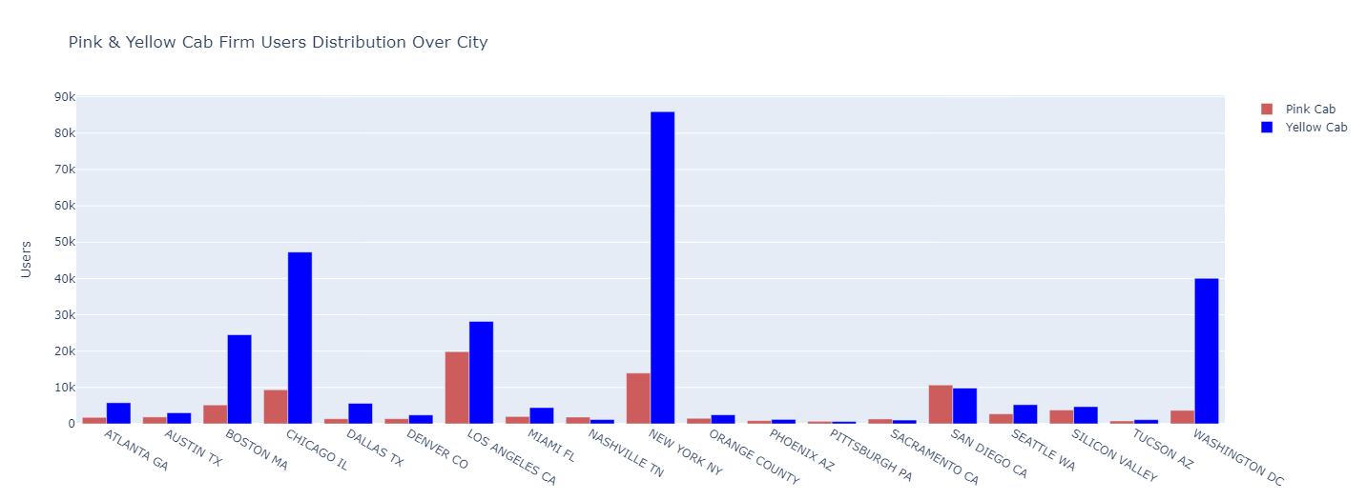
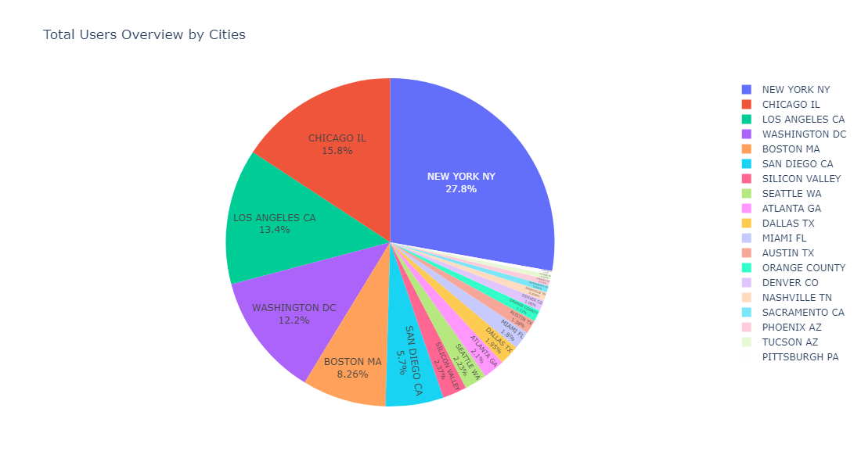
⚫ As seen from this Pie Chart; The total number of users of Yellow Cab is approximately 3 times that of Pink Cab. ⚫ As seen from this Bar Chart; For the Yellow Cab Company, the highest number of users on a city basis are in New York, Washington and Chicago, while for the Pink Cab Company, the most are in Los Angeles, New York and San Diego. ⚫ As seen from this Pie Chart; On the basis of cities, the highest number of total users are in New York, Chicago, Los Angeles, Washington and Boston.
Total User Profile Analysis

Slide 5
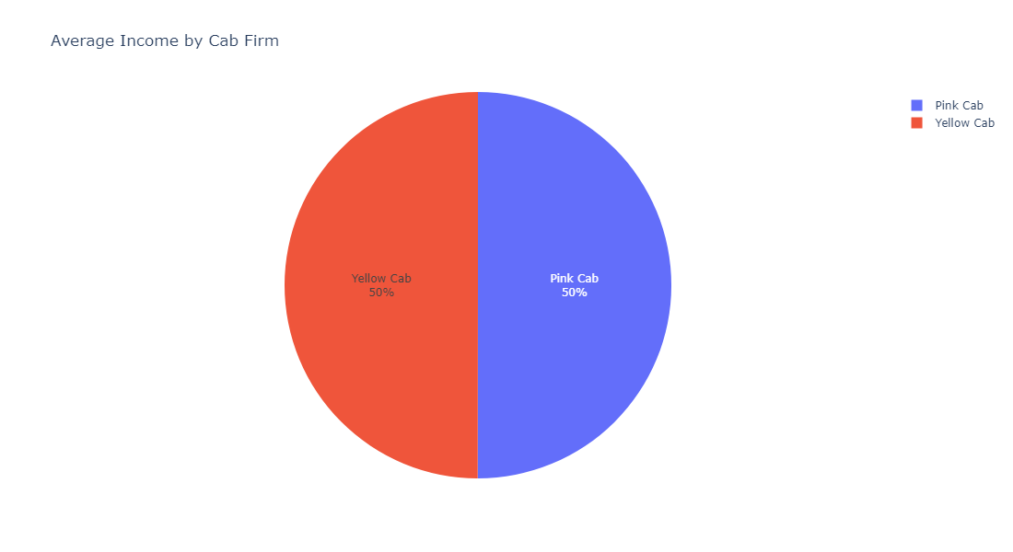
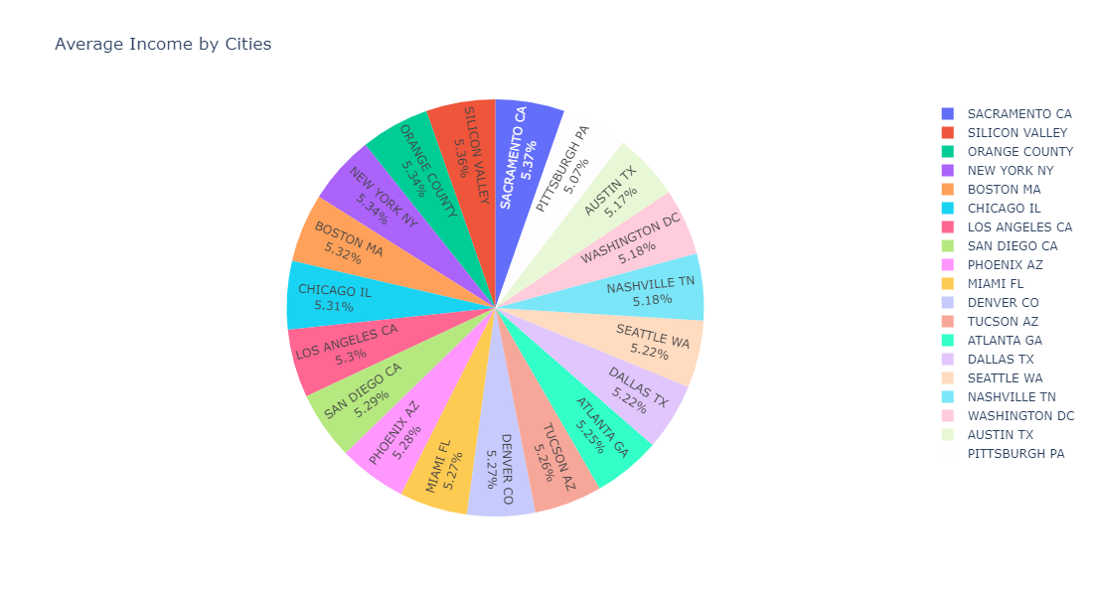
⚫ As seen from this Pie Chart; The average income of all users by city is approximately equal. ⚫ As seen from this Pie Chart; The average income of all users by companies is approximately equal.
Users Average Income Analysis

Slide 6
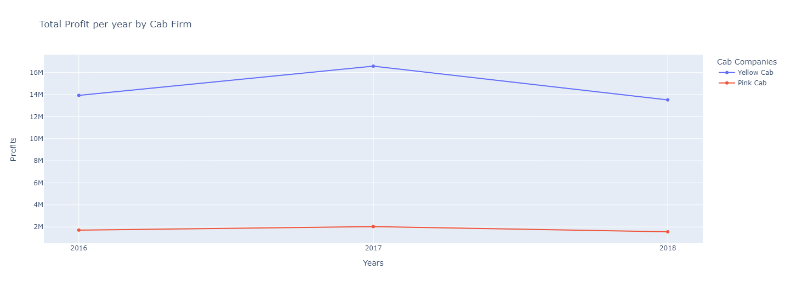
⚫ As seen from this Pie Chart; In 2016 , The total market profit share of Yellow Cab is approximately 8.15 times that of Pink Cab. In 2017 , The total market profit share of Yellow Cab is approximately 8.16 times that of Pink Cab. In 2018 , The total market profit share of Yellow Cab is approximately 8.66 times that of Pink Cab
Yearly Profit Analysis

Slide 7
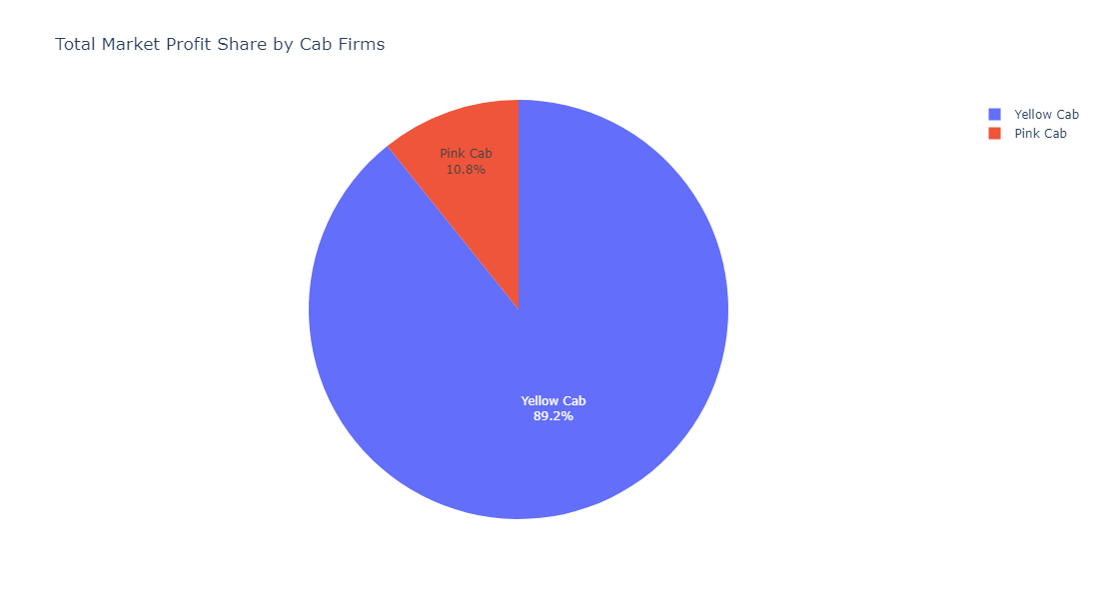
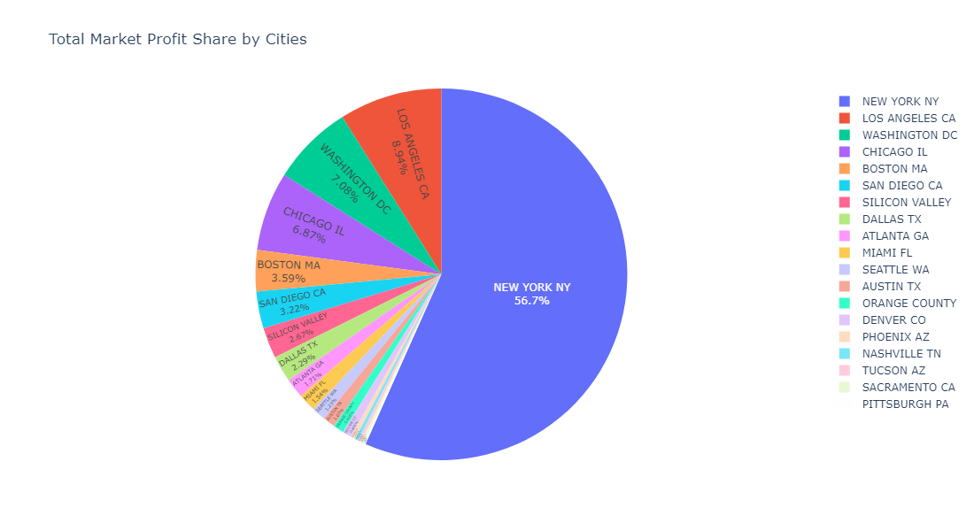
⚫ As seen from this Pie Chart; The total market profit share of Yellow Cab is approximately 9 times that of Pink Cab. ⚫ As seen from this Pie Chart; More than half of the total market profit share on the basis of cities belongs to New York.
Total Market Profit Share Analysis

Slide 8
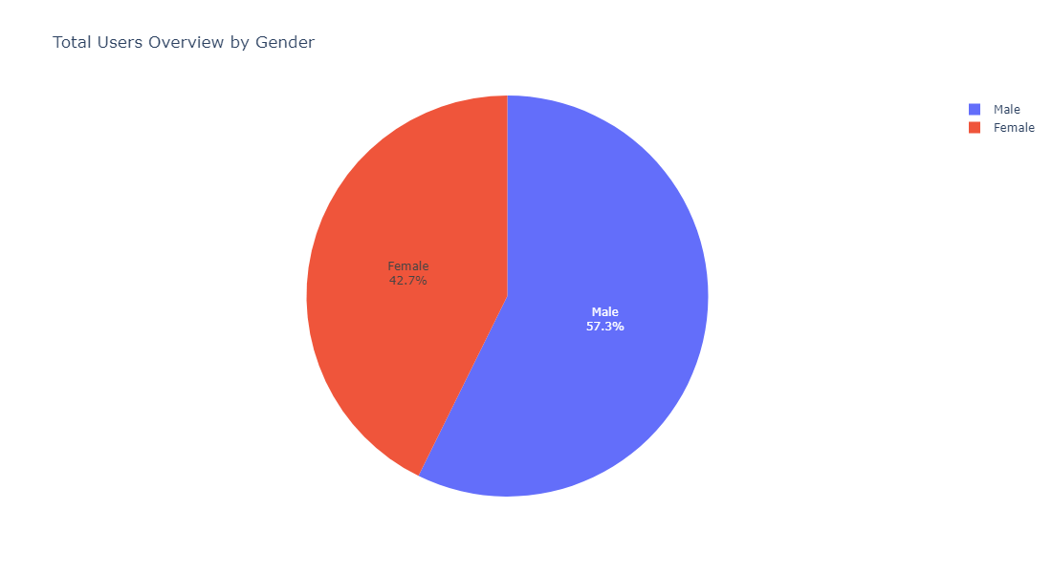
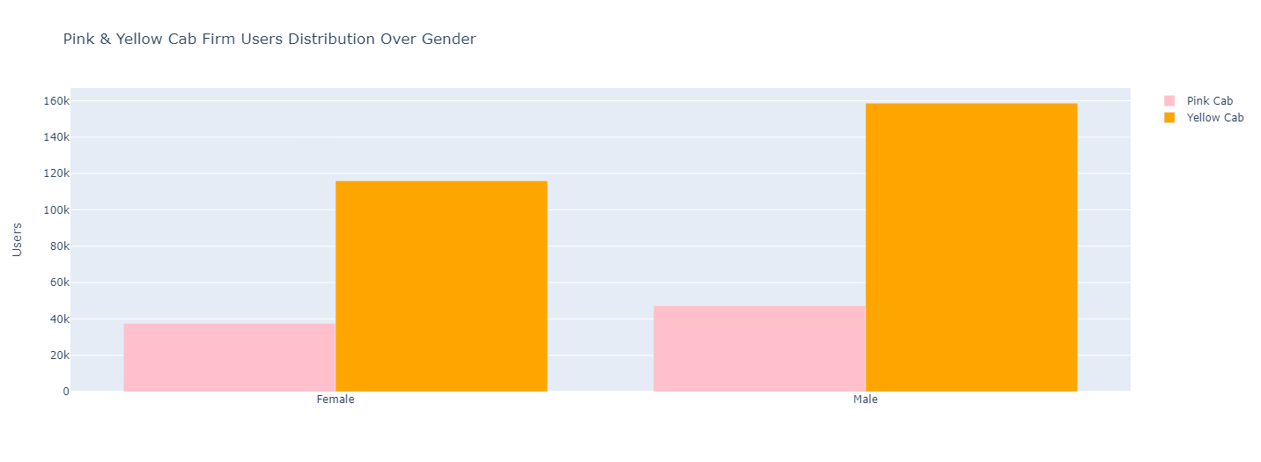
⚫ As seen from this Pie Chart; In the distribution of users by gender, there is an approximate 3 to 2 ratio for men and women. ⚫ As seen from this Bar Chart; When the distribution of users by gender is analyzed on a company basis, while the male-female ratio is 57.6% - 42.4% in Yellow Cab Company, the male-female ratio is 55.9% - 44.1% in Pink Cab Company.
Total User Gender Analysis

Slide 9
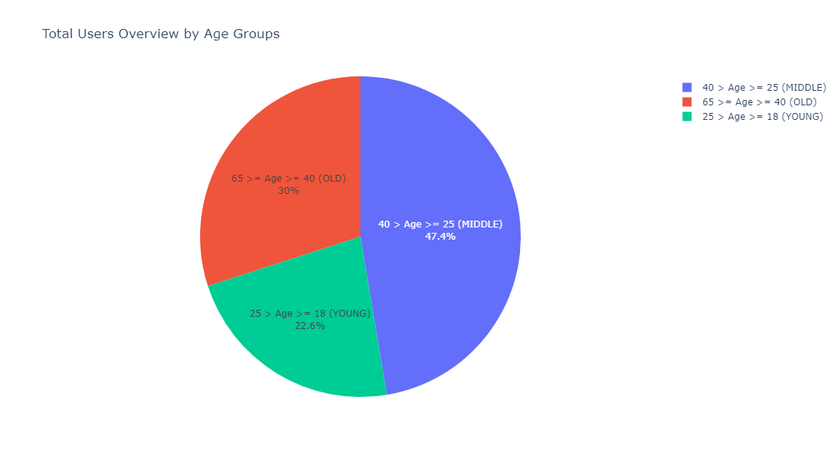
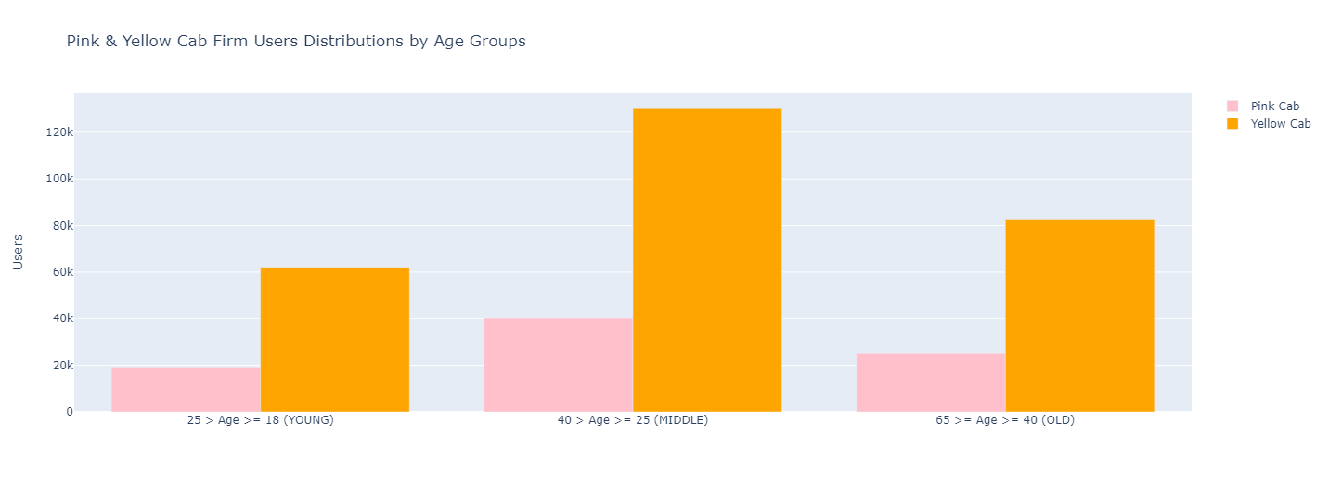
⚫ As seen from this Pie Chart; Looking at the age distribution of all users, it is seen that approximately half of them are between the ages of 18-25. ⚫ As seen from this Bar Chart; Looking at the age distribution of all users in the basis of companies, it is seen that both have the same percentage distribution for every age group.
Total User Age Group Analysis

Slide 10

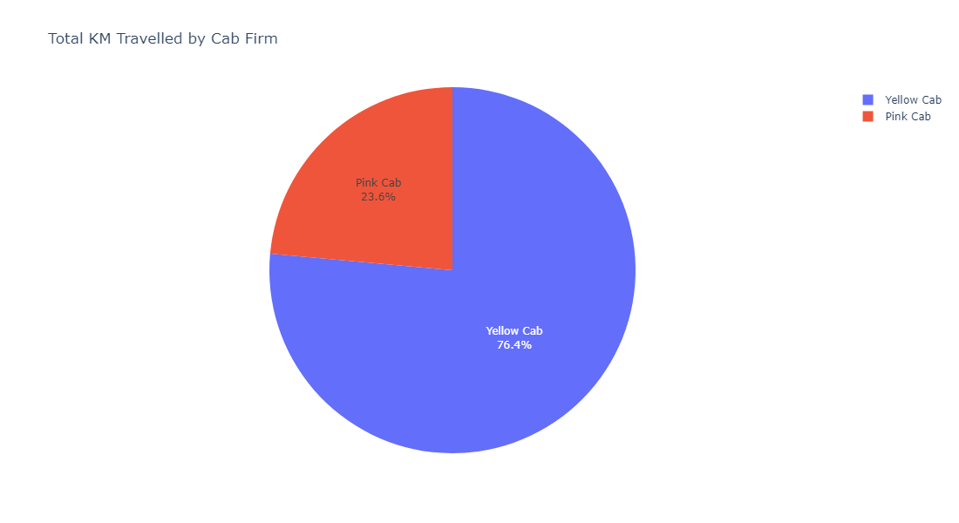
⚫ As seen from this Pie Chart; On the basis of cities, the most travelled in KM are New York, Chicago, Los Angeles, Washington and Boston. ⚫ As seen from this Pie Chart; The total travelled in KM for Yellow Cab is approximately 3 times that of Pink Cab.
Total Travelled in KM Analysis

Slide 11
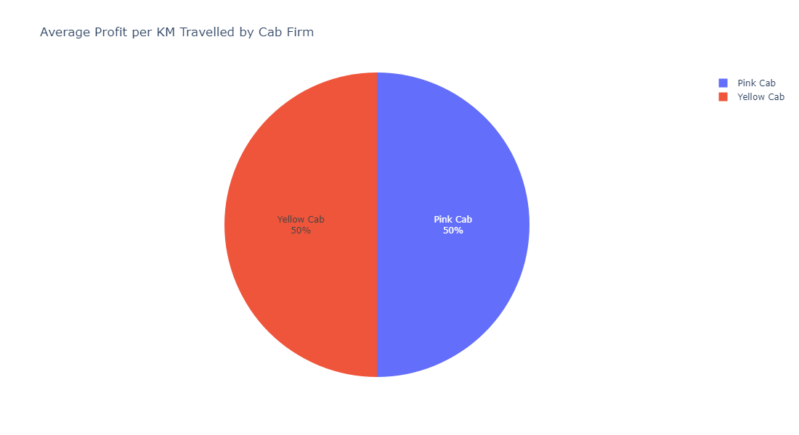
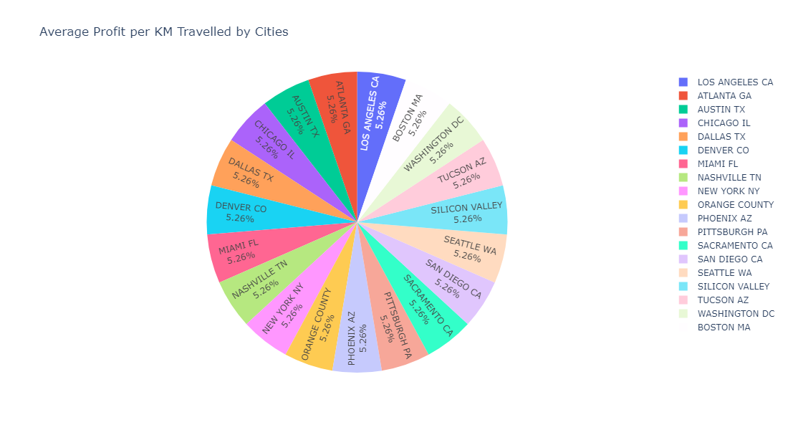
⚫ As seen from this Pie Chart; The average profit per travelled in KM by companies is approximately equal. ⚫ As seen from this Pie Chart; The average profit per travelled in KM by cities is approximately equal.
Average Profit per Travelled in KM Analysis

Slide 12
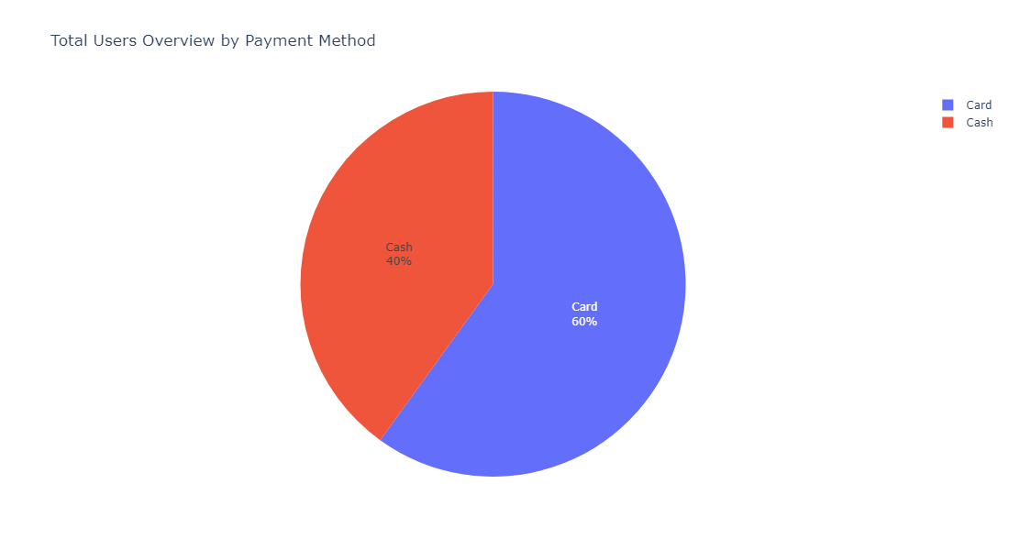
Users Payment Preference Analysis
⚫ As seen from this Pie Chart; Considering the payment preferences of all users, the credit card- cash payment ratio is 3 to 2.

Slide 13
Thank You

