Slide 1
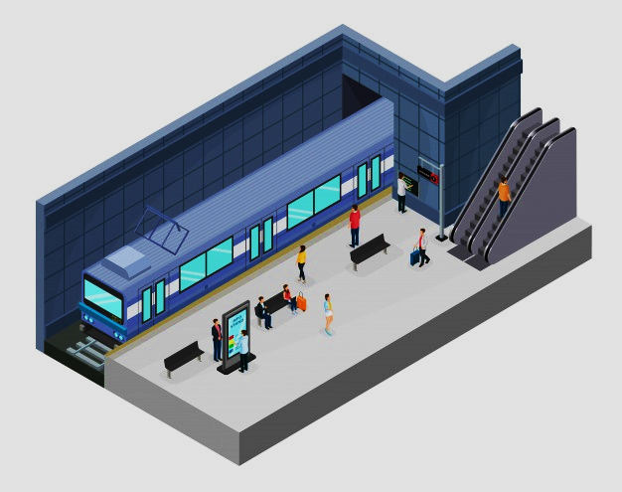

WomenTECHWOMENYES (WTWY) Street Team Recommendations
Furkan Şükrü Kütük
Senanur Özdemir
Uğur Selim Özen
Muhammed Berk Önder

Slide 2

PrOblem
‘‘How should WTWY place street teams most effectively ? ’’
Gather maximum email addresses
Gain ideal attendees for WTWY
Find financial contributors
Consider size and time constraints

Slide 3


Methodology
Finding Top 7 NYC Stations by Total Traffic
Filtering Top 5 NYC Stations by Household Income
Suggesting most appropriate NYC Stations by Hourly Traffic

Slide 4
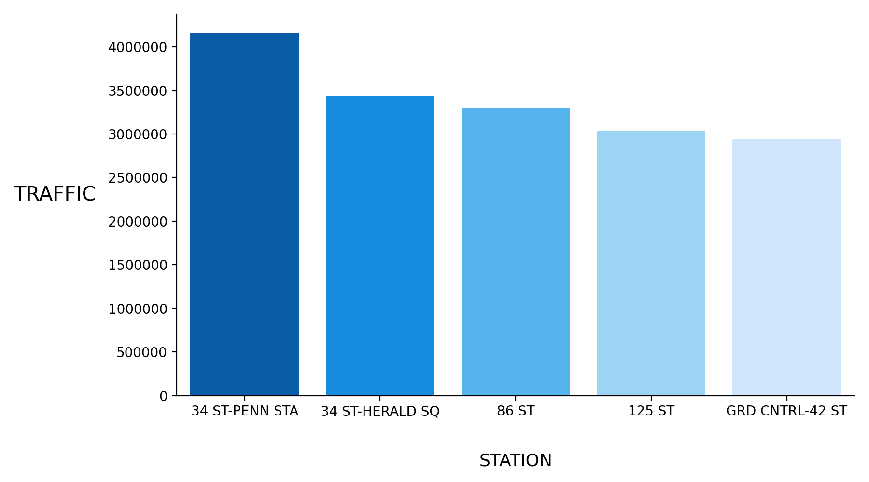
TOP 5 STATIONS BY TOTAL TRAFFIC
34 ST-PENN STA
34 ST-HERALD SQ
86 ST
125 ST
GRD CNTRL-42 ST

Slide 5
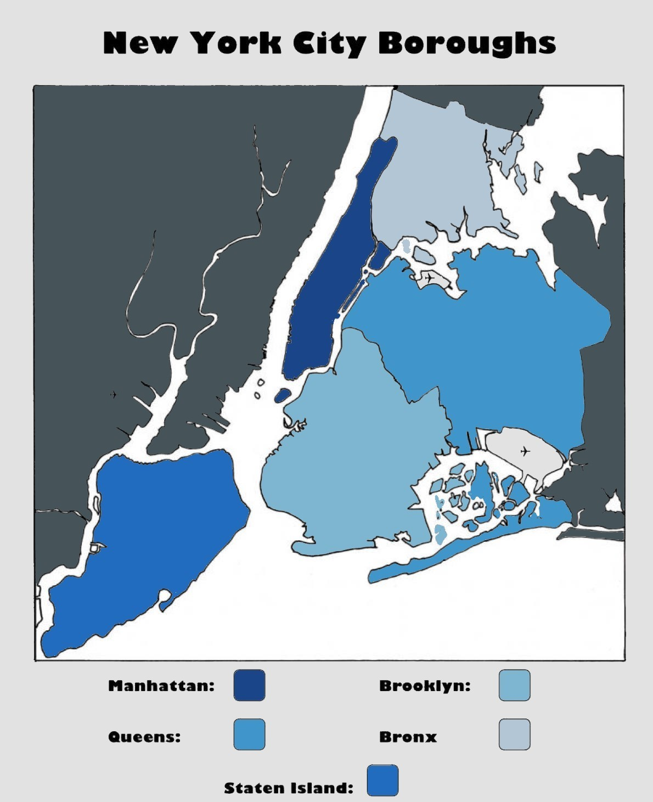
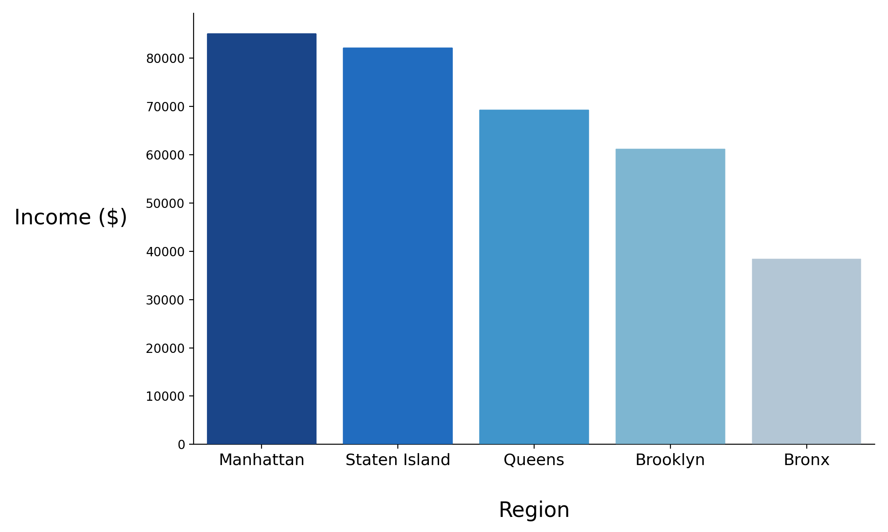
NYC REGIONAL AVERAGE HOUSEHOLD INCOME

Slide 6
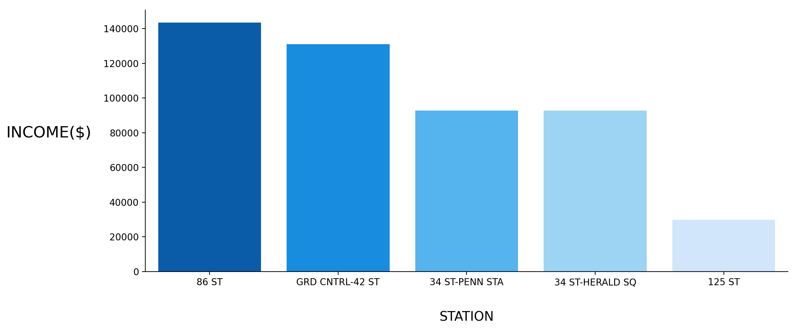
TOP 5 STATIONS MEDIAN HOUSEHOLD INCOME

Slide 7
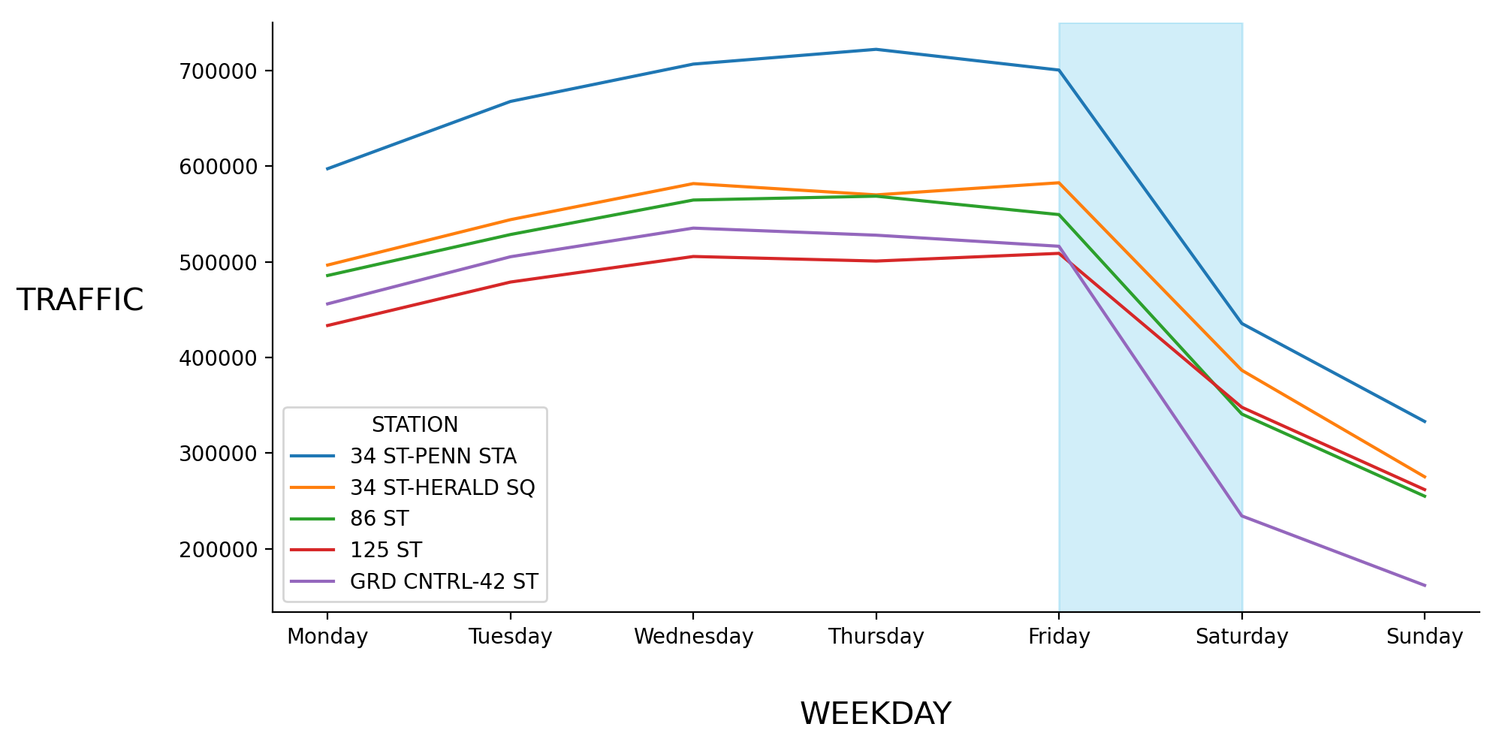
Stations should have high difference between weekday and weekend in total traffic

Slide 9
Fınal RECOMMENDATIONS

