Slide 1



SmartPhone Price Prediction Project
Furkan şükrü kütük
Uğur selim özen

Slide 2
Problem
‘‘ We are data analytics consulting team that serve on marketplace domains.
Our client requests building a prediction model for actual smartphone prices. ’’
Methodology
Data Collection with Web Scraping
Data Cleaning and Tranformation
Exploratory Data Analysis (EDA)
Feature Selection and Modeling
Model Prediction
Interpreting Results

Slide 3









Utilized Technologies
Data Overview
Observation : 1282
Feature : 18
Target : PRICE
Data Size : 318 KB

Slide 4
Web Scraping Process
1
getAndParseURL()
2
getPageLinks()
3
getProductLinks()
4
getDataFrame()
5
getResult()

Slide 5
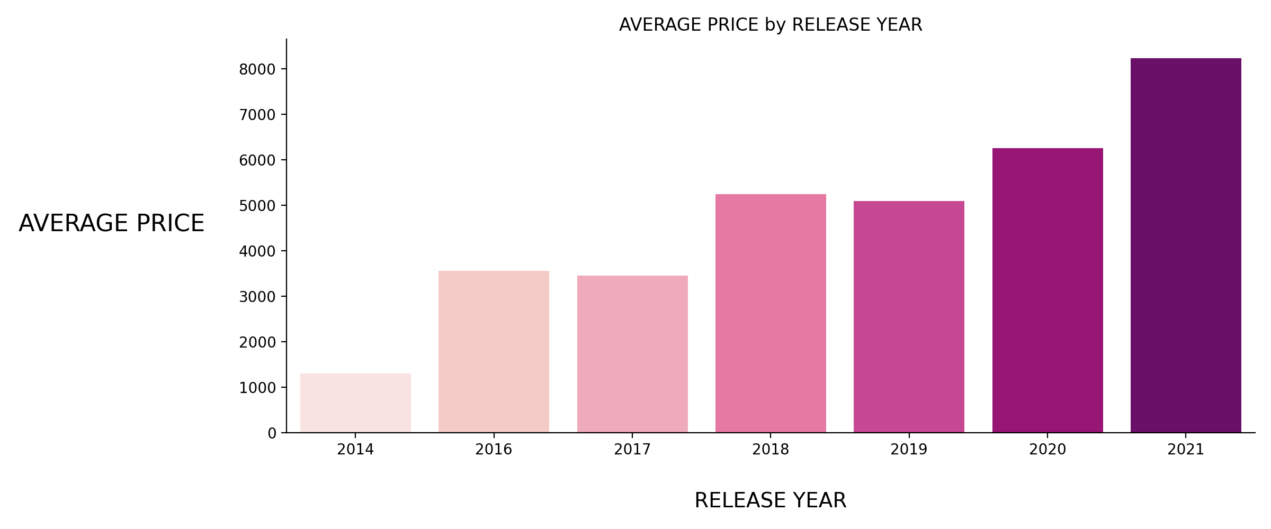
EDA - 1

Slide 6
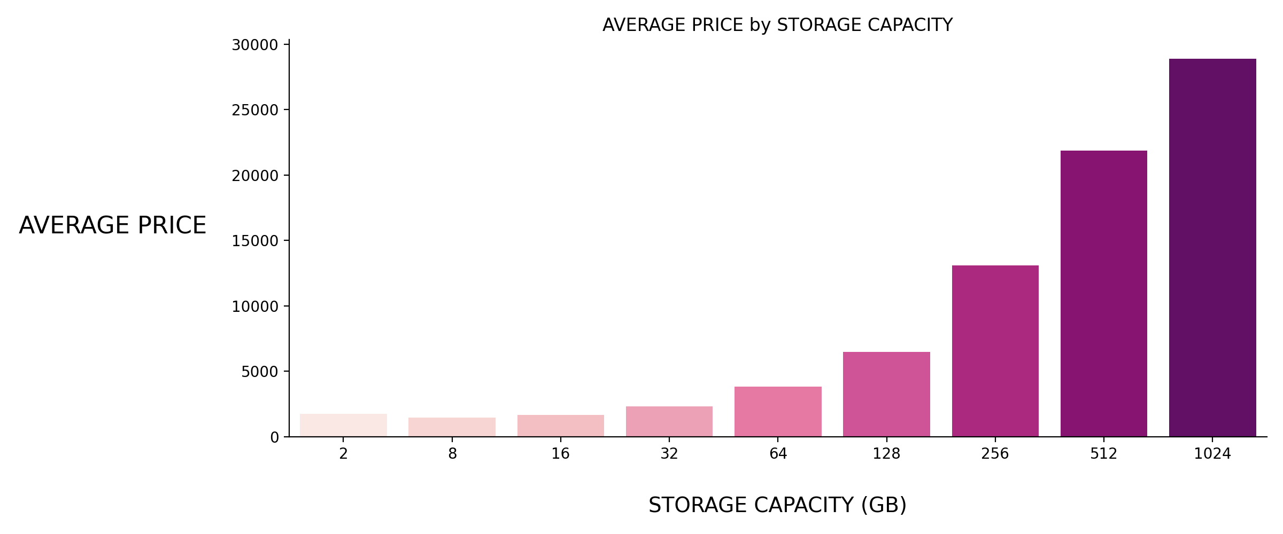
EDA - 2

Slide 7
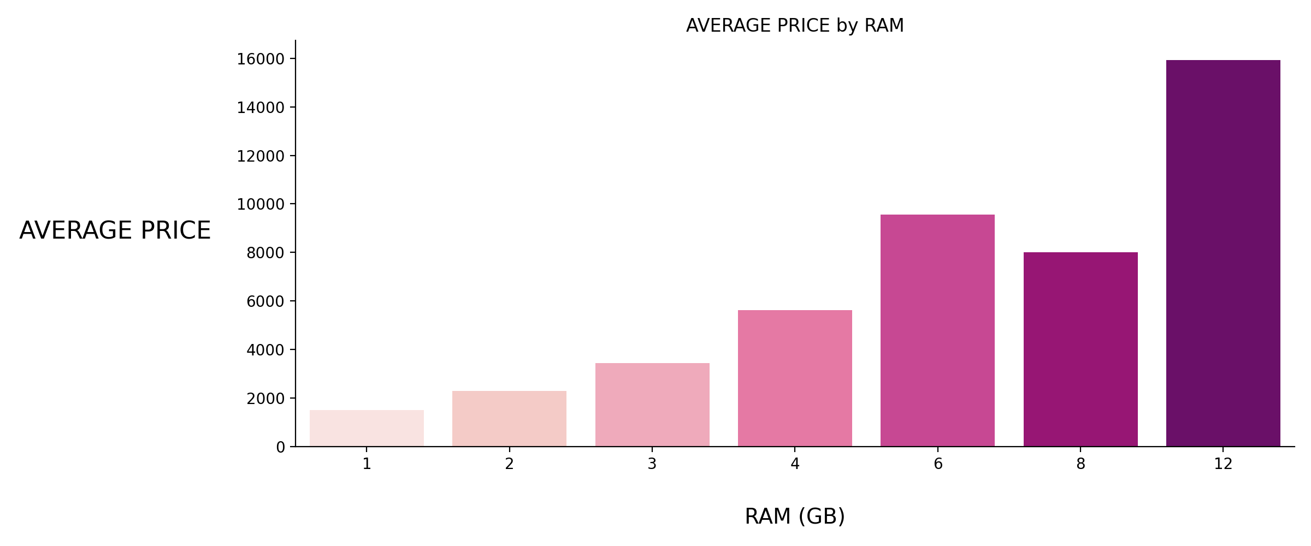
EDA - 3

Slide 8
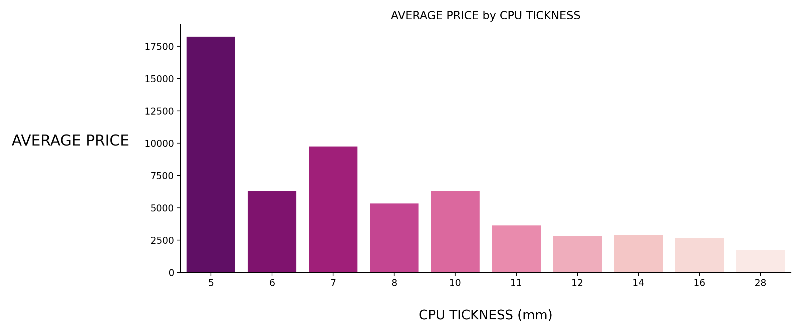
EDA – 4

Slide 9
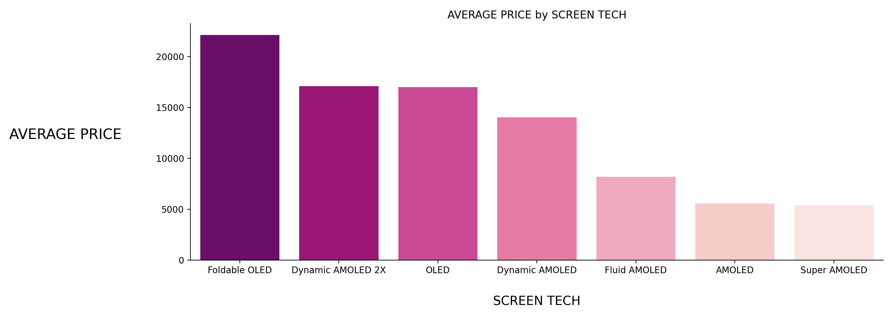
EDA – 5

Slide 10
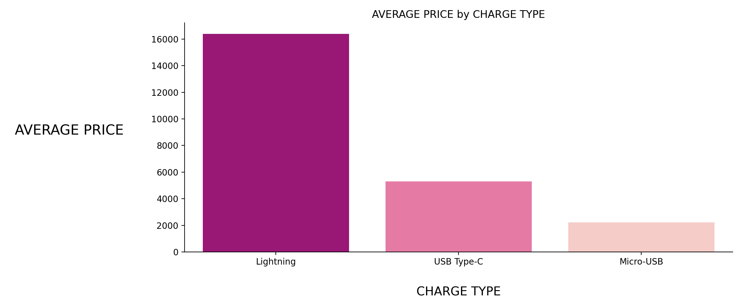
EDA – 6

Slide 11
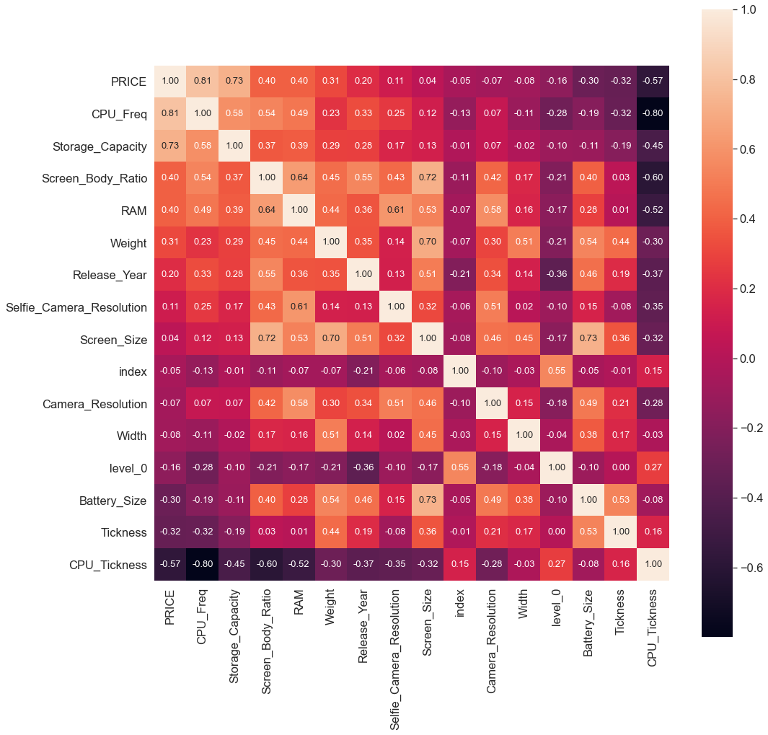
Correlation Heatmap

Slide 12
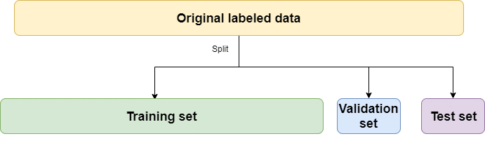
Data Modeling & Feature Selection
Sorting dataset by product release year for testing built model with the most up-to-date data.
One-Hot Encoded Features
Screen_Tech , CPU_Model , GPU_Model , Operating_System , Charge_Type
%60
%20
%20

Slide 13
Model Prediction Test Results
Model Algorithm | R2-Score (%60 Train) | R2-Score (%80 Train) | MSE (%60 Train) | MSE (%80 Train) | 10-Fold Cross Validation
Linear Regression | 0.923 | 0.863 | 5461971 | 9759771 | 0.917
Ridge Regression | 0.941 | 0.954 | 4206589 | 3261140 | 0.950
Lasso Regression | 0.942 | 0.950 | 4757696 | 3565501 | 0.948
Elasticnet Regression | 0.825 | 0.849 | 12468972 | 10791699 | 0.821

Slide 14
‘‘ Ne kadar zor, işte bu kadar zor ! ’’
Thank you !
Zekeriya Beşiroğlu

