Slide 1


FOOTBALL PLAYER RANKING CLASSIFICATION PROJECT
Furkan Şükrü KÜTÜK – Uğur Selim ÖZEN

Slide 2

Problem
Methodology
Our client who is a scout, wants to find the best players with a classification model for the player ranking system.
Writing & Reading with SQLite
Data Cleaning & Data Preprocessing
Tableau EDA
Feature Engineering
Model Building & Evaluation
Streamlit App & Deployment

Slide 3
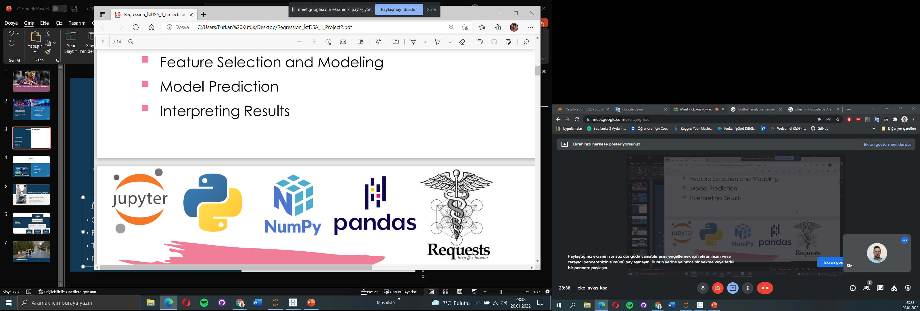








Utilized Technologies
Data Overview
▪ Observation : 10848
▪ Feature : 20
▪ Target : Overall_Ranking
▪ Data Size : 2,31 MB

Slide 4
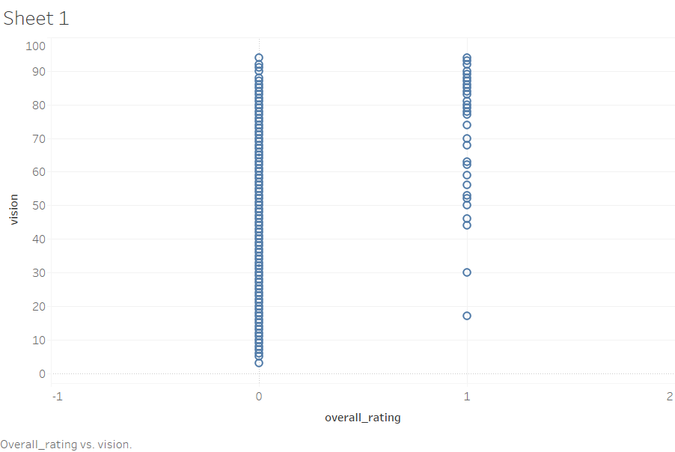
EDA

Slide 5
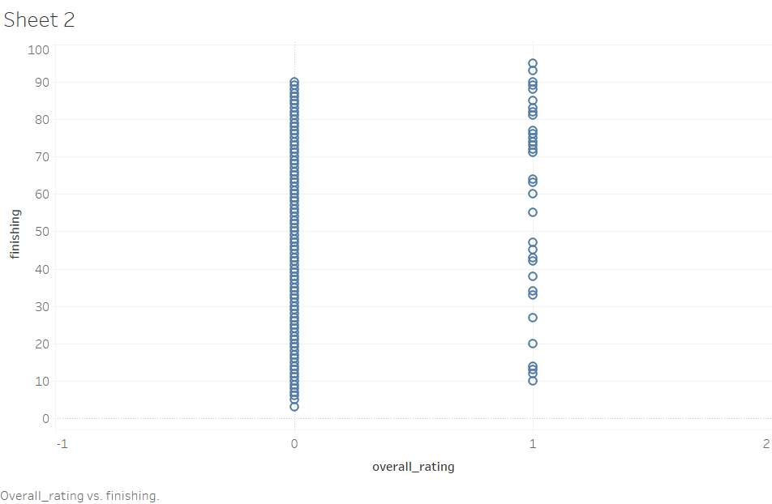
EDA

Slide 6
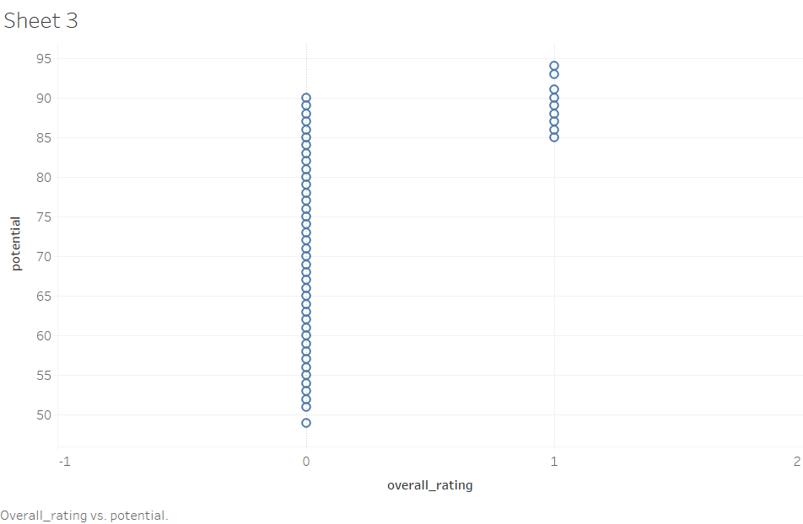
EDA

Slide 7
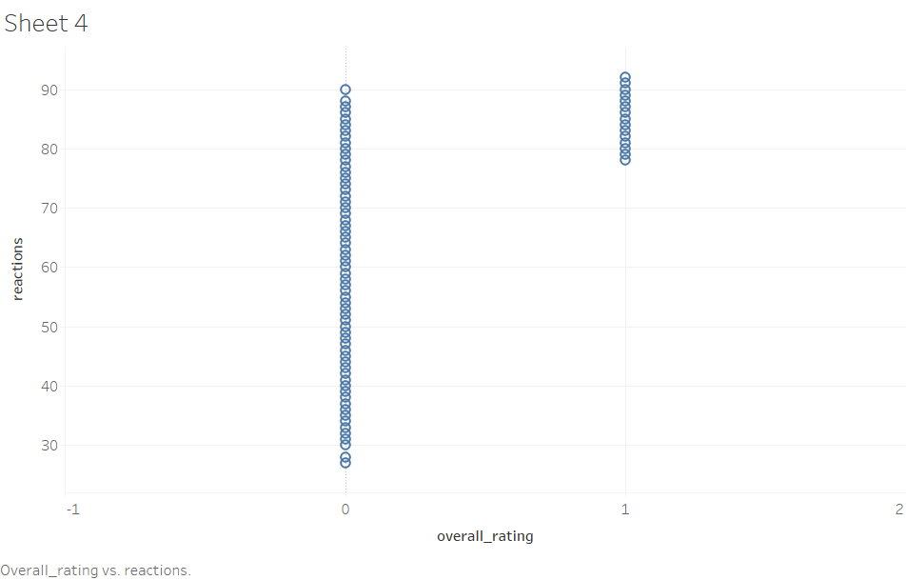
EDA

Slide 8
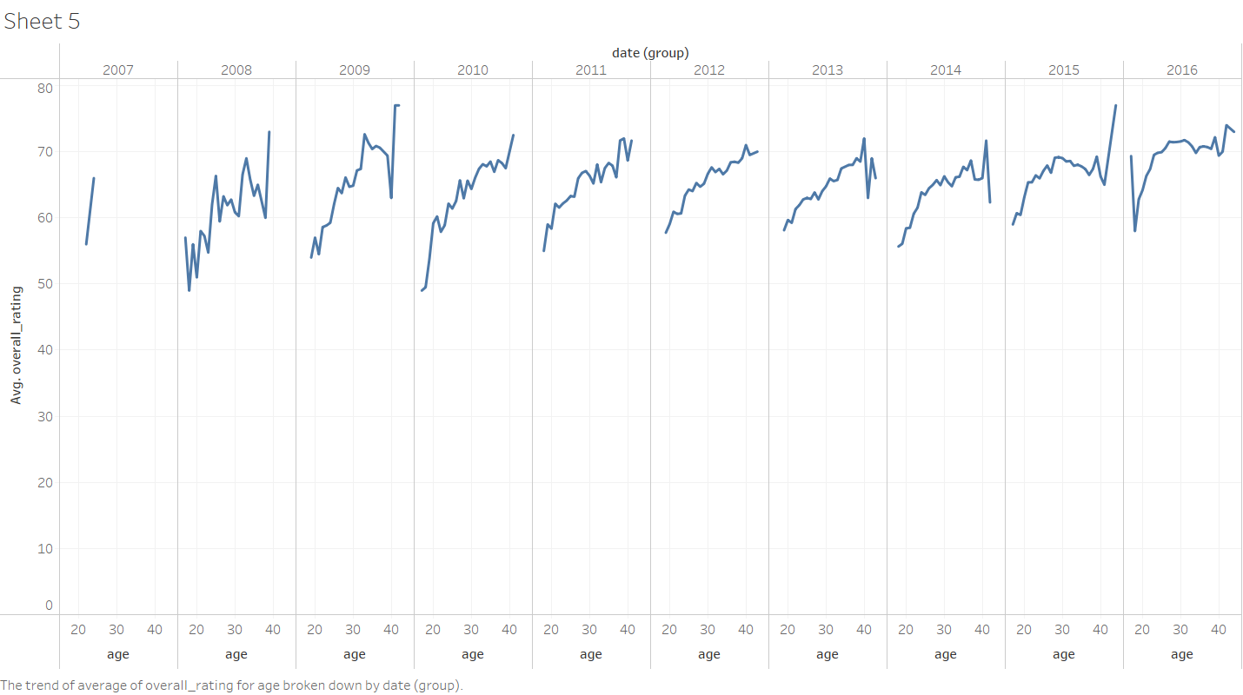
EDA

Slide 9
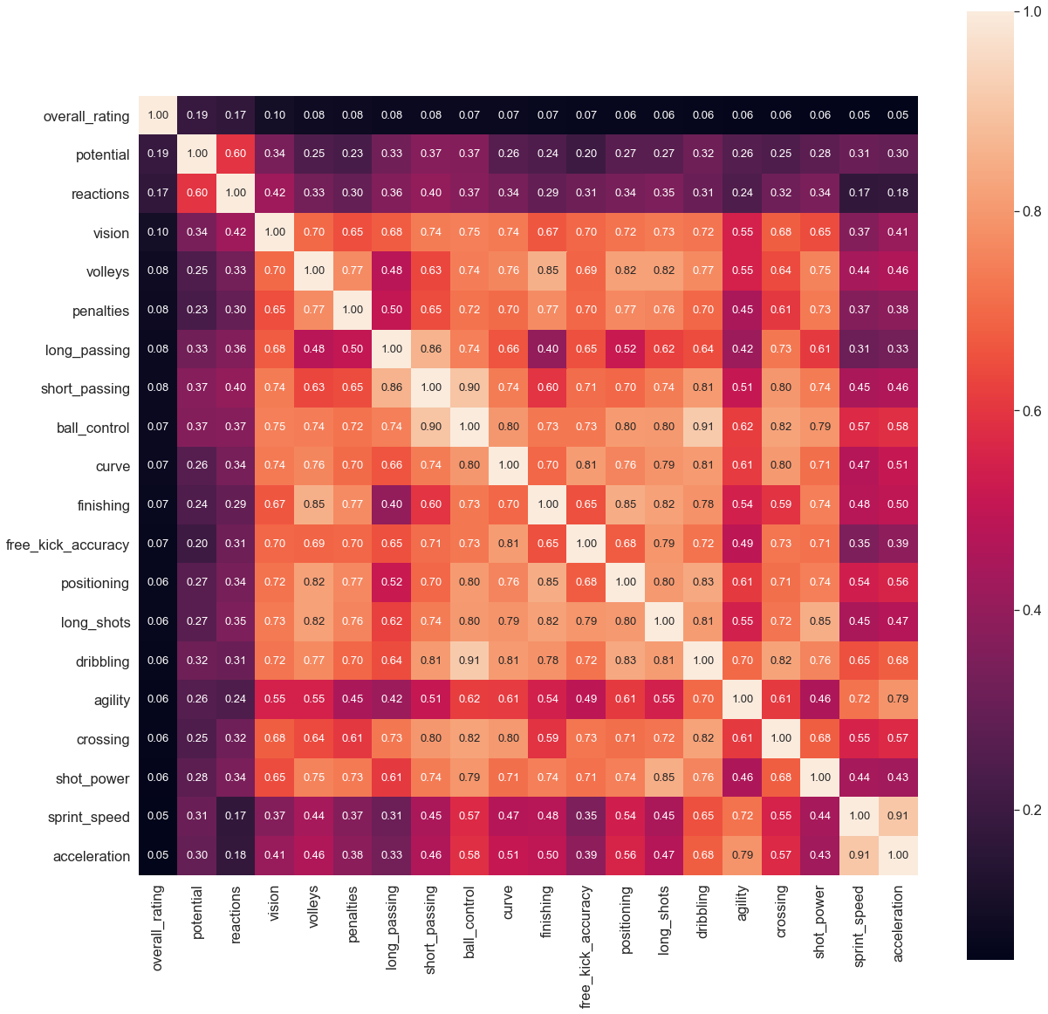
Correlation Heatmap

Slide 10
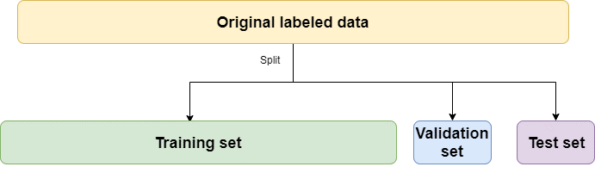
Data Modeling
%60
%20
%20

Slide 11
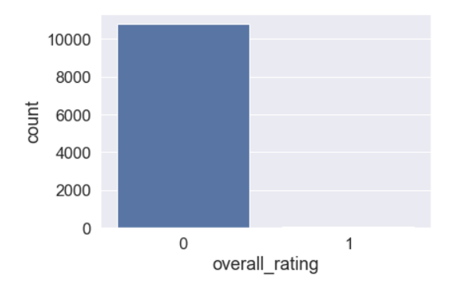
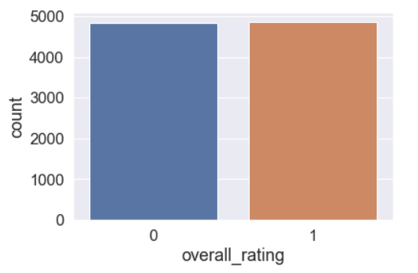
Oversampling on Imbalanced Data

Slide 12
Classification Model Prediction Test Results
Cl. Model Algorithm | Precision (A Class Players) | Recall (A Class Players) | F1-Score (A Class Players)
Decision Tree Classifier | 0.60 | 0.71 | 0.65
Logistic Regression | 0.29 | 0.29 | 0.29
Random Forest Classifier | 0.80 | 0.50 | 0.60
CatBoost | 0.83 | 0.70 | 0.75
LightGBM | 0.83 | 0.74 | 0.78
K-Fold Results
XGBoost | 0.78 | 0.77 | 0.77

Slide 13
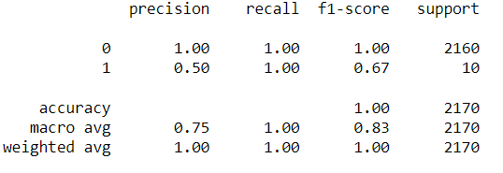
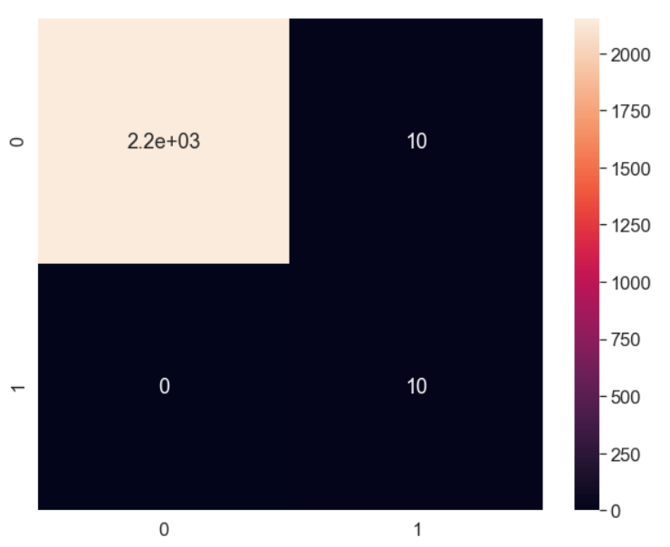
The Best!
XGBoost
KATILIMCILAR
BİLİŞİM
TEKNOLOJİ

Slide 14

Thank You !

