Slide 1
SubLiMat
Add simple logo if possible
Substitution matrix benchmarking with pairwise alignment
Project Name
1/18

Slide 2




Problem statement
Substitution matrices are hypothesis of evolutionary change.
There are many substitution matrices used in the literature.
Their effects in different types of sequences isn’t easy to determine
2/18

Slide 3
5’
3’
A
B
5’
3’
3/18

Slide 4
_
_
4/18

Slide 5
Goals
Given two genetic sequences of size n:
Generate a pairwise alignment: match nucleotides based on a substitution matrix. Get a score
Evaluate multiple substitution matrices: Rank the quality of alignments produced by different substitution matrices.
5/18

Slide 6
Symbols
Symbol | Meaning
A,G | Purine nucleotides
T,C | Pyrimidine nucleotides
↔ | Transition
/↔/ | Transversion
JC | Jukes Cantor model
K80 | Kimura model
TN93 | Tamura Nei model
HKY85 | Hasegawa-Kishino-Yano model
Mb | Mega bases
6/18

Slide 7
Terminology
Term | Definition
SNP | Atomic positional unit that carries DNA genetic information
Codon | Atomic positional unit that carries protein information
Genetic Unit of Information (GenUI) | Atomic positional unit of genetic information (includes SNP and Codon)
Quality | The capacity of an alignment to maximize the pairing of same GenUIs, while avoiding mismatches.
7/18

Slide 8
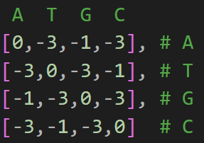
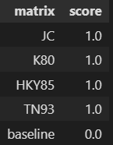
Example of calculation
Add multiple cases. One default, one easy,
One hard
Case 1. base case
Output
Input
sequence1 = “A"
sequence2 = “A"
8/18

Slide 9
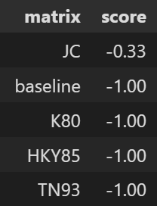
Example of calculation
Add multiple cases. One default, one easy,
One hard
Case 1. easy case
Output
Input
sequence1 = “G"
sequence2 = “A"
9/18

Slide 10
Example of calculation
Case 1. algorithm
Input
sequence1 = “ATGGA"
sequence2 = “TGGAT"
10/18

Slide 11
Assumptions
Each genUI exists only once for a given alignment.
A genUI is only relevant by its relative position to other such units.
A strand is always read from the 5’ to 3’ direction.
The quality of an alignment is a strictly comparative metric.
The cost of inserting a gap is constant among substitution matrices.
11/18

Slide 12

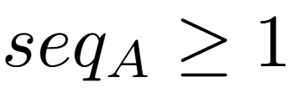
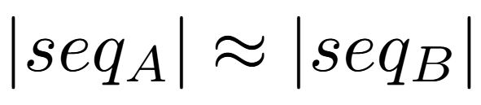
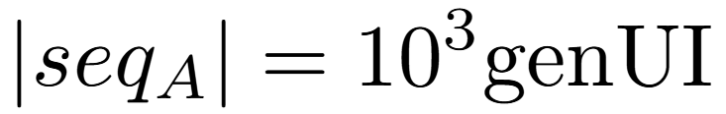

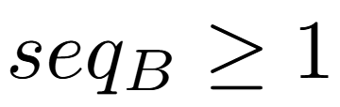
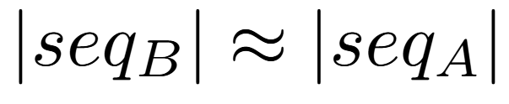
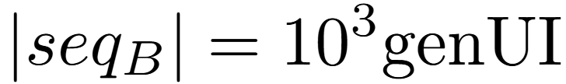

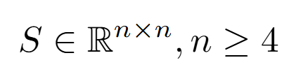



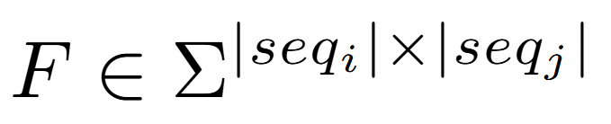
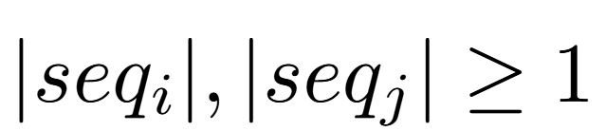
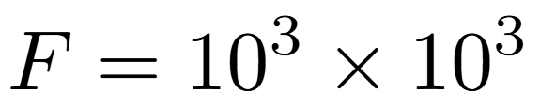

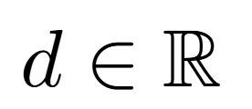

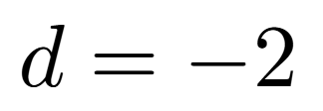
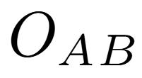
Inputs and outputs (Data constraints)
Var | Physical Constraints | Software Constraints | Typical Value | Uncert.
 |  |  |  | 10%
 |  |  |  | 10%
 |  |  |  | 10%
 |  |  |  | 0%
12/18

Slide 13
Inputs and outputs (Data constraints)
Var | Definition | Units
 | String of genUIs of arbitrary size to be compared with seqB | SNP/Codon
 | String of genUIs of arbitrary size to be compared with seqA | SNP/Codon
 | Substitution Matrix encoding penalties and rewards for genUI transformations. | --
 | Comparative matrix of seqA and seqB | Index
 | Penalty associated with gap insertions | --
 | 1D vector encoding the performance of multiple substitution matrices | --
13/18

Slide 14
Theoretical models
Label | Needleman-Wunsch recursive model
Equation
Description | g is gap penalty x is a genetic sequence y is a genetic sequence F is 2D comparative matrix of sequences A and B S is a substitution matrix i is the index mapping to position in matrix A j is the index mapping to position in matrix B
Notes | Recursive function for the pairwise alignment of two genetic sequences to return the best global solution.
Source | wikipedia.org/wiki/Needleman%E2%80%93Wunsch_algorithm
14/18

Slide 15
General definitions/Theoretical models
Label | Needleman-Wunsch recursive model
Equation
Description | d is gap penalty A is a genetic sequence B is a genetic sequence F is 2D comparative matrix of sequences A and B S is a substitution matrix i is the index mapping to position in matrix A j is the index mapping to position in matrix B
Notes | Recursive function for the pairwise alignment of two genetic sequences to return the best possible solution.
Source | wikipedia.org/wiki/Needleman%E2%80%93Wunsch_algorithm
15/18

Slide 16
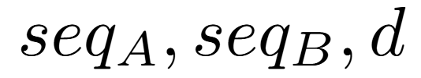
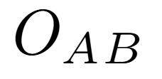
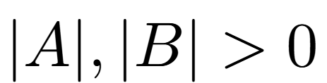
Instanced models
Label | Traversing substitution matrices with pairwise alignment
Input
Output
Input constraints
Output constraints
Equation
16/18

Slide 17

Questions
17/18

Slide 18
Questions
17/18

Slide 19
Areas where my projects struggles
Too simple?
Hard to find more inputs/outputs
Where should I include the iterative process that involves testing multiple substitution matrices?
If the substitution matrix S is NOT part of the input, does it still have to be added to the Instanced models?
18/18

