Slide 1
Proof of Concept
Uriel Garcilazo Cruz

Slide 2
GOALS (SRS)
PROBLEM
Substitution matrices are critical assumptions that greatly impact studies in the area of comparative biology, yet, benchmarking these matrices is a laborious task.
1/12

Slide 3
Overview
Given
Two sequences of DNA of similar size n
A set of substitution matrices
Produce:
Empty table
For each substitution matrix:
Build a comparison matrix F
Calculate a score for the quality of the alignment
Add the identity of the matrix and its score to table
-/12

Slide 4
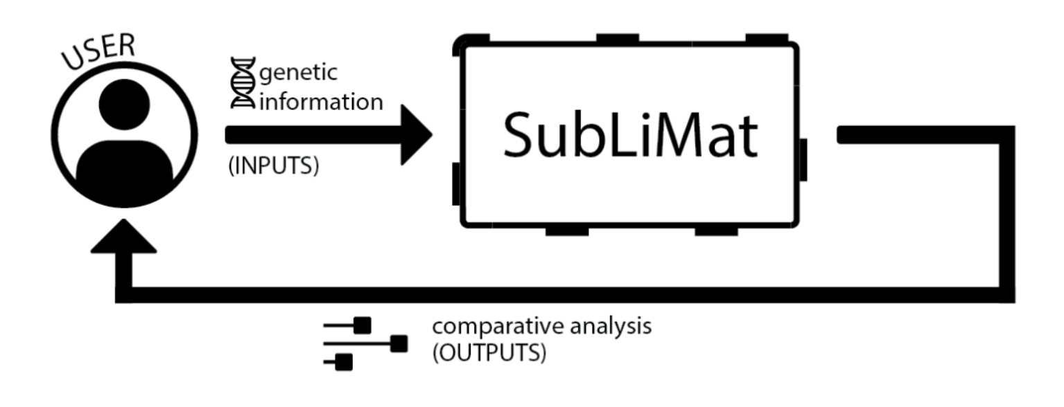
2/12

Slide 5


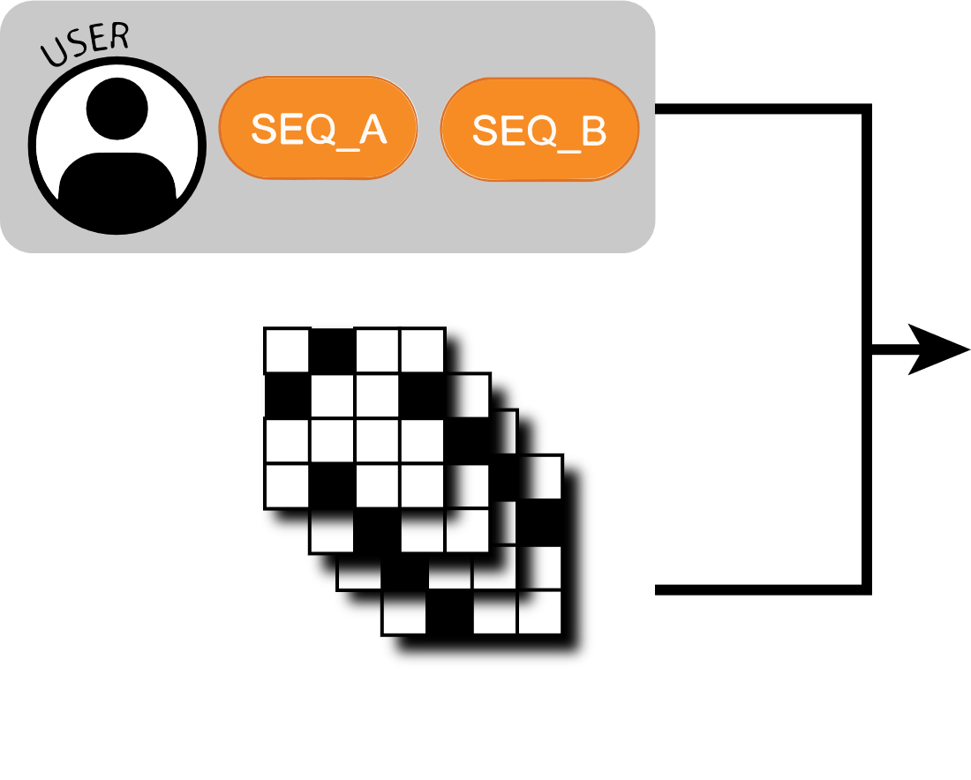




R1
R2
R3
3/12

Slide 6
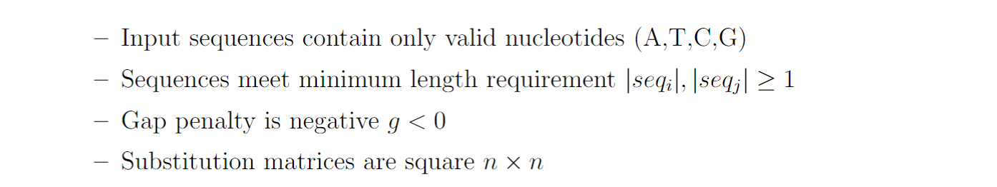
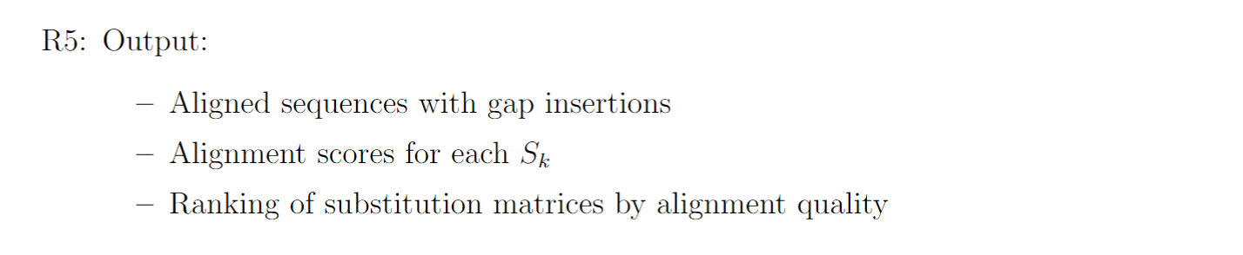
Looking for class feedback…
4/12

Slide 7
5/12

Slide 8
INPUTS
5/12

Slide 9
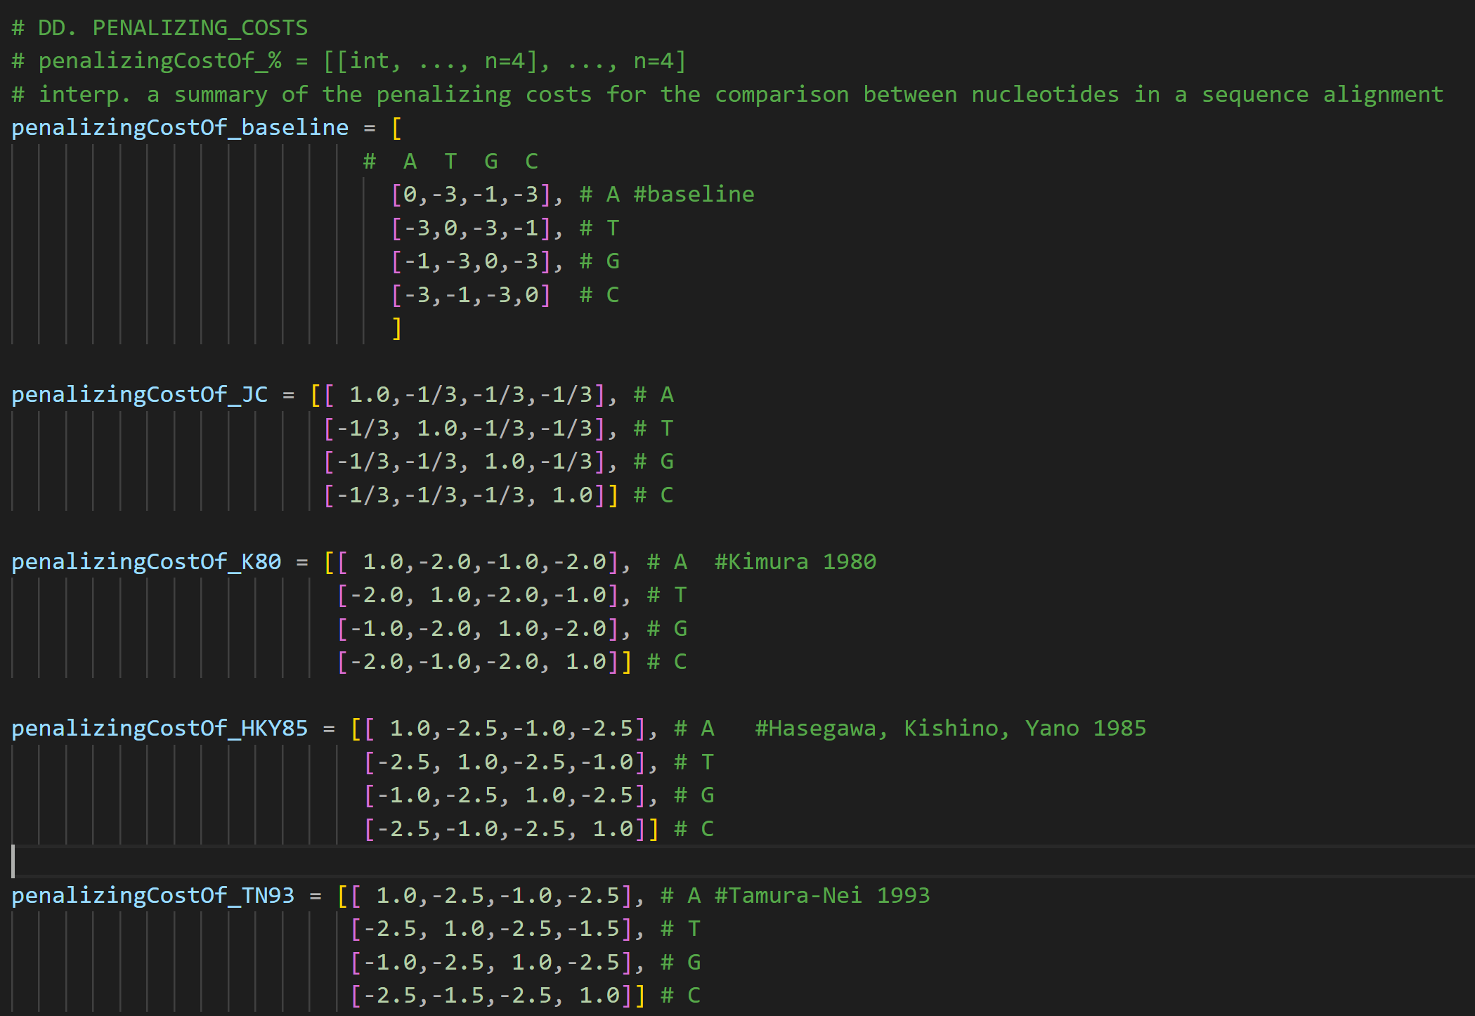

6/12

Slide 10

7/12

Slide 11
MODULES
8/12

Slide 12

9/12

Slide 13
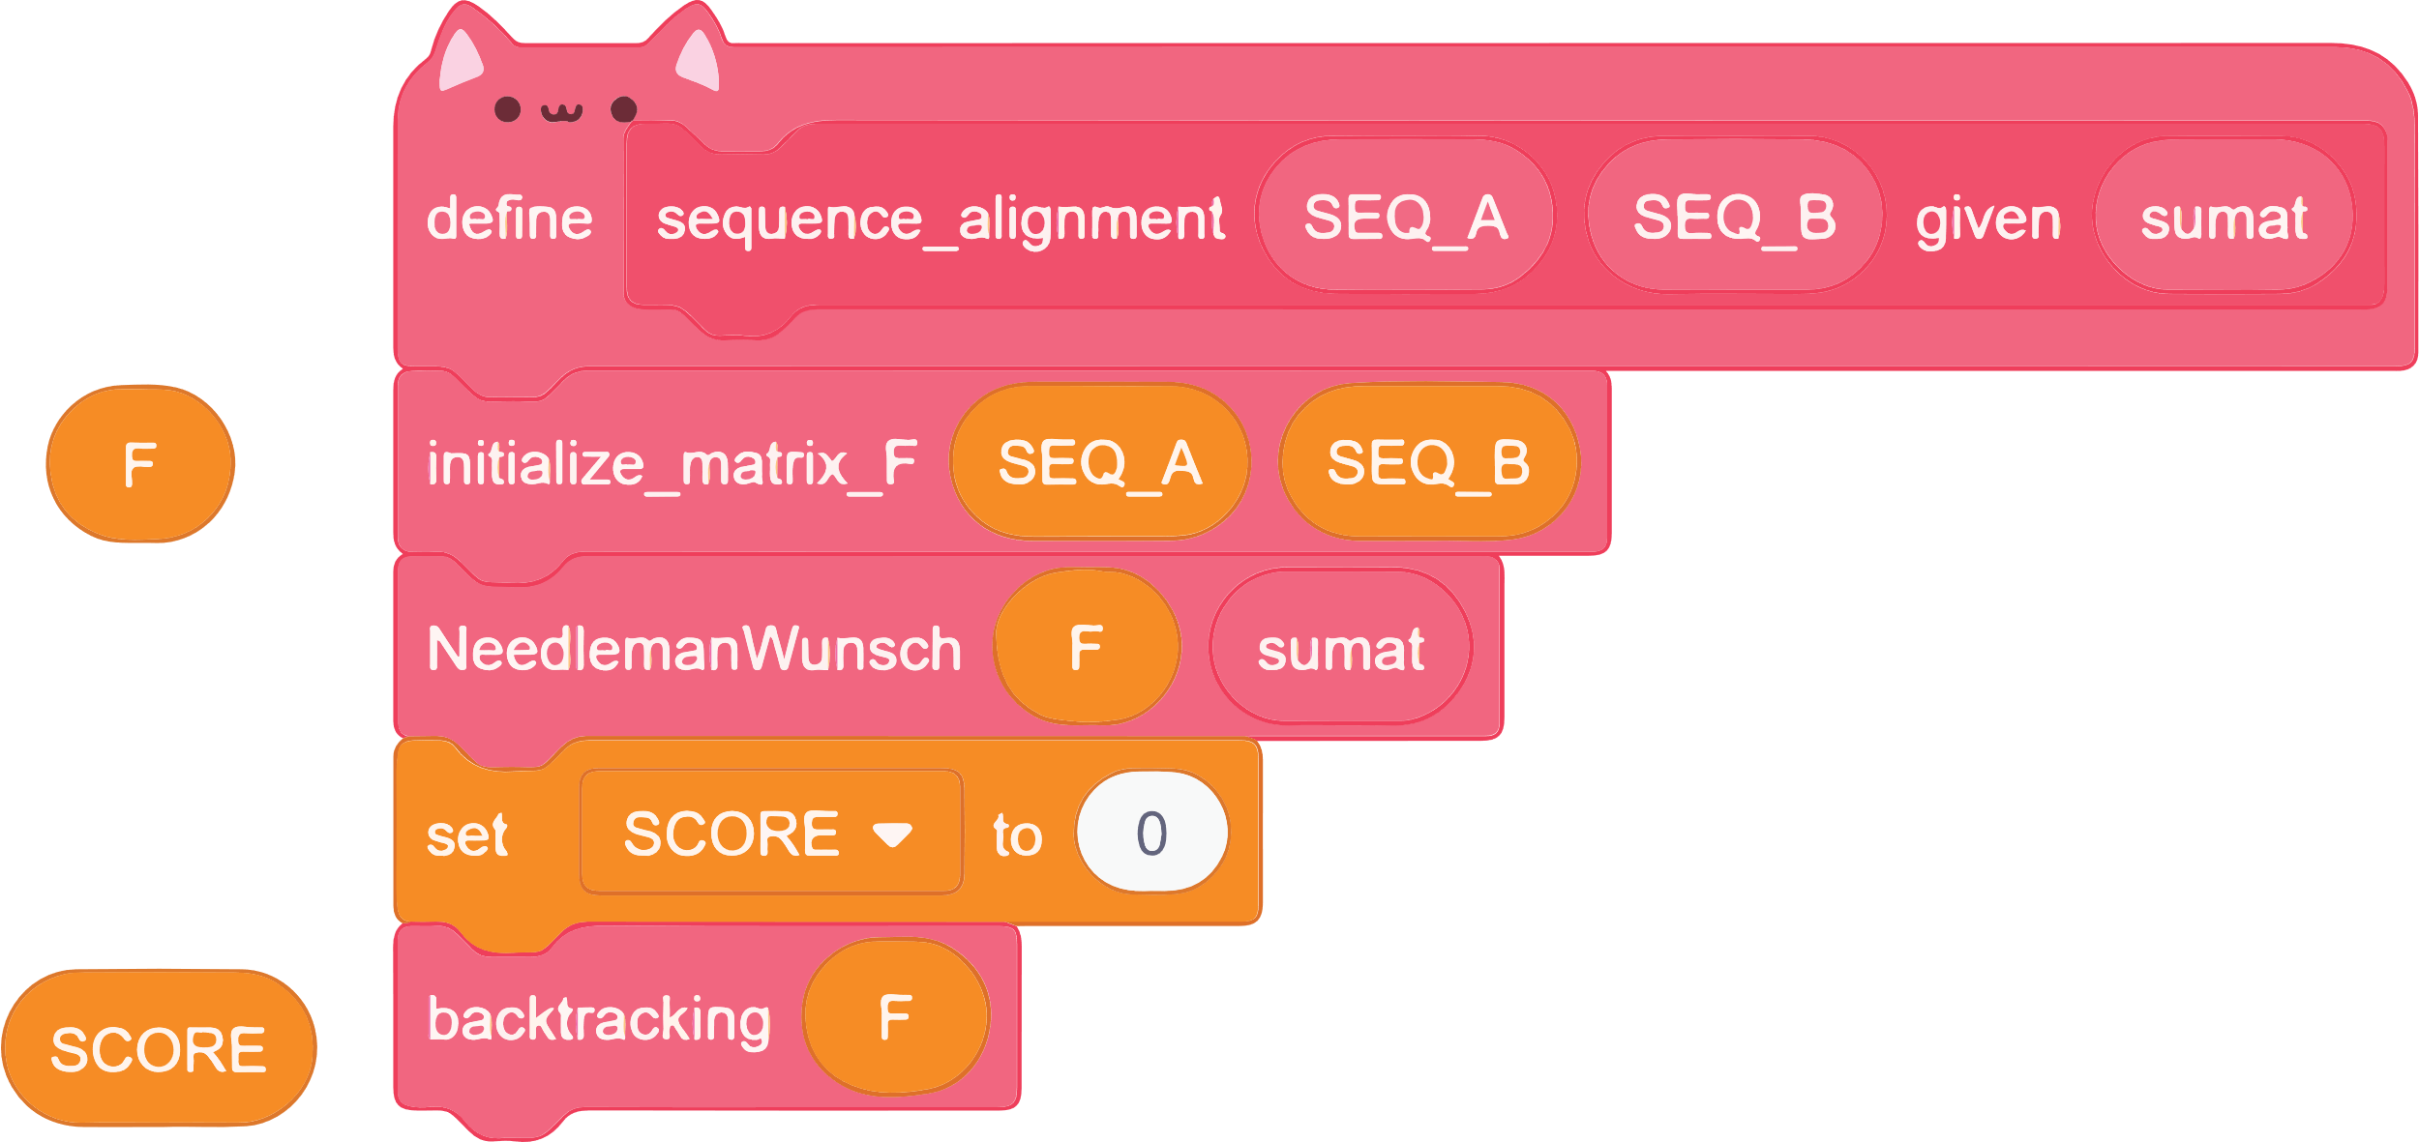
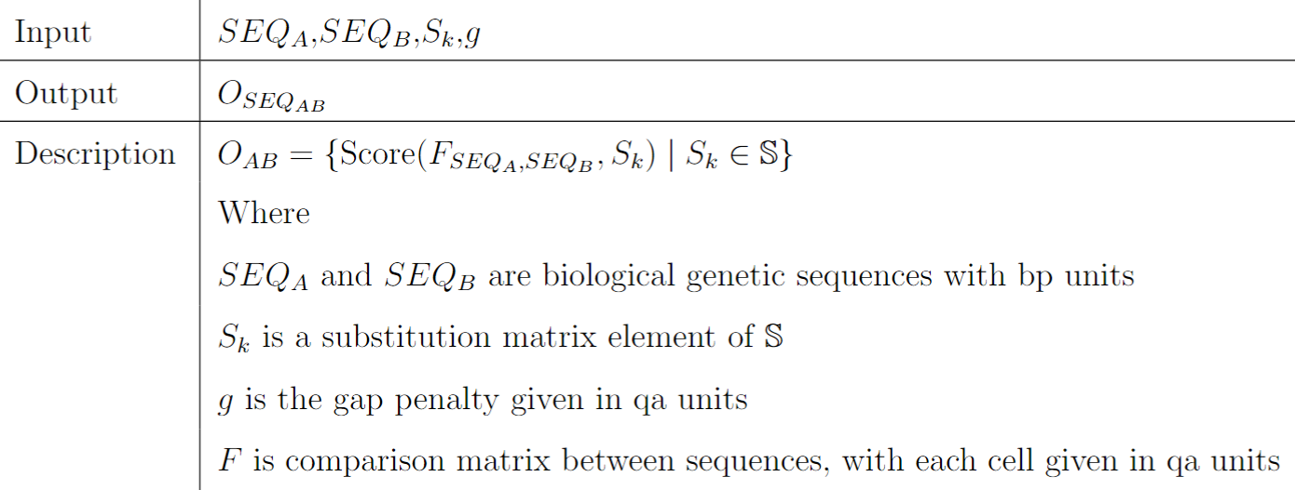
10/12
M1

Slide 14
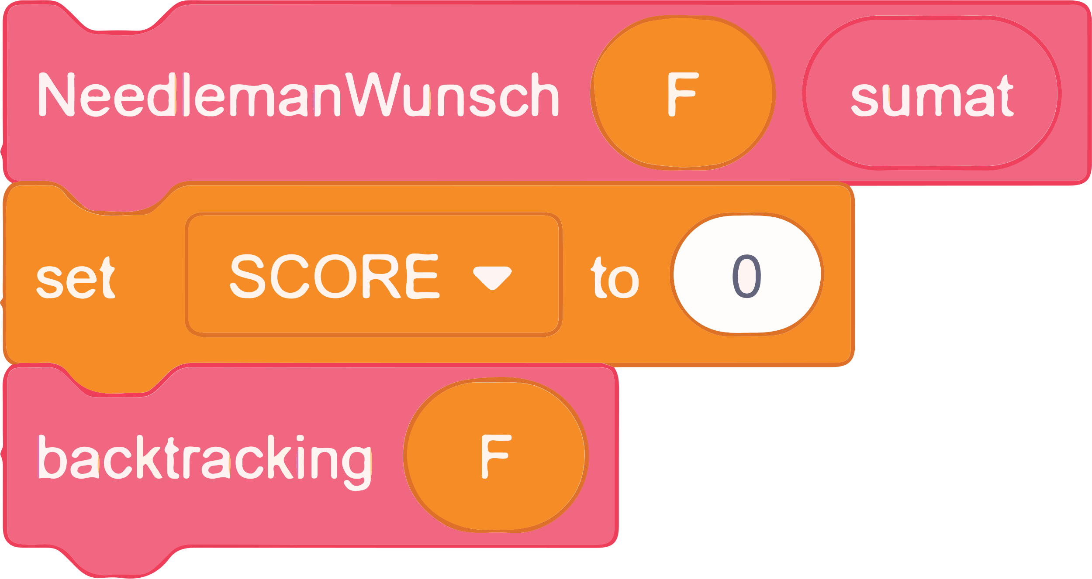
11/12

Slide 15

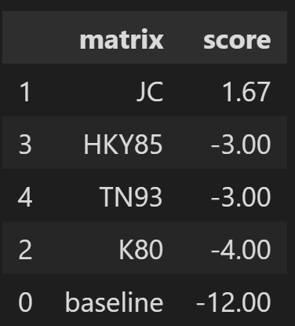

12/12

