Slide 1
ECE 5397/6397:
Introduction to Robotics
Lecture 20:
Visual servo control
Reference: Chapter 12, RD&C
Instructor: Aaron Becker

Slide 2
Exam 1 Review
Hand back, count points
Posted on blackboard
Was long, but you did well
Problems like 1.ii, 1.iii, 4, 6.a will definitely be on the final
Open answer sheet, work through
Show the mathematica demo for 5

Slide 3
Scores per problem

Slide 4
Total Scores

Slide 5
For the Next Class
Study Ch. 5.1 for Lecture 21

Slide 6
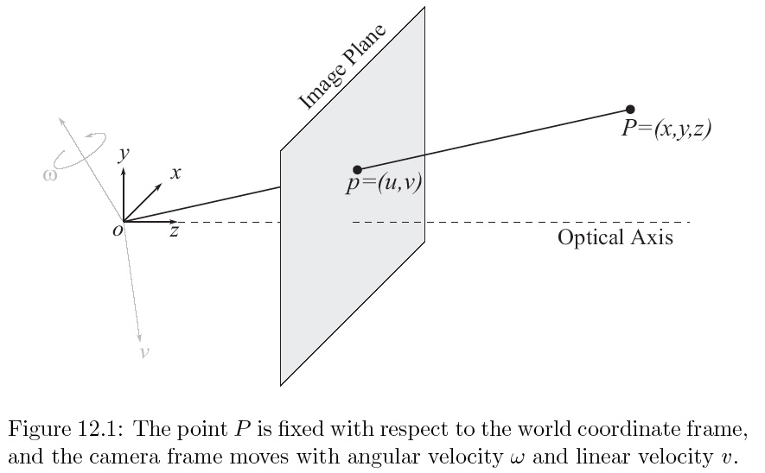

Slide 7
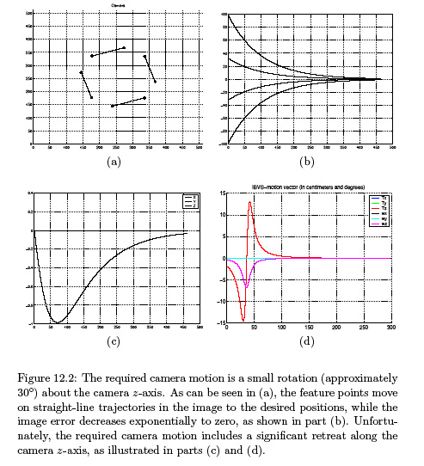

Slide 8
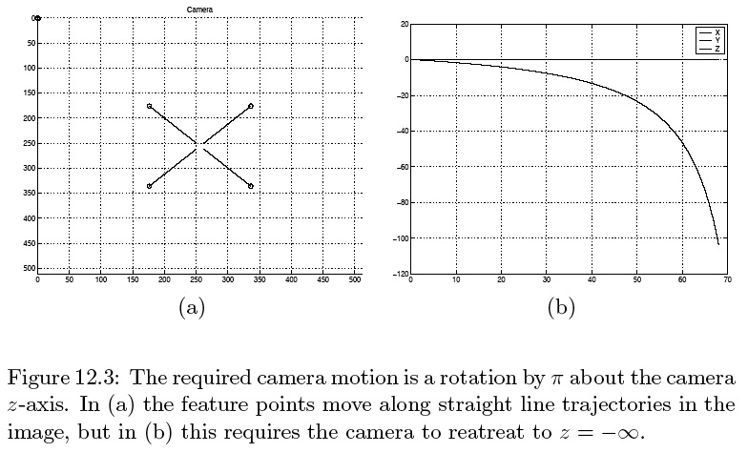
12_03
12_03
Notes:
12_03.jpg

Slide 9
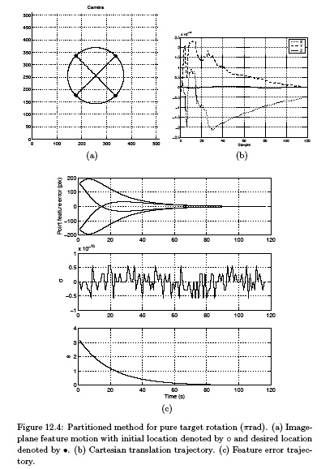

Slide 10
In class worksheet

