Slide 1
ECE 5397/6397:
Introduction to Robotics
Lecture 21:
Introduction to path planning: configuration space obstacles for polygons that translate in the plane, generalized Vornoi graphs, visibility graphs, cell decomposition.
Reference: Chapter 5.1, RD&C
Instructor: Aaron Becker

Slide 2
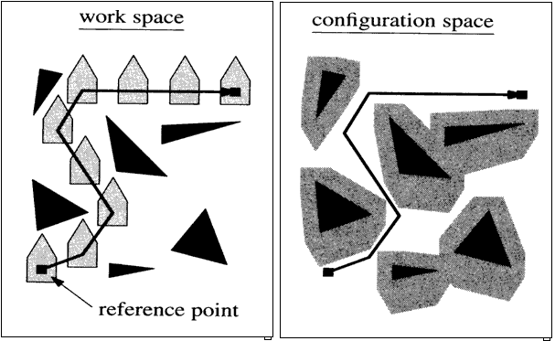
Welcome!
Image: http://www-scf.usc.edu/~peiyingc/gra_planning.html

Slide 3
For the Next Class
Study Ch. 5.2 for Lecture 22

Slide 4
In class worksheet

