Slide 1
ECE 5397/6397:
Introduction to Robotics
Lecture 22:
Path planning using artificial potential fields Reference: Chapter 5.2, RD&C
Instructor: Aaron Becker
Additional resources:
https://parasol.tamu.edu/groups/amatogroup/research/demos/
https://en.wikipedia.org/wiki/Motion_planning

Slide 2
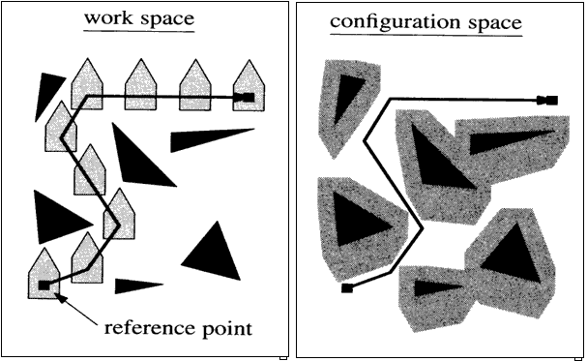
Configuration Space
Notes:
Teleoperators from WWII to handle radioactive materials
CNC developed because of high precision required to machine certain items

Slide 3
On board example
Configuration space drawing

Slide 4
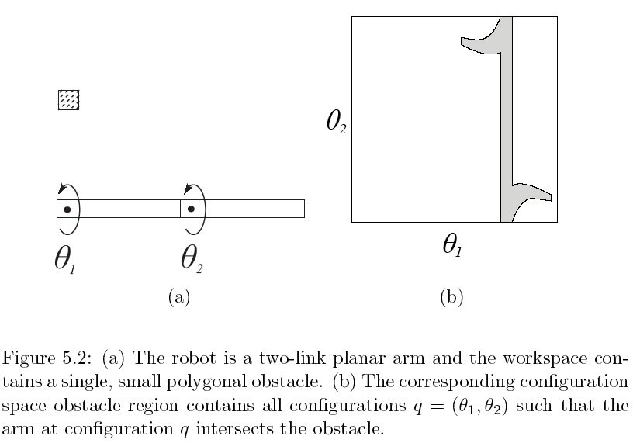
05_02
05_02
Notes:
05_02.jpg

Slide 5
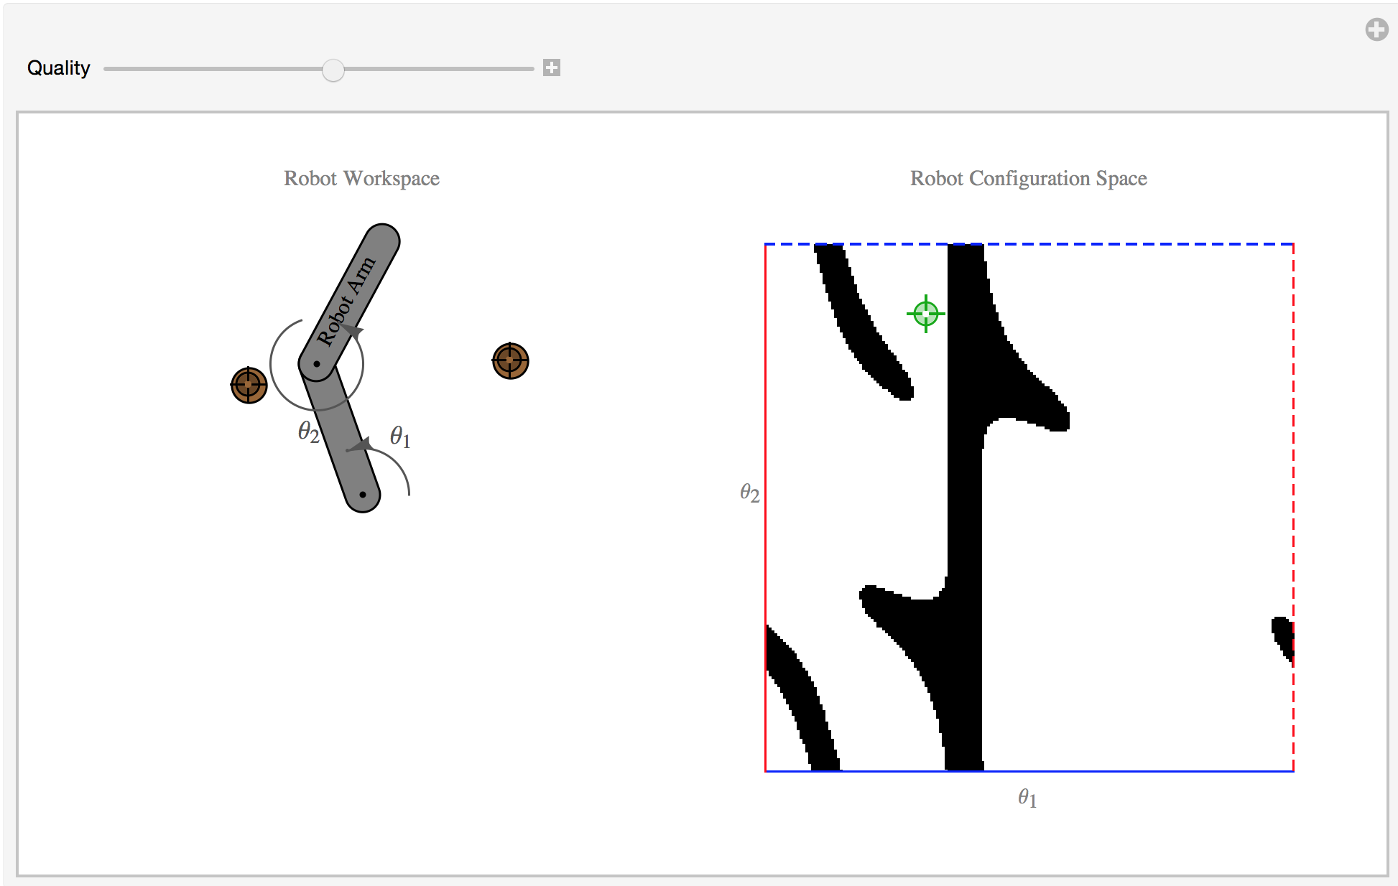
Mathematica (under development)

Slide 6
The ‘sweetest lesson’
Whats the big deal between S and T?
In geometry, a torus (plural tori) is a surface of revolution generated by revolving a circle in three-dimensional space about an axis coplanar with the circle. If the axis of revolution does not touch the circle, the surface has a ring shape and is called a torus of revolution.
The three different classes of standard tori correspond to the three possible aspect ratios between R and r:
When R > r, the surface will be the familiar ring torus.
R = r corresponds to the horn torus, which in effect is a torus with no "hole".
R < r describes the self-intersecting spindle torus.
When R = 0, the torus degenerates to the sphere.
https://en.wikipedia.org/wiki/Torus#/media/File:Sphere-like_degenerate_torus.gif

Slide 7
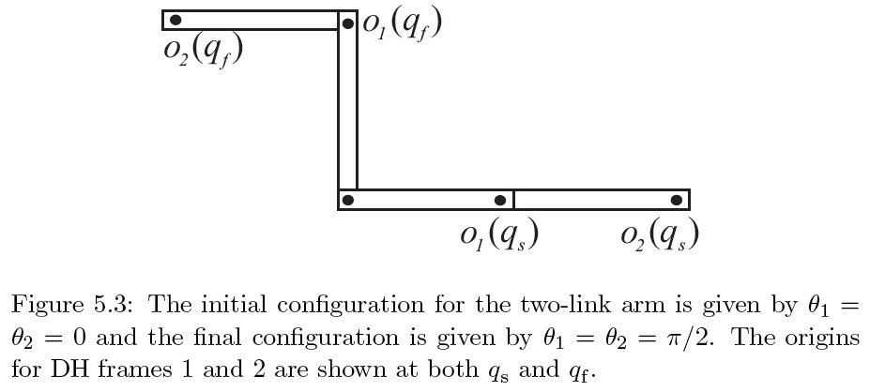
05_03
05_03
Notes:
05_03.jpg

Slide 8
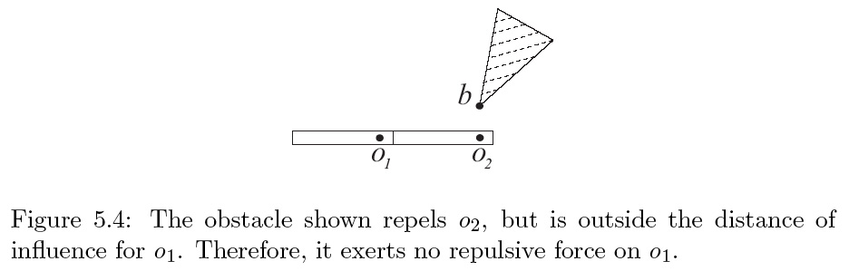
05_04
05_04
Notes:
05_04.jpg

Slide 9
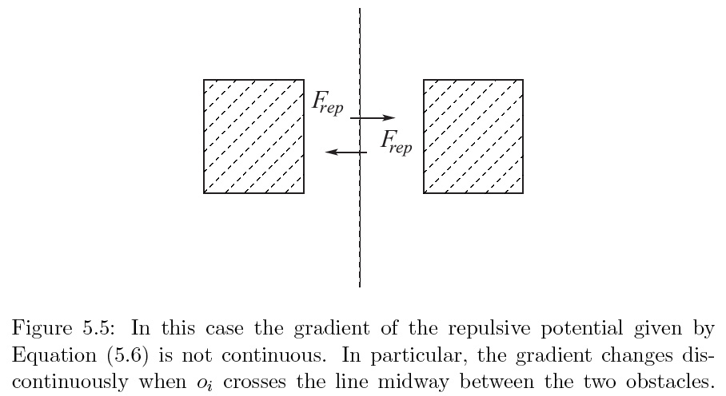
05_05
05_05
Notes:
05_05.jpg

Slide 12
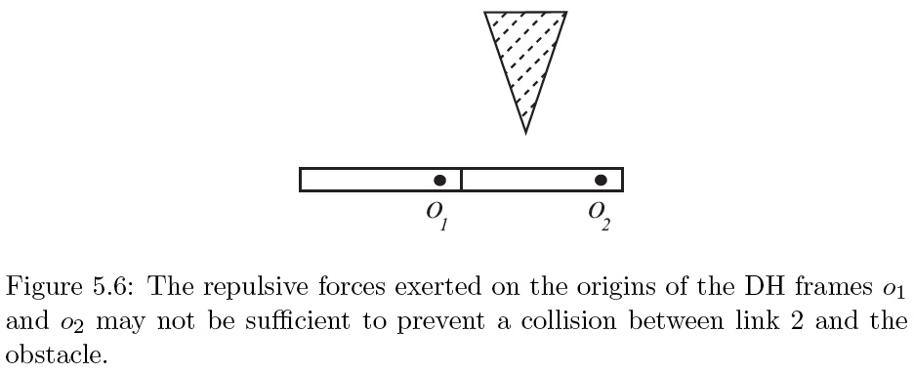
05_06
05_06
Notes:
05_06.jpg

Slide 13
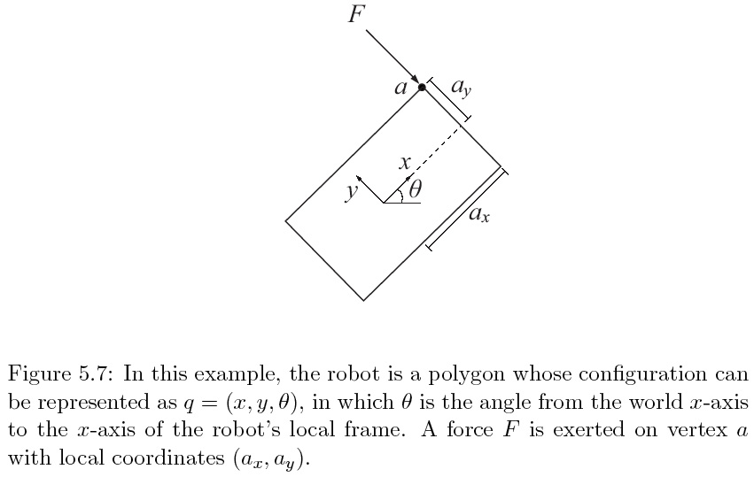

Slide 14
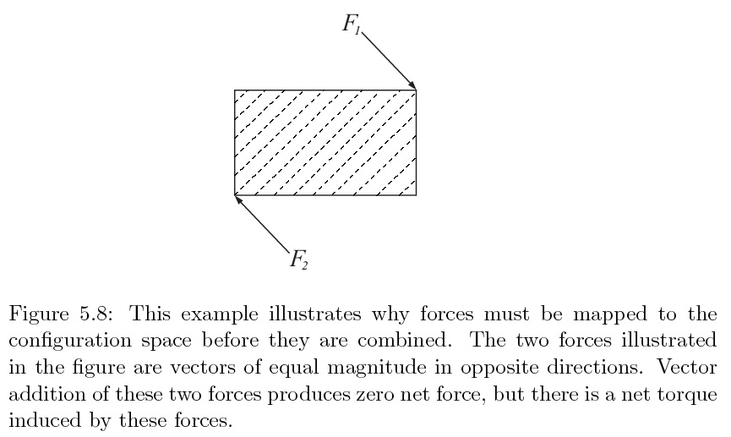

Slide 15
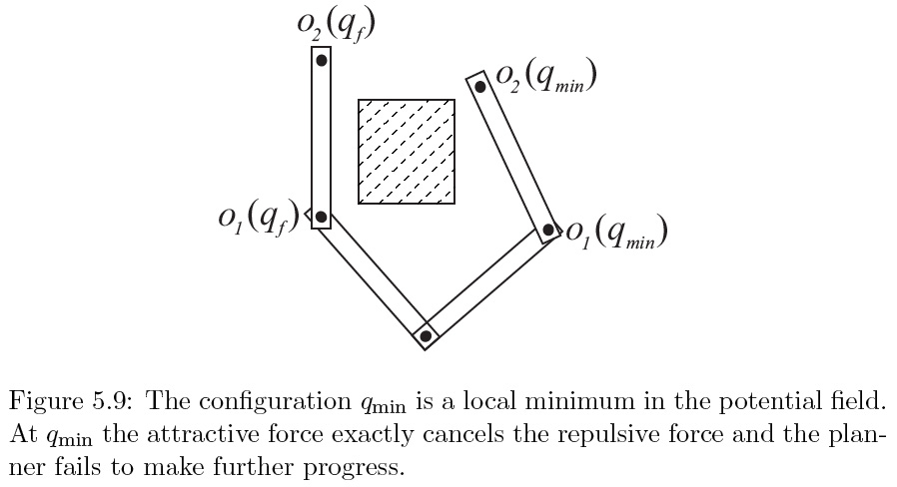

Slide 16
For the Next Class
Study Ch. 5.3 for Lecture 23

Slide 17
In class worksheet

