Slide 1
ECE 5397/6397:
Introduction to Robotics
Lecture 26:
Singular value decomposition, Manipulability Reference: Chapter 4.12 & Appendix B, RD&C
Instructor: Aaron Becker

Slide 2
3 Laws
A robot may not injure a human being or, through inaction, allow a human being to come to harm.
A robot must obey orders given it by human beings except where such orders would conflict with the First Law.
A robot must protect its own existence as long as such protection does not conflict with the First or Second Law.

Slide 3
Review worksheet
On white board

Slide 4
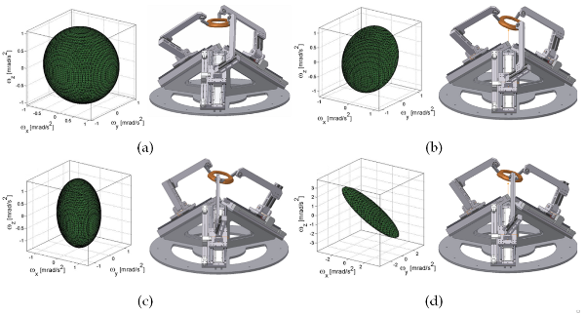
Manipulability Ellipsoid
Manipulability: Capacity of change in position and orientation of the end-effector of a robot given a joint configuration.
Image: https://engineerjau.wordpress.com/2013/05/04/advanced-robotics-manipulability-ellipsoids/
Notes:
If a designer starts the study of the kinematics of a robot, it is essential to analyze the manipulability which is one of the most important parameters of functionality of a robotic manipulator; in fact, this term has a major impact on design since it facilitates the definition of kinematics performance indicators which allow optimizing the size of the robot.

Slide 5
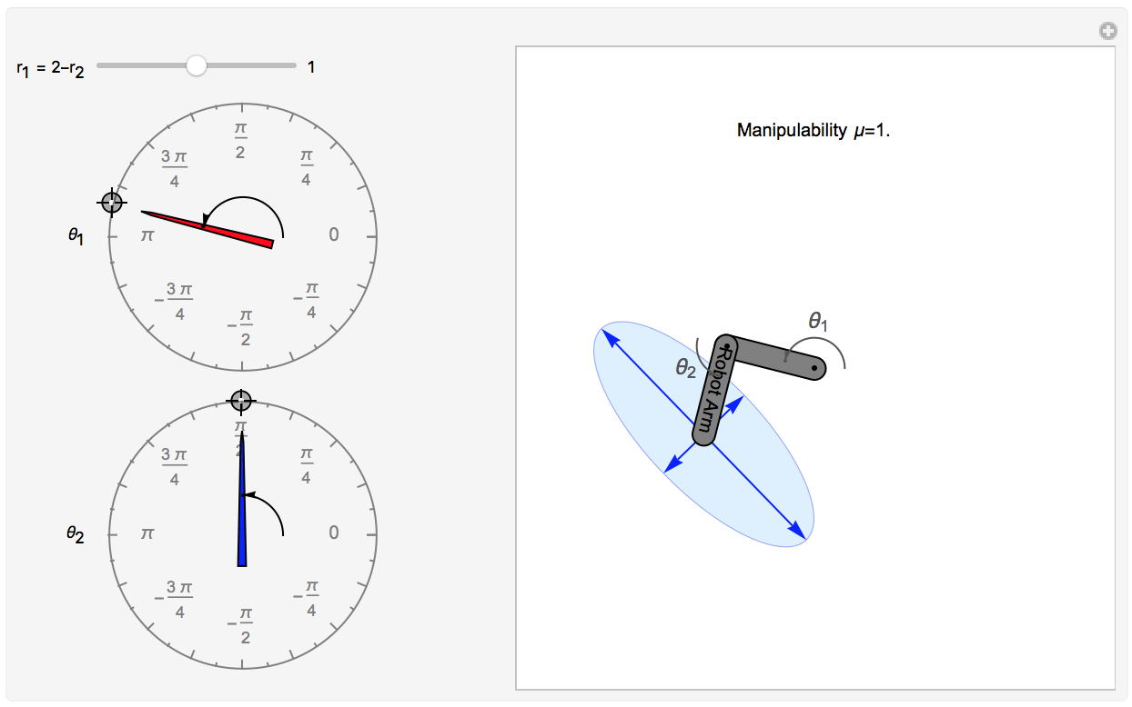
2-link arm
Extra credit opportunity: Change this to make a 3-link robot manipulability ellipse

Slide 6
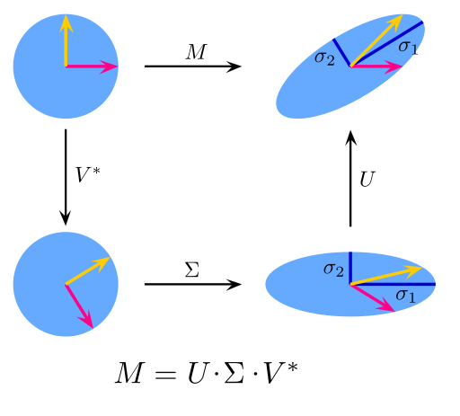
SVD
J
V^{T}
J
V^{T}
Image: https://engineerjau.wordpress.com/2013/05/04/advanced-robotics-manipulability-ellipsoids/

Slide 7
Now what?
Review for final
The FINAL EXAM will be given on Tues., May 10 from 11:00 am-2:00 pm
Want more?Consider taking
COMP 550 001 at Rice « Algorithmic Robotics »
MECE 3400 “Introduction to Mechanics” ,
COSC 4332 or 6332 - Medical Robots & Interventions, INDE 7361 - Industrial Robotics
ECE 6325 - State-Space Control Systems, ECE 6335 - Digital Control Systems, ECE 6390 - Linear Multivariable Control Systems, ECE 7333 - Optimal Control Systems, ECE 7334 - Advanced Digital Control Systems

Slide 8
In class worksheet

