Slide 1
ECE 5397/6397:
Introduction to Robotics
Lecture 3:
Coordinate transformations, composition of rotations, homogeneous transformations
Reference: Chapter 2.3, 2.4, 2.7 in RD&C
Instructor: Aaron Becker

Slide 2
Upcoming:
Office hours 2-3:30pm Tues & Thurs, in N386
TA: 2-3:30pm, Mon & Wed in N386
ROS install night: Tues, Jan 26, 7pm, N386
Swarmathon video: http://nasaswarmathon.com/webinars/
This webinar covered: how the Swarmie software works, a close up view of the hardware, the new schedule, how teams will be scored, cash prizes, and exciting opportunities available to you beyond the competition.
If you have already created a Swarmathon webinar account, you can view this recording by entering your Email and Password. If not, all you have to do is to create an account by filling out a short form. Once you have an account, you are then able to participate in all future webinars, as well as watch recordings of past webinars.
Linux/Unix tutorial: Thurs & Fri, Jan 28th, from 10:00am-12:00pm, in the Engineering Computing Center (ECC), Engineering Building 2, Room W129.
HW 1 due Feb 2 at 11:32am
Notes:
https://github.com/BCLab-UNM/Swarmathon-ROS for

Slide 3
Linux tutorials
The ECC/EERC will offer two levels of Linux workshops ­this week - an Introduction to Linux and Intermediate Linux .
The Introduction to Linux Workshop* will be offered on Thurs, Jan. 28th, from 10am-12pm, in the Engineering Computing Center (ECC), Engineering Building 2, Room W129.
Topics covered include:
-Linux/UNIX Systems Overview -Interoperability with Windows
-Linux/UNIX Accounts ­ Email & Personal Web Page
-File Systems, Permissions -System Commands & Applications
The Intermediate Linux Workshop* will be offered on Friday, Jan. 29th, from 10am-12pm, also scheduled in the ECC, Engineering Building 2, Room W129.
Topics covered include:
-Input, Output & Pipes -Compiling UNIX Software Packages
-Symbolic and Hard Links-Setting Environment Variables
-File Transfers & Processes
*If you plan to attend either of the Linux/Unix workshops, you MUST have a UNIX account and be able to login to UNIX before the workshop begins - get your UNIX account at the ECC Front Desk.
All workshops are “hands-on” and free to Engineering students. Seating is limited - no reservations are required.

Slide 4
Review
Coordinate frame: an origin and 3 mutually-orthogonal, right-hand-rule basis vectors
o₀x₀y₀z₀
Rotation matrix is these 3 mutually-orthogonal, right-hand-rule basis vectors:
p¹ = Coordinates of p in frame o₁x₁y₁z₁
p⁰ = Coordinates of p in frame o₀x₀y₀z₀

Slide 5
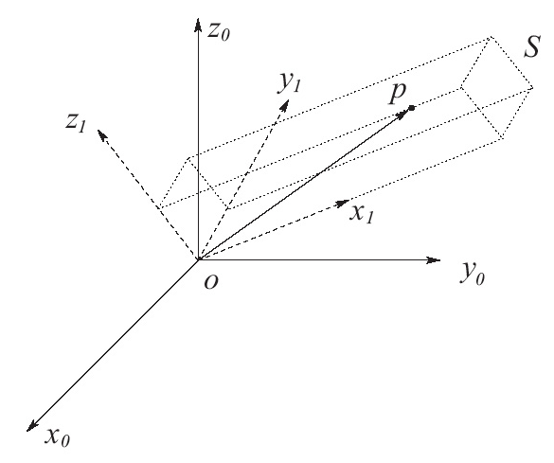
2.3 Rotational Transforms!
Given a rigid object S with a coordinate frame attached: o₁x₁y₁z₁
Given coordinates p¹, determine p⁰
p = ux₁+vy₁+wz₁
Notes:
p¹ = Coordinates of p in frame o₁x₁y₁z₁
p⁰ = Coordinates of p in frame o₀x₀y₀z₀

Slide 6
p = ux₁+vy₁+wz₁

Slide 7
Def #1
A rotation matrix R₁⁰ can be used to represent the orientation of coordinate frame o₁x₁y₁z₁ with respect to o₀x₀y₀z₀
Also can transform coordinates of a point from one frame to another
If a given point is expressed relative to
frame o₁x₁y₁z₁ by coordinates p¹, R₁⁰p¹ represents the same point expressed relative to the frame o₀x₀y₀z₀

Slide 8
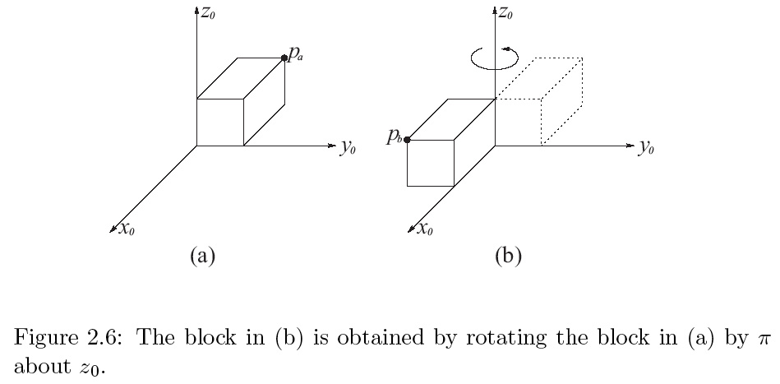
Rotation example

Slide 9
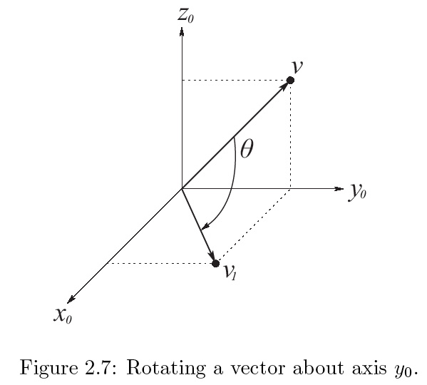
Example 2.3
Vector v has coordinates
v⁰=[0,1,1]^{T}, is rotated about y₀ by π/2
Notes:
Fill in R_{y,} _{π/2}

Slide 10
Rotation definitions
A rotation matrix R ∈ SO(3) or R ∈ SO(2), can be represented 3 ways:
A coordinate transformation relating the coordinates of a point p in tw different frames
Orientation of a transformed coordinate frame w.r.t. a fixed coordinate frame
Operator taking a vector and rotating it to give a new vector in same coordinate frame.

Slide 11
Similarity Transforms
Coordinate frame is defined by set of basis vectors
If A is matrix representation of given linear transformation in o₀x₀y₀z₀ and B is the same linear transformation in o₁x₁y₁z₁, then A and B are related as

Slide 12
Draw example 2.4 on board

Slide 13
Composing Rotations
Write out 2.12 through 2.15 on board

Slide 14
Composition of Rotations
The frame relative to which the rotation occurs is called the current frame
Frame o₀x₀y₀z₀ is the fixed frame
When a rotation R is performed with respect to the world coordinate frame, the current rotation matrix is pre-multiplied by R

Slide 15
Example 2.8
Then do in-class worksheet

Slide 16
Homogenous transforms
4 x 4 matrices to represent both rotation and translation. Key for robotics frames.
H =

Slide 17
Homogenous transforms
we must augment vectors, so p⁰ becomes P⁰:
If rigid motion H is relative to the current frame, then post-multiply
If rigid motion H is relative to the fixed frame, then pre-multiply

Slide 18
For the Next Class
Github checkin: need one per team
Study Sections 2.5 & 2.6 for Lecture 4
This is important: I want you to come prepared for each class by reading ahead, and have an idea of what to expect
Write down your questions and bring them with you
I may do a quiz in class based on your assigned reading
This is good for you
Advance reading will help you grasp the subject with much less effort

Slide 19
In class worksheet

