Slide 1
ECE 5397/6397:
Introduction to Robotics
Lecture 13:
Jacobian examples
Reference: Chapter 4.4-4.6, RD&C
Instructor: Aaron Becker

Slide 2
Welcome!
Another outreach!
Swarmathon update
Hw 4 due Thursday
Notes:
Teleoperators from WWII to handle radioactive materials
CNC developed because of high precision required to machine certain items

Slide 3
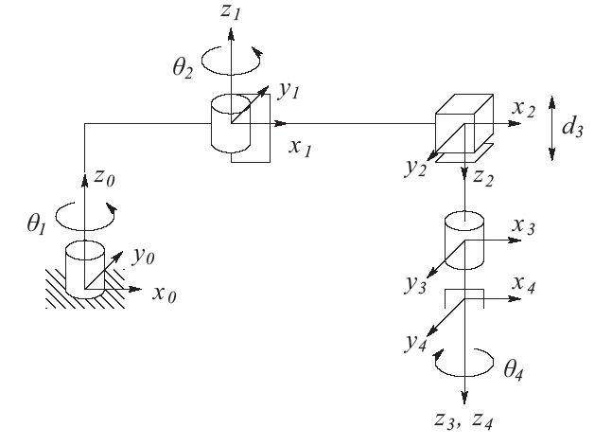
Tool Velocity
Notes:
Go from tol velocity to velocity of end effector frame

Slide 4
Analytical Jacobian

Slide 5
Nutation, spin, precession

Slide 6
Linear Algebra for robotics (B.2 to B.5)
Linear independence
Basis
Rank
Transpose
Symmetric
Skew symmetric
Orthogonal
Inverse
Null space
Norm of matrix
Image
Similarity transform

Slide 7
Singularities

Slide 8
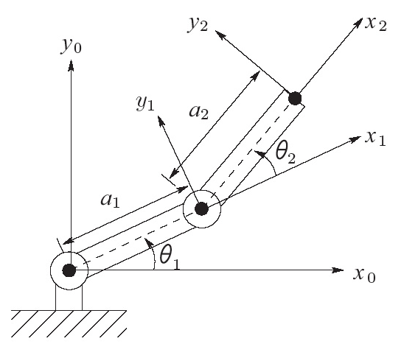
Two-link planar manipulator
Notes:
Linear velocity in xy plane since neither column has non zero for third row

Slide 9
Rank of Jacobian

Slide 10
Singular configurations

Slide 11
Manipulator singularity properties
Configurations from which certain directions of motion are unattainable
Bounded end-effector velocities may correspond to unbounded joint velocities
Bounded joint torques correspond to unbounded end-effector forces & torques
Often on boundary of manipulator workspace
Points on workspace unreachable under small perturbations of link parameters

Slide 12
How to find?
Square matrix is singular when its determinant is equal to zero
We will decouple singularities (spherical wrist)

Slide 13
For the Next Class
Study Read 4.9 for Lecture 14

