Slide 1
ECE 5397/6397:
Introduction to Robotics
Lecture 15:
Computer vision overview, segmentation Reference: Chapter 11.1—11.3, RD&C
Instructor: Aaron Becker

Slide 2
Welcome!
Thursday(03/10/2016) 10 a.m tour of exoskeleton lab by Sri Ranga Prasad Maddi, Research Staff, Laboratory for Noninvasive Brain-Machine Interface Systems. Room [??], 3rd floor Engr. Building 1
We’ve begun to assign tasks for Swarmathon. There will be significant progress over spring break. There is still time to get involved.

Slide 3
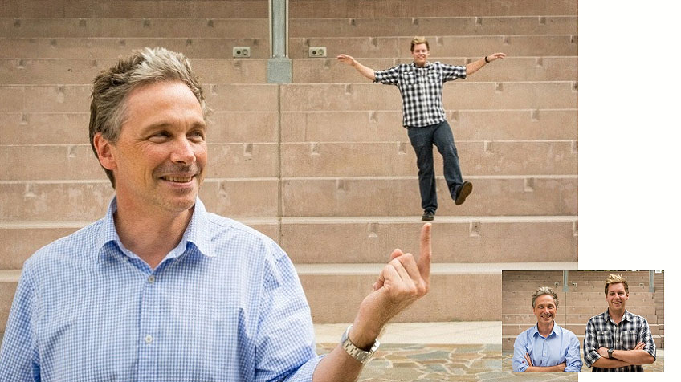
Computer vision
Huge topic (entire courses http://www.cbl.uh.edu/courses/6373s15/
http://robohub.org/robots-quest-for-computer-vision/

Slide 4
We’ll focus on camera calibration
So we can tell how real-world object are turned into pixel coordinates
So we can tell where real world objects are from pixel coordinates
Lots of ways to do calibration: http://www.umiacs.umd.edu/~ramani/cmsc828d/lecture9.pdf
. We’ll look at a simpler method
In practice, you use a checkerboards

Slide 5
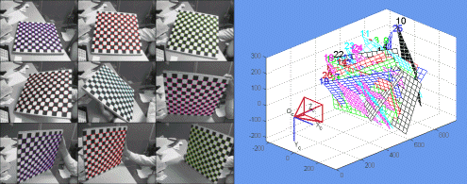
Camera calibration
http://www.vision.caltech.edu/bouguetj/calib_doc/
Video: http://www.mathworks.com/videos/camera-calibration-with-matlab-81233.html?refresh=true

Slide 6
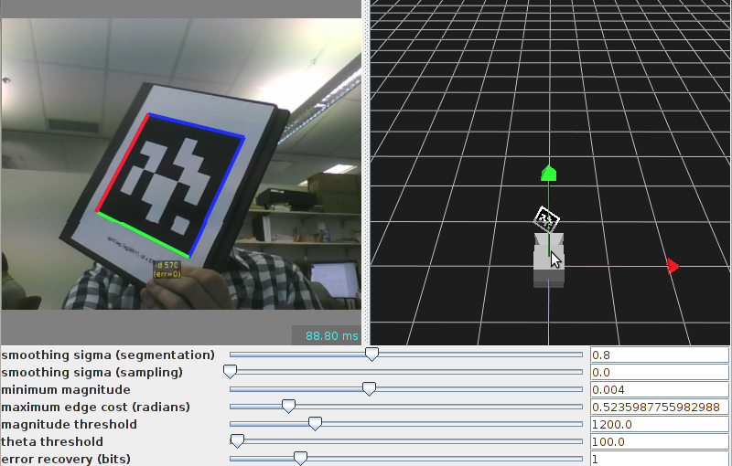
Why we care
https://april.eecs.umich.edu/wiki/index.php/AprilTags-Java

Slide 7
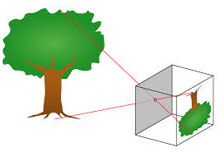
https://en.wikipedia.org/wiki/Pinhole_camera_model
Notes:
https://en.wikipedia.org/wiki/Pinhole_camera_model

Slide 8
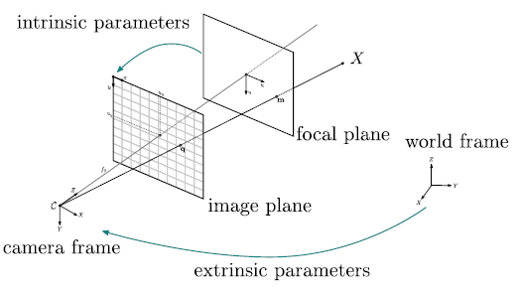
Parameters
The pinhole camera geometry models the projective camera with two sub-parametrizations, intrinsic and extrinsic parameters
Image from http://openmvg.readthedocs.org/en/latest/openMVG/cameras/cameras/

Slide 9
. Intrinsic parameters model the optic component (without distortion) and extrinsic model the camera position and orientation in space. Extrinsic are therefore:
Image from http://openmvg.readthedocs.org/en/latest/openMVG/cameras/cameras/
Notes:
Extrinsic: a homogenous transformation
Intrinsic are four parameters: oc,o_r, fx = \lambda/sc, fy = \lambda/sy
\lambda, s_x, o_r, s_y, o_c

Slide 10
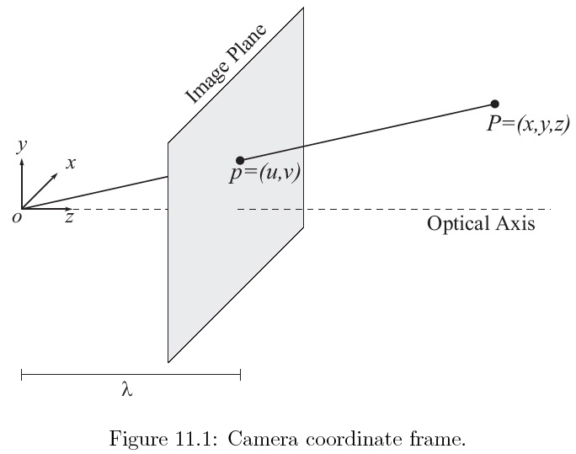
11_01
11_01
Notes:
11_01.jpg

Slide 11
http://openmvg.readthedocs.org/en/latest/openMVG/cameras/cameras/
Pinhole camera model
Notes:
A camera could be approximated by a projective model, often called pinhole projection. The simplest representation of a camera is a light sensible surface (sensor): an image plane, a lens (projective projection) at a given position and orientation in space.

Slide 12
For the Next Class
Study Read 11.3 for Lecture 16

Slide 13
In class worksheet

