Slide 1
ECE 5397/6397:
Introduction to Robotics
Lecture 16:
Segmentation by minimizing within-group variance, recursive formulation for within-group variance
Reference: Chapter 11.3, RD&C
Instructor: Aaron Becker

Slide 2
Welcome!

Slide 3
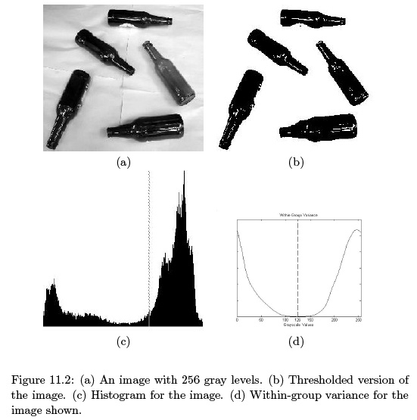

Slide 4
For the Next Class
Study Read 11.4-11.5 for Lecture 17

Slide 5
In class worksheet

