Slide 1
ECE 5397/6397:
Introduction to Robotics
Lecture 17:
Connected components, moments
Reference: Chapter 11.4-11.5, RD&C
Instructor: Aaron Becker

Slide 2
Welcome!
Swarmathon Houston competition, this Friday at 12. We’ll leave from UH at 11 am
Robotics Outreach opportunity: Chevron Girl’s 1-5 pm April 2nd. N386 “Making Jewelry with Robots”

Slide 3
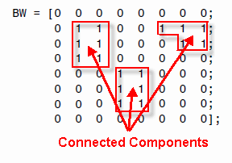
Connected components
A connected component in a binary image is a set of pixels that form a connected group. For example, the binary image below has three connected components.
http://www.mathworks.com/help/images/labeling-and-measuring-objects-in-a-binary-image.html

Slide 4
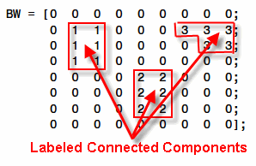
Connected components
Connected component labeling is the process of identifying the connected components in an image and assigning each one a unique label, like this:
http://www.mathworks.com/help/images/labeling-and-measuring-objects-in-a-binary-image.html

Slide 5

Connected components
Create a pseudo-color image, where the label identifying each object in the label matrix maps to a different color in the associated colormap matrix
http://www.mathworks.com/help/images/labeling-and-measuring-objects-in-a-binary-image.html

Slide 6
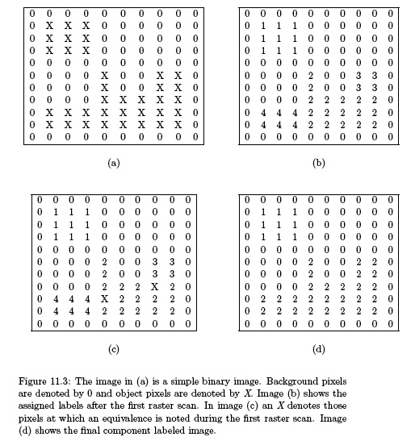

Slide 7
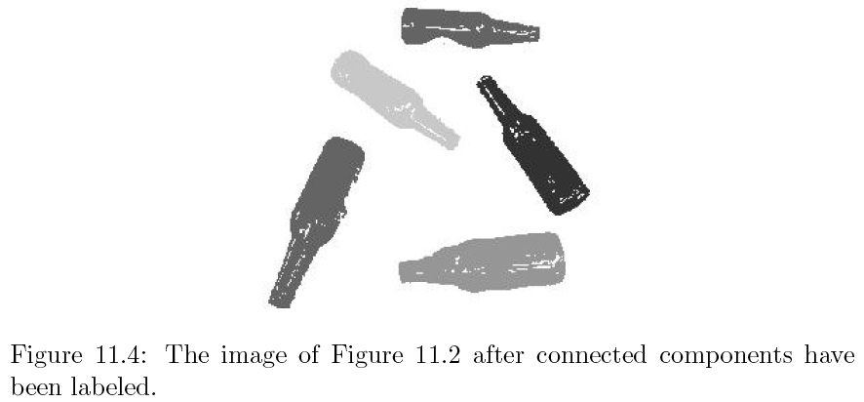

Slide 8
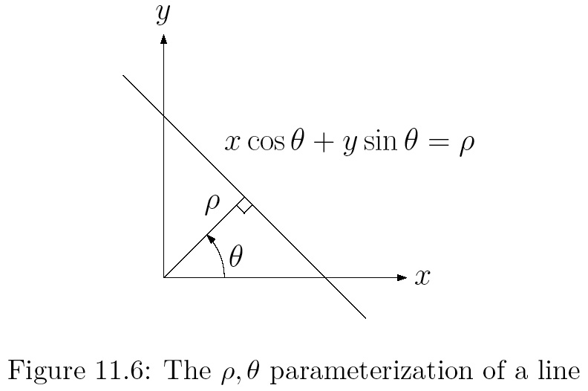

Slide 9
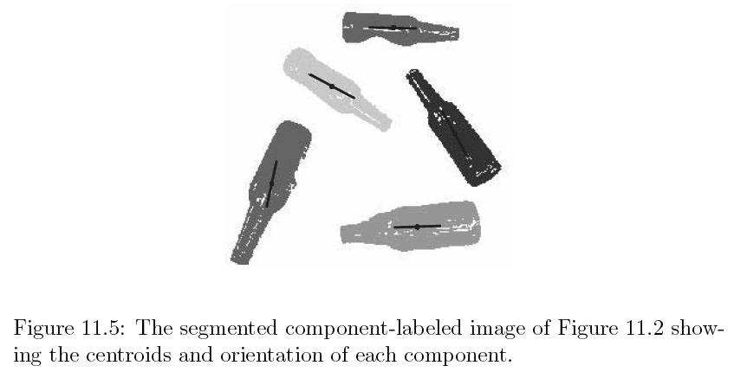

Slide 11
Moments
http://homepages.inf.ed.ac.uk/rbf/CVonline/LOCAL_COPIES/OWENS/LECT2/node3.html

Slide 12
For the Next Class
Study Ch 9 A Gentle Introduction to ROS for Lecture 18

Slide 13
In class worksheet

