Slide 1
ECE 5397/6397:
Introduction to Robotics
Lecture 18:
Position and orientation in binary images Reference: Chapter 11.5, RD&C
Instructor: Aaron Becker

Slide 2
Exam 1 on Mar 31
Closed book and notes, during class, 5 questions
1 page 8.5”x11.5” front and back handwritten notes
Covers chapters 1-4, 11.1--11.2
CONTENTS:
Rotations & transformations
Composition of rotations about world or current frame
Construct a homogenous transform
Kinematics
Assign DH parameters
Given DH parameters, construct A matrix
Given two A matrices, construct T matrix
Notes:
Teleoperators from WWII to handle radioactive materials
CNC developed because of high precision required to machine certain items

Slide 3
Exam 1 on Mar 31
Inverse Kinematics
Two-argument arc tangent function
Solve inverse position kinematics for a 3-link arm
Jacobian
Construct Jacobian given sketch and T matrices
Computer Vision
3D coordinates to image-plane coordinates
Move from camera frame to world frame
Notes:
Teleoperators from WWII to handle radioactive materials
CNC developed because of high precision required to machine certain items

Slide 4
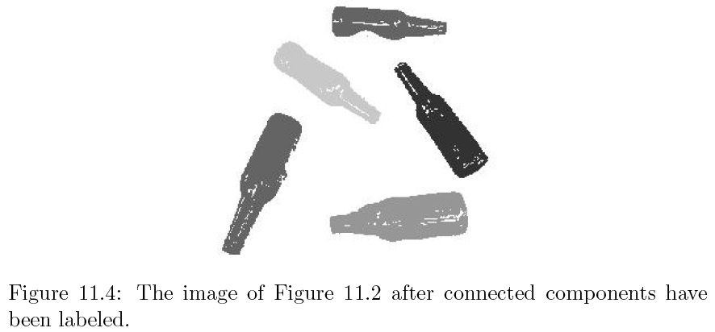

Slide 5
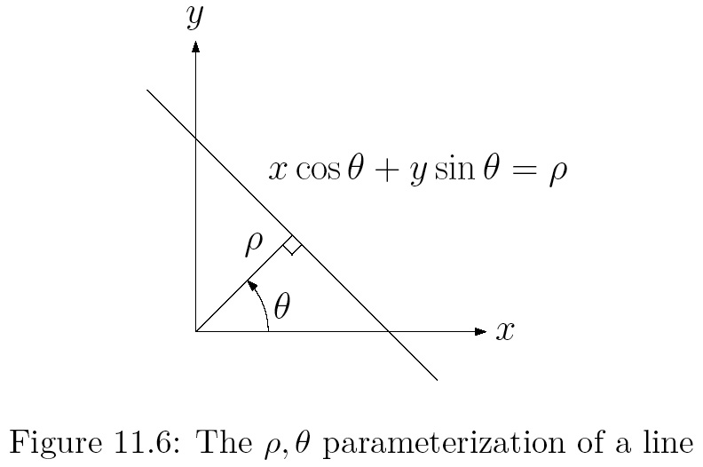

Slide 6
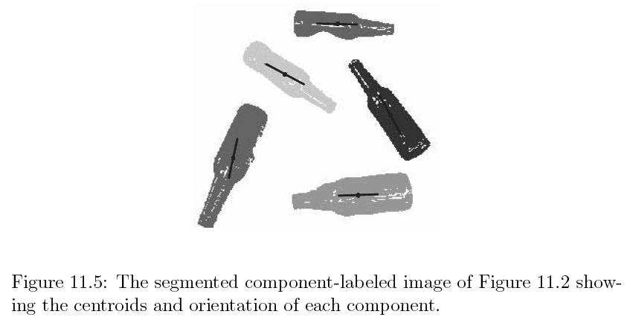

Slide 8
For the Next Class
Study Ch. 11.1-11.2 for Lecture 19

Slide 9
In class worksheet

