Slide 1
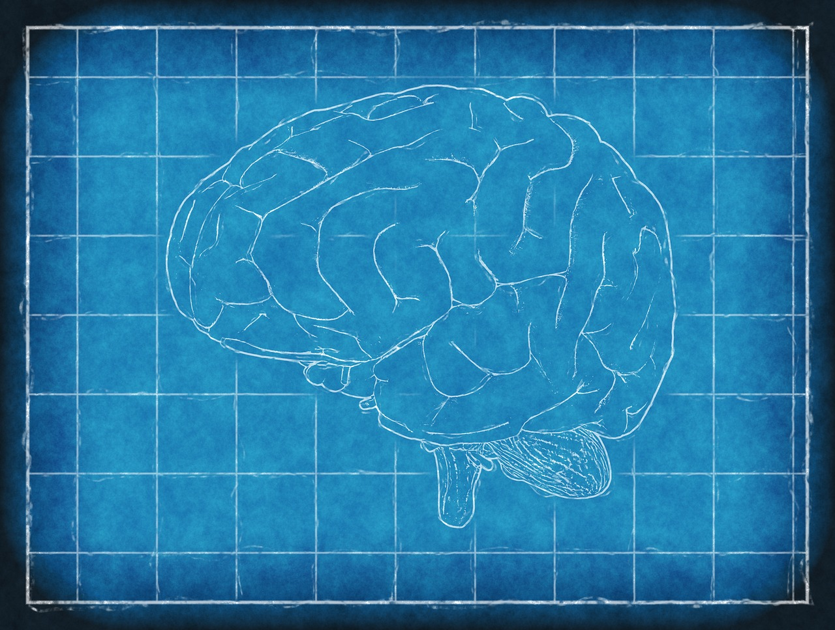
MIPPY

Slide 2
Contents
What is MIPPY?
What is MIPPY based on?
What requirements are there?
What can MIPPY do?
What can’t MIPPY do (yet)?
How do I use MIPPY?
How do I develop for MIPPY?
What are the key components of MIPPY?
“How do I take advantage of MIPPY’s features for my own work?”

Slide 3
What is MIPPY?
Modular Image Processing in Python
A DICOM browser (and backend) which handles:
Scanning/sorting folders of DICOM files
Displaying DICOM images
Region of Interest (ROI) drawing
Including and statistics/profiles etc
Image manipulation
Built around the idea of modules
All image analysis code in separate modules
MIPPY can be extended with any number of modules

Slide 4
What is MIPPY based on?
Python 2.7
May work on earlier versions of Python 2, but not tested
Tkinter
Most common GUI package for Python
pydicom
Pure Python package for working with DICOM images
pillow
A current fork of the now defunct “Python Imaging Library” (PIL)
NumPy and SciPy
Numerical and scientific packages for Pythong

Slide 5
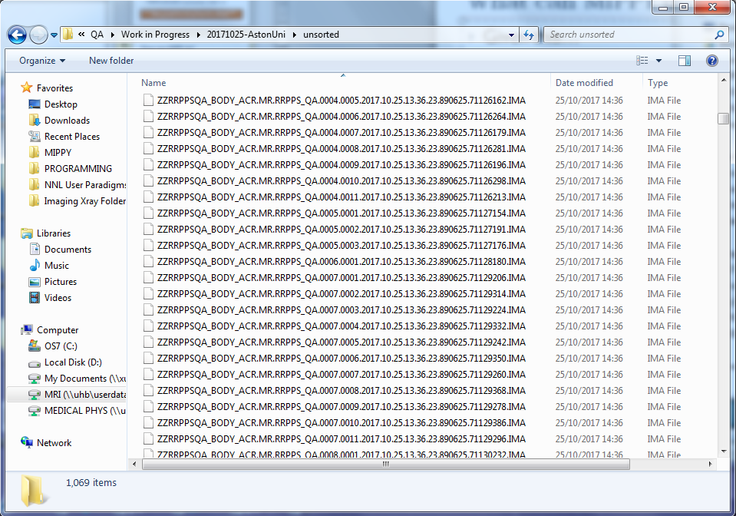
What can MIPPY do?
Given this…

Slide 6
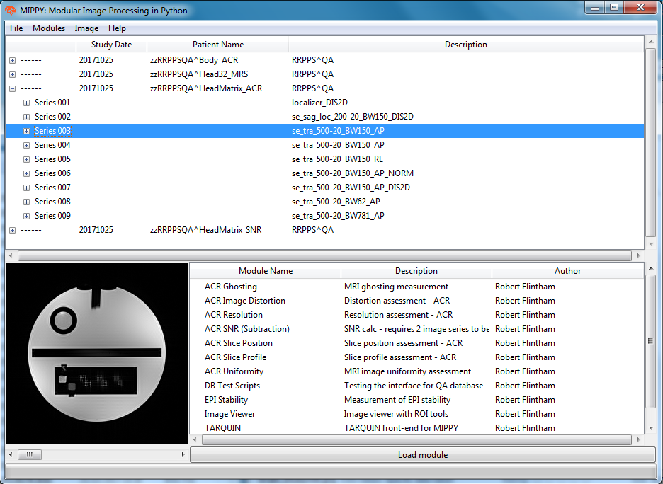
What can MIPPY do?
It produces this…

Slide 7
Key MIPPY Components “This is where the magic happens”
MIPPYImage
Custom objects designed to translate DICOM images into images you can actually display on screen
MIPPYCanvas
Based on Tkinter “Canvas” objects
Built in tools for ROI drawing/management
Built in tools for creating, displaying and managing MIPPYImage objects
mippy.mdicom
Submodule within MIPPY
Handles sorting/reading/writing/manipulating DICOM files
This code can all be imported into other Python projects (without running the MIPPY application) where you might want to work with DICOM

Slide 8
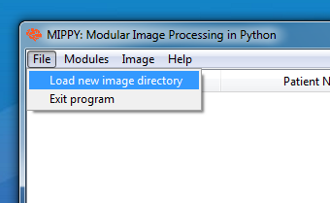
DICOM Image Browser
The main window in MIPPY
Scans a directory of images and displays DICOM tree
Scans arranged using UID’s into
Study / Series / Instance
File >> Load New Image Directory
Images DO NOT need to be sorted before loading

Slide 9
DICOM Image Browser

