Slide 1
JGradeBook
By: Scott Blick
Scott Murray
Thanh Bui

Slide 2
Tools
Java language, using both NetBeans and IntelliJ IDEs
ArgoUML for diagrams
Microsoft Word, Excel, PowerPoint
Internet Browsers
SMS messaging for communication
Github for version control and storage

Slide 3
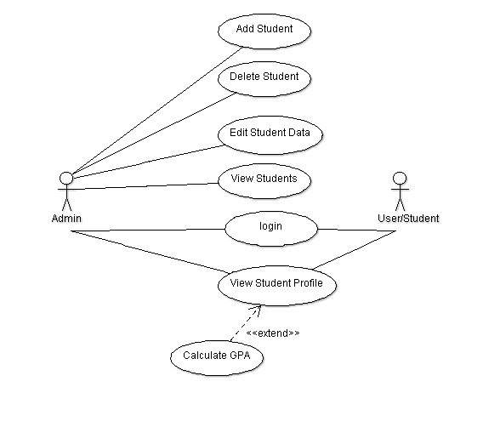
Requirements Documentation
Requirement Elicitation Document
Use-Case Diagram

Slide 4
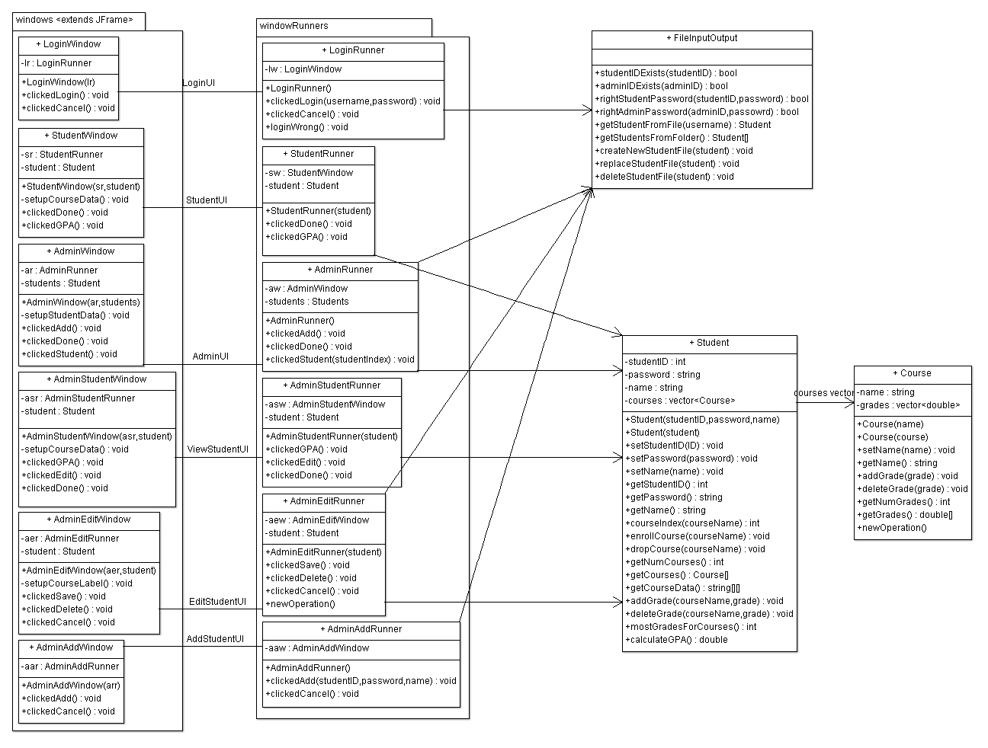
Analysis Workflow
Various UML Diagrams:
Class Diagram
Sequence Diagram
Collaboration Diagram

Slide 5
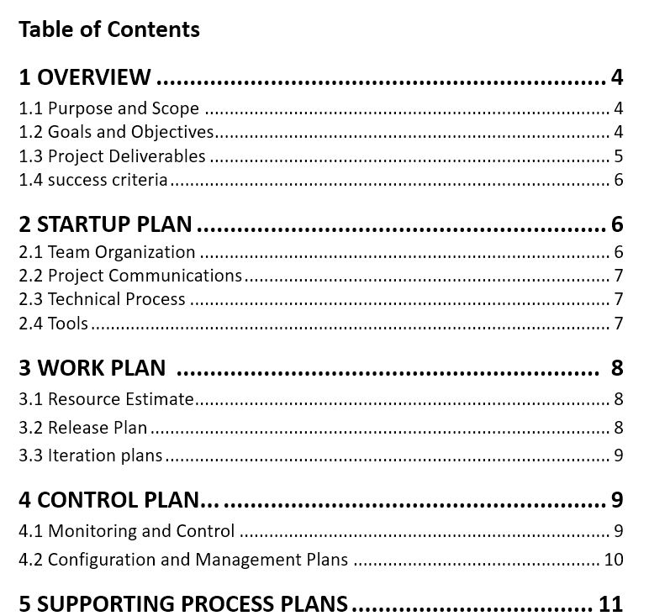
Design Documentation
A Software Project Management Plan (SPMP) using the template provided by the IEEE

Slide 6
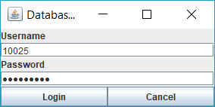
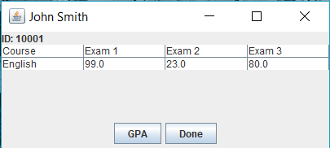
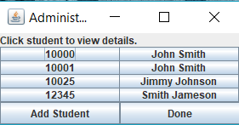
Implementation Workphase
Login Screen
Student Screen
Admin Screen
Accepts both admin and student logins by looking in both folders for the entered ID, and can distinguish which folder it came from.
Displays the name, id, course and their test grades. GPA button will calculate the average and display the GPA in a pop-up window
Displays a list of all students in the database (txt files), both the id and name are clickable and will show the admin version of a student’s window. There is also an option to add a student at the bottom.

Slide 7
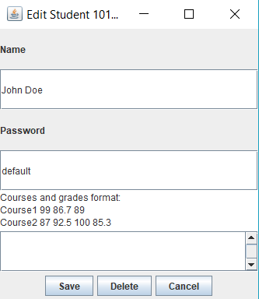
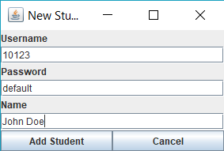
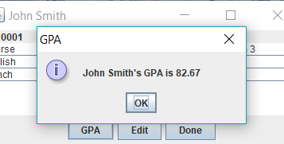
Implementation cont.
Add Student
GPA Screen
Creates a new student file based on the information loaded here. Only usable/accessible by admin
Student Edit Screen
Pop-up window that displays the student’s current GPA based the average grade
Displays the name, id, course and their test grades. GPA button will calculate the average and display the GPA in a pop-up window

Slide 8
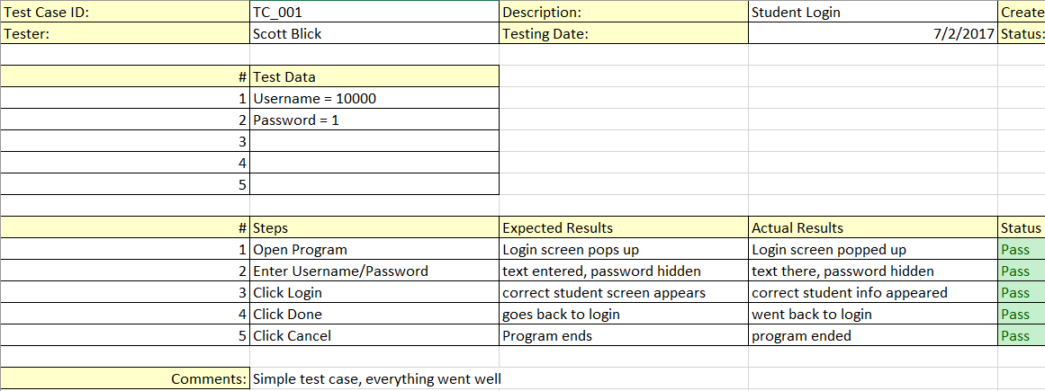
Testing
Used Excel spreadsheets to write up test cases and then manually executed them.

