Slide 1

Humanoid Robots and the Future of Work
A Mathematical & Data Analytics Perspective
Presented by
Toshima Jaiswal (2448369) , Utkarsh Misra (2448370) , Chetan Verma (2448380)
Under Guidance of
Dr. Kavitha S

Slide 2
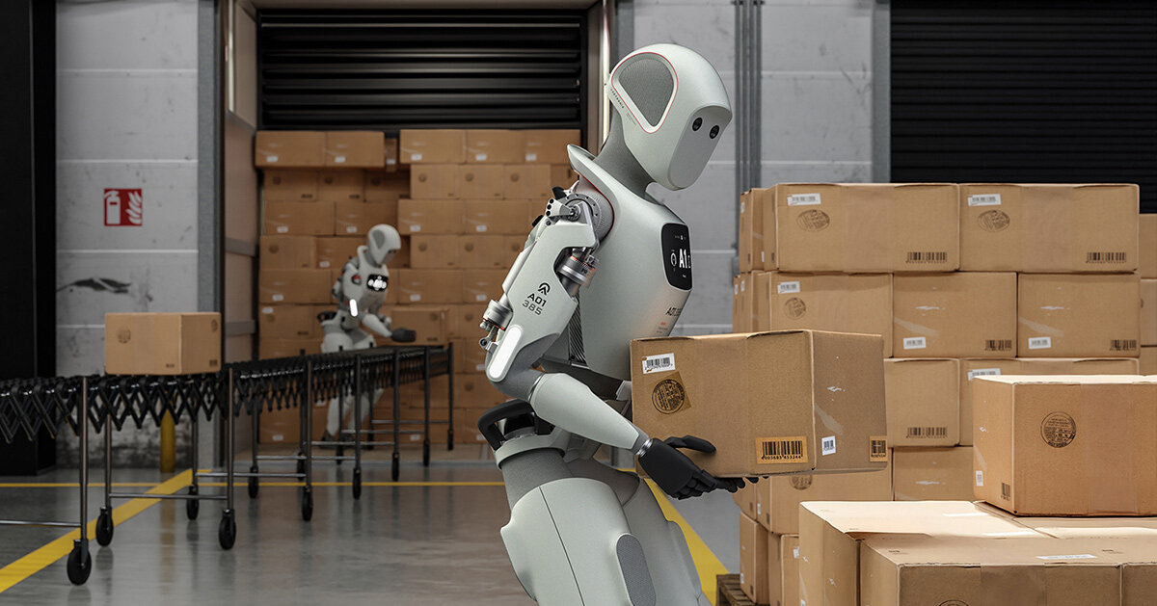
Contents
Problem Statement
Project Objective
System Requirements
Dataset
Model Formulas and Parameters
Module Description
System Architecture
Frontend/Backend Design
Future Plan
Expected Outcome
Individual Contribution

Slide 3
Problem Statement
Humanoid robots are being introduced more and more into sectors that previously were thought to be immune to automation — including healthcare, education, and retail. Yet, there is very little known regarding the impact these robots have on work patterns, skill needs, and productivity.
Current research tends to exaggerate the risks of automation because it does not take into consideration human interaction, cognitive flexibility, and task diversity.
Our project seeks to fill this void by creating a data-driven and quantitative model to forecast how humanoid robots will change the future of work.

Slide 4
Project Objective
To analyze adoption of humanoid robots and employment risk in various industries.
To develop mathematical equations such as the Employment Risk Index (ERI), Productivity Gain Equation, and Displacement Function.
To integrate O*NET, ILO, and robotics capability database data for industry-wide comparisons.

Slide 5
Project Objective Conti.
To facilitate visualization of findings through an interactive dashboard with automation curves, sector heatmaps, and skill-gap indicators.
To create a Streamlit-based simulation tool where users can change significant parameters (like automation rate, wage, and skill adaptability) and observe their impact in real time.

Slide 6
System Requirements
Software
  Python (Pandas, Numpy, Scikit-learn, Matplotlib, Streamlit)
  Database: CSV/SQLite (storing task-level & occupation-level data)
  Libraries: Plotly, Seaborn for data visualization
  APIs: O*NET / ILO datasets for occupational data
Hardware
  Standard Workstation or cloud VM (for computation and hosting)

Slide 7
Dataset
O*NET (Occupational Information Network)
  Contains detailed information on skills, abilities, and work activities for hundreds of jobs.
  It maps human task profiles and checks automation vulnerability.
International Labour Organization (ILO) Statistics
  Provides global data on employment, wages, and industries.
  This data helps track employment trends in different sectors and make forecasts.

Slide 8
Dataset Conti.
IFR – World Robotics Report (International Federation of Robotics)
  Offers information on how robots are adopted in various industries and regions.
  It is used to model how automation will grow over time.
Public Opinion & News Datasets (Kaggle / Twitter API)
  Contains text data for sentiment analysis to examine how the public views humanoid robots.

Slide 9
Model Formulas and Parameters
Mathematical Formula
ERI= A x W / (S+1)
A : Automation Speed
W: Wage Factor
S: Skill/ Reskilling Investment
(All values normalized between 0 and 1 for comparability)
Parameter | Description | Source
A (Automation Speed) | Measures how rapidly robots/humanoids are being adopted in an industry | ILO / IFR Robotics Dataset
W (Wage Factor) | Average cost of human labor in that sector; higher values mean greater automation incentive | ILO Wage Reports
S (Reskilling Investment) | Index of workforce adaptability and training programs; higher means lower risk | ILO/O*NET Skill Data
ERI (Output) | Computed risk score of employment vulnerability to humanoid automation | Model Output

Slide 10
Model Formulas and Parameters
Mathematical Formula
P= (1+𝛂A)
P :Projected productivity after automation
: Baseline productivity (without robots)
𝛂 : Elasticity of productivity to automation
A : Automation Speed
(All values normalized between 0 and 1 for comparability)
Parameter | Description | Source
P₀ (Baseline Productivity) | Measured as GDP per employed person in a sector | ILO Productivity Dataset
A (Automation Speed) | Growth rate of humanoid robot adoption | IFR Robotics Report / Industry Data
α (Elasticity Constant) | Sensitivity of productivity to automation | Estimated empirically (0.2–0.5 typical)
P (Output) | Predicted productivity level after robot integration | Model Output

Slide 11
Model Formulas and Parameters
Mathematical Formula
D(t) =
D(t) : Number of displaced jobs after time t
: Current or initial job displacement
:Sensitivity factor of displacement to automation
: Automation Speed
: Time (years)
(All values normalized between 0 and 1 for comparability)
Parameter | Description | Source
D₀ (Initial Displacement) | Current estimated jobs lost to automation | ILO Employment Statistics
A (Automation Speed) | Annual growth in automation adoption | IFR Robotics / Sector Data
β (Sensitivity) | Rate at which job displacement accelerates | Calibrated using historical ILO trends
t (Time) | Forecast horizon (years) | User input or model simulation period
D(t) (Output) | Projected jobs displaced over time | Model Output

Slide 12
Module Description
Data Collection & Preprocessing: Integrating datasets from O*NET, ILO, and robot capability sources.
Model Development: Implementing ERI, Productivity Gain, and Displacement mathematical models.
Analysis & Visualization: Generating correlation plots, sectors risk maps, and skill adaption curves.

Slide 13
Module Description Conti.
Dashboard: Integrating datasets from O*NET, ILO, and robot capability sources.
Streamlit App: Allows policymakers or researchers to simulate alternative automation scenarios and view projected workforce shifts in real-time

Slide 14
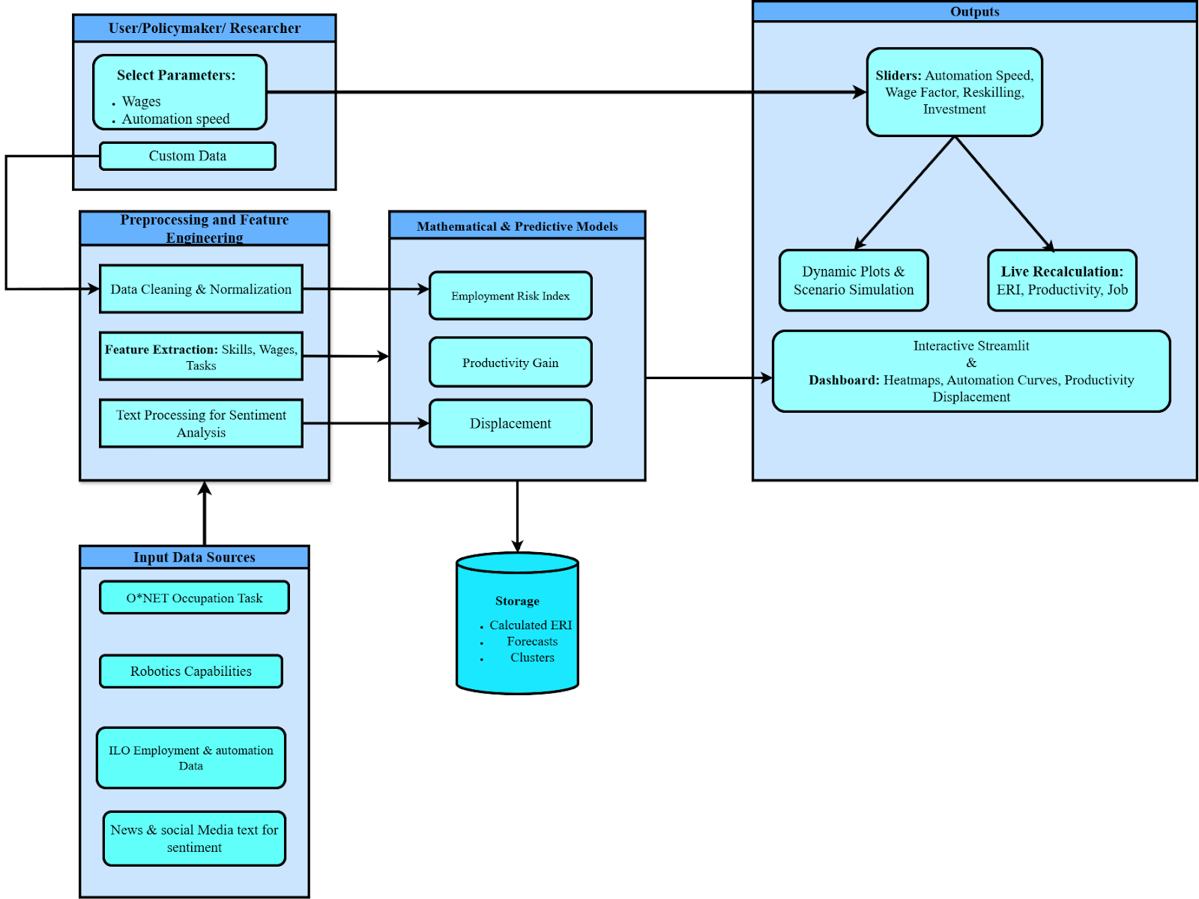
System Architecture

Slide 15
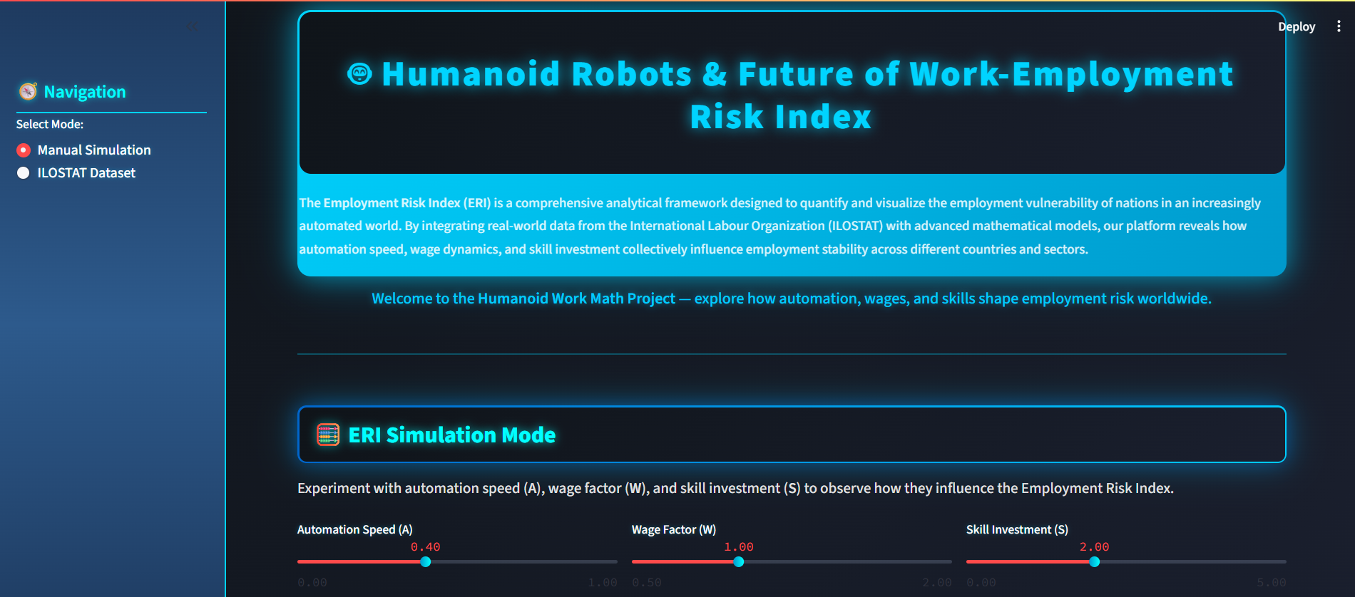
Frontend Design for ERI

Slide 16
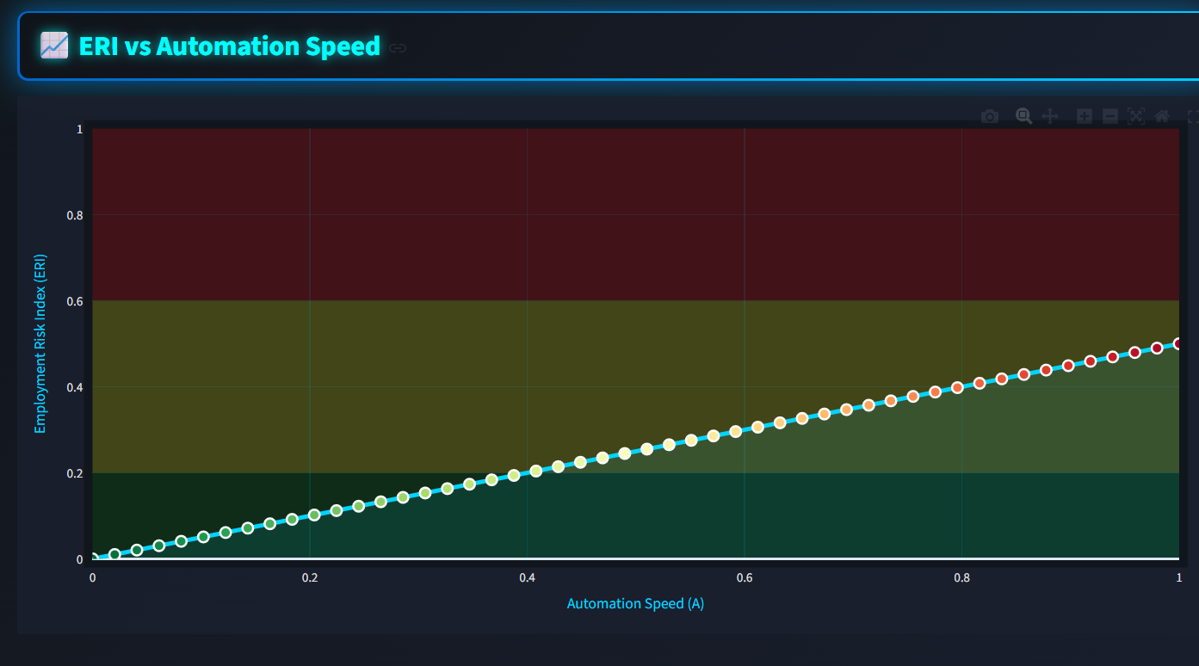
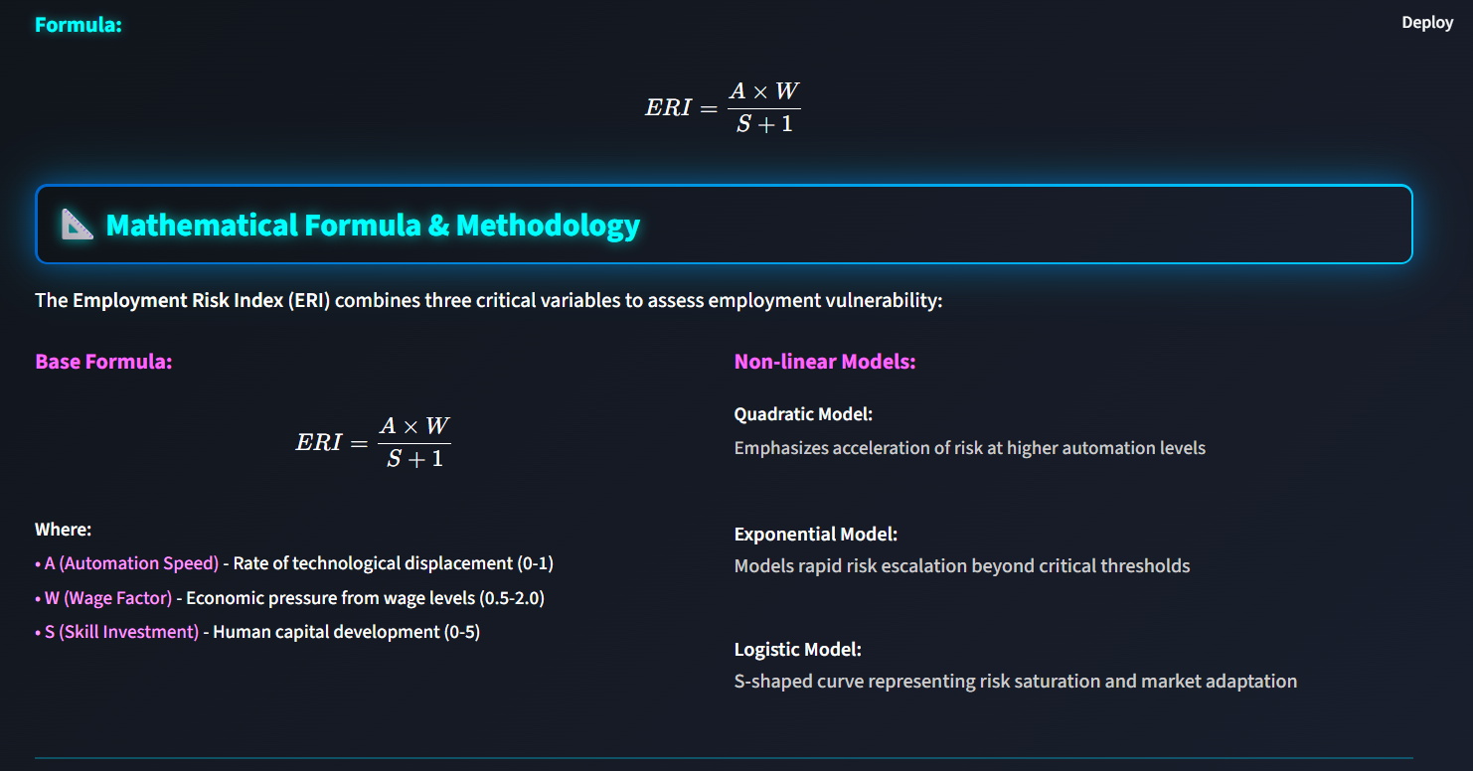
Frontend Design for ERI Conti.

Slide 17
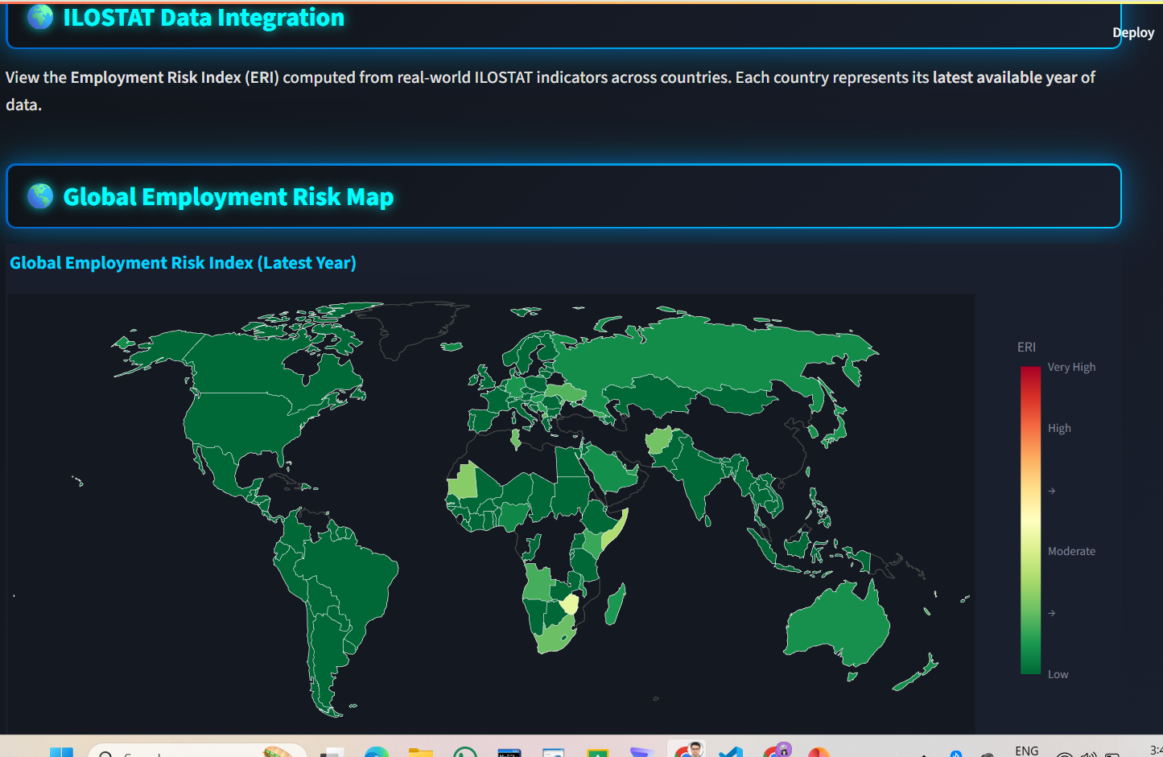
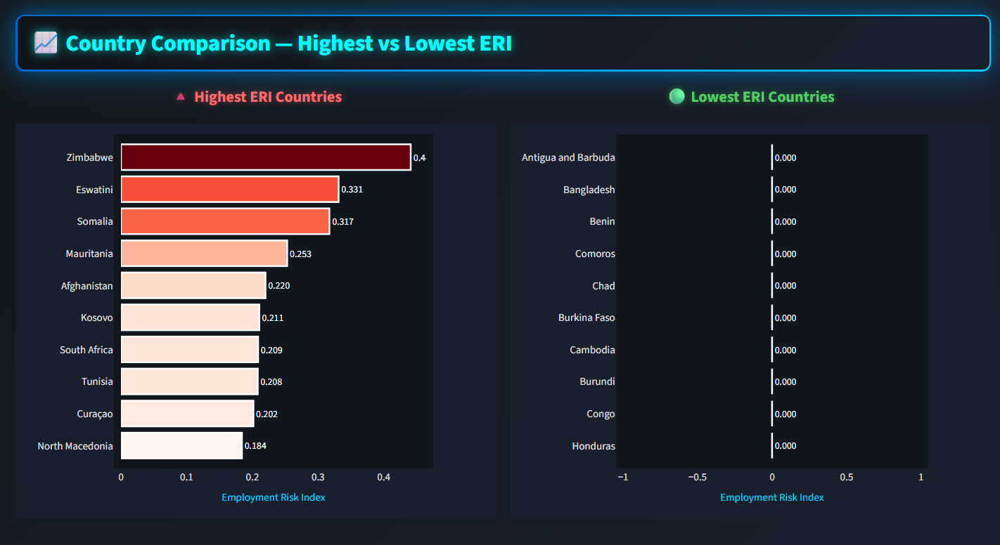
Frontend Design for ERI Conti.

Slide 18
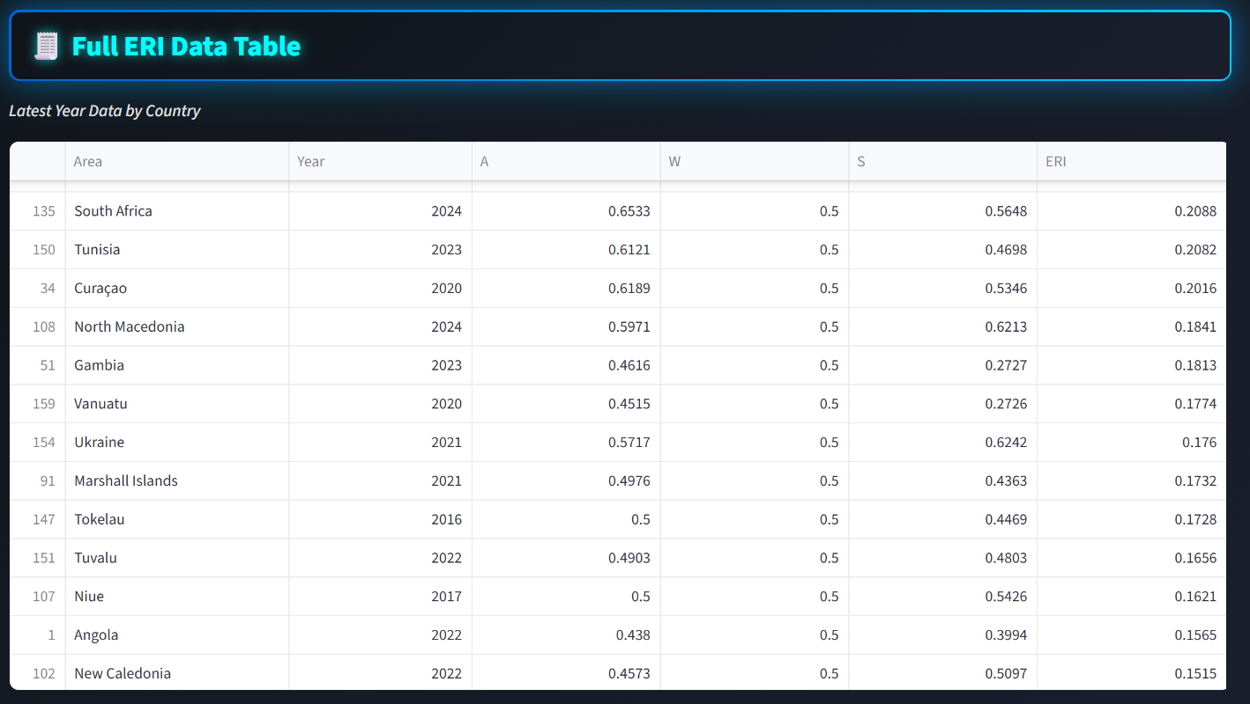
Frontend Design For ERI Conti.

Slide 19
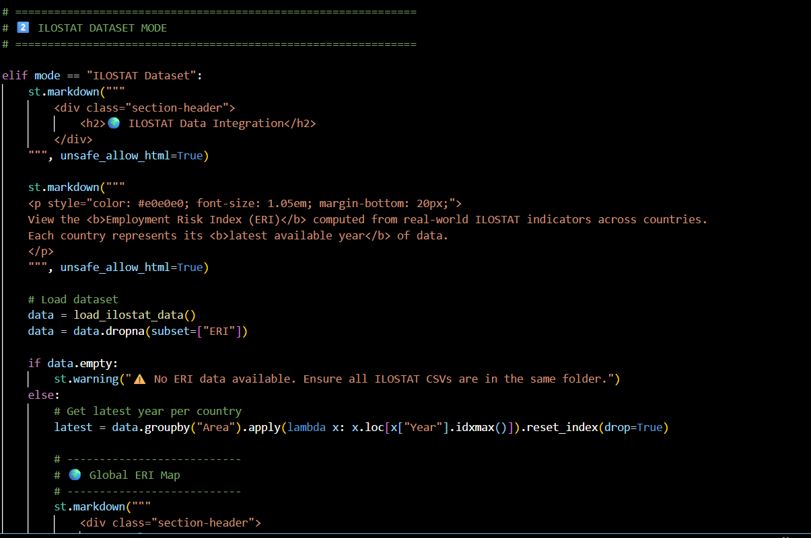
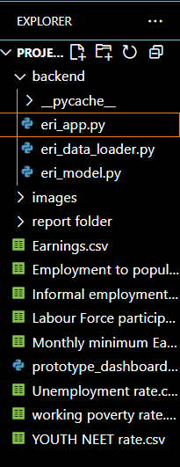
Backend Design for ERI

Slide 20
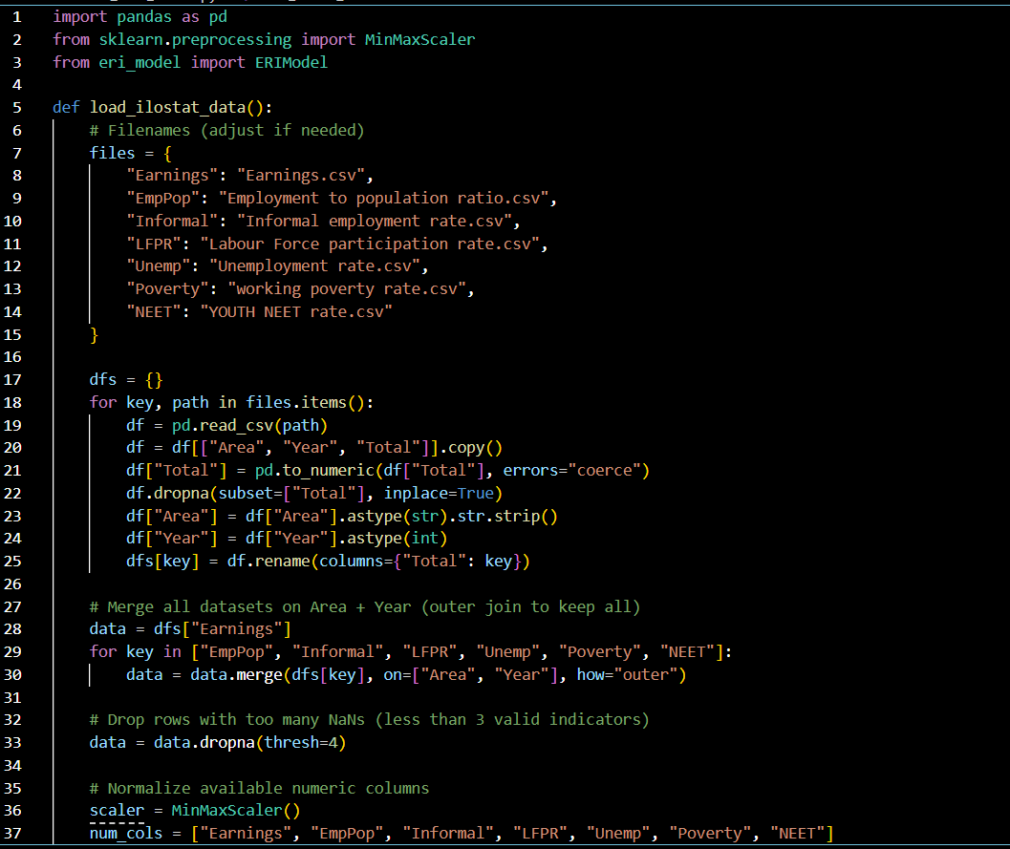
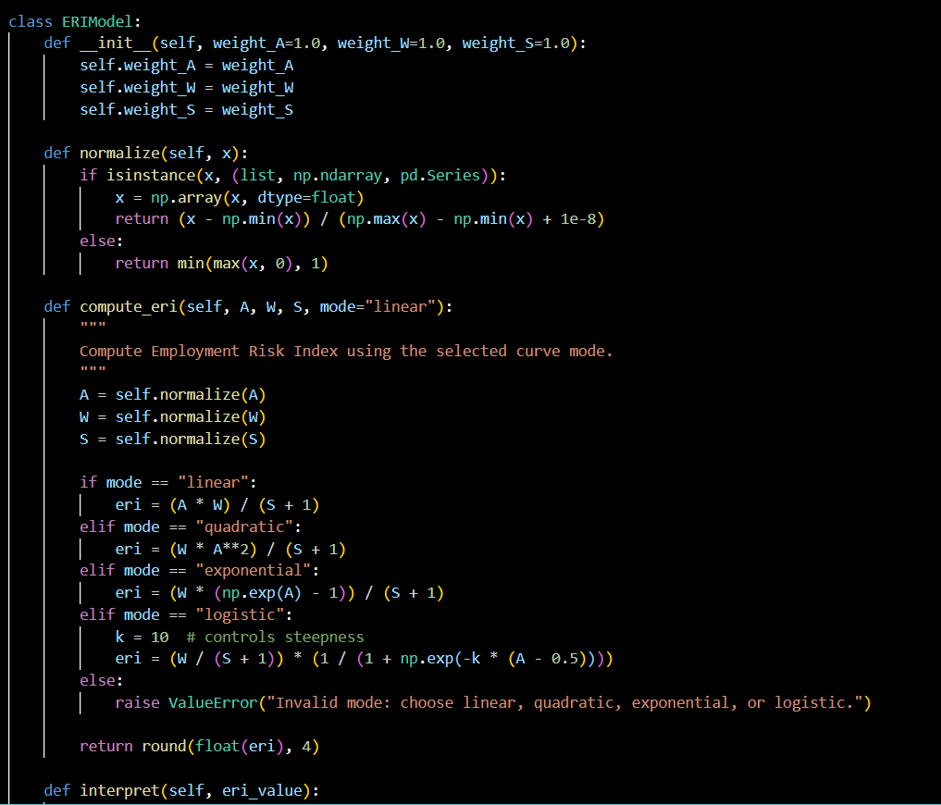
Backend Design for ERI Conti.

Slide 21
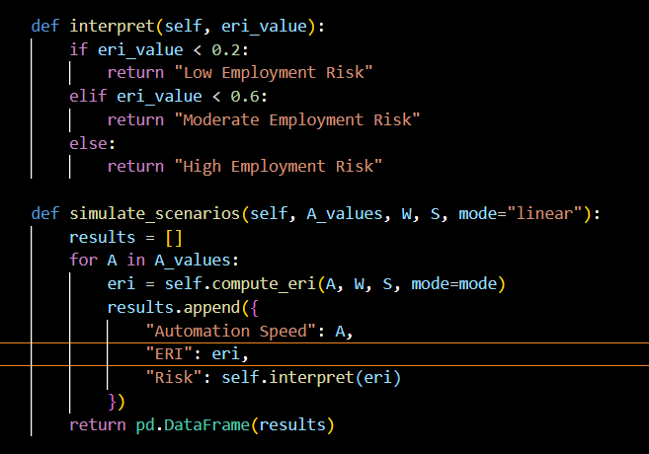
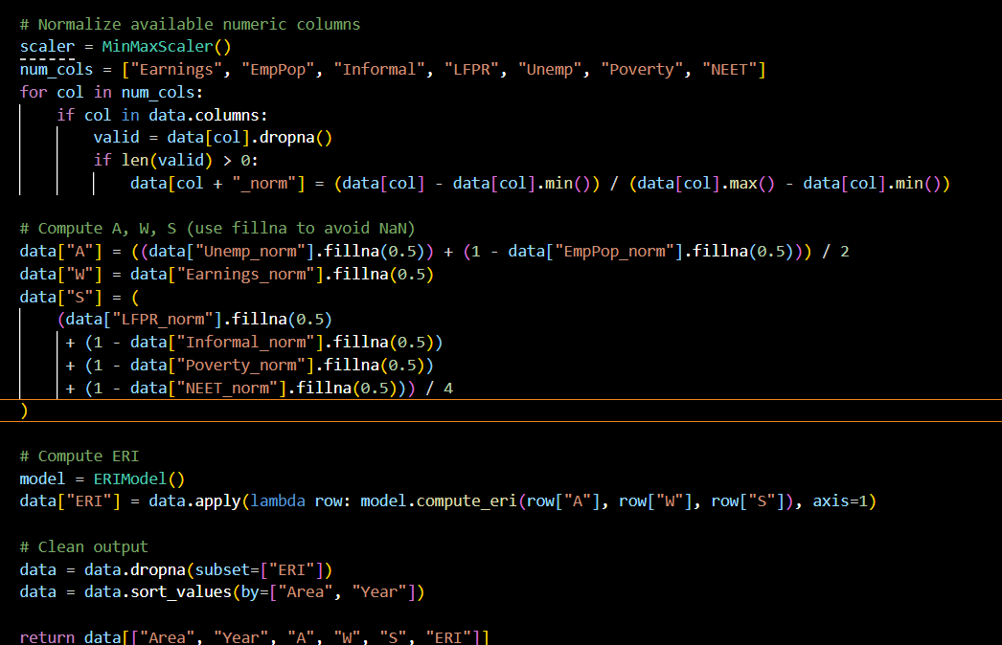
Backend Design for ERI Conti.

Slide 22
Future Plan
Extend the model to predict long-term employment trends, covering 10 to 20 years.
Incorporate AI explainability to ensure transparency in decision-making.
Add country-specific datasets for focused analysis.
Publish findings in a research paper or an open-source dashboard.

Slide 23
Expected Outcome
Create a data-driven mathematical framework that measures how humanoid robots affect employment and productivity.
Develop a dashboard and an interactive app that allow policymakers to explore “what-if” scenarios.
Provide insights that inform future workforce policies, reskilling strategies, and industry readiness.

Slide 24
Individual Contribution
Toshima Jaiswal (2448369): Worked on frontend of the model, data cleaning & merging all ILOSTAT CSVs files for model Integration and currently working on building productivity gain model.
Utkarsh Misra (2448370): ERI model building, connecting the backend to the frontend and currently working on Displacement functions and how to enhance all these models formulas and integrate all 3 of them together in a Dashboard(final outcome).
Chetan Verma (2448380): Model Integration with ILOSTAT dataset and currently working on integrating O*NET database to the other models (Displacement Functions and Productivity Gain model & integration of the final report in the models.

Slide 25
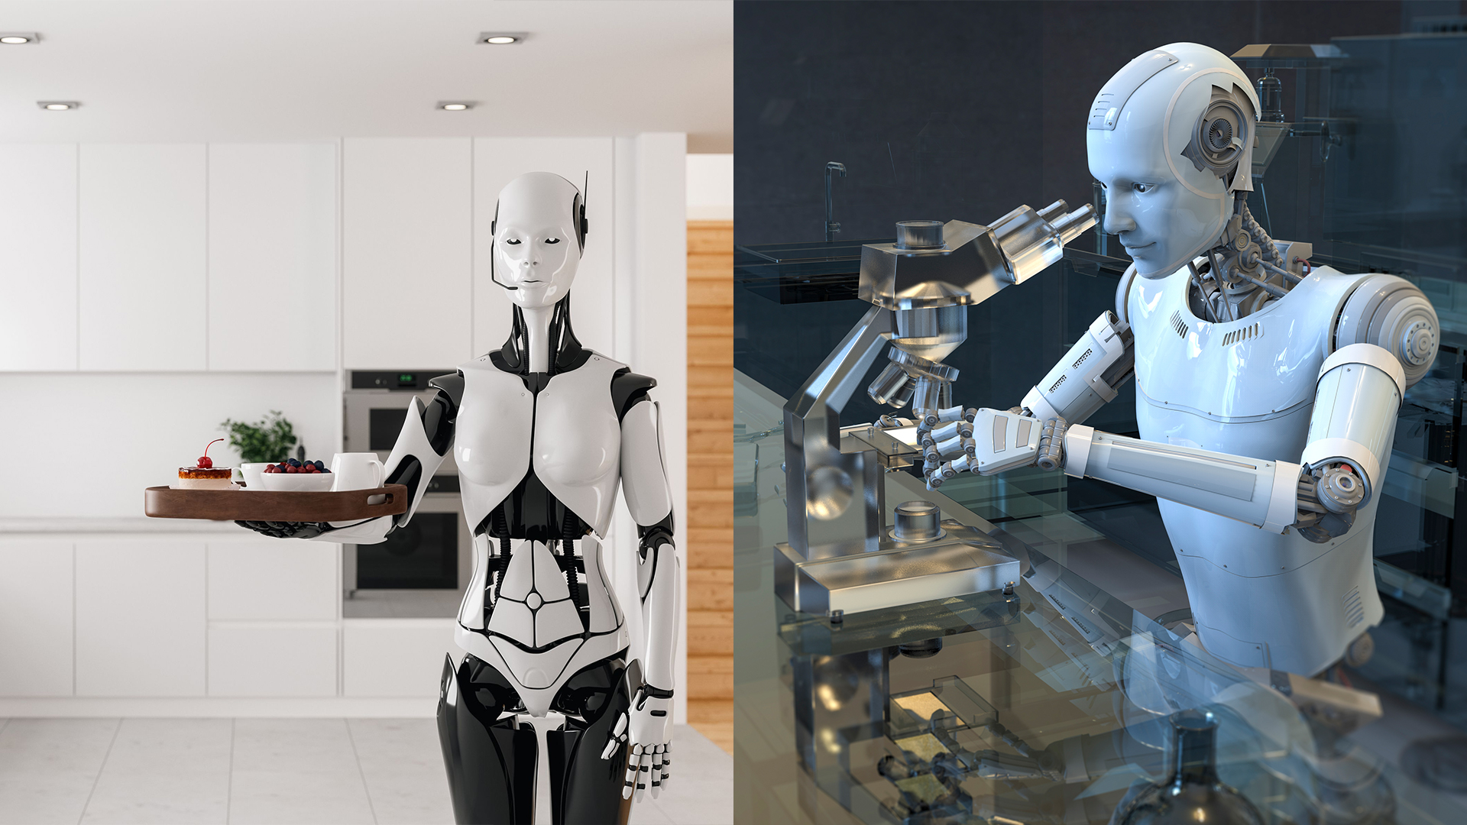
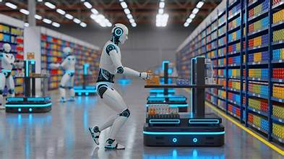
Thank You
(Any Questions/Feedback)

