Slide 1
Raspberry Pi Project:
Retro Game Emulator
Soiberry Group 3

Slide 2
What is it really that we chose to do?
We chose to make a Raspberry Pi retro gaming emulation console. It will be able to play various classic games, such as Super Mario Bros, Sonic the Hedgehog, and other retro games for systems like NES, Atari 2600, Game Boy, Playstation, and more.
Notes:
https://www.pcworld.com/article/3190347/how-to-build-a-raspberry-pi-retrogaming-emulation-console.html
Nardiena: For our group project, we have decided to build a Raspberry Pi retro gaming emulation console. Using this console, we will be able to emulate some of the most popular gaming systems, like Gameboy and Atari. We will then be able to install and play lots of different old-school games, such as Super Mario and Sonic the Hedgehog.

Slide 3
Why Do This Project?
For years, retro gaming enthusiasts have dreamed of making a “universal game console” that is able to play games from different systems.
This emulation system we are planning to build with our Raspberry Pi allows us to do this for a relatively cheap price.
Notes:
Davin:
Other than the obvious fact that we have to do this, the members in our team enjoy playing game and have taken interest in this project that is related. And by utilising the Raspberry Pi diversity power and the many existing libraries for emulating retro gaming console, we will be able to simulate a wide range of retro games from the old times.

Slide 4
How we are going to do the project
We are going to run the raspberry pi as a virtual emulator for retro gaming consoles. The software for emulating gaming consoles is packaged in a free software called RetroPie. The ROM of the games will be stored in the pi’s microSD card or by network share by using another computer as a network attached storage (NAS).
Notes:
Rizal
three LED (equalizer, IO status, NAS connection)

Slide 5
What are the features are we going to add
The features that we are going to add :
An emulator for a wide selection of retro gaming consoles
Equalizer for retro games’ amazing soundtrack
Support for various games
More features
Notes:
Rizal

Slide 6
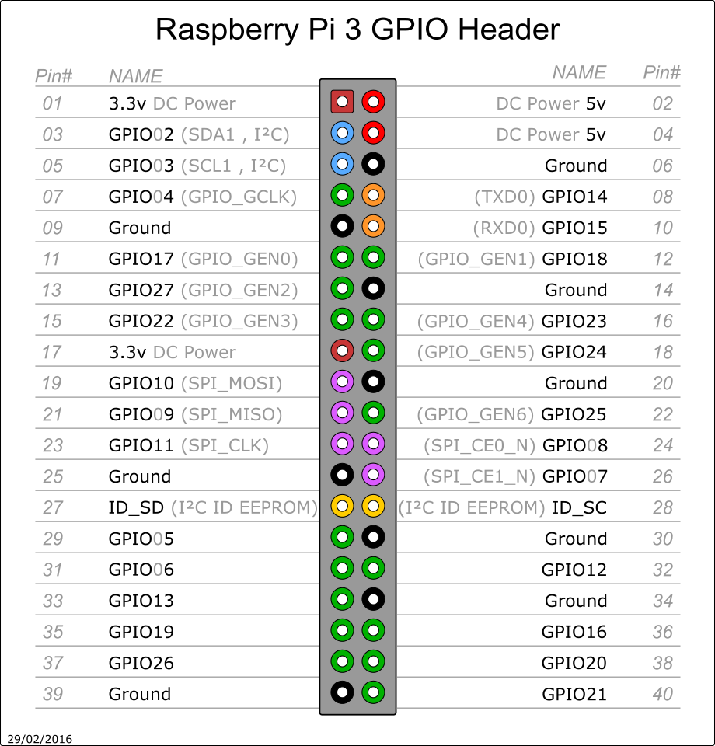
How our project will fulfill the requirements
Two LEDs will be used to check the controller’s connection status and the console’s power
gamecon_gpio interface for NES, SNES, and N64 controllers
db9_gpio interface for Atari, Sega saturn, and Amiga CD32 pads
The console could stream its output to multiple screens
Notes:
M Naufal

Slide 7
Task designation
We will meet at the end of the week to compile all our work and make sure that each of our works are compatible with each other.
Amal = Boot Script
Naufal and Nardiéna = RetroPie
Rizal and Davin = Setting up access point and gather components
Notes:
Amal
Wut
Lu wut

Slide 8
Development Phase
Week 1:
Beginning of development, set up RetroPie on the Raspberry Pi and making a startup script that will be fest.
Week 2 - * : Polishing week 1 results, Setting up network connectivity to the NAS and optimizing boot time
Notes:
Amal

Slide 9
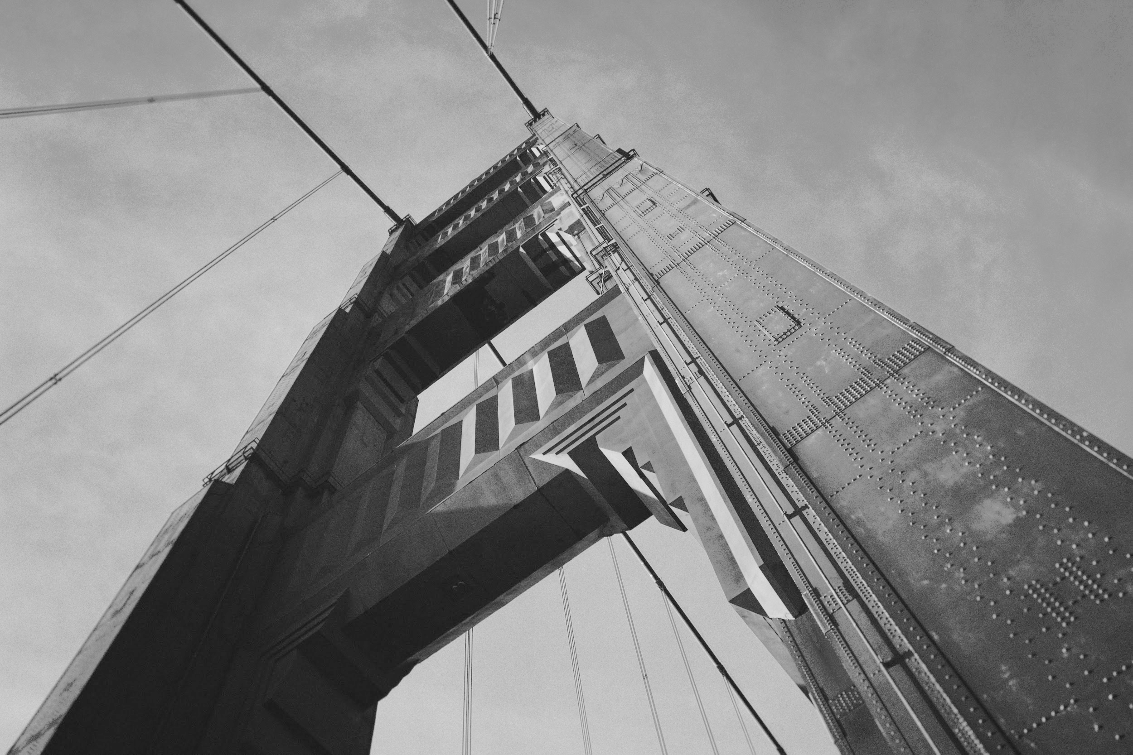
Thanks!
Contact us:
Kutek , Kutek, Depok
www.wepassthesysprog.com
Notes:
>:(

