Slide 2
Baby Bonds Simulations
The Baby Bonds program as defined in the American Opportunity Accounts Act starts in 2024.
We simulate the use of baby bonds for college education, home purchase, and retirement savings.
College students who would take student loans use the maximum anount of baby bonds up to the amount of loans.
People who did not use their baby bonds for college, use them for home purchase if they decide to buy one.
Any residual baby bonds are added to retirement savings.

Slide 3
Analysis
This analysis observes people born from 2024 to 2028
It analyzes the following outcomes:
At age 18, demographic composition, the amount of baby bonds.
At age 45, the share of people with college degree, student loan debt, earnings, and homeownership.
At age 65, retirement savings and lifetime earnings.

Slide 4
Analysis (continued)
This analysis disaggregates outcomes along the following dimensions:
Sex,
Race/ethnicity (Non-Hispanic Black, Hispanic, and Non-Hispanic White), and
Quintile of family income at birth.

Slide 5
Results at Age 18

Slide 6
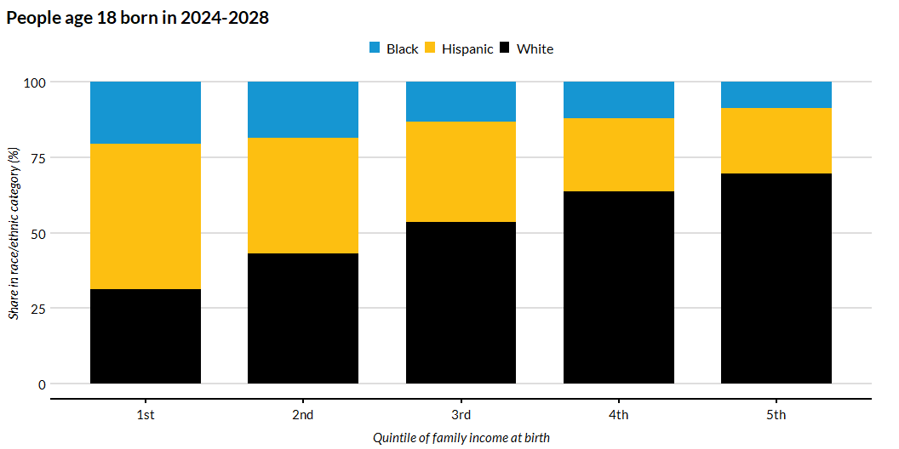
Race/Ethnicity Shares by Quintile of Family Income at Birth

Slide 7
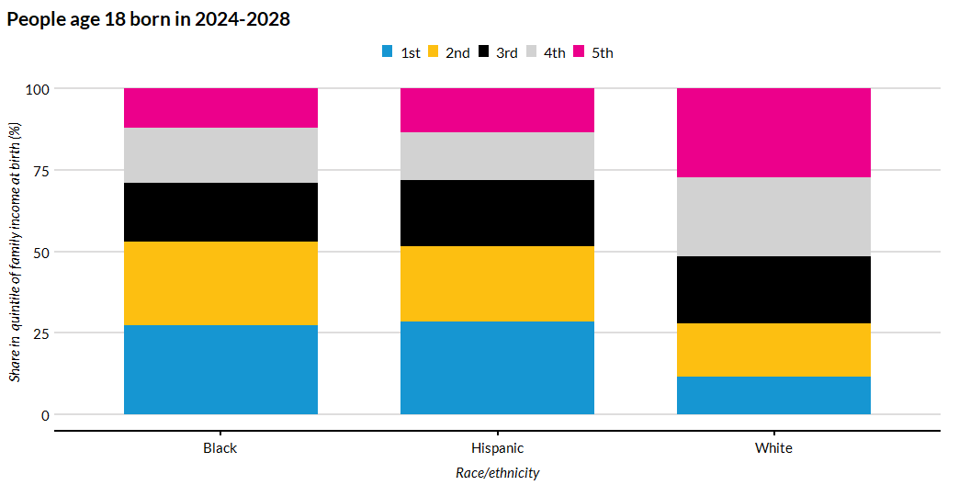
Shares of Quintile of Family Income at Birth by Race/Ethnicity

Slide 8
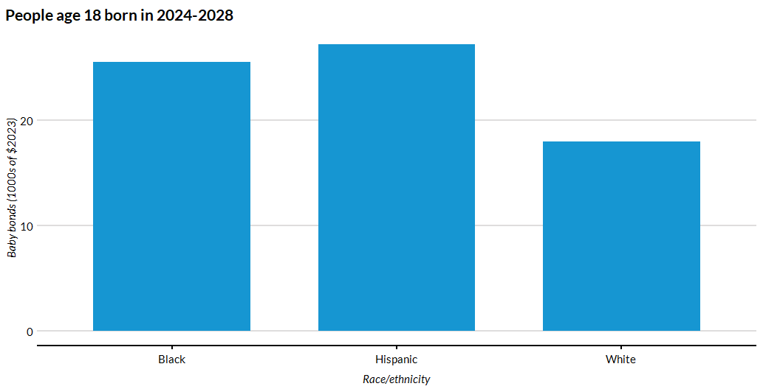
The Average Baby-Bonds Amount by Race/Ethnicity

Slide 9
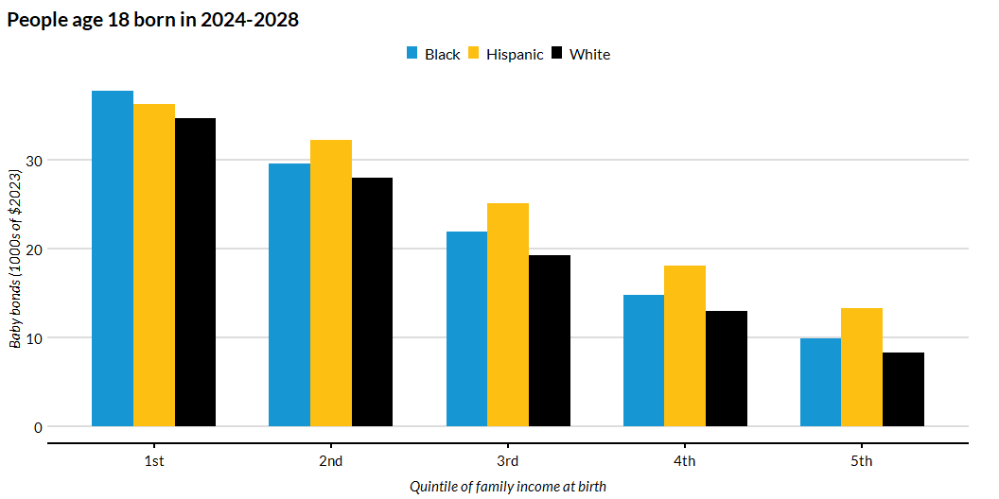
Baby Bonds Amount by Quintile of Family Income at Birth and Race/Ethnicity

Slide 10
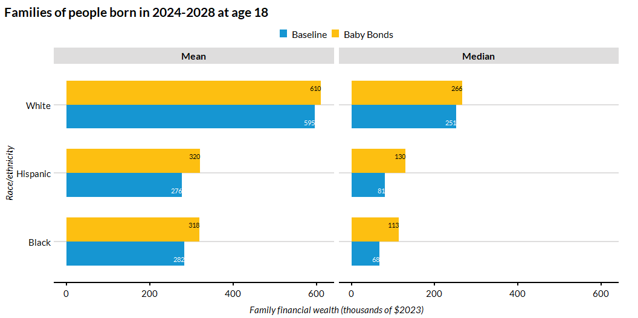
Family Financial Wealth at 18 by Race/Ethnicity

Slide 11
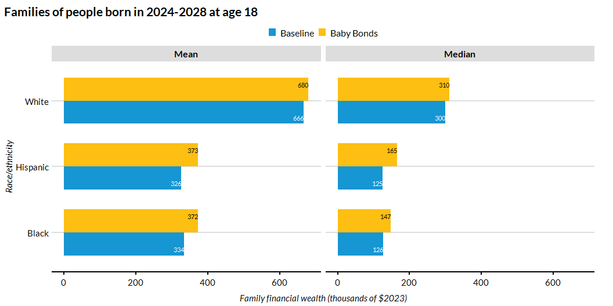
Family Financial Wealth by Race/Ethnicity (Restricted to dependent 18-year-olds)

Slide 12
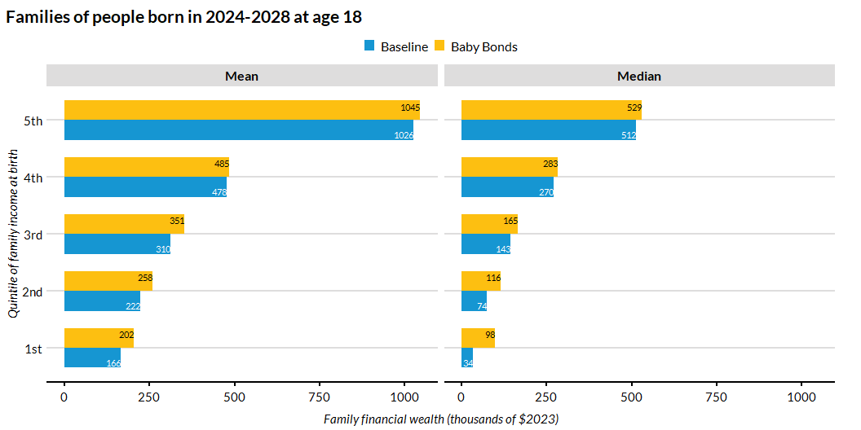
Family Financial Wealth at 18 by Family Income at Birth

Slide 13
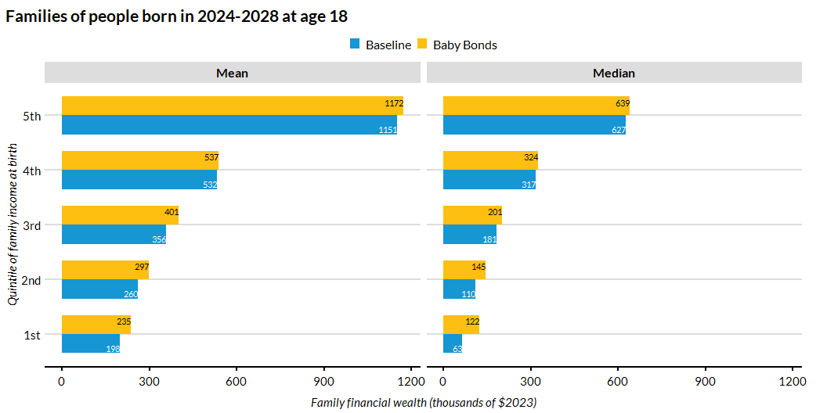
Family Financial Wealth by Family Income at Birth (Restricted to dependent 18-year-olds)

Slide 14
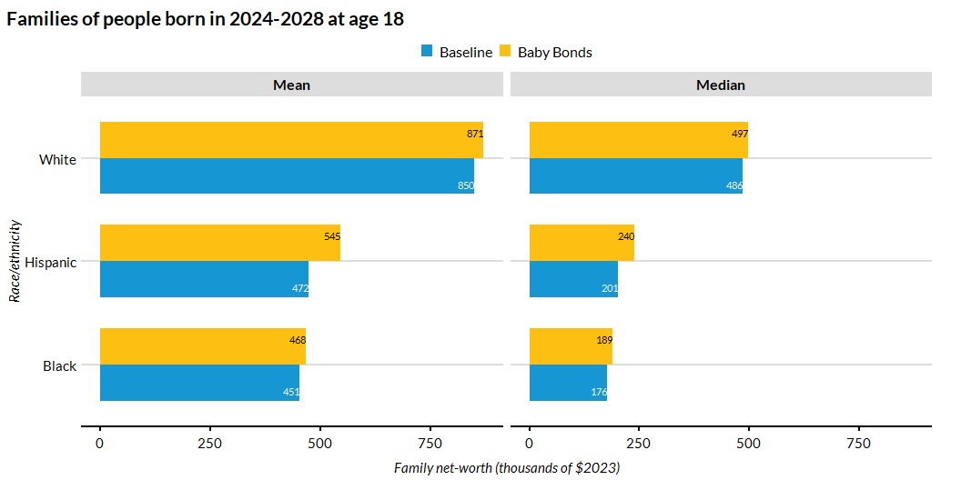
Family Net-Worth by Race/Ethnicity

Slide 15
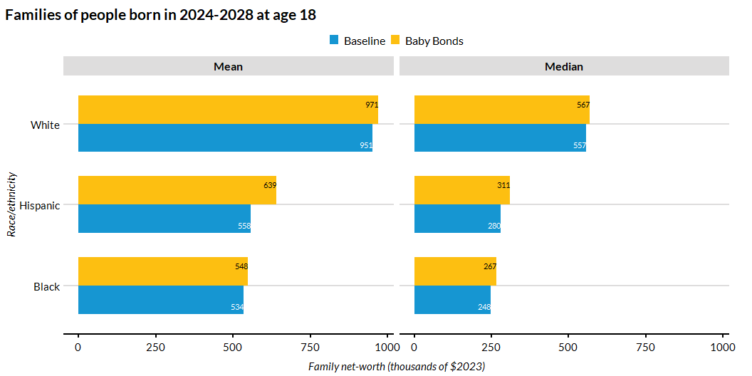
Family Net-Worth by Race/Ethnicity (Restricted to dependent 18-year-olds)

Slide 16
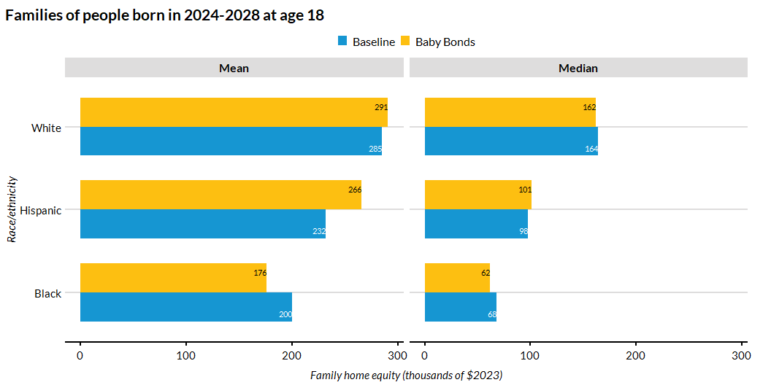
Family Home Equity by Race/Ethnicity

Slide 17
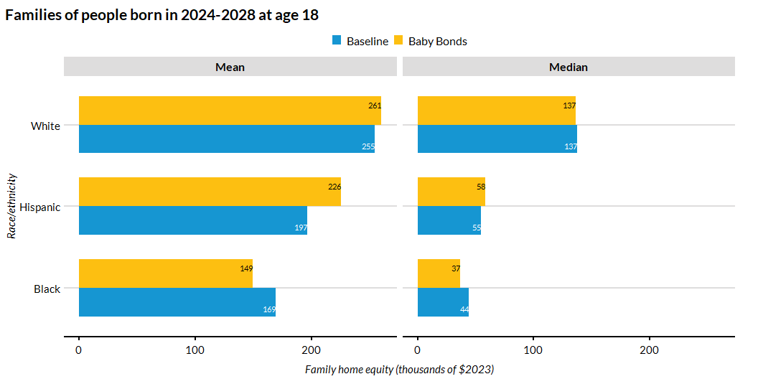
Family Home Equity by Race/Ethnicity (Restricted to dependent 18-year-olds)

Slide 18
Results at Age 45

Slide 19
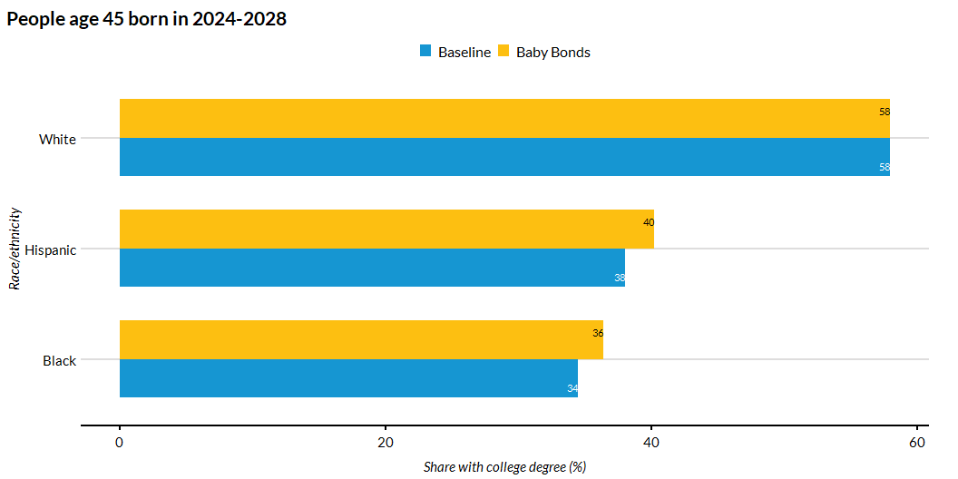
Share of People with College Degree by Race/Ethnicity

Slide 20
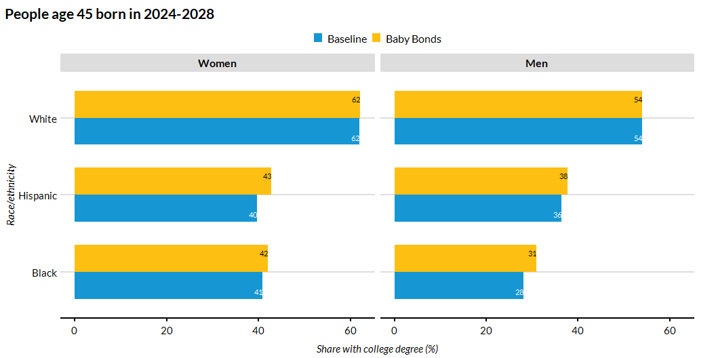
Share of People with College Degree by Race/Ethnicity and Sex

Slide 21
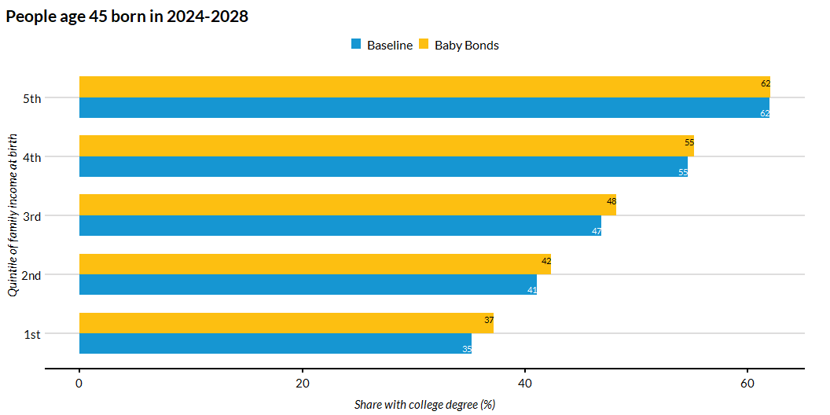
Share of People with College Degree by Quintile of Family Income at Birth

Slide 22
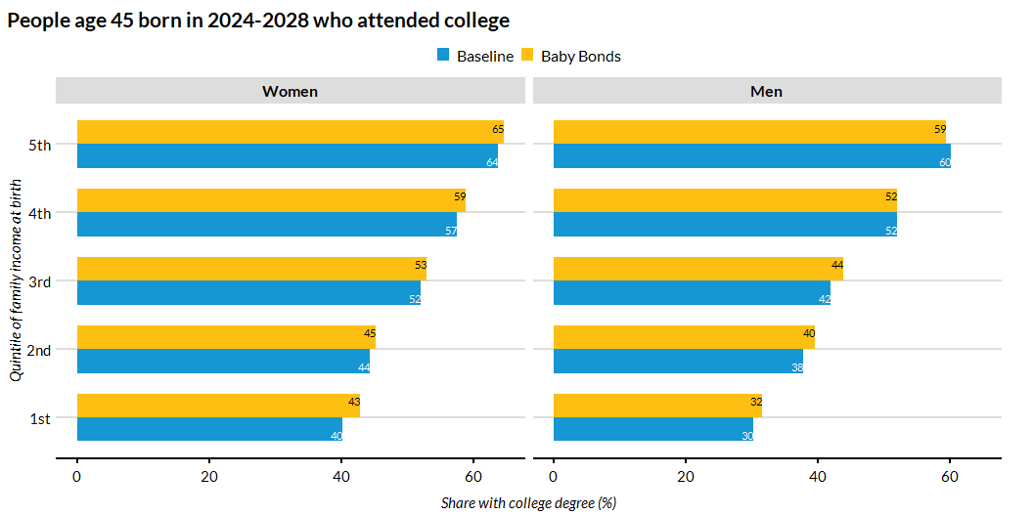
Share of People with College Degree by Quintile of Family Income at Birth and Sex

Slide 23
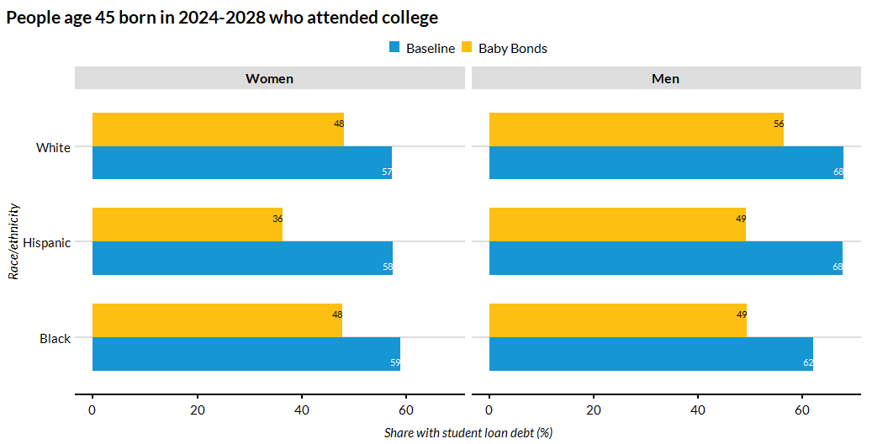
Share of People who Took a Student Loan by Race/Ethnicity and Sex

Slide 24
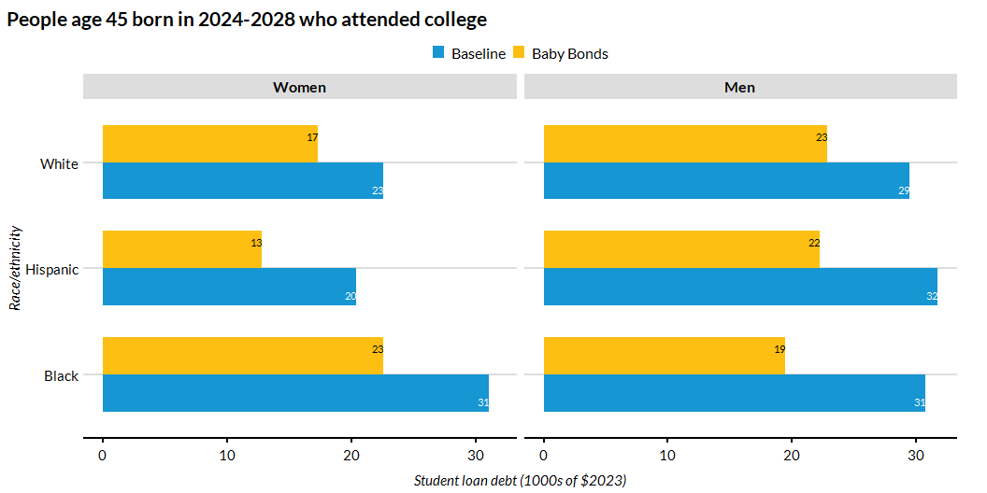
Average Student Loan Debt at College Exit among College Attendees by Race/Ethnicity and Sex

Slide 25
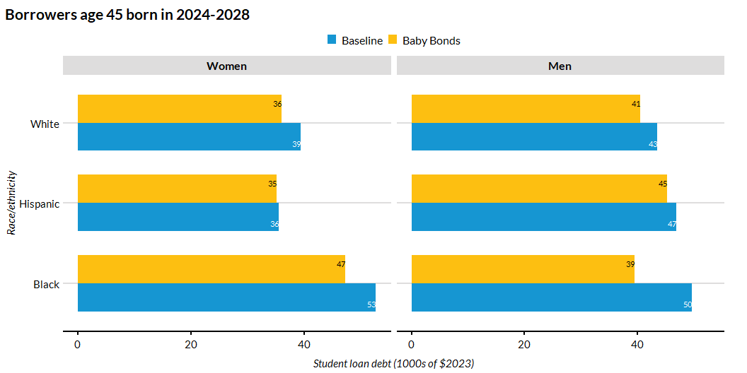
Average Student Loan Debt at College Exit Among Borrowers by Race/Ethnicity and Sex

Slide 26
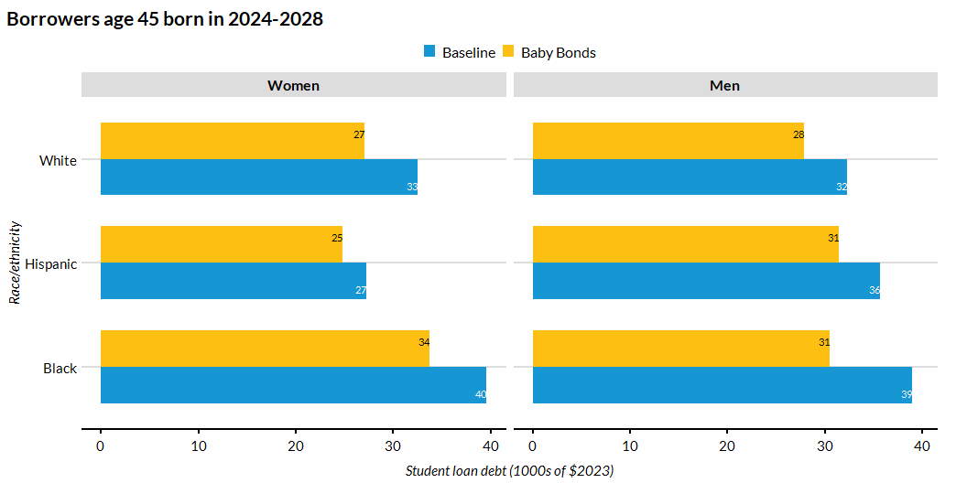
Median Student Loan Debt at College Exit Among Borrowers by Race/Ethnicity and Sex

Slide 27
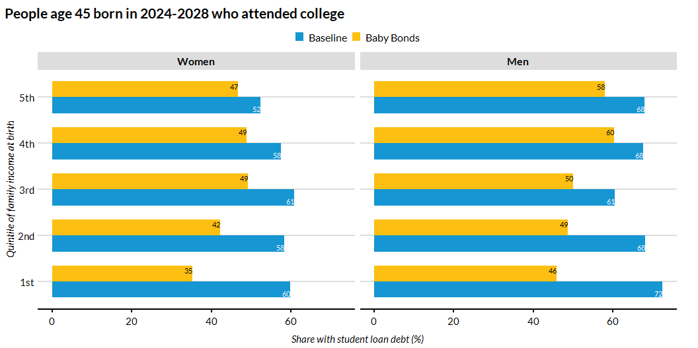
Share of People who Took a Student Loan by Family Income at Birth

Slide 28
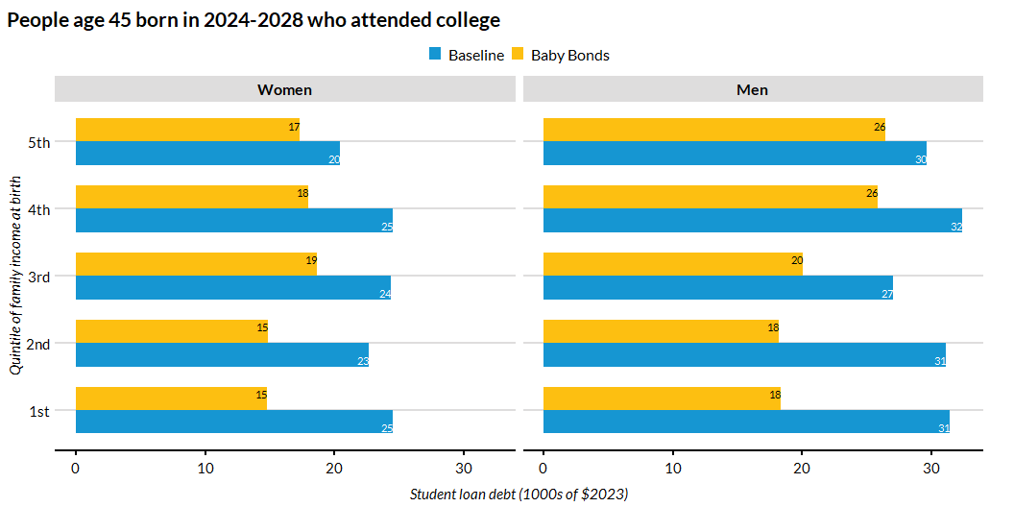
Average Student Loan Debt at College Exit among College Attendees by Quintile of Family Income at Birth and Sex

Slide 29
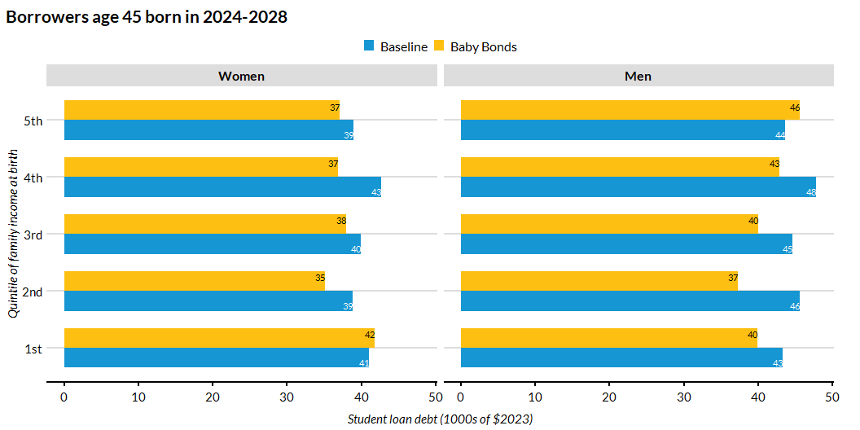
Average Student Loan Debt at College Exit Among Borrowers by Family Income at Birth and Sex

Slide 30
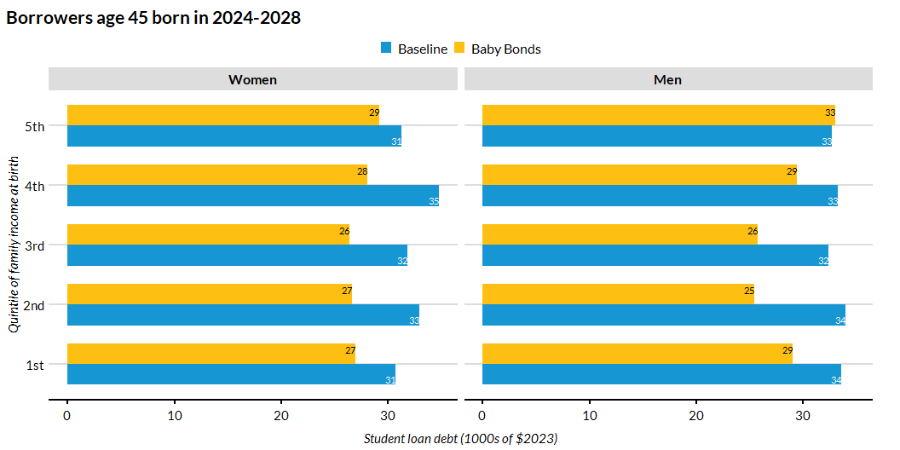
Median Student Loan Debt at College Exit Among Borrowers by Quintile of Family Income at Birth and Sex

Slide 31
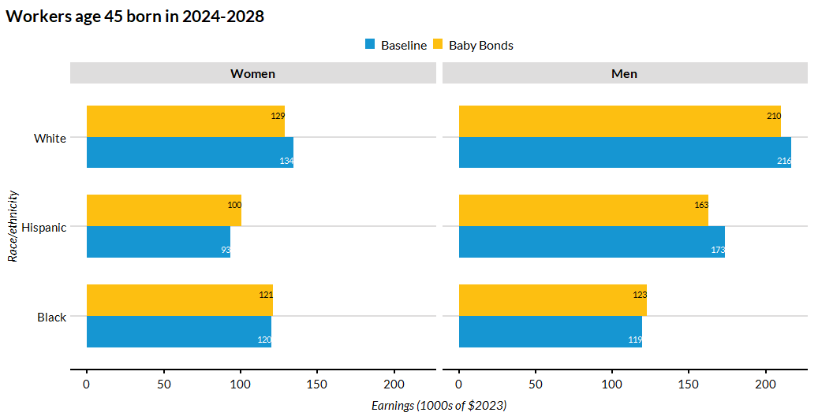
Average Earnings by Race/Ethnicity and Sex

Slide 32
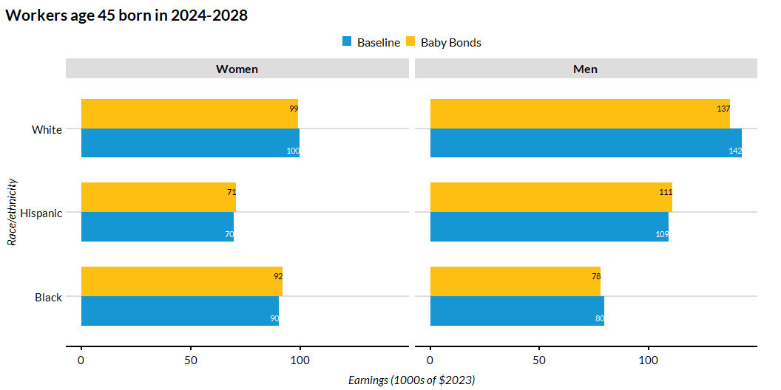
Median Earnings by Race/Ethnicity and Sex

Slide 33
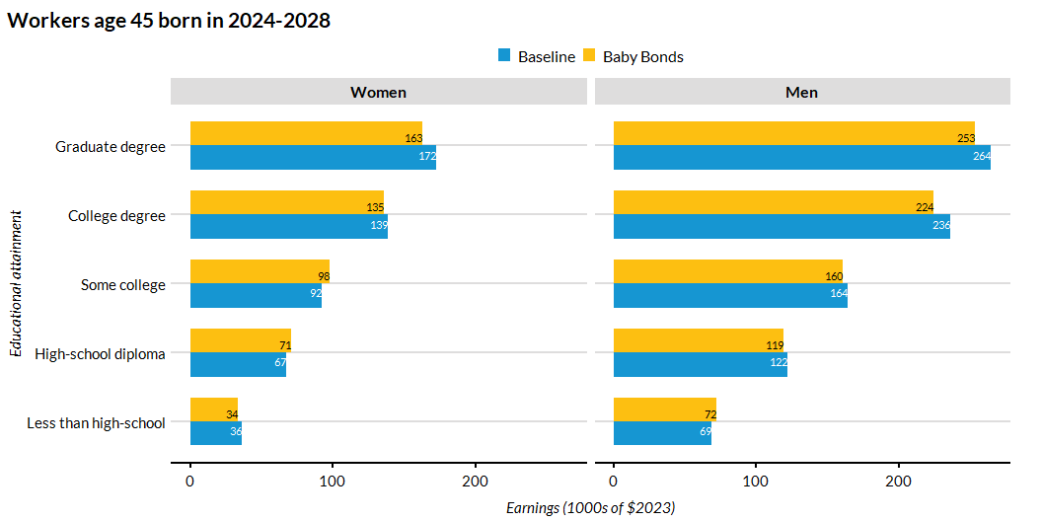
Average Earnings by Educational Attainment and Sex

Slide 34
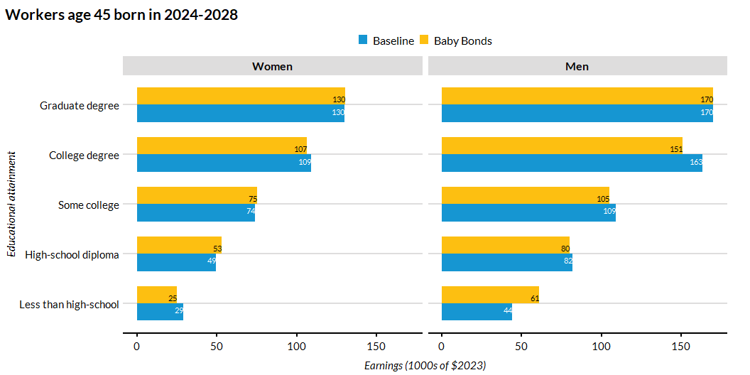
Median Earnings by Educational Attainment and Sex

Slide 35
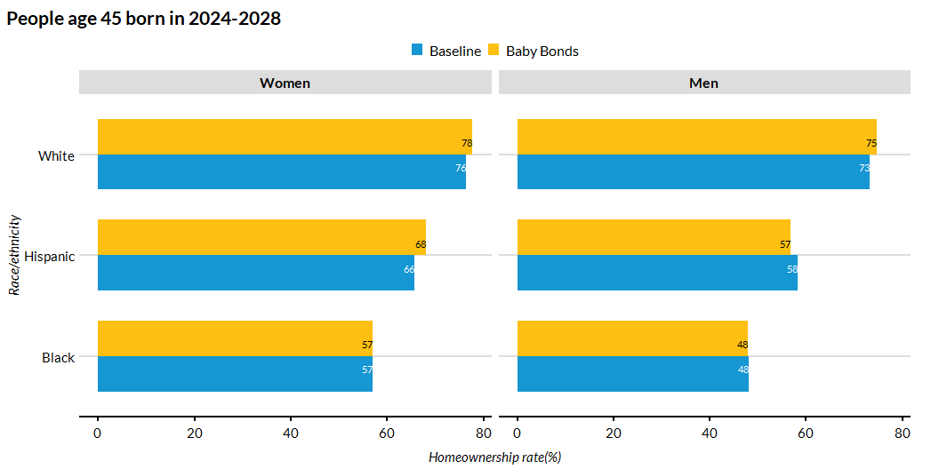
Homeownership by Race/Ethnicity and Sex

Slide 36
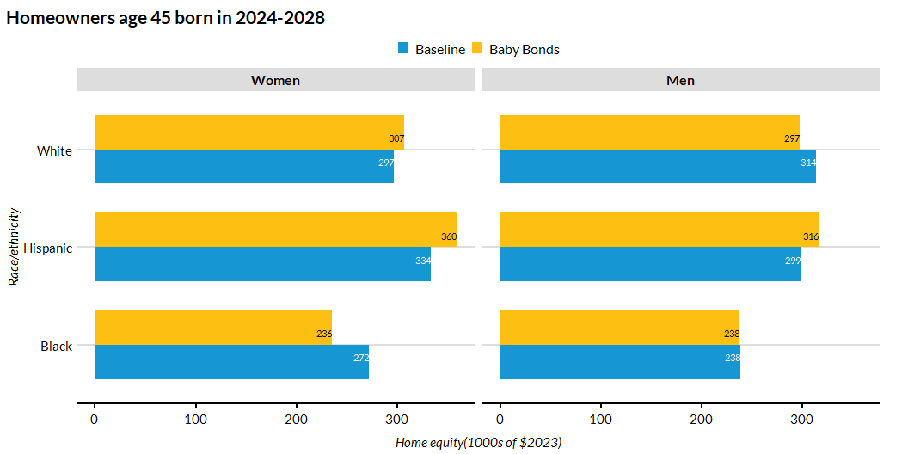
Average Home Equity by Race/Ethnicity and Sex

Slide 37
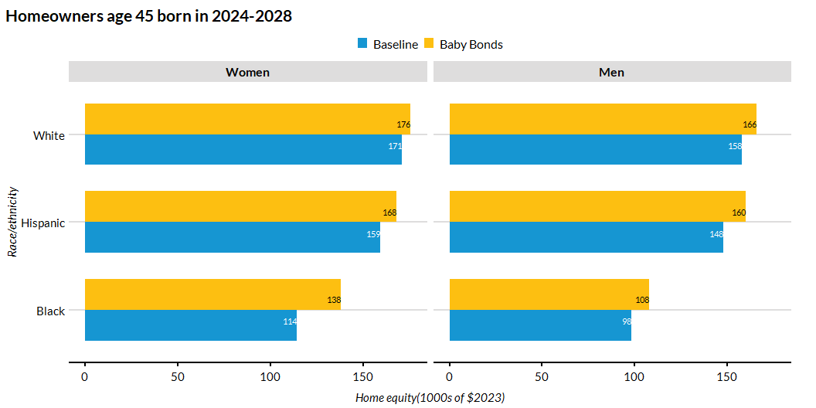
Median Home Equity by Race/Ethnicity and Sex

Slide 38
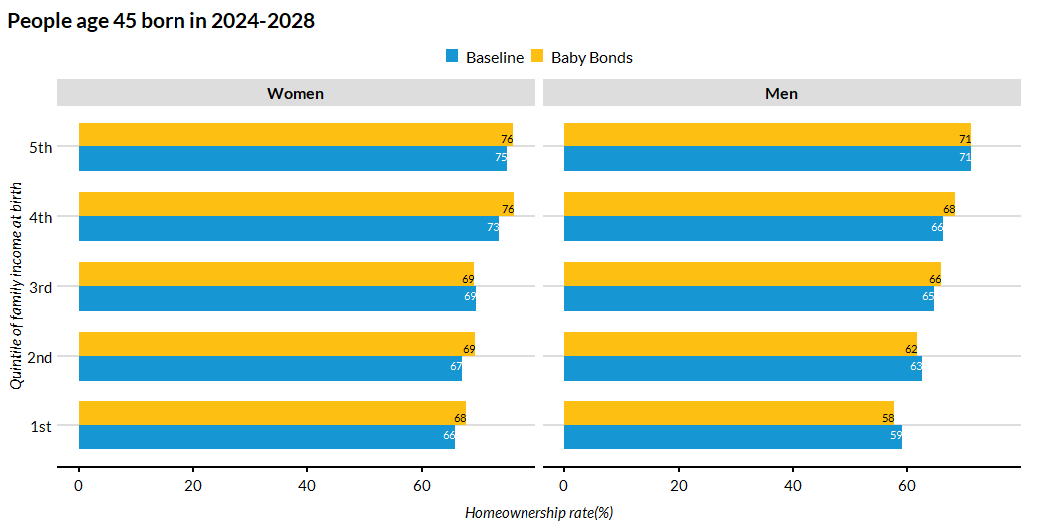
Homeownership by by Quintile of Family Income at Birth and Sex

Slide 39
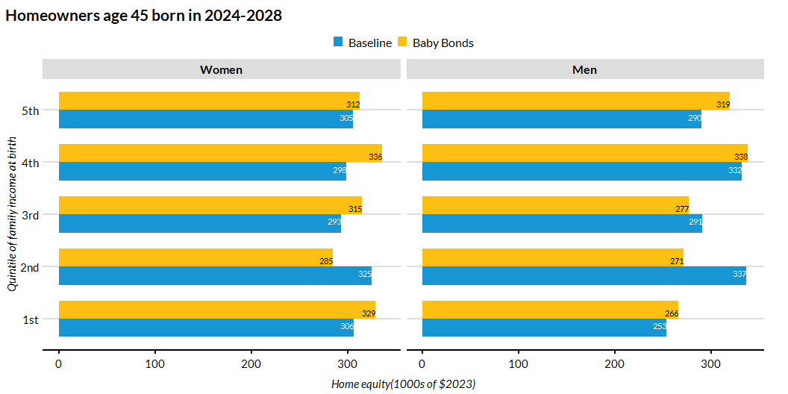
Average Home Equity by by Quintile of Family Income at Birth and Sex

Slide 40
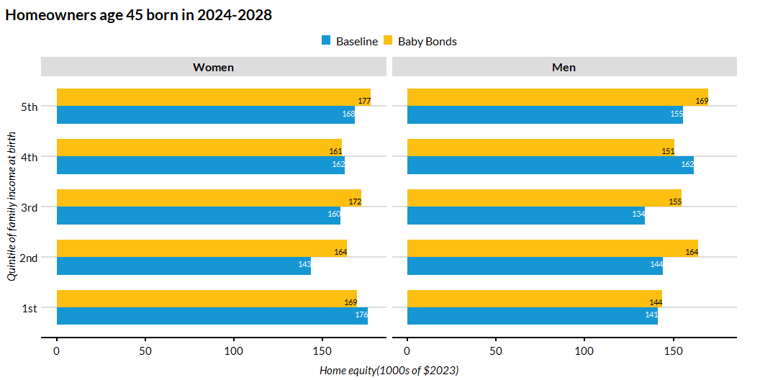
Median Home Equity by by Quintile of Family Income at Birth and Sex

Slide 41
Results at Age 65

Slide 42
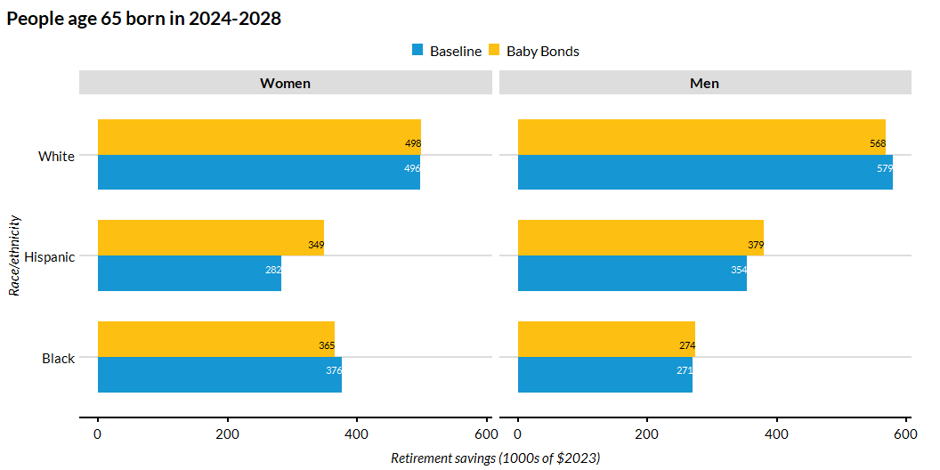
Average Per-Capita Retirement Savings by Race/Ethnicity

Slide 43
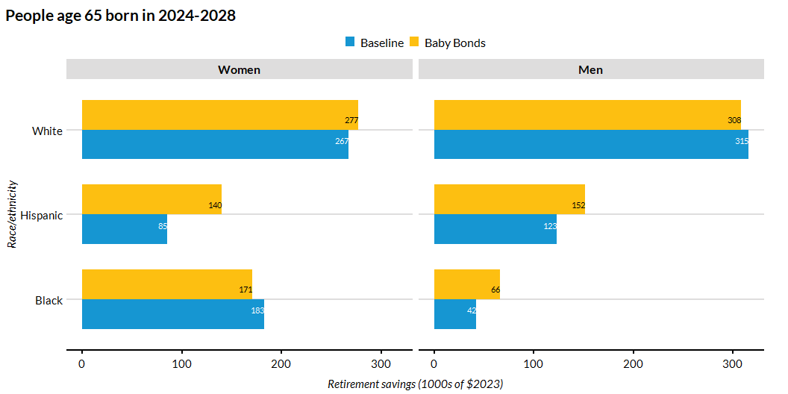
Median Per-Capita Retirement Savings by Race/Ethnicity

Slide 44
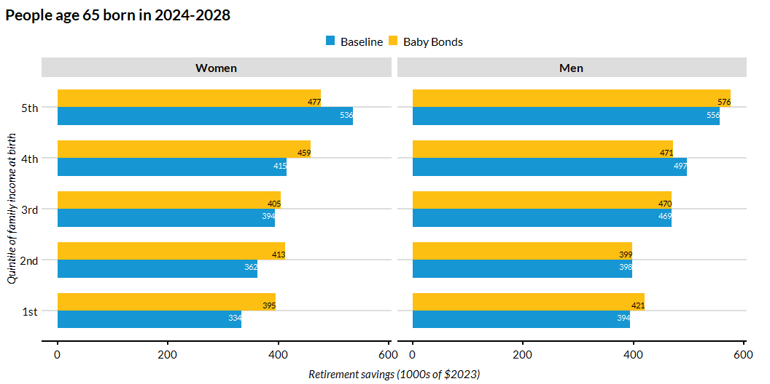
Average Per-Capita Retirement Savings by Family Income at Birth and Sex

Slide 45
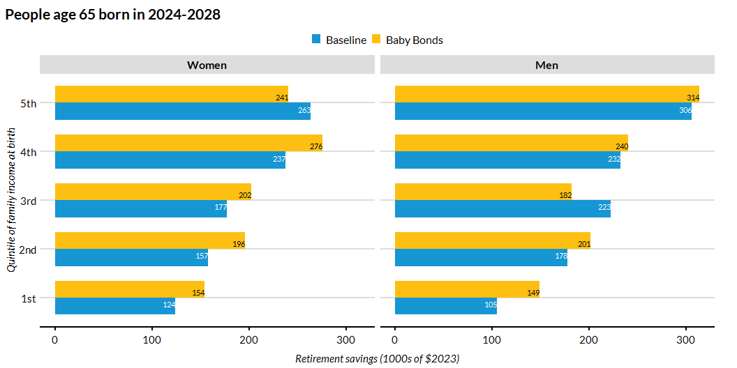
Median Per-Capita Retirement Savings by Family Income at Birth and Sex

Slide 46
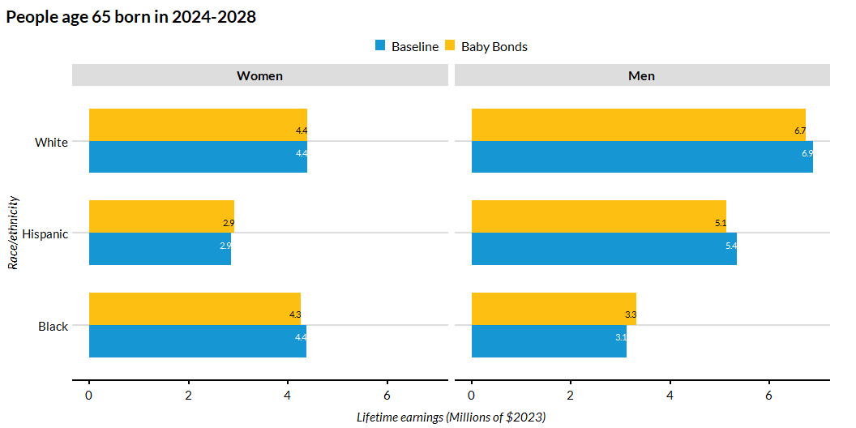
Average Per-Capita Lifetime Earnings Savings by Race/Ethnicity

Slide 47
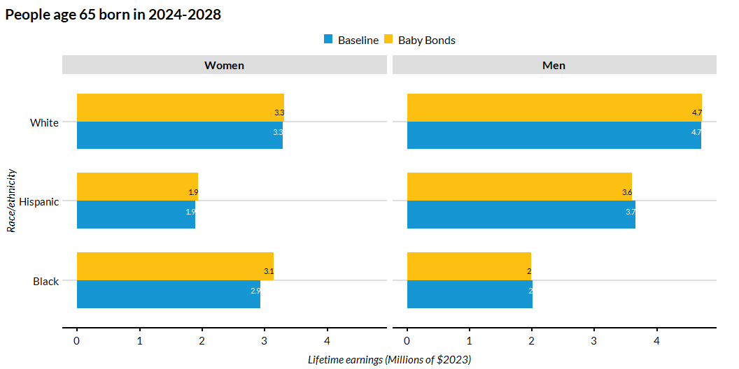
Median Per-Capita Lifetime Earnings Savings by Race/Ethnicity

Slide 48
Conclusion
The effect of baby bonds on college education is small and positive for4 people from lower-income families and for Black and Hispanic people.
The biggest effect of baby bonds is on student debt. For all race-sex groups, they reduce the share of people who take this debt and they reduce the amount of debt for borrowers.
The effect of baby bonds on earnings (annual and lifetime), homeownership rates, home equity, and retirement savings varies by race and sex, not only in magnitude but also in sign. Most likely, this is due to the random variation.

