Slide 1

Baby Bonds: Preliminary Results of DYNASIM Simulations
11 July 2024
Damir Cosic

Slide 2
Introduction
The Baby Bonds program starts in 2024
This analysis observes people born from 2024 to 2028
It analyzes the following outcomes:
At age 18, demographic composition, the amount of baby bonds.
At age 45, the share of people with college degree, student loan debt, earnings, and homeownership.
At age 65, retirement savings and lifetime earnings.

Slide 3
Introduction (continued)
This analysis disaggregates outcomes along the following dimensions:
Sex,
Race/ethnicity (Non-Hispanic Black, Hispanic, and Non-Hispanic White), and
Quintile of family income at birth.

Slide 4
Age 18

Slide 5
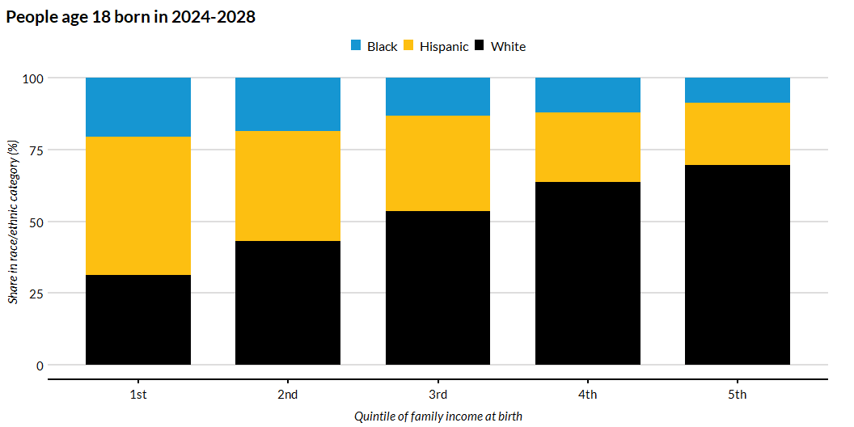
Race/Ethnicity Shares by Quintile of Family Income at Birth

Slide 6
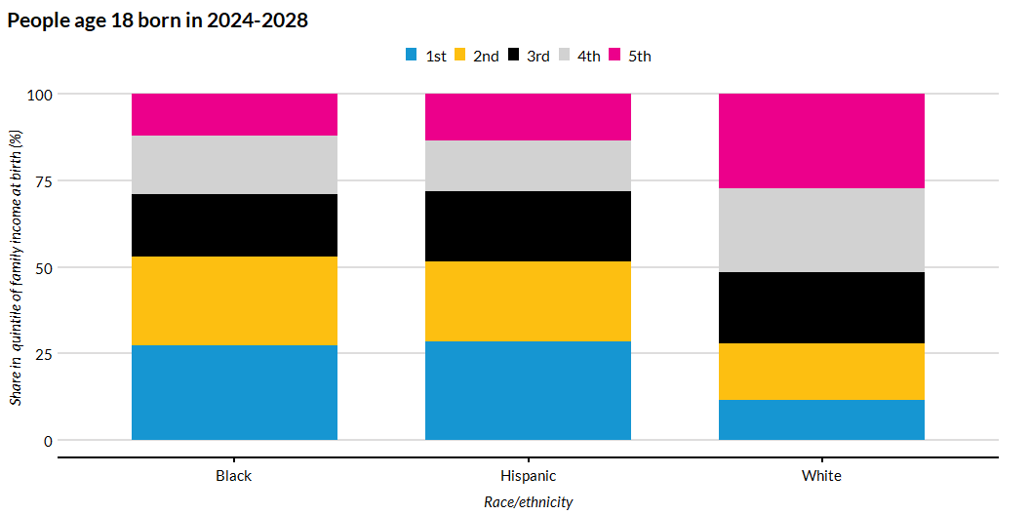
Shares of Quintile of Family Income at Birth by Race/Ethnicity

Slide 7
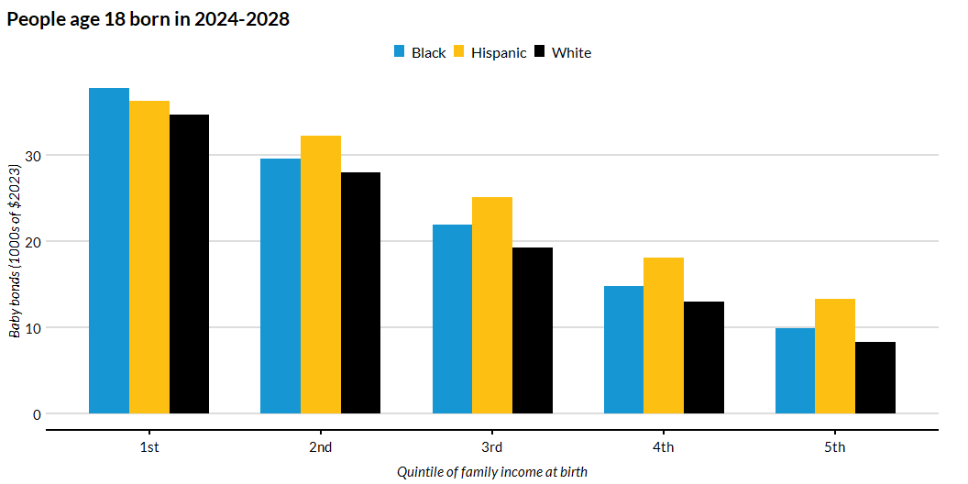
Baby Bonds Amount by Quintile of Family Income at Birth and Race/Ethnicity

Slide 8
Age 45

Slide 9
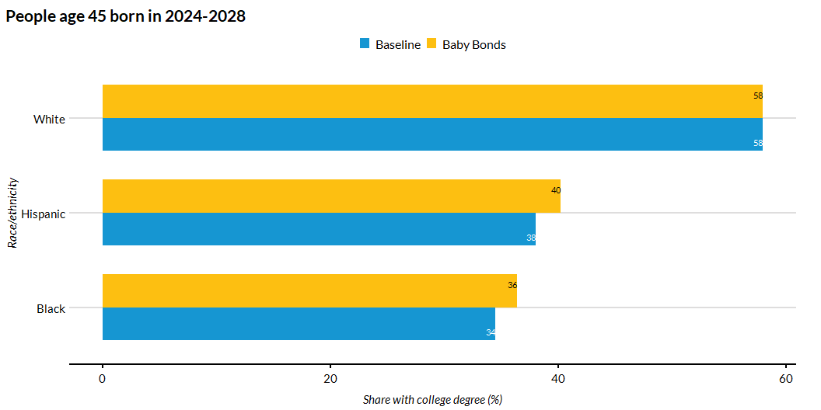
Share of People with College Degree by Race/Ethnicity

Slide 10
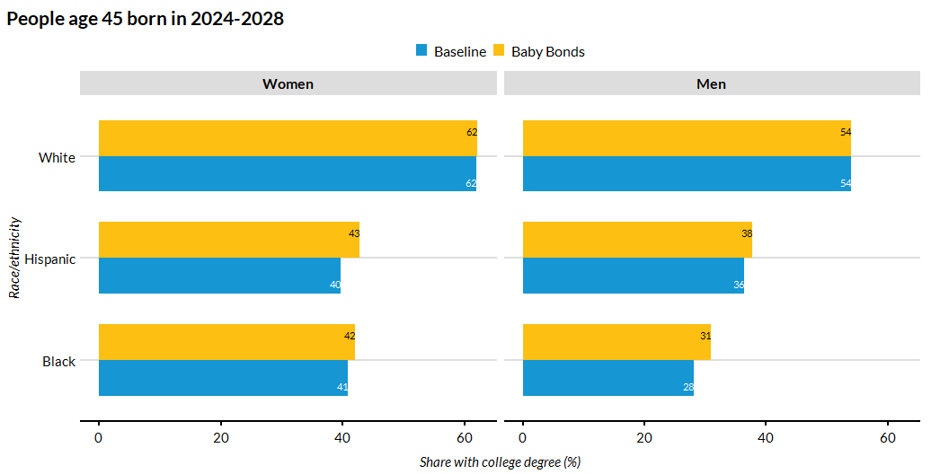
Share of People with College Degree by Race/Ethnicity and Sex

Slide 11
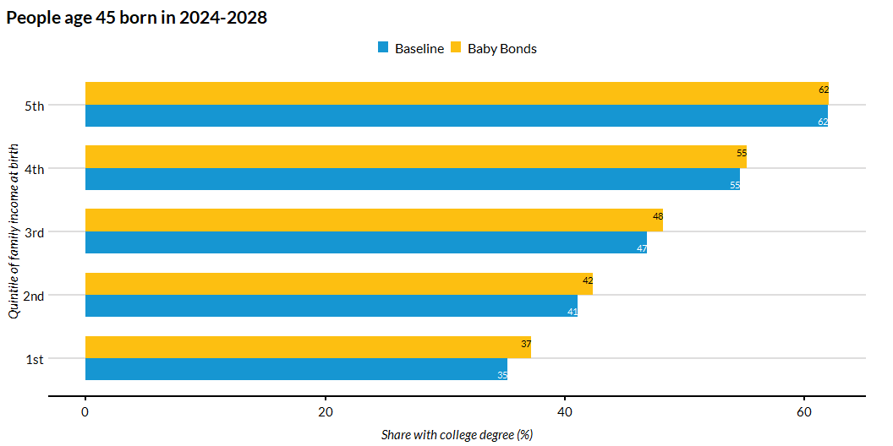
Share of People with College Degree by Quintile of Family Income at Birth

Slide 12
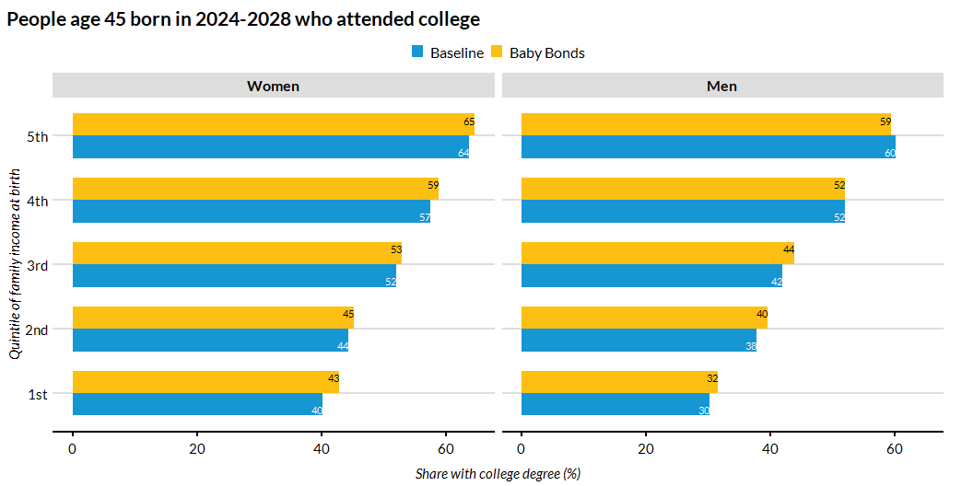
Share of People with College Degree by Quintile of Family Income at Birth and Sex

Slide 13
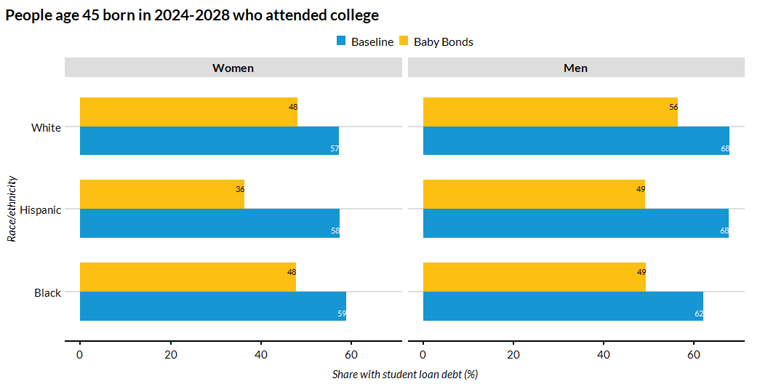
Share of People who Took a Student Loan by Race/Ethnicity and Sex

Slide 14
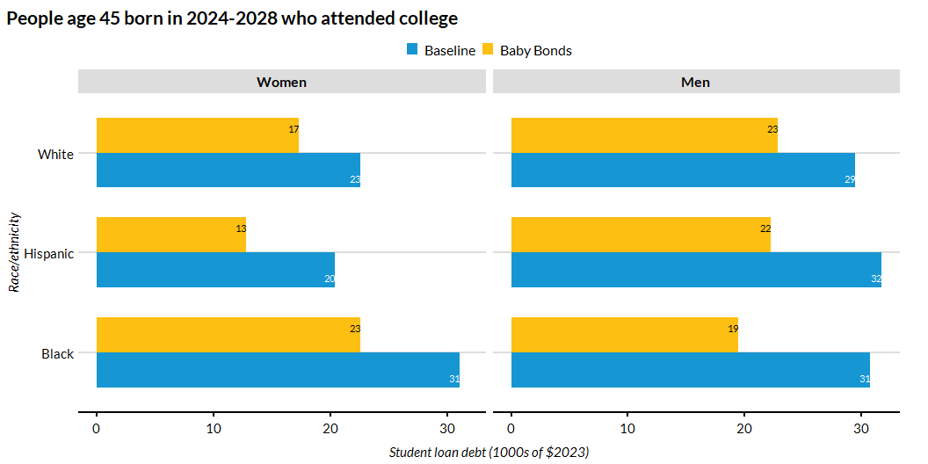
Average Student Loan Debt at College Exit among College Attendees by Race/Ethnicity and Sex

Slide 15
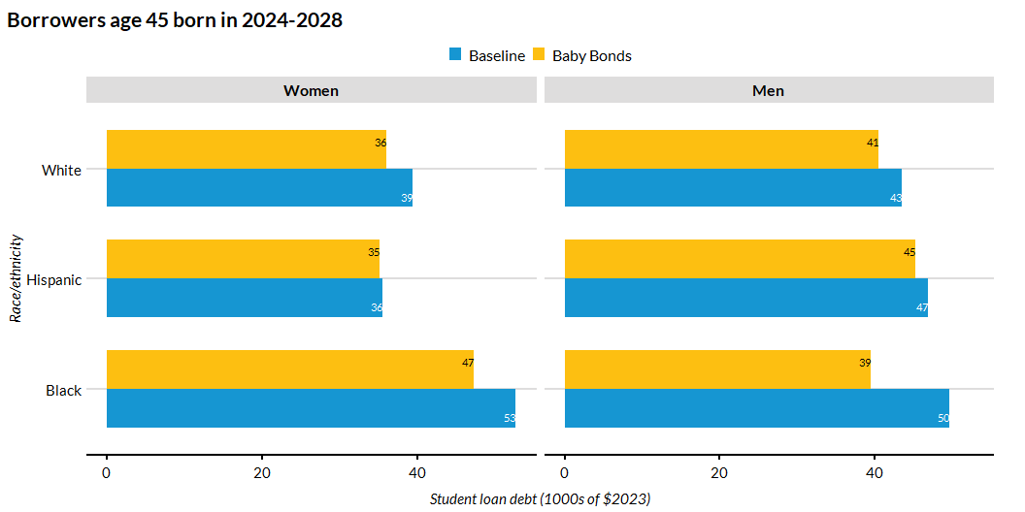
Average Student Loan Debt at College Exit Among Borrowers by Race/Ethnicity and Sex

Slide 16
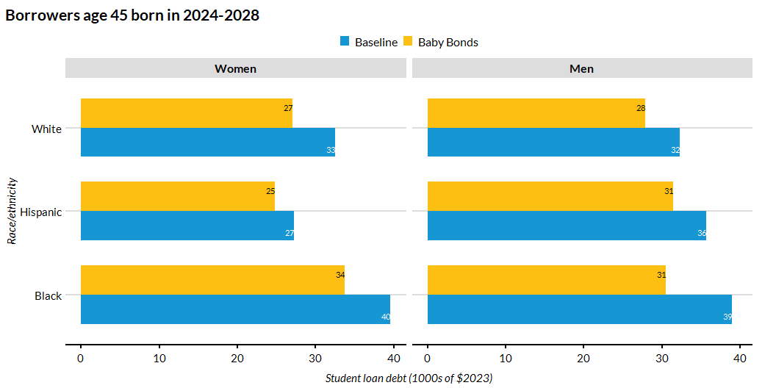
Median Student Loan Debt at College Exit Among Borrowers by Race/Ethnicity and Sex

Slide 17
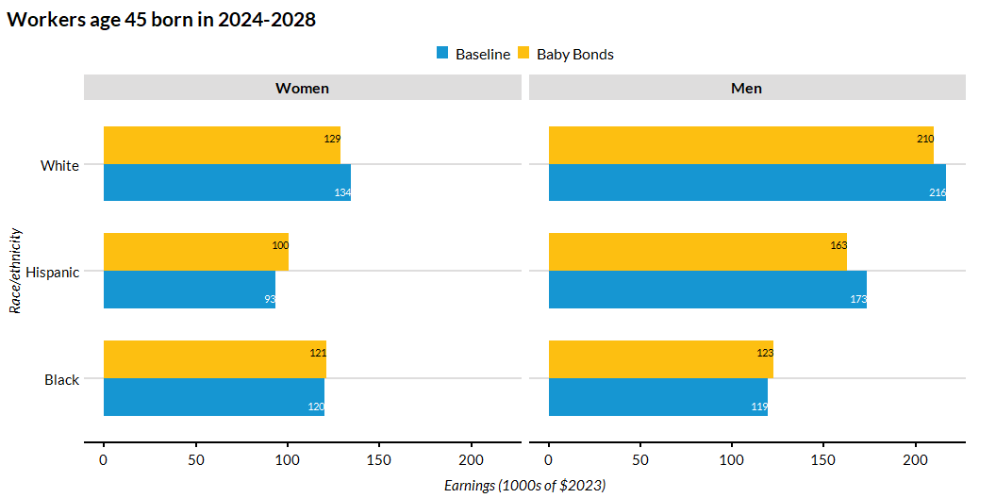
Average Earnings by Race/Ethnicity and Sex

Slide 18
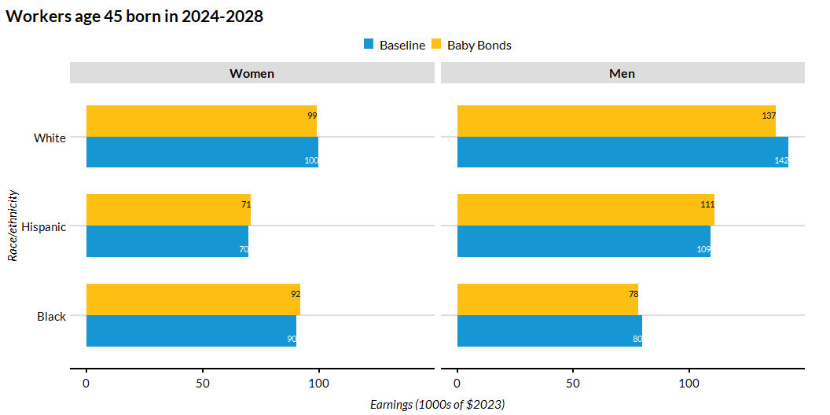
Median Earnings by Race/Ethnicity and Sex

Slide 19
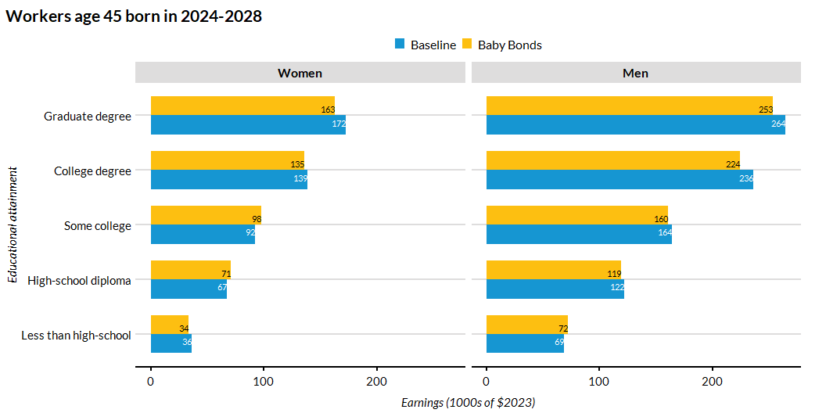
Average Earnings by Educational Attainment and Sex

Slide 20
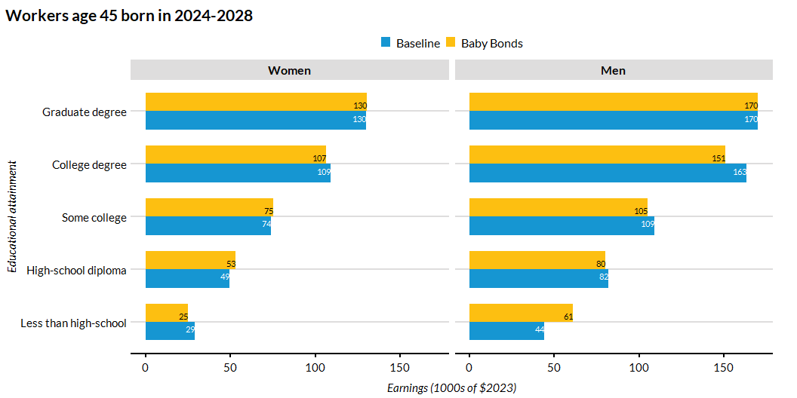
Median Earnings by Educational Attainment and Sex

Slide 21
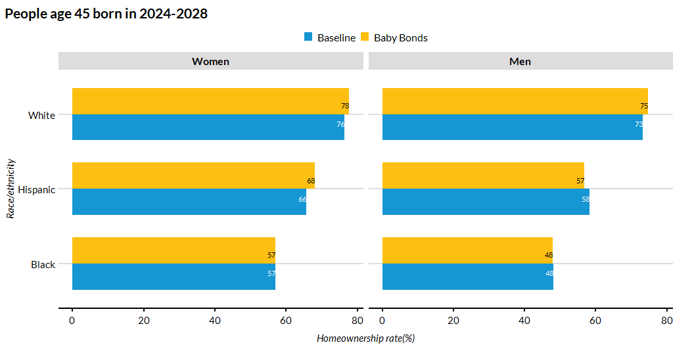
Homeownership by Race/Ethnicity and Sex

Slide 22
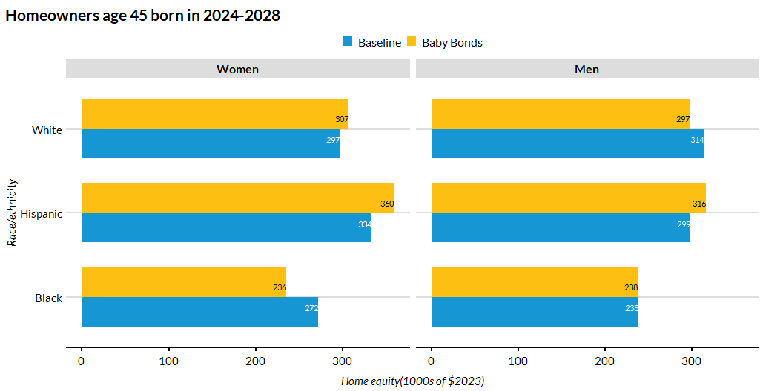
Average Home Equity by Race/Ethnicity and Sex

Slide 23
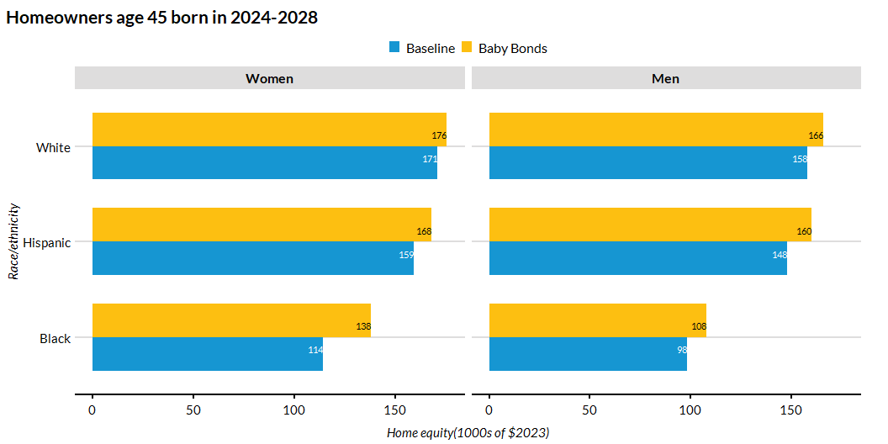
Median Home Equity by Race/Ethnicity and Sex

Slide 24
Age 65

Slide 25
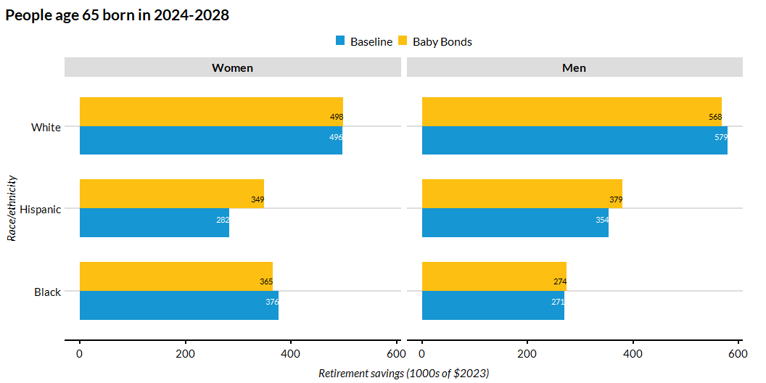
Average Per-Capita Retirement Savings by Race/Ethnicity

Slide 26
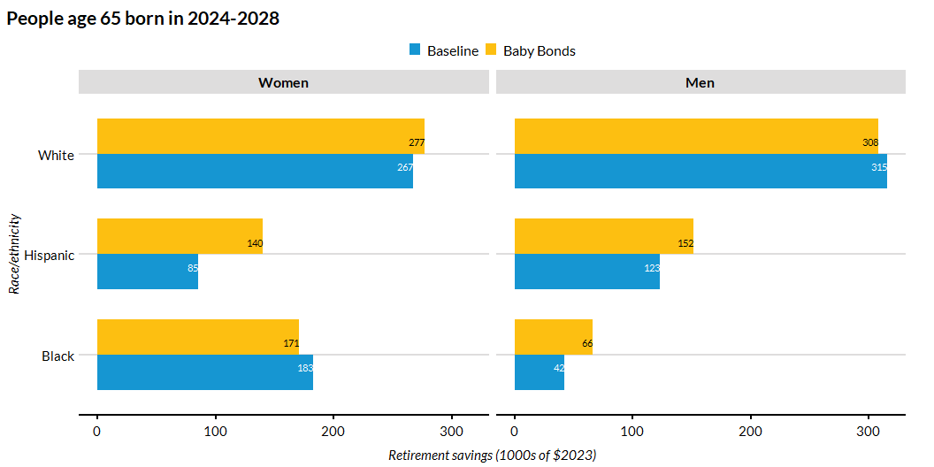
Median Per-Capita Retirement Savings by Race/Ethnicity

Slide 27
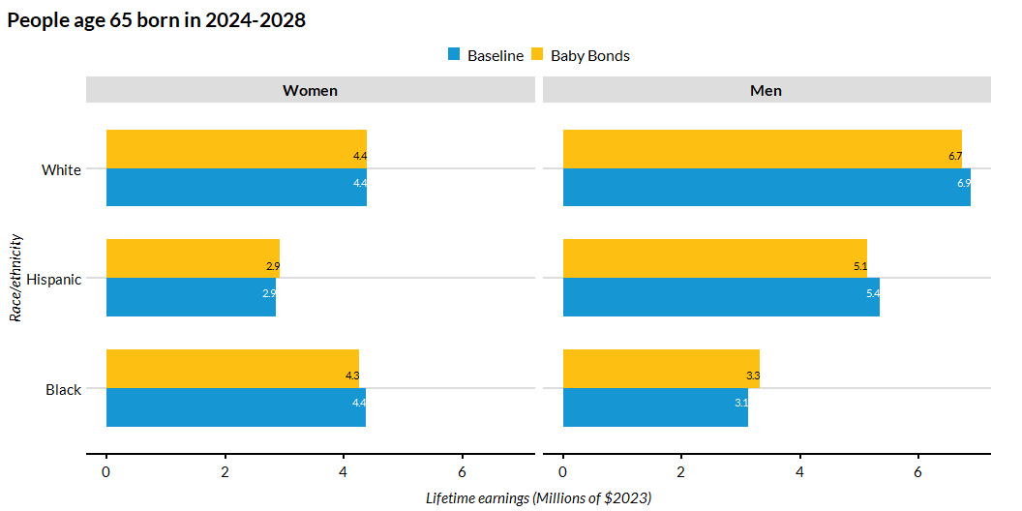
Average Per-Capita Lifetime Earnings Savings by Race/Ethnicity

Slide 28
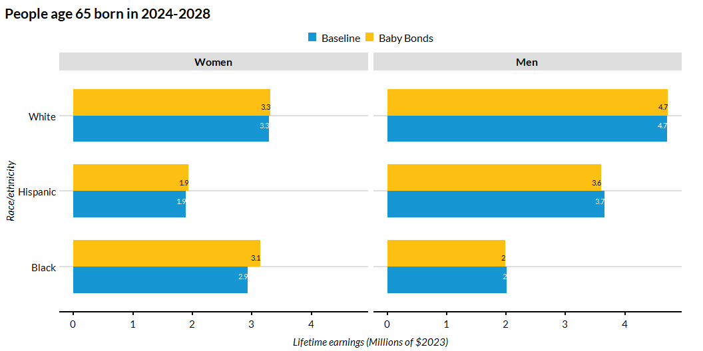
Median Per-Capita Lifetime Earnings Savings by Race/Ethnicity

Slide 29
Conclusion
The effect of baby bonds on college education is small and positive for people from lower-income families and for Black and Hispanic people.
The biggest effect of baby bonds is on student debt. For all race-sex groups, they reduce the share of people who take this debt and they reduce the amount of debt for borrowers.
The effect of baby bonds on earnings (annual and lifetime), homeownership rates, home equity, and retirement savings varies by race and sex, not only in magnitude but also in sign. Most likely, this is due to the random variation.

