Slide 1

R Shiny at the Urban Institute

Slide 2
What is R Shiny?
An R package
Enables the creation of interactive web-based applications
Can be extended with CSS, Javascript, and htmlwidgets

Slide 3
What is my typical use case at Urban?
Most often used internally
To examine data or results with many variables or models
Sometimes given to partners for private use
When visual aids may be easier to digest than long tables

Slide 4
Some (rough) examples
Economic Development Administration Impact Evaluation: Showing regression results of an evaluation of construction grants intended to improve local economies – outcomes include jobs, firms, and median income. Also shows event study graphs and results in table form.
Urban Alliance Impact Evaluation (with Amy Rogin): Showing regression results of an evaluation of the Urban Alliance – outcomes include college preparation, academic achievement, job preparation, and employment outcomes.
Margaret A. Cargill Philanthropies Landscape Analysis: Showing maps visualizing various descriptive variables for 8 states
JP Morgan Chase Small Business Analysis: Showing line plots over time for various business outcomes for 8 cities

Slide 5
How to start developing a shiny app

Slide 6
When do I NOT use a shiny app?
Public-facing tool is needed
There is no reason to examine multiple results
The project is short and/or does not have enough budget
The results are easily digestible in another format (such as R Markdown)

Slide 7
urbntemplates::construct_shiny()
To install: remotes::install_github("UrbanInstitute/urbntemplates")
Generates four documents
app.R (do not change the name of this document)
shiny_instructions.md
.gitignore
www/shiny.css

Slide 8
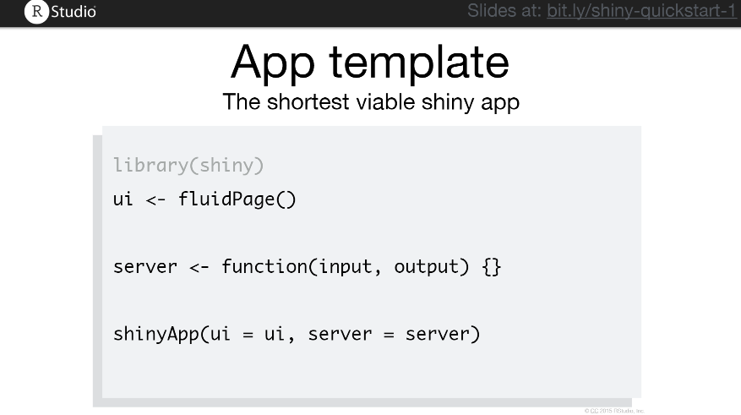
WHAST’S NEW

Slide 9
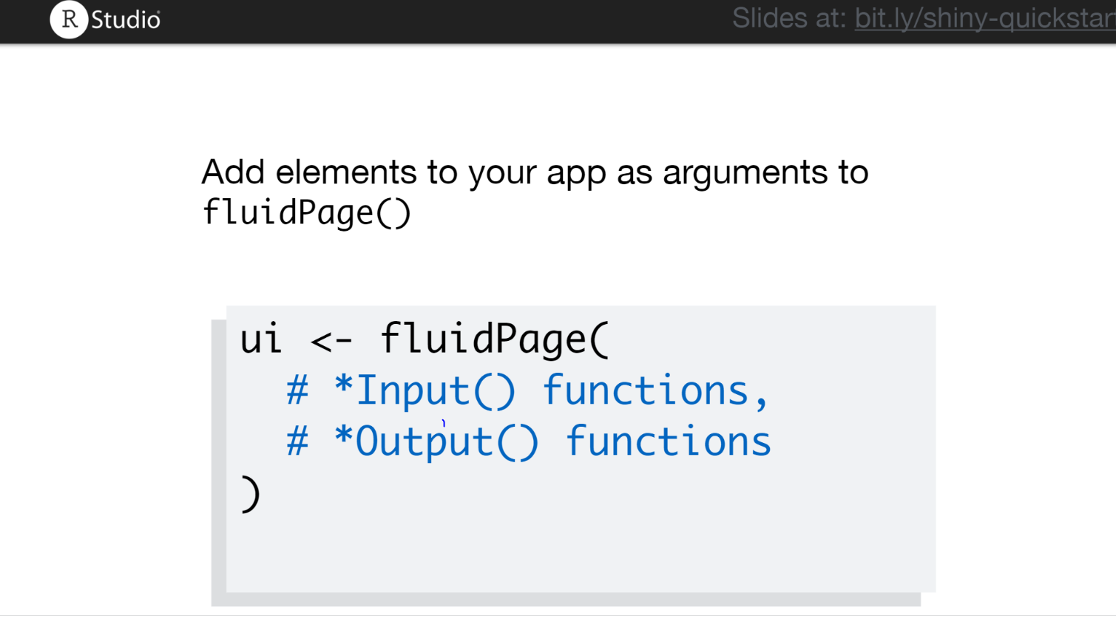
WHAT’S NEW

Slide 10
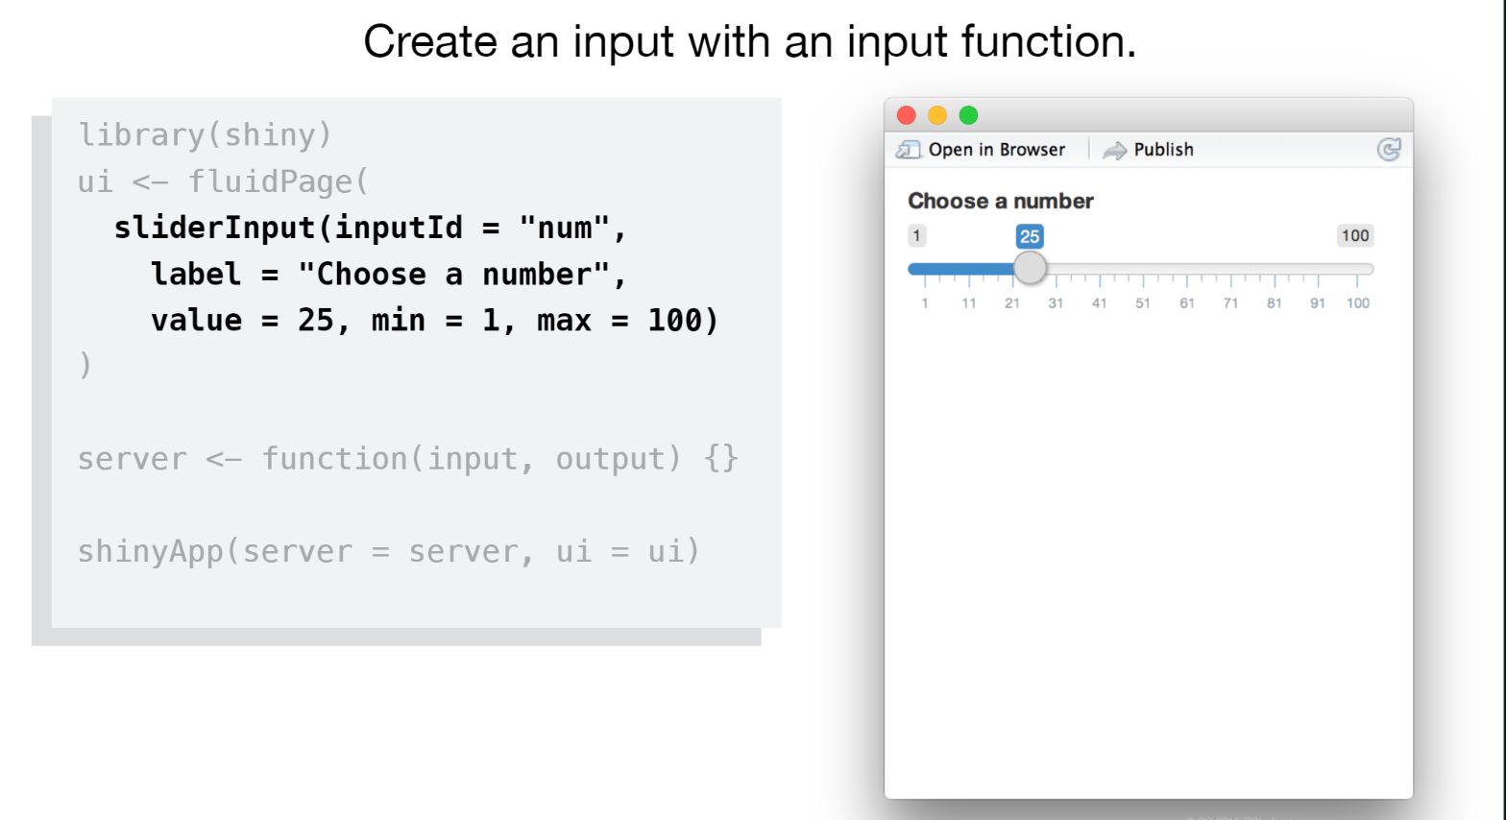

Slide 11
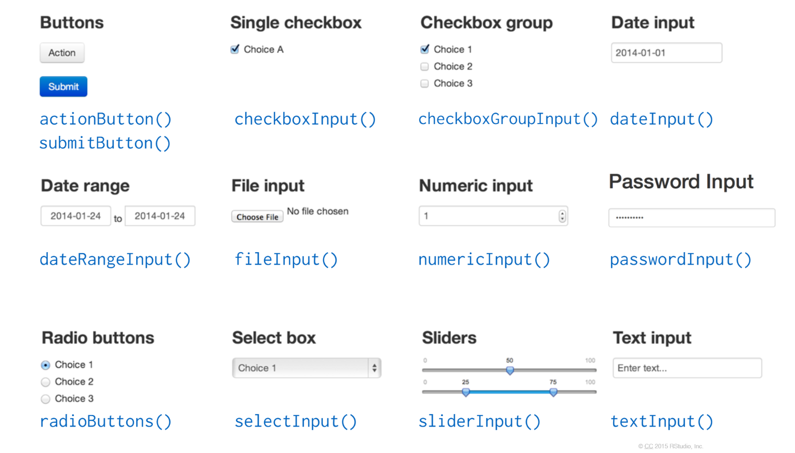

Slide 12
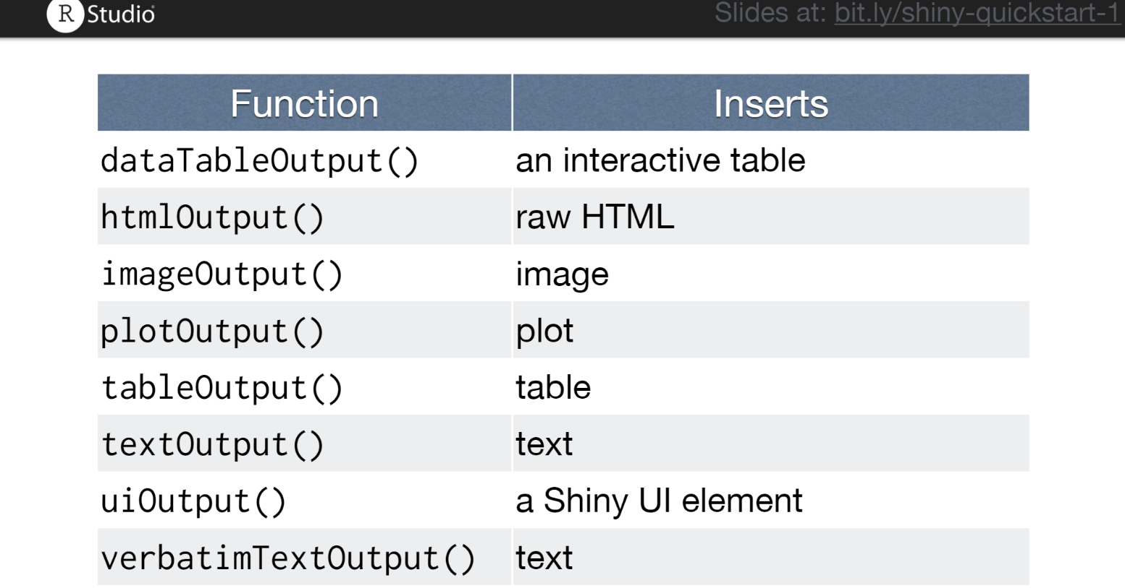

Slide 13
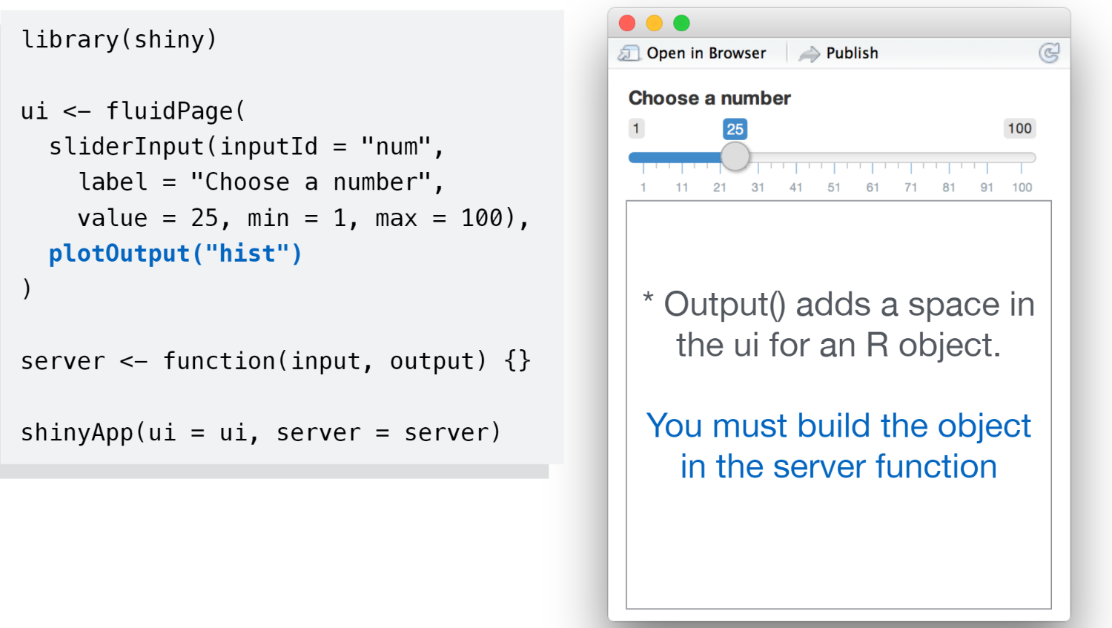

Slide 14
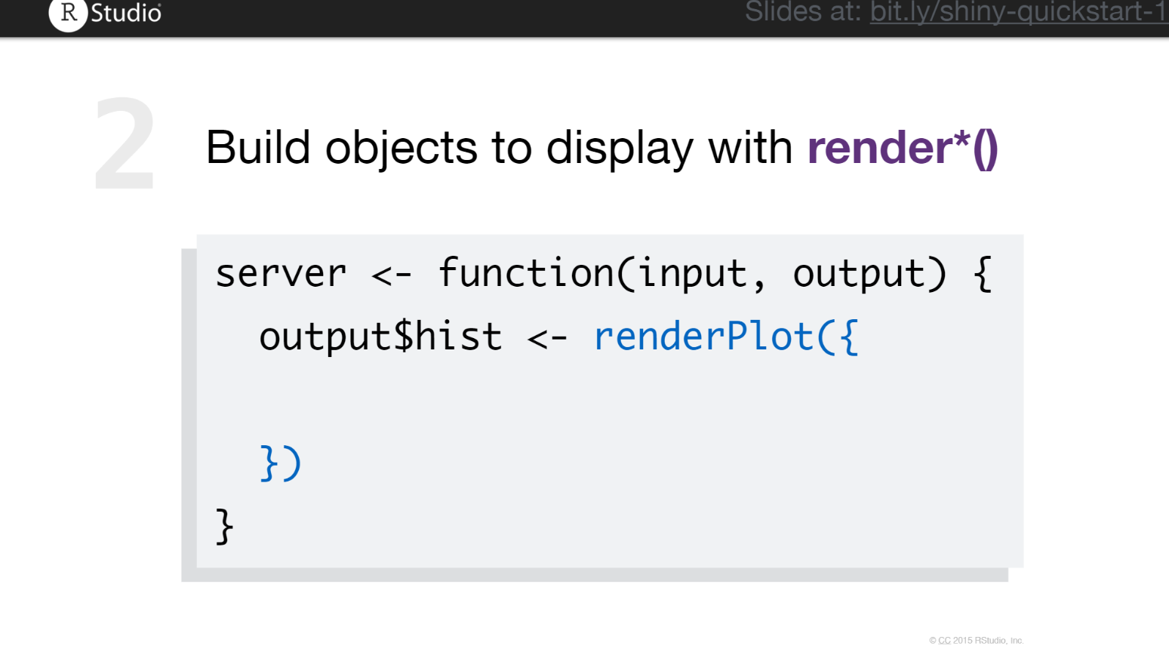

Slide 15
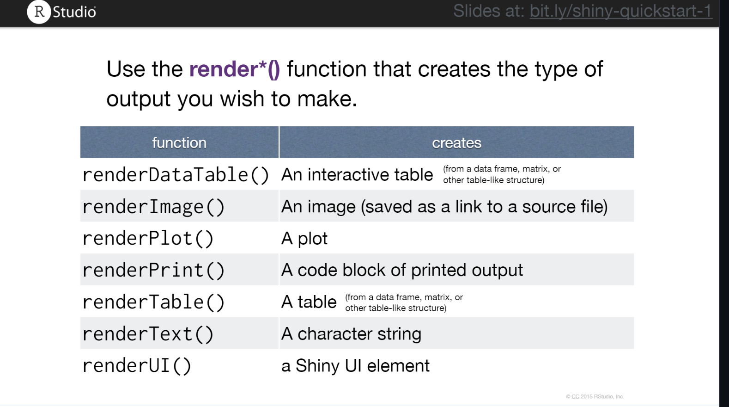

Slide 16
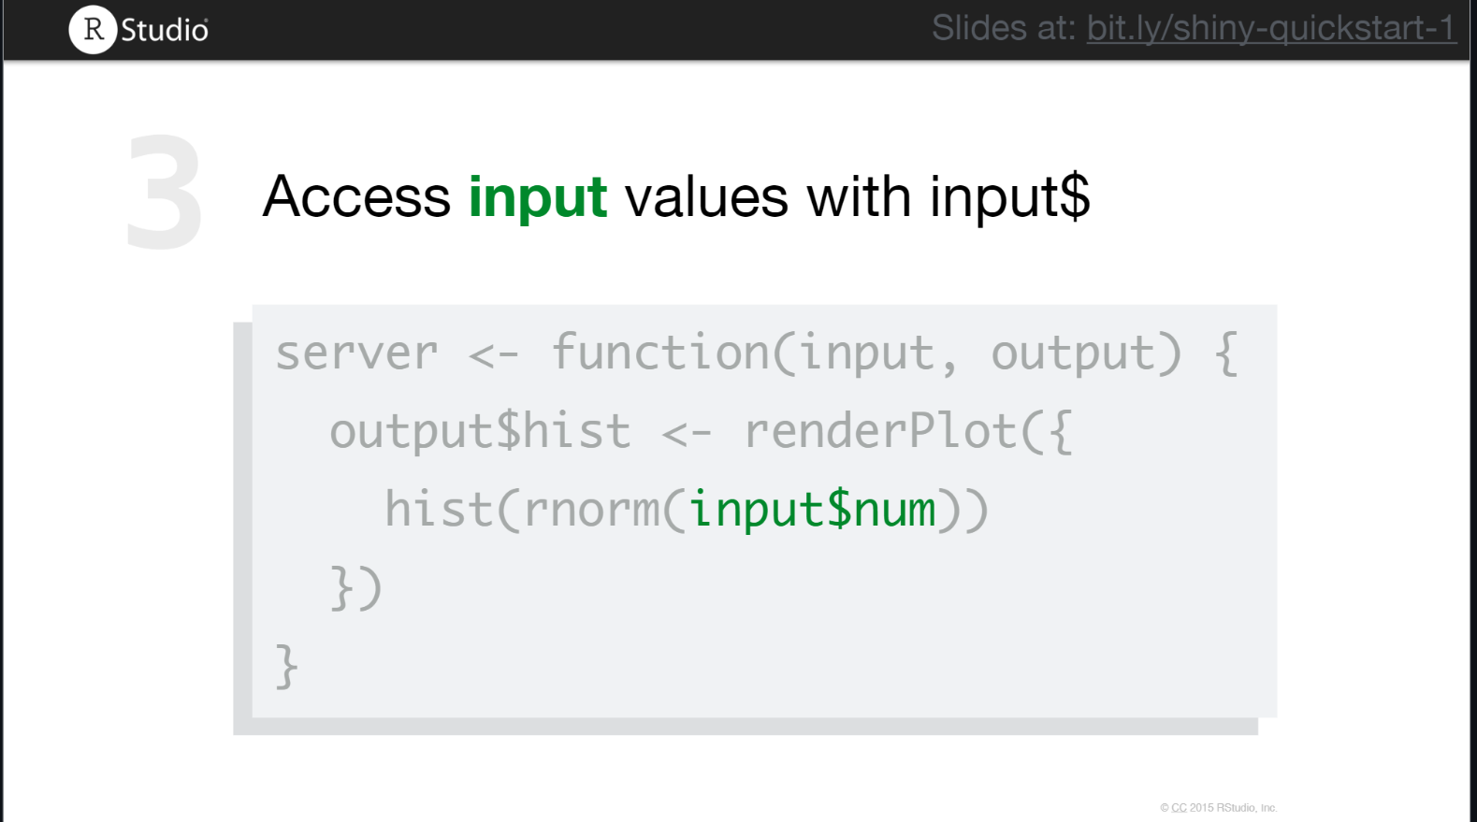

Slide 17
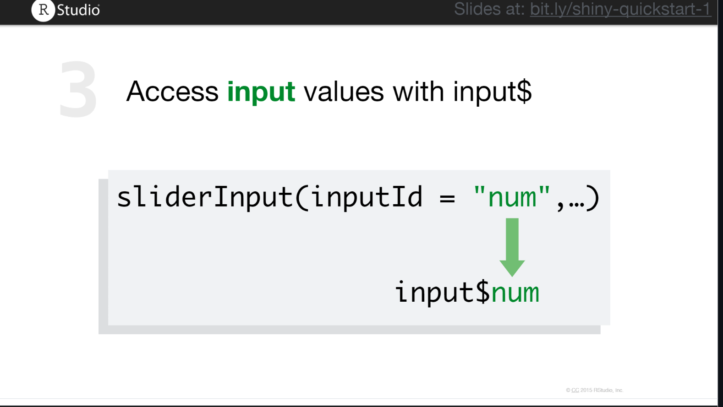

Slide 18
Demo

Slide 19
Publishing options
Shinyapps.io
Urban Shiny Server

Slide 20
Shinyapps.io
Quick and easy
Public
Do not have to update packages on Shiny Server
Create an account and follow instructions here: https://shiny.rstudio.com/articles/shinyapps.html

Slide 21
Urban Shiny Server
More complicated
Private
Have to update packages (can be a pain)
Follow the instructions at https://github.com/UI-Research/shinyapps-stg.urban.org

