Slide 1













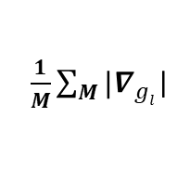





(A)
Importance Computation
(B)
Training
$$L_{MLM}$$
$$L_{Contrast}$$
$$L_{impt}$$
…
$$o^{full}$$
$$o^{gen}$$
…
…
X$l$
$$g_{l}$$
X$l$
Multi-head Attention
Multi-head Attention
$$Il$$
Forward
Forward
X$l$
$$I^{norm}$$
X$l$
$\frac{1}{M}\sum_{M}{{|∇}_{gl}}$|
$$Il$$
$$Il$$
$$Tanh(Norm(Il))$$
$$∇_{att}$$
$$∇_{gl}$$
X
$$1−I^{norm}$$
Multi-head Attention
Multi-head Attention
Backward
Backward

