Slide 1

Git: The Version Control System
Junru Zhong
April 24, 2018
In associate with UIC HCC Computer Association

Slide 2
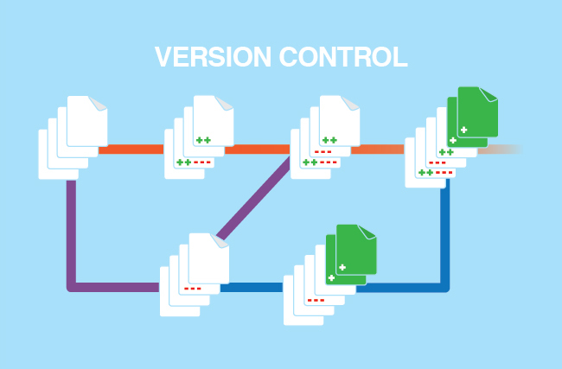
Contents
Version Control
Git
Remote Git
Cooperating with Git
Image source: https://blog.learntoprogram.tv/wp-content/uploads/2016/05/version-control.png

Slide 3
Examples of Version Control
Notes:
Demo with MS Word undo.

Slide 4
VCS: Manage differences

Slide 5
Git: The Version Control System
Cat proof!

Slide 6
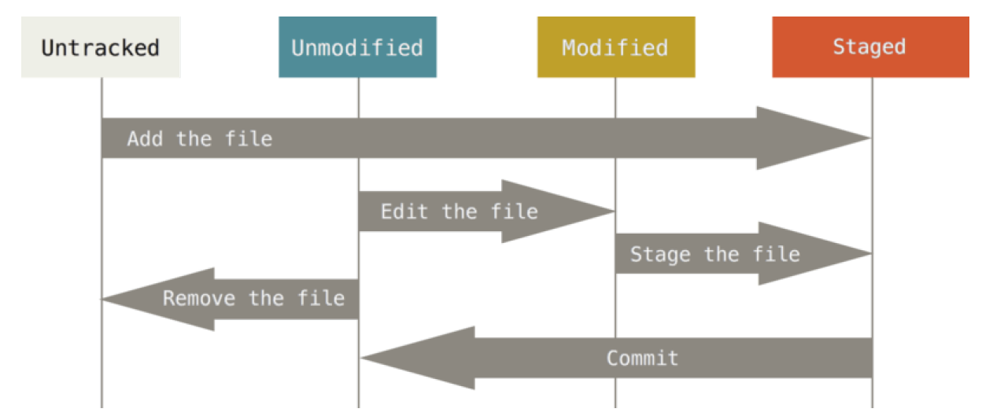
Git basic
Credit: S. Chacon & B. Straub, Pro Git (2nd Edition), 2014

Slide 7
Git basic
Repository (仓库): where tracked files are stored.
Commit (提交): tell Git to store this change.
Staging area (暂存区): changes will be committed.
Basic operations:
$ git init #Initialize a repository in current directory.
$ git add [file] #Put changed file(s) to staging area.
$ git commit –m “[message]” #Commit a change.

Slide 8
Git may fail…
We need backups!
Data backup 3-2-1 principle: 3 backups, 2 media, 1 remote

Slide 9
Remote Git Repository
Backup & cooperation

Slide 10
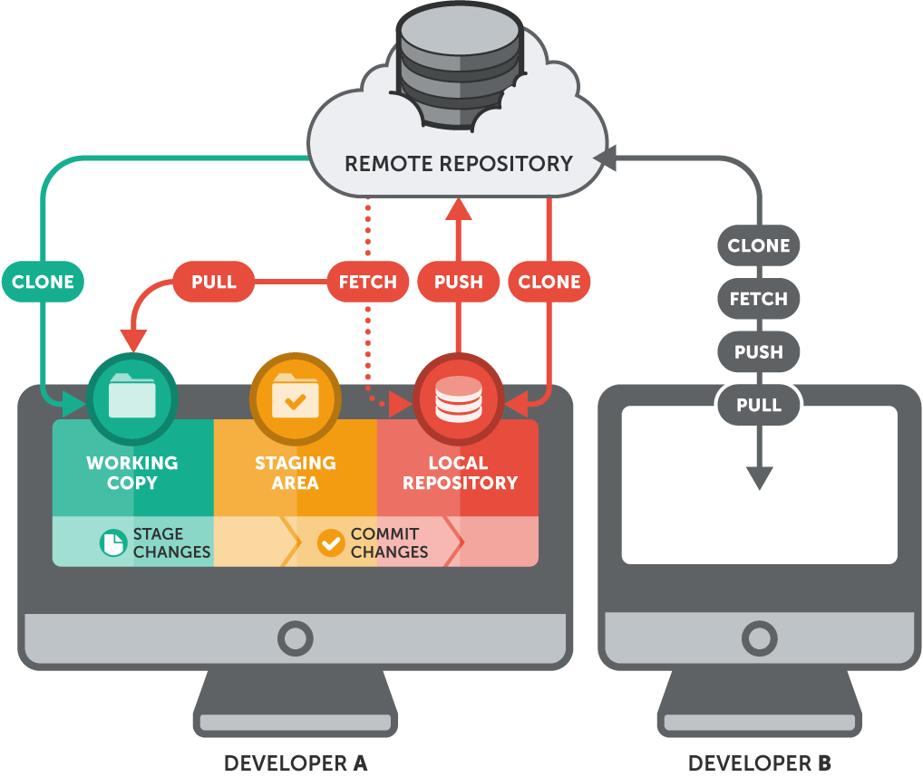
Remote Git basic
All repositories are same.
Always pull before push.
Basic operation
$ git clone [URL]
$ git fetch
$ git pull
$ git push

Slide 11

Cooperating
Header
Body
Footer
Image source: https://www.vervelogic.com/images/img/hire-developer/ishank-sir.png

Slide 12
Cooperating
Header
Body
Footer
Image source: https://www.vervelogic.com/images/img/hire-developer/ishank-sir.png

Slide 13
Cooperating
Deploy!
Header
Body
Footer
Image source: https://www.vervelogic.com/images/img/hire-developer/ishank-sir.png

Slide 14
Wrong version was deployed!

Slide 15
Cooperating with Git branches
Deploy!
Header
Rework
Deploy!
Body
Header
Footer
Footer
Body
$ git init

Slide 16



Cooperate with Git branches
Always keep code in master branch is available.
Use branches to differ different stages of code.
Use Pull Requests to allow others to evaluate your contribution.
Merge code after testing.

Slide 17
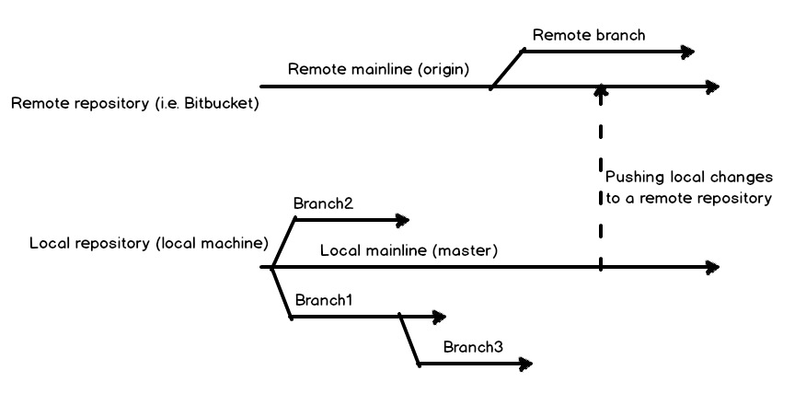
Local & Remote Branches
Image source: https://solutioncenter.apexsql.com/wp-content/uploads/2016/05/word-image-78.png

Slide 18
Frequently Asked Questions
What is GitHub? What is its relationship with Git?
GitHub is an online Git repository hosing service.
Why Git requires user to save manually?
Unlike documents, software code has a long lifecycle. It is necessary to push only meaningful code.
Why there is conflict in Git?
Because there is situation that Git cannot handle and only human can.
Why there is a fast-forward problem?
Because you didn’t pull before push.

Slide 19
Useful Tips
Always create repository with a .gitignore file.
Always pull before modify files.
Always commit with meaningful information.
Try to make use of branches by forking.
Try to work with git by command line.
Be social in git communities!

Slide 20
References & Useful Resources
GitHub Guides: https://guides.github.com/
Git Cheat sheet: https://services.github.com/on-demand/resources/cheatsheets/
GitHub Help: https://help.github.com/
The Book Pro Git: https://git-scm.com/book/en/v2
Handling Conflicts: https://stackoverflow.com/questions/161813/how-to-resolve-merge-conflicts-in-git

