Slide 1
Introduction to Git Version Control System
Junru (Bill) Zhong
March 1st, 2018
Ver. 2.0 – 28/02/2018

Slide 2
Contents
Git Version Control System
Local Repositories
Remote Repositories
Useful Tips & Resources

Slide 3
What is Git?
A distributed version control system
Developed by Linux kernel community in 2005
Characteristics
Fast
Simple design
Strong support to non-linear development

Slide 4
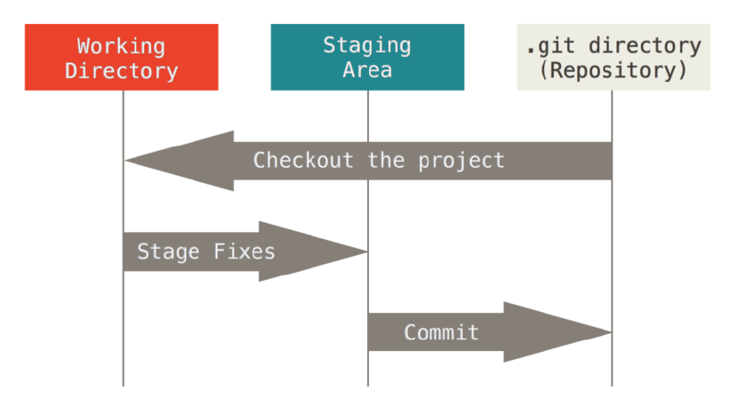
Local Git Workflow
Credit: S. Chacon & B. Straub, Pro Git (2nd Edition), 2014

Slide 5
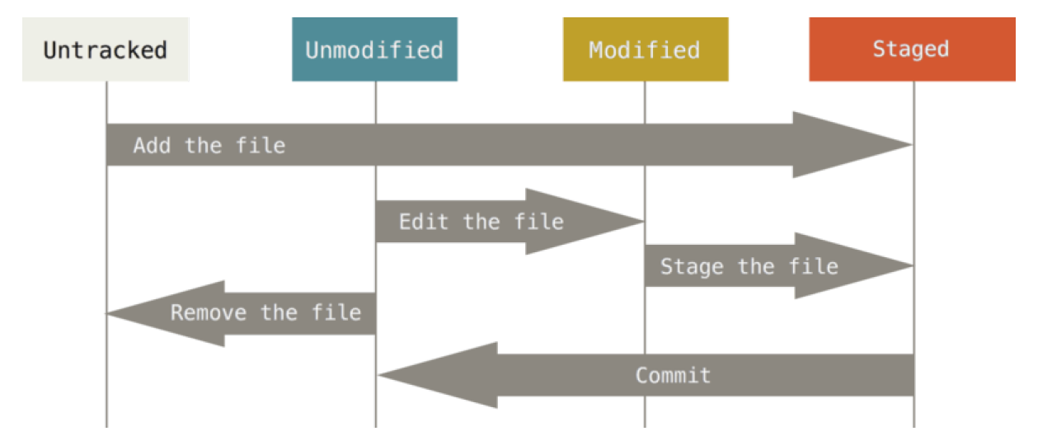
Status of Files
$ git add
$ git commit
Credit: S. Chacon & B. Straub, Pro Git (2nd Edition), 2014

Slide 6
Basic Operations (local)
Initialize a repository:
$ git init
Stage files
$ git add #file name, use * or . for all files
Commit changes
$ git commit –m “Your message”
Check status
$ git status

Slide 7
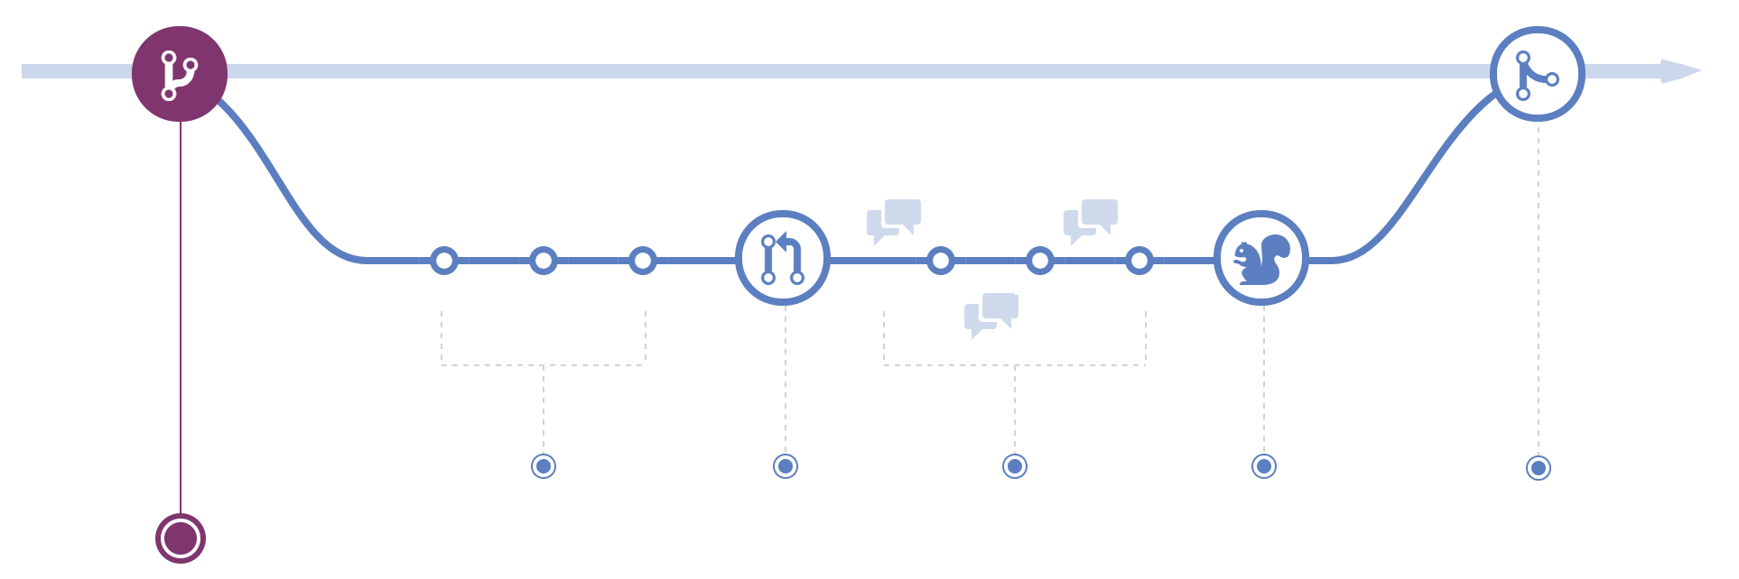
Using Branches
Master
Developing
Credit: https://guides.github.com/introduction/flow/

Slide 8
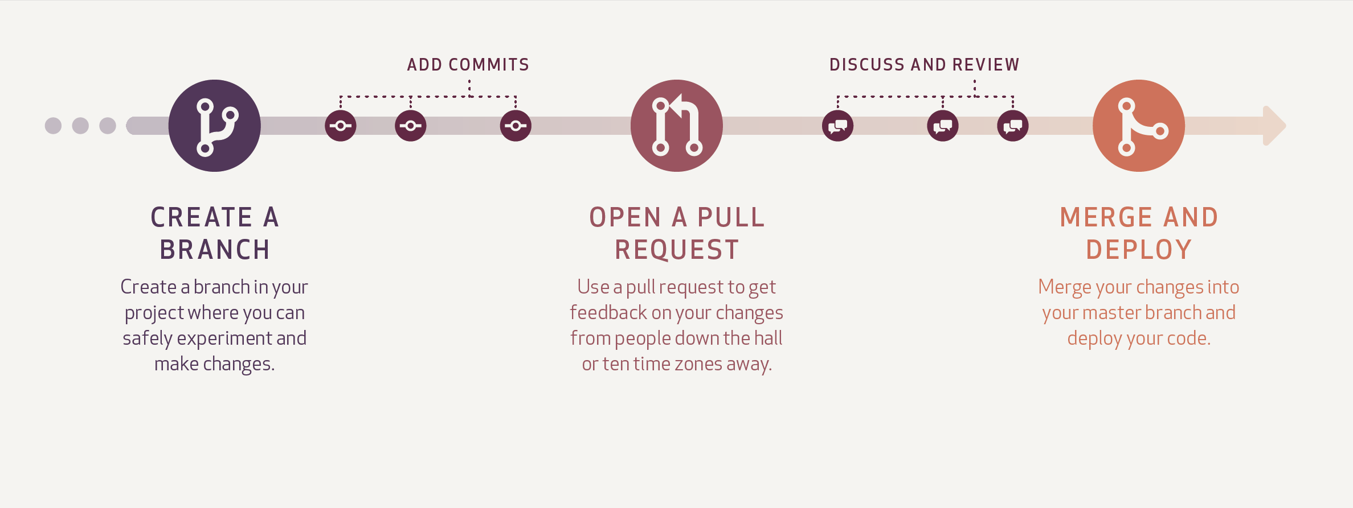
Using Branches (Cont’d)
Credit: https://guides.github.com/introduction/flow/

Slide 9

Using Branches (Cont’d)
Credit: http://nvie.com/img/git-model@2x.png

Slide 10
Working with Git Remotely

Slide 11
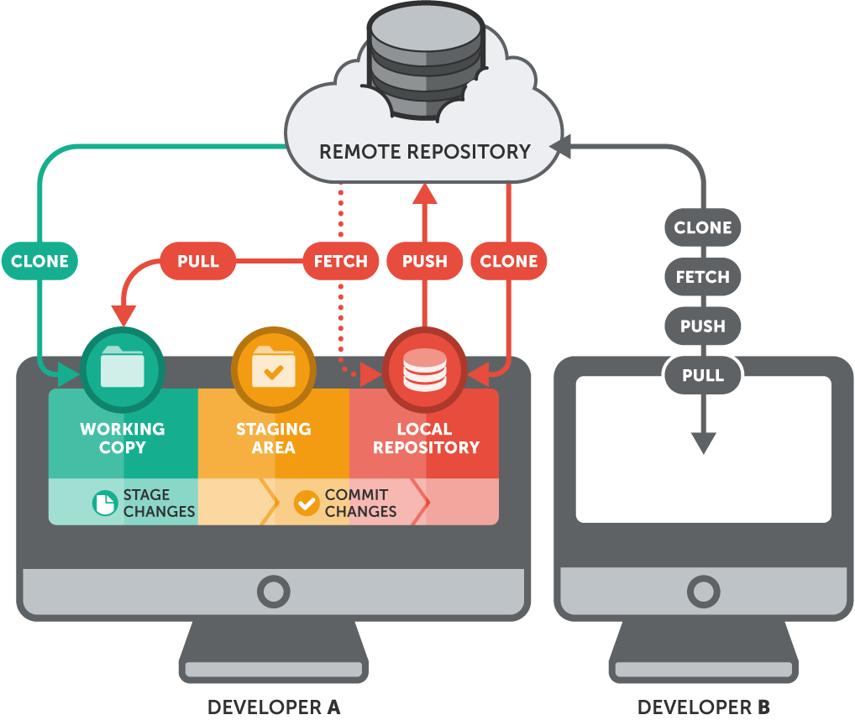
Gitee by OSChina (开源中国社区)
Credit: https://www.git-tower.com/learn/git/ebook/en/command-line/remote-repositories/introduction

Slide 12
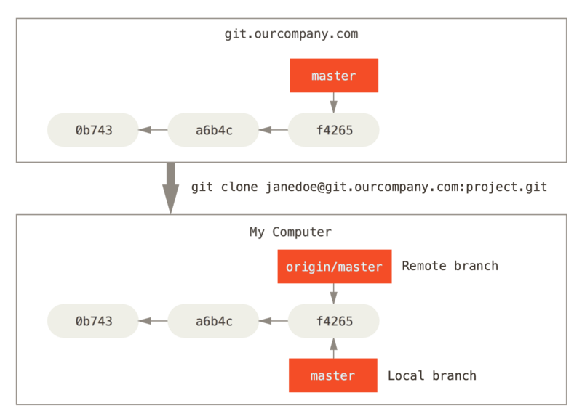
Remote Branches
Clone: An exactly same copy
Commits
Credit: https://git-scm.com/book/en/v2/Git-Branching-Remote-Branches

Slide 13
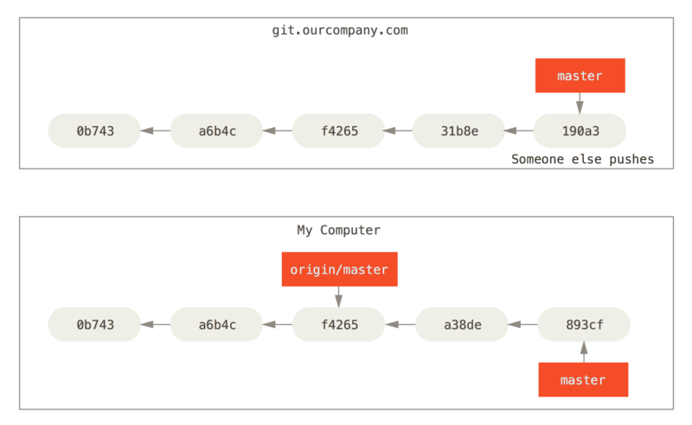
Handling Fast-forward Problem
Credit: https://git-scm.com/book/en/v2/Git-Branching-Remote-Branches

Slide 14
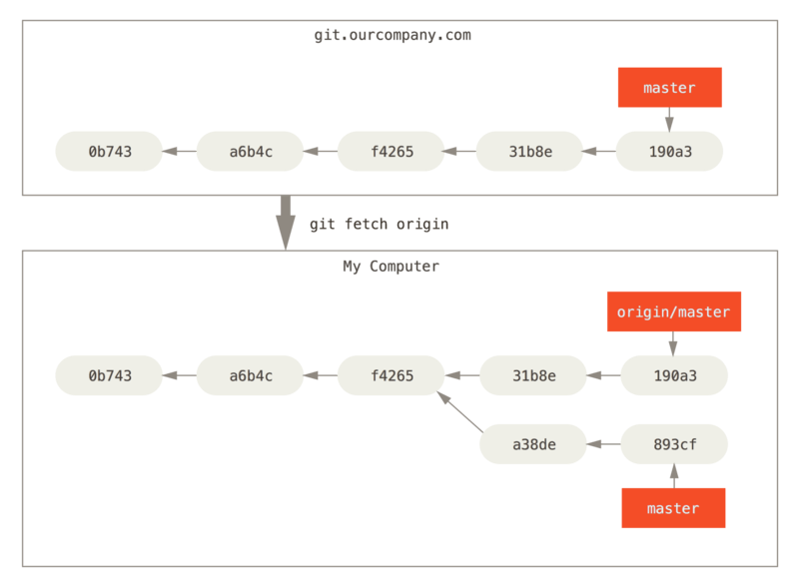
Handling Fast-forward Problem (Cont’d)
Merge changes
New commit
Credit: https://git-scm.com/book/en/v2/Git-Branching-Remote-Branches

Slide 15
Basic Operations (with remote)
From remote to local:
$ git clone #from a remote repo
$ git fetch #changes
$ git pull
#Fetch changes and merge to local repo.
After staged, committed your changes:
$ git push #local changes to remote
Add a remote repo. to a local repo.:
$ git remote add #to a local repo.

Slide 16
Useful Tips

Slide 17
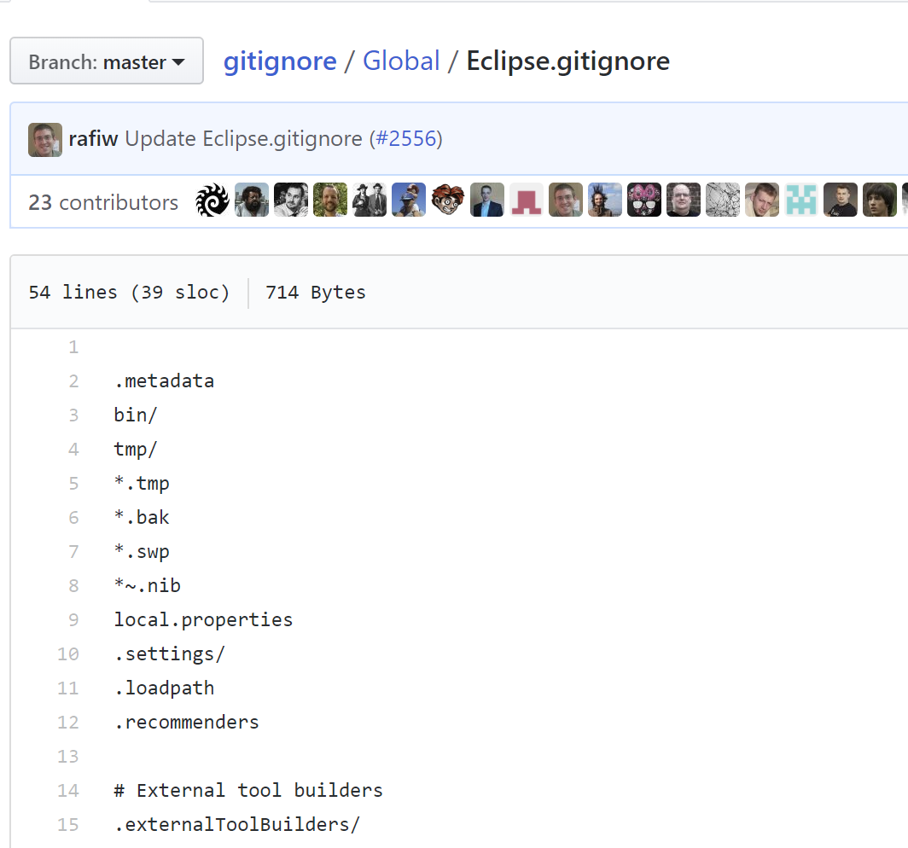
The .gitignore File
Tells Git to ignore some files.
Avoid conflicts.
Download templates from:
https://github.com/github/gitignore
according to your source languages, editors, IDEs.
Put it in your tracked directories with file name “.gitignore”.

Slide 18
Handling Conflicts
Conflict changes from different branches
e.g. Different modifications in a same line.
Git don’t know how to merge changes.
Requires human to make choices.
Accept changes from one branch.

Slide 19
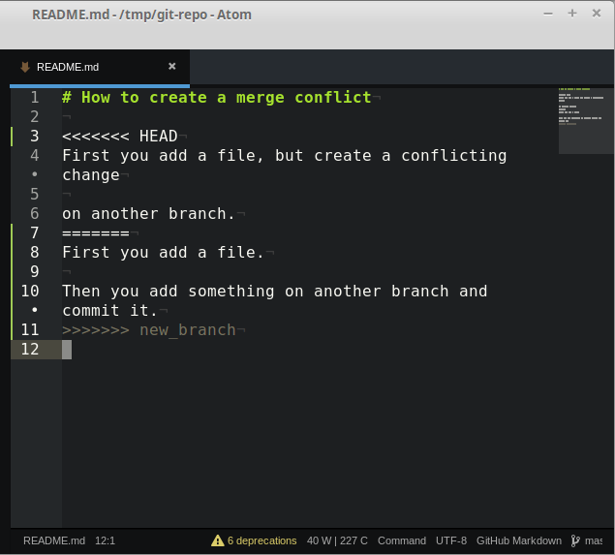
Handling Conflicts (Cont’d)
Changes from all branches
Notations added by Git
Credit: http://jonathanmh.com/wp-content/uploads/2015/06/temporary-git-merge-conflict-files.png

Slide 20
Handling Conflicts (Cont’d)
Leave the correct change
Delete change you don’t want
Commit and push again.
Delete all notations
Credit: http://jonathanmh.com/wp-content/uploads/2015/06/temporary-git-merge-conflict-files.png

Slide 21
Useful Tips
Always create repository with a .gitignore file.
Always pull before modify files.
Always commit with meaningful information.
Try to make use of branches by forking.
Try to work with git by command line.
Be social in git communities!

Slide 22
References & Useful Resources
GitHub Guides: https://guides.github.com/
Git Cheat sheet: https://services.github.com/on-demand/resources/cheatsheets/
GitHub Help: https://help.github.com/
Gitee Documentation (Chinese): http://git.mydoc.io/
The Book Pro Git: https://git-scm.com/book/en/v2
Handling Conflicts: https://stackoverflow.com/questions/161813/how-to-resolve-merge-conflicts-in-git

