Slide 1
Adapt what is useful, Reject what is useless, and Add what is specifically your own.
RESPONSIVE DESIGNING

Slide 2
Things we will cover
Meaning of Responsive
What is A Responsive Web Design (RWD)?
What is the need to construct Responsive Designs?
Basics of Responsive Web Designing
Essentials to create your first Responsive Website
Advantages of RWD

Slide 3
Meaning of Responsive
The term Responsive means , To provide
“Responses or Adaptiveness
Quickly and Positively”
to the users.

Slide 4
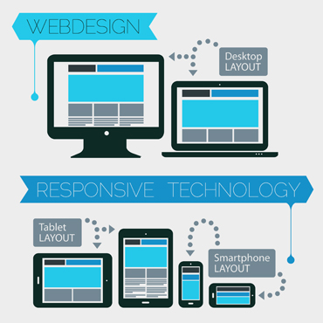
What is A Responsive Web Design (RWD)?
Responsive Web design is the approach that suggests that design and development should respond to the user’s behavior and environment based on screen size, platform and orientation

Slide 5
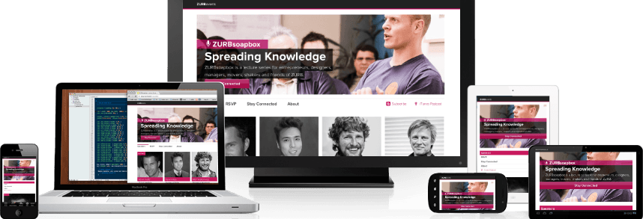
A Big Question ???
A Big Question ???
A Big Question ???
A Big Question ???
What is the Need to Construct A Responsive Website?

Slide 6
Why Do You Need A Responsive Website?
Just check out the upcoming statistics

Slide 8
Why Do You Need A Responsive Website?
Growing Demand for Smartphones
Multiple Screen Sizes and Mobile Browsers
Wide Usage of Internet
Permits wider browser support
Compulsory for Getting Good Business

Slide 9
Basics of Responsive Web Designing

Slide 10
Adapting the Appropriate Layout
Designers should use appropriate layout to suit completely different screen sizes.
Devices Size
Phones 480px and below
Phones to Tablets 767px and below
Portrait Tablets 768px and above
Net Book 990px to 1024px
Monitor 1024px and above

Slide 11
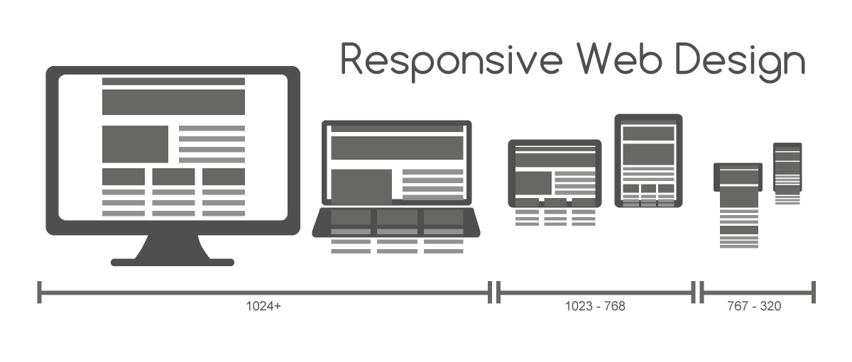

Slide 12
Other Important Guidelines
Resizing images to fit the screen resolution
Hiding non-essential elements especially for smaller screen
Avoid web technologies that don’t work on mobile
Make sure that website can be read in seconds
Optimize your page for vertical scrolling

Slide 13
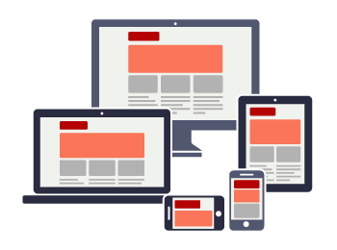
Essentials to Create Your First Responsive Website
Small + Medium + Large
One site for every screen.

Slide 14
Major Components of A Responsive Website
Responsive website designing is a modern approach of website designing. It comprises of four core elements.
Meta Tags
CSS3 Media Queries
Grid Systems
Frameworks

Slide 15
What are Meta Tags?
Meta tag is a coding statement in HTML.
It describes few aspects of the contents of a web page.
Information provided in the meta tags is used by the search engines for page indexation.
Placed at the top of a web page as a part of heading.
Metadata is always passed as name/value pairs.
We use viewport meta tag for making a web page Mobile Optimized. See the example on next page.

Slide 16
Types of Meta Tags
There are different meta tags that work for old, new, and modern hand held devices like mobiles (all types) and tablets.
Example:
Put theselines in the head section of your site.
<meta charset="UTF-8">
<meta name="description" content=“Responsive Designing"> <meta name="keywords" content="HTML,CSS,JavaScript,Mobile,RWD"> <meta name="author" content=“Prince"> <meta name="viewport" content="width=device-width, initial-scale=1.0">
A responsive designer needs to add these meta tags to make a website mobile optimized.

Slide 17
What are CSS3 Media Queries ?
CSS3 Media Queries consists of a media type and zero or an optional expression to assign different style-sheets depending on browser window size using media features such as width, height, orientation, resolution, pixel aspect ration, and color etc.
Using CSS3 media queries, presentations can be tailored to a specific range of output devices without changing the content itself.
You can use media queries in different ways for different reasons.

Slide 18
Example 1 of Media Queries
Use following CSS media query syntax for calling an external stylesheet:
<link rel='stylesheet' media='screen and (min-width: 320px) and (max-width: 480px)' href='css/phone.css' />
And you can control css presentation in css file too:
@media screen {
body {
width: 75%;
}
}
@media print {
body {
width: 100%;
}
}

Slide 19
Example2 of Media Queries
Likewise, you can use more advanced CSS media queries like:
@media all and (max-width: 699px) and (min-width: 520px), (min-width: 1151px)
{
body {
background: #ccc;
}
}
https://css-tricks.com/snippets/css/media-queries-for-standard-devices/

Slide 20
What is A Grid System?
Grids are the simplest, strongest, and quick way to create page layouts. A grid is a set of number of “columns” and intervening “gutters” (margins) inside a “container” with any width and flexibility.
It gives a feeling of considered organization of one’s website.
In the words of Josef Muller Brockmann,” The grid system is an aid, not a guarantee. It permits a number of possible uses and each designer can look for a solution appropriate to his personal style. But one must learn how to use the grid; it is an art that requires practice.”

Slide 21
Useful Frameworks of RWD
Frameworks can be defined as a set of tools, libraries, conventions and best practices that enable the designers to cut down their routine tasks into reusable generic modules.
CSS3 frameworks provide following benefits to web designers and developers:
1. Faster designing and building of websites.
2. Designers can focus on crucial segments of website building-
using a grid, including a print style sheet, browser compliance,
creation of multiple layouts, etc.

Slide 22
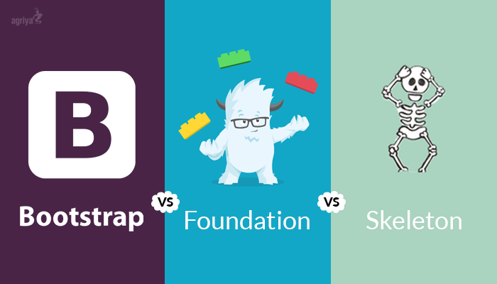
Some Common Frameworks
Following are the popular frameworks that web designers and developers used to develop responsive websites:
Skeleton
Foundation
Bootstrap

Slide 23
Advantages to the Users
Using Smartphone, Tablets, and Notebooks for accessing internet has become a common fashion or trend. A popularity or charm had been seen among the users for responsive sites as it serve the following advantages.
A Responsive website is flexible to use.
It automatically shuffles content, resizes images, and adjusts font size.
Users are able to read information as per their needs and preferences.
Helps encountering fast and intelligent sites.
Saves user’s time while browsing the site.
Helps increasing the user experience.

Slide 24
Try out your favorite site
http://www.responsinator.com/

Slide 25
Questions?

